Slide 1
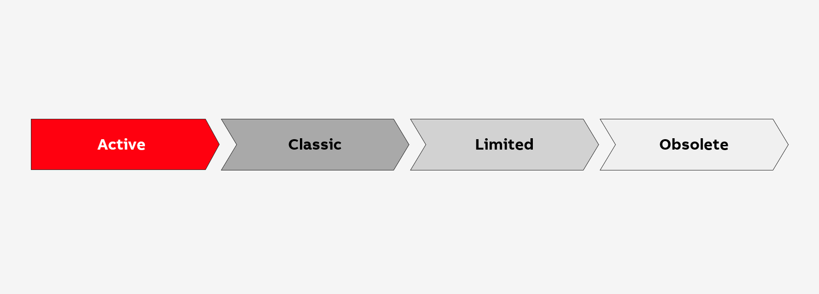
Life-Cycle Management (LCM)
Abb ELECTRIFICATION
Presentation
2023
9AKK107992A6807
D

Slide 2
Life-Cycle Management (LCM)
Agenda
01
Life-cycle process
02
Life-cycle stages
03
IEC 62402 Application Guide and ABB LCM
04
Life-cycle services
05
Where to find information about your products’ life cycle

Slide 3

Life-Cycle Management (LCM)
Life-cycle process
Life-cycle management (LCM) is the process that enables ABB to innovate and manage products and related services throughout the entire business life cycle – effectively and efficiently.
It is ABB’s goal to protect our customers’ investment beyond
the life cycle of the underlying platform products.
ABB LCM originates from:
  IEC 62402, the IEC Application Guide about Obsolescence Management, stressing the importance of managing obsolescence as an integral part of design, development, production and in-service support of a product.
  The long experience of ABB on the management of products and their life cycle
ABB products are designed for continuous evolution. The Life-cycle management process supports ABB
and our customers to properly manage products’ transition through the different life-cycle stages

Slide 4
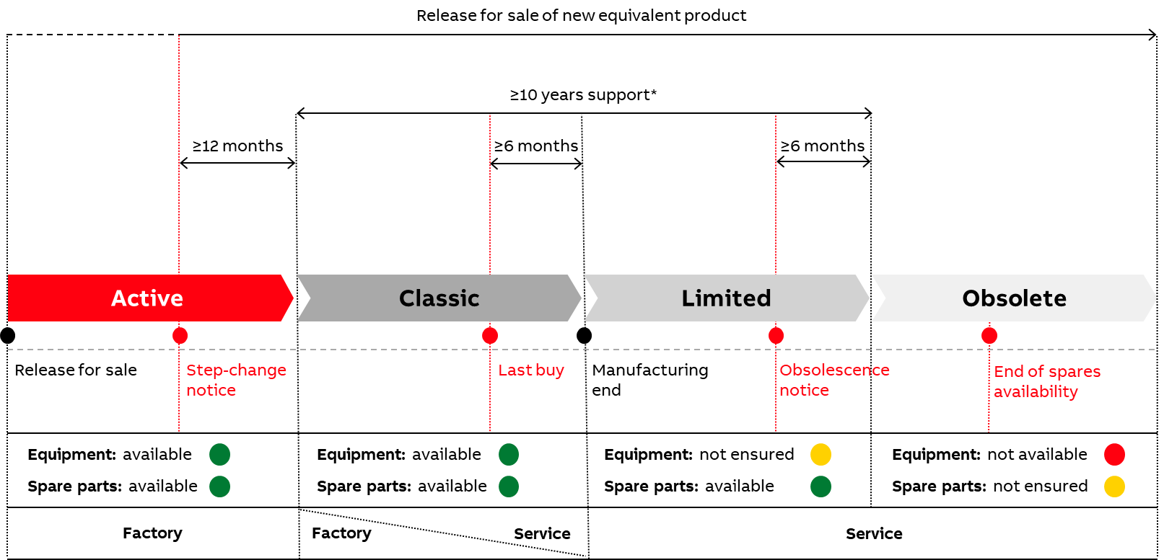
Life-Cycle Management (LCM)
Life-cycle stages
Four stages define life-cycle policy for ABB Electrification products:
Active
Classic
Limited
Obsolete
Open communication with our customers is continuous, with notifications provided for each status change several months
in advance, as well as a minimum
of 10 years of support granted from the Classic phase to the beginning of the Obsolete phase.

Slide 5
Life-Cycle Management (LCM)
Life-cycle stages
Active
Equipment: available
Spare parts: available
  Released for sale
  No limitations to manufacturing
  Actively promoted in assigned markets, available to all customers
  Fully supported both technically and via after-sales network
  Periodically enhanced
Classic
Equipment: available
Spare parts: available
  Product not extensively promoted by the sales force
  Product’s ownership moves to Service
  Product still available for sale, mainly for expansions of existing systems, supply under frame agreements, etc.
  No further enhancements and developments
Limited
Equipment: not ensured
Spare parts: available
  Product no longer promoted by the sales force
  Product is no longer manufactured
  Very limited and selected production might be done
  Service support ensured
  Life extension solutions granted
Obsolete
Equipment: not available
Spare parts: not ensured
  No longer manufactured
  as a complete product
  Spare parts availability diminishes over time with decreasing installed base
  Life extension solutions granted

Slide 6
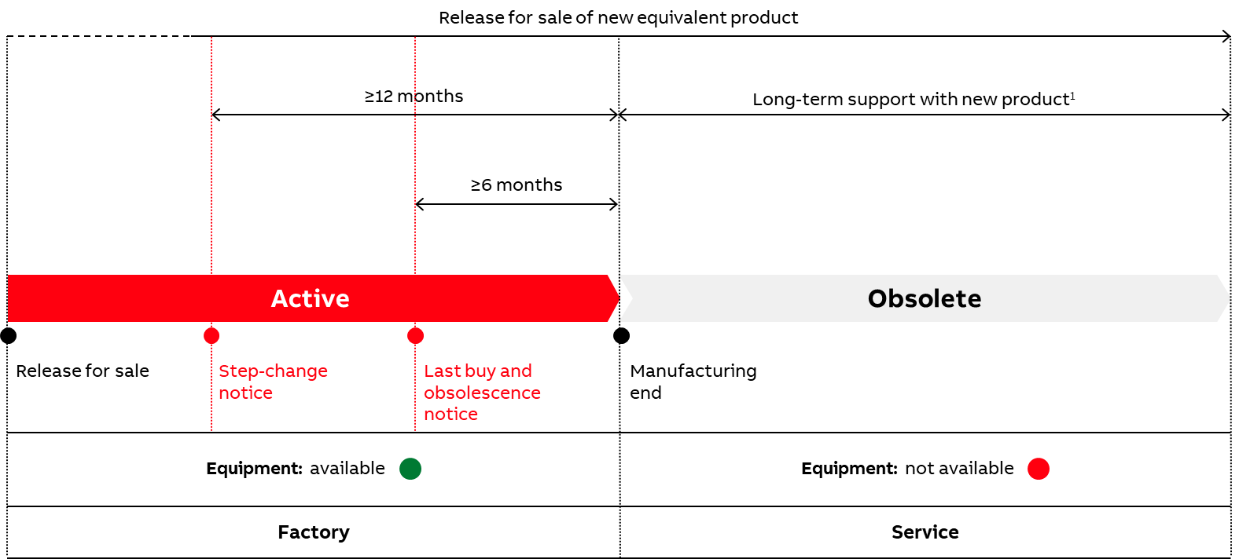
Life-Cycle Management (LCM)
Life-cycle stages – Discrete equipment
Classic and Limited phases
are not foreseen for discrete equipment (instrument transformers and sensors, fuses and cut-outs).
These products are characterized by a long and stable lifetime and no spare components requirements.
When they are no longer available, they can be replaced by new interchangeable products or upgraded with
the use of adaptation kits.

Slide 7
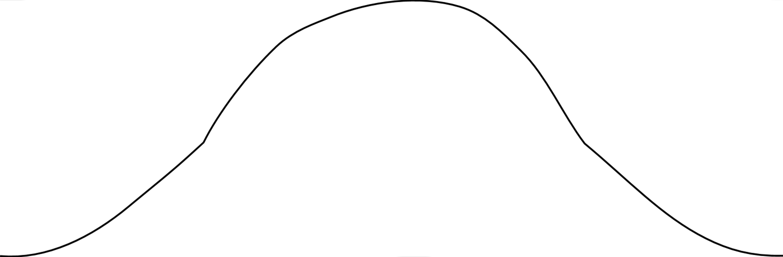
Life-Cycle Management (LCM)
IEC 62402 Application Guide and ABB LCM
Production volume
Obsolescent
Qualification
Production
Obsolete
Samples
Time
IEC 62402
Availability phase
Obsolescence phase
ABB LCM
Active
Classic
Limited
Obsolete

Slide 8
Life-Cycle Management (LCM)
IEC 62402 Application Guide and ABB LCM
IEC 62402 Application Guide
ABB LCM
Aim: ensuring that obsolescence is managed as an integral part of design, development, production and in-service support
Two steps approach: Availability and Obsolescence
Aim: innovate and manage the products and related services throughout the entire business lifecycle
Four steps path: Active, Classic, Limited and Obsolete
Much smoother transition, with clear definition of support levels after Active phase
Specifically addressing long lasting lifetime equipment
Addressing full support of aged equipment also when one-to-one backward compatibility with new one is not possible
Same process with same targets.
Common points: phases’ structure, communication, proactive and reactive strategies

Slide 9
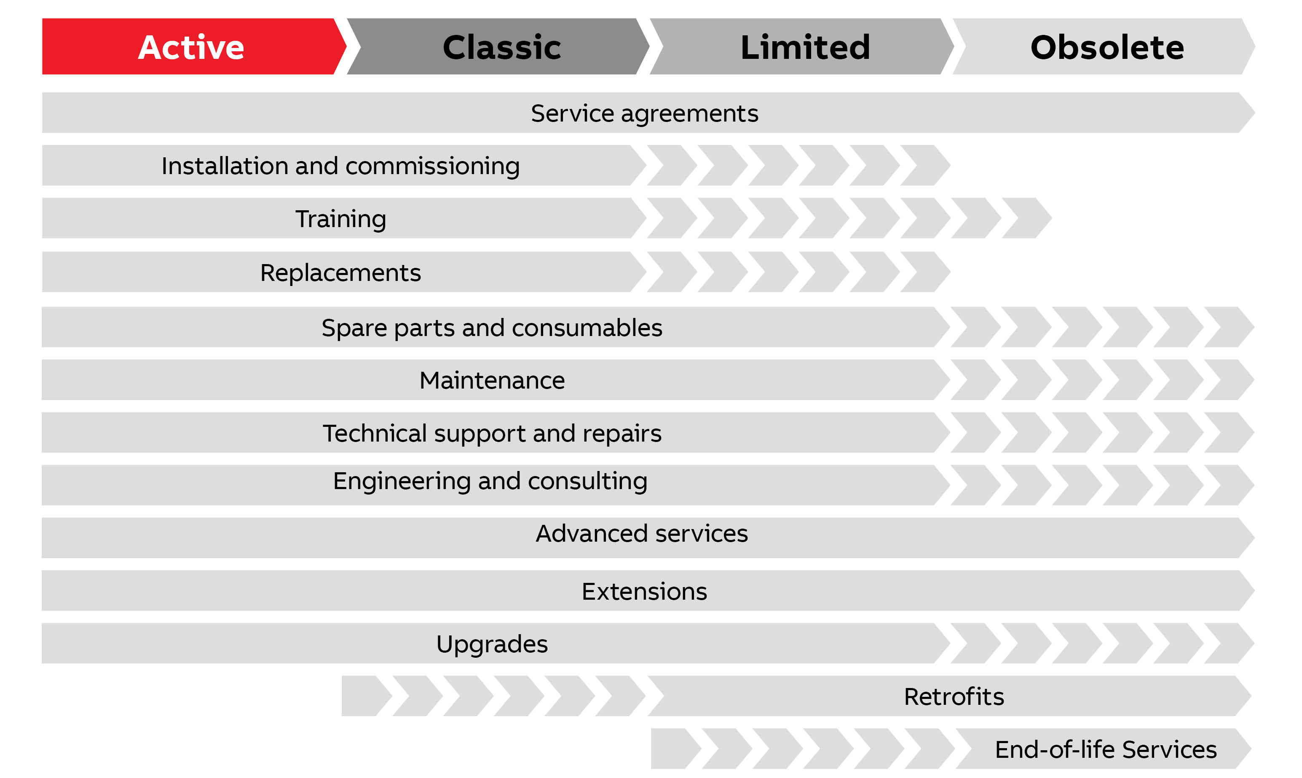
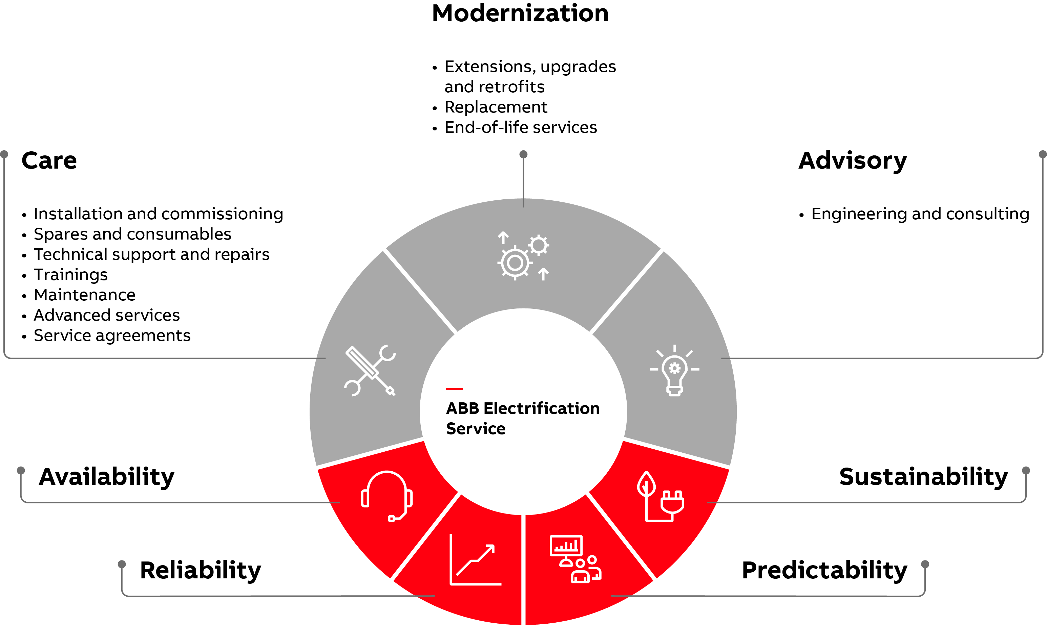
Life-Cycle Management (LCM)
Life-cycle services
ABB maintains close contact with customers throughout the entire lifetime of products via the broad ABB Service solutions portfolio.

Slide 10
Life-Cycle Management (LCM)
Life-cycle services and best practices
Active
  Request ABB to install and test the product to avoid issues down the road.
  Protect your investment and operations with a Power Care Support Agreement for maintenance and repairs.
  Consider setting up an IoT-powered Monitoring & Diagnostics system on those switchgears with the highest system impact.
  Leverage ABB expertise to train your personnel and make sure they are prepared for emergencies.
Classic
  Opt for a Power Care Support Agreement that provides extensive coverage, including 24/7 callout or remote support.
  Update your maintenance program according to the new conditions and considering powering it with Monitoring & Diagnostics.
  Make sure to purchase your spares. ABB spare parts stock management can be a convenient solution during this phase.
Limited
  Maintain and if necessary, upgrade your Power Care Support Agreement, considering the higher risk of faults.
  Make sure you have spares in stock and get in touch with ABB to find the best retrofitting solution for your system.
Obsolete
  Obsolete products have come to the end of the phase-out process. Get in touch with ABB for an urgent retrofit of your equipment.
  It is advisable to plan extraordinary site assessments to monitor the entire installed base. You can get in touch with ABB to plan urgently a modernization or upgrade plan of the entire site.

Slide 11

Life-Cycle Management (LCM)
Where to find information about your products’ life cycle
Detailed information about all the life-cycle status of products is available
and continuously updated.
You can get them through the following channels:
  On demand from ABB representatives
  Visiting ABB website
  Periodically notified by activating a Power Care customer support agreement

