Slide 1
ABB Zenith ATS Introduction - External
July 18, 2019
Name - Title

Slide 2

Introductions
Presenters
John Smith
  Regional Sales Manager
  ABB Critical Power Sales
  Phone: (123)-456-7890
  E-mail: john.smith@us.abb.com

Slide 3
Intro to TruONE™
All-in-one open-style ATS

Slide 4
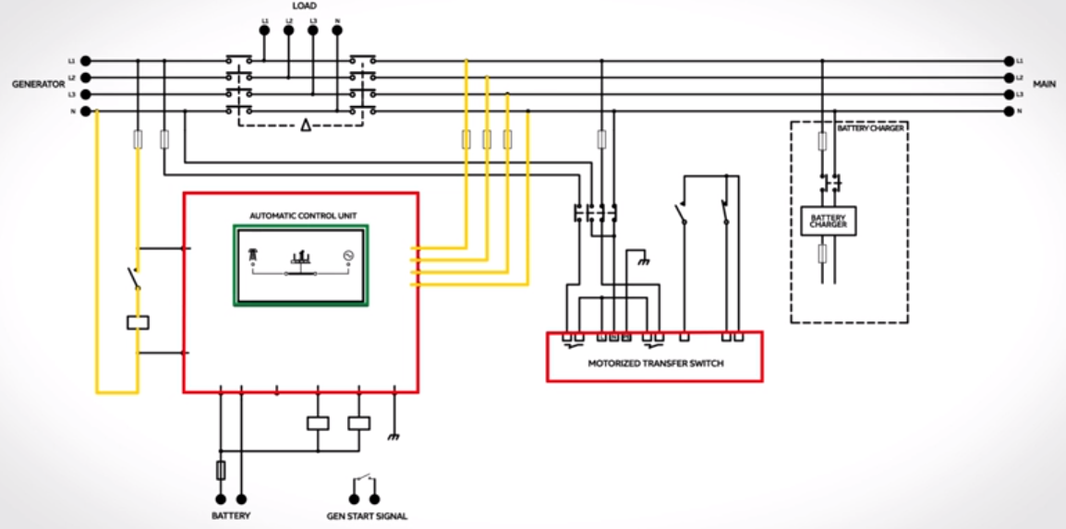
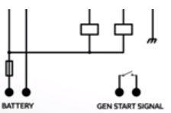
TruONE™ - World’s first true all-in-one ATS
The only ATS engineered to incorporate switch and controller in one seamless unit.
ABB TruONE
Conventional ATS technology
TruONE ATS
Sensors
Controllers
Switch Mechanism
Simplicity vs Complexity – TruONE ATS
Notes:
The conventional ATS technology has variety of components like controllers, sensors and switch mechanism to make ATS… These components needs to be wired together. Compared to this TruONE ATS has all these components in one seamless unit. This basically reduces the failure points.

Slide 5
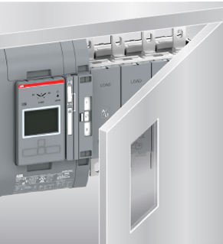
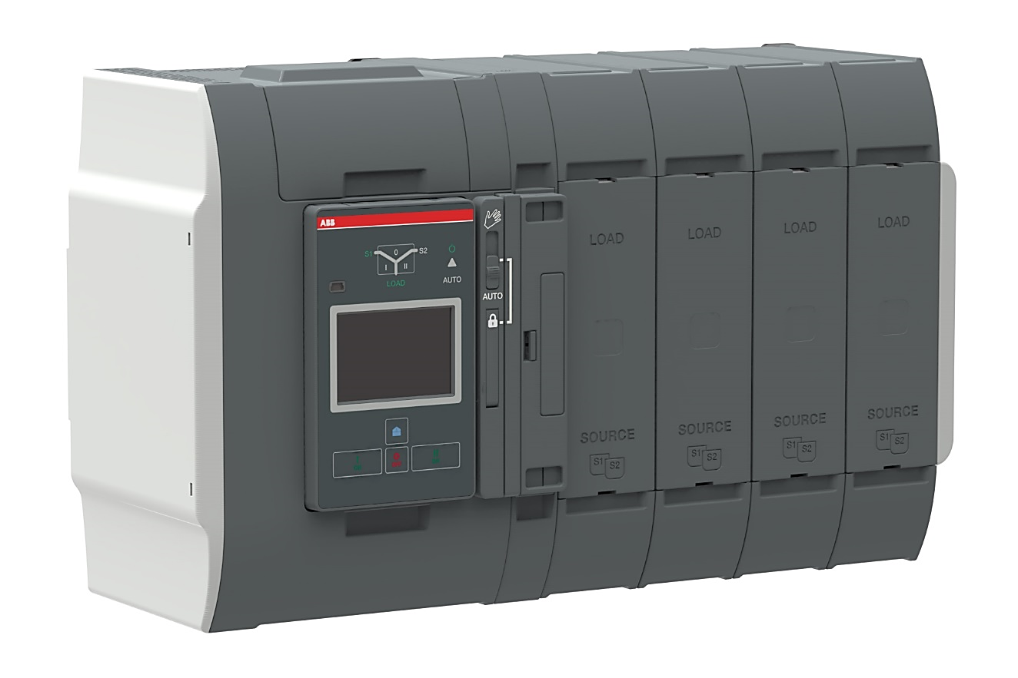
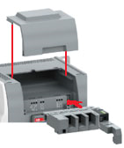
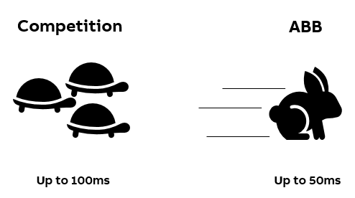
TruONE™ - World’s first true all-in-one ATS
Launched for sales in March 2018
Highlights
  The all-new ATS from ABB is the world’s first true, purpose-built ATS integrating switch and controller in one seamless unit
  With UL short-time ratings (STR) in every frame, TruONE stands ready to ensure the steady delivery of critical power at all times
  Its predictive maintenance (lvl 4 controller) and modular construction simplify service
  Its unique switch design allows manual operation, even when power is on
  And its advanced connectivity with 7 comm protocols is ready for the future
  Fast in-phase open transition, up to 50ms transfer time; delayed transition also available
Notes:
So, what’s come out:
What you typically have out there is a complicated mechanism with over 20 connections going to the controller. Our product was designed from the beginning with simplicity in mind
As a result of the integration between switch and controller, the number of connections is highly reduced – nearly eliminated
ATSs are typically tested to the standards and can fail as long as it transfer to the emergency side. Ours were engineered to be fully operational after a big hit
The most advanced controller has predictive maintenance capabilities – based on the Emax2 technology – that allows you to know when to performance maintenance. This is all based on power measurement and the conditions the switch is operated allowing you to connect to ABB Ablity – the cloud service and receive remove alerts about abnormalities with your electrical system.
Manual Operation - This is something new to the market. All switch and contactor based solution today needs to be disconnected before you perform manual operation. Our design allows safe manual operation even then the power is on
When it comes to connectivity, we share the same capabilities as the Emax2: the most common protocols are available totalling 7 different ones
the cool thing about it is that it’s all installed within the switch limits without adding any extra footprint.
EKIP COM Modbus RS485
EKIP COM Modbus/TCP
EKIP COM Profibus DP
EKIP COM ProfiNet
EKIP COM DeviceNet
EKIP COM Ethernet IP
EKIP COM 61850

Slide 6
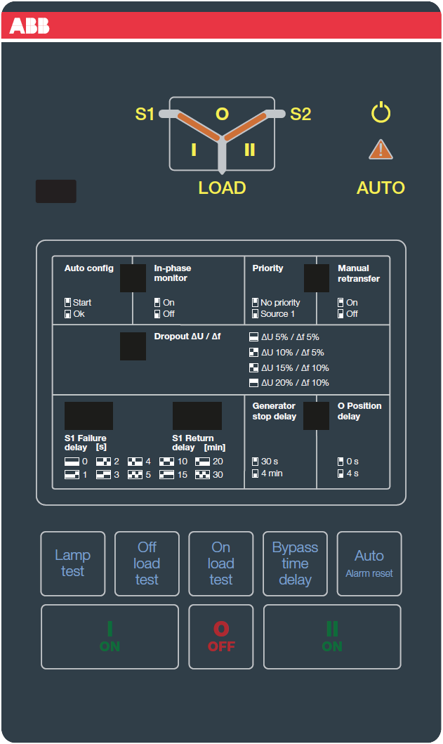
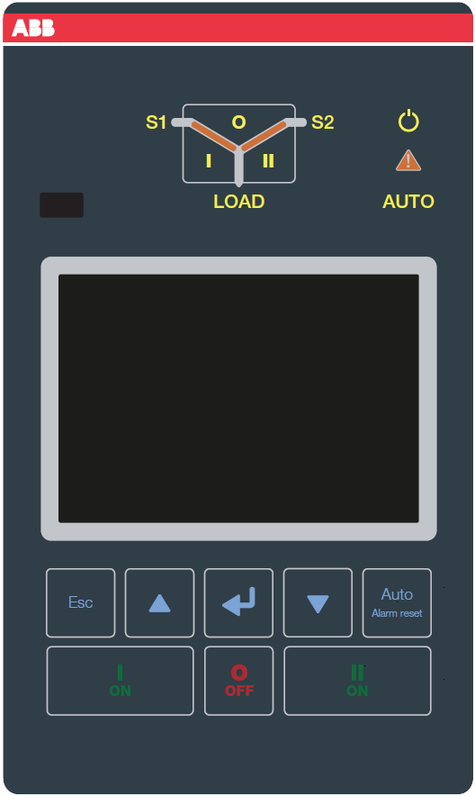
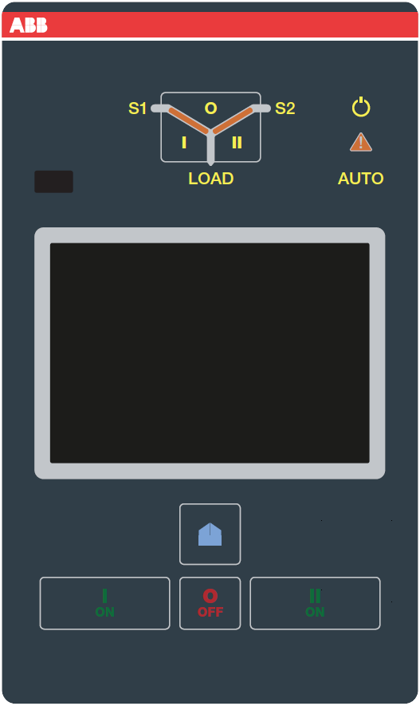
TruONE™ - World’s first true all-in-one ATS
Three control levels
Level 2 controls
Level 3 controls
Level 4 controls
Standard
    Standard features to meet the standard application reqs.
    DIP switch controls
    Mains-Mains and Mains-Gen applications
    Specific breaker ratings
Advanced
    Enhanced product features
    LCD screen controls
    Programmable I/O, and field mount comm. & I/O
    Flexible time delays
    Specific breaker ratings
Pro
    Superior product features
    Touch screen controls
    Power measurement
    Predictive maintenance
    UL Short-time, time-based, and specific breaker ratings
Notes:
There’s three levels of controller
Standard where you have the basic but enough features to fully control the switch including time delays
The advanced comes with additional features such as LCD display mimicking analog meters, programmable I/O, flexible time delays and comm modules
The Pro version is the one that includes the power measurement and predictive maintenance.

Slide 7
Intro to ABB Zenith
Enclosed Automatic Transfer Switches

Slide 8

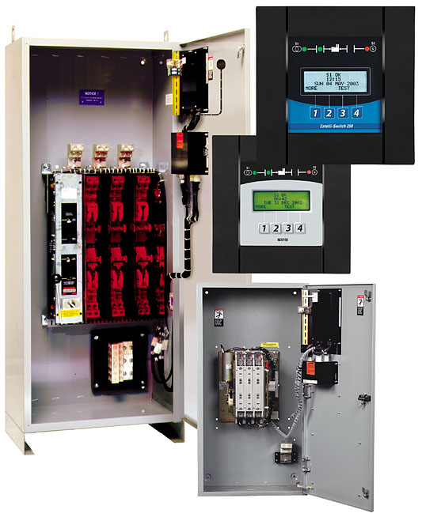
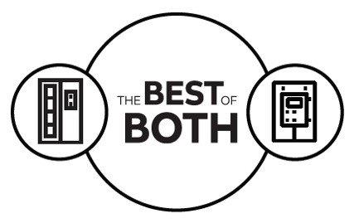
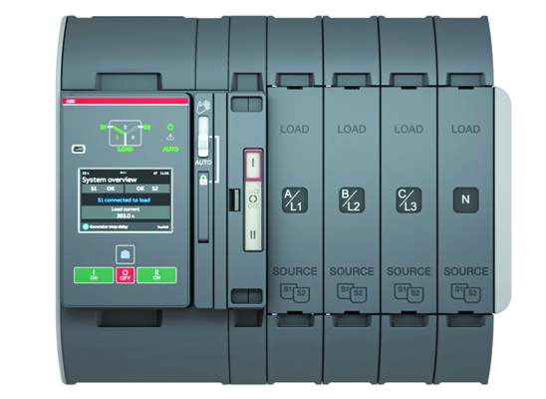

ABB Zenith
Enclosed automatic transfer switches
ZENITH
ZENITH
Ease of installation and operation
Advanced communication capabilities (ABB AbilityTM)
Decades of US Market Experience
Full UL ATS portfolio

Slide 9
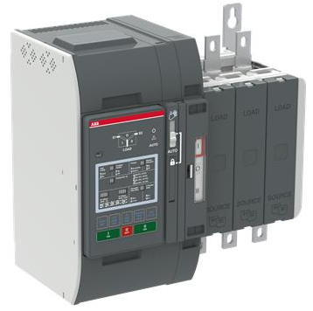
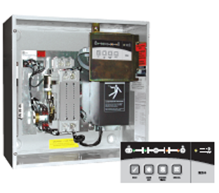
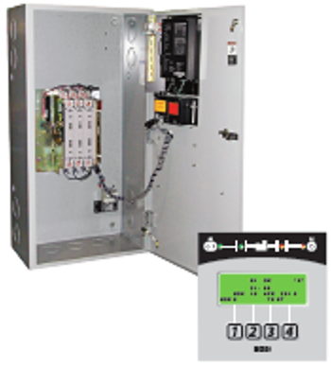
ABB’s Full UL rated Transfer Switch portfolio
Full NEMA transfer switch offering – Today
TruONE
ZTX
ZTG
ZTS
ZTE
OEM general purpose, industrial & critical
General purpose commercial & industrial
Small frame residential, commercial & light industrial
General purpose commercial & industrial
Business & industrial critical
Small frame residential, commercial & light industrial
Mission, process & healthcare critical
Open style ATS in standard or delayed transition
30-1200A, 200-480V ratings
2, 3 or 4 pole applications
Modular all-in-one design with wide range of features in 3 controller levels
Standard transition
40-400A, 120-480V ratings
2, 3, or 4 pole
Standard or delayed transition for motor, transformer or UPS switching
Extended ratings up to 3000A & 600Vac (2, 3, or 4 pole), and service entrance
Standard, delayed, or closed transition for make-before-break switching
Extended ratings up to 4000A & 600Vac (2, 3, or 4 pole), and service entrance
Maintenance bypass available on all frames and transition types
Specially-designed for critical applications, with built-in PQ metering, enhanced diagnostics, and connectivity
Full color graphical display
Standard, delayed, closed transition & bypass up to 4000A & 600Vac (2, 3 or 4 pole)

Slide 10
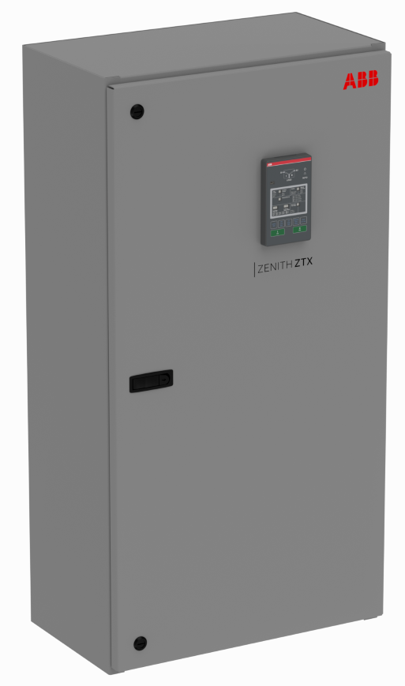
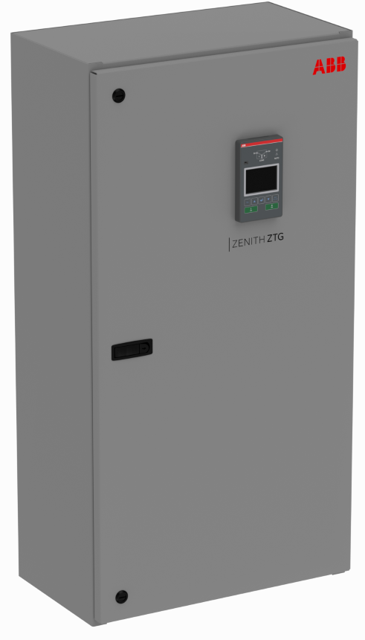
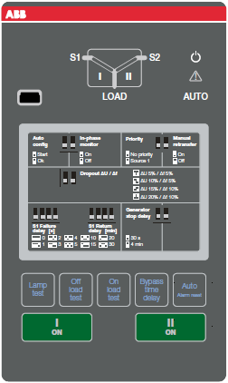
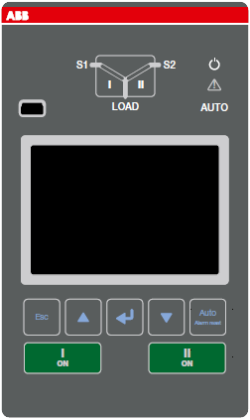
ABB’s Full UL rated Transfer Switch portfolio
Full NEMA transfer switch offering – Shipping September* 2019
TruONE
ZTX
UPDATED
ZTG
UPDATED
ZTS
ZTE
OEM general purpose, industrial & critical
Small frame residential, commercial & light industrial
General purpose commercial & industrial
Business & industrial critical
Mission, process & healthcare critical
Open style ATS in standard or delayed transition
30-1200A, 200-480V ratings
2, 3 or 4 pole applications
Modular all-in-one design with wide range of features in 3 controller levels
Standard transition
30-1200A, 200-480V ratings
2, 3, or 4 pole applications
Enclosed in type 1 or type 3R enclosures
Standard or delayed transition for transfer with a timed “off” position
Ekip connectivity and advanced interface from 30-1200A,
Extended ratings up to 3000A & 600Vac (2, 3, or 4 pole), and service entrance
Standard, delayed, or closed transition for make-before-break switching
Extended ratings up to 4000A & 600Vac (2, 3, or 4 pole), and service entrance
Maintenance bypass available on all frames and transition types
Specially-designed for critical applications, with built-in PQ metering, enhanced diagnostics, and connectivity
Full color graphical display
Standard, delayed, closed transition & bypass up to 4000A & 600Vac (2, 3 or 4 pole)
Notes:
- Updated solution with TruONE to replace ZTX and ZTG within the 30-1200A, 200-480Vac range
- Rebranded line completely in documentation and in product labeling – will now say ABB Zenith on the products as well as the manuals and brochures

Slide 11

Production Facility
ABB Senatobia, MS – 30 minutes south of Memphis, TN
Acquired in December 2015 and began producing February 2016
85,000 sq. ft. manufacturing facility supporting Low Voltage Breakers, Switches and Control Products with a 50,000 sq. ft. off site warehouse
38 acre site accommodates plant expansion to more than 500,000 sq. ft.
Employs over 145 people, most of which are from the surrounding communities
Manufactures products specifically for the US Market using advanced manufacturing methods
Truck shipments can reach more points next day than in any other US city
The new Zenith ZTX and ZTG series ATS will be assembled here starting in July 2019
Announced in March 2019, ABB is investing $36M in this facility, with plans to add 200,000 sqft of production and warehouse area to the existing building. This will create an additional 200 jobs.

Slide 12
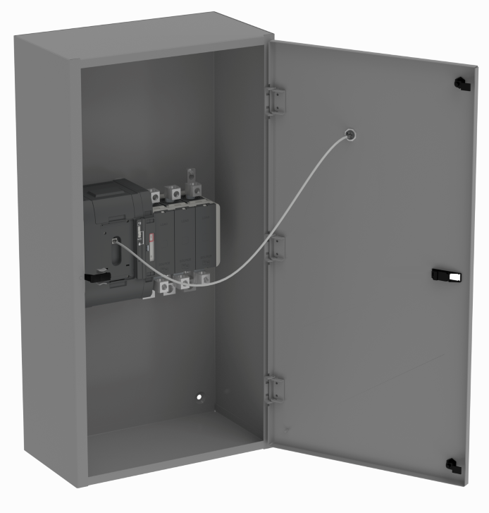
Zenith ZTX Reimagined
Ratings comparison
OUTGOING | Feature | NEW
Residential/Light Commercial | Target Application | Residential/Light Commercial
Standard (Open) | Transition Type | Standard (Open)
40A - 400A | Amperage Range | 30A – 1200A
120-480V | Voltage Range | 200-480V
50 or 60 Hz | Rated Frequency | 50 or 60 Hz
Single or three | Phase Application | Single or three
Open, NEMA 1, NEMA 3R | Enclosure Type | NEMA 1, NEMA 3R
MX60 | Controller | TruONE Level 2 (DIP Switch)
UL 1008, CUL, CSA | Certification | UL 1008, CUL
Coordinated breaker | WCR Ratings | Coordinated breaker
Notes:
Coordinated Breaker Ratings with ABB breakers already established. Testing with GE and Schneider breakers going on right now
Comment on 2 pole: Not currently UL, 3 pole sold for 2 pole application
No fundamental difference between CUL and CSA from a product perspective

Slide 13
Zenith ZTG Reimagined
Ratings comparison
OUTGOING | Feature | NEW
General Purpose Commercial & Industrial | Target Application | General Purpose Commercial & Industrial
Standard (Open), Delayed | Transition Type | Standard (Open), Delayed
40A - 3000A | Amperage Range | 30A – 3000A *Split Offer
120-600V | Voltage Range | 200-480V *Split Offer
50 or 60 Hz | Rated Frequency | 50 or 60 Hz
Single or three | Phase Application | Single or three
Open, NEMA 1, NEMA 3R/4/12, NEMA 4X | Enclosure Type | NEMA 1, NEMA 3R/4/12, NEMA 4X
MX150 | Controller | MX150 or TruONE Level 3 (LCD) *Split Offer
UL 1008, CUL, CSA | Certification | UL 1008, CUL
Coordinated breaker | WCR Ratings | Coordinated breaker
Notes:
Coordinated Breaker Ratings with ABB breakers already established. Testing with GE and Schneider breakers going on right now
Comment on 2 pole: Not currently UL, 3 pole sold for 2 pole application
No fundamental difference between CUL and CSA from a product perspective

Slide 14
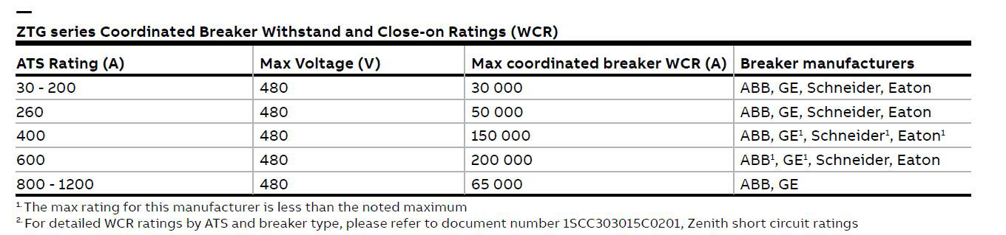
ABB Zenith
Coordinated withstand and close-on ratings (WCR)

Slide 15
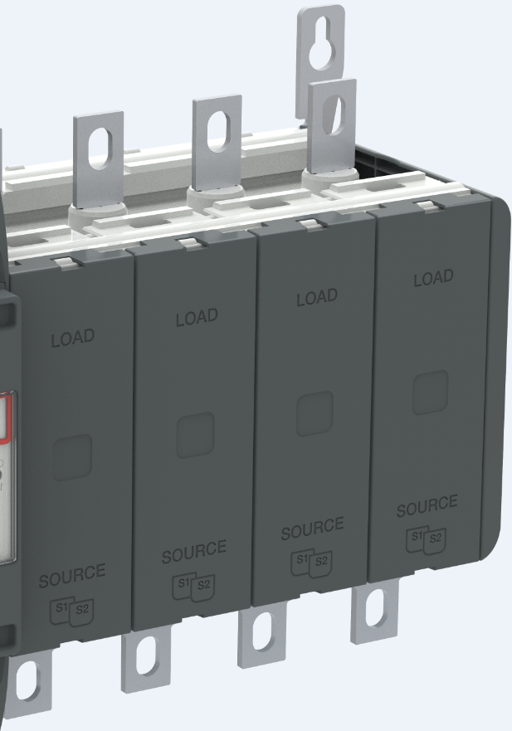
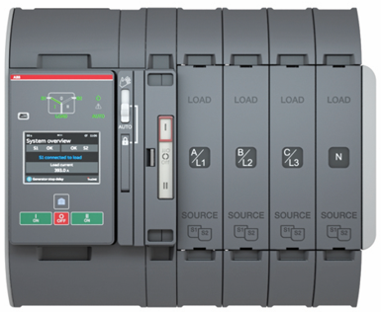
ABB Zenith
Construction
Terminal Shrouds Removed
Mechanism + electronics
Position indicator module
Power poles
Phase markings with both IEC/UL terms A/L1…
Source markings
S1 on the back
S2 on the front
Notes:
TruONE can be devided in to three main parts:
Mechanism with embedded electronics on the left hand side
A dedicated position indicator module in the middle
Power poles on the right hand side

Slide 16
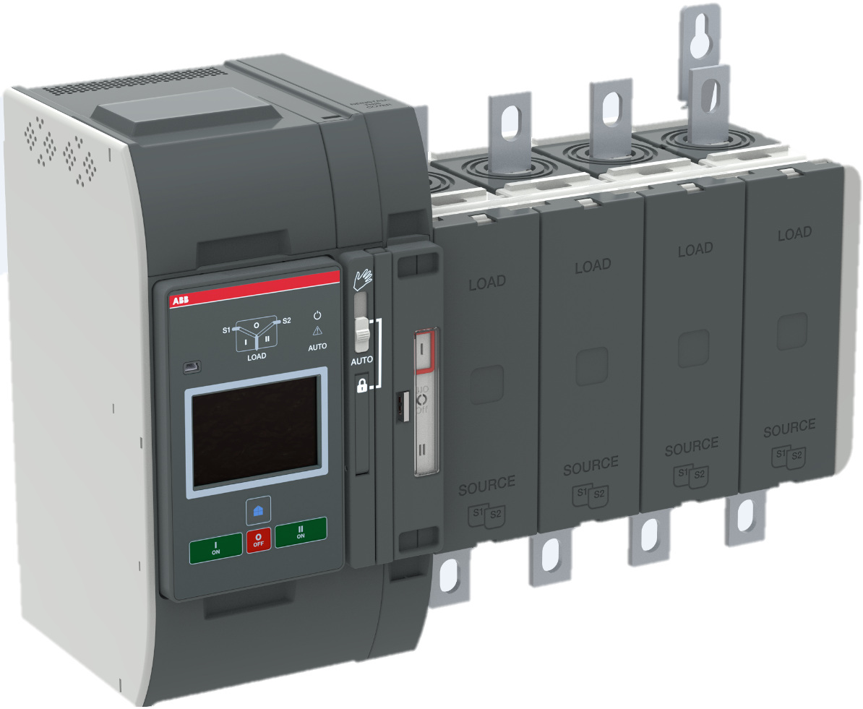
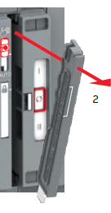
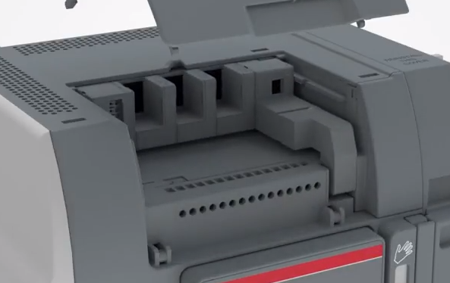


ABB Zenith
Power panel features
Connectivity modules*
Manual mode
Locking mode
Power poles
Standard digital inputs and outputs
Mechanism + electronics
Position indicator module
Automatic mode
Notes:
TruONE can be devided in to three main parts:
Mechanism with embedded electronics on the left hand side
A dedicated position indicator module in the middle
Power poles on the right hand side
Here’s an example of both versions; Top fed, sources on the top – load on bottom /// Bottom fed, load on the top – sources on the bottom
You can see in the images that on the left hand side there are two set of terminals on the top whereas on the right hand side there is only one set of terminals
Source 1 is always on the back and Source 2 in the front
Then let’s take a closer look inside the pole
Customer has to specify which type (top of bottom fed) version is needed when placing the order (type code OX_________B = bottom fed // OX__________T = top fed).
MAN/AUTO selector is used to select between automatic and manual operating modes.
When the selector is in Manual, emergency manual operation can be done with the handle and electrical operation is inhibited (let’ s focus on the manual operation on the following slide).
Standard inputs and outputs are located on the top of the mechanism, behind the cover (check animation ”installation of accessories” https://www.youtube.com/watch?v=qV2KoIv38GY)
This is also the place where the connectivity modules (communication and signalling) are mounted. More of this later. Locking mode in between is used for padlocking the TruONE, disabling both manual and electrical operation.
Automatic mode is used to set the TruONE back to AUTO mode after e.g. manual operation has been completed.

Slide 17

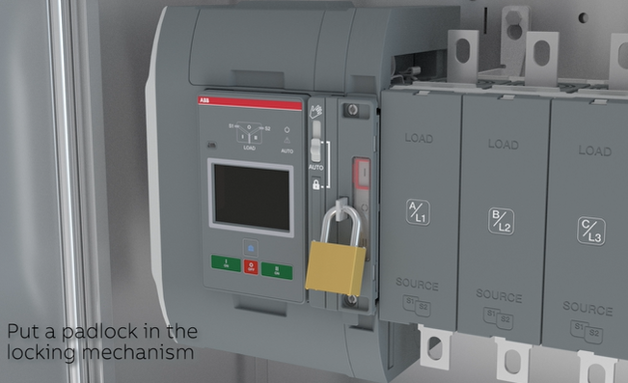
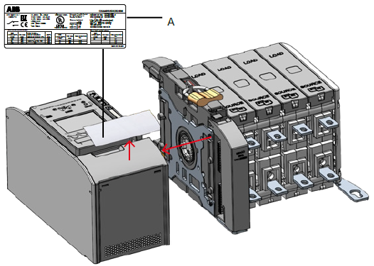
ABB Zenith
Mechanism removal
Locking latch
Notes:
TruONE is available in two versions:
Open transition which is an ATS without stable OFF-position
Delayed transition, an ATS with the stable OFF-position.
In the US, open transition is the standard ATS making 80-90% of the market whereas in the IEC, the delayed transition is more preferred and making 99% of the market. The transfer time is the same, no matter if the ATS has open or delayed transition - this is a unique feature with TruONE.

Slide 18

ABB Zenith
Installation – Ekip modules (communication, I/O)
Available Modules:
Aux Supply Module
Ekip 2k (2 DI, 2 DO)
Ekip Hub (EDCS)
EKIP COM Modbus RS485
EKIP COM Modbus/TCP
EKIP COM Profibus DP
EKIP COM ProfiNet
EKIP COM DeviceNet
EKIP COM Ethernet IP
Notes:
Input functions
Emergency Stop
Remote Test On Load
Remote Test Off Load
Inhibit AUTO Mode
Manual Retransfer to Priority
Source Priority S1
Source Priority S2
Inhibit Transfer
Bypass Running Time Delays
Remote Control to S1
Remote Control to OFF
Remote Control to S2
Reset Alarm
Manual/Auto Mode
Output functions
Alarm / Product availability
Load connected S1
Load disconnected
Load connected S2
Pre-transfer Signal
Source 1 available
Source 2 available
Load Shed 1

Slide 19
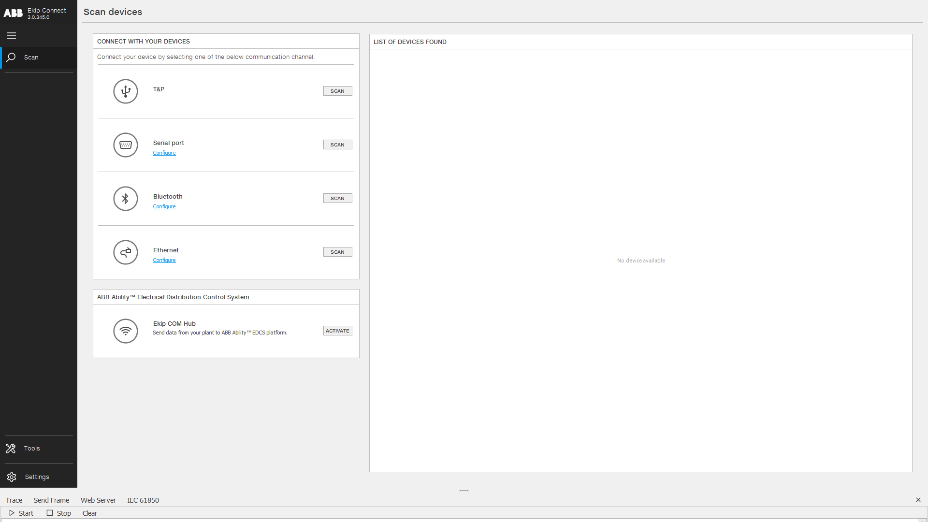

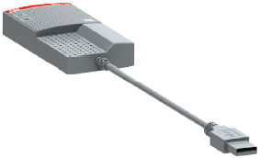
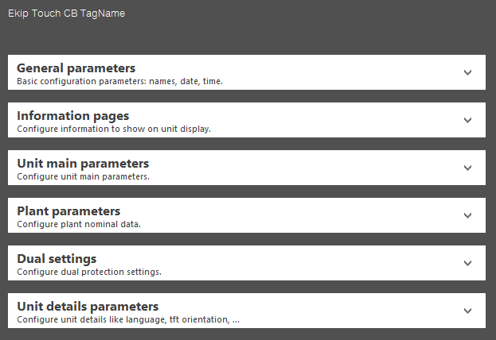
ABB Zenith
HMI – Programming port
Programming port (with Ekip Connect 3)
Ekip Programming module
+
+
Notes:
Programming port: Used for downloading, setting and reading the controller parameters with Ekip Connect 3 software.
TruONE is fully compatible with Ekip Connect 3. The same tool can now be used for programming TruONE and ABB XT and Emax 2 circuit breakers. The benefit is that no other software is needed and that it’s much faster than the traditional manual programming where you need to go the sub-menus through one by one.
Programming is done with Ekip T&P programming module, which is used for connecting the TruONE to your laptop where you run the Ekip Connect 3 software and the cool thing is the T&P module powers up the controller so you don’t even need to bring any power to the TruONE to program it. Programming optional Ekip modules - communication and signaling - requires either power from the Source 1, Source 2 or 12-24Vdc from the aux power supply module.

Slide 20
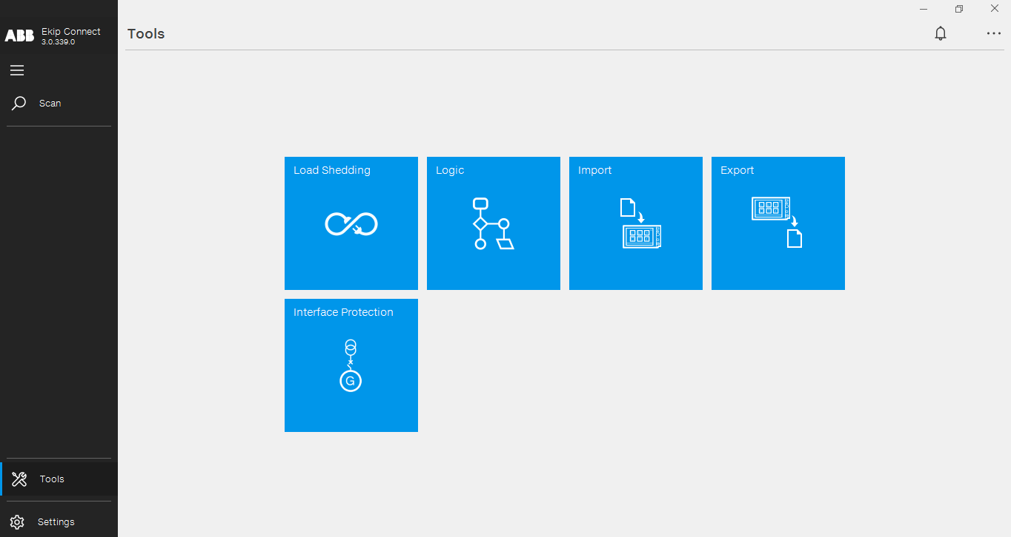
ABB Zenith
Optimal programming
Ekip Connect 3
  In addition to local programming via HMI, Zenith offers simplified programming with Ekip Connect 3 software
    No other software needed
    ATS status and logs in one place
    Settings Import/export
    Can access controller a number of ways: Ekip Programming module, Bluetooth module, Modbus TCP, Ethernet IP
    Allows programming an unpowered unit
    Same tool used for ABB breakers
Notes:
Like mentioned earlier, TruONE is fully compatible with Ekip Connect 3 commissioning tool. Same tool can now be used for programming TruONE and ABB XT and Emax 2 circuit breakers and the benefit is that no other software is needed and that it’s much faster than the traditional manual programming where you need to go the sub-menus through one by one. Programming is done with Ekip T&P programming module which is used for connecting the TruONE to your laptop where you run the Ekip Connect 3 software and the cool thing is the T&P module powers up the controller so you don’t even need to bring any power to the TruONE to program it. And this is of course a safety feature as well as the unit is not powered while doing the programming.

Slide 21
ABB Zenith
ABB Ability™ Electrical Distribution Control System
ABB Ability EDCS and TruONE
  Zenith ZTG features cloud-based services under the common ABB Ability EDCS platform for ensuring continuous operation in critical power applications
  With EDCS, end users are able to access valuable data remotely
    Real time supervision of the system and critical components like automatic transfer switches
    Service reports available at any time
    Receive configurable email alerts based on device conditions
Notes:
Continuous operation is the most important requirement in critical power applications and with ABB Ability Electrical Distribution Control System (or simply EDCS) combined with TruONE predictive maintenance we simplify the supervision of the system and critical components.
Electrical Distribution Control System is part of the ABB Ability portfolio which is a cloud service and an innovative solution for energy and asset management of low-voltage power distribution systems.
A simple and integrated architecture enabling truly plug & play approach.
Front-end services are provided on a webapp with scalable and always up to date features to always suit customers’ need.
Some qualitative Values
Remove inefficiencies and identify room for improvements in the processes
integrate a ready made plug and play solution for LV into more complex systems, cutting down costs and time
Get alerts and notifications when abnormal conditions are in place to take action proactively
Real time supervision help avoid failures and downtimes
Smart service helps reduce unnecessary costs due to preventive maintenance
No complex hardware or connections are needed, nor engineering time and costs
Let’s focus more on the benefits what we can bring to the table with the TruONE, EDCS and predictive maintenance in the following slide.

Slide 22

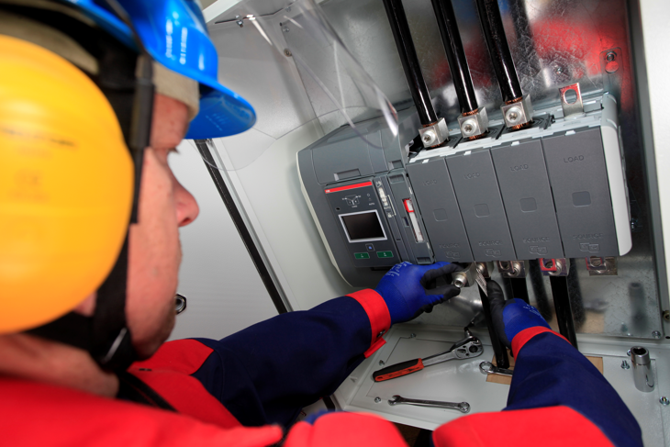
Zenith ZTX/ZTG
Easy to Install and Commission
COMMISSION IN MINUTES, NOT HOURS.
  Weighs up to 30% less, but has up to 25% more wire bending space than comparable ATS
  No exposed wiring except customer connections – power cables, control, and comms
  200-480Vac range in every unit
  Auto-configure voltage system, freq, phase order from HMI
  Expandable and programable I/O
  All accessories snap on, even within a finished panel.
  Program with laptop, even to unpowered ATS
                *Than comparable ATS (size and ratings)

Slide 23
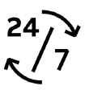
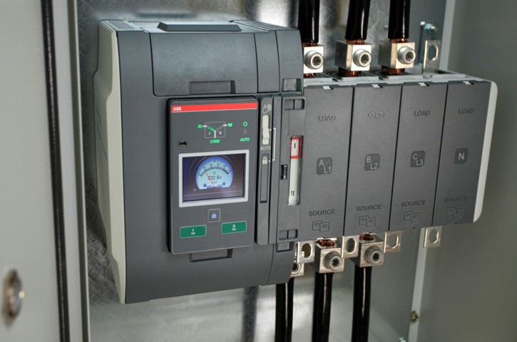
Zenith ZTX/ZTG
Continuous Operation
MINIMIZE UNPLANNED OUTAGES.
  Tested to last up to 6000 operations without any service or maintenance – at 10 transfers per month, that’s 50 years of reliable operation!
  All critical modules and accessories are field replaceable with less than 15 replacement part SKUs!
  Controller/solenoid/power supply can be replaced as a single module in under 10 minutes with just a flathead screwdriver
  Ekip Connect software allows easy import/export of settings
  Over center mechanism means manual handle operation is possible under load
Notes:
Option: show manual operation animation video
The TruONE® ATS is designed to reduce the risk of operator injury.
It enables safe emergency manual operation with the panel door closed—even under load. This is a unique feature. With other ATS solutions, you must open the Source 1 and Source 2 breakers before transferring the load manually.
Because the HMI module is connected to the ATS controller inside the product frame via a local communication bus, there’s no need to bring dangerous line voltages to the panel door. So there’s no risk of operator injury due to an equipment malfunction.
Costly downtime is minimized.

Slide 24
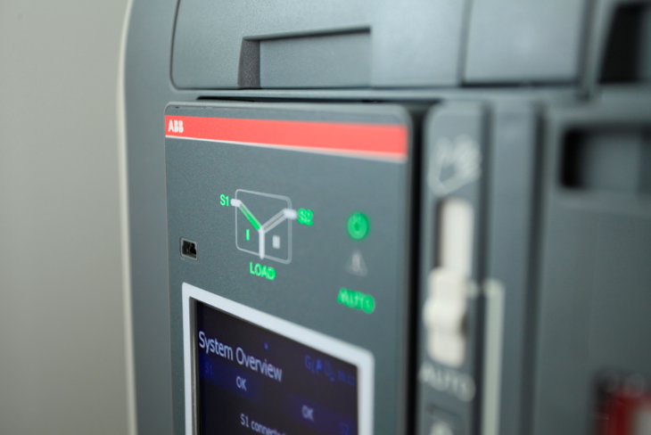

Zenith ZTG
Advanced Data and Connectivity
MAKE DATA-DRIVEN DECISIONS.
  Programmable digital I/O is expandable up to 6 additional inputs and outputs
  Market-leading 7 communications protocols
    Modbus RS485, Modbus TCP, Profibus DP, ProfiNet, DeviceNet, Ethernet IP, IEC61850*
    Up to 4 slots available for comms and I/O
  ABB Ability™ Electrical Distribution Control System (EDCS) compatible – allows cloud monitoring of ABB devices and email alerts
Notes:
Seven different communication protocols (Modbus RS485, Modbus TCP, Profibus DP, ProfiNet, DeviceNet, Ethernet IP, IEC61850). These are plug-in modules, which can be added at any point during the lifetime of the installation, so the technology won’t become outdated.

Slide 25


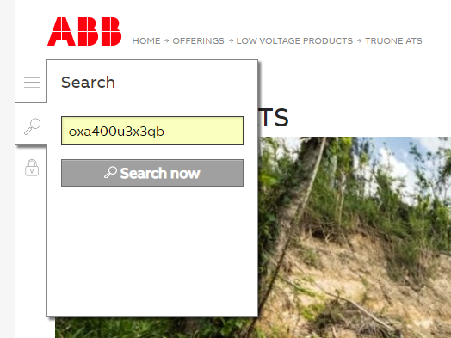

ABB Automatic Transfer Switches
Resources and Tools
Documentation & Tools
Videos & Animations
Zenith Launch Page
Zenith ZTG series Catalog
Zenith ZTG series ACW Flyer
Zenith ZTG series O&M manual
Zenith ZTG series Spec Guide
Zenith ZTX series Catalog
Zenith ZTX series ACW Flyer
Zenith ZTX series O&M manual
TruONE Virtual HMI
Ekip Connect 3 Download
Promotional video: The Power of One
Simplicity vs. Complexity
Installation of TruONE in panel
Accessory installation
Manual and automatic operation
Success Stories
Puerto Rico Regains Reliable Power
One Bishopsgate Plaza
Complete resource package!

Slide 26

Questions?
?

