Slide 1
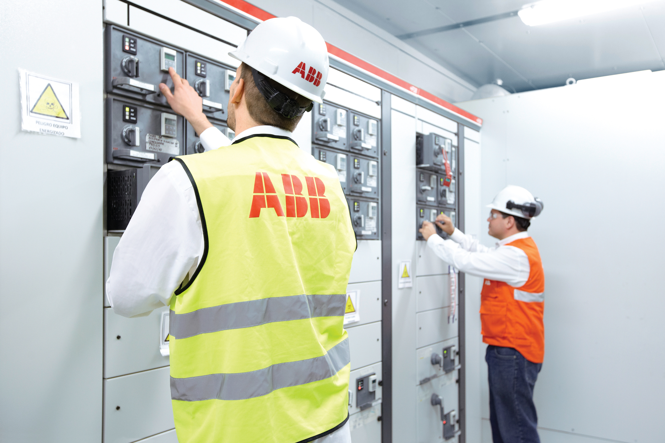
OEM system integrators and panel builders
Industry brochure
Installation Products Division
October 2023
2023
Notes:
Presentation= 9AKK108468A7923 Release 2023.08.30
https://search.abb.com/library/Download.aspx?DocumentID=9AKK108468A7923&LanguageCode=en&DocumentPartId=&Action=Launch
Brochure= 7TKK001632 / Release 2023.11.02
https://search.abb.com/library/Download.aspx?DocumentID=7TKK001632&LanguageCode=en&DocumentPartId=&Action=Launch

Slide 2
— Thomas & Betts is now part of ABB’s Installation Products Division, but our long legacy of quality products and innovation remains the same. From connectors that support wire buildings on Earth to cable ties that help put machines in space, we continue to work every day to make, market, design and sell products that provide a smarter, safer and more reliable flow of electricity, from source to socket.

Slide 3
Contents
04 Designed to perform
05 Challenge and commitment
08 Continuous operation & sustainability
10 Safety and contamination
12 Total project cost reduction
14 SKU reduction
16 Total project cost reduction
18 Liquid ingress protection
20 Grounding and bonding
22 Services & training
24 Product selection guide

Slide 4
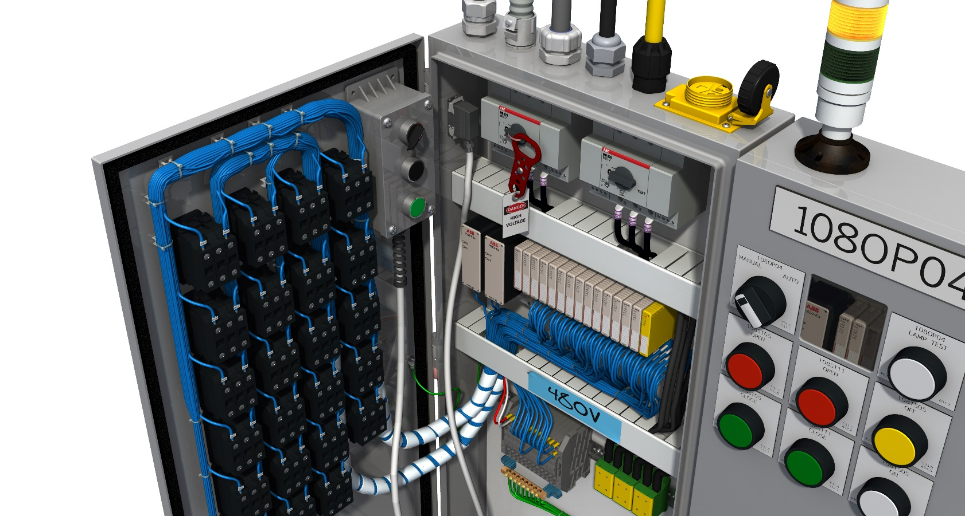
Designed to perform
OEM system integrators and panel builders
ABB understands the everyday challenges you face in the panel-building market. We’re focused on providing you with electrical solutions that address the critical issues in your operation, enabling you to focus on your product’s design, performance, quality, reliability, cost and customer installation schedule.
Our family of electrical solutions matches specific application criteria from start to finish both inside and outside your electrical control panel, ensuring the quality, reliability and profitability of your project. And with the industry’s most efficient distribution system, we’re prepared to meet your ongoing electrical components needs now and into the future.

Slide 5
Challenge and commitment
Electrical control panels are an essential part of manufacturing. They ensure that the right amount of electrical power is sent to the right equipment at the right time, allowing the manufacturing process to be performed consistently and repeatedly.
Panel board applications

Slide 6
Challenge and commitment
In order to operate at full capacity around the clock, it is critical that rail companies continually evaluate the design, construction, maintenance and operation of their electrical systems.
Today’s system integrators and panel builders
must remain competitive while facing:
Reduced or tight budgets
Fluctuating raw material costs
Increased competition
Changing technology and global standards
Key business drivers include:
Building high-performance, reliable and safe electrical panel boards
Improving operational efficiencies and revenues while maintaining high quality
Completing jobs on time and to specifications
Electrical control panels are used to control water pumping stations to irrigate farms, to keep our nation’s food supply healthy and to keep parks and golf courses saturated with the right amount
of water so you can enjoy an outdoor activity.
Electrical control panels are used in commercial
building HVAC and lighting systems to ensure
workers are comfortable and effective while at
work. They are used nearly everywhere power is
used, from industrial and commercial markets
to institutional and residential markets.
System integrators and panel builders are
increasingly being challenged to design a variety
of panel types for different environments
(approximately 80 percent of panels are unique)
and to build and install their electrical control
panels on time, at a competitive cost and with a
high degree of reliability. Their panel boards are
often required to operate 24/7 without interruption
and in harsh environments.
The critical need for continuous clean power
without downtime is key to many manufacturing
processes as well as healthcare. The losses from
power failure in an industrial plant can be huge; the
loss of power in a hospital can threaten life itself.
ABB understands system integrators’ and panel
builders’ electrical system issues and has solutions
that will help them to:
Increase personnel and equipment safety
Improve revenues and profitability
Ensure high-performance, high-quality and high reliability electrical systems with extended life
Reduce labor and installation costs while increasing productivity
Build and install safer equipment with flexible design options
Save space in their panels
Keep up to date with new technologies and global standards
Meet their customers’ specifications and exceed their expectations
Maintain high brand value and company reputation in order to gain market share

Slide 7
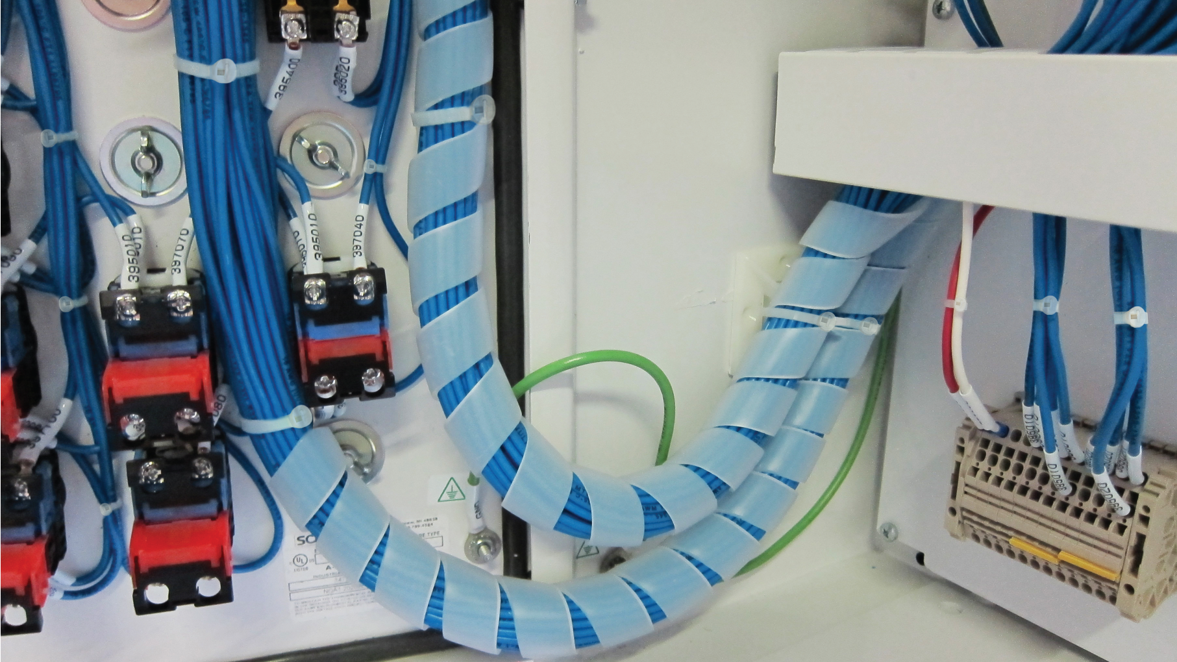
— ABB solutions help you build safe,
reliable, high-performance panels.

Slide 8
Continuous operation & sustainability
ABB offers high-quality electrical system solutions for consistent, reliable connections to maintain your brand reputation.
System integrators and panel builders are under pressure to create high-reliability panels with technical features that solve complex processing problems. Panels must be produced quickly, able to run continuously in a variety of environments with high performance and at a lower installe cost. Loose connections are a serious issue. ABB products comply with industry standards, which helps your factory acceptance testing (FAT) go smoothly and eliminates rework. In addition, we offer components designed to provide long, reliable service in harsh, wet, corrosive and extreme-temperature environments.
Carlon® non-metallic enclosures
NEMA and JIC designs
Lightweight, impact-resistant and non-metallic
Withstands harsh, wet and corrosive environments
Sta-Kon® crimped wire termination systems
Complete line of rings, forks, splices, pin terminals, disconnects and wire ferrules
Longer, selectively annealed barrel for increased pull-out strength and lower crimping force
UL listed and CSA certified
Shrink-Kon® wire insulation provides superior conductor and connection protection
T&B® Fittings cord and cable fittings
Exceptional strain relief
Dependable seal against dust, oil and liquids
UL listed and CSA certified
T&B Liquidtight Systems® Liquid-tight flexible conduit and fittings
Available in steel, stainless steel, aluminum and high-temp versions to suit various applications
Withstand harsh, wet and corrosive environments
Safe Edge® ground cone accepts raceway variations
Suitable for grounding and bonding applications
UL listed and CSA certified

Slide 9
— Panel boards are found in indoor and outdoor applications, exposed to various environmental conditions, such as high and low temperatures, ultraviolet light, rain, snow, liquids, chemicals and corrosive agents.

Slide 10
Safety and contamination
ABB offers a variety of ergonomic manual, battery-powered and pneumatic/hydraulic installation tools for terminals, lugs and cable ties, providing consistency, efficiency and comfort and helping to reduce the risk of injury.
NFPA 70E is the U.S. “Standard for Safety in the Workplace” that governs worker safety. UL 508A is the primary listing agency for U.S. industrial control panels. Safety issues for system integrators and panel builders encompass both the well being of personnel building the panels and protection of the employees and assets of customers who use the panels.
Many safety products are being designed into panels to identify and monitor critical processes, make them “touch safe” with arc flash protection, indicator lights, safety relays, touch screens, viewing windows, door ports, deadfront barriers and interlocked safety switches that offer emergency stop circuitry for added protection. For the safety of your employees, ABB offers a variety of ergonomic installation tools for terminals, lugs and cable ties, providing consistency, efficiency and comfort and helping to reduce the risk of injury. We also provide safety products to help protect your customers’ employees while working in your panel.
Color-Keyed® | Sta-Kon® | Ty-Rap®
Ergonomic application tooling
Consistent installation of lugs, terminals and ties
Save time and increase reliability and profitability with hydraulic and pneumatic tooling
Reduced handle force and ergonomic design lowers the risk of repetitive motion injuries
EZCODE®
Safety labels, tags, signs, markers and tapes
Help to ensure personnel and workplace safety, as well as regulatory compliance
Highly visible and long-lasting materials
Custom labels, tags and signs available
PMA®
Halogen-free nylon liquidtight conduit systems
Free of halogen and cadmium — will not expose workers to hazardous smoke fumes
Non-metallic fittings with metallic and nonmetallic threads providing IP66, IP68 and IP69K ingress protection
STAR TECK®
Cable fittings
Metal-clad and armored cable fittings provide exceptional mechanical strain relief
UL listed and CSA certified

Slide 11
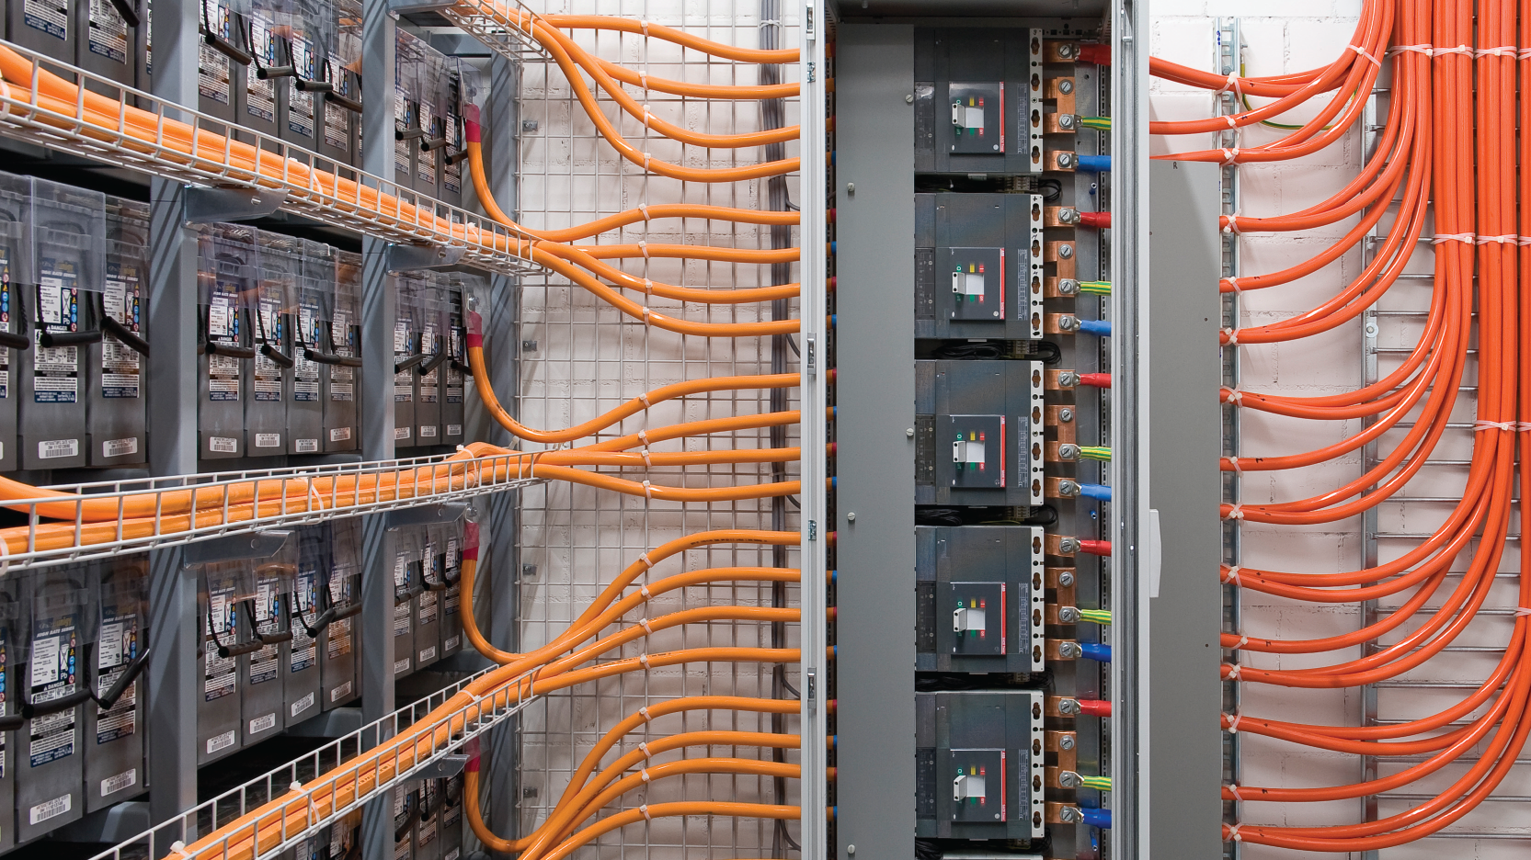
— What are your panels’ safety features?
According to OSHA, repetitive stress injury (RSI) affects approximately 1.8 million workers per year. The right tools can help reduce operator strain when installing crimp terminals, compression lugs and cable ties.

Slide 12
Total project cost reduction
ABB offers total project cost reduction solutions to help you achieve savings.
Increasing profitability while maintaining quality, reliability and safety requires continuous improvement of operational efficiencies. With global commerce increasing, many U.S. system integrators and panel builders are using more IEC components, which often cost less. The labor-to materials-and-equipment mix changes with the level of panel design complexity, and with labor representing as much as 50 percent of panel cost, installation time reduction is an ideal way to reduce costs and increase profit margin. ABB offers total project cost reduction solutions to help you achieve savings in labor, materials, equipment and logistics.
Carlon® non-metallic enclosures
NEMA and JIC designs
Lightweight, impact-resistant and non-metallic
Withstands harsh, wet, corrosive environments
Color-Keyed® compression connectors
Compression connectors and tools
Design, quote and order custom lugs easily with fast turnaround
HEX-FLEX® die system yields superior terminations with fewer crimps for flex cable
PMA® PACOF divisible flexible nylon conduit
Ideal for use with panel door joints
Fast, easy installation for labor savings
Can be opened and closed again in longitudinal direction at any time
Specially modified polyamide 6 construction — self-extinguishing and free from halogen and cadmium
Operating temperature of -40° C to 100° C
Ty-Duct® non-metallic wiring duct, tools and
accessories
Triple-restricted slots and universal mounting clip enable fast and neat internal wire bundling
Two-point contact cover with writable protective film installs/removes easily, yet won’t accidentally slip off
Bench-mount cutter provides fast, dust-free operation

Slide 13
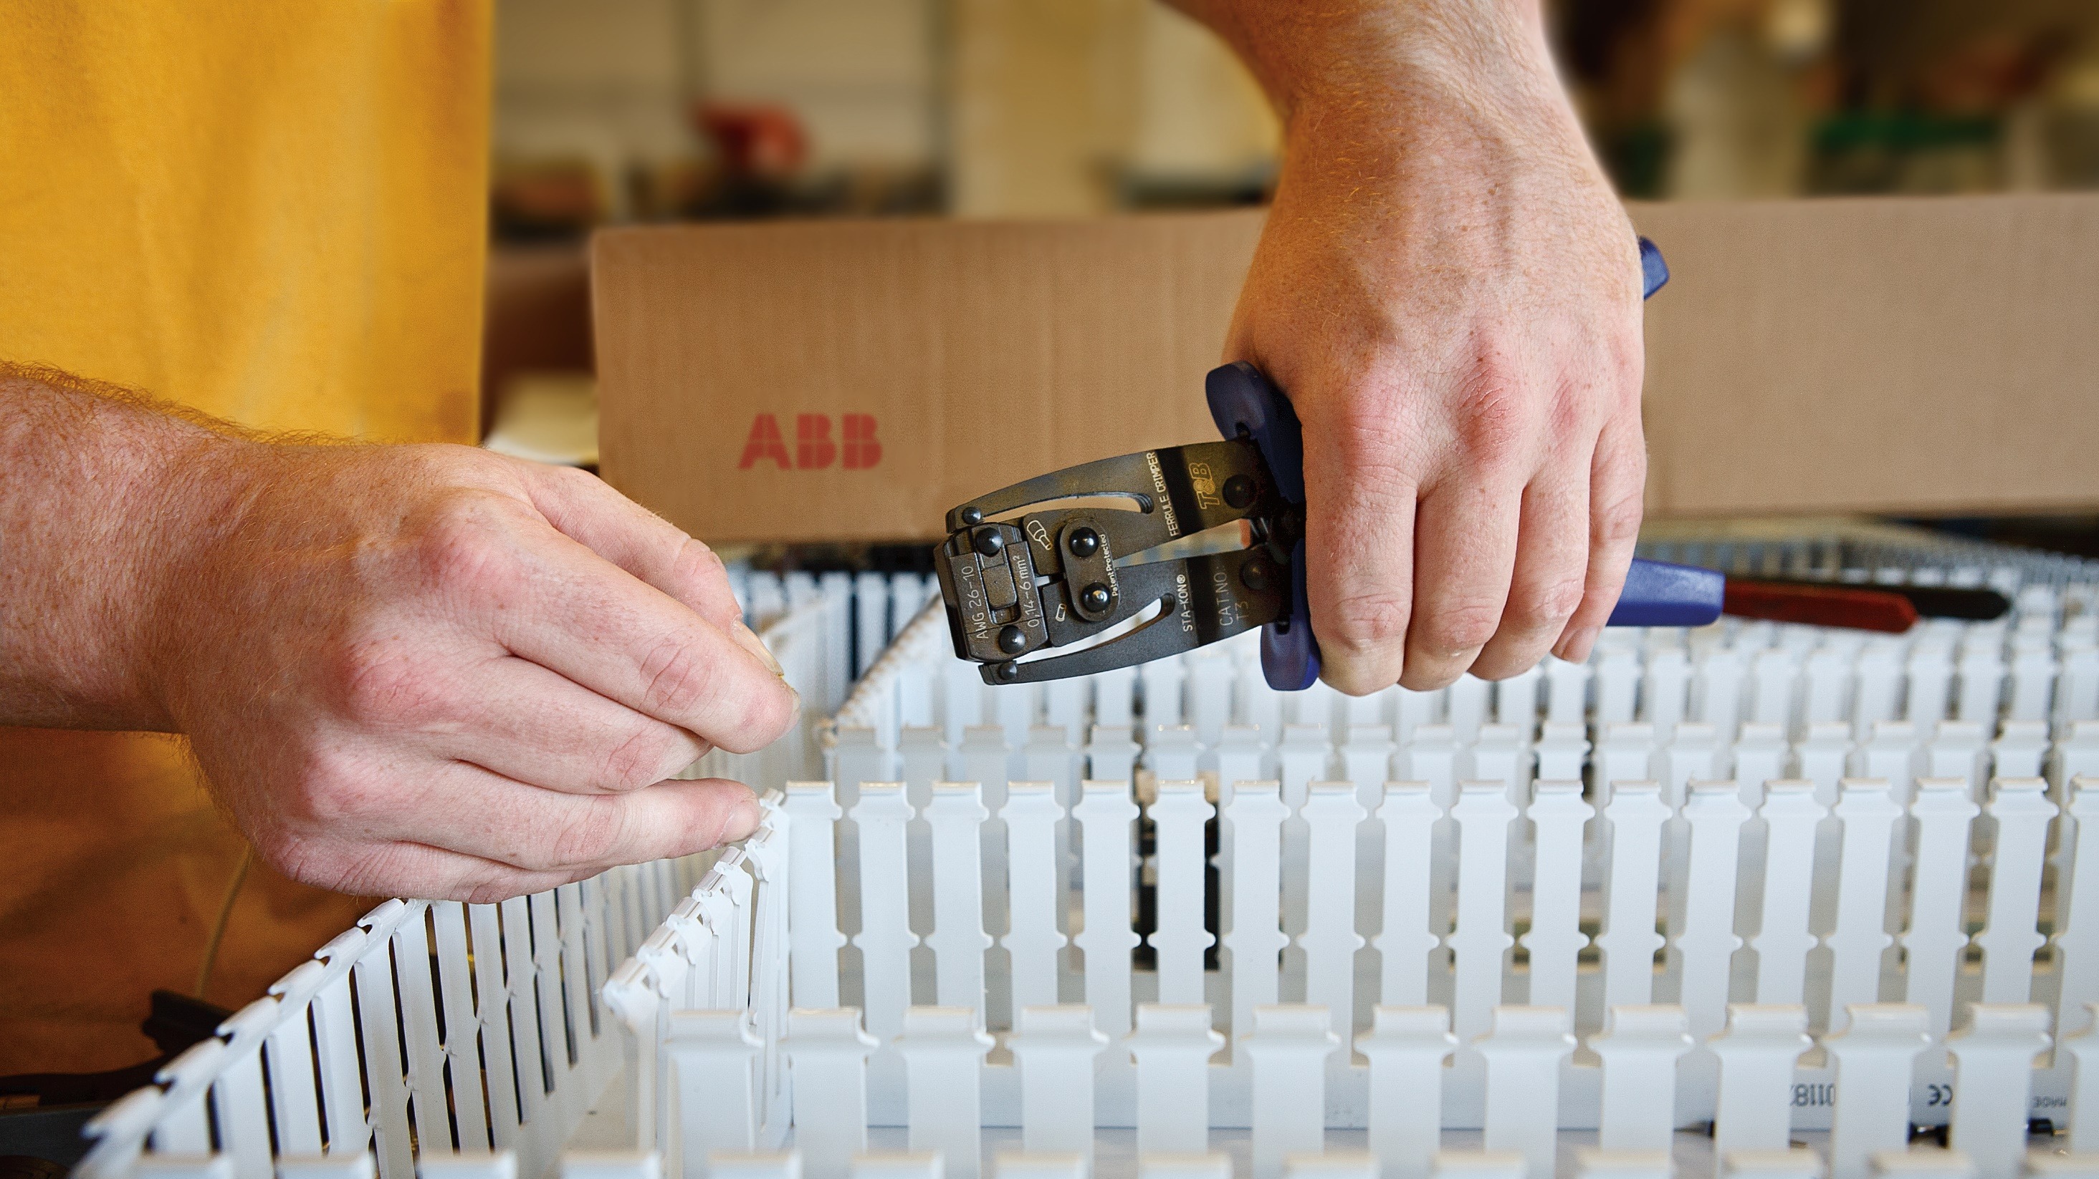
— In what areas of your operation could you reduce costs to increase your profit margin? Approximately 80% of panels are custom-built. The average panel is 3 ft. x 3 ft. in size and takes 40 hours to build.

Slide 14
SKU reduction
ABB has a heritage of innovation, and an important characteristic of many new ABB products is their ability to replace multiple existing SKUs with one.
Carrying excess inventory is as much of a drag on company profitability as inefficient production processes. The more item SKUs (stock keeping units) you maintain, the greater the complexity of tracking systems and expense to manage inventory — both of which result in revenue loss. ABB has a heritage of innovation, and an important characteristic of many new ABB products is their ability to replace multiple existing SKUs with one.
Our SKU reduction solutions help you:
Save space in your store room
Reduce inventory items to manage
Increase cash on hand
Color-Keyed® HEX-FLEX® die system
Reduces installation time by providing a superior termination with fewer crimps for flex cable
Color-Keyed connector and die matching system helps ensure proper connections
STAR TECK®
STAR TECK EXTREME® DIRECTOR™
jacketed metal-clad cable fittings
Innovative range-taking design reduces inventory and speeds installation
Allow angle adjustment from 90° to 180° to eliminate the need for a conduit elbow
Easy to install — no disassembly required
T&B® Fittings
Blackjack® grounding bushings
Dual rated for threaded and unthreaded conduit, aluminum and copper wire to cut inventory in half
Speeds installation Dual rated and improves aesthetics
LU® universal conduit elbows
Can replace LL, LR, LB and C conduit bodies for a 4-to-1 SKU reduction
Radius is the same as bent conduit — rated for 40% wire fill
UL listed as an enclosure — splices allowed inside
Available in BlueKote® finish, stainless steel or with Ocal® PVC coating
Ranger® cord connectors
Cable range of 0.25" — twice that of ordinary strain-relief connectors — reducing inventory
Smaller overall size to fit into tight spaces
Choice of aluminum, steel, stainless steel and non-metallic materials

Slide 15
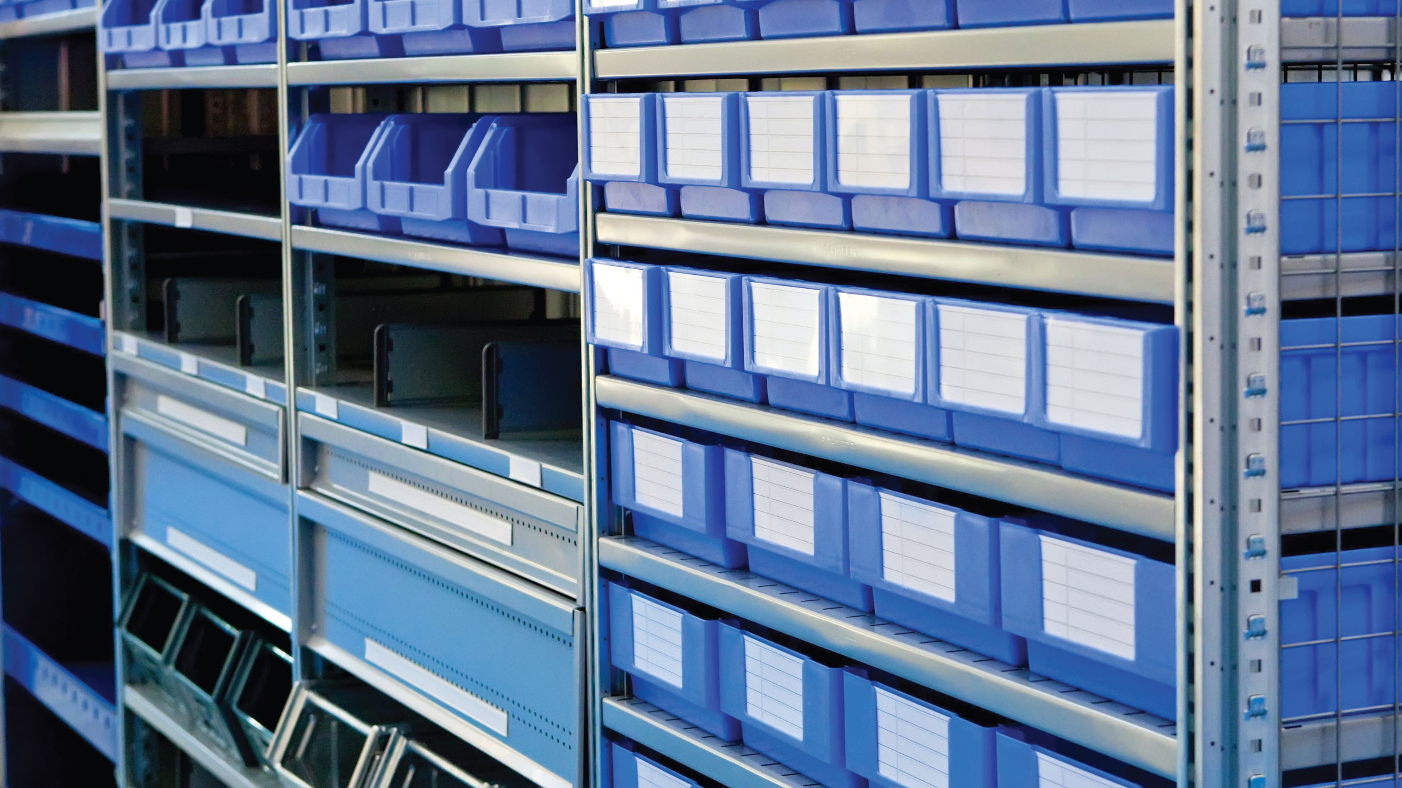
— Reducing inventory increases cash on hand.
Fewer SKUs also means less time spent managing inventory — time savings that translate to lower operating costs.

Slide 16
Total project cost reduction
ABB offers products designed to maximize panel real estate, enhance wire management and help boost your panels’ aesthetics.
When it comes to panels, space is money. The switch from analog to digital components requires less space and reduces wiring, saving space, labor, time and money. ABB offers products designed to maximize panel real estate, enhance wire management and help boost your panels’ aesthetics. We also provide high-temperature solutions. Our space-saving panel solutions:
Make your panels easier to build and maintain
Keep your panel technicians and customers safer
Reduce the size and cost of your panel enclosure and wiring
Color-Keyed® narrow-tongue lugs
Consistent narrow width from barrel to tongue to fit into tight spaces
Color-Keyed connector and die matching system helps ensure proper connections
Pos-E-Kon® rectangular pin-and-sleeve
connectors
Best use of space for multiple contacts in heavy duty housings
Rugged, industrial-grade connectors provide universal raceway flexibility
Easy-lock, cam-action latch eliminates guesswork and speeds installation
T&B Fittings® cord and cable fittings
Labor-saving metallic and non-metallic fittings to route cables into the panel
CHASE® fittings feature compact and low profile cord connectors to save space inside the panel
Ranger® fittings provide up to a 4-to-1 SKU reduction — purchase, stock and install one fitting versus four
Multi-hole cord grips allow multiple smaller cords to be installed in the same fitting
Ty-Rap® cable ties, accessories and tools
Low-profile head and smooth, molded body
Available in high-performance materials to handle harsh and plenum environments
Complete line of mounting bases, spiral wrap harnessing, abrasion-protection sleeving and installation tools

Slide 17
— Would you like more space in your panels?
ABB offers space-saving solutions to help.

Slide 18
Liquid ingress protection
ABB offers you electrical system solutions that protect against liquid, moisture and dust ingress, which will help reduce corrosion and downtime, increasing electrical system lifecycle and improving operating revenues.
Electrical control panels are used in a variety of environments that can negatively affect their performance and lifespan, such as areas that have liquids and steam present from manufacturing processes or outdoor weather exposure. Lubricants and oils can also find their way into electrical systems. Panels installed in food and beverage processing plants may be exposed to high-pressure washdown cleaning procedures, while panels in paper mills must be able to withstand steam. When specifying electrical components for electrical control panels, consider the following:
Liquid ingress can deteriorate or short out an electrical system immediately or over time
Electrical system components designed with round and sloped surfaces help to shed liquids and contaminants, rather than creating a shelf where they can collect
ABB offers solutions that protect against liquid, moisture and dust ingress, which will help reduce corrosion and downtime, increasing electrical system lifecycle and improving operating revenues.
Shrink-Kon® self-fusing tape
Easy-to-install insulation for harnesses, wires or cables — no heat or adhesive required
Just two layers form a moisture-proof, abrasion resistant, dielectric seal for low- or high-voltage applications (600 V max.)
Shrink-Kon® heat-shrink insulation
Provides superior conductor, connection and termination protection
Helps to ensure continuous, reliable operation
T&B® Fittings
Ranger® series cord connectors
Provide exceptional mechanical strain relief
Create a dependable seal against dust, oil and other liquids
Designed to handle the unique connection demands of flexible cords and power cables
UL listed and CSA certified
T&B Liquidtight Systems®
Liquid-tight conduit fittings
Withstands harsh, wet and corrosive environments
Provides a water- and oil-tight seal where flexible metal conduit enters a box or enclosure
Safe Edge® ground cone design accepts variations in raceway convolutions
Suitable for both grounding and bonding
UL listed and CSA certified
Type A liquid-tight flexible non-metallic
conduit and fittings
Create a liquid-, dust- and oil-tight seal
Ideal for continuous flexing applications
Suitable for operating temperatures from -20° to 60° C
Fittings available in non-burning, non dripping thermoplastic, steel and stainless steel materials

Slide 19
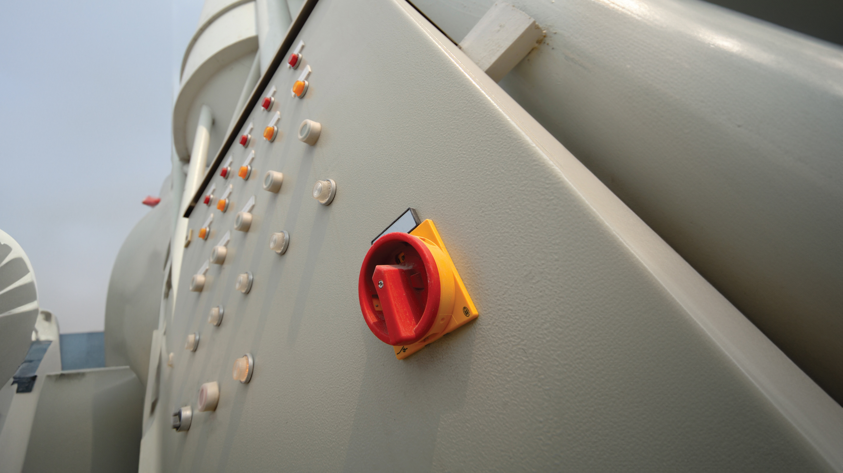
— What NEMA and IP ratings are required to prevent liquids from getting into your electrical control panels?

Slide 20
Grounding and Bonding
ABB grounding and bonding solutions are designed to ensure personnel safety, eliminate lightning interruptions and protect critical equipment.
A stable power supply is the backbone of any facility. Power failure or instability can cause safety, production and operational issues, significantly impacting a company’s bottom line. Ineffective grounding can lead to voltage variances that damage electrical equipment or electronic devices, resulting in power loss and costly downtime. Many power problems stem from incorrect bonding of transformers, main electrical panels, subpanels, UPS systems and generators. ABB grounding and bonding solutions are designed to help provide electrical continuity and reliability and meet IEEE, NEC, UL and CSA requirements.
Blackburn® grounding systems
Superior grounding and bonding of electrical systems and equipment
EZGround® compression connectors provide a consistent, irreversible bond
Mechanical connectors require no special tools
Blackburn® flexible braids
Extra-flexible links for applications to 3,600 A
Standard links for applications to 2,350 A
T&B® Fittings Blackjack® grounding bushings
For grounding and bonding of threaded and unthreaded conduit, aluminum and copper wire
Speeds installation and improves aesthetics
T&B® Fittings bonding locknuts
Ensure positive bonding of conduit to enclosure
Available in steel or aluminum
T&B Liquidtight Systems®
Revolver® grounding fittings
Designed for use where an external bonding jumper is required for liquid-tight flexible conduit
Revolving grounding ring provides flexibility in positioning for ease of installation

Slide 21
— Are your technicians up to date on current NEC grounding and bonding and NFPA 79 safety requirements? ABB offers onsite NEC update training to help you keep your team abreast of changes.

Slide 22
Services & training
The consequences of an improperly installed or maintained electrical system can range from costly downtime to a significant disaster. Proper training is essential.
Electrical systems are becoming increasingly complex, requiring skilled technicians. Proper training can help you avoid expensive and often dangerous situations. Proper installation, maintenance and training not only help to ensure the safety of your workforce and reduce the occurrence of downtime, they also extend the lifecycle of the electrical system by reducing unnecessary wear and tear on assets. New high-tech equipment used in panels requires skilled technicians for programming and design. Most of their training comes on the job, and ABB provides services and training that will help you to:
Maximize worker safety
Reduce installation time
Increase panel life and performance
Grow your brand equity and gain repeat business
Improve your revenues and profitability
Color-Keyed® compression
Lug Express program provides quick turnaround on both standard and custom lug orders
Product configurator enables online design of custom connectors
Product specialists are available nationwide to train in the proper use and installation of Color-Keyed products
Tech Services group provides expertise for call-in customers
Ocal installer certification training
Onsite installation training
Provides hands-on practice of clamping, cutting, threading, assembling and repairing the Ocal® PVC-coated conduit system
Extends warranty from 2 to 5 years on a system installed by a certified contractor
Onsite grounding and bonding training
Covers proper electrical safety protection and grounding of electrical services, equipment and raceway systems
Conforms to National Electrical Code (NEC) regulations, UL 508 and NFPA 79 safety standards
T&B Tool Services
Technical support and calibration services
Tool rental programs available
Additional services and training
Free online CAD Library for downloadable 2D and 3D models in 90+ native CAD file formats
Mobile solutions vehicle for onsite demos of connectors, grounding and other products
NEC update training provides an overview of the latest changes to the NEC

Slide 23
—
Do you have personnel who could benefit from additional training?

Slide 24
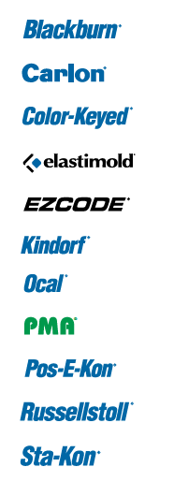
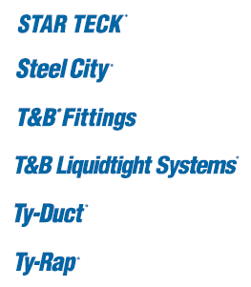
Product selection guide
For OEM system integrators and panel builders
Product description | Continuous operation & sustainability | Safety and contamination | Total project cost reduction | SKIU reduction | Space savings | Liquid ingress protection | Grounding and bonding | Services and training
Blackburn®
Grounding systems, flexible braids, ADR mechanical connectors, aluminum and copper lay-in lugs | • |  | • |  |  |  | • | •
Carlon®
Non-metallic enclosures | • |  | • |  |  | •
Color-Keyed®
Compression connectors — standard, narrow-tongue, 45° and 90° angled and stacking lugs | • |  | • | • | • |  | • | •
Battery-powered and hydraulic compression tools and die systems | • | • | • | • |  |  |  | •
EZCODE®
Safety labels, tags, signs, wire markers and barricade tapes |  | •
Kindorf®
Modular metal framing system and accessories | • |  | • | •
Seismic bracing system | • | •
Trapnut® strut fastener and Cobra® clamp |  |  | •
Ocal®
Corrosion-resistant PVC-coated conduit and fittings | • |  |  |  |  |  |  | •
PMA®
Flexible nylon cable protection systems — halogen-free, ATEX and divisible styles | • | • | • |  |  | •
Pos-E-Kon®
Rectangular pin-and-sleeve connectors |  |  |  |  | •
Russellstoll®
DuraGard® industrial interconnect system and UniGard® IEC 309 rated pin-and-sleeve plugs, interconnections | •
Shrink-Kon®
Shrink-Kon® heat-shrink wire protection insulation and self-fusing tape | • | • |  |  |  | •

Slide 25
Product selection guide
For OEM system integrators and panel builders
Product description | Continuous operation & sustainability | Safety and contamination | Total project cost reduction | SKIU reduction | Space savings | Liquid ingress protection | Grounding and bonding | Services and training
Sta-Kon®
Automated, hydraulic, pneumatic, battery-powered and manual application tools |  | • | • |  |  |  |  | •
Crimped wire termination systems — rings, forks, splices, disconnects and wire joints | •
Insulated and non-insulated ferrules and pin terminals | • |  |  |  | •
Shield-Kon® coaxial grounding connectors |  |  |  |  |  |  | •
STAR TECK®
STAR TECK® fittings for jacketed metal-clad and Teck cables |  | • | • | • | • | • | •
Steel City®
Device boxes and covers | •
Solid and stranded wire grounding pigtails and clips |  |  |  |  |  |  | •
T&B® Fittings
Blackjack® grounding bushings |  |  | • | • | • |  | •
CHASE® fittings — nipples and conduit hubs |  |  |  |  | •
LU® universal conduit bodies — BlueKote® and stainless steel |  |  | • | •
Form 8 conduit bodies — BlueKote® and stainless steel |  |  | • |  |  | •
CorroStall® aluminum conduit boxes |  |  |  |  |  | •
TITE-BITE® metal-clad and armored cable fittings |  | • |  |  |  |  | •
Bonding locknuts |  |  |  |  |  |  | •
Multi-hole cord grips — metallic and non-metallic |  |  | • | • | •
Ranger® cord connectors |  |  |  | • | • | •
Wire-mesh strain-relief cord and conduit grips | • | •

Slide 26
Product selection guide
For OEM system integrators and panel builders
Product description | Continuous operation & sustainability | Safety and contamination | Total project cost reduction | SKIU reduction | Space savings | Liquid ingress protection | Grounding and bonding | Services and training
T&B Liquidtight Systems®
CHASE® fittings — liquid-tight conduit and cord fittings |  |  |  |  | •
Liquid-tight cord connectors — steel, stainless steel, aluminum and non-metallic and Silver Grip® tray cord fittings | •
Liquid-tight conduit and fittings systems — types A, B, C, ATX high-/low-temp. and XTRA FLEX® | • |  |  |  | • | •
Revolver® liquid-tight grounding fittings |  |  |  |  | • |  | •
Ty-Duct®
Non-metallic and halogen-free wiring duct, bench-mount cutter, tools and accessories | • | • | • |  | •
Ty-Rap®
Abrasion-protection sleeving and spiral wrap harnessing | • | • |  |  | •
Multi-colored nylon cable ties, fasteners and mounting accessories |  |  | • |  | •
Low-smoke, flame-retardant UL94V-0 and detectable cable ties |  | •
Coated and uncoated stainless steel cable ties |  |  |  |  |  | •
Ergonomic manual cable tie installation tools and Ty-Rap Tote® cable tie dispensers |  | • | • |  | • |  |  | •

Slide 27
9AKK108468A7923 V2023.11

