Slide 1
ABB MNS® 5 essentials of low voltage switchgear solutions
ABB Business Unit Low Voltage Systems, 2013
Notes:
As the old saying goes, there’s nothing more constant than change. Nowhere is this more true than in the rapidly changing energy industry. Over the next few minutes, we’ll take a look at the many power challenges faced by businesses. We’ll also explore how ABB low voltage switchgear solutions help our customers overcome these challenges to keep the power flowing.

Slide 2
Low voltage switchgear solutions Essential solutions to everyday challenges
Industrial challenges
Tight budgets
Project deadlines
Limited resources
Ensuring safety of personnel and property
Minimizing downtime
Increasing reliability
Adapting to changing business needs
Notes:
Today’s business environments can be tough. Everyday, executives are faced with challenges such as tight budgets, project deadlines and limited resources. Each of these can have an impact on business, especially when it comes to ensuring the safety of personnel and property , minimizing downtime, and increasing reliability. And, as if that weren’t enough, no one really knows what the future will bring. Business leaders need to be able to adapt quickly to changing business needs - be they new challenges or new opportunities.

Slide 3
Five essentials of low voltage switchgear solutions
Ease
of doing business
Safety
Availability and reliability
Flexibility
Ease of maintenance
Notes:
As diverse as the customers ABB serves may be, they look for the same things when shopping for low voltage switchgear solutions. They want a supplier that’s easy to do business with, solutions that protect their personnel and property, and equipment they can count on that also has the flexibility to meet today’s challenges as well as tomorrow’s opportunities. On top of that, these solutions must be cost-effective and easy to maintain.
That may sound like a lot to ask for from some vendors, but ABB builds low voltage switchgear solutions that meet each of these requirements.

Slide 4
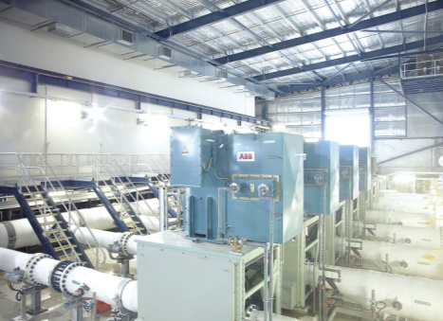
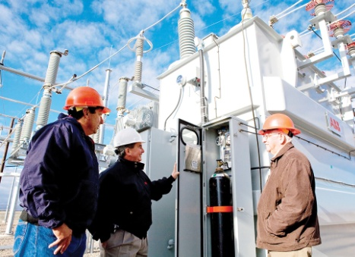
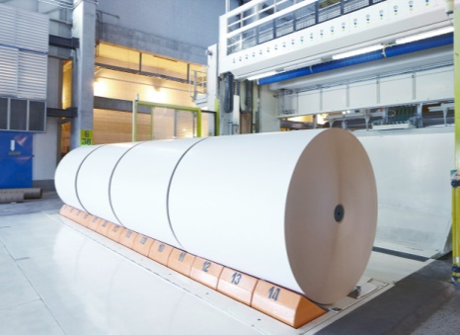
ABB low voltage switchgear systems Solutions for power distribution and motor control
Chemicals, oil and gas
Data centers
Infrastructure
Marine
Metals and mining
Nuclear power
Power, utilities, and renewables
Pulp and paper
Water
Notes:
Who uses ABB low voltage switchgear solutions? For over 40 years, ABB has been providing low voltage switchgear to demanding, power-hungry industry sectors like chemicals, oil and gas, pulp and paper, marine, and metals and mining.
A data center is a newer type of business, but it is one in which low voltage switchgear plays a vital role. Experts estimate that even a hour’s downtime in a data center can mean more than a million dollars in lost revenues.
And, of course, ABB serves the needs of utilities and power generation whether it be from traditional sources or renewables.

Slide 5
Ease of doing business
Notes:
The importance of a having a low voltage switchgear supplier that is easy to work with can’t be underestimated, and ease of doing business often tops the buyer’s list of important criteria.

Slide 6
Ease of doing business Challenges
Businesses need vendors they can count on
Need to know who they can call and where
Direct access to experts (no middlemen)
Consistency in design
Availability and easy access to services during start-up and product life-cycle
Notes:
Ease of doing business starts with knowing who to call and where to reach them. Supplier representatives who understand your language and culture, and are available during normal business hours can improve access to experts who understand your unique challenges. It’s even better if the representative works for the vendor, not a middleman with minimal ties to the manufacturer.
But ease of doing business is about more than just who you contact for every day needs. Many global vendors have a number of factories around the world, but they lack the systems and processes that allow them to collaborate. With no consistency in design, the same part ordered from a plant in the United States may not be the same as one built in Europe or Asia. The location of the factory can also have a significant impact on the availability of spare parts, training, and access to after-sale services in general. In turn, all of these factors have a significant impact on your ability to serve customers.

Slide 7
Ease of doing business Solutions
A single point of contact
Single point of contact from purchase order to delivery
No middlemen
On-site supervision and services during start-up
Training
Comprehensive after-sale support
Notes:
ABB strives to be the easiest low voltage switchgear manufacturer to do business with in the world. No matter where your business is located, ABB provides customers with a single point of contact. No middlemen separate your business from the experts at ABB. On-site supervision during start-up as well as training and comprehensive after-sale support helps provide for worry-free installation and commissioning of new projects.

Slide 8
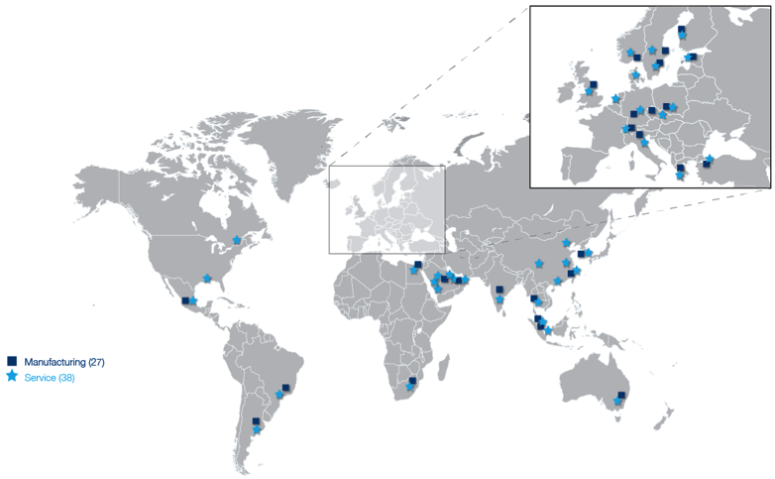
Ease of doing business Solutions
Global expertise; local service
Global expertise; local service
3000+ ABB professionals in > 30 countries
3000+ ABB professionals in > 30 countries
Notes:
ABB employs over 3000 low voltage switchgear professionals in more than 30 countries. This means our customers have an opportunity to work with someone who understands the unique needs of their business and their culture. In most cases, the representative will be in a time-zone that ensures their availability during normal working hours.

Slide 9
Ease of doing business Solutions
Global design; local expertise
Global design platform
Unified best practices
40+ years of experience
Millions of MNS vertical sections and tens of millions of functional units installed and in operation
Watch the video
Notes:
When sourcing low voltage switchgear from ABB, customers can be sure they are buying the same high-quality design regardless of the factory from which they order. ABB engineers and project managers collaborate using a global design platform and best practices, ensuring global consistency of design while serving customers from the closest ABB factory.
Over 40 years of experience have gone into our switchgear designs, and ABB has installed millions of MNS vertical sections and tens of millions of functional units around the world.

Slide 10
Safety
Notes:
Every business has the responsibility to protect personnel and property from the inherent risks involved in electricity. The safety of low voltage switchgear is a top priority.

Slide 11
Safety Challenges
Protect personnel and property
Arc flash incidents kill more than 1 person per day in the US¹
Average medical costs are $1.5 M²
Over $1 M in property damages per incident
¹Source: IEEE
²Source: Flacon Engineering Consultants
Photo © Coastal Training Technologies Corp
Average litigation costs are $5-10 M per incident²
Notes:
According to IEEE estimates, there are more than 2000 arc flash incidents per year and many of them have deadly consequences. The road ahead for those who survive an incident isn’t easy either. The injuries can be devastating with medical costs averaging more than 1.5 million dollars per incident. For the company, these accidents often lead to litigation which can easily cost as much as 5-10 million dollars per incident.
In addition to the tragic cost in lives, an arc flash incident can also cause damage to property and equipment. The extent of the damage is often dependent on how well the arc flash is contained, but it can easily top 1 million dollars per incident even if the damage is limited to the switchgear line-up. Damage to equipment further results in unplanned downtime, lost production and lost revenues.

Slide 12
Safety Solutions
The MNS low voltage switchgear solutions meet and exceed the IEC 61439-1/-2 and IEC 61641 safety standards for arc flash protection.
Notes:
The ABB Safety Plus design philosophy provides two levels of protection – active protection to prevent an incident from happening and passive protection to protect personnel and property in the unlikely event an incident does occur. With Safety Plus, ABB low voltage switchgear solutions go beyond the IEC standards for arc flash protection to provide the highest level of protection for personnel and property available on the market today.

Slide 13
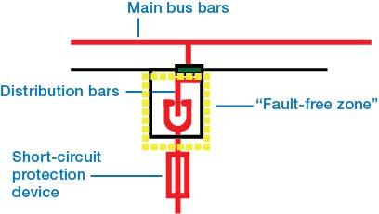
Safety Solutions
Active protection prevents incidents from occurring
Fault-free zone extends from multi-function wall over power contacts to the short-circuit protection device of the functional unit
Embedded vertical distribution bars for superior phase segregation and maximum creepage distance
No exposed live parts (touch-proof design IP2X)
No shutters required
Notes:
Safety starts with prevention, and ABB builds in a number of design features to prevent an arc flash from occurring. For example, ABB’s unique multi-function wall creates a fault-free zone that extends from the main bus bars downstream to the short-circuit protection device of the functional unit, making it virtually impossible for an arc flash to occur. Embedded vertical distribution bars allow for superior phase segregation and maximum creepage distance, with no exposed live parts.
The design of the multi-function wall also eliminates the need for shutters, and the problem of shutter jams that cause headaches for maintenance personnel and unplanned downtime for the business.
In addition, when performing installation, commissioning or maintenance, separation of the power and control circuitry isolates personnel from power circuits, keeping control technicians safe and equipment secure from human error.

Slide 14
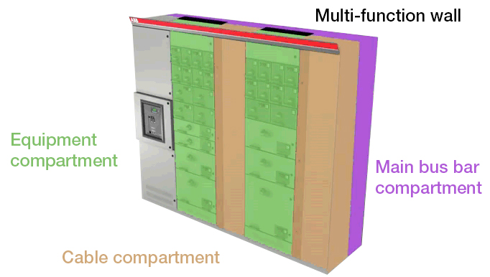
Safety Solutions
Passive protection safeguards personnel and property
Compartmentalized/ modular design approach limits arc damage
Segregated compartments
Multi-function wall forms a gas-tight seal between main bus bar and equipment compartment
Separation of the power and control circuitry isolates control technicians from power circuits
Watch the video
Notes:
In the unlikely event an arc flash does occur, ABB low voltage switchgear provides passive protection to contain the incident and prevent damage to personnel and property. The compartmentalized design of the vertical sections and the modular design of the functional units limit the damage to the area where the arc originates.
The multi-function wall is an exclusive ABB safety feature, and it forms a complete barrier between the main bus compartment and the equipment compartment to prevent the arc from traveling in between. Many competitors have tried to copy this feature, but none have managed to provide the same level of protection as the original ABB design does.

Slide 15
Availability and reliability
Notes:
For most businesses, if the power is not flowing, they are not in business. They need low voltage switchgear systems they can count on.

Slide 16
Availability and reliability Challenges
Low voltage switchgear environments can be tough
e.g. corrosive, dusty, high vibration
Hot spots
Heat dissipation
Regular maintenance requirements, upgrades, retrofit
Unplanned downtime
Notes:
Many industry environments are tough on low voltage switchgear, requiring that they work extra hard or in areas that may be subject to intense vibrations or corrosive substances. Hot spots can also be a major source of wear and tear and heat dissipation is critical to extending the life and ensuring the reliability of low voltage switchgear solutions. Anyone of these issues can lead to unplanned downtime that drains revenues from the business.
Furthermore, no matter how rugged the system, there are always regular maintenance requirements. Businesses can maximize uptime by minimizing the maintenance required.

Slide 17
Availability and reliability Solutions
Designed for reliability
Power contacts are independently certified for 1000+ operations, more than 5X industry standard
Cable forces are decoupled from the power contacts to eliminate hot spots
Cables are double-insulated
Better cooling through individual venting of compartments to avoid thermal interference
Notes:
The ABB MNS family of products is designed to withstand the toughest environments and provide years of safe and reliable operations. For example, ABB’s precision-engineered power contacts are independently certified for over 1000 operations. That’s more than five times the industry standard! In addition, cable forces are decoupled from the power contacts, reducing cable stress and breakage. Individual venting of compartments provides better cooling and eliminates thermal interference and hot spots to further increase reliability.

Slide 18
Availability and reliability Solutions
Address problems before they occur
Real-time condition monitoring to monitor the health of the asset and address problems before they occur
Redundant communications interfaces ensure 100% process control back up
Reduces downtime by as much as 50%
Watch the video
Notes:
Predictive maintenance helps businesses reduce downtime by addressing problems before they occur. Real-time condition monitoring solutions from ABB allow operators to continuously monitor equipment performance and receive an alert when a problem needs to be addressed. These alerts contain specific diagnostic information that provides technicians with the data they need to solve the problem quickly and effectively.
Redundant communications interfaces ensure 100% back up of process control.
Thanks to ABB technologies, many of our customers have been able to leverage real-time condition monitoring to reduce downtime by as much as 50 percent. In addition, with real-time maintenance information available, such as motor operating hours and number of operations, the need for maintenance can be identified and arranged to minimize business disruptions.

Slide 19
Flexibility
Notes:
There is nothing as constant as change, and businesses need low voltage switchgear solutions that allow them to adapt to today’s challenges as well as take advantage of tomorrow’s opportunities.

Slide 20
Flexibility Challenges
Control costs; prepare for the future
Changing business and market requirements
Constrained budgets
Regulations
Notes:
Industries are constantly changing. New types of businesses like data centers or other, power-hungry facilities require more energy than ever. New regulations affect both industry and power sources. And, although budgets are almost always constrained, economic conditions in many parts of the world cause all types of businesses searching for additional ways to do more with less.
ABB low voltage switchgear solutions are designed to provide the flexibility to control costs while adapting to changing business needs.

Slide 21
Flexibility Solutions
Adapt to changing business needs
Mix and match feeders, motor starters, variable speed drives, soft starters, and reactive power compensation, all in a single line-up
99% of ABB’s customers use standardized components for a customized line-up
Notes:
The ABB MNS platform provides the flexibility to mix and match feeders, motor starters, variable speed drives, soft starters, and reactive power compensation – all in a single line-up. This allows you to custom design the switchgear line-up that best meets your changing demands. The modular design of our functional units allows more than 99 percent of our customers to leverage the advantages of mass-produced standard components.

Slide 22
Flexibility Solutions
Adapt to changing business needs
Front accessible – install virtually anywhere, without the need to access the back of the structure
Flexible arrangements to meet the customer’s footprint requirements
Notes:
The mechanical structure (frame) and the main bus bar system are designed to be maintenance-free and front accessible. By eliminating the need to access the equipment from the rear, MNS can be installed virtually anywhere in a facility and flexible arrangements (L-shape, U-shape, back-to-back, etc.) allow to meet the customer’s footprint requirements.

Slide 23
Flexibility Solutions
Lower costs through industry standardization
Non-proprietary, human-machine interface
Support for industry standard communications protocols including Modbus RTU, Modbus TCP, Profibus, and Profinet
Watch the video
Notes:
ABB also helps reduce expenses by deploying industry standards wherever possible. With our non-proprietary, human-machine interface, businesses can choose any off-the-shelf hardware with web-based functionality. This lowers the cost of training and spare parts. Additionally, customer can choose from several industry standard communications protocols such as Modbus RTU, Modbus TCP, Profibus, and Profinet to fit the requirements of their control systems.

Slide 24
Ease of maintenance
Notes:
Finally, as businesses try to do more with less, they need systems that are easy to maintain.

Slide 25
Ease of maintenance Challenges
Do more with less
Maintenance = downtime
Constrained operations budgets
Fewer resources
Less experienced workforce
Unmanageable spare parts inventories
Notes:
Maintenance time is downtime, and even planned downtime needs to be minimized as much as possible.
As the cost of doing business rises, many businesses are reducing spare parts inventories as a way to cut inventory carrying costs and free up capital. Of course, they need to ensure they make the right cuts, or they risk being without a critical component when they need it.
Businesses are also maintaining a tighter control over their operating expenses and trying to do more with less. In many cases, this means scaling back maintenance crews and not hiring to replace seasoned workers who retire. This leaves businesses with a less experienced workforce, making ease of maintenance more critical than ever.

Slide 26
Ease of maintenance Solutions
Lower maintenance requirements
Maintenance-free mechanical structure and main bus bar system
Withdrawable units – get back online 20-30X faster
No exposed live parts (touch-proof design IP2X) even inside compartments
No need to power down the unit for software application changes
Notes:
ABB low voltage switchgear helps keep maintenance downtime to a minimum with standard design features such as a maintenance-free mechanical structure and main bus bar system.
In addition, withdrawable functional units permit easy replacement and reduce downtime to minutes instead of hours. This reduced downtime helps facilities get back online 20 to 30 times faster than common fixed installed modules.
Software application changes can even be made without powering down the unit.

Slide 27
Ease of maintenance Solutions
Reduce inventory with standardized parts
Reduce spare parts inventory by as much as 75%
Manageable with less capital lockup
Increased availability
Less downtime
Notes:
ABB helps further ease the financial burden and free up capital by designing standardized functional units. This standardization has allowed many ABB customers to reduce spare parts inventory by as much as 75 percent, without risking excess downtime because they don’t have a critical component when they need it.

Slide 28
Ease of maintenance Solutions
Service after the sale
Level 1 Priority care | Level 2 Preventive care | Level 3 Performance care | Level 4 Advanced care
Technical support | Visual inspection | Visual inspection | Installation of condition monitoring software
Practical user guidance | Functional testing | Functional testing and verification | Remote access connection setup
Operational care training | Service report | Thermographic scan | 24/7 remote diagnostics and support
Priority emergency service | Component replacement | Performance report | Condition-based maintenance
 |  | Complete spare parts handling
Watch the video
Notes:
At ABB, service doesn’t stop when our products leave the factory. The MNS platform is supported by a full range of after-sales support solutions. We offer four different levels of maintenance services from priority care which gives our customers peace of mind, knowing we’ll be there to help them when they need it, to advanced service solutions that monitor asset condition to identify potential problems before they occur and keep your systems and your company in peak operating condition.

Slide 29
MNS platform At-a-glance
Ease of
doing business
3000+ professionals in more than
30 countries
Safety
Exceeds the IEC standards for arc flash prevention and protection
Availability and reliability
Reduce downtime by as much as 50%
Flexibility
Standardized components and support for industry standard communication protocols
Ease of maintenance
Decrease spare parts inventory by as much as 75%
Notes:
ABB answers the call from businesses by being the easiest vendor to do business with around the globe. No vendor has more low voltage switchgear professionals in more countries than ABB.
With our Safety Plus philosophy, ABB goes beyond IEC standards providing the highest level of protection for personnel and property in the industry.
ABB low voltage switchgear solutions are designed to provide years of reliable operations in the toughest environments. Combined with ABB technologies such as real-time condition monitoring, ABB customers have reduced downtime by as much as 50%.
Business challenges and requirements differ across industries and even across businesses within the same industry. ABB’s support for standardized components and industry standard communication protocols gives customers maximum flexibility to meet their unique needs.
Features such as withdrawable units, standardized components, and a complete after-sale service offering help our customers do more with less.

Slide 30
Notes:
For energy-intensive businesses, the 21st century promises to be both exciting and challenging. ABB low voltage switchgear solutions allow business to adapt to new energy demands and compete in an ever-changing world.

