Slide 1
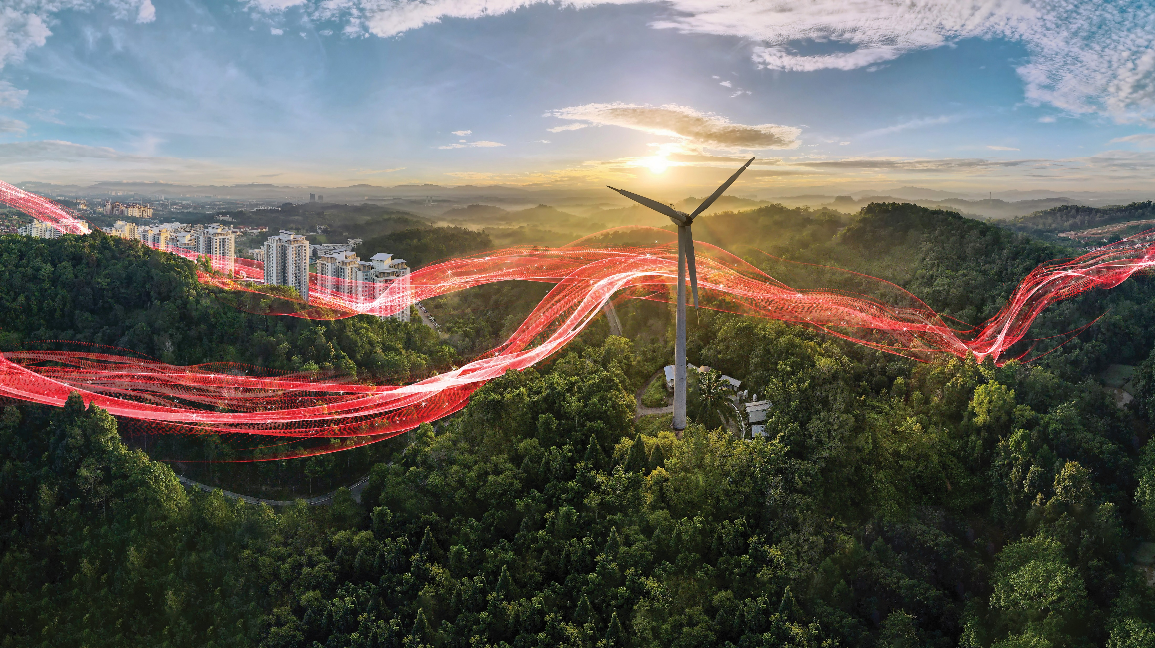

Electrifying Canada
—
ELECTRIFICATION business area
in a safe, smart and sustainable way
Copyright ABB. March 2024. All rights reserved.
Notes:
Updated: Q1 2024

Slide 2




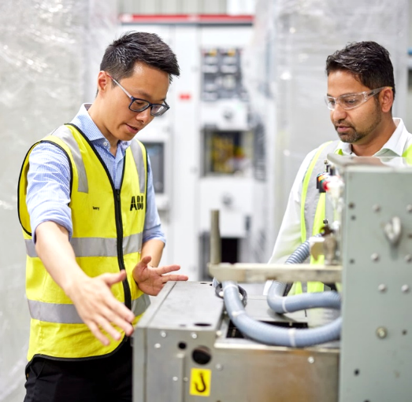
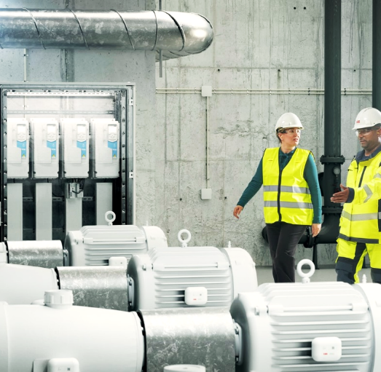
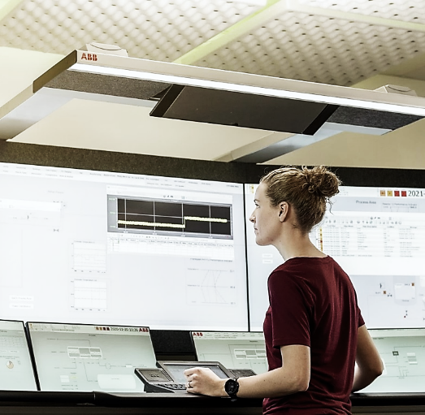
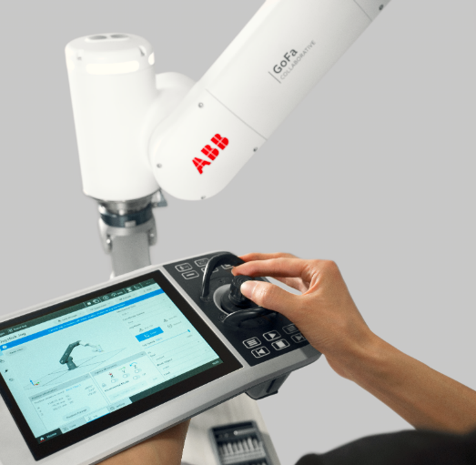

ABB Canada at a glance
National collaboration enables a more sustainable and resource-efficient future
33
Locations coast to coast
ELECTRIFICATION
MOTION
PROCESS
AUTOMATION
ROBOTICS + DISCRETE AUTOMATION
~ 3 200
Employees
100+
Years of innovation
in Canada

Slide 3
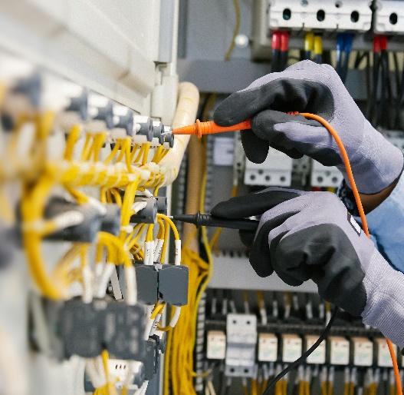



ABB Electrification in Canada: from source-to-socket
+23,000
Products shipped/month
~ 1,900
Employees
15
Manufacturing
locations
+2,800
Regional distribution
partners
9
Distribution
centers

Slide 4
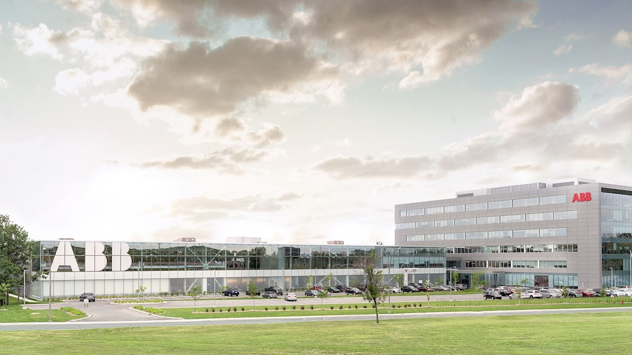
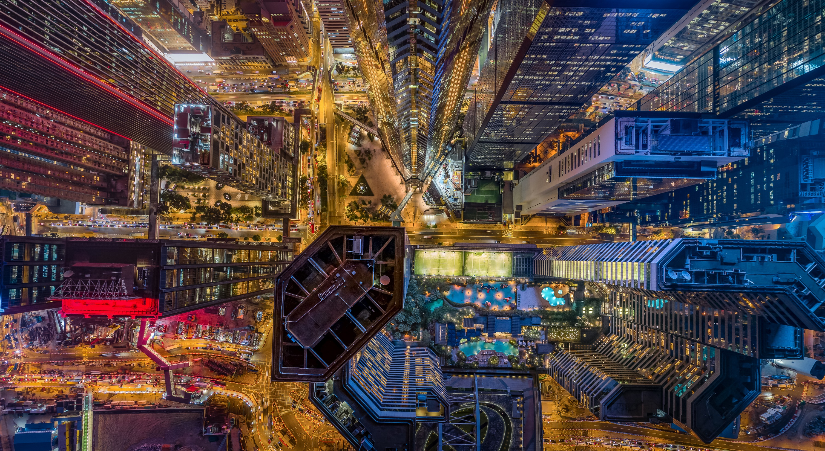
—
Electrification in Canada
Electrifying the world in a safe, smart and sustainable way, ABB Electrification in Canada is a technology leader in electrical distribution and management from source to socket.
As the world’s demand for electricity grows, our 1,900 employees across the country collaborate with customers and partners to transform how people connect, live and work.
We develop innovative products, solutions and digital technologies that enable energy efficiency and a low carbon society across all sectors.
By applying global scale with local expertise, we shape and support global trends, deliver excellence for customers and power a sustainable future for society.

Slide 5
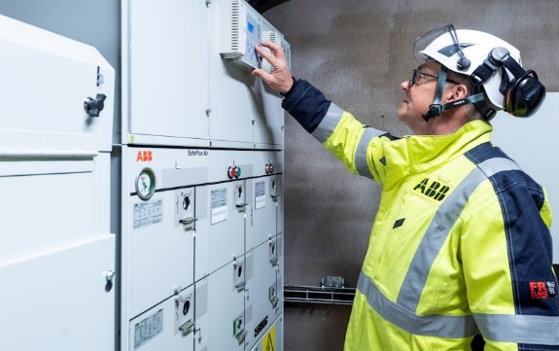
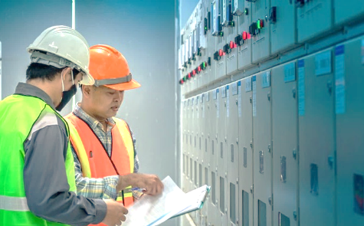

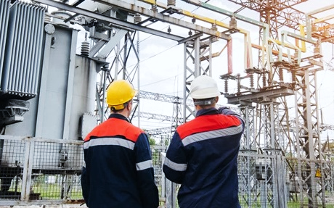
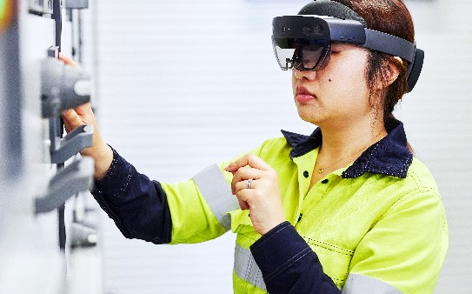
Electrification’s five divisions
Helping to solve our customers biggest cross-industry challenges
DISTRIBUTION
SOLUTIONS
SMART POWER
SMART BUILDINGS
INSTALLATION
PRODUCTS
SERVICE
Segment specific medium-voltage switchgear and components as well as solutions that protect, control and facilitate efficient and reliable distribution of electric power strengthening the resilience of the grid.
Energy distribution solutions
that include the ABB Ability™
Energy Manager, industrial breakers, UPS solutions, motor starting applications, and essential safety devices such as switches and relays.
Energy distribution and home and building automation products and solutions, energy management and metering solutions, modular DIN-rail devices, distribution enclosures, wiring accessories.
Components to safely connect and protect in Electrification, including connectors and terminals, cable management and protection, switchgear reclosers and accessories.
Extensive portfolio of services and technology for low- and medium-voltage products and networks to improve reliability, availability, predictability
and sustainability of electrical systems.

Slide 6
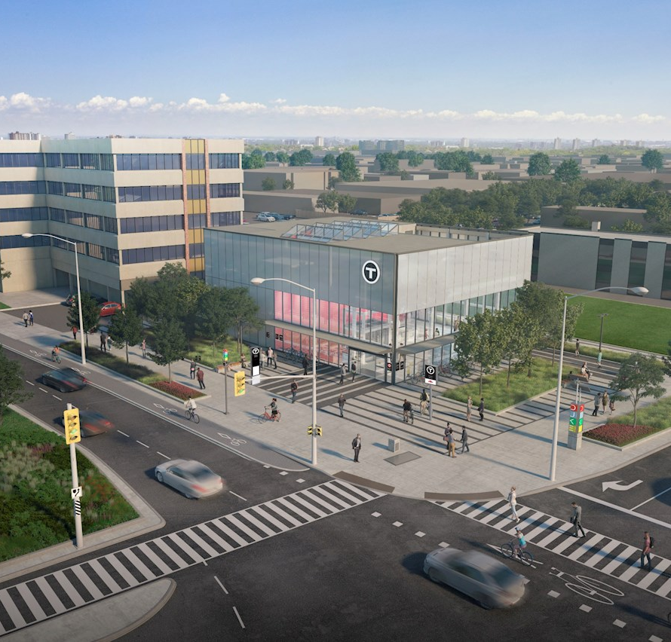
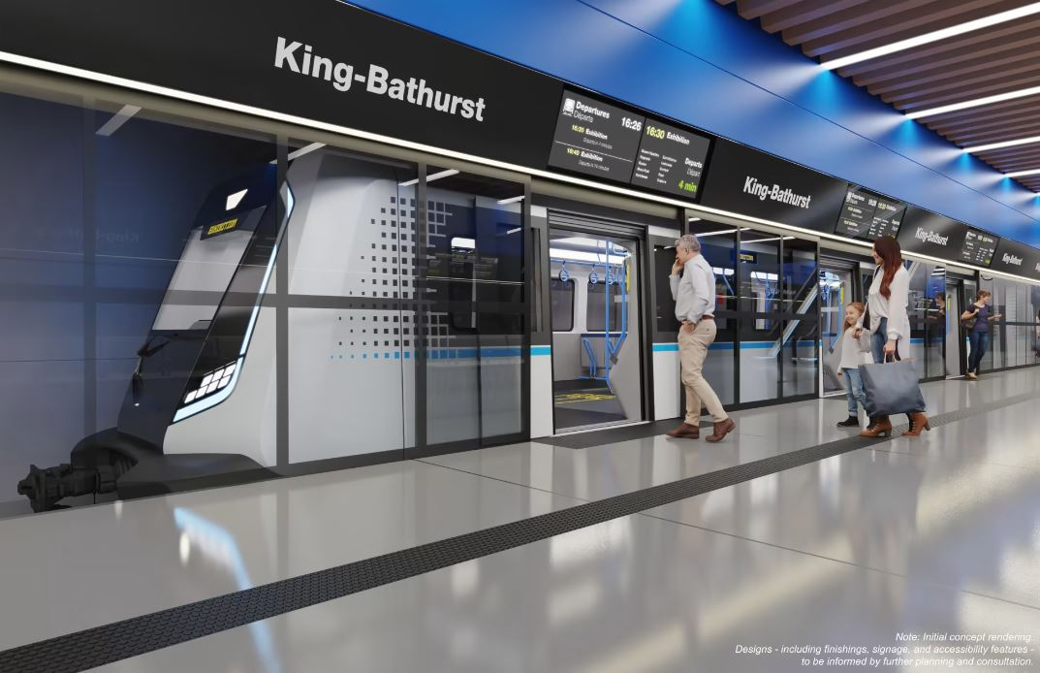
Distribution Solutions
Image courtesy: Mosaic Transit Group and Metrolinx
Offerings:
  Control & Protection Products
  Low-voltage Switchgear, Motor Control Centers & Busway
  Medium-voltage Switchgear (AIS, GIS & secondary GIS)
  Relays & Digital Systems
  Rail Infrastructure – Energy storage systems (ESS) & Traction power substation (TPSS)
  Solutions
Ontario Line, Toronto
Solution: UniGear ZS3.2 medium-voltage switchgears, ZX2 gas-insulated switchgear, ABB Relion® relays

Slide 7
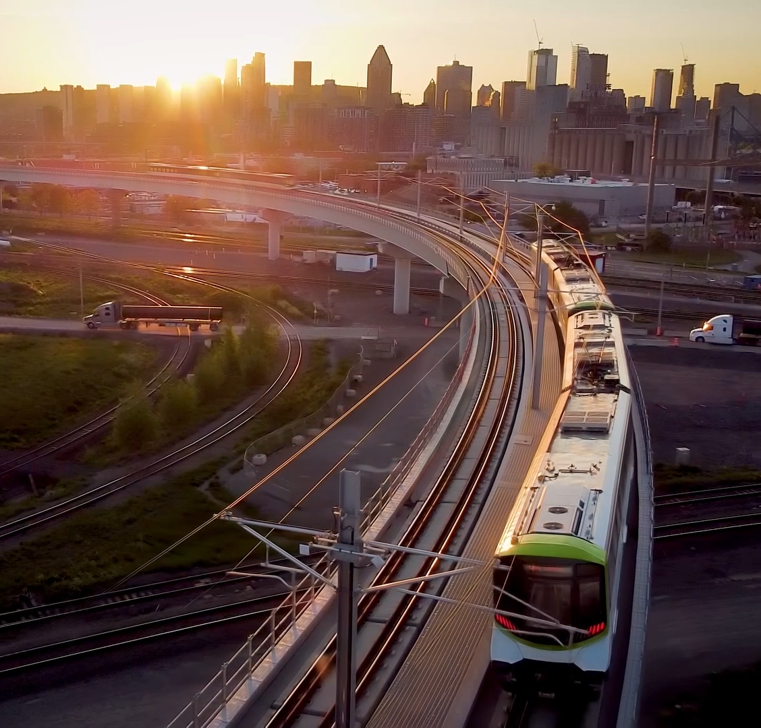


Installation Products
Image courtesy: NASA/JPL – Caltech
Offerings:
Wire & cable management
Boxes, fittings and meter sockets
Cable Tray, Metal framing and fastening
Cable Protection systems
Teck and Tray cable fittings
Rigid conduit systems
Flexible conduit and cable protection systems
Liquidtight systems
Power Connection & Control
Wire termination
Connectivity and grounding
Switchgear and reclosers
Cable apparatus and accessories
REM, Montreal
Solution: T&B Cable Tray Systems® with Superstrut® metal framing and Star Teck® fittings

Slide 8
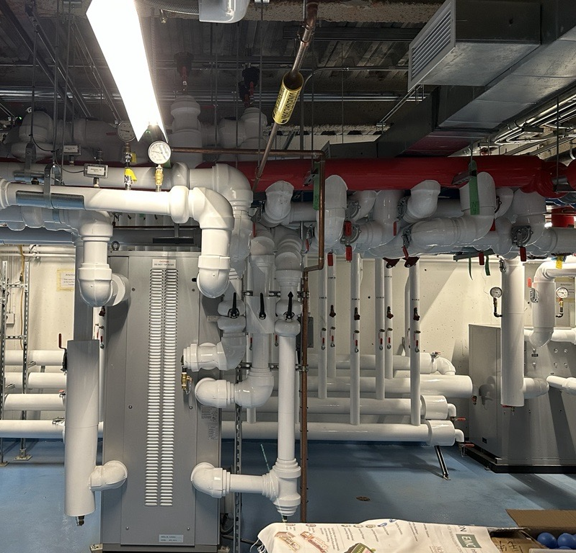
Smart Building
Offerings:
  Building Control
  Door Entry Systems
  Access Control & Security
  DIN-Rail products
  Distribution Enclosures
McMaster University, Hamilton
Solution: ABB Cylon®

Slide 9
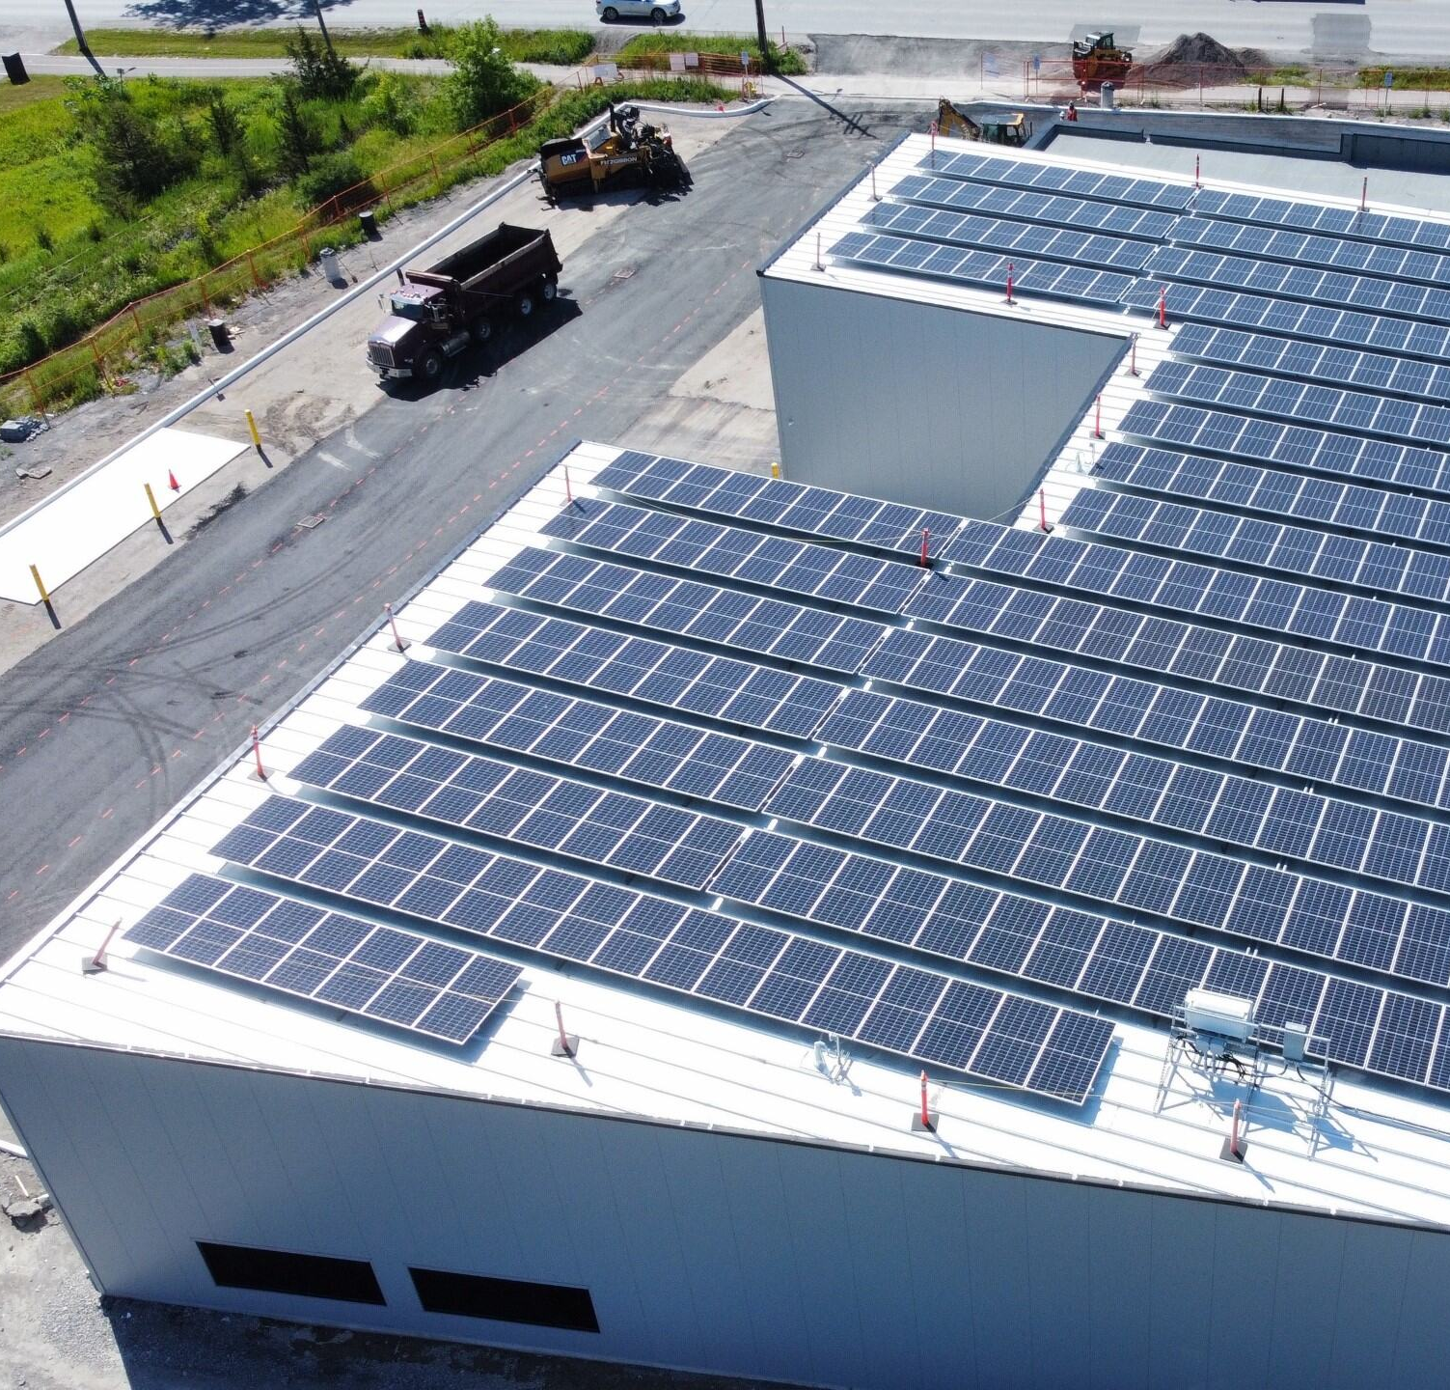
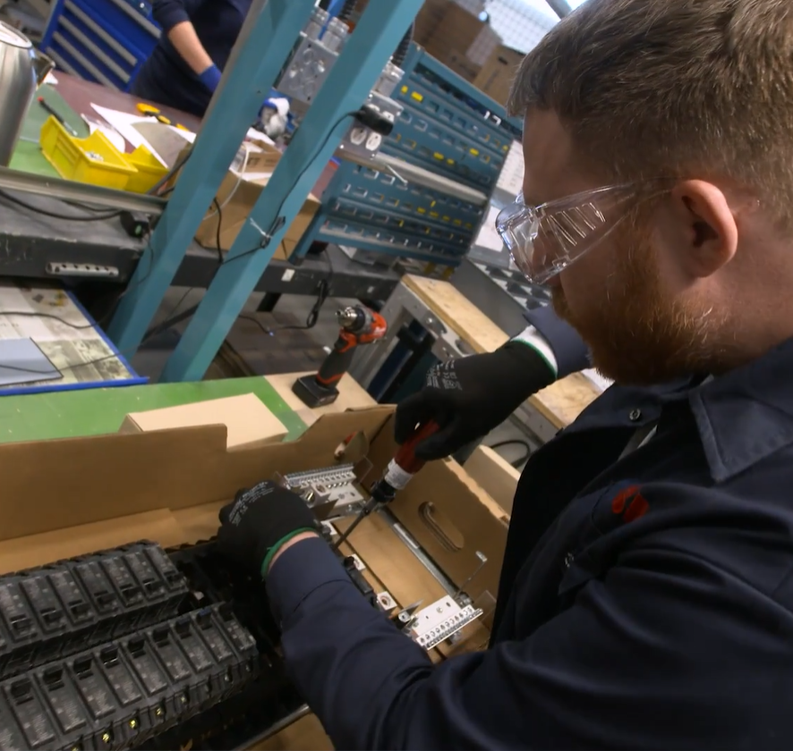
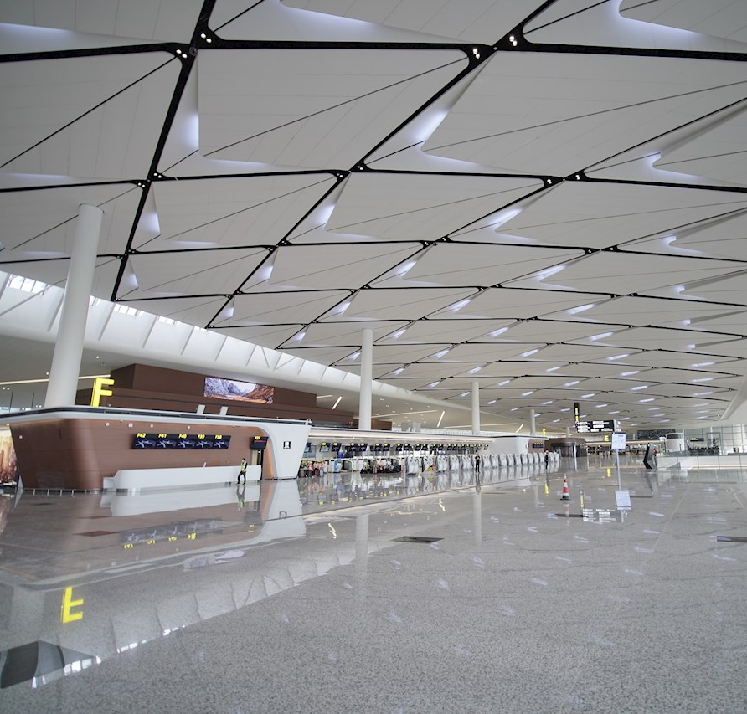
Smart Power
Offerings:
  Breakers & Enclosures
  NEMA Enclosed Products
  Motor Starting & Safety
  Power Protection
  Switches & Fusegear
Solutions assembled at Campus Montreal
Solution: ReliaGear® family solutions

Slide 10
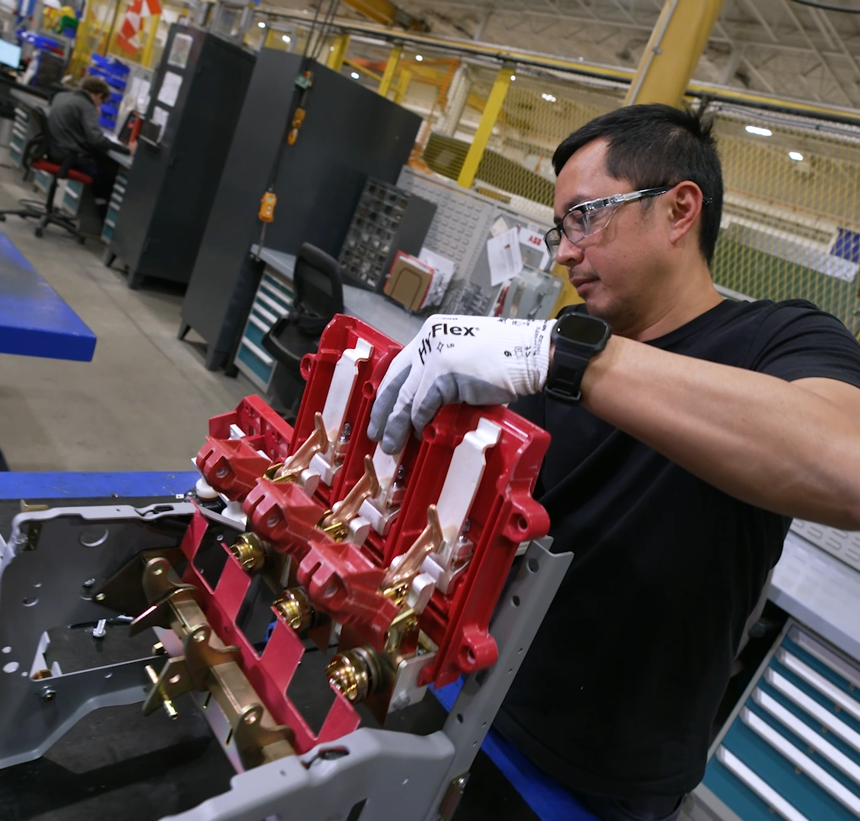
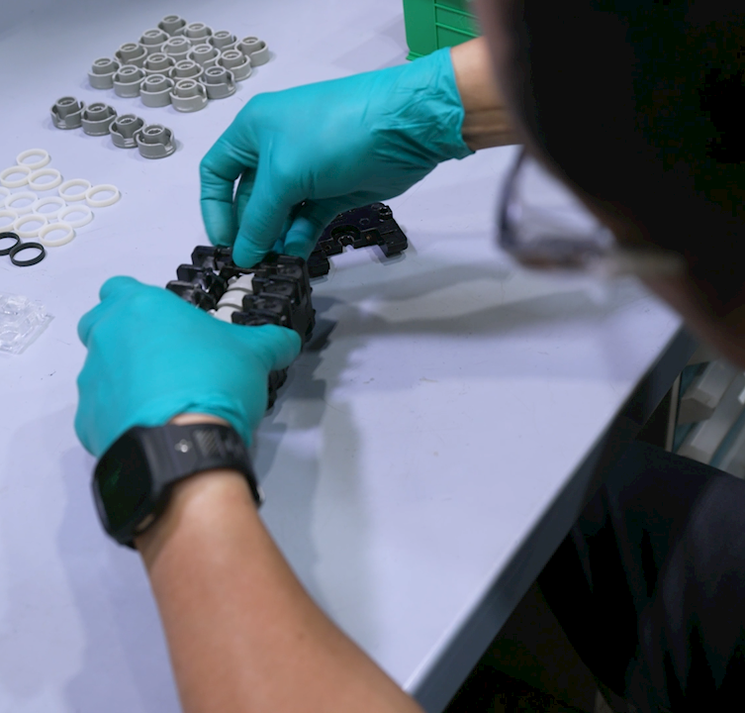
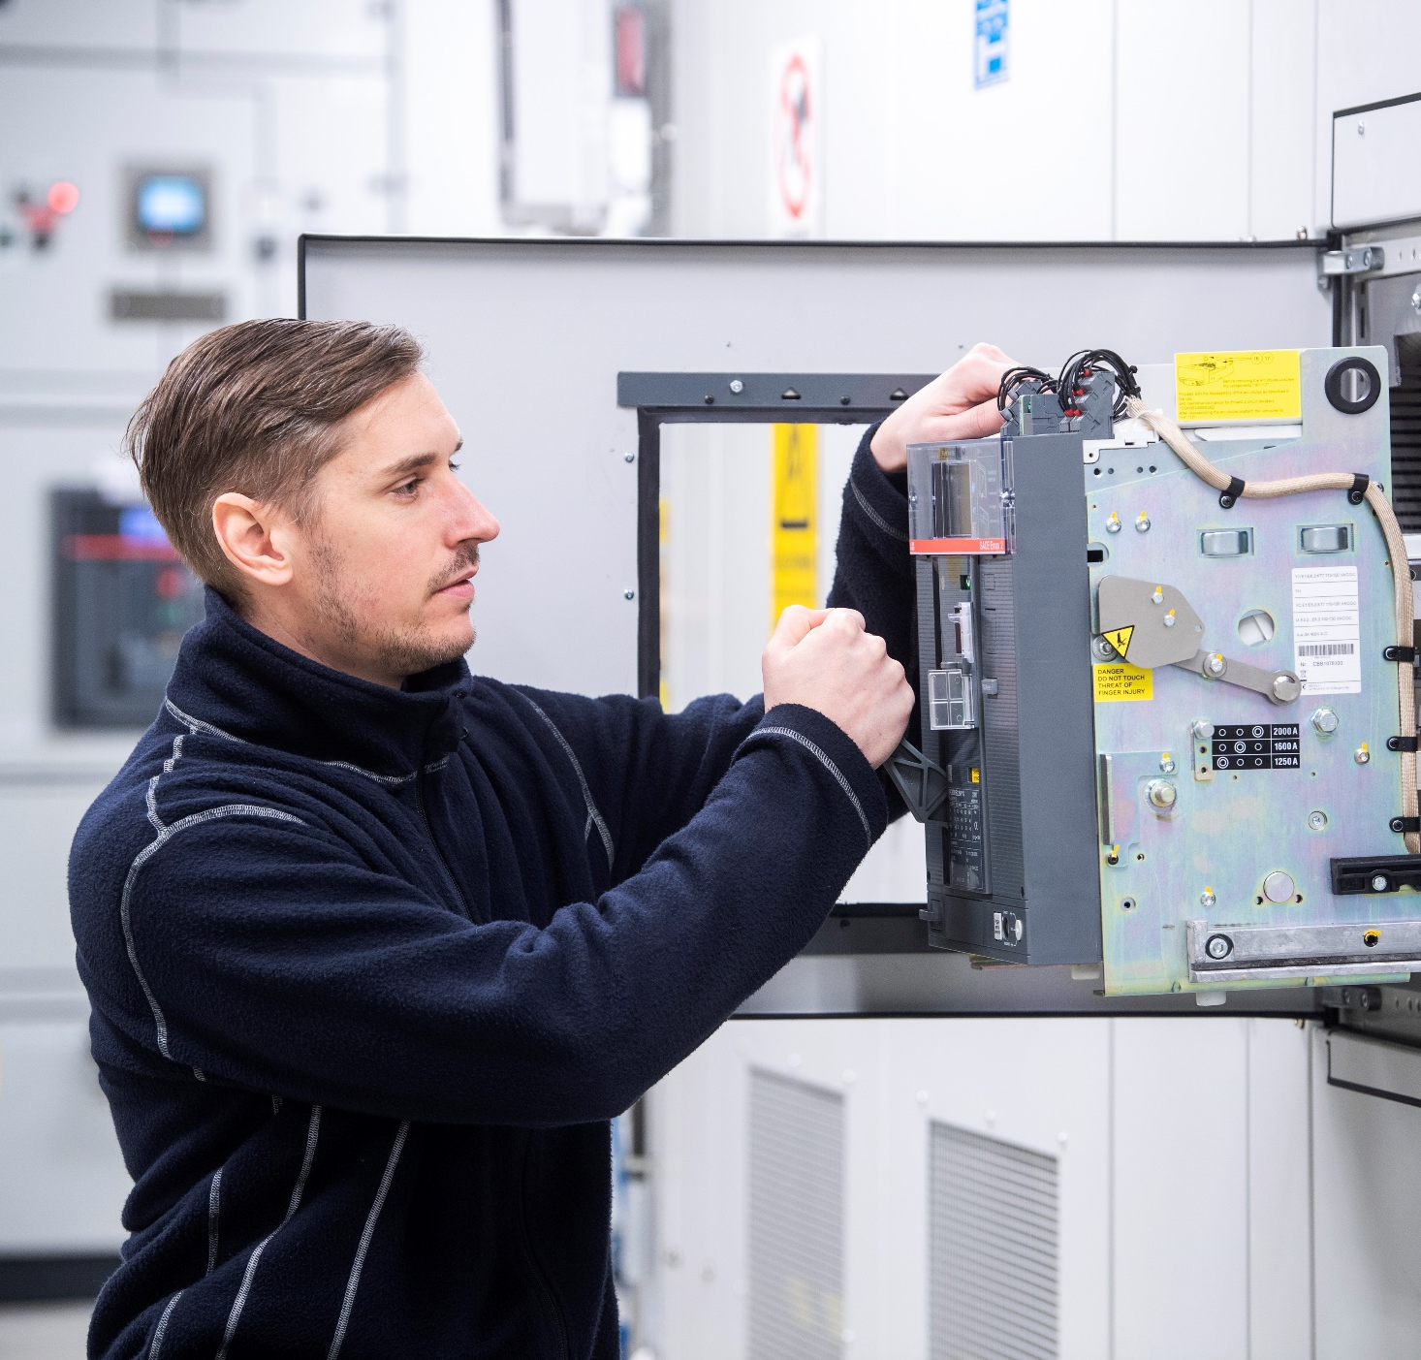
Service
Offerings:
  Installation and commissioning (I&C)
  Training
  Spares and consumables
  Maintenance
  Repairs
  Engineering and consulting
  Upgrades
  Extensions
  Retrofits
  End of life services
  Replacement
  Support agreements (Power Care)
  Advanced services (Smart Asset Management)
Circuit Breaker Shop, Brampton
Solution: K-Line breaker refurbishment solution

Slide 11





The world needs electrification solutions more than ever
—
Demand for electricity
>50% of decarbonization
driven by electrification
electricity growing >10x faster
3X more renewable integration
needed by 2030
~50% more investment
in electricity grids by 2030
Energy transition
Energy efficiency
2x more energy efficiency improvements needed by 2030
to reach net-zero by 2050
Source: IEA 2023 report, McKinsey; 1. than other energy sources in 2022–30 and vs. 2016 – 2022
Improvements needed by 2030 in order to reach net-zero targets by 2050

Slide 12



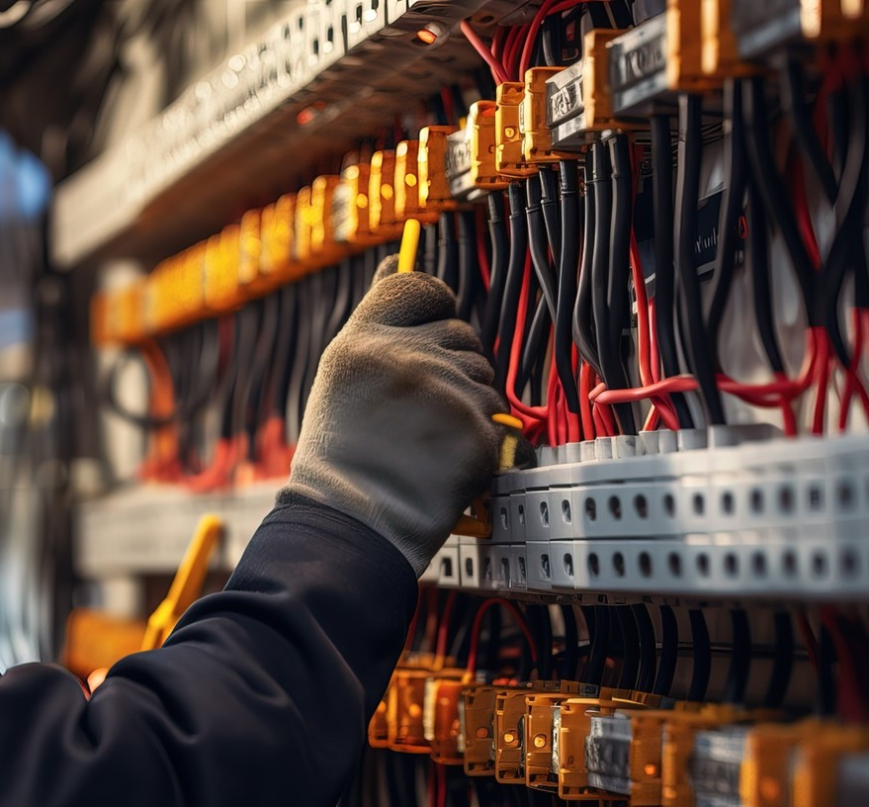

Net Zero Roadmap IEA
making net-zero
future a reality
integrating more
renewables
—
How ABB
Electrification technology is
accelerating the energy transition
enabling decarbonization​
increasing
energy efficiency
April 29, 2024
Slide 12

Slide 13










Sustainability at ABB
Focus on a low-carbon society, resources and social progress through a culture of integrity + transparency
CARBON DISCLOSURE PROJECT
We are committed
to reaching net zero by
2050 and to enabling
our customers
to avoid emissions
We embed circularity
in our products, reduce
waste, protect water
and biodiversity, and
use land responsibly
We take care of our
people and promote
social progress with
our partners, suppliers
and communities
A – List 2023
Leadership in corporate
transparency + performance
MSCI ESG
AAA rating
2023 Ecovadis Gold
2030 TARGET ACHIEVED
LOW-CARBON
SOCIETY
PRESERVE
RESOURCES
SOCIAL
PROGRESS
80%
Electrification
emissions reduction
Scope 1 + 2 emissions vs. 2019
April 29, 2024
Slide 13

Slide 14

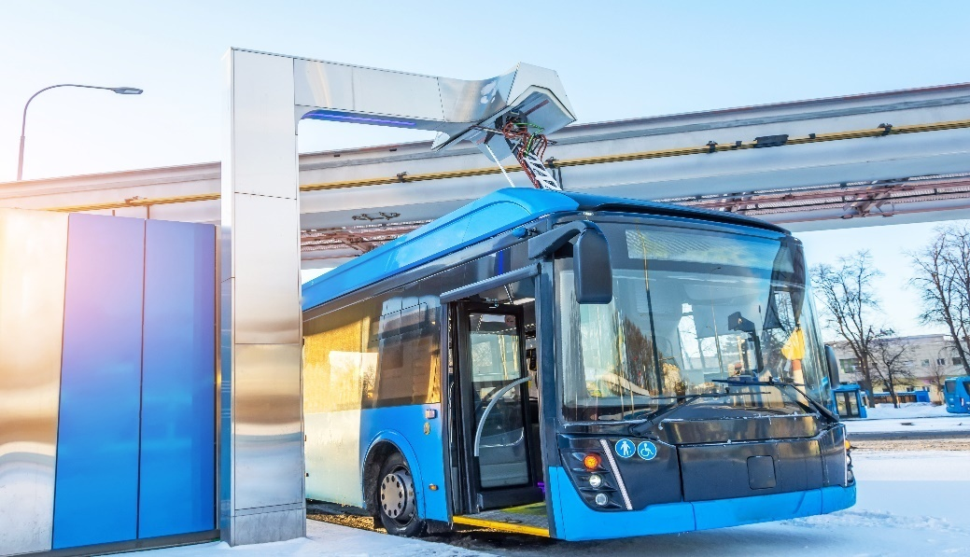
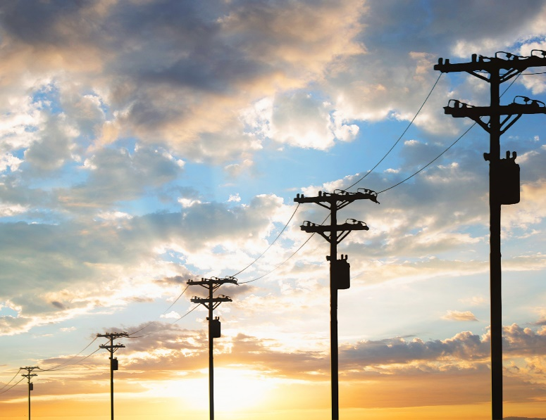




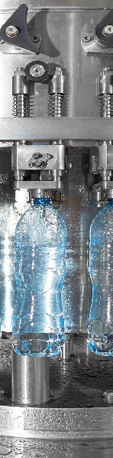
Supporting customers in a wide range of sectors
BUILDINGS
OTHER
32%
20%
DATA CENTERS
RENEWABLES
UTILITIES
INFRASTRUCTURE
FOOD + BEVERAGE
OIL GAS + CHEMICALS
15%
12%
8%
7%
4%
3%
3%
April 29, 2024
Slide 14
Electrification Global segments by percentage of 2023 orders

Slide 15

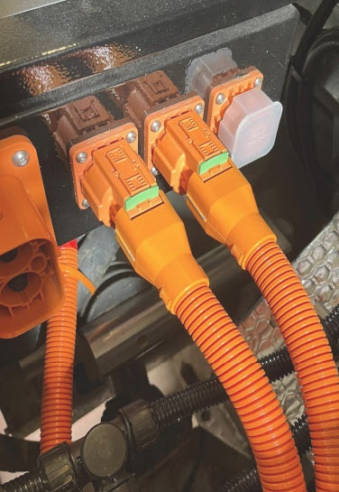

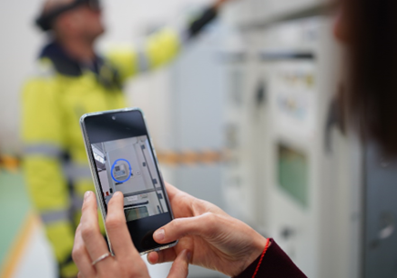

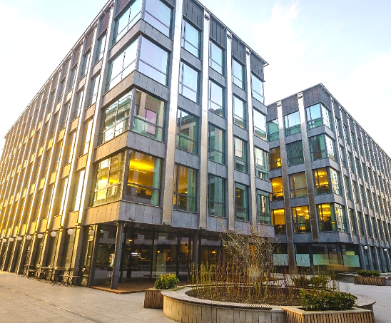
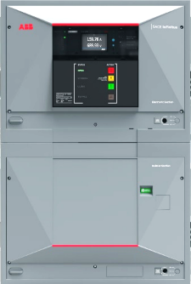
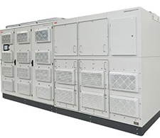
Pioneering technology + innovation
4200+ Patent families
InSite system extensions unlock more functions
for scalable, flexible and smart energy management
in buildings
Service Assist
The world’s first
Augmented Reality (AR) powered mobile application for safe remote servicing
Harnessflex EVO™ connector interfaces
world’s first full-range
of hinged high-voltage connector backshells
for heavy-duty EVs
HiPerGuard
ABB’s
industry-first medium-voltage Uninterruptible
Power Supply
SACE Infinitus
The world’s first DC solid-state circuit breaker

Slide 16
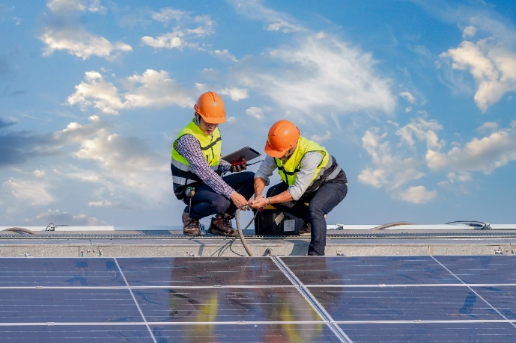

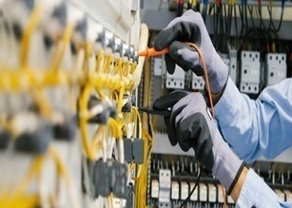




Collaborating to accelerate the energy transition
Partnering to help customers optimize, decarbonize and electrify their operations
customers
Startup companies
tech-focused businesses
UNIVERSITIES
CHANNEL PARTNERS
SUPPLIERS
April 29, 2024
Slide 16

Slide 17
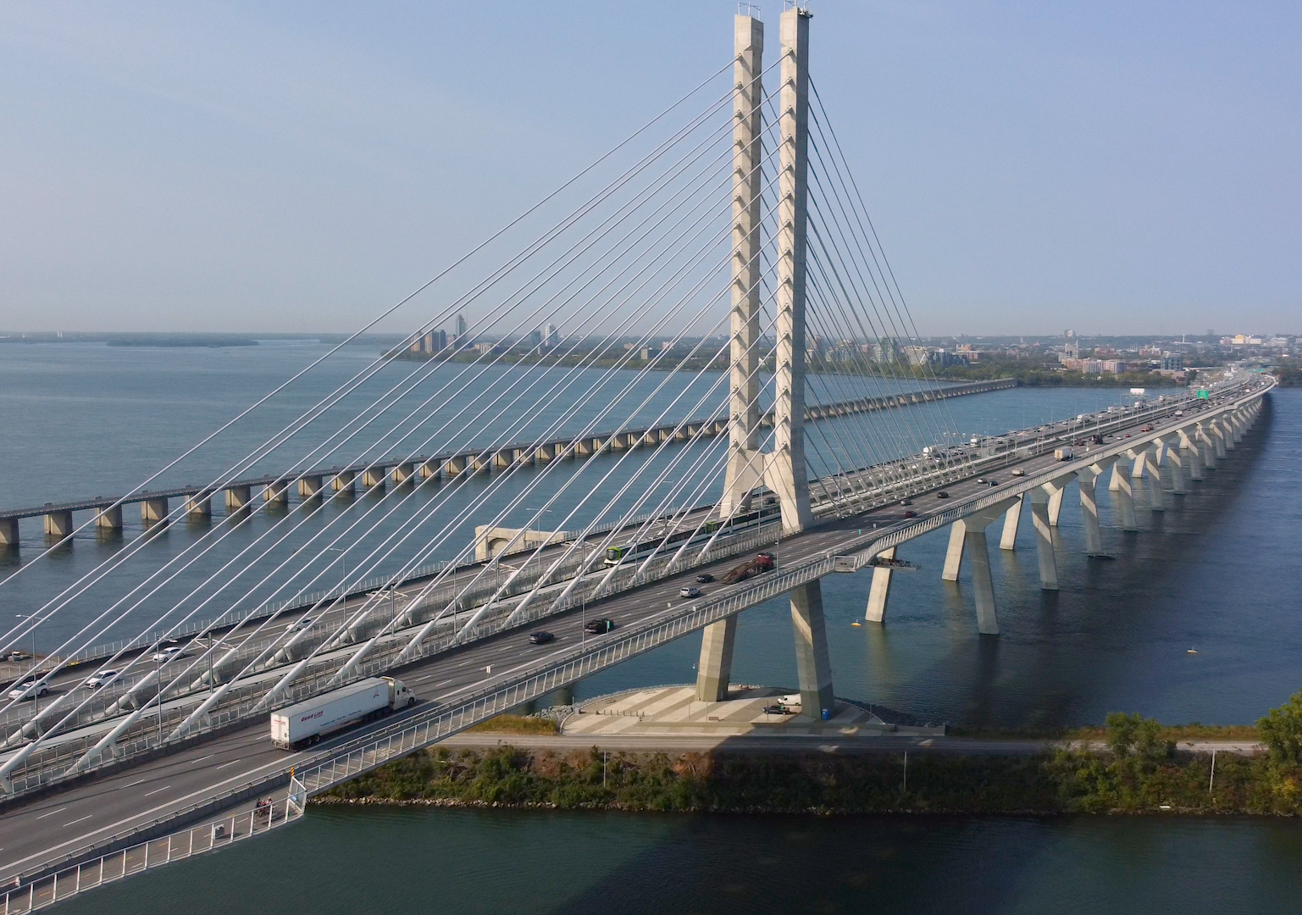
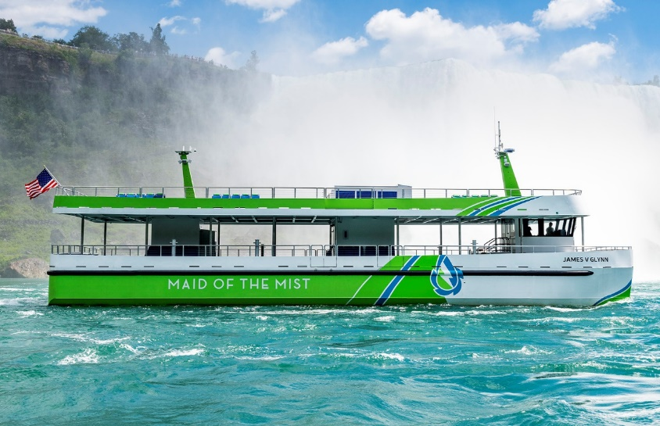
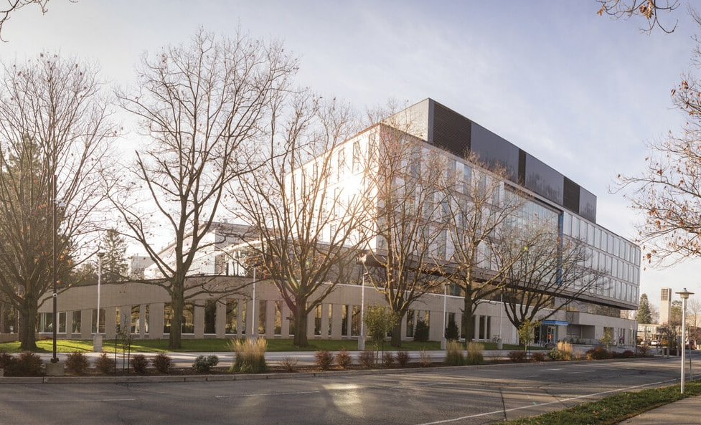
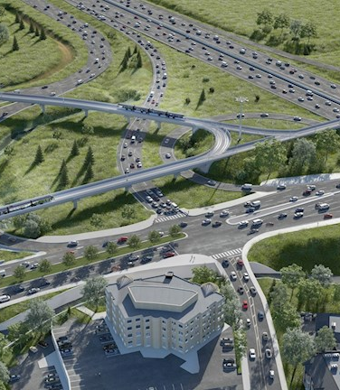
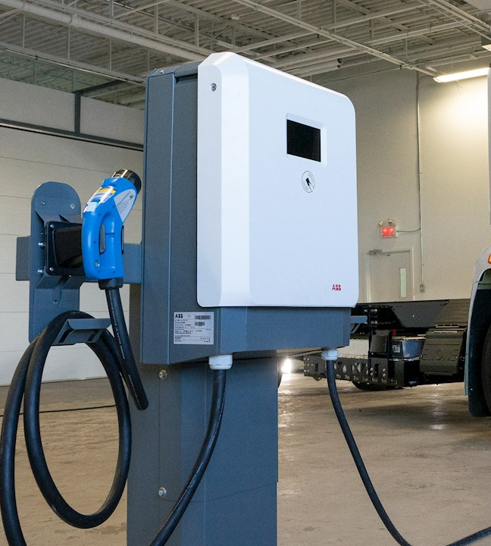
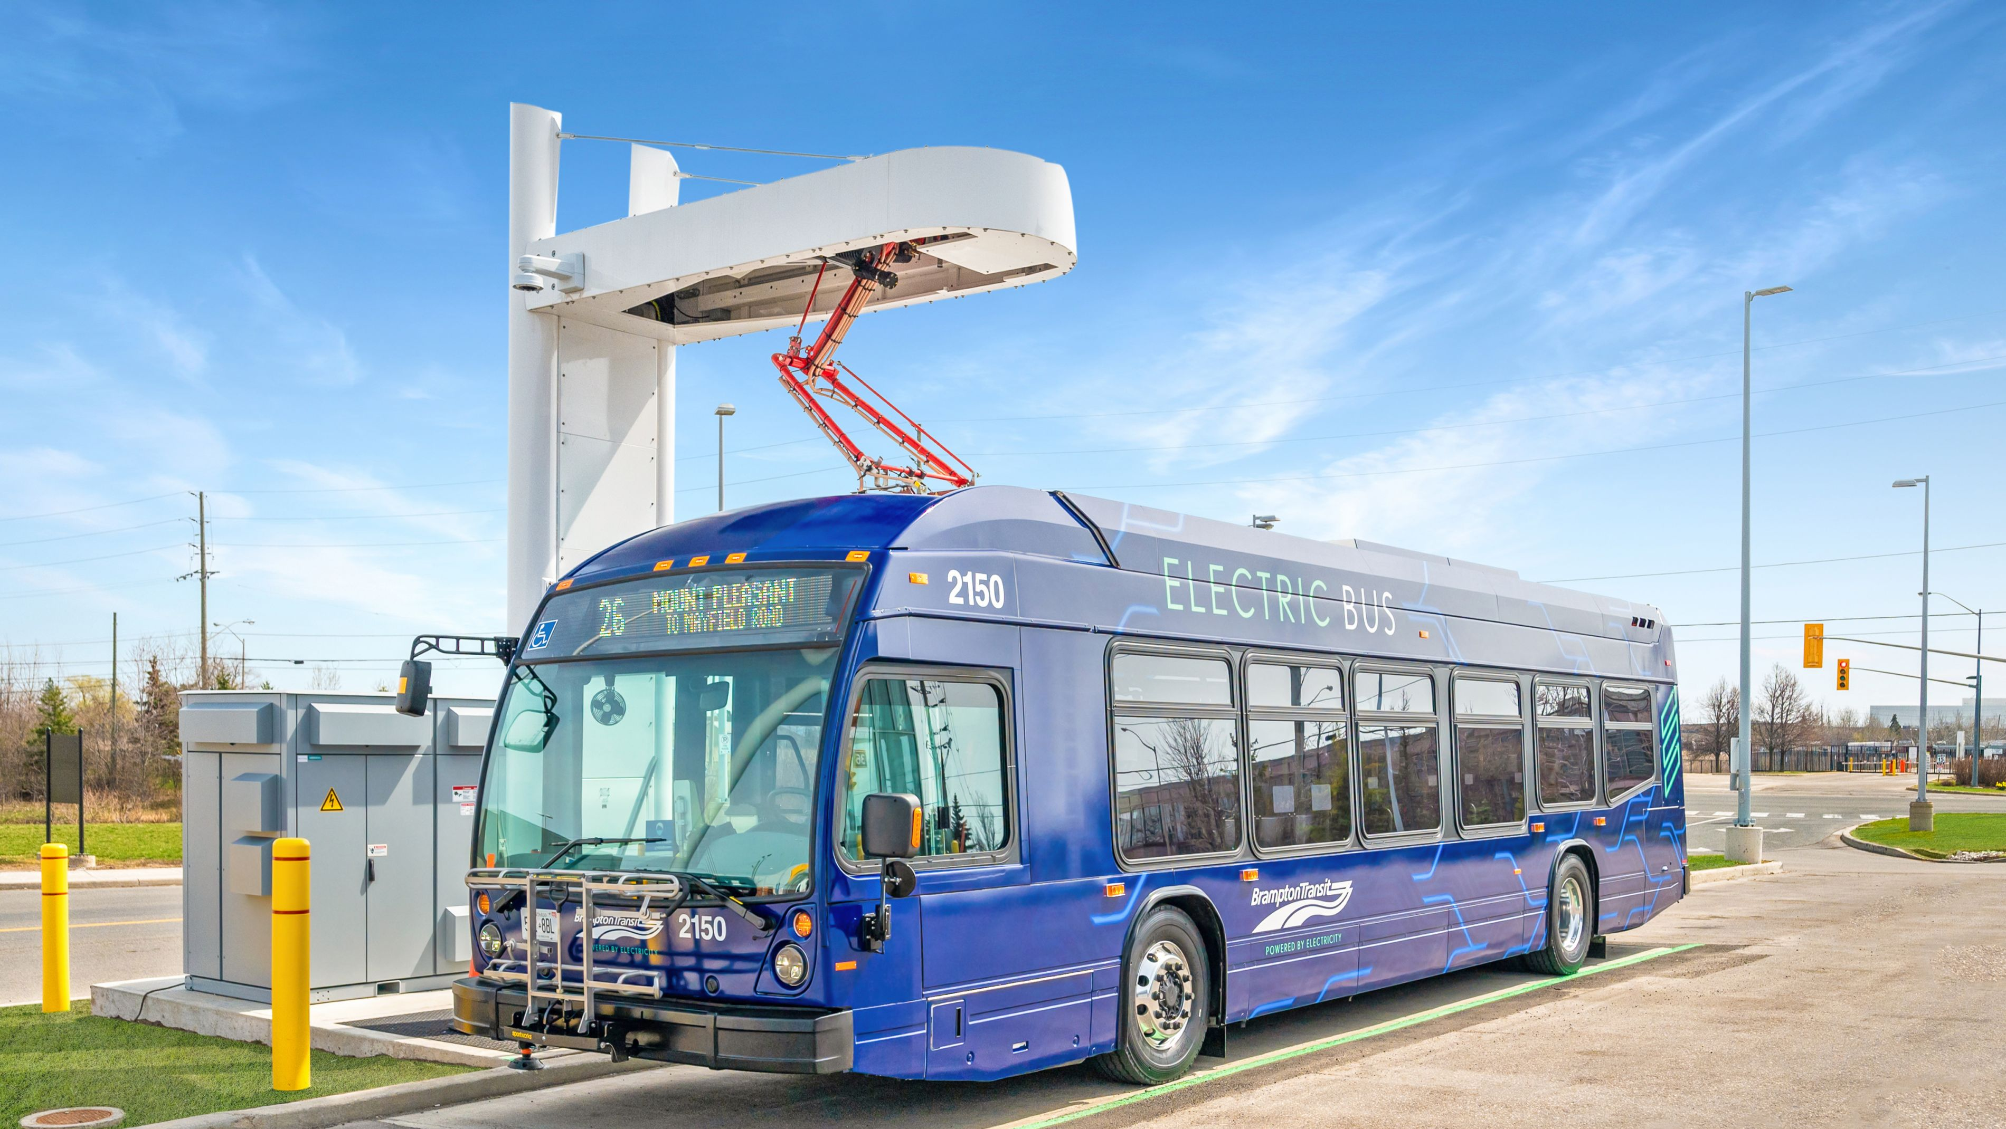

Solutions with impact across Canada
ABB Electrification’s products and solutions are found from coast to coast
CONNECTING CITIES
Ontario Line, Toronto
UPGRADING LEGACY INFRASTRUCTURES
McMaster University, Hamilton
ENGINEERING INGENUITY
REM, Montreal
EFFICIENT FERRIES
Maid of the Mist, Niagara falls
POWERING HURONTARIO LIGHTRAIL IN A SAFE AND RELIABLE WAY
Toronto
ELECTRIC BUS CHARGING STATION
Brampton
CHARGING OF THE WORLD’S FISRT ELECTRIC SNOWMOBILES
Quebec
CHARGING SOLUTIONS FOR LION ELECTRIC
Quebec
April 29, 2024
Slide 17

Slide 18
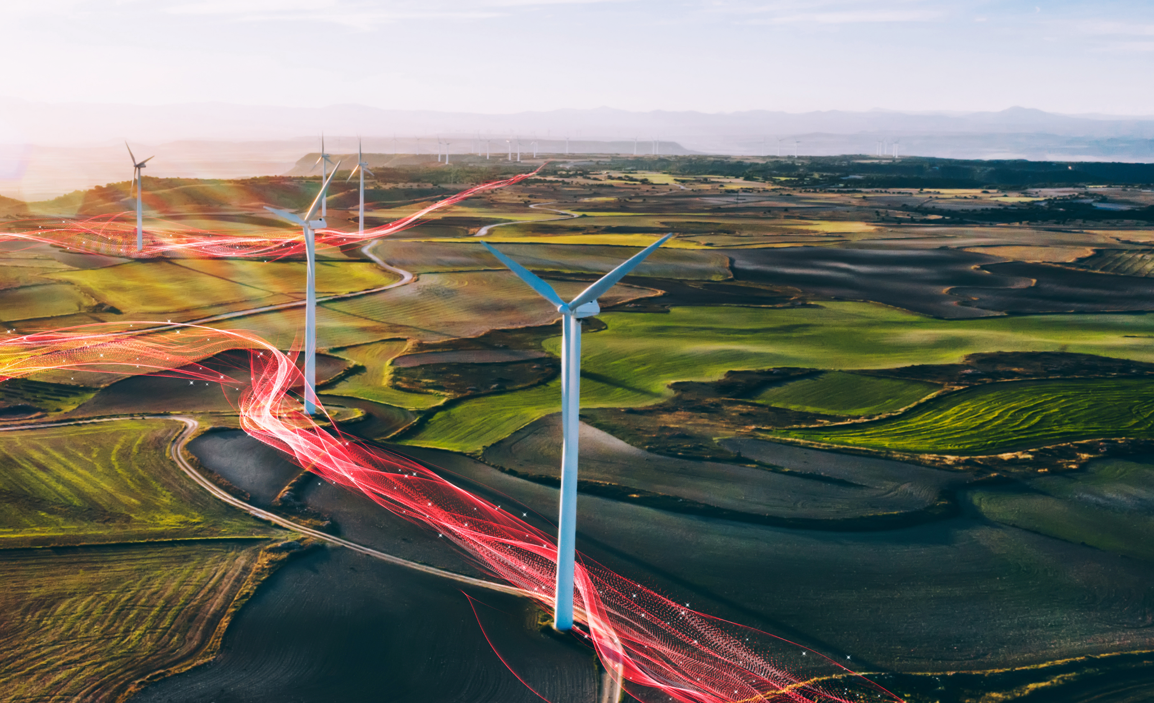
—
Electrifying Canada
in a safe, smart and sustainable way
go.abb/electrification
Copyright ABB. March 2024. All Rights reserved. 9AKK107046A0852
Notes:
Library Document ID 9AKK107046A0852

