Slide 1
F&B Segment Electrification Solutions
confidential
Electrification products | distribution solutions | digital, February 2018
Summary

Slide 2
F&B Segment Electrification Solutions
Content
Introduction
Industry needs and customer trends
Operational considerations
Constructing the solution
Mapping KPIs, solutions and products
Conclusion

Slide 3
F&B Segment Electrification Solutions
I. Introduction
Background
F&B manufacturing and ancillary industry
largest on the planet, about 1.2 million F&B production plants worldwide
Impacts almost all human beings and domesticated pets
Present in both urban and rural parts of the world

Slide 4
F&B Segment Electrification Solutions
I. Introduction
Challenges and expectations (1/2)
Mainly attributed to globalization and diverse cultural ‘mix’
Market related
Shorter product cycles
High levels of hygiene, nutritional value, health consciousness etc.
Stringent food safety and quality
Adapting to local market preferences
Cost-consciousness
Business related
Intense competition and minimal margins
Innovation, new market pursuits, deeper market penetration, faster time-to-market
‘Business climate’ change due to M&A, consolidations etc.

Slide 5
F&B Segment Electrification Solutions
I. Introduction
Challenges and expectations (2/2)
Process related
Relentless quality
High level of personnel safety
Optimal supply and delivery chain
Efficient production process chain
Meeting above challenges essential to ensure survival, sustenance and prosperity of F&B players.
Directly/indirectly deployed technologies need to be
safe, reliable, eco-efficient, smart and futuristic.

Slide 6
F&B Segment Electrification Solutions
II. Industry needs and customer trends
Outstanding trends
Reduced labor and human interface
Increased prevalence of ‘smart-enabled’ and ‘self-learning’ equipment
More demand for skilled technical experts
Shift towards energy-efficient solutions
Cost pressure driven by emerging market countries
Energy efficiency
is the major cost driver for the F&B factory production process
is addressed through electrification solutions
Reduction of Total Cost of Ownership (TCO)
High priority for safety
Overall Equipment Effectiveness (OEE) improvements
Electrification solutions contribute towards energy efficiency.

Slide 7
F&B Segment Electrification Solutions
II. Industry needs and customer trends
Across F&B industries (soft-drinks, dairy, beer etc.)
High quality, healthy/safe food products with maximum shelf life
Local presence in emerging markets
Minimum cost and optimum value
Energy efficiency solutions to reduce consumption of water and energy
Minimal raw material wastage
High quality of power
Predictive maintenance of equipment
High levels of automation; new solutions that are easy retrofit-able
Compliance of performance and safety standards
Best returns on CAPEX based investments
Safety of plant, personnel
Reliability, production/service continuity
Reliable, proactive supplier to do business with

Slide 8
F&B Segment Electrification Solutions
III. Operational considerations
Related to power system equipment
Equipment aging
Extending equipment life through maintenance
Avoiding maintenance mistakes
Upgrade or update wisely to create safer and efficient systems
Intelligent maintenance
Process visualization
Smart energy monitoring
Protection systems
‘Straighten the sags and kill the spikes’ – Power Quality
Multiple-power source management
Collaboration with solution providers/vendors

Slide 9
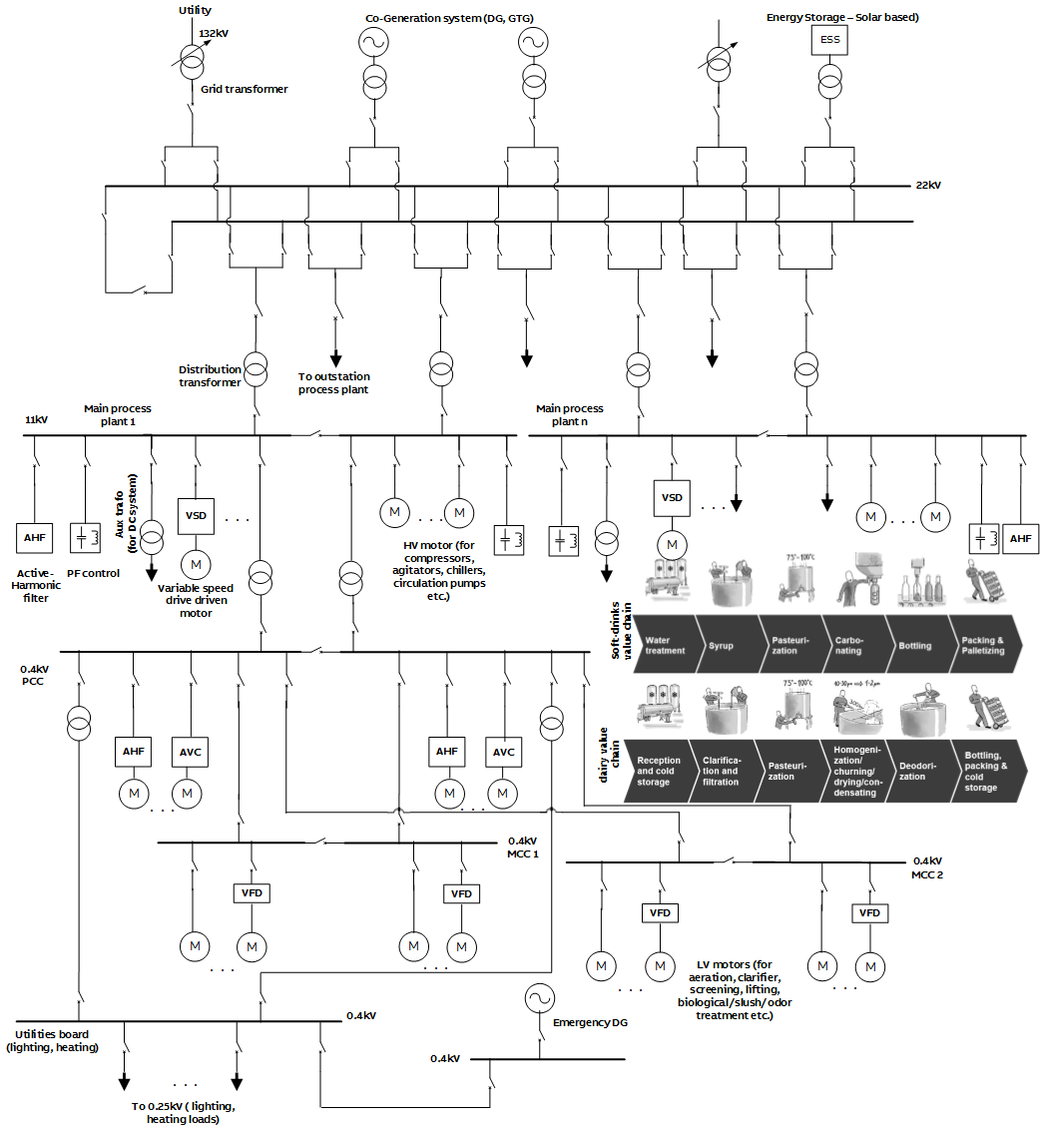
F&B Segment Electrification Solutions
IV. Use case for F&B plant electrification solutions
SLD and process (1/2)
Describing main power evacuation center with multiple power sources
Main process plant area substation to power motors/drives etc. associated with rotating machinery.
Examples of main processes for soft-drinks chain, dairy chain, beer are mentioned.
(Note: SLD arrangement, voltage levels etc. is for representation purposes only, in order to establish the intended electrification solutions).

Slide 10
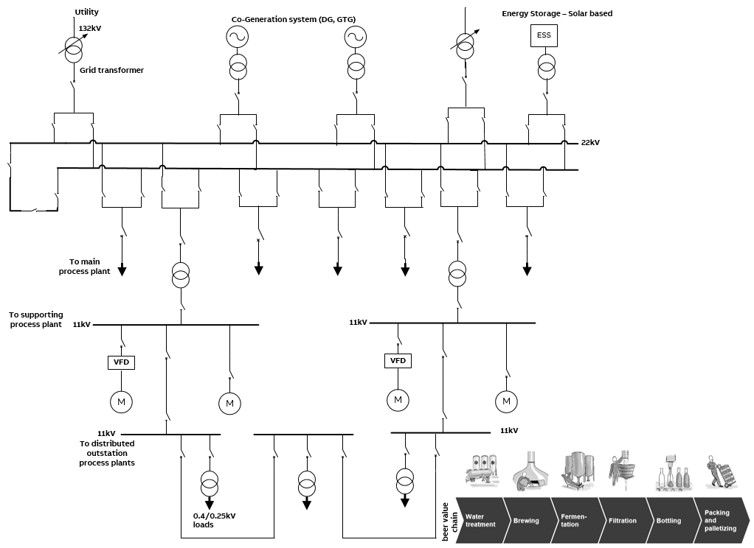
F&B Segment Electrification Solutions
IV. Use case for F&B plant electrification solutions
SLD and process (2/2)
Supporting process plant area like water treatment plants having an associated substation with bulk motor/drive loads to drive heavy duty pumps.

Slide 11
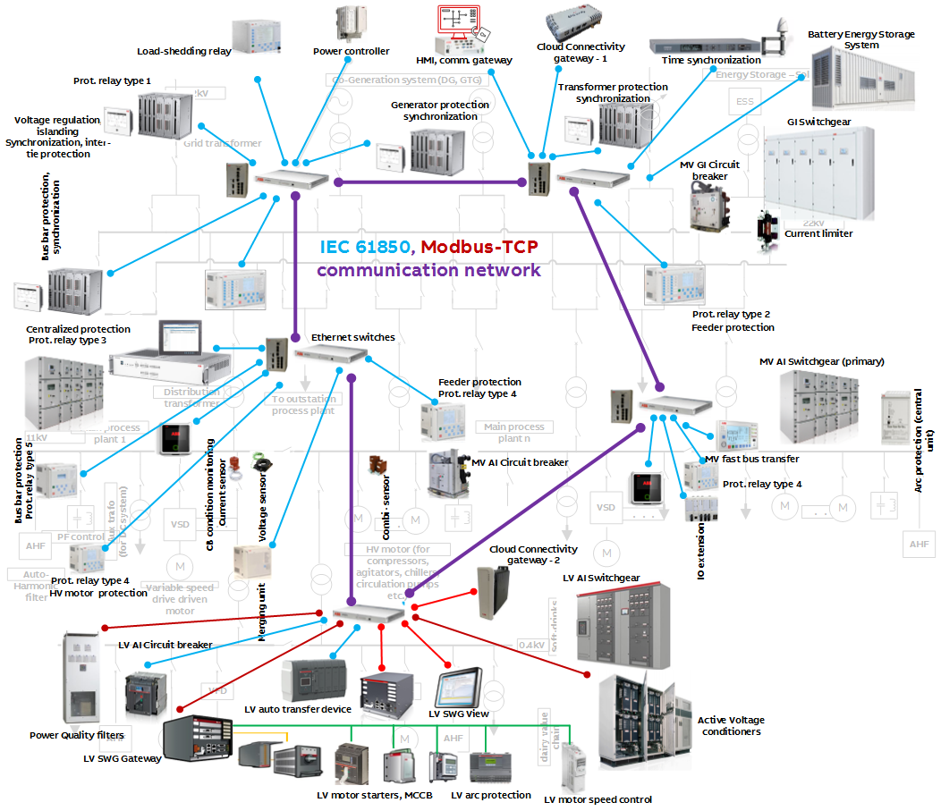
F&B Segment Electrification Solutions
IV. Constructing the solution
System overview (1/2)
Describes the following at power evacuation center and main process substations:
primary and secondary equipment
substation infrastructure (indoor)
proposed equipment at different voltage levels, depending on type of solutions or applications or usage required
network connectivity
communication network

Slide 12
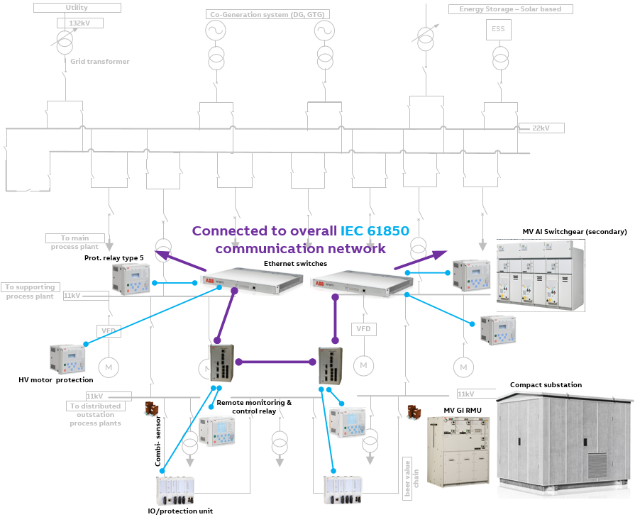
F&B Segment Electrification Solutions
IV. Constructing the solution
System overview (2/2)
Describes the following at supporting process plant and distributed outstation substations :
primary and secondary equipment (indoor and outdoor)
substation infrastructure
proposed protection and related equipment at different voltage levels
network connectivity
communication network

Slide 13
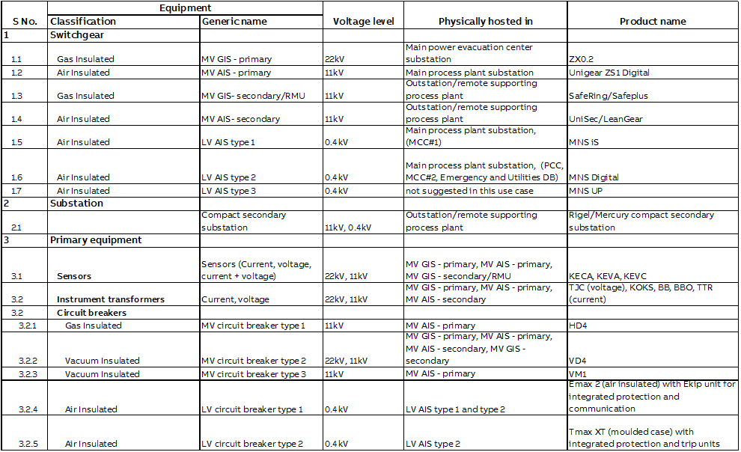
F&B Segment Electrification Solutions - Guidebook
VI. Constructing the solution
List of products used and referencing to ABB product offerings, not restricted to EPDS offering (1/4)

Slide 14
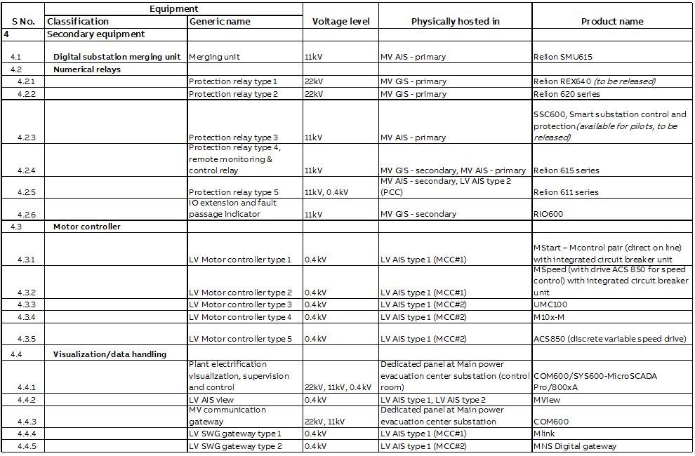
F&B Segment Electrification Solutions - Guidebook
VI. Constructing the solution
List of products used and referencing to ABB product offerings, not restricted to EPDS offering (2/4)

Slide 15
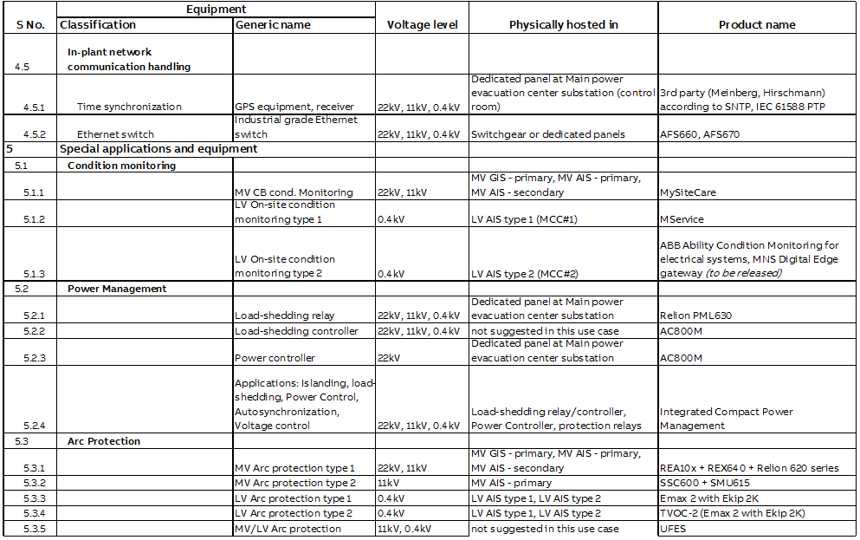
F&B Segment Electrification Solutions - Guidebook
VI. Constructing the solution
List of products used and referencing to ABB product offerings, not restricted to EPDS offering (3/4)

Slide 16
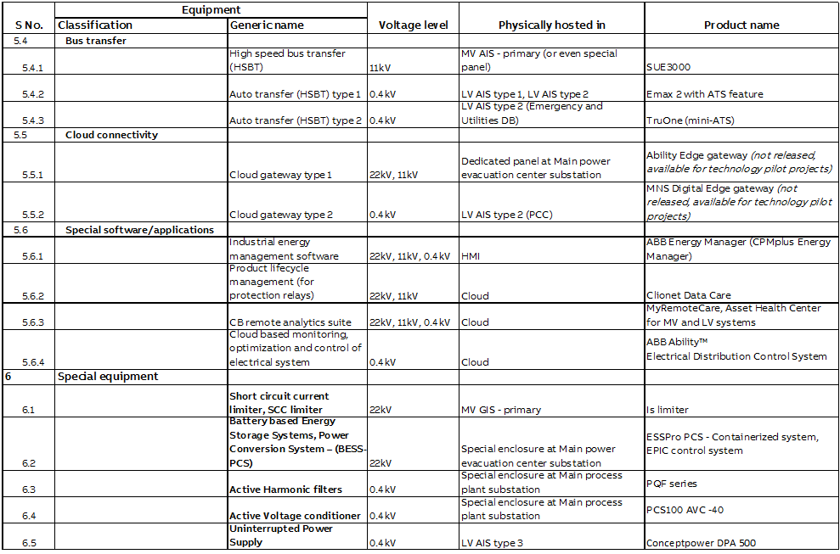
F&B Segment Electrification Solutions - Guidebook
VI. Constructing the solution
List of products used and referencing to ABB product offerings, not restricted to EPDS offering (4/4)

Slide 17
F&B Segment Electrification Solutions
IV. Constructing the solution
List of suggested solutions
Contd.
IEC 61850 based power automation system
Islanding and fast load-shedding
In plant power generation (co-generation)
Power generation control and voltage regulation
Automatic synchronization
Gas insulated, air insulated switchgear and equipment layout
Power automation system AND dedicated/advanced protection (to secure each part of the network)
Bus bar protection
Fast acting and coordinated arc protection system
Short circuit current limiters facilitating system augmentation
High-speed bus transfer / Automatic transfer switching
Power Quality monitoring and corrective control
Communication system redundancy
Intelligent substation asset analytics aiding predictive maintenance
Interface to Distributed Control System (DCS)
Above solutions use mentioned products from the previous slide.

Slide 18
F&B Segment Electrification Solutions - Guidebook
VII. Mapping KPIs to solutions to products
Value mapping to products (1/3)
KPI | Solution | Components/Products
Food safety People Safety Manufactured product quality Reduce outages (smart system management) Continuous operations Preventing unplanned downtime and lost production | IEC 61850 based power automation system Islanding and fast load-shedding In plant power generation Power generation control and voltage regulation Automatic synchronization Power automation system AND dedicated/advanced protection (to secure each part of the network) Busbar protection High-speed bus transfer / Automatic transfer switching Power Quality monitoring and control Communication system redundancy Cybersecurity DCS Interface | AFS660, AFS670 GPS/time servers Relion PML630 Relion 611, 615, 620 series, REX640 SSC600, Relion SMU615 Emax, Emax2 + Ekip, MStart+MControl, UMC100, M10x-M, Tmax AC 800M + Small PMS library COM600S, SYS600, MView, Mlink SUE3000 TruOne – ATS Relion 611 series ESSPro PCS PQF series PCS100 AVC -40 ARx600, ABB Ability Edge gateway, MNS Digital Edge gateway MNS iS, MNS Digital MySiteCare, MySiteCondition, MyRemoteCare, MService, ABB Ability Condition Monitoring, ABB Ability EDCS Clionet Data Care, MVAM , Asset Health Center Low voltage motors UPS Conceptpower DPA 500

Slide 19
F&B Segment Electrification Solutions - Guidebook
VII. Mapping KPIs to solutions to products
Value mapping to products (2/3)
KPI | Solution | Components/Products
Food safety during storage (maintaining supply voltage, temperature) | Power generation control and voltage regulation Power automation system (temperature control) | Relion REX640, REU615 AC 800M + Small PMS library SSC600 RIO600 COM600S, MView, Mlink, ABB Ability Condition Monitoring
People (operational) safety Protection of capital investment on assets Preventing unplanned downtime and lost production | Fast acting and coordinated arc protection system Gas insulated, air insulated switchgear and equipment layout Power automation system AND dedicated/advanced protection (to secure each part of the network) Bus bar protection Short circuit current limiters facilitating system augmentation Power automation system (substation HMI) | KEVA, KECA, KEVC series VD4, HD4, EMax2 Unigear ZS1 Digital, ZX1.2, SafeRing/Safeplus, UniSec/LeanGear, MNS Digital Rigel/Mercury compact secondary substation UFES, REA10x, EMax 2 Relion 611, 615, 620 series, REX640 SSC600, Relion SMU615 Is-limiter Surge arrestor (MWD) COM600S, SYS600, MView, Mlink, MNS Digital Gateway, ABB Ability Condition Monitoring

Slide 20
F&B Segment Electrification Solutions - Guidebook
VII. Mapping KPIs to solutions to products
Value mapping to products (3/3)
KPI | Solution | Components/Products
Increased asset utilization Optimized total cost of ownership Protection of capital investment Increased operational efficiency Trusted partner for long term partnership, solution oriented, on-site support | Short circuit current limiters facilitating system augmentation Power automation system AND dedicated/advanced protection (to secure each part of the network) Gas insulated, air insulated switchgear and equipment layout Intelligent substation asset analytics aiding predictive maintenance | Is-limiter Relion 611, 615, 620 series, REX640 Relion SMU615, SSCP VD4, HD4, EMax2 Unigear ZS1 Digital, ZX1.2, SafeRing/Safeplus, UniSec/LeanGear, MNS iS, MNS Digital ARx600, ABB Ability Edge gateway, MNS Digital Edge gateway MySiteCare, MySiteCondition, MyRemoteCare Clionet Data Care, MVAM , Asset Health Center, MService, ABB Ability Condition Monitoring, ABB Ability EDCS SUE3000 ESSPro PCS PCS100 AVC -40
Ambient insensitivity | (product characteristics) | All equipment can operate in harsh climate (temperature and humidity)

Slide 21
F&B Segment Electrification Solutions
VI. Conclusion
Takeaways
Using the suggested F&B plant use case, all necessary solutions have been suggested, which in turn have been mapped to specific ABB products and solutions in the power distribution area are clearly identified, justified.
These ABB solutions and products are further mapped to the identified key customer KPIs.
Based on the above, it is quite clear that ABB’s products and solutions can ensure a major contribution towards making a safer, more reliable and smarter F&B process.

