Slide 1
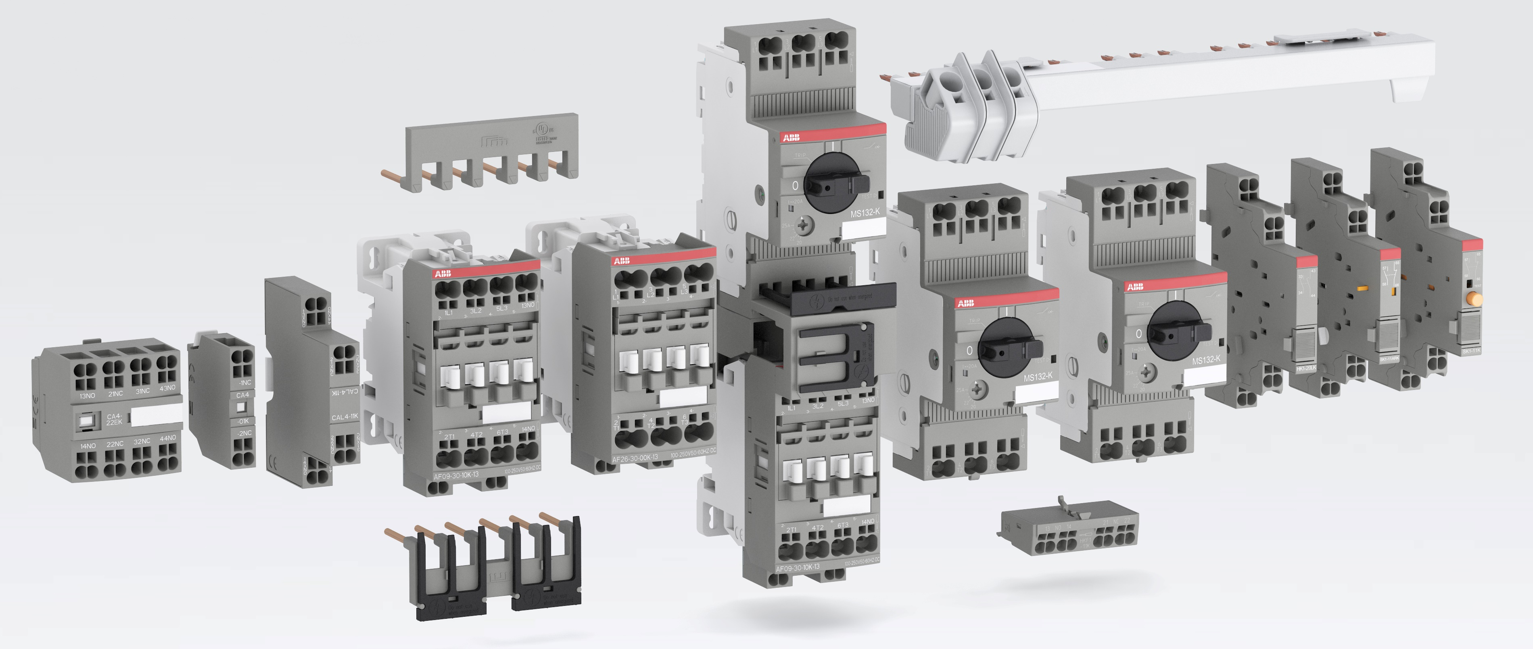
Just push it
Push-in Spring motor starting solution

Slide 2
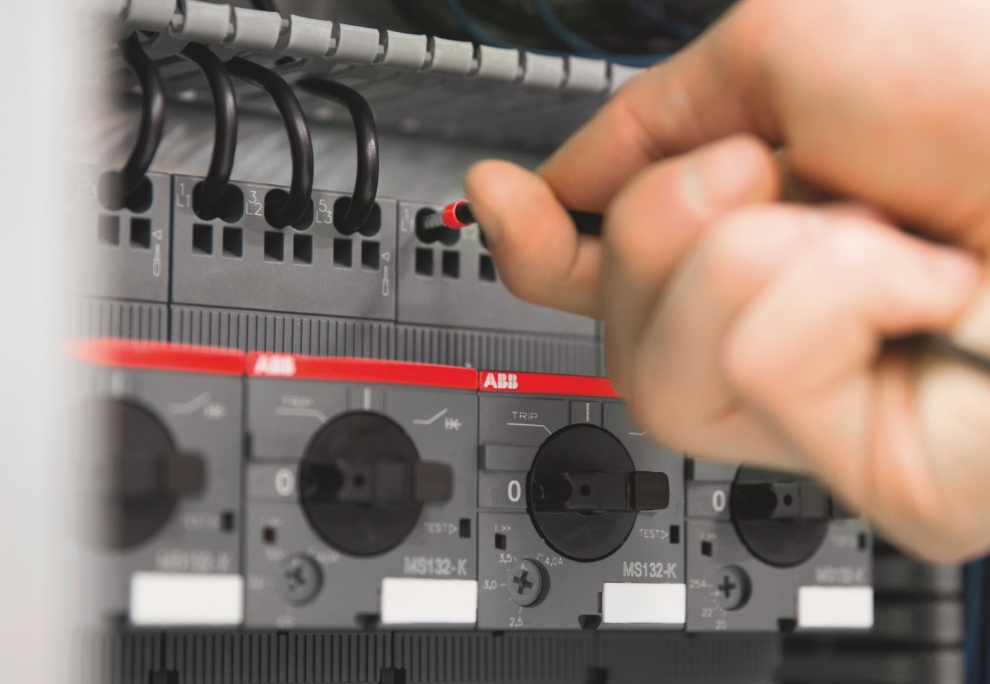
The next generation of spring technology
One push is all you need
extremely fast wiring
no tool is required
save up to 50% wiring time
and the connections are just as reliable.
For speed, ease and reliability, just push it !
Notes:
With the new Push-in Spring motor starting solution, one push is all you need for extremely fast wiring.
No tool is required, so you can save up to 50% wiring time with Push-in Spring compared to conventional spring solutions.
And the connections are just as reliable

Slide 3

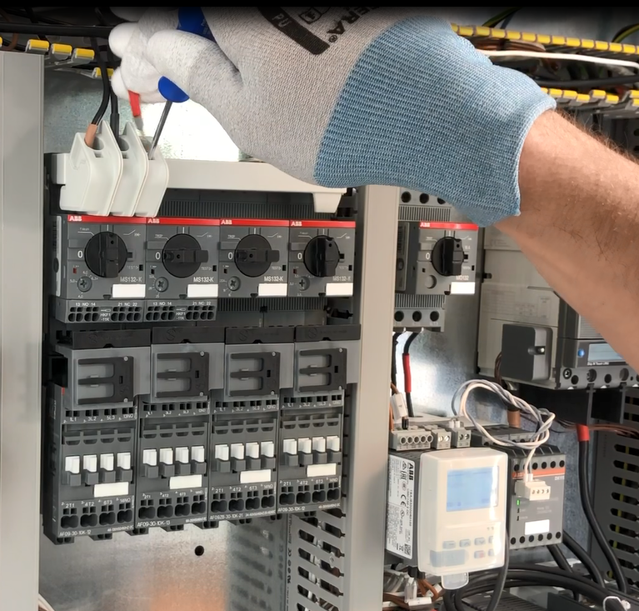
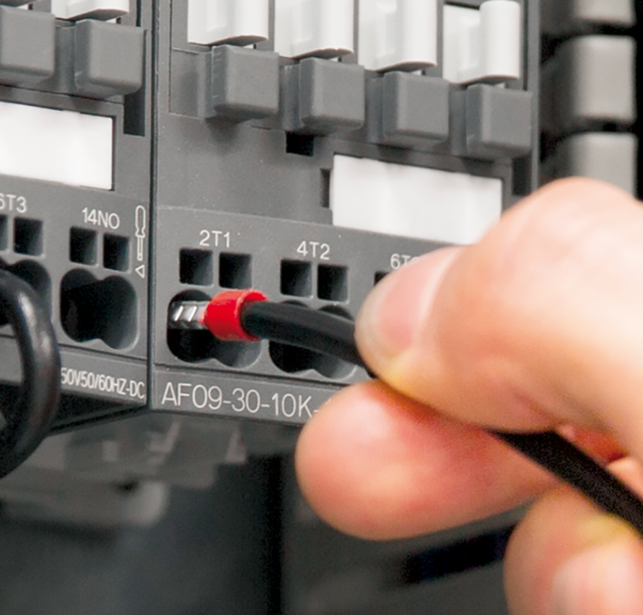

Push-in Spring solution benefits
Faster than ever installation
Easier than ever wiring
Reliable as ever connections
Notes:
Faster than ever installation
Imagine a motor starting solution that’s twice as fast to install. With Push-in Spring, you no longer need to imagine – it’s a reality.
Push-in mode allows you to insert both ferruled and rigid cables without the need to use any tools, boosting your productivity like never before.
Easier than ever wiring
Push-in Spring technology opens up new possibilities. With its unmatched ease of use, wiring becomes far more intuitive.
This eliminates the need for special training and reduces the chance of wiring error. What possibilities will it open up for you?
Reliable as ever connections
The speed and ease of Push-in Spring comes with the added reassurance of connections that are as reliable as ever.
This gives you complete peace of mind when using the Push-in Spring motor starting solution.

Slide 4

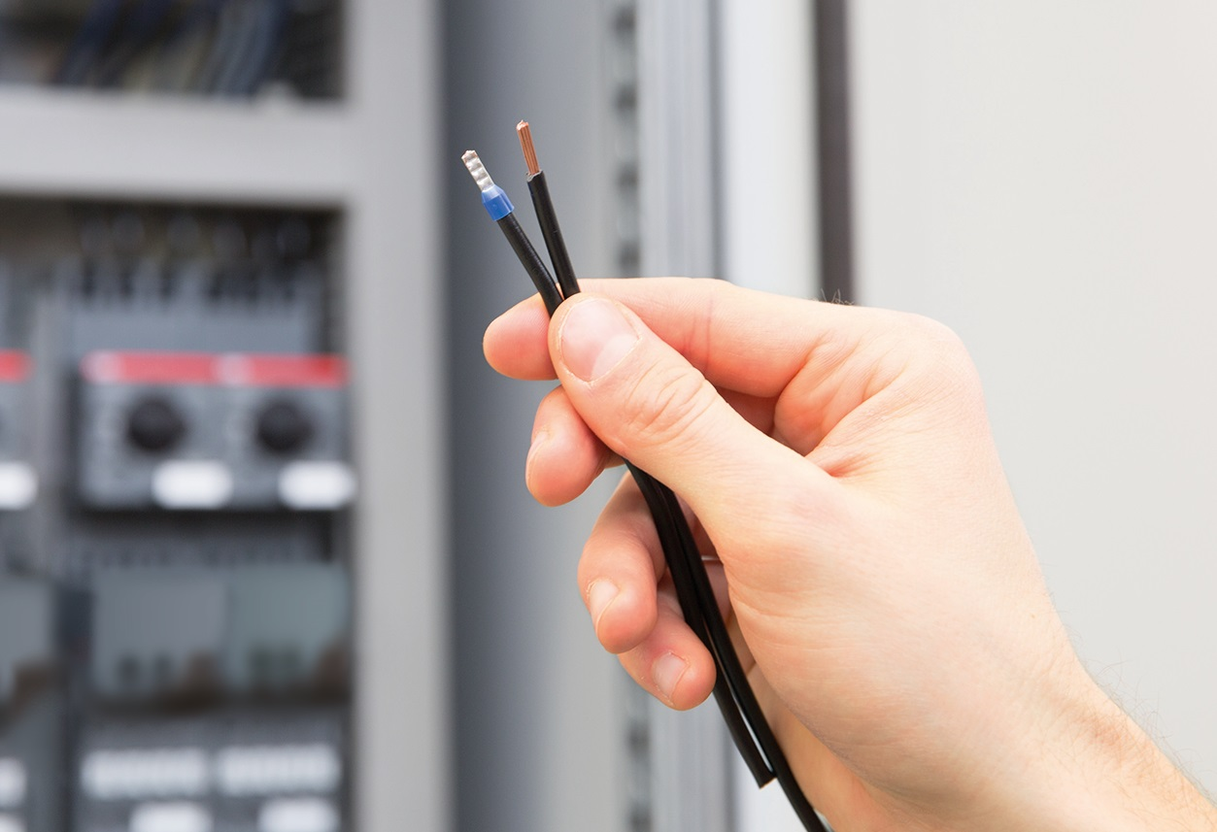
Faster than ever installation
Speed up your projects
2-in-1 connection
For the very first time, you can use
ferruled and rigid cables (Push-in mode)
cables without ferrules (Spring mode)
in the same terminal.
Notes:
For the very first time on the market, ABB's 2-in-1 connection allows you to use ferruled and rigid cables (Push-in mode) or cables without ferrules (Spring mode) in the same terminal.
In Push-in mode, cables can be inserted by just simply pushing them in by hand.

Slide 5

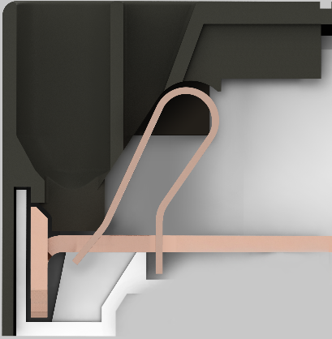
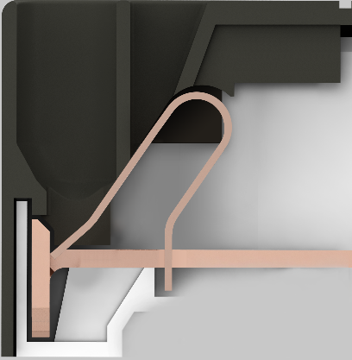
Faster than ever installation
Speed up your projects
Push-in mode
Connect rigid cables or ferruled cables simply by pushing them into the cable holes
no need to use any tools
intuitive wiring
self-tightening terminals
save up to 50% wiring time
Notes:
Connect rigid cables or ferruled cables simply by pushing them into the cable holes – no need to use any tools.
Push-in mode saves up to 50% wiring time compared to conventional spring solutions and makes installation a breeze.
Benefit from intuitive wiring, self-tightening terminals and less chance of wiring error.

Slide 6


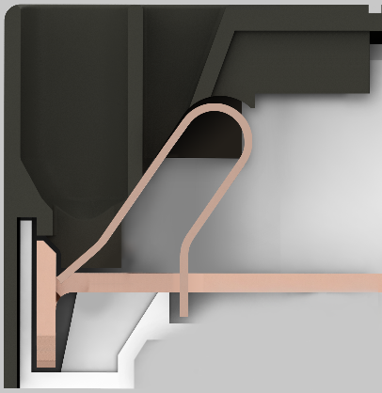
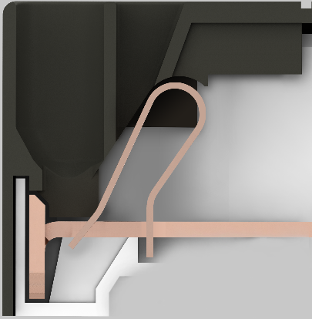
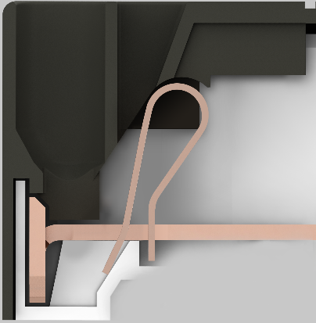
Faster than ever installation
Speed up your projects
Spring mode
Use spring mode for
small cable cross-sections or for cables without ferrules
de-wiring the motor starting solution
Simply push a screwdriver into the clearly marked holes
no twisting or turning is required
easier to use than conventional spring technology, with less chance of damage to terminals
Notes:
This mode is used for small cable cross-sections or for cables without ferrules. It is also used for de-wiring the solution.
Before inserting the cable, simply push a screwdriver into the clearly marked holes to open the terminal.
ABB’s Spring mode is easier to use than conventional spring technology, with less chance of damage to terminals as no twisting or turning is required.

Slide 7
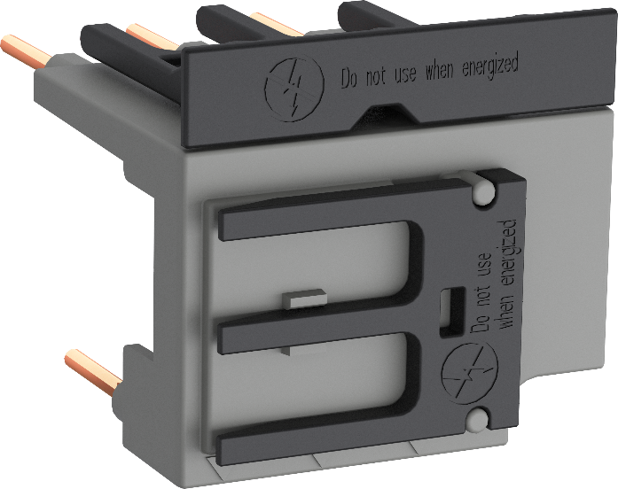
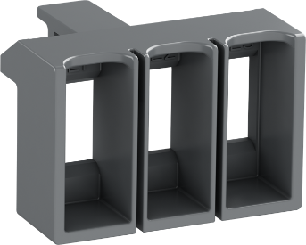
Faster than ever installation
Speed up your projects
Smart accessories
Use ABB´s smart connection accessories
100 % tool-free mounting
significantly reduced installation time
busbars, connecting kits and electrical interlock
Direct on-line, Reversing or Star-Delta starters
possible without using any wires
Notes:
100% tool-free mount busbars and connecting kits significantly reduce installation time.
You can connect devices for direct on-line starters, without using any wires.

Slide 8
Faster than ever installation
Speed up your projects
Complete solution
High connecting capacities
up to 18.5 kW 400 V AC-3/AC3-e (and 25 hp 480 V) for motor starting
up to 50 A for AC-1 (and 45 A 600 V general use) applications
fuseless short-circuit protection up to 100 kA
Auxiliary accessories can also be mounted on the standard screw range of manual motor starters and contactors.
Notes:
High connection capacities are optimized for motor starting solutions up to 18.5 kW 400 V AC-3 and 50 A AC-1 (25 hp 480 V and 45 A general use).
This includes short-circuit fuseless protection up to 100 kA.
Push-in Spring auxiliary accessories can be mounted on the standard screw range of manual motor starters and contactors:
The auxiliary and signaling contacts of MS132-K are compatible with MS116, MS132 and MS165. AF… K auxiliary contacts can be used up to AF 96

Slide 9
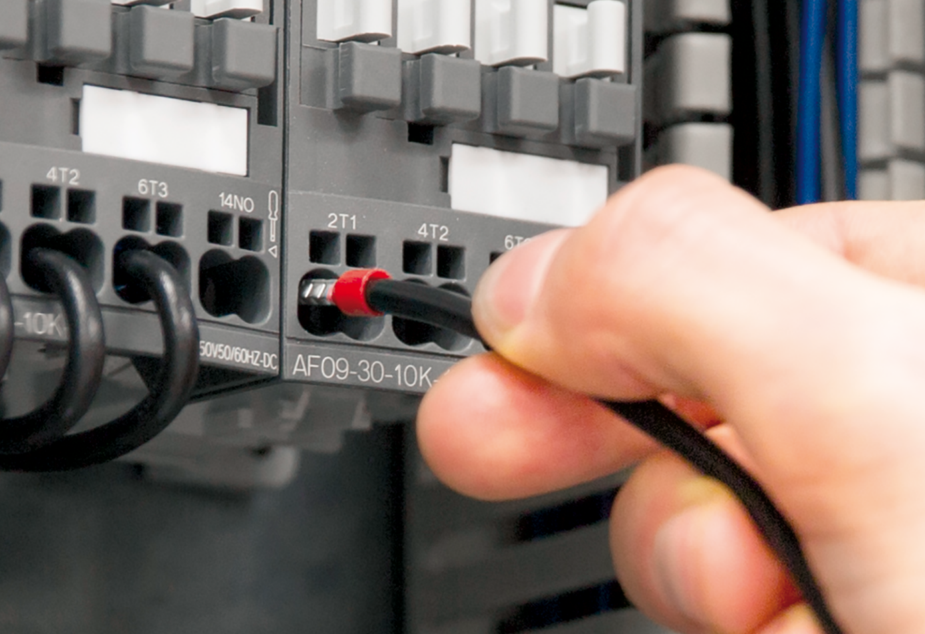
Easier than ever wiring
Intuitive wiring
With ABB's Push-in Spring, wiring is intuitive
one same round shape entry for all cables and connecting links
square entry holes clearly marked with screwdriver symbols
intuitive wiring and de-wiring
easily repeatable without cabling error
little to no training is required
Easy to install
Notes:
With Push-in Spring, all cables and connecting links use the same round shape entry, whilst the square terminals are clearly marked with screwdriver symbols.
The result? Wiring and de-wiring that’s intuitive and easily repeatable without cabling error, with little to no training required.

Slide 10

Easier than ever wiring
Just one screwdriver required
For spring mode or de-wiring the solution
only one screwdriver size is needed for the entire range
no twisting or turning is required
there's less chance of damage to the terminals and to the installation as a whole
Easy to install
Notes:
For Spring mode or de-wiring, only one 3 mm flat screwdriver size is needed for the entire range.
No twisting or turning is required either, so there's less chance of damage to the terminals and to your installation as a whole.

Slide 11
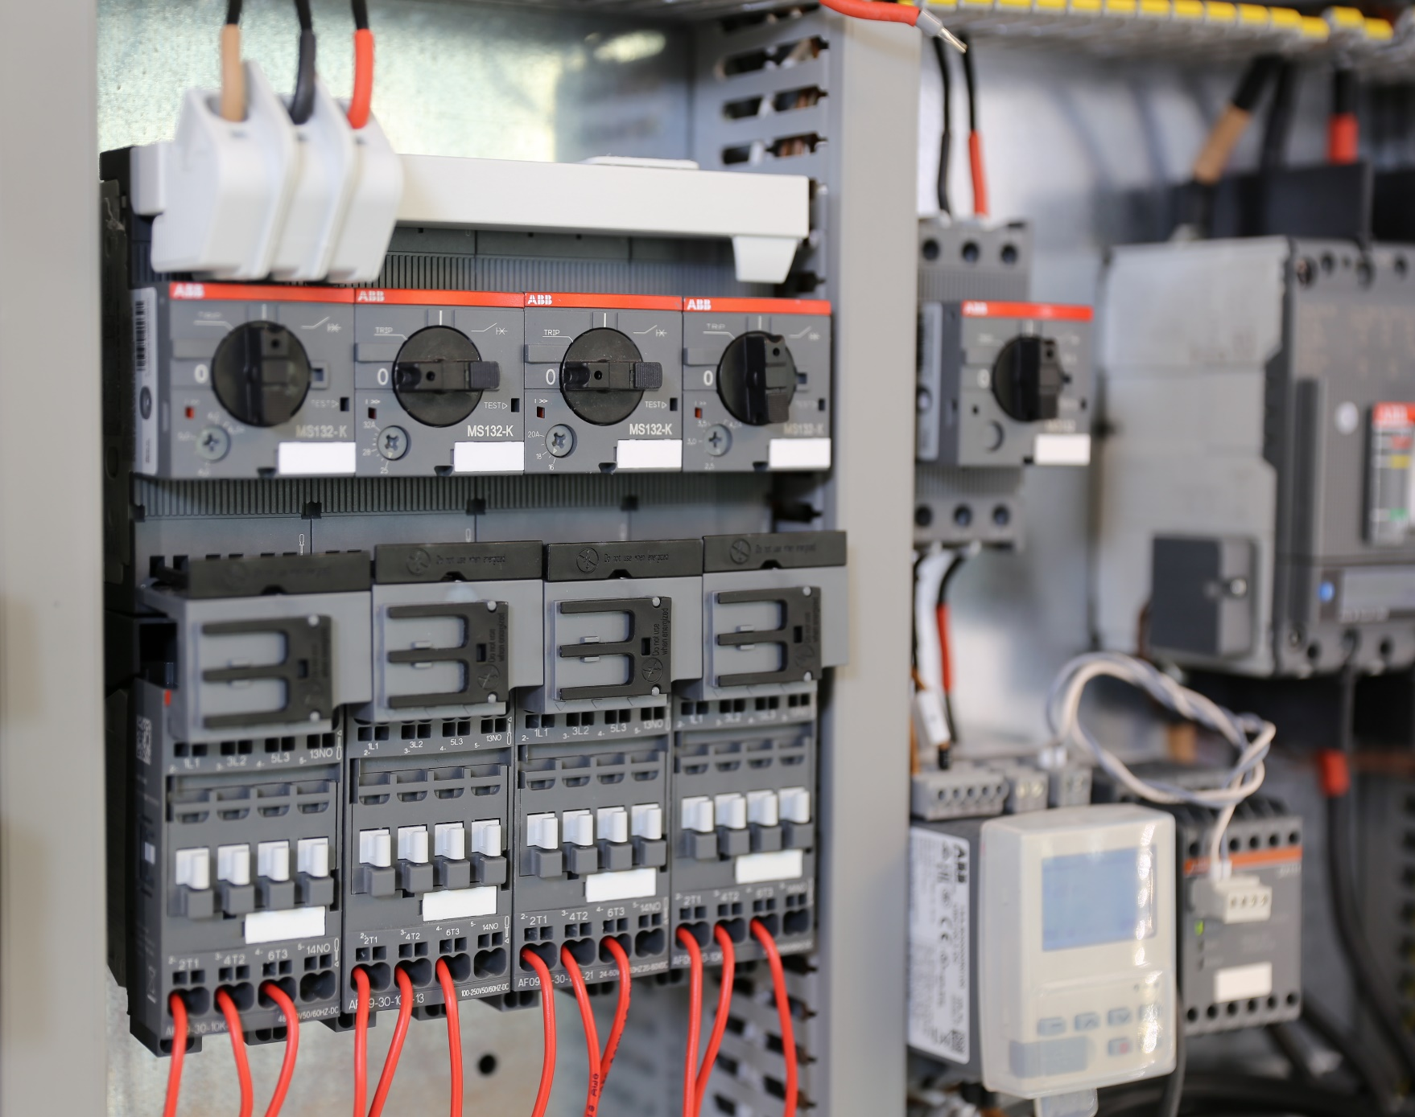
Easier than ever wiring
Automated wiring
The Push-in Spring motor starting solution features
90° cable insertion for all terminals
front terminals access
smooth, robust cables insertion
Easy to install
Notes:
The Push-in Spring motor starting solution features 90° cable insertion for all terminals.
Front access to terminals aids smooth, robust insertion of cables and makes automated robot wiring possible.

Slide 12
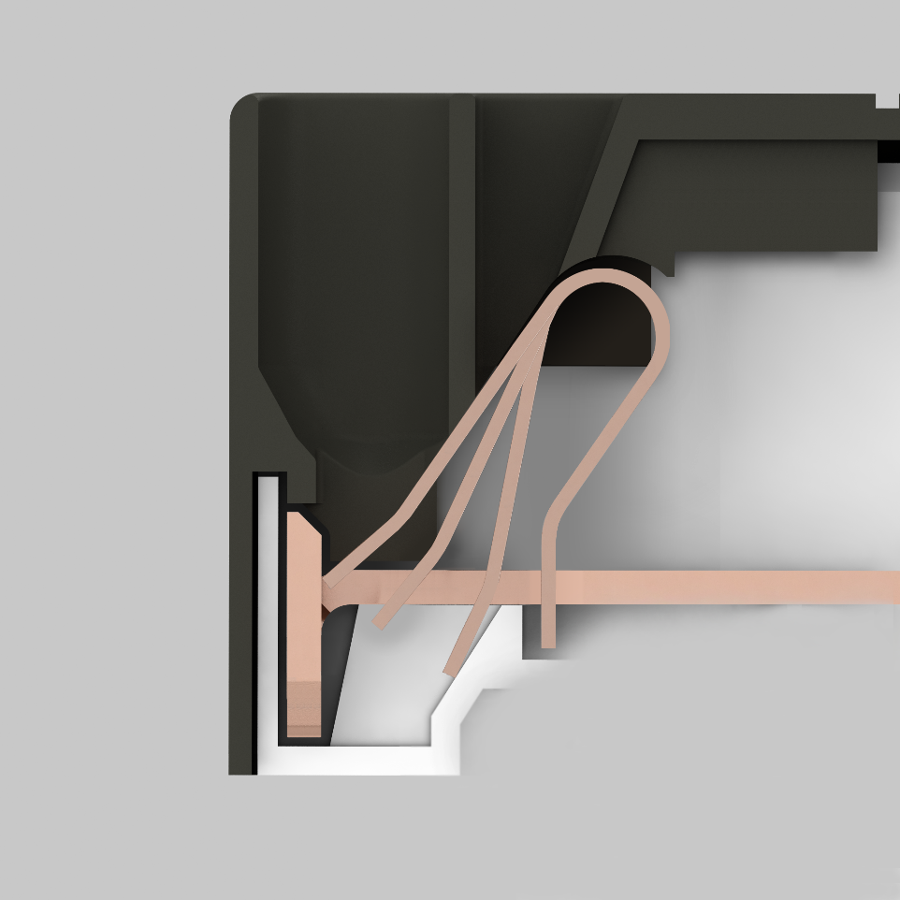
Reliable as ever connections
Robust by design
The special spring design
delivers excellent electrical contact
provides strict control of contact strength
is reliable independent from operator
Continuous operation
Notes:
The special spring design guarantees excellent electrical contact.
The design provides strict control of contact strength, independent from operator, giving you complete assurance.

Slide 13

Reliable as ever connections
No need to re-tighten
With self-tightening terminals,
there is no need to re-tighten after transportation
there is no need to re-tighten during the product life
high connection strength is throughout the whole lifetime of the device.
Continuous operation
Notes:
With self-tightening terminals, there’s no need to re-tighten after transportation or during the lifecycle of the product.
High connection strength is guaranteed throughout the whole lifetime of the device.

Slide 14

Reliable as ever connections
Vibration-proof
Devices with Push-in Spring terminals have been tested
according to:
Pull-out and flexion on each pole according to
IEC 60947-1
Shock and vibration tested according to IEC 60068-2-27
and IEC 60068-2-6
You can count on Push-in Spring connections, even in harsh environments.
Continuous operation

Slide 15


Application Examples
The more you wire, the more you win, with the most innovative motor starting solution available
Front access, 90° one-step insertion and robust terminals make wiring simpler and faster than ever before.
Self-tightening terminals help ensure high connection strength throughout the entire lifecycle of the products. High-vibration environments benefit from the reduced maintenance effort.
ABB is a one-stop shop for motor starting solutions, with a large product range and complete offering of accessories. Installation time is significantly reduced with the 100% tool-free connecting kits.
Notes:
Front access, 90° one-step insertion and robust terminals make wiring simpler and faster than ever before.
Self-tightening terminals ensure high connection strength throughout the entire lifecycle of the products.
High-vibration environments especially benefit from the reduced maintenance effort.
ABB is a one-stop shop for motor starting solutions, with a large product range and complete offering of accessories.
Installation time is significantly reduced with the 100% tool-free connecting kits.

Slide 16
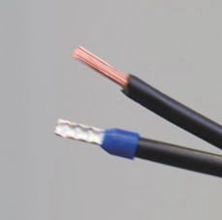
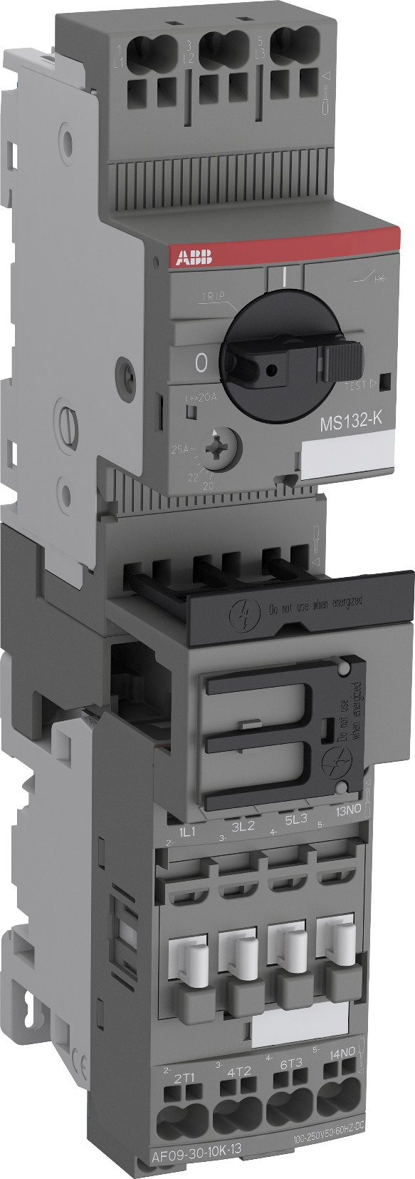
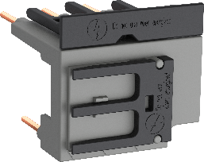
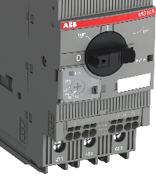
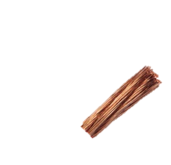
Push-in Spring motor starting solution
Complete range, complete efficiency
2-in-1 connection
Time-saving, easy &
fault-free assembly with
less cabling
Tool-free connecting links
Just one screwdriver
Accessories compatible
with screw range
High connecting capacity
Notes:
2-in-1 connection
Benefit from both push-in mode and spring mode and use ferruled cables or cables without ferrule in the same terminal.
Tool-less connecting links
100% tool-less mounting connecting links
Robust by design
Contact robustness by design, independent from operator.
Just one tool for everything
You only need a 3 mm screwdriver in spring mode as well as for de-wiring the complete solution.
Compatible with screw range
Mount accessories for control circuits on the screw range up to 30 kW AC-3 400 V on manual motor starters and up to 45 kW AC-3 400 V, 130 A AC-1 on contactors
Higher connecting capacity
ABB Push-in spring motor starting solution ranges up to 18.5 kW 400 V AC-3 and 50 A AC-1 (25 hp 480 V and 45 A 600 V general use).

Slide 17
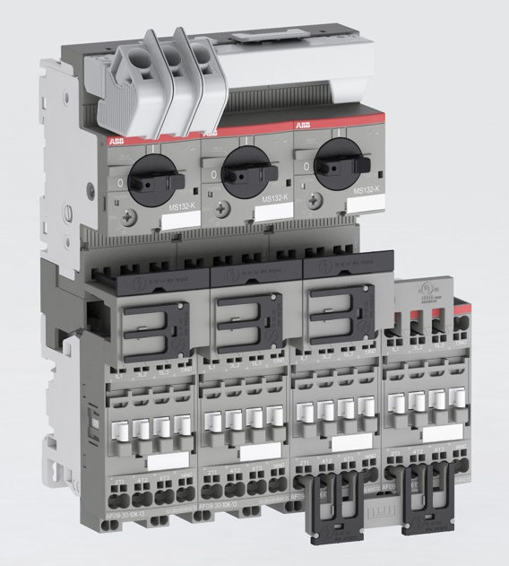
Push-in busbars
Complete range, complete efficiency
Push-in busbars for manual motor starters
The special design ensures a
time-saving installation
maintenance-free life cycle
fault-free assembly with less cabling
All this for
2, 3, 4 or 5 manual motor starters
with no or one lateral auxiliary contact,
integrated feeder block and
UL Type E / F approval.
Notes:
The special spring design guarantees excellent electrical contact.
The design provides strict control of contact strength and an easy installation, independent of the operator.

Slide 18
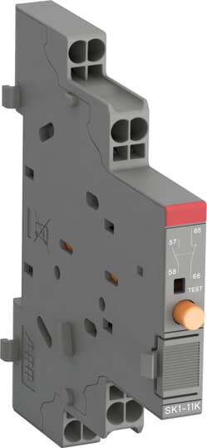
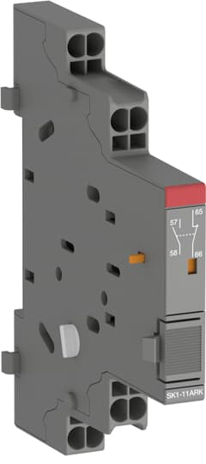
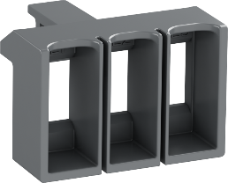
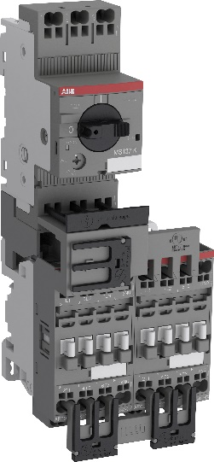
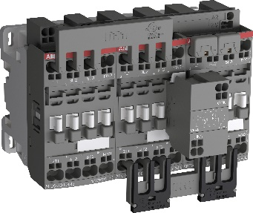
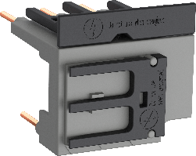

Push-in Spring motor starting solution
Complete motor starting solution
—
Manual motor starters
Up to 32 A, 15kW 400 V AC-3/AC-3e
Ics up to 100 kA
—
Contactors
3-pole (incl. PLC coil 30 version)
Up to 38 A, 18.5 kW 400 V AC-3/AC-3e (and 25 hp 480 V)
Up to 50 A, at 40°C AC-1 (and 45 A 600 V general use)
—
Manual motor starter accessories
Auxiliary contacts, signaling contacts and terminal spacer for UL Type E / F
—
Contactor accessories
Auxiliary contacts for front mounting and for side mounting
Possible combinations
Accessories for starter combinations / group starters
—
Direct on-line starters
Up to 15kW
—
Reversing contactors
Up to 15kW
—
Star-delta starter
Up to 25kW
—
Connecting links
Busbars
—
Plug and connect mechanical
and electrical interlock set
—
Connecting sets for
• Reversing starters
• Star-delta starters

Slide 19
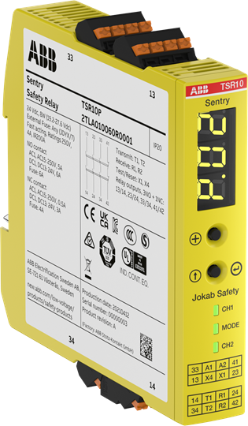
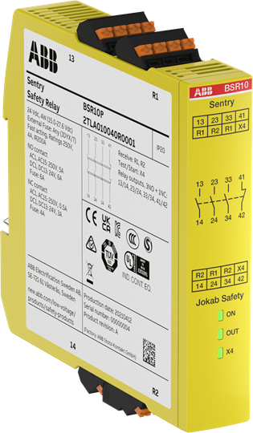
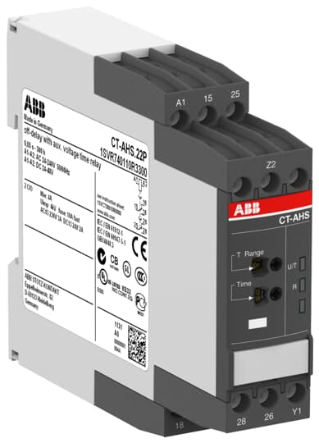

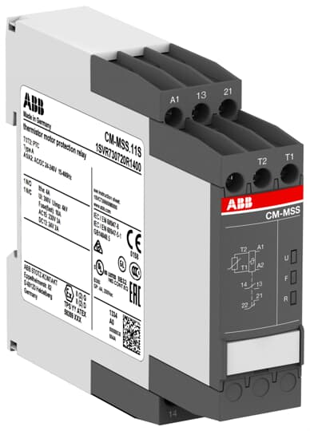
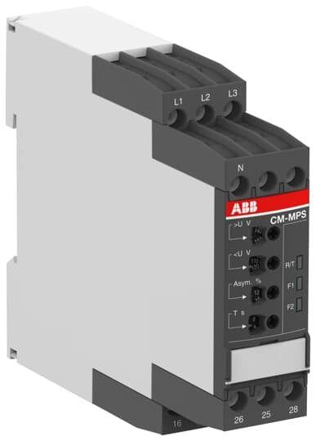
Also available with Push-in terminals
—
Sentry safety relays
—
Time relays
—
Measuring & Monitoring relays

