Slide 1
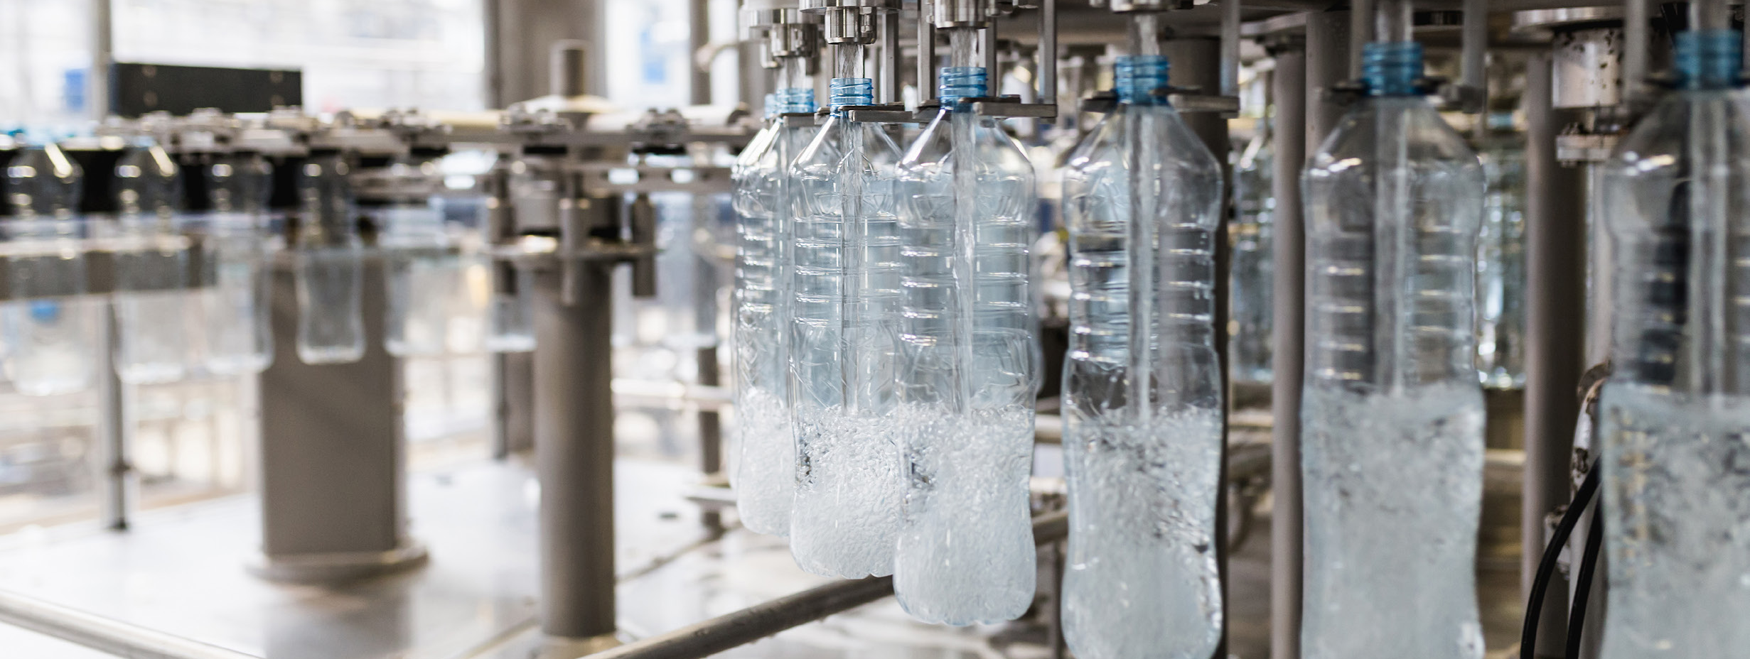
Food and Beverage Industry USA
Industry line card
Installation Products Division
December 2020
2020

Slide 2
—
Thomas & Betts is now part of ABB’s Installation Products Division, but our long legacy of quality products and innovation remains the same.
From connectors that support wire buildings on Earth to cable ties that help put machines in space, we continue to work every day to make, market, design and sell products that provide a smarter, safer and more reliable flow of electricity, from source to socket.

Slide 3
Contents
04 ABB Installation products for food and beverage
08 Innovative technologies for daily practice
09 Flexible metallic conduits
10 Flexible liquidtight metallic conduits
11 Flexible conduit systems - non metallic
12 Explosion protective conduit systems, cable glands and accessories
13 Wire and cable management
14 ABB's no-cost confidential plant assessment
15 Fittings and cable glands
16 Rigid conduit systems
17 Product selection guide

Slide 4







ABB Installation products
Dust and liquidtight
Extreme temperature protection
for food and beverage
Corrosion resistance
F&B plants are continuously challenged. F&B process equipment should operate as efficiently, safely and hygienically as possible, without compromising critical power and data connections. ABB offers you F&B dedicated installation products to protect and connect sensitive electrical wiring in complex processing equipment. Matching the high demanding environmental requirements in each product, to help your plant continuity and food safety.
Chemical resistance
Liquid ingress protection – IP69
Explosion proof
Anti-microbial

Slide 5
ABB Installation products
for food and beverage
Corrosion resistance
Harsh chemicals, pressurized washdowns and dissimilar metals in contact with one another accelerate the corrosion process. Save time and replacement costs with an array of corrosion preventive conduits, fittings, cable glands and cable ties that resist chemical attacks, extreme temperatures and washdown incursions.
Extreme temperature protection
ABB has created electrical components that work outside of standard
temperature ranges, to make them effective in both the extreme cold and heat. Our offering ranges conduits, fittings, cable glands and cable ties are designed with extreme temperatures, condensation protection and repeated thermal expansion / contraction in mind. Allowing you to run your operations no matter what the operational environment requires.
Dust and liquidtight
Exposure to dust, water, condensation and accidental spills of machine oils and lubricants can all shorten the life of your electrical system. ABB provides you a broad range of materials from metallic / non metallic flexible conduits, explosion protective conduit systems and cable glands to fittings, to keep your system running.
Chemical resistance
Harsh washdowns can quickly lead to failure. That is why ABB fittings, conduits and cable glands undergo rigorous testing in our state-of-the-art labs to help them meet the highest standards of ingress protection. ABB offers you a wide range of flexible metallic /non metallic conduits, explosion protective conduits systems / cable glands and fittings
Liquid ingress protection – IP69
Effective protection of your electrical system can mean the difference between consistent operations, or unscheduled downtime while liquid-damaged components are replaced, or the system is rebuilt. ABB offers you dedicated ranges of flexible liquidtight metallic / non metallic conduits as well as fittings and cable glands systems.
Anti-microbial
A single bacterial outbreak can eliminate decades of consumer trust and confidence, meaning the cleanability of all components and machinery
is crucial. Our antimicrobial installation products are suitable for food zone non-contact areas. Integrating ionic silver antimicrobial protection
into a new generation of cable protection and wire and cable management.
Explosion proof
ABB’s hazardous product solutions can help keep your electrical connections safe and secure, even in areas where potentially hazardous
dust, gases or chemicals are a concern. Our wide variety of high-performance, explosion protective conduit systems, fittings and accessories are specifically designed to protect electrical equipment in
NEC-defined hazard zones, even if frequent washdowns are involved.

Slide 6
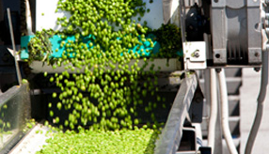
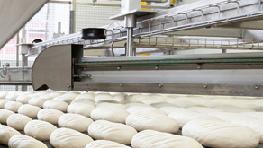
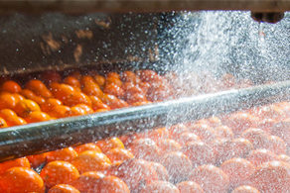
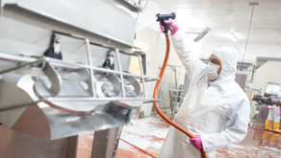

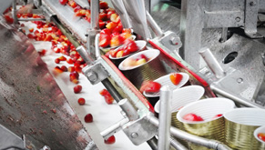
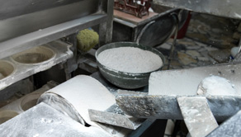
Installation solutions for Food & Beverage
Continuous operations – where it all comes together
Corrosion
Dust and liquidtight
Ingress protection
Chemical resistance
x
Extreme temperatures
Anti-microbial
Explosionproof
x

Slide 7






Your challenges to be solved
The impact of dust, water and moisture ingress
Liquid exposure
Dust exposure
High pressure hose down
Water and other liquid exposure due to high pressure hose down, condensation, accidental spills or machine oils and lubricants
By intentional or accidental contamination in the food or beverage processes.
Presence of combustible dust e.g. in grain elevators, flour and feed mills, spice-grinding, sugar and cocoa plants
Pressure impact on materials
Temperature impact on materials
Short out
High-pressure hose down cleaning up with pressure up to 3,500 psi
High-pressure hose down cleaning with temperatures up to 160° F.
Liquid ingress can deteriorate or short out an electrical system immediately or over time

Slide 8
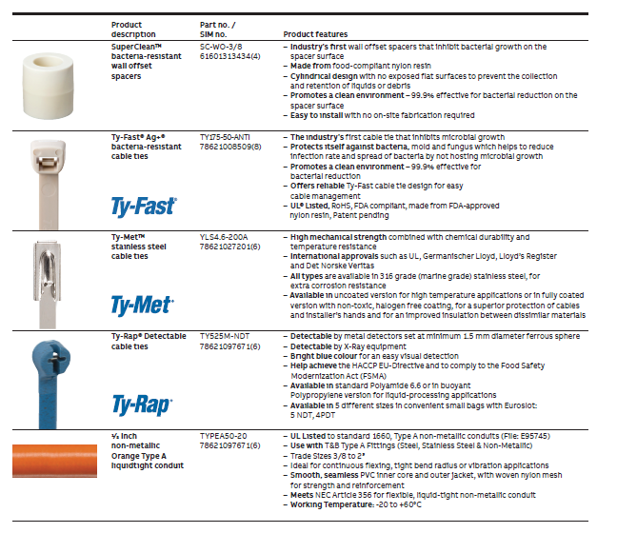
Innovative technologies for daily practice
Hygiene and stringent health and safety standards are a core part of achieving the required efficiency and security levels throughout the F&B supply chain. ABB Installation Products offer you the latest technologies and state-of-the-art materials conform the worldwide certifications and standards to keep your plant running: now and in the future.

Slide 9
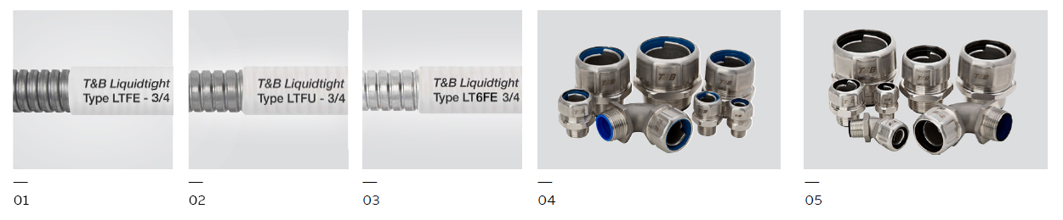

Flexible metallic conduits
Strength and flexibility for motion, vibration and bending
—
01 LTFE - Food & beverage, CE certified
—
02 LTFU - Food & beverage, UL listed
—
03 LT6FE - Food & beverage 316L stainless steel, CE certified
—
04 Series 5300 9300SST6 Stainless steel
—
05 Series 5300 9300SST6HT High temperature
The next generation in liquidtight conduits.
Dust and liquidtight. Stainless steel 316 liquidtight and system solutions for the most demanding corrosive environments, where extreme temperatures are encountered.

Slide 10
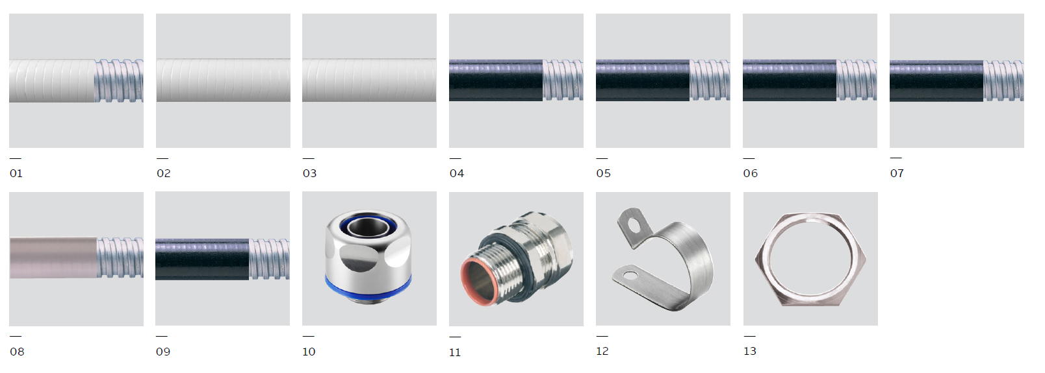

Flexible Liquidtight metallic conduits
ABB flexible conduits boost food safety and fight corrosion, which is the number one cause of downtime
—
01 Type SSAMHL Antimicrobial stainless steel core conduit
—
02 Type SAMHURL Antimicrobial UL
recognized conduit
—
03 Type SAMHL Antimicrobial CE conduit
—
04 SSPLHC High and low temperature 316 stainless steel conduit
—
05 SSPL 316 Stainless steel core conduit
—
06 SPLHC High and low temperature conduit
—
07 LFH-SPL Low fire hazard and halogen free conduit
—
08 SPUL UL compliant conduits
—
09 SPL Oil resistant conduit
—
10 Type SAM one piece fitting
—
11 Type SSPL 316 Stainless steel fitting
—
12 F&B P-Clip Stainless steel - for liquidtight conduit
—
13 F&B Locknut
Designed to protect complex equipment with sensitive electrical wiring.
Food Safety. Bacteria-eliminating protection reduces the level of microbes on the surface of Adaptaflex® conduit by up to 80% in the first 15 minutes and by 99% in just two hours.
Corrosion resistance. Stainless steel and chemical resistant materials inhibit corrosion.
High Motion. Nylon flexible conduits move with your machines, with a uniquely cleanable surface.

Slide 11
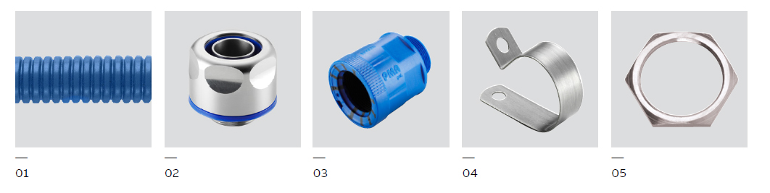

Flexible conduit systems – non metallic
Flexibility and cleanability for the food and beverage industry
—
01 JFBD nylon conduit
—
02 JENQ-316L Stainless steel fitting
—
03 Type JKNH Nylon fitting - PMA®
—
04 JSGB P-Clip stainless steel - for JFBD conduit
—
05 GME Stainless steel lock nut
Global technology leader in cable protection systems.
Corrosion resistant. Stainless steel and chemical resistant materials inhibit corrosion.
Dust and liquidtight. Exposure to dust, water, condensation and accidental spills of machine oils and lubricants.
Ingress protection. IP 69 rating for wash downs.
Chemical resistance. High resistance to chemicals and cleaning agents.
High strength. For dynamic or static applications in the food & beverage industry.

Slide 12
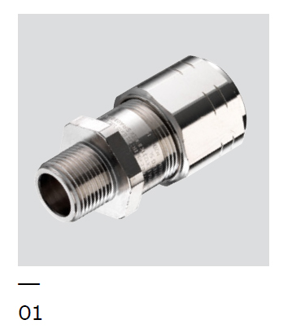

Explosion protective conduit systems, cable glands and accessories
For use in hazardous areas or where hazardous manufacturing processes are performed
—
01 HA-G1 Barrier fitting
Liquidtight hazardous area flameproof conduit fitting
Corrosion protection. Stainless steel and chemical resistant materials inhibit corrosion.
Dust and liquidtight. For high hygienic requirements.
Chemical resistance. High resistance to chemicals and cleaning agents.
Extreme temperatures. For more demanding applications there is a wide temperature range.
Explosion proof. Group I flameproof glands, ideal for all hazardous area applications.

Slide 13
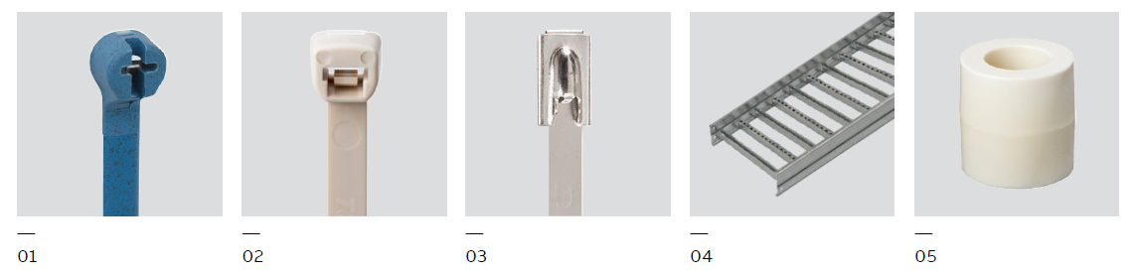
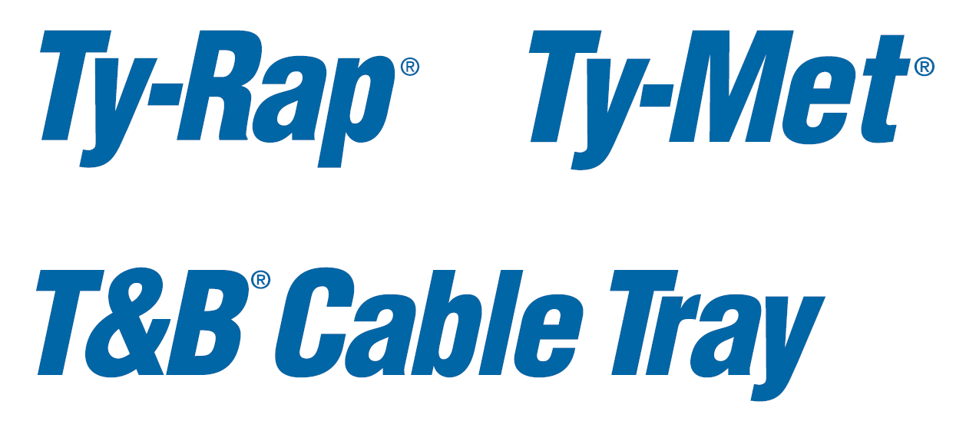
Wire and cable management
Innovative design and engineered materials for safety and continuity
—
01 Ty-Rap® Detectable cable ties
—
02 Ty-Fast® Ag+® bacteria-resistant cable ties
—
03 Ty-Met™ stainless steel cable ties and tools
—
04 ABB Cable tray
—
05 SuperClean™ bacteria resistant wall offset spacers
Easily bundle, secure and manage your cables
Bacteria-resistant. ABB nylon wall offsets are infused with microbe-fighting silver ions that help keep their surfaces clean between washdowns.
Safety and contamination. Industry’s first cable ties to inhibit microbial growth, which helps to reduce infection rates and the spread of bacteria by not hosting microbial growth.
Secure and easy. ABB Cable tray® provide secure support with minimal onsite modification and can be used in non-washdown areas.

Slide 14
ABB’s no-cost confidential plant assessment
The ABB Plant Electrical System Assessment (PESA) is a no-cost, confidential service that helps food and beverage processors find and address existing and potential electrical issues. After assessing your facility’s electrical system concerns, ABB provides a customized proposal of solutions that can help your plant.
1
2
Consultation and plant walkthrough
After consulting with your team about plant electrical challenges, ABB Electrical System Assessors will evaluate your facility’s electrical system assets. Plant walkthroughs average 2-4 hours per 500,000 sq. ft. The objective is to identify existing and potential threats to your plant’s uptime and profitability.
Findings and recommendations
Next, ABB prepares a Final Value Proposition (FVP) document that focuses on key application areas and challenges, including food safety and facility sustainability. The FVP matches your plant’s challenges with proven ABB food and beverage solutions – your company is under no obligation to implement the recommendations.

Slide 15
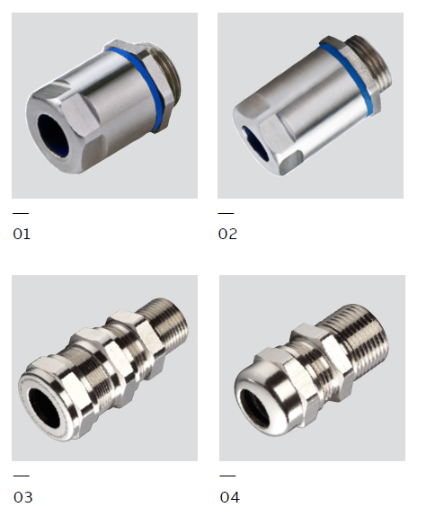
Fittings and cable glands
Fittings, cable glands and accessories for use in hazardous areas
—
01 Cable glands –
FSCG Series
—
02 Cable glands –
FSEM Series
—
03 Explosion proof cable glands – C1 Series
—
04 Explosion proof cable glands – C2 Series
High performance solutions for safety critical areas
Corrosion resistance. Stainless steel and chemical resistant materials inhibit corrosion.
Dust and liquidtight. Exposure to dust, water, condensation and accidental spills of machine oils and lubricants.
Chemical resistance. High resistance to chemicals and cleaning agents.
Extreme temperatures. For more demanding applications there is a wide temperature range.
Explosion protection. Group I flameproof glands, ideal for all hazardous area applications.

Slide 16
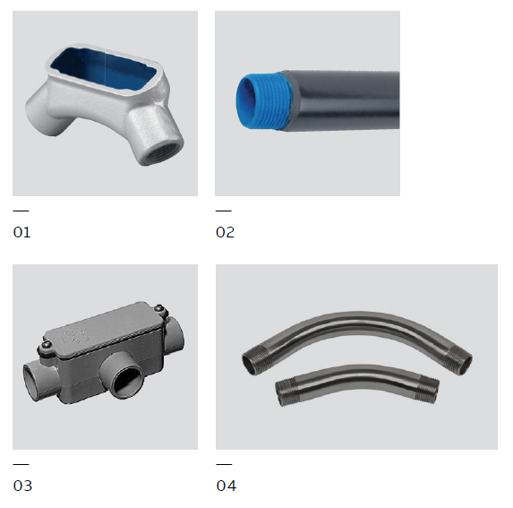

Rigid conduit systems
Rugged systems for tough conditions
—
01 T&B® Fittings sand cast aluminum form 7 conduit bodies
—
02 Ocal® Corrosion-resistant conduit systems
—
03 Carlon® PVC elbows & fittings
—
04 TNB® Fittings –
Stainless steel rigid UL certified conduits and fittings
ABB has conduit and accessories for a complete corrosion protection package
Corrosion resistance. Stainless steel and Ocal® PVC-coated conduit protects wiring from harsh environments and extends useful life.
Heavy Use. Rugged metallic conduits protect against strikes, dings and heavy loads.

Slide 17







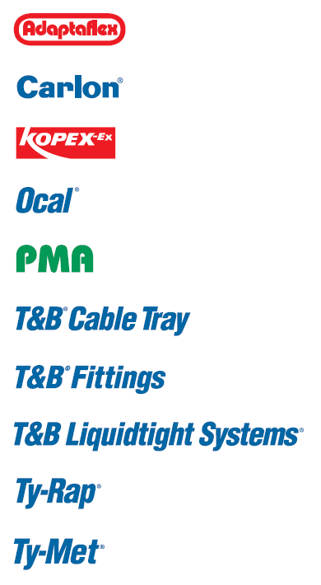
Product selection guide
Food & beverage industry
Product description | Corrosion resistance | Dust and liquid tight | Ingress protection IP 69 | Chemical resistance | Extreme temperatures | Anti-microbial | Explosion proof
ABB
Cable glands – FSCG series | • |  | • | •
Cable glands – FSEM series | • |  | • | •
Adaptaflex
Type SSAMHL Antimicrobial stainless steel core conduit | • | • | • | • | • | •
Type SAMHURL Antimicrobial UL recognized conduit | • | • | • | • | • | •
Type SAMHL Antimicrobial CE conduit | • | • | • | • | • | •
SSPLHC High and low temperature 316 stainless steel conduit | • | • | • | • | •
SSPL 316 stainless steel core conduit | • | • | • | • | •
SPLHC High and low temperature conduit |  | • | • |  | •
LFH-SPL Low fire hazard and halogen free conduit |  | • | •
SPUL UL compliant conduits |  | • | • | •
SPL Oil resistant conduit |  | • | • | •
Type SAM one piece fitting | • | • | • | • | • | •
Type SSPL 316 stainless steel fitting | • | • | • | • | •
F&B P-Clip stainless steel for Liquidtight conduit | • |  |  | • | •
F&B Locknut | • |  |  | • | • | •
Carlon®
Carlon® PVC elbows and fittings | •
Kopex-Ex™
HA-G1 barrier fitting | • | • |  | • | • |  | •
EXN… C1 + EXS… C1 | • | • | • | • | • |  | •
EXN… C2 + EXS… C2 | • | • | • | • | • |  | •

Slide 18
Product selection guide
Food & beverage industry
Product description | Corrosion resistance | Dust and liquid tight | Ingress protection IP 69 | Chemical resistance | Extreme temperatures | Anti-microbial | Explosion proof
Ocal®
Ocal® corrosion-resistant conduit systems | •
PMA®
JFBD Nylon conduit | • |  | • | •
JENQ 316L stainless steel fitting | • | • | • | • | •
Type JKNH Nylon fitting | • | • | • | •
JSGB P-Clip stainless steel for JFBD conduit |  |  |  | • | •
GME stainless steel locknut |  |  |  | • | •
Superclean™
Bacteria-resistant wall offset spacers |  |  |  |  |  | •
T&B® Cable tray
Summary for all types | •
T&B® Fittings
T&B® Fittings sand cast aluminum form 7 conduit bodies | •
T&B® Liquidtight Systems®
LTFE – Food & beverage, CE Certified | • | •
LTFU – Food & beverage, UL listed | • | •
LT6FE – Food & beverage 316L stainless steel, CE certified | • | •
Series 5300 9300SST6 stainless steel | • | •
Series 5300 9300SST6HT high temperature | • |  |  |  | •
Ty-Rap®
Ty-Rap® detectable cable ties |  |  |  |  | •
Ty-Fast® Ag+® Bacteria-resistant cable ties | • |  |  | • | • | •
Ty-Met®
Ty-Met® stainless steel cable ties and tools | •

