Slide 1
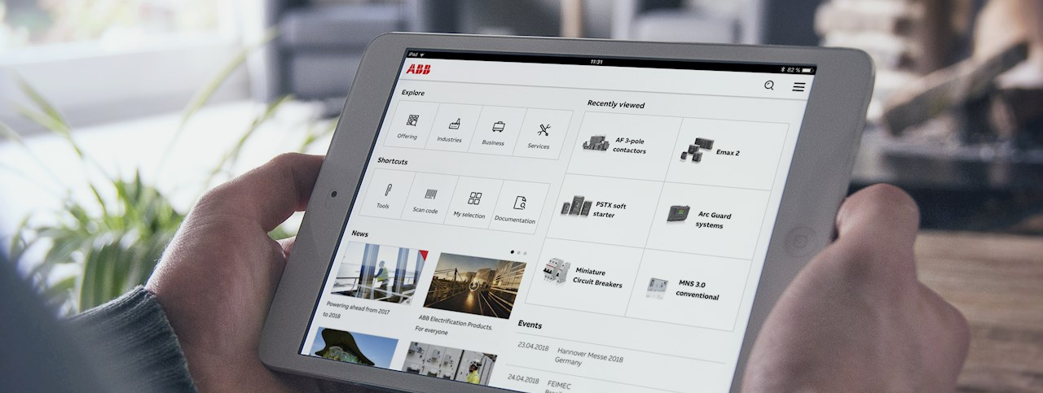
ABB Connect
INTERNAL
May 2020
New Functionality

Slide 2
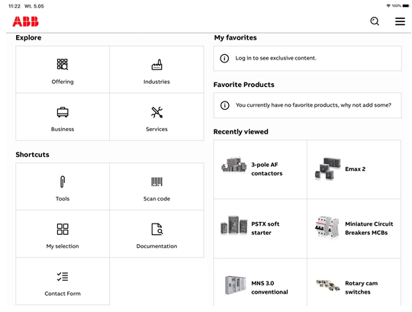
“Fast Track” contact form to sales
Enabling a faster route to sales support
What’s new?
A tile has been introduced to fast track contact requests to sales via a dashboard shortcut.
Users are now able to easily access the form, provide their contact information and be contacted by an ABB representative.

Slide 3
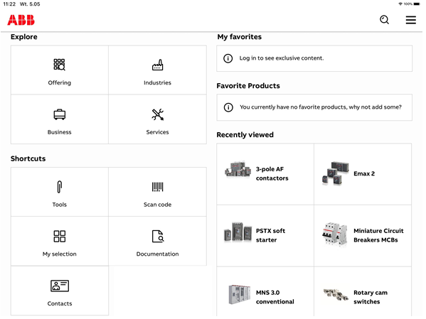
Clearer contact information
Enabling a faster route to general customer support
What’s new?
In a similar way to the Fast Track, users now have an easier way to access the broader ABB support contacts for non sales enquiries.
Users simply select the new ‘Contacts’ shortcut from the dashboard

Slide 4
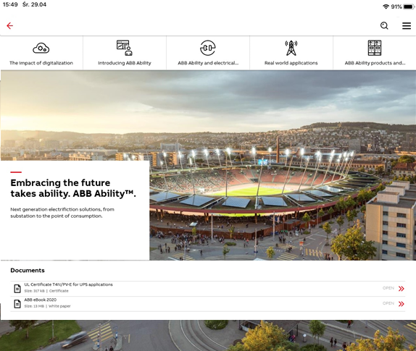
ABB Ability Business Section documentation
Faster access to relevant documentation
What’s new?
Easily find and download the documents relevant to Our Business & ABB Ability through the Document widget added to each section

Slide 5
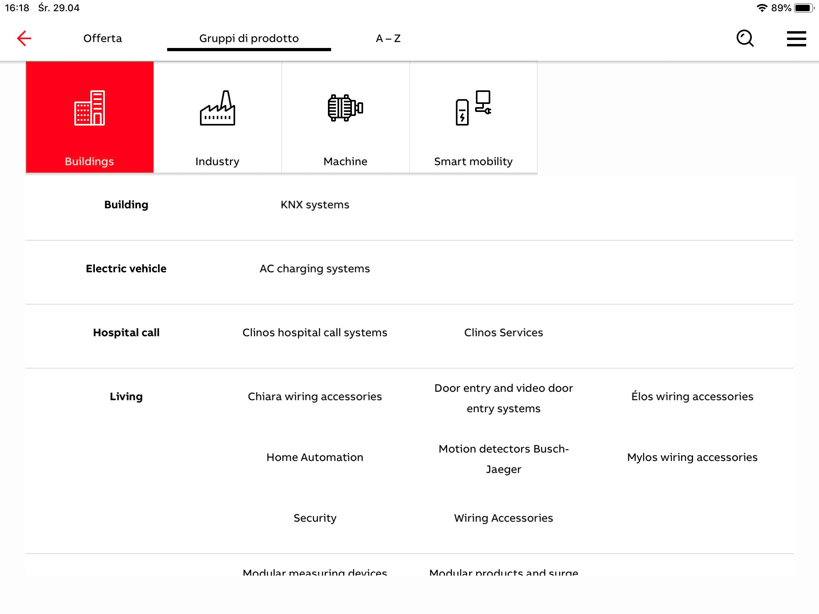
Bird’s Eye View
View the Italian portfolio in a simple and ordered way
What’s new?
A new way to get an overview of the portfolio via the ‘Bird’s Eye View’ has been introduced for the Italian portfolio
Testing and user feedback is being gathered in this pilot phase.

Slide 6
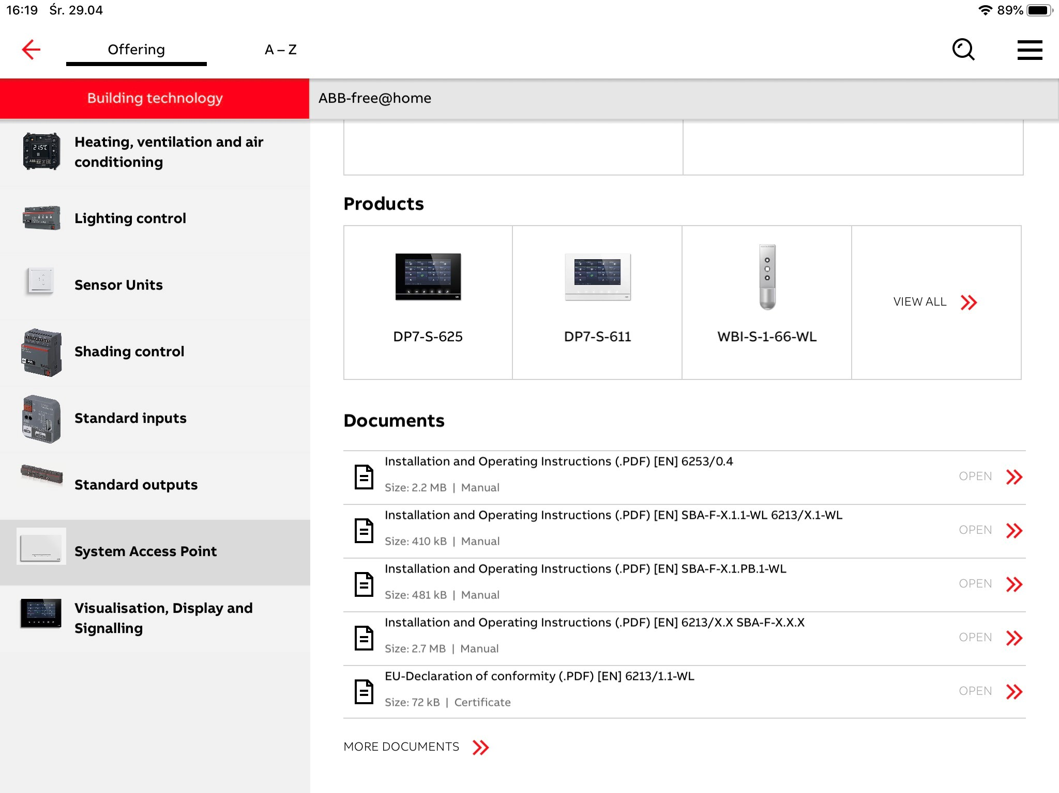
Document enhancements
Get into the details from a single glance
What’s new?
From the overview you can now see a range of additional information before you decide to download, from filesize to document type, in all places documents are displayed.

Slide 7
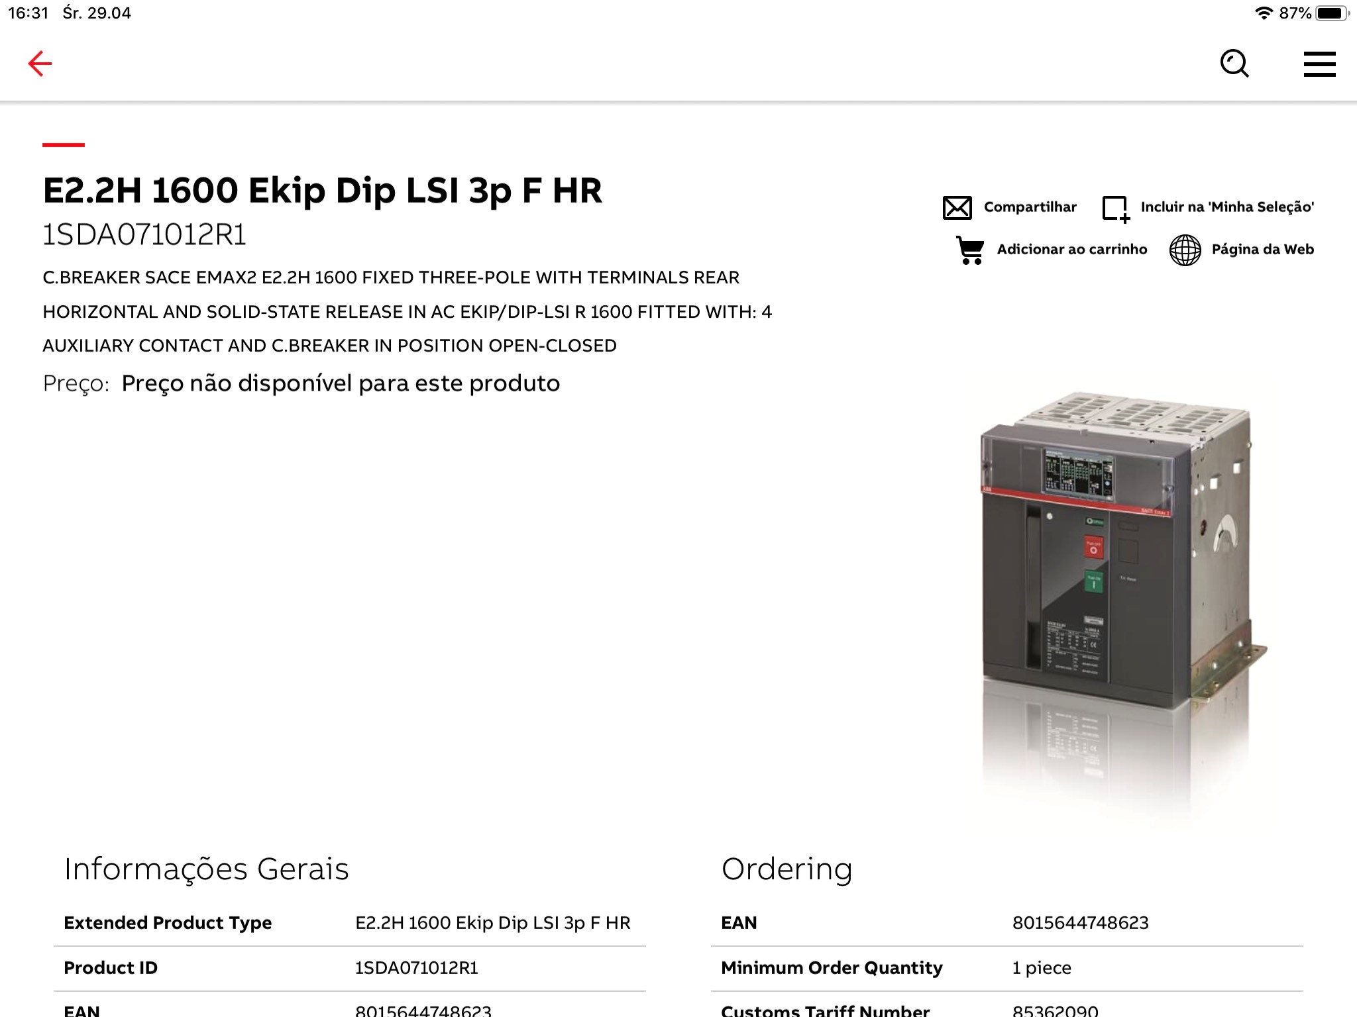
Connecting the ABB Ecosystem
‘Add to cart’ connects the Brazil POC
What’s new?
Products included in the Brazilian marketplace POC now include direct links to loja.br.abb.com marketplace.
Tapping the link will redirect you to the specific page to complete the transaction.

Slide 8
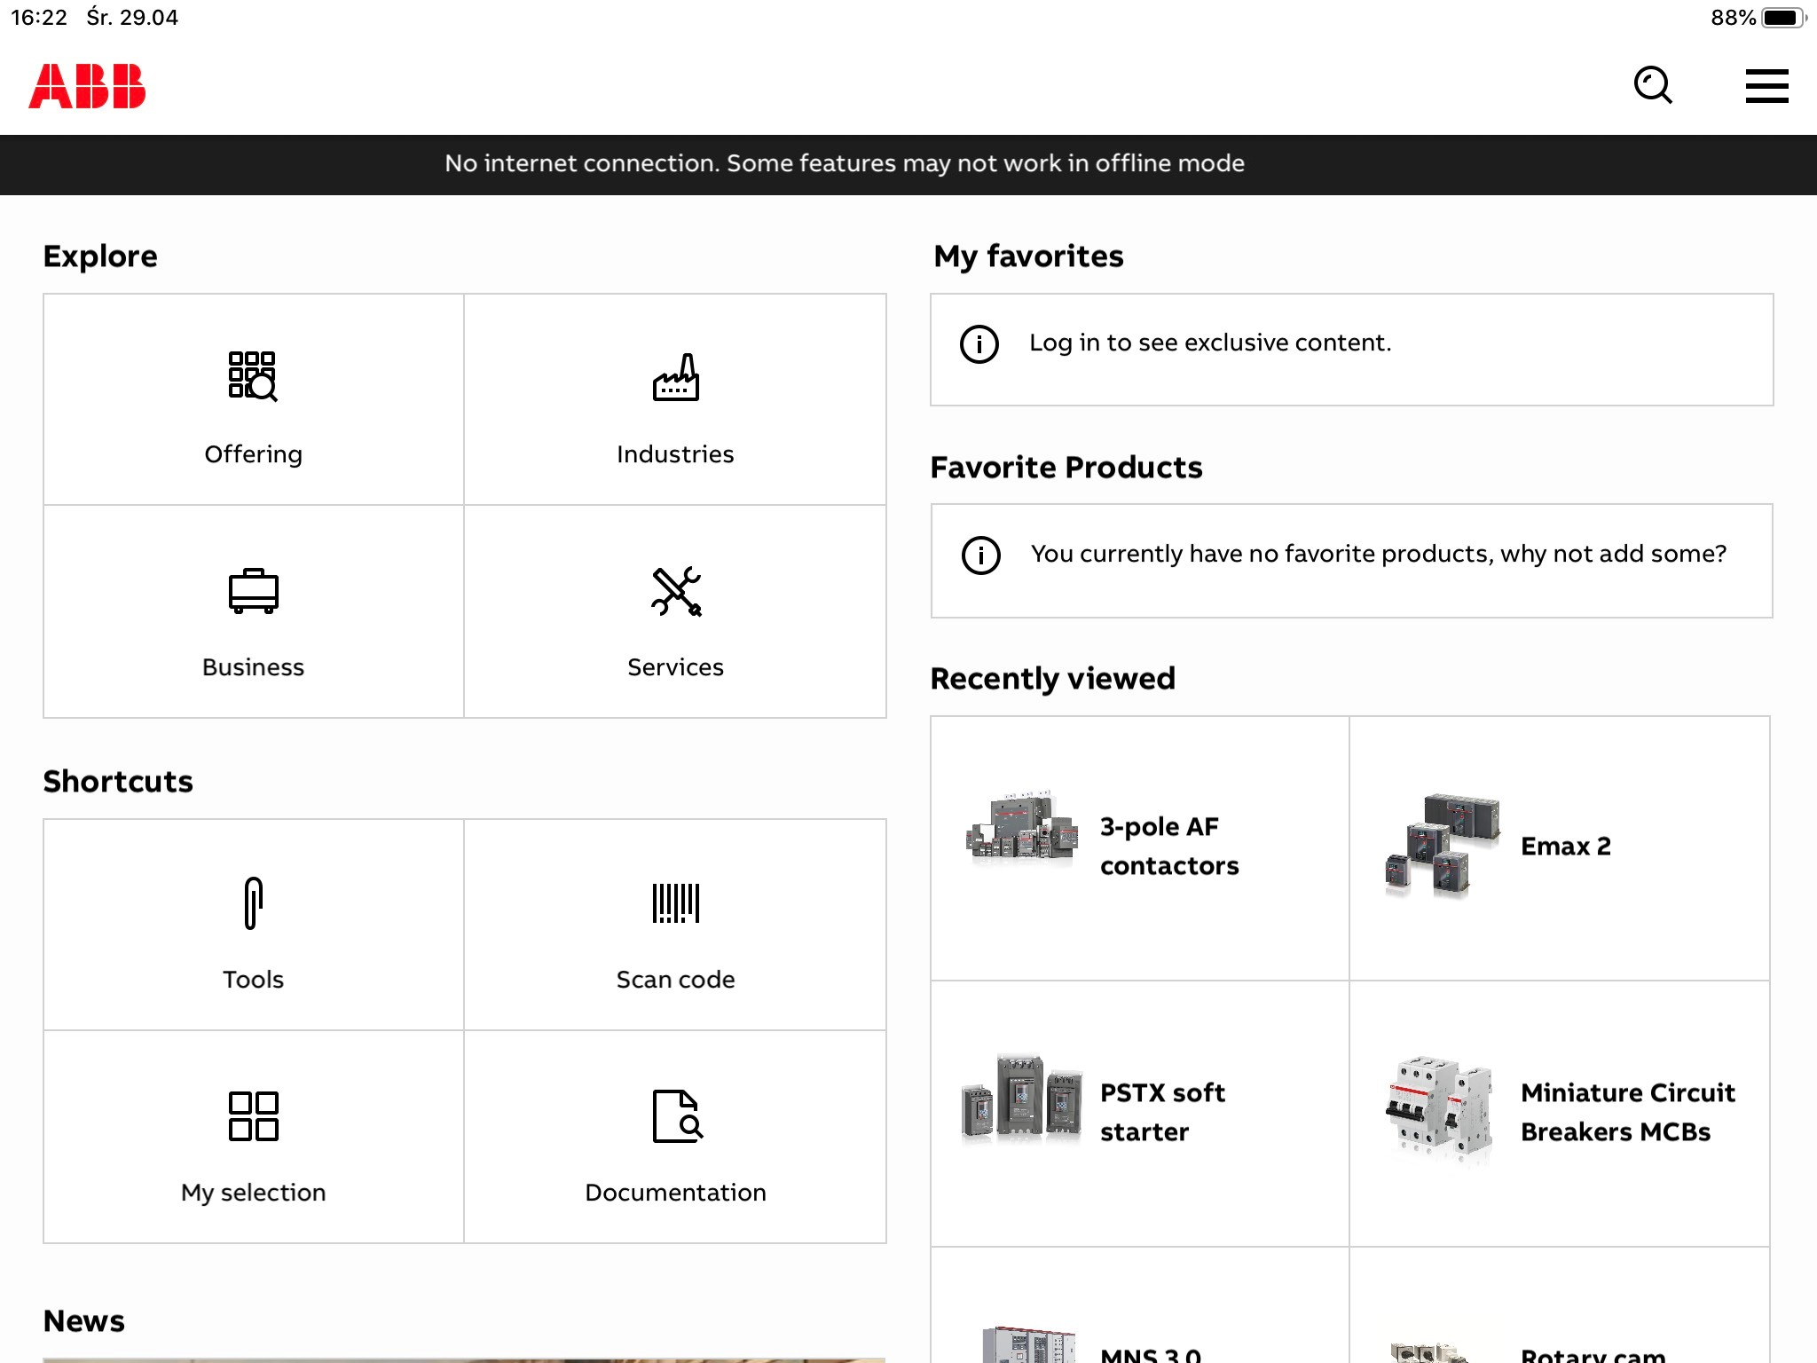
Offline Notifications
Improving user experience with visual feedback
What’s new?
Being online enables users to get the full experience of ABB Connect. Being offline restricts some of the functionality, so the notification was introduced to avoid confusing users and to give clear connection feedback.
When the user goes back online, the notification is automatically removed.

