Slide 1
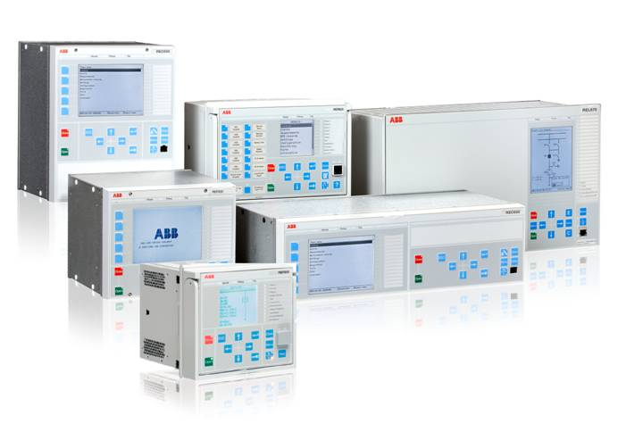
This webinar brought to you by the Relion® product family
Advanced protection and control IEDs from ABB
Relion. Thinking beyond the box.
Designed to seamlessly consolidate functions, Relion relays are smarter, more flexible and more adaptable. Easy to integrate and with an extensive function library, the Relion family of protection and control delivers advanced functionality and improved performance.

Slide 2
ABB Protective Relay School Webinar Series
Disclaimer
ABB is pleased to provide you with technical information regarding protective relays. The material included is not intended to be a complete presentation of all potential problems and solutions related to this topic. The content is generic and may not be applicable for circumstances or equipment at any specific facility. By participating in ABB's web-based Protective Relay School, you agree that ABB is providing this information to you on an informational basis only and makes no warranties, representations or guarantees as to the efficacy or commercial utility of the information for any specific application or purpose, and ABB is not responsible for any action taken in reliance on the information contained herein. ABB consultants and service representatives are available to study specific operations and make recommendations on improving safety, efficiency and profitability. Contact an ABB sales representative for further information.

Slide 3

Realizing the digital substation: Introduction to the process bus (IEC 61850-9-2)
ABB Protective Relay School Webinar Series
Alejandro Schnakofsky
August 12, 2014

Slide 4
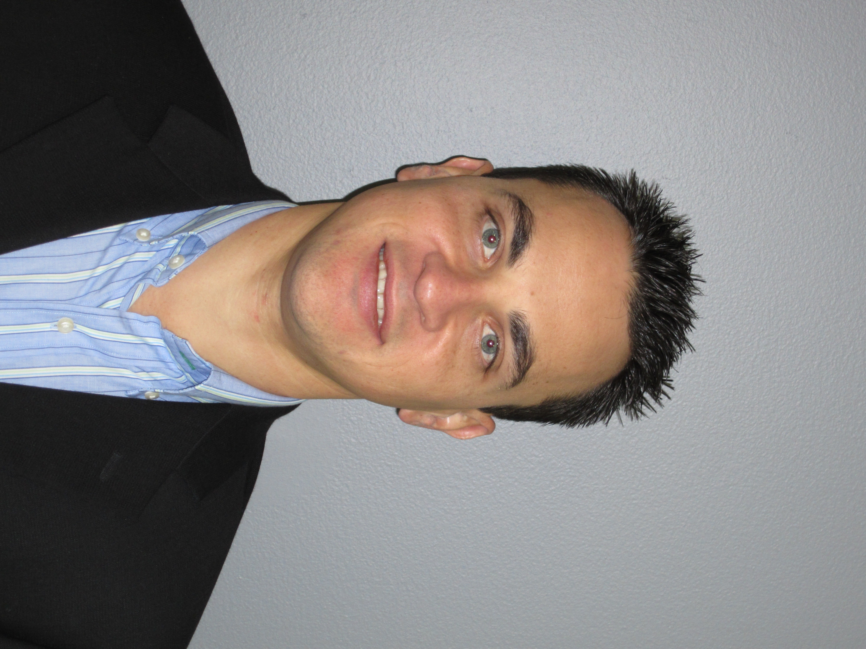
Presenter
Alejandro Schnakofsky graduated from Florida International University in Miami, FL with a BS in Electrical Engineering. During his studies he conducted research in the field of digital relays and centralization of protection functions within the substation (multi object protection systems).
In 2002 Alejandro joined Bussiere Communications were he engineered, deployed and tested Ethernet networks.
In 2005 he joined ABB Inc. were he has contributed in a variety of roles from Application Engineering to Management.
Alejandro is now global lead product manager for ABB’s bay level products business.
Alejandro
Schnakofsky

Slide 5
Learning objectives
Brief introduction to IEC 61850
IEC 61850 Process Bus
UCA Implementation Guidelines
System Architecture
Project example

Slide 6
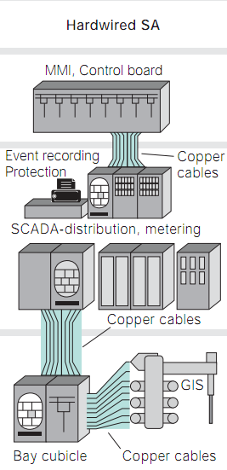
SA System Architecture - RTU / Hardwired
IEDs do not have communication capability
Status monitoring and control via RTU hardwired connections
Significant amount of connections / documentation

Slide 7
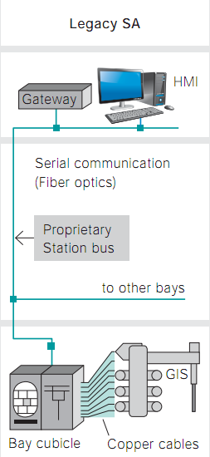
SA System Architecture - DNP / Modbus
Integration of status monitoring into IEDs
Reduction/elimination of RTU cabinet
Defined protocol stack
Non standard modeling of substation equipment and functions
Non standard data format
Integration requires intimate knowledge of each device
Protocol conversion may be necessary

Slide 8
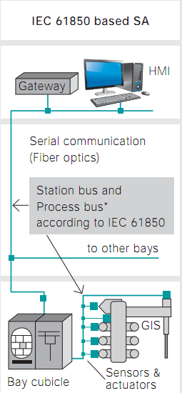
IEC 61850 SA system
Integration of status monitoring, protection, automation, and control into IEDs
Digitization of copper wires
  61850-8-1
  61850-9-2
Modeling of the substation, equipment and functions
Protocol stack
Interoperability by standardization and verification

Slide 9
IEC 61850 - Goal of the Standard
Interoperability
  Exchange information between IED’s (Intelligent Electronic Device) from several manufacturers
  IEDs use this information for their own function
Free Configuration
  Free allocation of functions to devices
  Support any philosophy of customer – centralized or decentralized systems
Long Term Stability
  Future proof
  Follow progress in mainstream communication technology
  Follow evolving system requirements needed by customers

Slide 10
Introduction to process bus
The process bus is i.e. a communication network at the process level
It is responsible for publishing the quantities related to the process; i.e.
  Voltage
  Current
IEC 61850 9-2 Defines the mapping of “Sampled Values” over Ethernet
“Sampled Values” are current and voltage samples obtained from CTs and VTs
IEC61850 9-2 define the communication protocol over Ethernet that enables the publication of such samples for the purposes of protection, monitoring, and metering

Slide 11
Introduction to process bus
IED
Conventional
21
87
…
IEC61850
Process Bus
MU
IED
Multiple devices can subscribe to the broadcasted current and voltage signals
21
Ethernet Switch
87
MU
…

Slide 12
Introduction to process bus
What is a merging unit
IEC 61850-9-2
Communication interface according to IEC 61850-9-2
Sync
Merging Unit
Merging and timely correlation current and voltage values from the three phases
Sampling or re-sampling of current and voltage values
Technology specific interface between NCIT/CIT and MU
IT
IT
IT
Time synchronization
  Synchronize IEDs or other MUs when acting as time master, if required
  Receive time synchronization when acting as time slave, if required
Phase 1
Phase 2
Phase 3

Slide 13


Introduction to process bus
Station level
IEC 61850 station bus
Bay level
IEC 61850
process bus
Process level
MU
MU
MU
BIED
BIED
SAMU
IT
IT
IT
Conventional connections to CT/VT and drives
Process bus to merging units for current and voltage sensors – conventional and non-conventional ITs
Process bus to merging units for current, voltage and binary signals

Slide 14
Introduction to process bus
The process bus is a communication network on process level, and also connecting the process to the bay level
IEC 61850-9-2 describes the transmission of sampled analogue values over Ethernet
IEC 61850 also allows transmission of binary data on process level (GOOSE, MMS)
Bay level
IEC 61850-9-2
process bus
Process level
MU
MU
IT
IT

Slide 15
Introduction to process bus
What is process bus for sampled analogue values
Sampled analogue values are transferred as multicast messages and can be received by all IEDs on the same network
The receiving IEDs decide whether to process the data or not
The transmission time of the messages on the network is not deterministic
  A time reference is required to align samples from different sources
Bay level
IEC 61850-9-2
process bus
Process level
MU
MU
IT
IT

Slide 16
Introduction to process bus
IEC 61850 9-2 allows protection relays to operate based on digitized current and voltage signals that are distributed on a communication network in the form of Ethernet frames
Voltage and current signals from different CTs and VTs are “published” on the network and available to all devices that are connected to it
Galvanic CT and VT inputs to the relays are no longer necessary
  Safety
  Wire reduction
CT and VT signals are processed by the Merging Unit (MU), an intelligent device that samples the current and voltage signals, creates their digital IEC 61850 9-2 form, and publishes them on the network
Allows integration of non-conventional Instrument Transformers (IT) for improved performance
  e.g. Can use Rogowski technology for current sensing – output is not at 1A or 5A - to avoid traditional CT saturation issues for protection

Slide 17


Introduction to process bus
IEC 61850-9-2 standard and implementation guideline
The standard: IEC 61850-9-2
  Communication networks and systems in substations Part 9-2: Specific Communication Service Mapping (SCSM) - Sampled values over ISO/IEC 8802-3
    The standard leaves wide room for implementation and considerable effort is required for full implementation
Implementation Guideline for Digital Interface to Instrument Transformers using IEC 61850-9-2
    To facilitate implementation, the UCA International Users Group created an implementation guideline that defines a subset of IEC 61850-9-2.
        Commonly referred to as IEC 61850-9-2LE for “light edition”

Slide 18
Introduction to process bus
Difference between IEC standard and implementation guideline
Area | Standard IEC 61850 | Implementation guideline (IEC 61850-9-2LE)
Sampling rate of analog values | Free parameter | 80 samples per period for protection and metering 256 samples per period for power quality
Content of dataset | Configurable | 3 phases current + neutral current 3 phases voltage + neutral voltage
Time synchronization | Not defined | Optical pulse per second (1PPS)
Logical device “Merging Unit” | Content and naming is not specified | Specified with rules for logical device name and contained logical nodes
Notes:
18

Slide 19
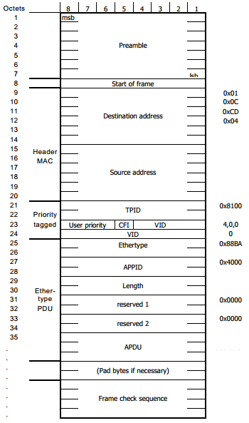
61850 9-2 Ethernet Frame
Destination: multicast mac address
Source: source mac address
Vlan info (Priority tagged)
Ethertype: 0x88BA
Ethertype APPID: 0x4000
Sampled Values Protocol Data Unit (APDU)

Slide 20
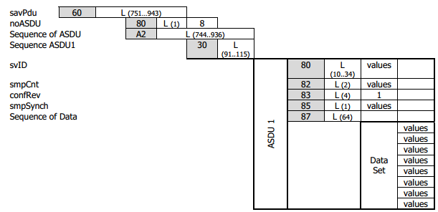
61850 9-2 Ethernet Frame
ASDU: Application Service Data Unit
svID: Sampled Values ID
Each Ethernet frame contains 1 sampled of Va, Vb, Vc, Vn, Ia, Ib,Ic,In
For protection applications the transmission rate is 80 frames per cycle (4800 per second)

Slide 21
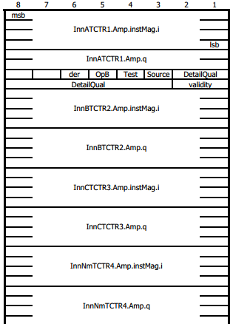
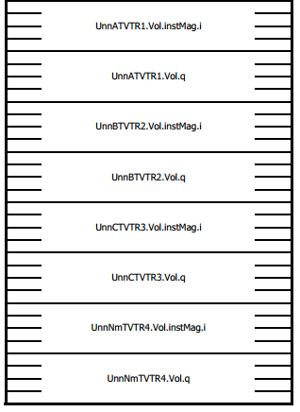
61850 9-2 Ethernet Frame

Slide 22
Introduction to process bus
Time Synchronization
Time synchronization is needed for IEDs to properly align the current and voltage samples
Pulse Per Second (PPS) is the defined source of time synchronization in the current implementation guidelines published by UCA
The source must have an accuracy of +-1 micro second
IEDs are given a small period of time to ride through any transient loss of time synch. This is based on the magnitude of the drift the IED’s clock has

Slide 23

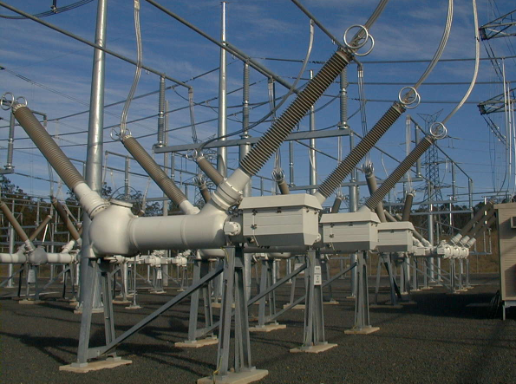
61850 9-2 Sample Project
Powerlink Queensland’s 275kV substation is located next to Brisbane in Australia
The substation is supplying parts of Brisbane and the tourist region Gold Coast with electrical energy
With the Loganlea secondary system upgrade ABB undertook its first commercial NCIT installation with
IEC 61850-9-2LE process bus and protection and control IEDs
The station has been completed and handed over to the customer in December 2011
IEC 61850-9-2LE stands for “Implementation Guideline for digital Interface to instrument transformers using IEC 61850-9-2”. Defined by UCA International Users Group.

Slide 24



ABB’s solution
Process bus overview
REC670
Control
REC670
Control
The picture shows simplified one of two fully redundant protection systems
RED670
Main X
CP
CP
RET670
Main X
REB500
BFP
A10-T1
A30-T2
REB500
BFP
CP
A30-T1
CP
A10-T2
CP
A40-T1
A20-T2
CP
REC670
Control
REC670
Control
A40-T2
A20-T1
RET670
Main X
CP
CP
REL670
Main X
REB500
BFP
REB500
BFP

Slide 25
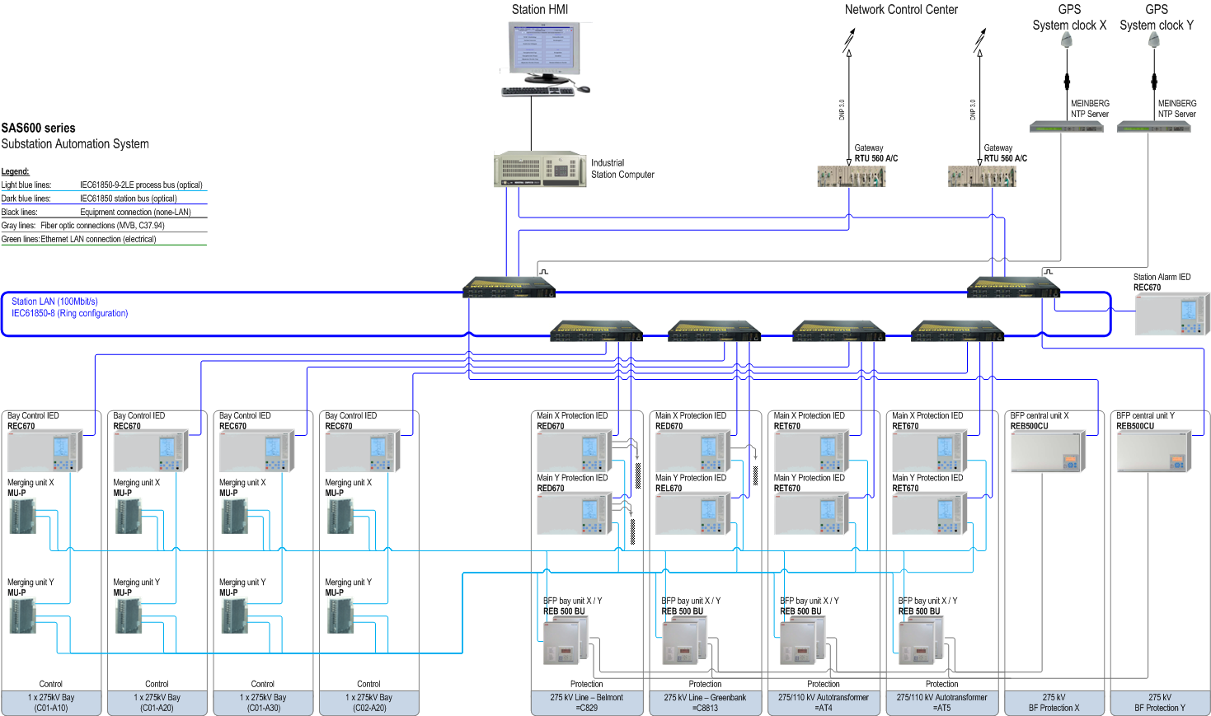
ABB’s solution
IEC 61850 compliant SA system
Station bus
Process
bus

Slide 26
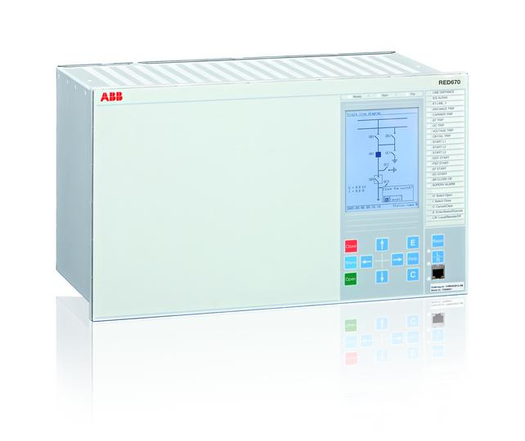

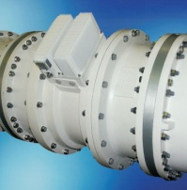
ABB’s solution
670 series protection and control IEDs
670 series high-end protection and control IEDs with IEC 61850-9-2LE:
  Bay control IED REC670
  Line distance protection REL670
  Line differential RED670
  Transformer protection RET670
All IEDs can have a 1PPS input for synchronized sampling
All devices support mixed mode with conventional CT and VT interfaces
eg, transformer low-voltage side for transformer differential protection
Line differential protection runs with conventional and 9-2 remote-end substations
IEC 61850-9-2LE

Slide 27
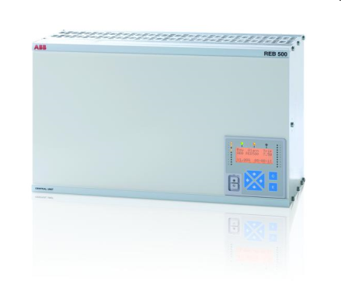

ABB’s solution
REB500 busbar and breaker failure protection system
REB500 decentralized busbar protection system is fully compliant with IEC 61850-9-2LE
  Busbar protection
  Breaker failure protection
  End-fault protection
Seamless combination of bay units with IEC 61850-9-2LE
and conventional bay units in one system
  This allows flexible extension of conventional substations
IEC 61850-9-2LE

Slide 28
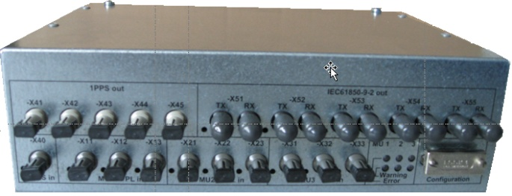
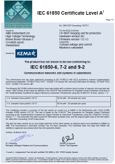
ABB’s solution
CP-MUP merging unit for protection and control
The world’s first UCA-certified merging unit
IEC 61850-9-2LE-compliant
Interfaces with ELK-CP14/
ELK-CP3 sensors of up to three three-phase measuring points
  Reducing the number of components in 1½ breaker and double busbar arrangements
Multiple Ethernet ports bring high flexibility to system design
  Reducing the need for Ethernet switches in protection circuits
The UCA International Users Group is a not-for-profit corporation focused on assisting users and vendors in the deployment of standards for real-time applications for several industries with related requirements.

Slide 29
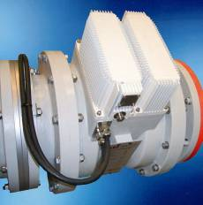

ABB’s solution
ELK-CP sensors for metal-clad switchgear
ELK-CP14
Nominal values:
100 … 4000A
175 … 300 kV/√3
The already installed sensors are early versions of today's
ELK-CP sensor. That are…
Fully redundant, combined current and voltage sensor with
Rogowski coils for current and capacitive dividers for voltage
Redundant secondary converter (sensor electronics) can be replaced during operation, no calibration necessary
Configurable current ratings enable future adaptation of CT ratios without the need to replace CT cores or to open gas compartments
Covers metering, protection and control accuracy in a single device
ELK-CP3
Nominal values:
100 … 4000A
330 … 550 kV/√3

Slide 30



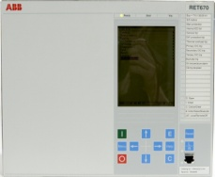
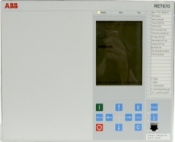


ABB’s solution
Connection from primary to secondary equipment
PPL*
IEC61850-9-2LE
Merging unit for protection CP-MUP
Merging and timely correlation of current and voltage from the sensors
Supply values at IEC 61850-9-2LE interface
Synchronization by optical pulse per second (PPS)
R
S
T
The CP-MUP consists of 4 logical merging units
  3 logical MUs to merge and timely correlate the current and voltage values from 3 times 3 phases
  1 logical MU for summation of measured currents from the other 3 logical MUs
R
S
R
T
S
5 optical Ethernet ports for IEC61850-9-2LE
T
*PPL: Point to Point link, one fiber for U and I per sensor phase
August 7, 2014
| Slide 30

Slide 31
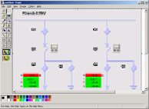

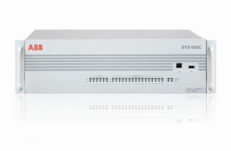
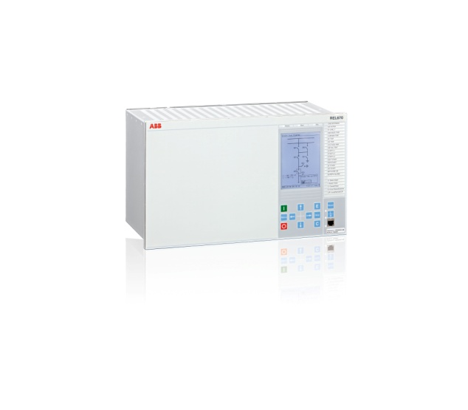


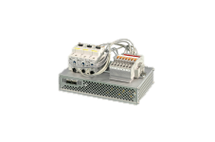
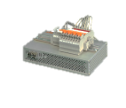
ABB’s solution
Retrofit to conventional sensors
Hybrid solution can use conventional ITs and convert to digital process bus
  Utilize IEC 61850-9-2LE with 80 samples/cycle for protection and operational metering
Supporting the digital substation architecture
Remote control
IEC 61850 station bus
IEC 61850 process bus

Slide 32
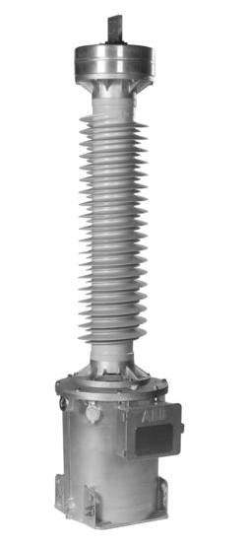
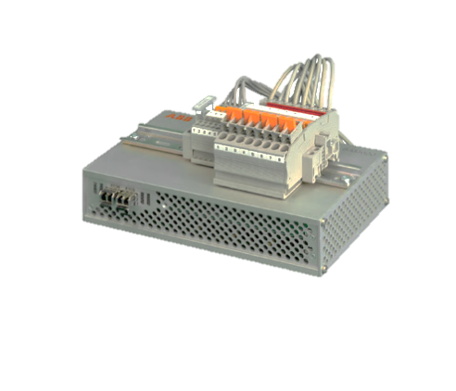
ABB’s solution
Retrofit to conventional sensors
control house
Low level signals in
the control house
Analog Signal
Digital Signal
SAM600-CT

Slide 33


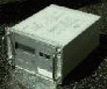

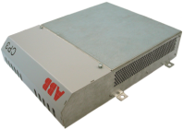
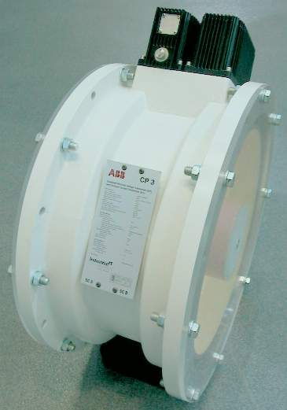
ABB’s solution
Fully redundant and independent system design
System 1
System 2
Protection
Metering
Metering
Protection and control
IEC 61850-9-2LE
IEC 61850-9-2LE
PPL
PPL
Metering is not installed at Loganlea
System 1
System 2

Slide 34
ABB’s solution
Highly available process bus without Ethernet switches
Extract of the applied concept:
Highest availability of the process bus system was achieved by
  Building two fully independent process bus and protection systems from NCIT to protection IEDs
  Minimizing number of components without using Ethernet switches
  Refraining from common devices across feeders and the redundant protection system
REC670
Control
C01-A10
1
CP-MUP
Main 1
2
RED670
PDIF
Main 1
C01-A10
1
REB500
PDIF, RBRF
Main 1
2
RED670
PDIF
Main 2
1
2
REB500
RBRF
Main 2
C01-A30
CP-MUP
Main 2
1
2
Control and redundant line and busbar/breaker failure protection

Slide 35
ABB’s solution
Protection concept – Line 1 (PDIF)
Line 1
Control A10-Q0
REC670
RSYN
CSWI
…
MU
V: A10-T2
V: A10-T1
CP
CP
Protection Line 1
RED670
PDIF
…
I: remote end
A10-T2
A10-T1
I: A10-T2
A10-Q0
CP
A30-T2
CP
I: A30-T1
A40-T1
BFP A10-Q0
REB500
RBRF
…
I: A10-T1
CP
A40-T2
A30-T1
CP
A20-T1
A20-T2
Overview of main control and protection functions and the values used
Because all IEDs receive I and U, most of them perform also other protection as well as measurement functions
CP
CP

Slide 36
ABB’s solution
Protection concept – Line 2 (PDIS)
Overview of main control and protection functions and the values used
Because all IEDs receive I and U, most of them perform also other protection as well as measurement functions
CP
CP
A10-T1
A30-T2
CP
CP
Control A20-Q0
REC670
RSYN
CSWI
…
A10-T2
A30-T1
V: A20-T1
V: A20-T2
A40-T1
A20-T2
Protection Line 2
CP
CP
MU
REL670
PDIS
…
V: A20-T1
A20-Q0
I: A20-T2
A40-T2
A20-T1
I: A40-T1
CP
CP
BFP A20-Q0
REB500
RBRF
…
I: A20-T1
Line 2

Slide 37
ABB’s solution
Protection concept – Transformer 2
Overview of main control and protection functions and the values used
Because all IEDs receive I and V, most of them perform also other protection as well as measurement functions
CP
CP
A10-T2
A10-T1
CP
A30-T2
CP
A40-T1
Control A40-Q0
Transf 2
REC670
RSYN
CSWI
…
V: A40-T1
V: A40-T2
Protection Tr. 2
MU
CP
A40-T2
A30-T1
CP
RET670
PDIF
…
I: conv.
A40-Q0
I: A10-T1
A20-T1
A20-T2
I: A40-T2
CP
CP
BFP A40-Q0
REB500
RBRF
…
I: A40-T1

Slide 38
Testing and maintenance
Impact on protection and control testing
“Wiring” test
Done automatically through self-supervision features of NCITs, MUs and IEDs
Protection and control testing
“Non-conventional” secondary injection
  Simulation of IEC 61850-9-2 LE traffic instead of secondary injection
Test modes to simulate V/I, by
  NCIT
  Merging unit
Primary injection
  Primary injection for stability and directional tests
Protection
Control
IEC 61850-9-2 LE
MU
9-2 LE
simulator
NCIT
Primary
injection

Slide 39
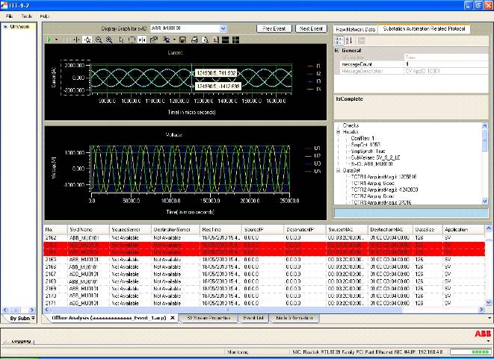
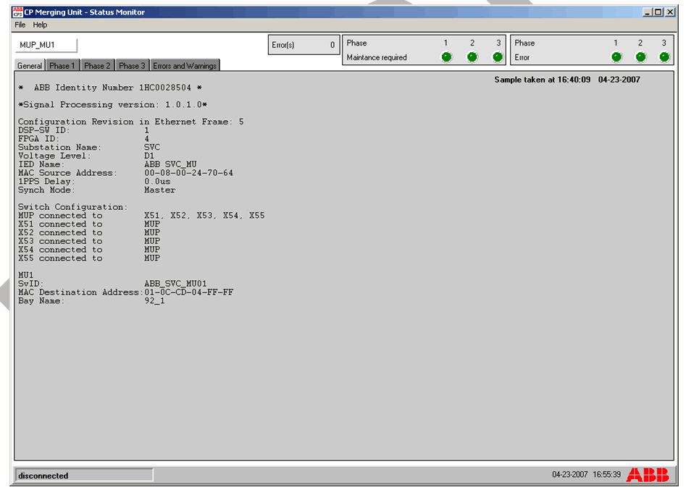
Testing and maintenance
Tool support
Software replaces multimeter
Intelligent software for the collection, display and evaluation of sampled value streams
  Oscilloscope display of V/I values
  Phasor diagram
  Quality information of all values
Built-in diagnostic functions in sensors, merging units and IEDs for supervision of:
  Device health status
  Connections
  Time synchronization
  Quality of samples and telegrams

Slide 40

Benefits against conventional technology
Process bus
Increased operational safety
  Handling of CT and VT circuits is obsolete
  Isolation from process
Reduced life cycle costs
  Permanent real-time system supervision increases system availability by increasing maintenance cycles and reducing outage times
Reduced copper cabling
  By replacing parallel copper wires with optical process bus
Future-proof interoperable design
  By applying the established IEC 61850 standard

Slide 41
This webinar brought to you by the Relion® product family
Advanced protection and control IEDs from ABB
Relion. Thinking beyond the box.
Designed to seamlessly consolidate functions, Relion relays are smarter, more flexible and more adaptable. Easy to integrate and with an extensive function library, the Relion family of protection and control delivers advanced functionality and improved performance.

Slide 42
This webinar brought to you by:
ABB Power Systems Automation and Communication
Relion Series Relays – Advanced flexible platform for protection and control
RTU 500 Series – Proven, powerful and open architecture
MicroSCADA - Advanced control and applications
Tropos – Secure, robust, high speed wireless solutions
We combine innovative, flexible and open products with engineering and project services to help our customers address their challenges.

Slide 43
Thank you for your participation
Shortly, you will receive a link to an archive of this presentation.
To view a schedule of remaining webinars in this series, or for more
information on ABB’s protection and control solutions, visit:
www.abb.com/relion

