Slide 1
PowerCare
2013 PM
Customer Support Agreement
LP Products and Systems

Slide 2
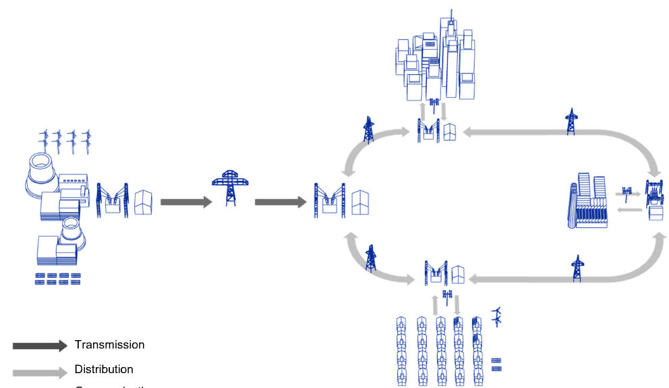
PowerCare Support contract suggestions for different needs
Power distribution utility in heavily populated areas
Industry with local power generation
Industrial power consumers
Power distribution or generation in remote places

Slide 3
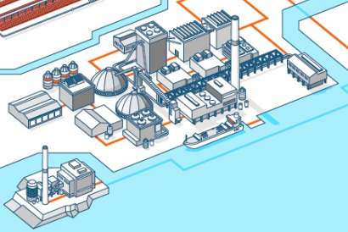
PowerCare Support contract suggestions for different needs
Customer operates process with big consequentinal damages or costs if stopped.
Customer operates distribution system with huge penalties for the off time.
Customer sees lack of skills to professionaly troubleshoot and maintein ABB equipment, irregular involvment in these activites and little confidence in actions taken
Customer misses single place with up to date documentation for his electrical equipment. Different persons in his team are keeping their own documentation sets and IED configurations backups resulting in revision conflicts and time lost in investigation
Customer operates remote facility with minimum operating personnel and no maintenance personnel present full time. So far only corrective maintenance was done after failure detection, but customer would prefer condition monitoring and condition based preventive maintenance
Customer utilizes a service provider for corrective and preventive maitenance and has job quality issues or spare parts origin issues

Slide 4
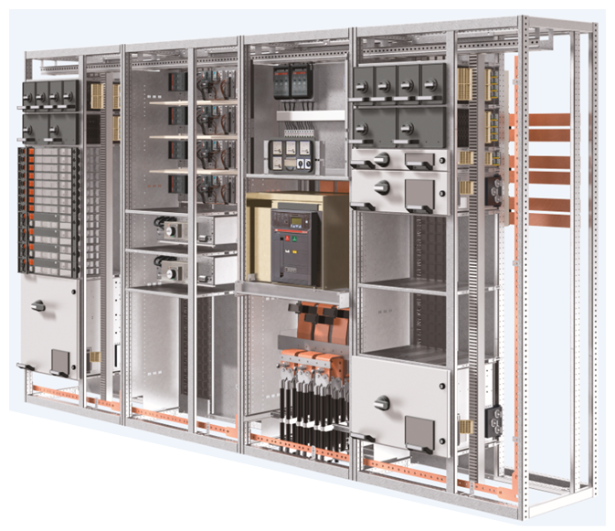
PowerCare
What is PowerCare
PowerCare, is an ABB multi divisional Service Customer Support Agreement concept in order to commonly fit customer’s needs.
PowerCare is a customer support agreement for LP products involves
Complete ABB Low Voltage systems
ABB Low Voltage Circuit Breakers
ABB Low Voltage Control Products

Slide 5
PowerCare
What is PowerCare
PowerCare Customer support Agreement consists in a matrix of five service areas targeting different customer needs:
Skilled Development Services
Emergency Maintenance Services
Diagnostic & Condition Assessment
Self-Maintenance Services
Delivered Maintenance Services
Each area has four service levels and for each area the ABB support content increases with the levels

Slide 6
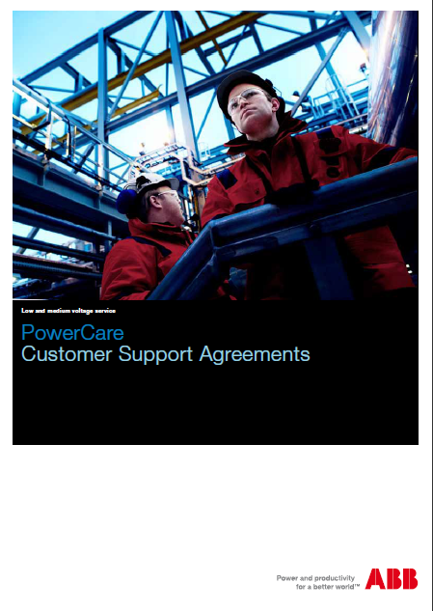
PowerCare
Matrix
Levels
Entry Level
Level .1
Level .2
Level .3
Service Areas
1. Skills Development Services
1.0 Product Training List
1.1 Product Training
1.2 Application Training
1.3 Coaching Services
2. Emergency Maintenance Services
2.0 Single Point of Contact
2.1 Technical Support with agreed response time
2.2 Call-out Support with agreed response time
2.3 Emergency Spare Parts Assessment and Purchasing
3. Diagnosis & Condition Assessment
3.0 Technical preliminary Survey
3.1 Asset and Risk Assessment
3.2 Local Asset Monitoring
3.3 Remote Asset Monitoring
4. Self-Maintenance Services
4.0Documentation of Installed Base & Cycle Status Report
4.1 Manuals and instructions On-line
4.2 On-Line Support for Self-maintenance
4.3 File Storage
5. Delivered Maintenance Services
5.0 Technical Assessment on Yearly Basis
Report
5.1 Product Engineering Services
5.2 Advanced Product Engineering Services
5.3 Full Switchgear Engineering Services
Notes:
PowerCare offering matrix consists of five service areas and four service levels, where each service area targets different customer needs and the ABB support content increases with the levels.
Skills Development Services area Covers services to develop and maintain your personnel skills. Product and Application Trainings aim to provide all participants with the necessary skills and knowledge of ABB equipment while Coaching Services help maintenance managers set up a strategy for the maintenance of personnel skills development.
Emergency Maintenance Services area provides rapid support in emergency situations. Single point of contact introduces a simplified process for call out support handling while technical support and call-out support offer agreed response time insurance. On site essential spare parts management can be included as well.
Diagnosis and Condition Assesment area covers your need to know the asset’s status and safety aspects and the required risk mitigation actions. Periodic condition surveys and assessments or installation of condition monitoring system is included in the ABB offering for this area.
Self-maintenance services area covers services that help you in self maintenance strategy implementation for specific tasks. Your maintenance teams can gain confidence on non-recurring tasks by getting access to product documentation on-line, contacting ABB experts or using the structured file storing space for the assets documents.
Delivered Maintenance Services area is intended for you if you do not have your own electrical maintenance personnel and thus outsource the electrical equipment maintenance tasks. ABB provides background engineering and on-site labor for preventive maintenance tasks and mainteins the equipment in good condition minimizing the risk of power outages and major electrical equipment failures.

Slide 7
PowerCare
1. Skill Development Services
Levels
Level .0
Level .1
Level .2
Level .3
Areas
1. Skills Development Services
1.0 Product Training List
1.1 Product Training
1.2 Application Training
1.3 Coaching Services
Skills Development Services area Covers services to develop, increase and maintain your personnel skills.
Product and Application Trainings aim to provide all participants with the necessary skills and knowledge of ABB equipment while Coaching Services help maintenance managers set up a strategy for the maintenance of personnel skills development.
2. Emergency Maintenance Services
2.0 Single Point of Contact
2.1 Technical Support with agreed response time
2.2 Call-out Support with agreed response time
2.3 Emergency Spare Parts Assessment and Purchasing
3.Diagnosis & Condition Assessment
3.0 Technical preliminary Survey
3.1 Asset and Risk Assessment
3.2 Local Asset Monitoring
3.3 Remote Asset Monitoring
4. Self-Maintenance Services
4.0Documentation of Installed Base & Cycle Status Report
4.1 Manuals and Instructions On-line
4.2 On-Line Support for Self-maintenance
4.3 File Storage
5. Delivered Maintenance Services
5.0 Technical Assessment on Yearly Basis
Report
5.1 Product Engineering Services
5.2 Advanced Product Engineering Services
5.3 Full Switchgear Engineering Services
Maintenance
Notes:
1.0 Access to the comprehensive list of ABB Low Voltage Products and Systems trainings.
The list is yearly updated and covers training courses on switchgear, breakers, protection relays and control products matching customers installed base.
1.1 According to customers installed base, ABB Low Voltage Products offers Service/Application e-learnings and Webinars.
Webinars include both theoretical aspects and practical actions by means of short videos.
1.2 ABB organizes dedicated on site application trainings to let customer promptly handle emergency cases and carry the correct standard maintenance activity.
1.3 Customer personnel will be trained with ABB training courses to be able to promptly react in case of problem.
Coaching Services programs are delivered on-the-job, at customer facility, where ABB Service representative works with the customer personnel through their typical daily routines to find the skills levels and gaps in the personnel skills.

Slide 8
PowerCare
2. Emergency Maintenance Services
Levels
Level .0
Level .1
Level .2
Level .3
Areas
1. Skills Development Services
1.0 Product Training List
1.1 Product Training
1.2 Application Training
1.3 Coaching Services
2. Emergency Maintenance Services
2.0 Single Point of Contact
2.1 Technical Support with agreed response time
2.2 Call-out Support with agreed response time
2.3 Emergency Spare Parts Assessment and Purchasing
Emergency Maintenance Services area provides rapid support in emergency situations. Single point of contact introduces a simplified process for call out support handling while technical support and call-out support offer agreed response time insurance. On site essential spare parts management can be included as well.
3.Diagnosis & Condition Assessment
3.0 Technical preliminary Survey
3.1 Asset and Risk Assessment
3.2 Local Asset Monitoring
3.3 Remote Asset Monitoring
4. Self-Maintenance Services
4.0Documentation of Installed Base & Cycle Status Report
4.1 Manuals and Instructions On-line
4.2 On-Line Support for Self-maintenance
4.3 File Storage
5. Delivered Maintenance Services
5.0 Technical Assessment on Yearly Basis
Report
5.1 Product Engineering Services
5.2 Advanced Product Engineering Services
5.3 Full Switchgear Engineering Services
Maintenance
Notes:
2.0 Simplified process for call-out support handling.
There is a dedicated phone number, email address or web portal per each country.
2.1 Technical support is telephone service that provides technical support and consulting services for ABB Low Voltage products users with an agreed response time
2.2 Call-out support is telephone support service that provides access to ABB service technician on-site support for ABB Low Voltage products users. Calling to the call-out support line you can raise a request for ABB service technician urgent mobilization for on-site support on emergency troubleshooting of ABB equipment performance issue. On site response by ABB service technician will be provided within response time agreed in the contract.
2.3 ABB supplies the suggested spare parts to customer site according to the installed base. Customer provides suitable storing facility for these spare parts. The spare parts are dedicated to emergency response actions on Customer installed base.

Slide 9
PowerCare
3. Diagnosis & Condition Assessment
Levels
Level .0
Level .1
Level .2
Level .3
Areas
1. Skills Development Services
1.0 Product Training List
1.1 Product Training
1.2 Application Training
1.3 Coaching Services
2. Emergency Maintenance Services
2.0 Single Point of Contact
2.1 Technical Support with agreed response time
2.2 Call-out Support with agreed response time
2.3 Emergency Spare Parts Assessment and Purchasing
3.Diagnosis & Condition Assessment
3.0 Technical preliminary Survey
3.1 Asset and Risk Assessment
3.2 Local Asset Monitoring
3.3 Remote Asset Monitoring
Diagnosis and Condition Assesment area covers customer’s need to know the asset’s status and safety aspects and the required risk mitigation actions. Periodic condition surveys and assessments or installation of condition monitoring system is included in the ABB offering for this area.
4. Self-Maintenance Services
4.0Documentation of Installed Base & Cycle Status Report
4.1 Manuals and Instructions On-line
4.2 On-Line Support for Self-maintenance
4.3 File Storage
5. Delivered Maintenance Services
5.0 Technical Assessment on Yearly Basis
Report
5.1 Product Engineering Services
5.2 Advanced Product Engineering Services
5.3 Full Switchgear Engineering Services
Maintenance
Notes:
3.0 ABB reccomends that an ABB Sales Engineer visits customer facility in order to complete the assessment and is documenting the installed equipment and visually assessing its condition.
3.1 Asset condition and risk assessment service defines the status of health of ABB switchgears and/or ABB low voltage products installed in customer‘s plant. The analysis combines product/device status of health and its importance inside the plant.
According to products risk profiles a clear list of recommended service activities is created
3.2 Local Asset Monitoring service introduces a monitoring of low voltage products and systems status of health.
This service represents the last piece in the puzzle of product preventive maintenance approach.
This strategy, in the long term, allows reducing drastically the costs associated with maintenance and minimizing the occurrence of serious faults, thus optimizing the available economic resources management.
3.3 Remote asset monitoring service adds remote supervision and ABB consulting services to Asset Monitoring service. It allows collect all the product and systems diagnostic information in one place, enables ABB experts to analyze the data and define the proper maintenance at the right time for each asset. Thanks to this regular condition monitoring, maintenance is planned only when it is required, reducing the need for purely schedule-based maintenance activities and guaranteeing high uptime and immediate response.

Slide 10
PowerCare
4. Self-Maintenance Services
Levels
Level .0
Level .1
Level .2
Level .3
Areas
Self-Maintenance Services area covers services that help you in self maintenance strategy implementation for specific tasks. Your maintenance teams can gain confidence on non-recurring tasks by getting access to product documentation on-line, contacting ABB experts or using the structured file storing space for the assets documents.
1. Skills Development Services
1.0 Product Training List
1.1 Product Training
1.2 Application Training
1.3 Coaching Services
2. Emergency Maintenance Services
2.0 Single Point of Contact
2.1 Technical Support with agreed response time
2.2 Call-out Support with agreed response time
2.3 Emergency Spare Parts Assessment and Purchasing
3.Diagnosis & Condition Assessment
3.0 Technical preliminary Survey
3.1 Asset and Risk Assessment
3.2 Local Asset Monitoring
3.3 Remote Asset Monitoring
4. Self-Maintenance Services
4.0Documentation of Installed Base & Cycle Status Report
4.1 Manuals and Instructions On-line
4.2 On-Line Support for Self-maintenance
4.3 File Storage
5. Delivered Maintenance Services
5.0 Technical Assessment on Yearly Basis
Report
5.1 Product Engineering Services
5.2 Advanced Product Engineering Services
5.3 Full Switchgear Engineering Services
Maintenance
Notes:
4.0 This service offer includes compilation and yearly update of Life Cycle Status Report for the Low Voltage Equipment covered by the Support Agreement. The report is issued to the customer describing the Life Cycle Phase of each equipment from the customer‘s installed base, which is an important information for selection of a suitable maintenance strategy and spare parts supplies for the equipment.
4.1 Manuals and Instructions On-line service provides access to technical information and application advice for ABB Low Voltage Product and Systems users on Web-based service accessible in PowerCare portal.
4.2 Remote troubleshooting: The tool is structured according to the product type. Customer chooses the product type and follows the guided path in order to find the solution of the problem. If there is no answer to the new request, the customer will be put in contact with ABB engineers.
4.3 One single place, where all the technical documentation (product datasheets) of assets (parameters and/or settings for protection releases, soft starters, drives, other electrical equipment, selectivity studies) is stored.
ABB is offering a secure file storage on ABB servers for data and information in case of product replacement/upgrades and disaster recovery.

Slide 11
PowerCare
5. Delivered Maintenance Services
Levels
Level .0
Level .1
Level .2
Level .3
Areas
Delivered Maintenance Services area is intended for customers who does not have an own electrical maintenance personnel and thus outsources the electrical equipment maintenance tasks. ABB provides background engineering and on-site labor for preventive maintenance tasks and mainteins the equipment in good condition minimizing the risk of power outages and major electrical equipment failures.
1. Skills Development Services
1.0 Product Training List
1.1 Product Training
1.2 Application Training
1.3 Coaching Services
2. Emergency Maintenance Services
2.0 Single Point of Contact
2.1 Technical Support with agreed response time
2.2 Call-out Support with agreed response time
2.3 Emergency Spare Parts Assessment and Purchasing
3.Diagnosis & Condition Assessment
3.0 Technical preliminary Survey
3.1 Asset and Risk Assessment
3.2 Local Asset Monitoring
3.3 Remote Asset Monitoring
4. Self-Maintenance Services
4.0Documentation of Installed Base & Cycle Status Report
4.1 Manuals and Instructions On-line
4.2 On-Line Support for Self-maintenance
4.3 File Storage
5. Delivered Maintenance Services
5.0 Technical Assessment on Yearly Basis
Report
5.1 Product Engineering Services
5.2 Advanced Product Engineering Services
5.3 Full Switchgear Engineering Services
Maintenance
Notes:
5.0 With a yearly technical assessment it is possible to check the condition of customer’s equipment.
5.1 ABB provides manpower for a single preventive maintenance operation on low voltage products and systems in order to
match the required original functionalities and strongly reduce the probability of unwanted shut down. Routine maintenance on products can be carried out by trained or coached customer staff.
5.2 ABB provides Advanced Manintenance which follows the preventive maintenance program suggested by ABB to maximize customer’s investments on low voltage products. Maintenance frequency is according to the real needs of the products according its usage and the environmental conditions in which it is inserted.
5.3 ABB provides Advanced Maintenance on ABB LV Systems which follows the preventive maintenance program suggested by ABB to maximize customer’s investments on low voltage products.

Slide 12
PowerCare
Matrix
Levels
Entry Level
Level .1
Level .2
Level .3
Areas
1. Skills Development Services
1.0 Product Training List
1.1 Product Training
1.2 Application Training
1.3 Coaching Services
2. Emergency Maintenance Services
2.0 Single Point of Contact
2.1 Technical Support with agreed response time
2.2 Call-out Support with agreed response time
2.3 Emergency Spare Parts Assessment and Purchasing
3.Diagnosis & Condition Assessment
3.0 Technical preliminary Survey
3.1 Asset and Risk Assessment
3.2 Local Asset Monitoring
3.3 Remote Asset Monitoring
4. Self-Maintenance Services
4.0Documentation of Installed Base & Cycle Status Report
4.1 Manuals and instructions On-line
4.2 On-Line Support for Self-maintenance
4.3 File Storage
5. Delivered Maintenance Services
5.0 Technical Assessment on Yearly Basis
Report
5.1 Product Engineering Services
5.2 Advanced Product Engineering Services
5.3 Full Switchgear Engineering Services
Maintenance
Notes:
Customers can choose the service products that better fit their needs.
It’s not mandatory to choose one product of each category.
It means maximum freedom for customers.

Slide 13
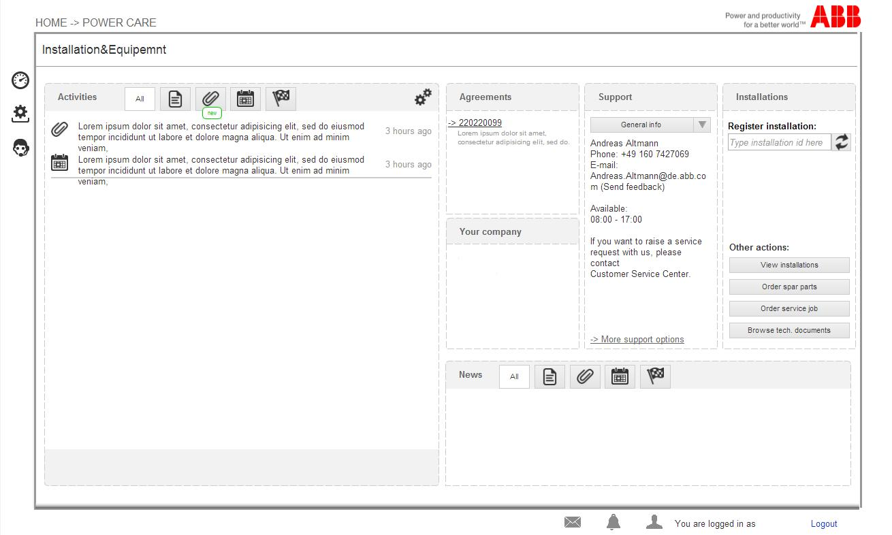
PowerCare A dedicated Portal for your support on ABB electrification equipment
Notes:
Should you need any further support on an existing PowerCare agreement, there is a single place to go.
PowerCare portal is a personilized web page, that contains all the details about the support agreement and related electrification system. It gives a direct contact to ABB contract coordinator. It is a gateway to on-line services.
As PowerCare is a contract platform covering all ABB electrification equipment, customer can get support for power tranformers, high and low voltage switchgears directly on this on-line portal.

