Slide 1
AF NEMA contactors
2020 12
The latest technology is our standard

Slide 2
AF NEMA contactors
Contents
Introduction
Speed-up your projects
Optimized logistics
Continuous operation

Slide 3
Introduction

Slide 4
AF NEMA contactor range
The latest technology is our standard
Secure uptime and optimize stock with the latest AF technology for motor starting and power switching up to 1650 A

Slide 5
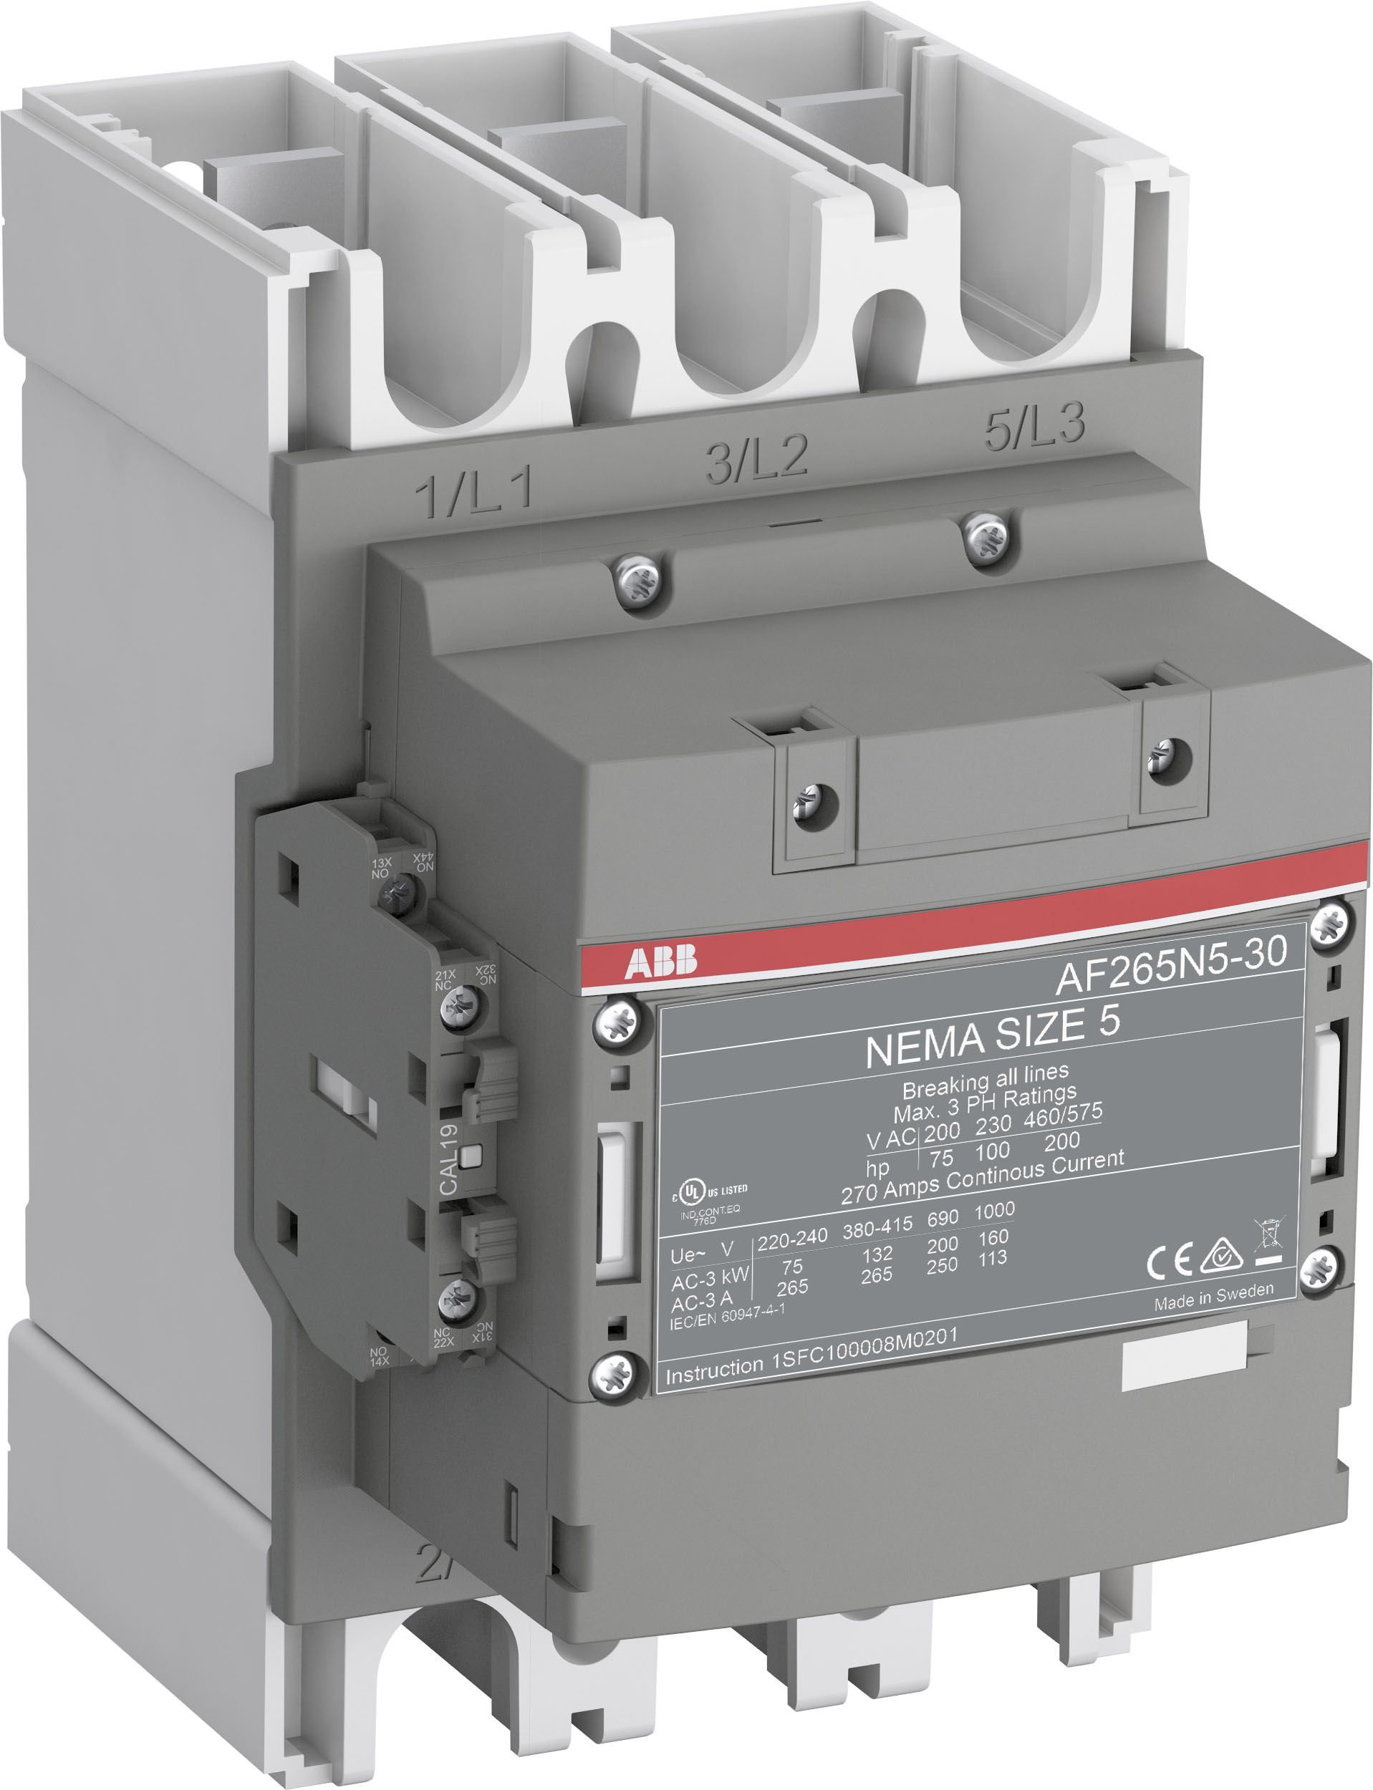
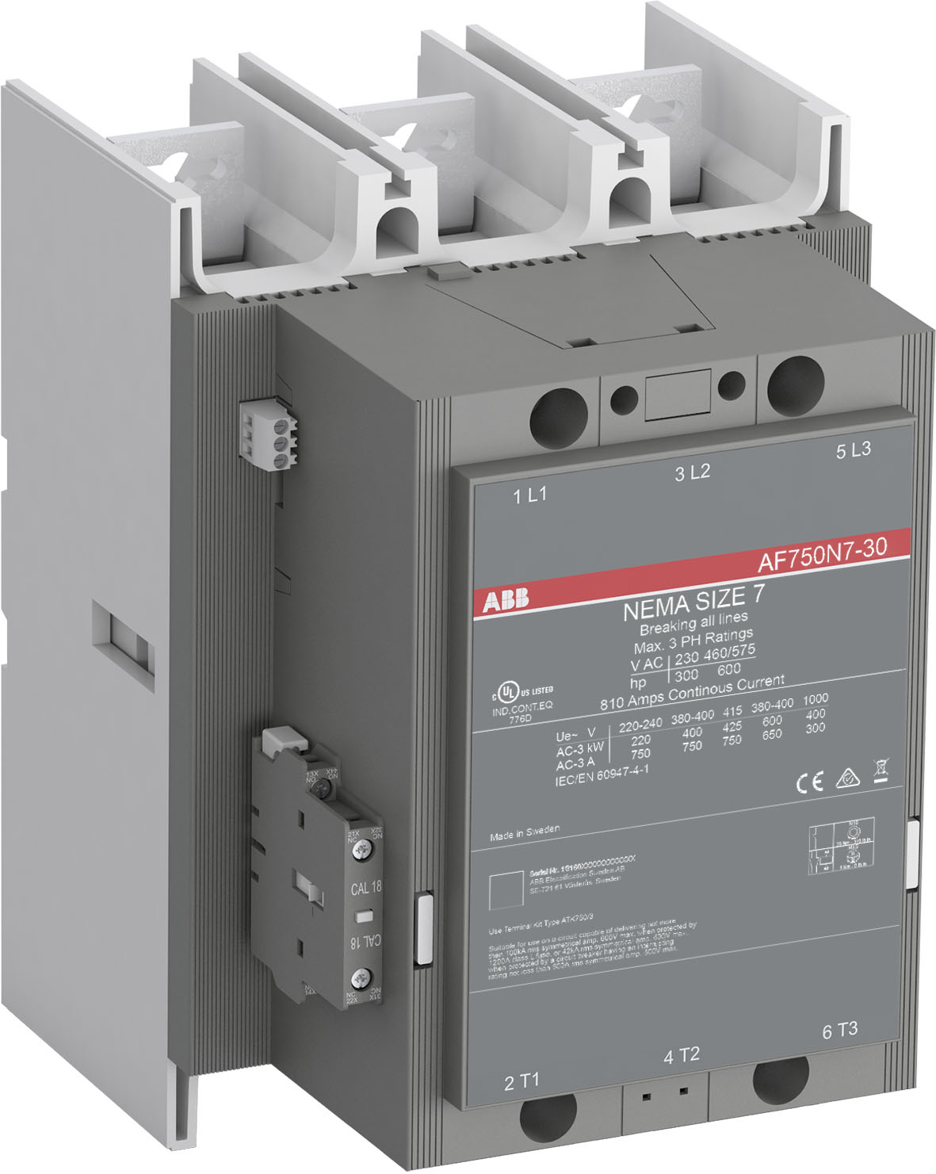
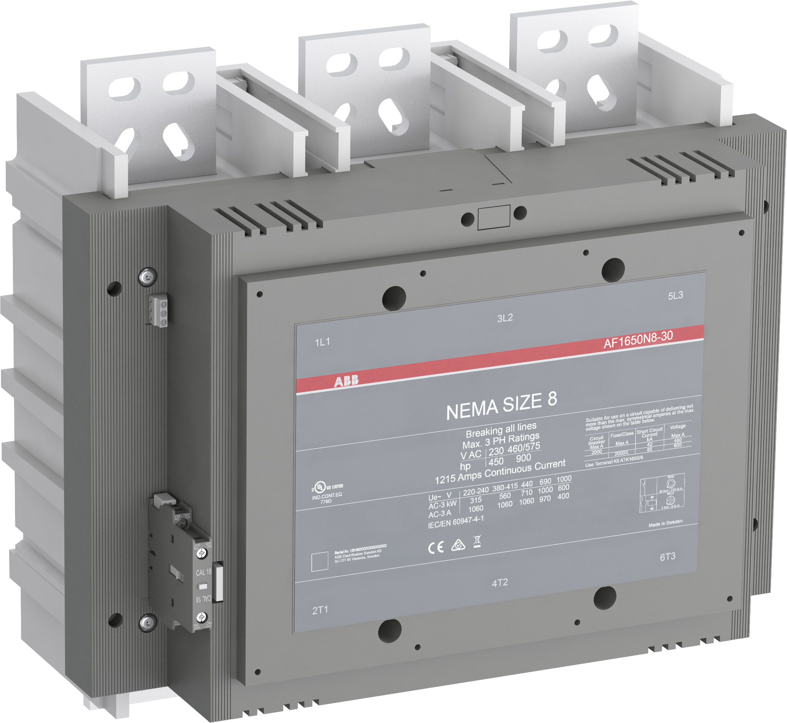
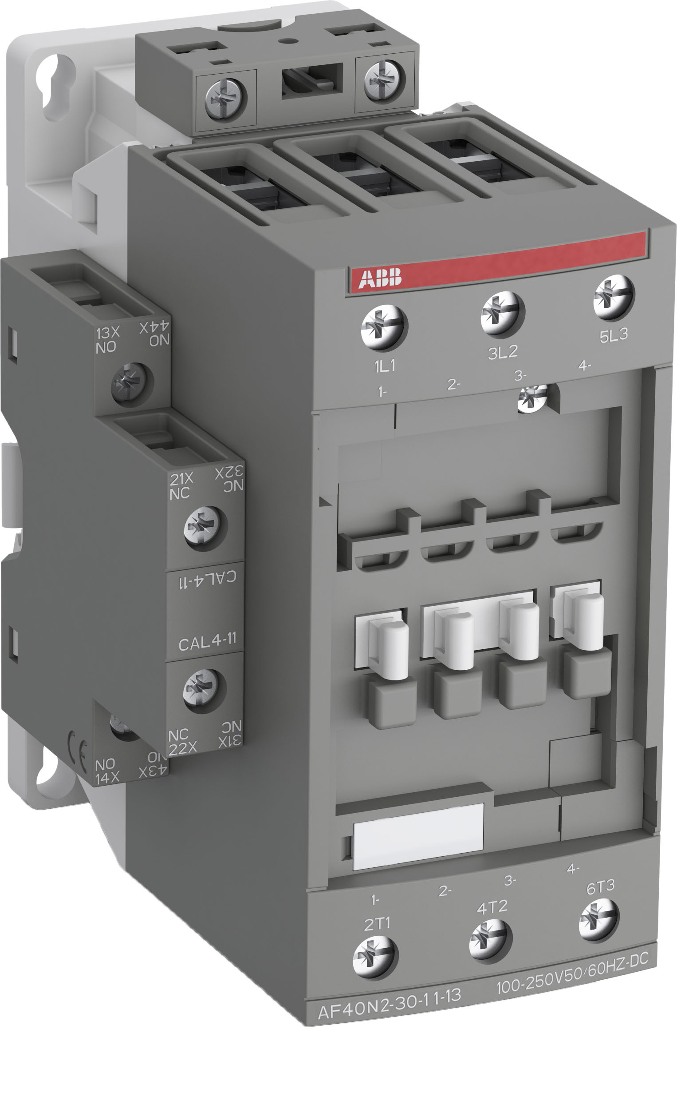
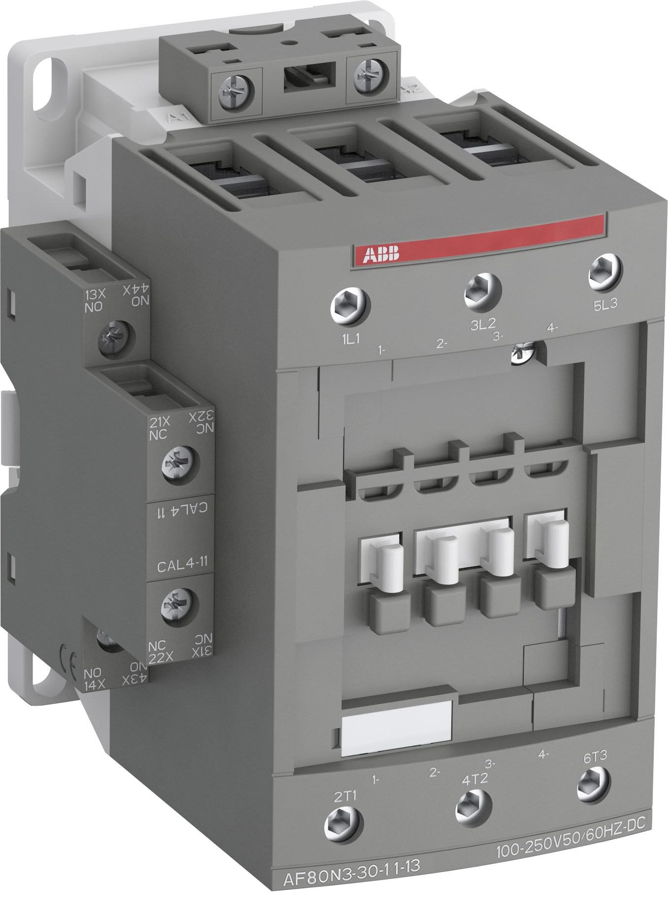
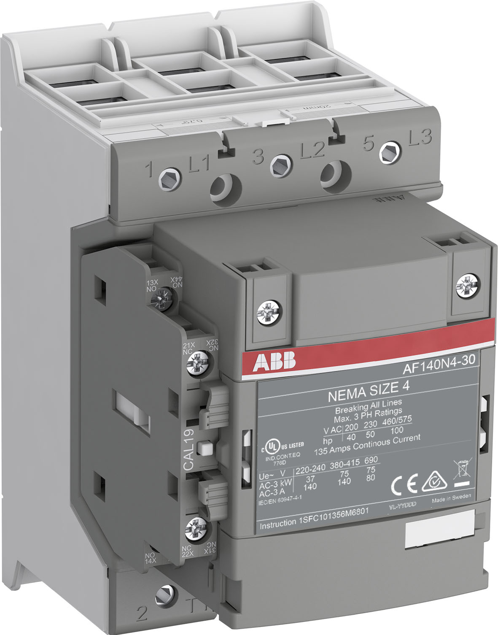
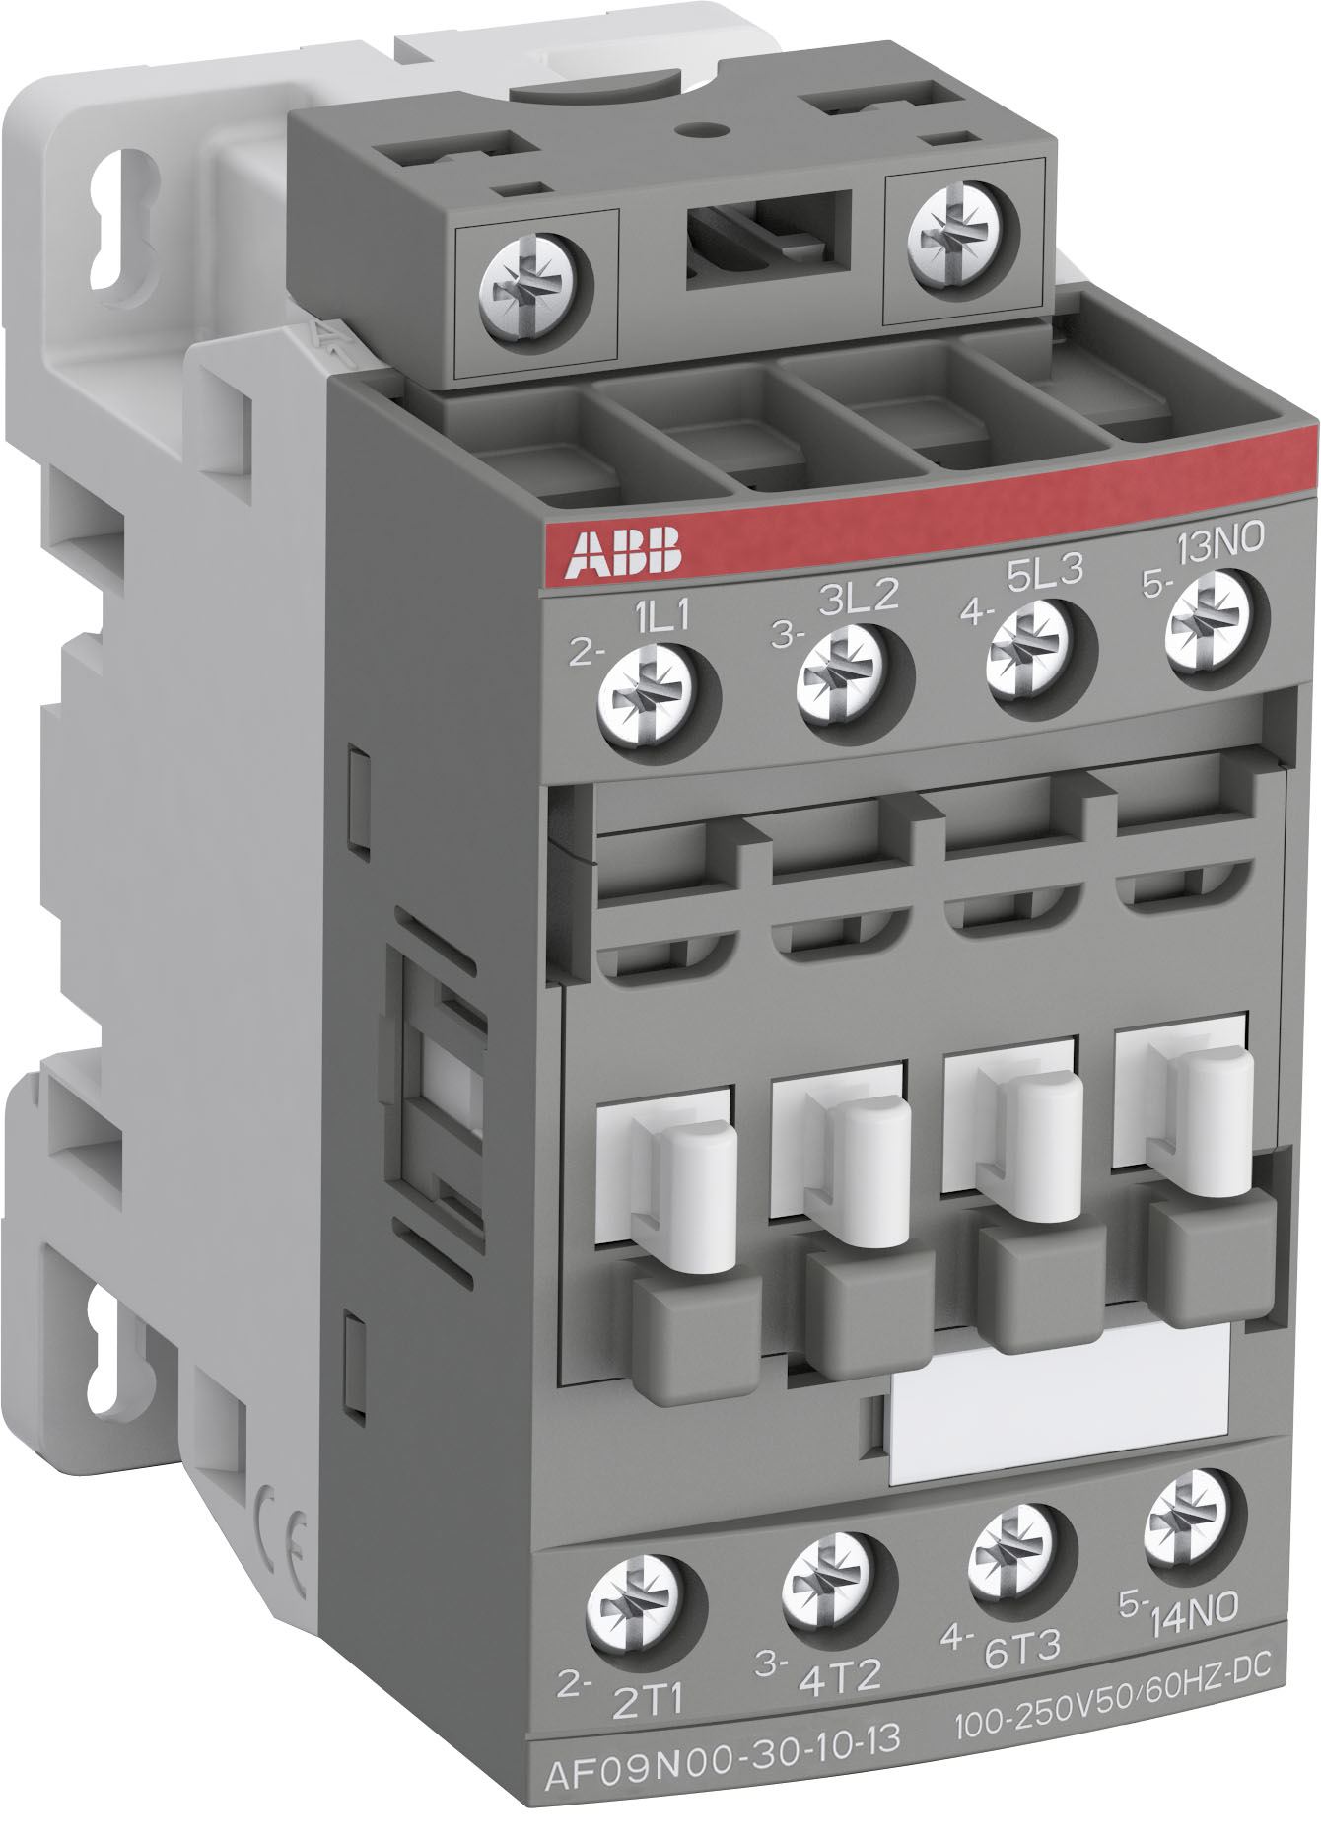
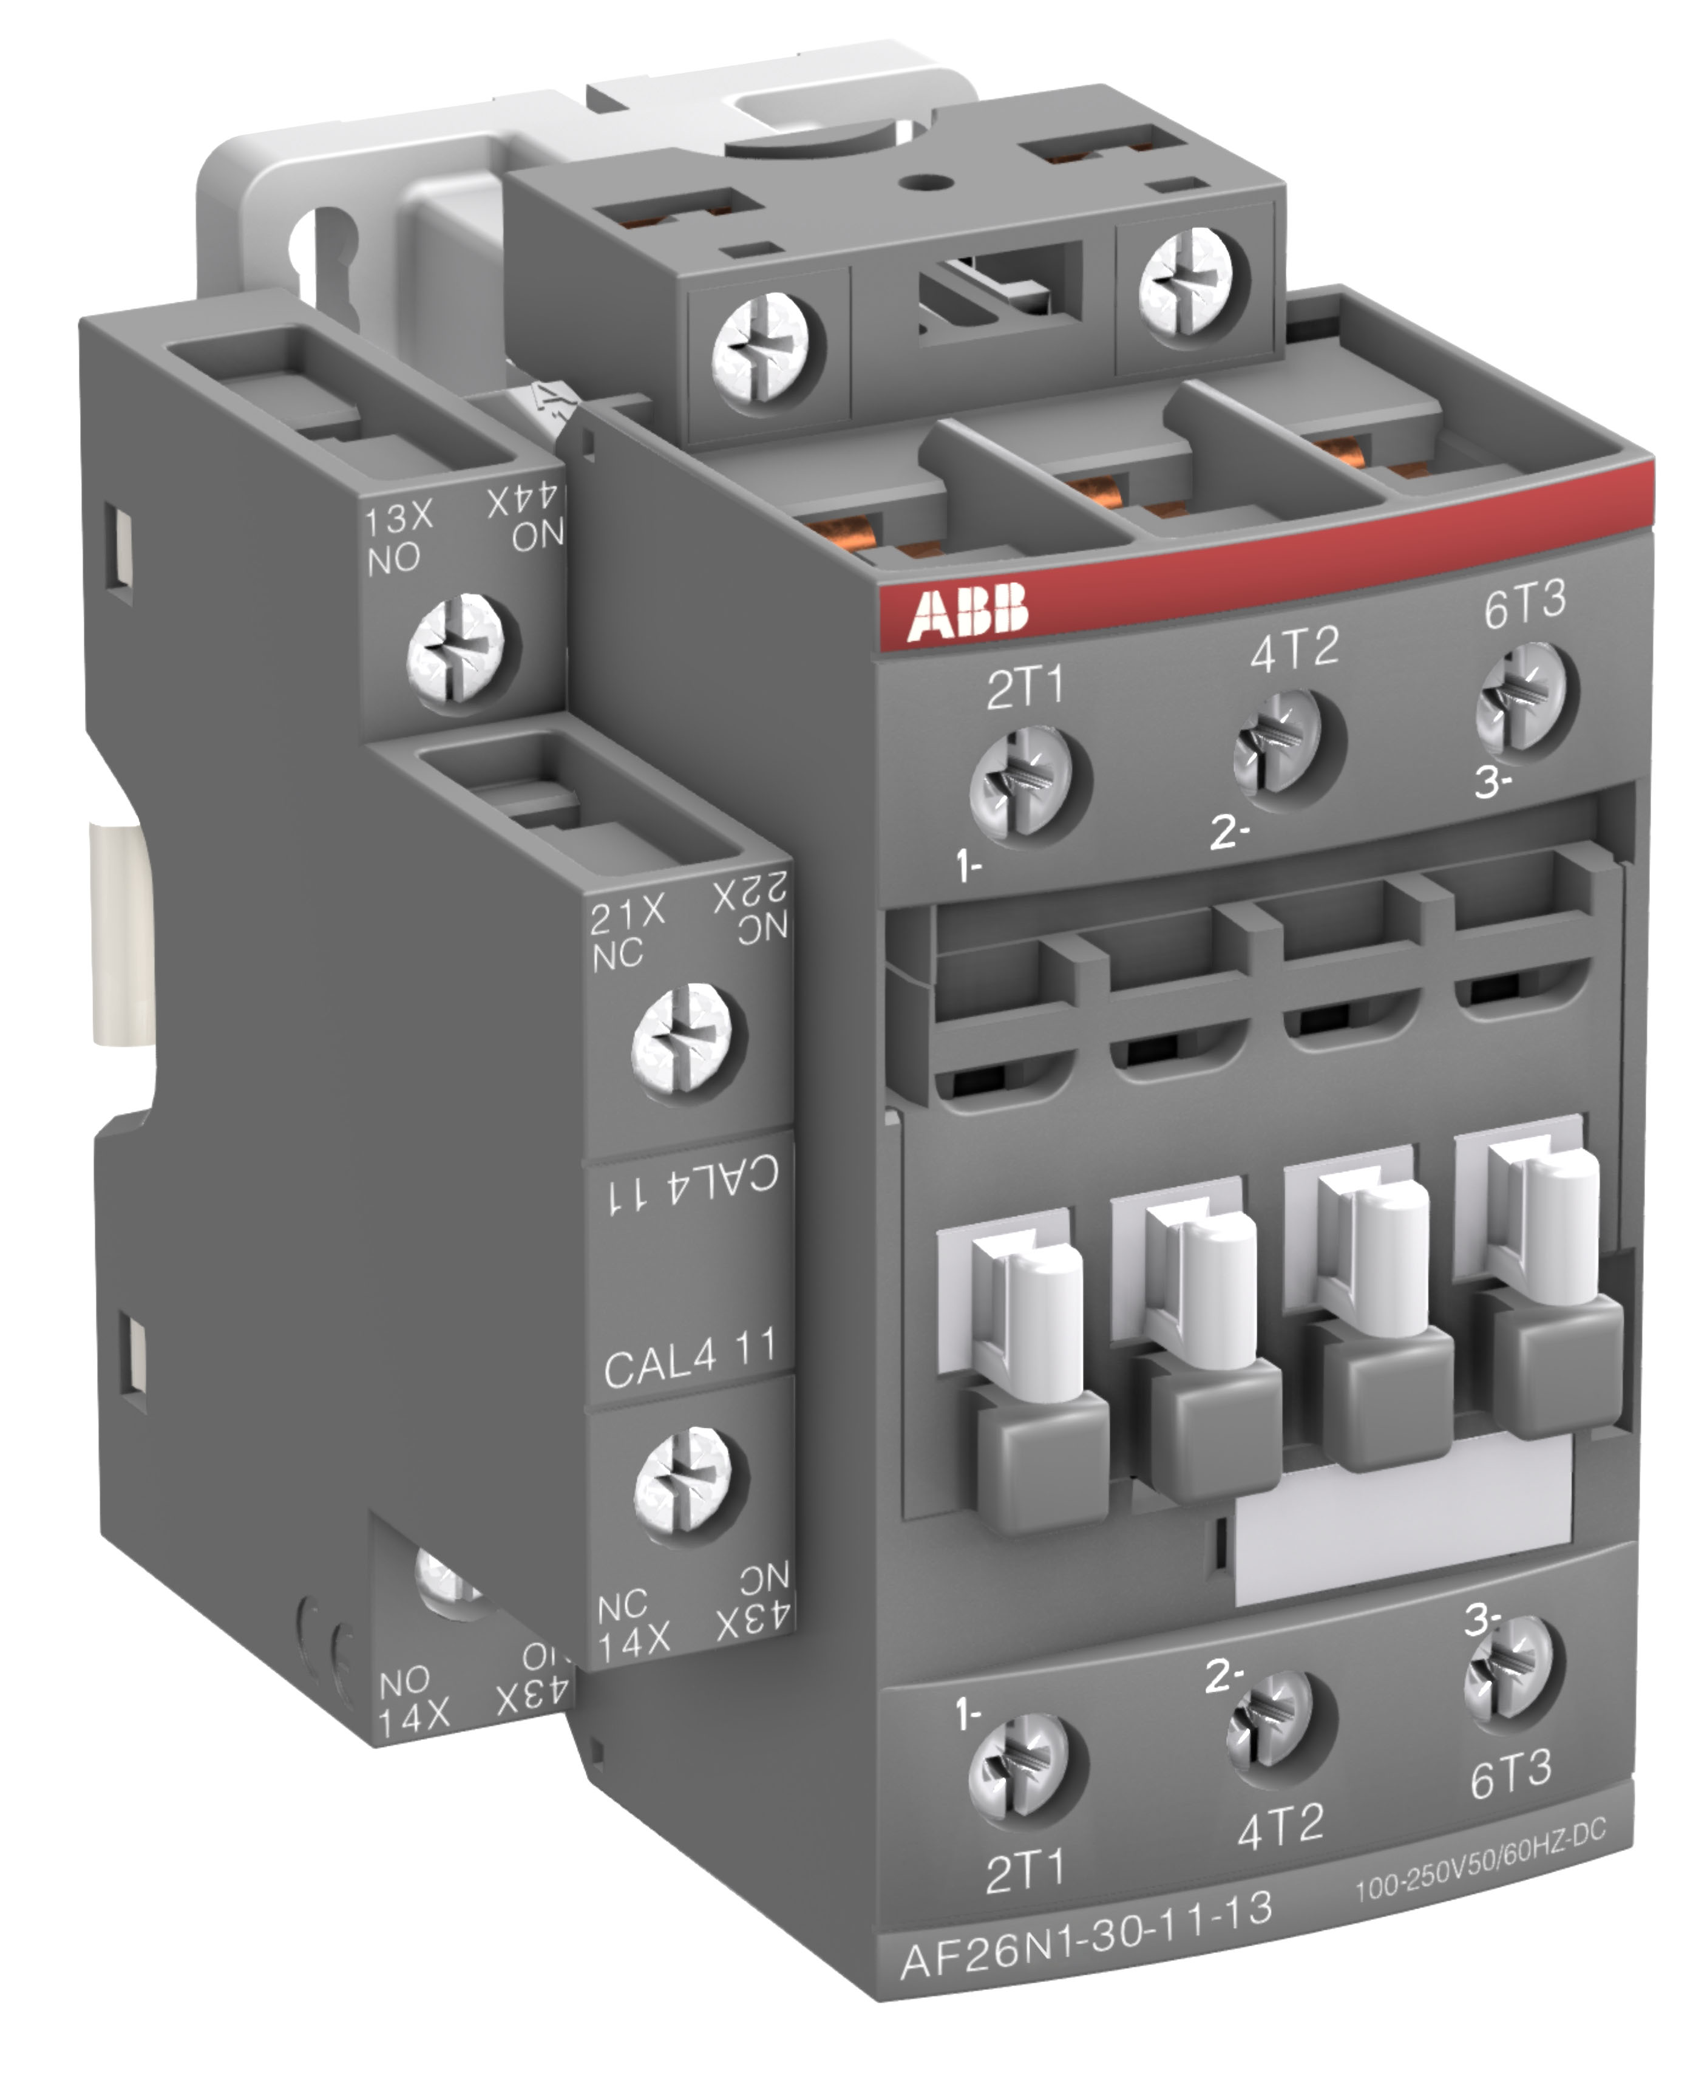
3-Pole range overview
AF09N00 … AF1650N8
Contactors | AF09N00 | AF12N0 | AF26N1 | AF40N2 | AF80N3 | AF140N4 | AF265N5 | AF460N6 | AF750N7 | AF1650N8
NEMA Size | 00 | 0 | 1 | 2 | 3 | 4 | 5 | 6 | 7 | 8
Rating (hp) 200 V | 0,5 | 3 | 7,5 | 10 | 25 | 40 | 75 | 150 | - | -
Rating (hp) 230 V | 0,5 | 3 | 7,5 | 10 | 30 | 50 | 100 | 200 | 300 | 450
Rating (hp) 460 V | 2 | 5 | 10 | 25 | 50 | 100 | 200 | 400 | 600 | 900
Rating (hp) 575 V | 2 | 5 | 10 | 25 | 50 | 100 | 200 | 400 | 600 | 900
Continuous amp rating (A) | 9 | 18 | 27 | 45 | 90 | 135 | 270 | - | - | -

Slide 6
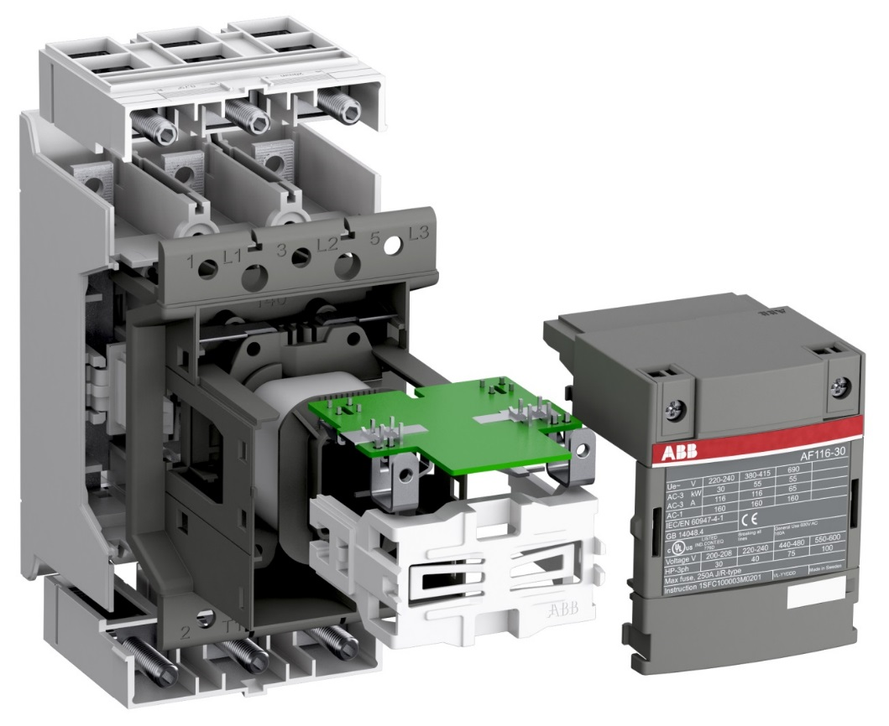
AF basic functionality
Optimized DC magnet with electronic control
Continuous current and voltage coil control trough the entire operating cycle
Distinct closing sequence
Low consumption holding sequence
Monitored opening sequence
Strong making force
Low heat dissipation in closed position
Humming and buzzing free
Contactor coil
Electronic PCB
Coil terminals

Slide 7
Optimized logistic

Slide 8
Optimized logistics
Only 4 coils
AF09N00, AF12N0, AF26N1, AF40N2, AF80N3, AF140N4, AF265N5 |  |  | AF460N6, AF750N7, AF1650N8*
Coils | V AC 50/60 Hz | V DC | Coils | V AC 50/60 Hz | V DC
Code 11 | 24...60 | 20...60 | Code 68 |  | 24...60
Code 12 | 48...130 | 48...130 | Code 69 | 48...130 | 48...130
Code 13 | 100...250 | 100...250 | Code 70 | 100...250 | 100...250
Code 14 | 250...500 | 250...500 | Code 71 | 250...500 | 250...500
* AF1650N8 only available with coil 70 : 100…250 V 50/60Hz, 100…250 V DC

Slide 9
Speed-up your projects

Slide 10
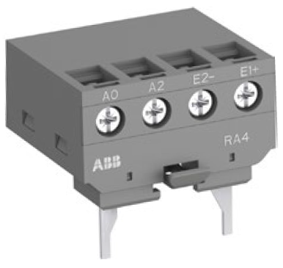
Speed-up your projects
Note about AF NEMA coil interface for PLC
Interface relay
AF09N00 up to AF80N3
Built-in PLC interface
AF460N6 up to AF1650N8
RA4
AF09N00
AF80N3
AF460N6
AF1650N8

Slide 11
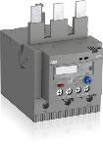
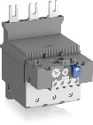
Speed-up your projects
Thermal and electronic overload protection
Contactors | AF09N00 | AF12N0 | AF26N1 | AF40N2 | AF80N3 | AF140N4 | AF265N5 | AF460N6 | AF750N7 | AF1650N8
Rating (hp) 200V | 1,5 | 3 | 7,5 | 10 | 25 | 40 | 75 | 150 | - | -
Rating (hp) 230V | 1,5 | 3 | 7,5 | 10 | 25 | 50 | 100 | 200 | 300 | 450
Rating (hp) 460V, 575V | 2 | 5 | 10 | 25 | 50 | 100 | 200 | 400 | 600 | 900
Width (mm) | 45 |  |  | 55 | 70 | 90 | 140 | 190 | 210 | 438
Thermal O/L | TF42 | TF65 | TF96 | TF140DU | -
Range (A) | 0,10 … 38 A | 22 … 67 A | 40 … 96 A | 66 … 142 A | -
Electronic O/L | EF19 | EF45 | EF65 | EF96 | EF146DU | EF370 | EF460 | EF750 | EF1250DU
Range (A) | 0,10 … 18,9 | 6 … 45 | 20 … 70 | 36 … 100 | 54 … 150 | 115 … 380 | 150 … 500 | 250 … 800 | 375 … 1250

Slide 12
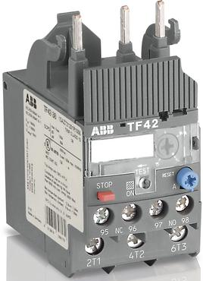
Thermal overload relays
Basics TF series
TF.. Series based on new technology¹
Trip Class 10
Operating temp. range -25 up to 60°C
Manual/ automatic reset selectable
Test function
Separate STOP button
Sealable cover for current setting, reset selection and test function
Perfect match to the contactor
Also available: ATEX certified types and kits for separate mounting
Marking
Current setting
Cover, sealable
Reset button
Test/ Status indication
Stop button

Slide 13
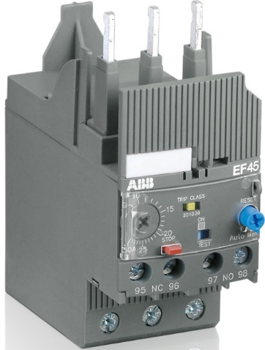
Electronic overload relays
Basics EF series
Trip Class 10E, 20E, 30E selectable
Operating temp. range -25 up to 70°C
Manual/ automatic reset selectable
Test function
Separate STOP button
Sealable cover for current setting, reset selection and test function
Perfect match to the contactor
Also available: ATEX certified types and kits for separate mounting
Marking
Current setting
Trip class selection
Cover, sealable
Reset
Test/ Status indication
Stop

Slide 14
Continuous operation

Slide 15
Continuous operation
Coil operating limits
IEC 60947-1 requirement
Conventional coil
AF coil
+10%
253V
+10%
253V
+10%
275V
Uc
230 V
230 V
250 V
-15%
220 V
-15%
187 V
187 V
-15%
100 V
85 V

Slide 16
Continuous operation
Drop-out zone
IEC 60947-1 requirement
Conventional coil
AF coil
+10%
253V
+10%
253V
+10%
275V
Uc
230 V
230 V
250 V
-15%
220 V
-15%
!
187 V
187 V
Uncertain
!
Uncertain
173 V
165 V
100 V
-15%
85 V
Safe
60 V

