Slide 1

Intelligent Distribution for Electric Power in Building
Sales Presentation

Slide 2

—
Agenda
1.
Market Trends
6.
Value Proposition
2.
Electric Power - Components
7.
Product Offerings
Electrical Scope
Competitive Analysis
3.
8.
4.
ABB Solutions and Components for Electric Power
5.
Digital Offerings

Slide 3
—
Market Trends

Slide 4
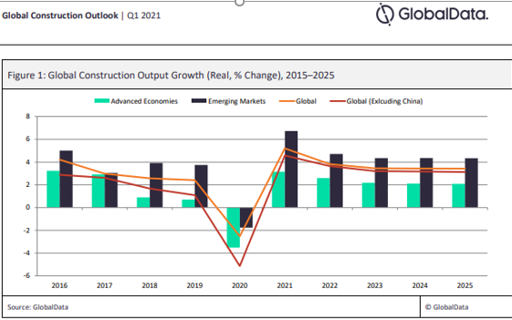
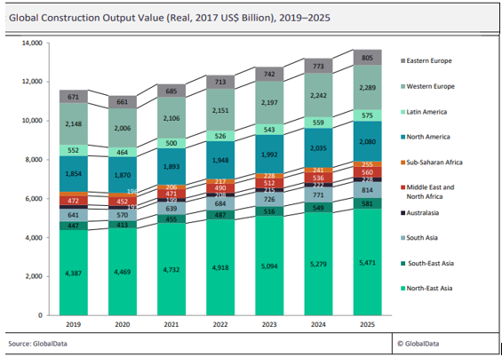
Global construction trend
INTERNAL ONLY
Global construction expected growth – 2015 to 2025

Slide 5


New Trends
Technologies which are changing the world we know
Cloud computing, big data, internet of things (IoT), artificial intelligence (IA), industry 4.0 are phenomenon which are changing the approach to the electrical distribution as we know it today

Slide 6

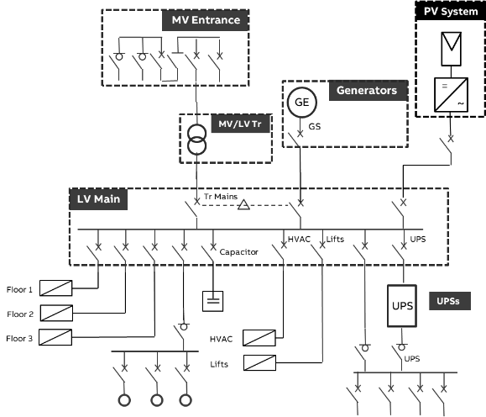
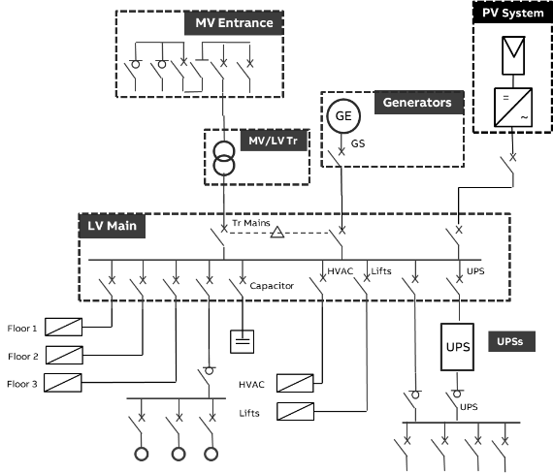
The journey towards digital transformation
The continuous evolution of the energy power distribution
—
In the past
—
Today
—
In the near future
1 external power meter for local monitoring of the electrical installation with high accuracy.
If necessary, additional meters with the local monitoring.
Additional metering devices along the distribution with high and mid/high accuracy and local monitoring system.
All the electrical parameters to be measured with high accuracy.
Devices exchanging the information among them and with cloud.
Local/remote monitoring system
Advanced power monitoring and network performance
power meter
for local monitoring
Advanced power monitoring and network performance:
P, Q, S, Ea, Er, Eap, f, I, IN, U and/or V, PF, THDU and/or THDV and/or THD-RU and/or THD-RV, THDI and/or THD-RI
Basic Power Monitoring:
P, Q, S, Ea, Er, Eap, f, I, IN, U and/or V, PF
Energy monitoring:
Ea
October 8, 2021
Slide 6

Slide 7
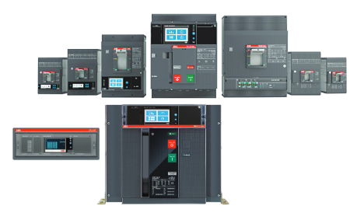

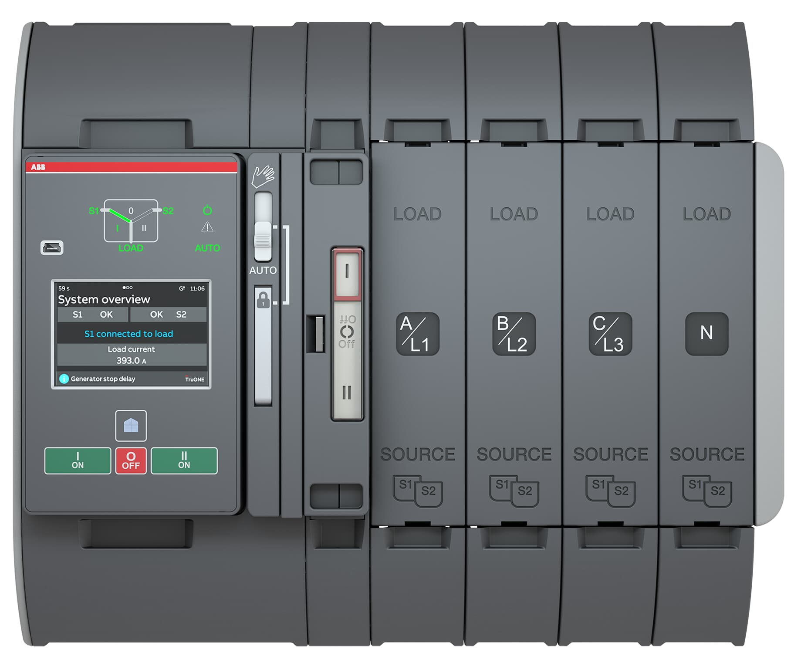
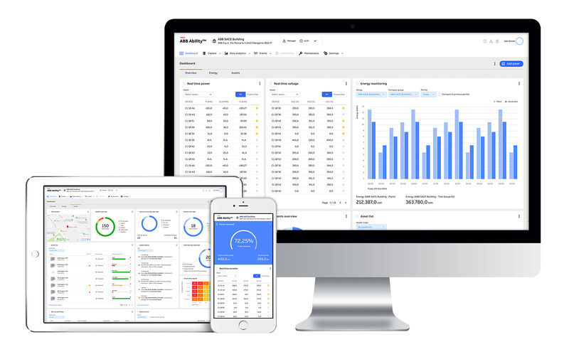

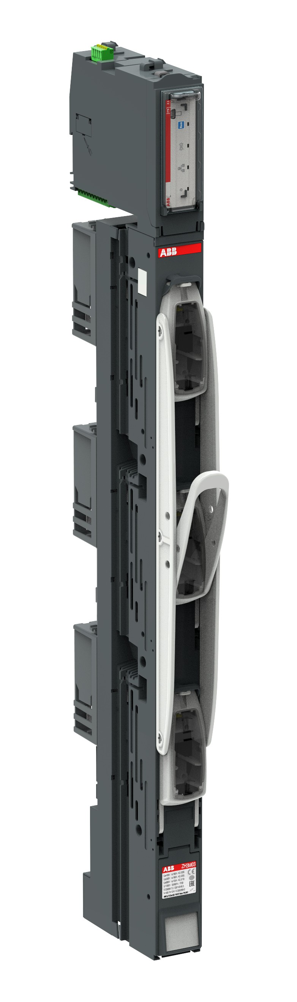


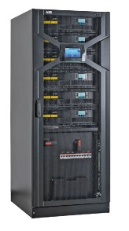
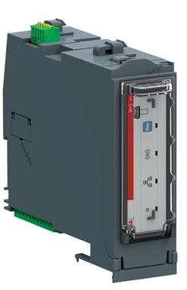
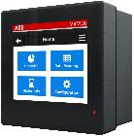
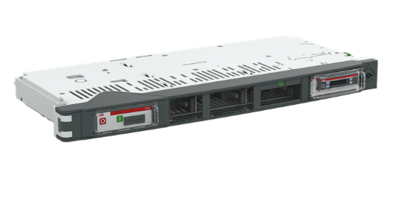




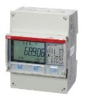
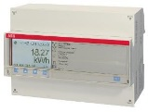
From smart and connected products to monitoring solutions
Key enabler of new technologies for the power systems
—
Smart components
—
Smart and connected architectures
—
Monitoring systems
Modbus TCP
October 8, 2021
Slide 7

Slide 8
—
Electric Power Components

Slide 9
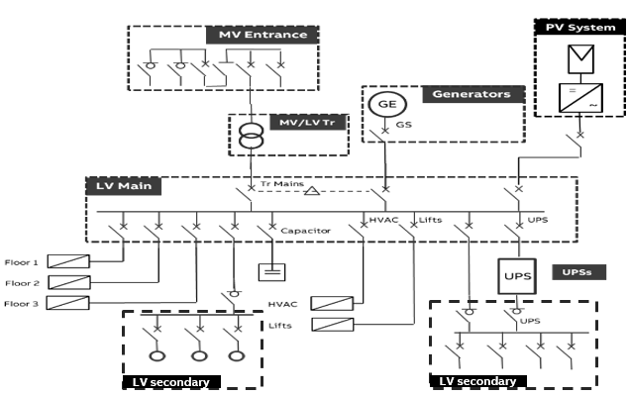
Electric Power
Components
—
Main components
Utility feed: transformer. It is highly recommended to use dry-type transformers
Generators: back up generators able to supply the critical load in case of failures.
Main Distribution board: connects a transformer and generator to the electrical distribution system. Automatic Transfer Switching (ATS) is needed between the generator and transformer circuit-breakers. The outgoing circuit breakers provide power supply to UPSs, cooling systems critical, non-critical loads.
UPS (Uninterruptable Power Supply): provides emergency power to the critical load when the input power source or mains power fails.
Secondary Distribution Board: serves to connect ligthing and other loads

Slide 10
—
Electrical Scope

Slide 11






Energy Efficiency in Electrical System
Certification & Standard
—
International Standard
—
National Regulation
—
European Directive
—
Certification System
ISO 50001 Energy management systems – Requirements with guidance for use (ISO 50001:2018)
IEC 60364-8-3 ed. 1 Low-voltage electrical installations
ANSI/ASHRAE/IES/USGBC Standard 189.1-2014, Standard for the Design of High-Performance Green Buildings
UNI EN 15232 Energy performance of buildings – Impact of Building Automation, Controls and Building Management
Many Countries developed local regulation for measuring new constructions and renovations
The Energy performance of buildings directive requires that all new buildings must be nearly zero-energy buildings (NZEB) as of 31 December 2020
Energy that NZEB require should comes mostly from renewable energy sources
Metering and monitoring is a key requirement for the energy efficiency improvements

Slide 12

What is ISO 50001
—
Introduction
ISO 50001 is an international voluntary standard for energy management
A continuous improvement model is divided into four steps: Plan, do, act and check
ISO 50001 is based on the same management system model used for ISO 9001 and 14001. This compatibility makes it easier for organizations to integrate energy management into their quality and environmental management efforts
However, ISO 50001 adds new data-driven sections related to energy planning, operational control and measuring and monitoring

Slide 13
ISO 50001
Benefits¹
By achieving certification to this international, best-practice Energy Management standard, customers’ organization will accrue some of the numerous benefits of ISO 50001, including:
Energy reduction, even up to 10% within first 12 months
Reduced greenhouse gas (GHG) emissions and carbon footprint
Globally recognized International Standard
Assist in compliance with current and future voluntary and/or mandatory energy efficiency targets
Improved corporate image and credibility among customers, clients and stakeholders
Informed decision-making processes from system design to operation and maintenance
Increased energy awareness among staff members at all levels
Improved operational efficiencies and maintenance practices

Slide 14

Intelligent Distribution for Electric Power in Building
What’s LEED®?
LEED® is the most widely used green building rating system in the world. It works for all buildings at all phases of development, from new construction to existing buildings, and all building sectors, from homes to hospitals to corporate headquarters.
Notes:
A concise framework for indetifying&implementing pratical&measurable green building design, construction operations and maintenance strategies and solutions.
US Green Building Council
Sustainability
Continues improvement
Voluntary certification process

Slide 15

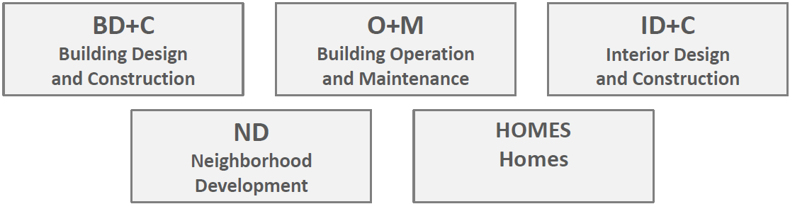
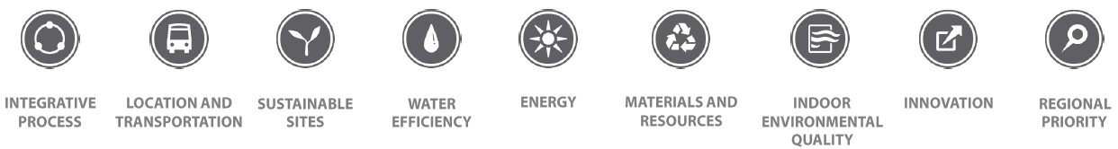
Intelligent Distribution for Electric Power in Building
ABB Credit Categories contribution for BD + C
—
5 rating systems:
—
4 building certification levels:
LEED certification from Design to Construction phase
Valid for new construction and major renovation
Dynamic approach – continuous improvement
—
9 credit categories for BD+C:

Slide 16
Intelligent Distribution for Electric Power in Building
ABB contribution for new construction and major renovation with ABB Ability Energy Manager

Slide 17
Recommendation from IEC 60364-8-1
Metering requirements
For the incoming part of the facility it is necessary to have the most detailed monitoring of all electrical parameters
Advanced power monitoring and network performance:
P, Q, S, Ea, Er, Eap, f, I, IN, U and/or V, PF, THDU and/or THDV and/or THD-RU and/or THD-RV, THDI and/or THD-RI
Less details is necessary for the sub distribution part
Basic Power Monitoring:
P, Q, S, Ea, Er, Eap, f, I, IN, U and/or V, PF
Only the monitoring of the energy is required for the final distribution
Energy Efficiency:
Ea

Slide 18
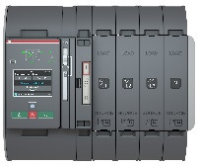



Smart metering devices
ABB solution for metering requirements
—
Metering devices
Circuit breakers: Emax 2 and Tmax XT
Digital Relay: Ekip UP
ATS: TruONE
Fusegear: InLineII ITS2
Circuit breakers: Emax 2 and Tmax XT
ATS: TruONE
Fusegear: Slimline XRG and InLineII ITS2
ITS2 with OS and OT switches
UPS
Network Analyzers: M4M 20 and M4M 30
Circuit Monitoring System: System pro M compact® InSite
Network Analyzer: M4M 20
EQ meters

Slide 19
—
ABB Solutions and Components for Electric Power

Slide 20









Intelligent distribution for Building
SLD – High level
PV panel
String combiner
PV panel
String combiner
Recombiner
inverter
Paralleling switchgear
MV Switchgear
PV panel
String combiner
Distribution Transformer
Distribution Transformer
PV panel
String combiner
Recombiner
inverter
LV Switchgear
LV Switchgear
Generator
VSD
Wastewater
pumps
Clean-water
pumps
HVAC
Lighting
Emergency Lighting
Offices
Power factor
correction
M
3~
M
3~
UPS

Slide 21
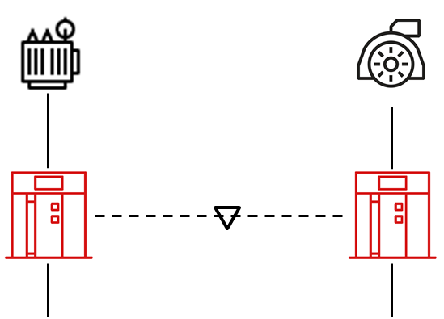
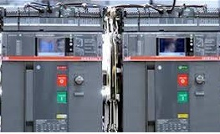
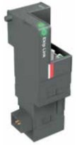
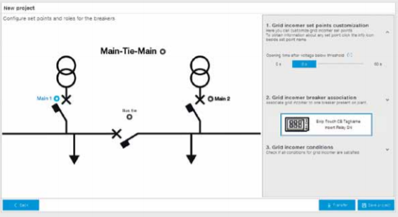
Intelligent Distribution for AC Power Distribution in Building
Application Bundle : Main – Gen
—
Description
—
SLD – High level
—
Main components
Thanks to the connection via ATS between generator and transformer, the power distribution is automatically provided also in case of transformer failure or maintenance.
The modules guarantee that parameters and statuses can be shared with other devices and used to monitor the entire system. You can use this capability to automate the response of the system according to any circuit breaker status or event.
ABB’s embedded ATS solution is based on four main elements:
• Ekip trip units that enable logic operations
• Ekip Link
• Ekip Synchrocheck (only in case of closed transition systems)
• Ekip Connect 3 tool for ATS

Slide 22


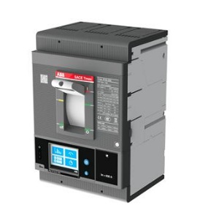

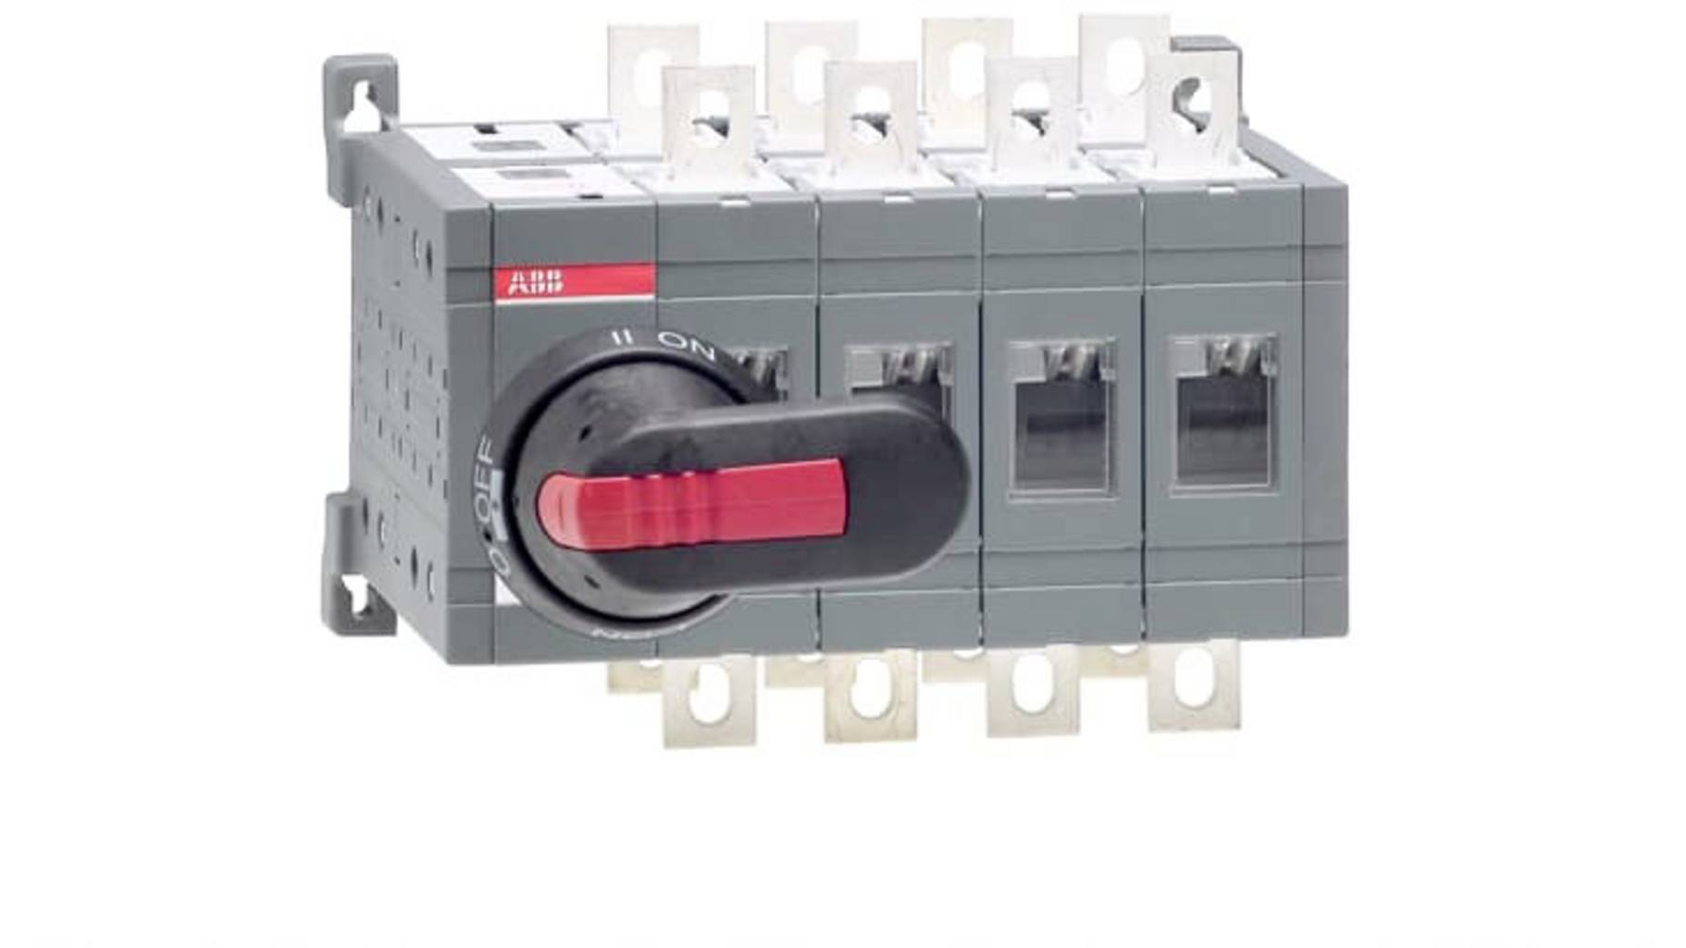





Intelligent Distribution for Building Cooling
Application bundle : Electrical distribution system for cooling (<1 MVA)
—
Description
—
SLD – High level
—
Main components
Small size building (<1MVA)
Typically, switch disconnector at the roof for manual control connected to a MCCB in MDB for protection. Cooling load is 250 kW up to 350 kW.
Switching (OT switch)
Protection (Tmax XT)
Metering (Ekip trip unit)
Bus Duct
Switch-disconnect
Cooling system
Roof
Tmax XT
CBP
Nth floor
CBP
Lighting
AC
Sockets
OT Switch-disconnector
2nd floor
CBP
1st floor
Cooling system
Ground floor
Tx
MDB
MDB: Main Distribution Board
CBP: Circuit breaker panel (UP to 400 A)

Slide 23


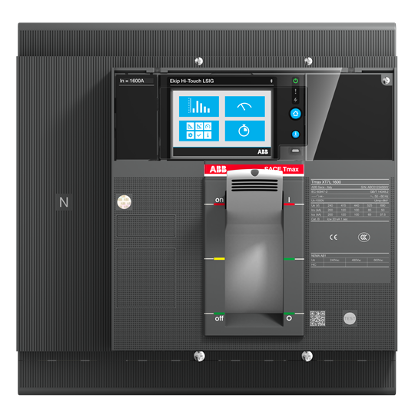



Intelligent Distribution for Building Cooling
Application bundle : Electrical distribution system for cooling (<3 MVA)
—
Description
—
SLD – High level
—
Main components
Bus Duct
MCC
Cooling system
Mid-size building (<3 MVA)
Typically, MCC with different configurations to start and control motors (Contactors, Soft starters, etc.) or in some cases VSD for higher efficiency connected to a main MCCB in MDB.
Protection (Tmax XT/Emax2)
Metering (Ekip trip unit)
Roof
Tmax XT
Tmax XT
SDB
Nth floor
or
SDB
Lighting
AC
Sockets
2nd floor
SDB
EDB
MCC
VSD
1st floor
Ground floor
Cooling system
CSS
MDB
ATS
Generator
CSS: Compact Substation
MDB: Main Distribution Board
ATS: Automatic transfer switch
SDB: Sub-Distribution Board (Up to 1250A)
EDB: Emergency distribution
board
AC: Air Conditioning units
MCC: Motor Control Center
VSD: Variable speed drive

Slide 24
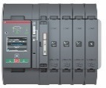
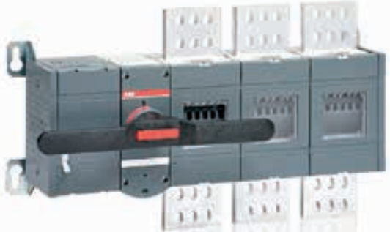


Intelligent Distribution for Building Cooling
Application bundle : Electrical distribution system for cooling (<5 MVA)
—
Description
—
SLD – High level
—
Main components
Roof
Large size building (<5 MVA)
Typically, VSD to start and control motor for energy efficiency connected to ATS and protected by MCCBs in MDB and Genset panel.
Switching (TruOne)
Protection (Tmax XT/Emax2)
Metering (Ekip trip unit)
  <1250A
High-Rise building (>5 MVA)
High rise building More than 5 MW can either be replicated from the above LV example to match the cooling needs or with MV HVAC solutions
SWG
Bus Duct
Nth floor
Tmax XT
Tmax XT
SWG
Lighting
AC
Sockets
2nd floor
SWG
EDB
1st floor
TruOne
or
OTM + PLC
VSD
TX SS
MDB
ATS
Generator
VSD
Cooling system
Ground floor
TX SS: Transformer Substation
MDB: Main Distribution Board
ATS: Automatic transfer switch
SDB: Switchgear Distribution Board
EDB: Emergency distribution board
AC: Air Conditioning units
MCC: Motor Control Center
VSD: Variable speed drive

Slide 25
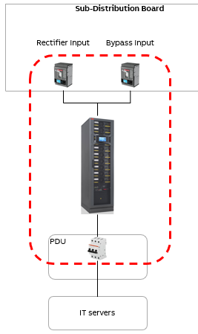
Intelligent Distribution for Server Room in Buildings
Application bundle description
—
Description
—
SLD – High level
—
Main components
Solution used to provide continuous power for IT loads in server rooms in buildings
ABB Solution
The solution contains UPS for continuous power, metering and upstream circuit breakers for protection.
Protection
Tmax XT MCCB
S200 MCB
Continuous Power
UPS
Metering & monitoring
Ekip Trip Unit (MCCB)
Notes:
Sources:
https://new.abb.com/news/detail/68516/keeping-data-centers-cool
https://new.abb.com/data-centers/cooling-system
https://new.abb.com/motors-generators/nema-low-voltage-ac-motors/hvac-motors/

Slide 26
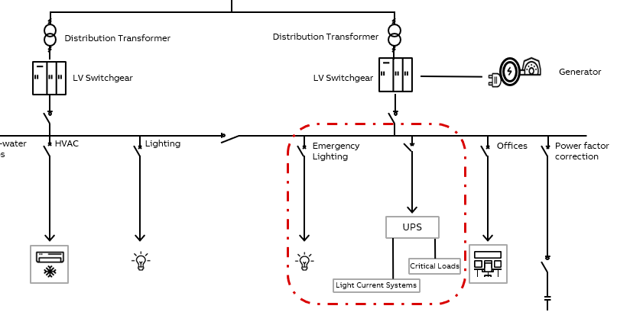
Intelligent distribution for Building – Emergency Power System
Application bundle: Emergency Power System
—
Description
—
SLD – High level
—
Main components
Protection devices - Protection devices must be provided along the all distribution lines, circuits shall be designed according to IEC 60364.
Switches: provide isolation in case of maintenance needed. Are perfect incoming devices for sub-distribution boards as do not impact on selectivity chain.
Contactors: can be used to control a variety of lighting loads in many commercial and industrial applications such as stadium, hospitals, airports, parking, offices etc.
Automation and control (out of scope)
Meters: for efficiency purpose, it is often required the metering of consumption for each usage type, including lighting.
Standby Generator : To provide power for the whole emergency system (within few seconds according to the building type). The generator will power up all the emergency loads such as lighting (20-30% of all system lighting fixtures), power (for special loads) and etc.
Central Battery System : Due to the generator will take some time to start and get into operation, central battery is required to provide supply instantaneously in case of power failure. Central batteries are mainly for lighting and HVAC (smoke dampers ) systems.
Automatic Transfer Switch : This device is responsible for sensing the absence of main supply and then starting the generator and put it into service. In case of power return it makes sure power is stable and the disconnect the generator and make the main supply in service.
Uninterruptible Power Supply : (UPS) is an electrical device that provides instantaneous backup power to a system when the normal power source goes down. UPS devices are commonly found connected in datacenters to avoid data loss. UPSs are also used for critical systems (healthcare, communications, etc) to provide enough operational time to let the emergency generator ramp up to full capacity.

Slide 27
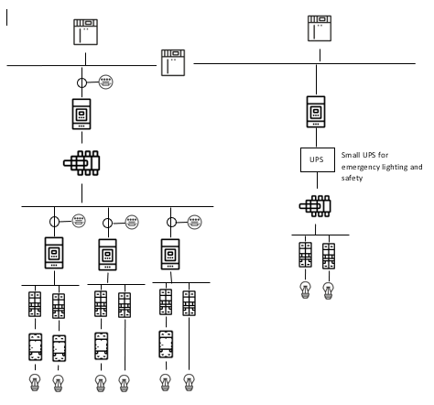
Intelligent distribution for Building – lighting system
Application bundle: lighting system
—
Description
—
SLD – High level
—
Solutions
Protection devices - Protection devices must be provided along the all distribution lines, circuits shall be designed according to IEC 60364.
Switches: provide isolation in case of maintenance needed. Are perfect incoming devices for sub-distribution boards as do not impact on selectivity chain.
Contactors: can be used to control a variety of lighting loads in many commercial and industrial applications such as stadium, hospitals, airports, parking, offices etc.
Automation and control (out of scope)
Meters: for efficiency purpose, it is often required the metering of consumption for each usage type, including lighting.
Monitor | Provides metering for lighting usage
With this basic solution we provides the possibility to monitor usage consumption (energy, water, gas…), as well as energy generated if present.
Monitor & Control| Allows metering and power quality check of usage by zone
Advanced solution provides a complete view of power consumption , enabling analysis for energy efficiency. As optional it is possible to check power quality of some specific loads.
Advanced Solution | Complete monitoring and supervision system
Advanced solution consists of complete packaging for metering of consumptions and ready to use predictive maintenance system. Redundancy of communication is also possible for large and critical buildings.

Slide 28
Intelligent distribution for Building – lighting system
Application bundle: lighting system
—
Description
—
SLD – High level
—
Solutions
A photovoltaic (PV) plant transforms directly and instantaneously solar energy into electrical energy without using any fuels.
The main advantages of photovoltaic (PV) plants can be summarized as follows:
• distribuited generation where needed;
• zero emission of polluting materials;
• saving of fossil fuels;
• reliability of the plants since they do not have moving parts (useful life usually over 20 years);
• reduced operating and maintenance costs;
• system modularity (to increase the plant power it is sufficient to raise the number of modules) according to the real requirements of users
For commercial building, PV Plant are around 20…1000KW
Single or multi-inverter solution are depending on the design and reliable approach
Monitor Solution | Provides Metering power generated
With this basic solution we provides the possibility to monitor the energy generated
Asset Management Solution | Complete Monitoring And Supervision System
Advanced solution consists of complete packaging for metering of consumptions, status of the devices and to use predictive maintenance system.
PV panel
String combiner
inverter
PV panel
String combiner
Recombiner
PV panel
String combiner
Paralleling switchgear
inverter
PV panel
String combiner
Recombiner
main
LV Switchgear

Slide 29
—
Digital Offerings

Slide 30








Intelligent Distribution for Building – Electric power
Application Bundle - Digital Offer
—
Features
—
Conceptual diagram
Monitoring through ABB Ability Energy and Asset Manager
Common Information Model (Digital Twin)
Common user-interface
Alarms, History, Trend analysis
Cybersecurity
Monitoring of all electrical parameters
Predictive Maintenance
Energy efficiency KPIs
Contribution for LEED certification
Compliance with ISO 50001 Life Cycle Management
(*)
(*)
(*)
Ethernet switch needed only for Ethernet networks
(*) = The application bundle might be connected to a gateway which is placed in another part of the installation

Slide 31


Intelligent Distribution for Building
The Importance Of Metering and Controlling
Monitor offer | Provides metering for Main Supply
With this basic solution we provides the possibility to monitor usage consumption (energy, water, gas…), as well as energy generated if present.
Asset
Management
Predictive Maintenance​​
Redundancy For Communication​
High Granularity Measurements
Monitor + Control offer | Allows Metering And Power Quality Check Of Usage By Zone
Advanced solution provides a complete view of power consumption , enabling analysis for energy efficiency. As optional it is possible to check power quality of some specific loads.
Monitor +
Control
Power Quality
7 native Communication Protocols
1% Accuracy
General And Auxiliary Service Consumptions
Asset Management offer | Complete Monitoring And Supervision System
Advanced solution consists of complete packaging for metering of consumptions and ready to use predictive maintenance system. Redundancy of communication is also possible for large and critical buildings.
Monitor
Total Building Consumptions
Automatic Report And Dashboard
* It is always possible to upgrade the current digital architecture thanks to a great product flexibility.

Slide 32

Intelligent Distribution for Building – Electric power
Monitor Offer
Monitor offer | Provides metering for Main Supply
With this basic solution we provides the possibility to monitor usage consumption (energy, water, gas…), as well as energy generated if present.
Asset
Management
Predictive Maintenance​​
Redundancy For Communication​
High Granularity Measurements
Monitor +
Control
Power Quality
7 native Communication Protocols
1% Accuracy
General And Auxiliary Service Consumptions
Monitor
Total Building Consumptions
Automatic Report And Dashboard

Slide 33
Intelligent Distribution for Building – Electric power
Monitor
Application Bundle - Digital Offer
Monitor
The minimum requirements for building metering is the possibility to monitor total consumptions, that is the total energy consumed, at the incoming of the installation, and the consumption of other energy sources such as gas, water etc.
For building, where only essential metering is required, generally it is not required the monitoring of critical loads.
ABB’S offer for power distribution includes protection devices that can be customized at any time, to enable an evolution of the installation from essential to enhanced or advanced even in the future.
Solution for small buildings up to 500K
Bundle | overview
AC power | Monitoring only for incomers
Cooling in Building
Server room | Monitoring Circuit Breakers
Emergency Lines
Lighting Application
Renewables | Monitoring incoming

Slide 34
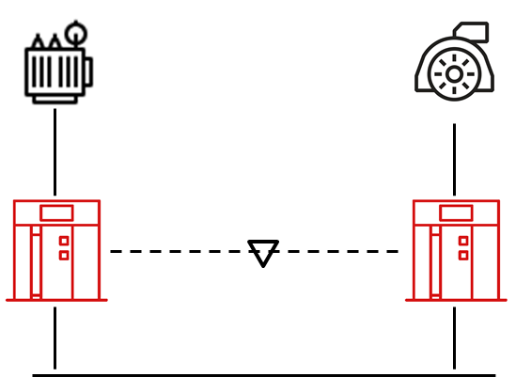


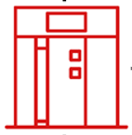
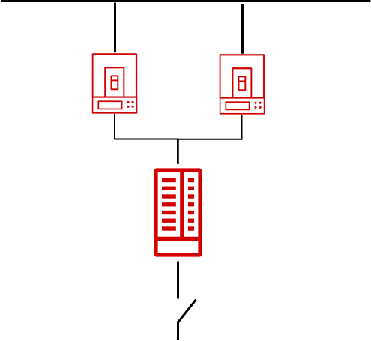
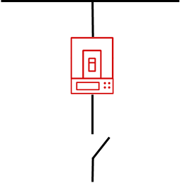




Intelligent distribution for Building
Monitor
Application Bundle - Digital Offer
Measuraments point
Lightning
Cooling
Emergency Lighting
Server Room
General critical loads
Safety Systems

Slide 35


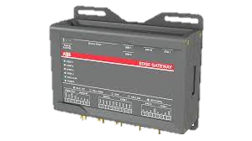
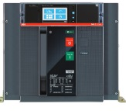
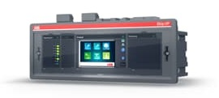
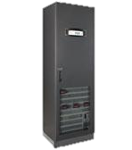
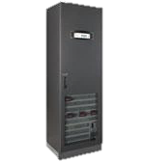
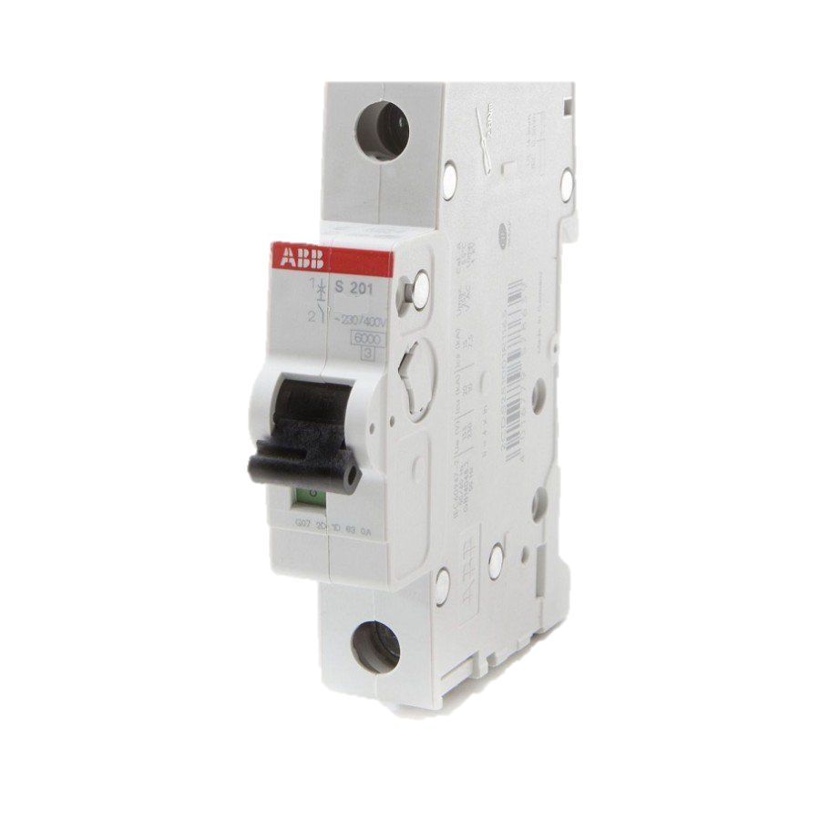
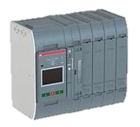
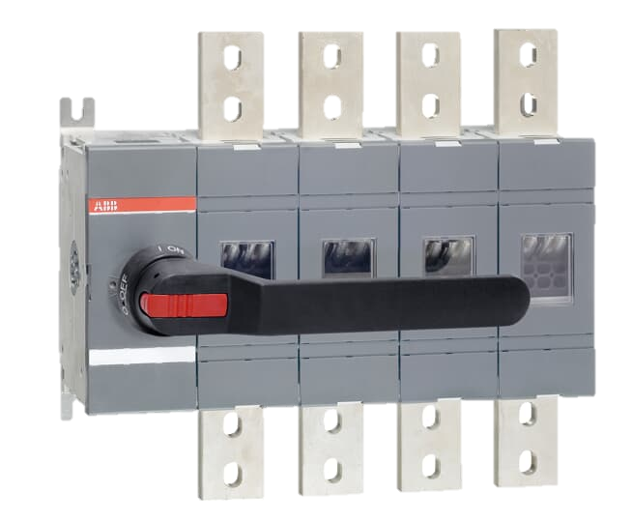
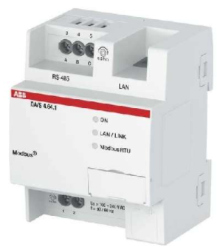
Intelligent distribution for Building
Monitor
Digital offering with enhanced components
—
Supporting communication
protocols
Cloud Monitoring
Normal Supply
ABB Edge industrial Gateway
Emergency Supply
Renewables
G
G
Fieldbus networks
Modbus RTU
Ethernet networks
Modbus TCP
Bus-tie
XT2 Ekip Touch Measuring
Tmax XT
XT2 Ekip Touch
Measuring
XT4 Ekip Hi-Touch MCCB
XT2 Ekip Touch Measuring
PowerScale or
Powerwave 33 S3
UPS
PowerScale or
Powerwave 33 S3
UPS
MCB
OT Switch disconnector
OT Switch-disconnector
TruOne
Lightning
OT Switch disconnector
DPA 250 S4
XT2 Ekip Touch Measuring
Cooling
MCB
MCB
MCB
MCB
Server Room
MCB
MCB
MCB
MCB
MCB
MCB
MCB
MCB
Safety Systems
General Critical Loads
Emergency Lighting
(*) It is recommended to monitor the transfer switch
For ABB Ability Energy & Asset Manager it is required Modbus TCP
Gas & water

Slide 36


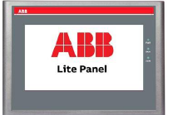
Intelligent distribution for Building
Monitor
Digital offering with enhanced components
BMS monitoring – Ethernet networks and /or ABB Ability Energy & Asset Manager
—
Supporting communication
protocols
ABB Edge industrial Gateway
Normal Supply
Emergency Supply
Renewables
ABB Lite Panel
(*)
G
G
Fieldbus networks
Modbus RTU
Ethernet networks
Modbus TCP
Bus-tie
XT2 Ekip Touch Measuring
Tmax XT
XT2 Ekip Touch
Measuring
XT2 Ekip Touch Measuring
XT4 Ekip Hi-Touch MCCB
(*)
PowerScale or
Powerwave 33 S3
UPS
PowerScale or
Powerwave 33 S3
UPS
MCB
OT Switch disconnector
OT Switch-disconnector
TruOne
OT Switch disconnector
Lightning
DPA 250 S4
+ CS141 Network Interface Card
XT2 Ekip Touch Measuring
Cooling
MCB
MCB
MCB
MCB
MCB
MCB
MCB
MCB
MCB
MCB
MCB
MCB
Server Room
Safety Systems
General Critical Loads
Emergency Lighting
(*) Lite Panel can be installed only if Modbus TCP protocol is used
For ABB Ability Energy & Asset Manager it is required Modbus TCP
Gas & water

Slide 37

Intelligent Distribution for Building – Electric power
Monitor + Control Offer
Monitor & Control Solution | Allows Metering And Power Quality Check Of Usage By Zone
Advanced solution provides a complete view of power consumption, enabling analysis for energy efficiency. As optional it is possible to check power quality of some specific loads.
Asset
Management
Predictive Maintenance​​
Redundancy For Communication​
High Granularity Measurements
Monitor +
Control
Power Quality
7 native Communication Protocols
1% Accuracy
General And Auxiliary Service Consumptions
Monitor
Total Building Consumptions
Automatic Report And Dashboard
* It is always possible to upgrade the current digital architecture thanks to a great product flexibility.
* 1% accuracy for Breakers, cannot be upgrade

Slide 38
Intelligent Distribution for Building – Electric power
Monitor +
Control
Application Bundle - Digital Offer
Monitor & Control
For Monitor & Control level of metering, it is suggested the monitoring of consumption of the services to carry out the main activity of the building and the total consumption for auxiliary services. For example, in an office building it is suggested the metering of general services required such as office lighting, HVAC, workstations, and metering of auxiliary services such as lifts, sockets other then workstations, lighting in common areas (not offices).
For what concern critical loads, it might be required the metering of emergency lighting and of some critical loads required to perform the main operation of the building.
As option, it is possible to use ABB Ability Energy and Asset Manager to benefit of automatic analysis and reporting for energy efficiency and predictive maintenance.
ABB’S offer for power distribution includes protection devices that can be customized at any time, to enable an evolution of the installation from essential to enhanced or advanced even in the future.
Solution for small – mid size building
Bundle | overview
AC power | Monitoring incoming and outgoing
Cooling in Building | Complete monitoring
Server room | Monitoring breakers & UPS
Emergency Lines | Monitoring only some critical loads
Lighting Application | Complete monitoring

Slide 39
Intelligent Distribution for Building – Electric power
Monitor +
Control
Application Bundle - Digital Offer
Measuraments point
Cooling
Lighting
Emergency Lighting
Server Room
General critical loads
Safety Systems

Slide 40
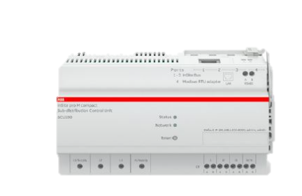
Intelligent Distribution for Building – Electric power
Monitor +
Control
Application Bundle - Digital Offer
SCADA monitoring and Control – Ethernet networks
—
Supporting communication
protocols
ABB Edge industrial Gateway
Emergency Supply
Renewables
Normal Supply
G
G
Ethernet networks
Modbus TCP
Profinet
Ethernet/IP™
IEC 61850
Bus-tie
XT2 Ekip Touch Measuring
Tmax XT
XT2 Ekip Touch
Measuring
XT2 Ekip Touch Measuring
XT4 Ekip Hi-Touch MCCB
PowerScale or
Powerwave 33 S3
UPS
PowerScale or
Powerwave 33 S3
UPS
MCB
OT Switch disconnector
OT Switch-disconnector
TruOne
Lighting
OT Switch disconnector
DPA 250 S4
+ CS141 Network Interface Card
XT2 Ekip Touch Measuring
Cooling
MCB
MCB
MCB
MCB
Server Room
MCB
MCB
MCB
MCB
MCB
MCB
MCB
MCB
Safety Systems
InSite Pro M
Emergency Lighting
General Critical Loads
(*) It is recommended to monitor the transfer switch
For ABB Ability Energy & Asset Manager it is required Modbus TCP
Gas & water

Slide 41
Intelligent Distribution for Building – Electric power
Monitor +
Control
Application Bundle - Digital Offer
SCADA monitoring and Control – Fieldbus networks
—
Supporting communication
protocols
Normal Supply
Emergency Supply
Renewables
G
G
Fieldbus networks
Modbus RTU
Profibus DP
DeviceNet™
Bus-tie
XT2 Ekip Touch Measuring
Tmax XT
XT2 Ekip Touch
Measuring
XT2 Ekip Touch Measuring
XT4 Ekip Hi-Touch MCCB
PowerScale or
Powerwave 33 S3
UPS
PowerScale or
Powerwave 33 S3
UPS
MCB
OT
TruOne
OT Switch disconnector
OT Switch disconnector
Lighting
XT2 Ekip Touch Measuring
DPA 250 S4
+ CS141 Network Interface Card
Cooling
Server Room
MCB
MCB
MCB
MCB
MCB
MCB
MCB
MCB
MCB
MCB
MCB
MCB
Safety Systems
General Critical Loads
Emergency Lighting
(*) It is recommended to monitor the transfer switch
For ABB Ability Energy & Asset Manager it is required Modbus TCP
Gas & water

Slide 42

Intelligent Distribution for Building – Electric power
The Importance Of Metering and Controlling
Asset Management Solution | Complete Monitoring And Supervision System
Advanced solution consists of complete packaging for metering of consumptions and ready to use predictive maintenance system. Redundancy of communication is also possible for large and critical buildings.
Asset
Management
Predictive Maintenance​​
Redundancy For Communication​
High Granularity Measurements
Monitor +
Control
Power Quality
7 native Communication Protocols
1% Accuracy
General And Auxiliary Service Consumptions
Monitor
Total Building Consumptions
Automatic Report And Dashboard
* It is always possible to upgrade the current digital architecture thanks to a great product flexibility.
* 1% accuracy for Breakers, cannot be upgrade

Slide 43
Intelligent Distribution for Building – Electric power
Asset
Management
Application Bundle - Digital Offer
Asset Management
Asset management level enables an in-depth monitoring of all consumptions, it is possible to group the measures by usage and by zones. It is also possible to measure power quality, when required.
As option, it is possible to use ABB Ability Energy and Asset Manager to benefit of automatic analysis and reporting for energy efficiency and predictive maintenance.
ABB’S offer for power distribution includes protection devices that can be customized at any time, to enable an evolution of the installation from essential to enhanced or advanced even in the future.
Solution for mid size building
Bundle | overview
AC power | Complete monitoring
Cooling in Building | Complete monitoring
Server room | Monitoring breakers & UPS
Emergency Lines | Complete monitoring of all the critical loads
Lighting Application | Complete monitoring
Renewables | Monitoring incoming & contact position

Slide 44
Intelligent Distribution for Building – Electric power
Asset
Management
Application Bundle - Digital Offer
Measuraments point
Lighting
Cooling
Emergency Lighting
Server Room
General critical load
Safety Systems

Slide 45
Intelligent Distribution for Building – Emergency Line
Asset
Management
Application Bundle - Digital Offer
SCADA monitoring and Control – Ethernet networks
—
Supporting communication
protocols
Normal Supply
ABB Edge industrial Gateway
ABB Lite Panel
(*)
Emergency Supply
Renewables
G
G
Ethernet networks
Modbus TCP
Profinet
EtherCAT
IEC 61850
Bus-tie
XT Ekip Hi-Touch
XT4 Ekip Hi-Touch MCCB
XT2 Ekip Touch
Measuring
XT2 Ekip Touch Measuring
PowerScale or
Powerwave 33 S3
UPS
PowerScale or
Powerwave 33 S3
UPS
MCB
OT Switch disconnector
OT Switch-disconnector
TruOne
OT Switch disconnector
Emergency
DPA 250 S4
+ CS141 Network Interface Card
XT2 Ekip Touch Measuring
Cooling
MCB
MCB
MCB
MCB
Server Room
MCB
MCB
MCB
MCB
MCB
MCB
MCB
MCB
Safety Systems
InSite Pro M
General Critical Loads
Gas & water
(*) It is recommended to monitor the transfer switch
For ABB Ability Energy & Asset Manager it is required Modbus TCP
Safety Lighting

Slide 46
Intelligent Distribution for Building – Emergency Line
Asset
Management
Application Bundle - Digital Offer
SCADA monitoring and Control – Fieldbus networks
—
Supporting communication
protocols
Normal Supply
ABB Edge industrial Gateway
Emergency Supply
Renewables
G
G
Fieldbus networks
Modbus RTU
Profibus DP
DeviceNet™
Bus-tie
XT Ekip Hi-Touch
XT4 Ekip Hi-Touch MCCB
XT2 Ekip Touch
Measuring
XT2 Ekip Touch Measuring
PowerScale or
Powerwave 33 S3
UPS
MCB
OT Switch disconnector
PowerScale or
Powerwave 33 S3
UPS
TruOne
OT
OT
Lighting
DPA 250 S4
+ CS141 Network Interface Card
XT2 Ekip Touch Measuring
Cooling
MCB
MCB
MCB
MCB
Server Room
MCB
MCB
MCB
MCB
MCB
MCB
MCB
MCB
Safety Systems
InSite Pro M
Emergency Lighting
General Critical Loads
(*) It is recommended to monitor the transfer switch
For ABB Ability Energy & Asset Manager it is required Modbus TCP
Gas & water

Slide 47
—
Value Proposition

Slide 48

Intelligent Distribution for Electric Power in Building
Value Proposition
Continuous operation
Energy Efficiency
Easy to Install
Reliable and simple to service, offering up to 40% less maintenance cost
ABB Ability Energy and Asset manager enables 24/7 monitoring with real time alerts for prompt response.
In any time, it is possible to check the healthy status of power distribution components.
Thanks to digital metering and monitoring of the electrical installation, it is possible to improve the energy efficiency by 7%, thus dramatically reducing CO₂ emissions
The protection and switching devices integrate measurement functions natively, increasing the useful information for the user and avoiding the installation of multiple sensors and elements.
ABB's Ekip Touch relays include Bluetooth technology by default to configure and supervise them at certain distance with the EPiC app, thus increasing the safety of operators in electrical installations
ABB Ability Energy and Asset Manager system automatically recognize all devices connected.

Slide 49



Intelligent Distribution for Electric Power in Building
Value Proposition
Flexibility
Optimize your project
Data and Connectivity
Simple to realize offering up to 66% less cables and up to 10% less connectivity components
Offering solutions designed to answer existing Standards and future requirements for electrical installations through Upgrade and Update solutions with near 0 downtime
Our pre-designed, pre-tested and easy to commission solutions improve the reliability of standardized critical applications, saving up to 95% of project time, up to 50% of switchgear footprint and up to 20% of UPS footprint
The Application Bundle is easily repetable thanks to the higher degree of customization or every device
Apply energy management process and diagnose problems earlier with advanced measuring, diagnostic and maintenance data
LEED and ISO 50001 system ready
Market-leading modular connectivity with Seven communication protocols.

Slide 50
—
Product Offerings

Slide 51
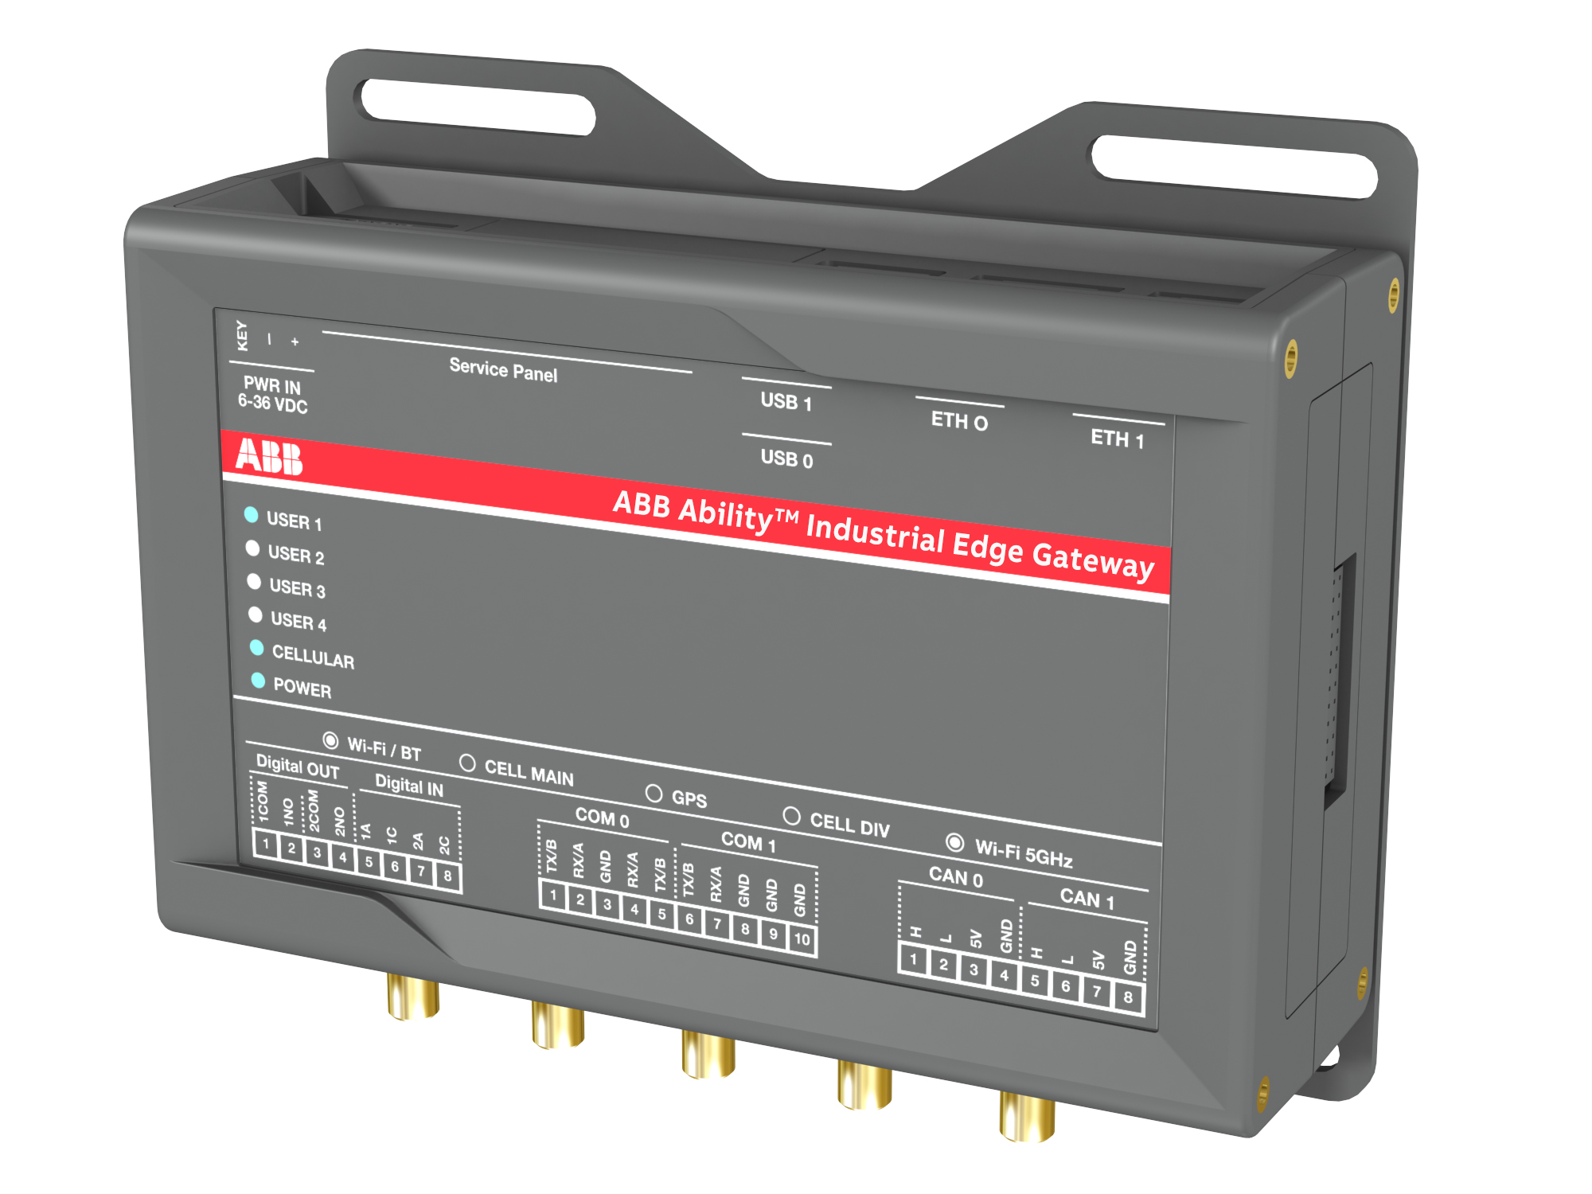

ABB AbilityTM Edge Industrial Gateway
Pricing model
—
Market adoption phase
—
Final solution
Web Server feature included within gateway price as promotional launching phase.
Leveraging on ABB AbilityTM Marketplace to align with cloud version price model positioning:
Description
Hardware gateway
Code
Code
Description
1SDA115508R1
ABB Ability Hybrid* Industrial gateway
1SDA115508R1
ABB Ability Hybrid* Industrial gateway
1SDA115509R1
ABB Ability Hybrid* Industrial gw 3G EU
1SDA115510R1
ABB Ability Hybrid* Industrial gw 3G US
Recurrent Subscriptions or Perpetual Licenses
+
Redeemed via CCT tool

Slide 52
ABB AbilityTM Edge Industrial Gateway Local View
Main details in a nutshell
—
Supported Devices
—
Available Widgets
—
Available Fuctions
45 by Modbus TCP + 15 by Modbus RTU
Device Connectivity Status
Device Current Trends
Device Power Data
Device Voltage Trends
Energy Cost
Energy Data
Energy Monitoring
Group Peak Monitoring
Group Real time currents
Group Real Time voltage
Group Real time Power
Power Demand
Power Factor
Power Generation
Power Quality
Real-time Voltage
Real-time Current
Real-time Power
Arc-guard widget
Asset Health overview (overall health condition of equipment)
Real time Temperature
Temperature Trend
Asset list (table) showing the connectivity status
Explore tab with list of assets (devices) with:
Details Status of the asset Edit asset
Data analytics tab
To create groups (also group of groups)
Settings tab:
Plant setting User management Billing parameters*
Events tab:
List of events occured Create new alert condition
In particular the alerts available are:
CB tripped, O/C, Any alarm, Any trip, and other as EAM.
Emax 2 Series Breaker
Tmax XT Breaker
New Emax series
Tmax T series
Ekip UP
TruOne
Slimline XR Gold
TVOC2 (Arc Guard)
CM-UFD
ITS2.1
Ekip Signalling TCP
CMS700
Insite Pro M
M4M
M2M
EQ Meter
EQ Matic
SWICOM
MDC4-M
REF542+

Slide 53
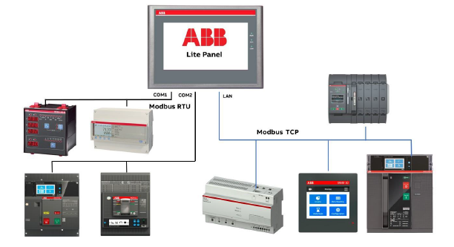
Lite Panel
Technical Data
—
Functionalities
—
Architecture
Monitoring:
  measure data like power, energy, current, voltage, power factor, power quality (harmonics for current and voltage up to 50th, THDv/i, voltage hourly average – sags – swells - spikes – unbalances - dips).
  Maintenance data like number of operations and trips, contact wears,
  fw versions, serial numbers.
  Diagnostics data like trips, warning, alarms, event and audit log, status.
Control:
  open, close and reset commands by fieldbus
Languages:
  English and Chinese with manual built-in the Panel
User administration: 5 level of user profiles to grant different access permissions by passwords (Administrator, Developer, Engineer, Operator, Guest)

Slide 54
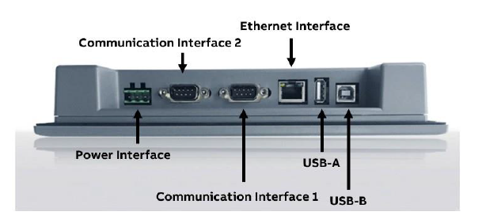
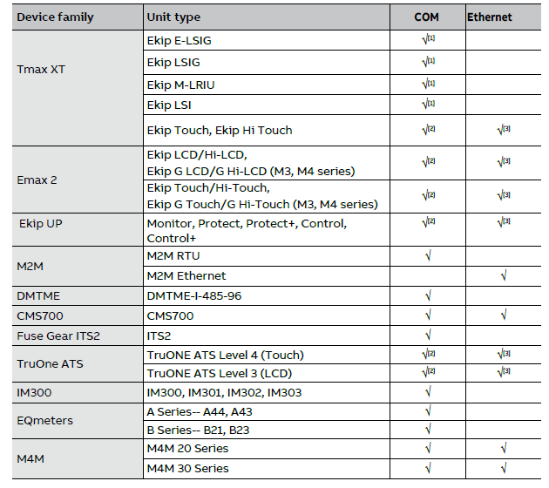
Lite Panel
Technical Data
—
Ports
—
Device supported
—
Functionalities
Product already integrated: Emax 2, Tmax XT, Ekip UP, TruOne, ITS2, CMS700*, M4M, M2M, EQmeters, DMTME, IM300
Communication ports: 1 x RJ45, 2 x RS485, 1 USB port for fw upgrade by ABB authorized personnel
Automatic scan: up to 20 devices by Modbus TCP/IP, up to 16 devices by Modbus RTU (8 for each port), up to 20 devices by Modbus TCP/IP + 8 devices by Modbus RTU at same time
Modbus TCP/IP connectivity recommended in order to work with other clients in parallel*
Use adapter for the RS485 port

Slide 55
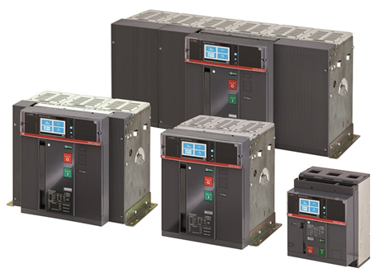

Digital Solutions - Components
Application Bundle - Digital Offer: useful ABB Ability Energy Manager widgets and acquired data
—
Emax 2 (with Ekip Hi- Touch trip units)
—
ABB Ability Energy Manager Widgets
Power Factor
Show both real-time and average values of the power factor for selected assets on main feeding lines.
Power Quality – THD
Monitor parameters on the network power quality for specific assets.
Power Quality – Voltage
Monitor parameters on the network power quality for specific assets.

Slide 56
Smart metering and monitoring
Emax 2 – metering and monitoring features
Measurements | Availability | Accuracy* | Accuracy**
Currents (RMS) [A] L1, L2, L3, Ne*** | X | 0.5 | 1
Ground fault current (RMS) [A] Ig | X | 0.5 | 2
Phase-phase voltage (RMS) [V] U12,U23,U31 | X | 0.5 | 0.5
Phase-neutral voltage (RMS) [V] U1,U2,U3 | X | 0.5 | 0.5
Frequency [Hz] f | X | 0.2 | 0.2
Active power [kW] P1,P2,P3,Ptot | X | 1 | 2
Reactive power [kVAR] Q1,Q2,Q3,Qtot | X | 2 | 2
Apparent power [KVA] S1,S2,S3,Stot | X | 1 | 2
Power factor PF1,PF2,PF3,PFtot | X | 1 | 2
Active energy [kW] Ep total, Ep positive, Ep negative | X | 1 | 2
Reactive energy [kVAR] Eq total, Ep positive, Ep negative | X | 2 | 2
Apparent energy [KVA] Es total | X | 1 | 2
Power Quality | X |  | Up to 50th harmonic
Data Logger | X
Sampling frequency |  |  | 1200-2400-4800-9600 Hz

Slide 57
Smart metering and monitoring
Emax 2 – metering and monitoring features
Communication protocols | Availability | Note
Modbus RTU | X | By adding Ekip module
Modbus TCP | X | By adding Ekip module
IEC61850 | X | By adding Ekip module
Profibus-DP | X | By adding Ekip module
Profinet | X | By adding Ekip module
Ethernet / IP | X | By adding Ekip module
DeviceNet | X | By adding Ekip module
BACnet/IP
Cloud connectivity | X | By adding Ekip module
Bluetooth | X | Available on the product
Ekip Link | X | ABB Proprietary protocol; By adding Ekip module
Digital I/O | X | Up to 10 digital I/O; By adding Ekip module
Other notes
Gateway to the cloud system EDCS |  | Yes
Internal memory |  | No
The lowest current value detected is 0,004 x In
3 inputs for PT1000 for temperature monitoring and 1 channel for 4-20mA Input

Slide 58

Digital Solutions - Components
Application Bundle - Digital Offer: useful ABB Ability Energy Manager widgets and acquired data
—
Tmax XT (with Ekip Hi- Touch trip units)
—
ABB Ability Energy Manager Widgets
Power Factor
Show both real-time and average values of the power factor for selected assets on main feeding lines.
Power Quality – THD
Monitor parameters on the network power quality for specific assets.
Power Quality – Voltage
Monitor parameters on the network power quality for specific assets.

Slide 59
Smart metering and monitoring
Tmax XT– metering and monitoring features
Measurements | Availability | Accuracy* | Accuracy**
Currents (RMS) [A] L1, L2, L3, Ne | X | 0.5 | 1
Ground fault current (RMS) [A] Ig | X | 0.5 | 2
Phase-phase voltage (RMS) [V] U12,U23,U31 | X | 0.5 | 0.5
Phase-neutral voltage (RMS) [V] U1,U2,U3 | X | 0.5 | 0.5
Frequency [Hz] f | X | 0.2 | 0.2
Active power [kW] P1,P2,P3,Ptot | X | 1 | 2
Reactive power [kVAR] Q1,Q2,Q3,Qtot | X | 2 | 2
Apparent power [KVA] S1,S2,S3,Stot | X | 1 | 2
Power factor PF1,PF2,PF3,PFtot | X | 1 | 2
Active energy [kW] Ep total, Ep positive, Ep negative | X | 1 | 2
Reactive energy [kVAR] Eq total, Ep positive, Ep negative | X | 2 | 2
Apparent energy [KVA] Es total | X | 1 | 2
Power Quality | X |  | Up to 50th harmonic
Data Logger | X
Sampling frequency |  |  | 1200-2400-4800-9600 Hz

Slide 60
Smart metering and monitoring
Tmax XT– metering and monitoring features
Communication protocols | Availability | Note
Modbus RTU | X | By adding Ekip module
Modbus TCP | X | By adding Ekip module
IEC61850 | X | By adding Ekip module
Profibus-DP | X | By adding Ekip module
Profinet | X | By adding Ekip module
Ethernet / IP | X | By adding Ekip module
DeviceNet | X | By adding Ekip module
BACnet/IP
Cloud connectivity | X | By adding Ekip module
Bluetooth | X | Available on the product
Ekip Link | X | ABB Proprietary protocol; By adding Ekip module
Digital I/O | X | Up to 10 digital I/O; By adding Ekip module
Other notes
Gateway to the cloud system EDCS |  | Yes
Internal memory |  | No
The lowest current value detected is 0,004 x In
3 inputs for PT1000 for temperature monitoring and 1 channel for 4-20mA Input

Slide 61




Smart metering and monitoring
Ekip Touch trip units: Circuit-breakers customization has never been so easy.
With the Ekip Touch trip units, the most advanced functionalities can be enabled following two different purchasing processes: ABB Ability MarketplaceTM or Traditional Ordering.
The great flexibility of these trip units allow customers to fulfill future needs without the drawback of replacing any part of the circuit breaker
Ekip Touch is the least requirement needed for having digital architectures including circuit breakers

Slide 62


Digital Solutions - Components
Application Bundle - Digital Offer: useful ABB Ability Energy Manager widgets and acquired data
—
TruOne ATS (Level 4 controls)
—
ABB Ability Energy Manager Widgets
ATS Diagnostics
Show the automatic transfer switch diagnostics.
ATS Source Status
Shows the source status of the Automatic Transfer Switch asset.
ATS Transfer Time
Measure the total transfer time form Priority (Normal) to Non-priority (Emergency) source. Compare the measured time with the preset threshold (pass/fail).

Slide 63



System pro M compact® InSite
System overview
SCU100 control unit
Digital Modules (DM)
InSite webserver
Control unit as single access point in the sub-distribution panelboard
  Data aggregator from field devices
  Data storage
  Send information to ABB Ability™ EDCS
Operations:
  In addition to branch monitioring sensors, control unit receives data from I/O modules (to support all main application functionalities), and metering via Modbus RTU
  Digital input module with 4 channels → DM11
  Digital output module with 4 channels → DM00
  Digital input/output module with 4 channels (2 inputs and 2 outputs) → DM10
No external power supply
Operations:
    Input to receive data from hard-wired connected devices (accessories, meters)
    Output to act on connected accessories
Monitoring of the complete system
Configuration
Remote action both manual and through implementation of automated logics
Real time alarms/alerts
Historical data, comparison between different devices

Slide 64


















System pro M compact® InSite
Solution architecture
DIGITAL SOLUTION
Digital platform (ABB Ability™) provider of services
Rest API – Connection
to 3rd party cloud
Embedded
local webserver
Integration in
any BMS/Scada
ABB Ability EDCS
ABB Ability™
Integration to any target platform in the market
CONNECTIVITY SYSTEM
Platform to gather information from electrical installation
Modbus TCP & RTU
InSite-Bus
Sub-distribution control unit
SCU100
I/O Modules
PROTOCOL
InSite-Bus
Digital I/O (2 wires each device)
ENERGY DISTRIBUTION PORTFOLIO
complete portfolio typically in sub-distribution panel
Energy & power qualiry
Branch monitoring
Protection & other devices
Energy meters
Power meters
Current sensors
Main breakers
Signal and auxiliary
Motor operating devices
Shunt trips
Other accessories, Contactors, relays
Pulse counters
Others

Slide 65

Smart metering and monitoring
TruONE ATS – metering and monitoring features
Measurements | Availability | Accuracy*
Currents (RMS) [A] L1, L2, L3, Ne | X
Ground fault current (RMS) [A] Ig | X
Phase-phase voltage (RMS) [V] U12,U23,U31 | X
Phase-neutral voltage (RMS) [V] U1,U2,U3 | X
Frequency [Hz] f | X
Active power [kW] P1,P2,P3,Ptot | X
Reactive power [kVAR] Q1,Q2,Q3,Qtot | X
Apparent power [KVA] S1,S2,S3,Stot | X
Power factor, PFtot | X
Active energy [kW] Ep total | X
Reactive energy [kVAR] Eq total | X
Apparent energy [KVA] Es total | X
Harmonics | X
OTHER NOTES
Gateway to the cloud system EDCS | Yes
Internal memory | No
The lowest current value detected is 0,05 x In
Temperature sensors embedded: on load side terminals, HMI display and device

Slide 66
Smart metering and monitoring
TruONE ATS – metering and monitoring features
Communication protocols | Availability | Note
Modbus RTU | X | By adding Ekip module
Modbus TCP | X | By adding Ekip module
IEC61850
Profibus-DP | X | By adding Ekip module
Profinet | X | By adding Ekip module
Ethernet / IP | X | By adding Ekip module
DeviceNet | X | By adding Ekip module
BACnet/IP
Cloud connectivity | X | By adding Ekip module
Bluetooth
Ekip Link
Digital I/O* | X | 2 digital I/O; By adding Ekip module
Other notes
Gateway to the cloud system EDCS |  | Yes
Internal memory |  | No
The lowest current value detected is 0,05 x In
Temperature sensors embedded: on load side terminals, HMI display and device

Slide 67

Smart metering and monitoring
Environmental data – Ekip Signaling 3T
Analog inputs | Temperature Current | 3 channels thermoresistance PT1000/PT100 1 channel 4-20mA
Type of sensors | Temperature Current | PT1000 2 wires with maximum length 3mt PT1000 2 wires ABB for bar mounting PT100 4÷20mA sensor with maximum length 3mt
Measurement Range | Temperature Current | -50÷+250°C 4÷20mA
Channel Accuracy | Temperature Current | ±0.25°C (without sensor), range -25÷ +150°C ±0.5°C (without sensor), full range ±1% fs ± 1 digit
Insulation Voltage | Module not insulate. Insulation must be guarantee using an adequate PT1000 or 4-20mA sensor

Slide 68

Smart metering and monitoring
SlimLine XRG – metering and monitoring features
Measurements | Availability | Accuracy* | Notes
Currents (RMS) [A] L1, L2, L3, Ne | X | 1 | 0 – 1,3 x In
Ground fault current (RMS) [A] Ig
Phase-phase voltage (RMS) [V] U12,U23,U31 | X | 1 | 10 – 900vac
Phase-neutral voltage (RMS) [V] U1,U2,U3 | X | 1
Frequency [Hz] f | X
Active power [kW] P1,P2,P3,Ptot | X
Reactive power [kVAR] Q1,Q2,Q3,Qtot | X
Apparent power [KVA] S1,S2,S3,Stot | X
Power factor PF1,PF2,PF3,PFtot | X
Active energy [kW] Ep total, Ep positive, Ep negative | X
Reactive energy [kVAR] Eq total, Ep positive, Ep negative | X
Apparent energy [KVA] Es total | X
Power Quality
Temperature(℃) | X |  | 0 – 127℃ on L2
Sampling frequency

Slide 69
Smart metering and monitoring
SlimLine XRG – metering and monitoring features
Communication protocols | Availability | Note
Modbus RTU | X
Modbus TCP | X
IEC61850
Profibus-DP
Profinet
Ethernet / IP
DeviceNet
BACnet/IP
Cloud connectivity | X | Do not represent a gateway
Bluetooth
Ekip Link
Digital I/O*
Other notes
Gateway to the cloud system EDCS | No
Internal memory | No

Slide 70

Smart metering and monitoring
InLineII – metering and monitoring features
Measurements | Availability | Accuracy* | Notes
Currents (RMS) [A] L1, L2, L3, Ne | X | 1 | 0 – 1,3 x In
Ground fault current (RMS) [A] Ig
Phase-phase voltage (RMS) [V] U12,U23,U31 | X | 1 | 10 – 900vac
Phase-neutral voltage (RMS) [V] U1,U2,U3 | X | 1
Frequency [Hz] f | X
Active power [kW] P1,P2,P3,Ptot | X
Reactive power [kVAR] Q1,Q2,Q3,Qtot | X
Apparent power [KVA] S1,S2,S3,Stot | X
Power factor PF1,PF2,PF3,PFtot | X
Active energy [kW] Ep total, Ep positive, Ep negative | X
Reactive energy [kVAR] Eq total, Ep positive, Ep negative | X
Apparent energy [KVA] Es total | X
Power Quality
Temperature(℃) | X |  | 0 – 127℃ on L2
Sampling frequency

Slide 71
Smart metering and monitoring
InLineII – metering and monitoring features
Communication protocols | Availability | Note
Modbus RTU | X
Modbus TCP | X
IEC61850
Profibus-DP
Profinet
Ethernet / IP
DeviceNet
BACnet/IP
Cloud connectivity | X | Do not represent a gateway
Bluetooth
Ekip Link
Digital I/O*
Other notes
Gateway to the cloud system EDCS | No
Internal memory | No

Slide 72
Smart metering and monitoring
OT with ITS2 – metering and monitoring features
Measurements | Availability | Accuracy | Note
Currents (RMS) [A] L1, L2, L3, Ne | X | 1 | 0 – 1,3 x In
Ground fault current (RMS) [A] Ig
Phase-phase voltage (RMS) [V] U12,U23,U31 | X | 1 | 10 – 900vac
Phase-neutral voltage (RMS) [V] U1,U2,U3 | X | 1
Frequency [Hz] f | X
Active power [kW] P1,P2,P3,Ptot | X
Reactive power [kVAR] Q1,Q2,Q3,Qtot | X
Apparent power [KVA] S1,S2,S3,Stot | X
Power factor PF1,PF2,PF3,PFtot | X
Active energy [kW] Ep total, Ep positive, Ep negative | X
Reactive energy [kVAR] Eq total, Ep positive, Ep negative | X
Apparent energy [KVA] Es total | X
Power Quality
Temperature(℃) | X |  | 0 – 127℃ on L2
Sampling frequency
OTHER NOTES
Gateway to the cloud system EDCS | Yes
Internal memory | No
The lowest current value detected is 0,05 x In
Temperature sensors embedded: on load side terminals, HMI display and device

Slide 73
Smart metering and monitoring
OT with ITS2 – metering and monitoring features
Communication protocols | Availability | Note
Modbus RTU | X
Modbus TCP |  | Will be enabled in 2020
IEC61850
Profibus-DP
Profinet
Ethernet / IP
DeviceNet
BACnet/IP
Cloud connectivity | X | Do not represent a gateway
Bluetooth
Ekip Link
Digital I/O*
Other notes
Gateway to the cloud system ABB Ability Energy and Asset Manager | No
Internal memory | No

Slide 74

Smart metering and monitoring
Contacts monitoring
Ekip Signalling 10K
external signaling accessory module that can be installed on a DIN rail.
It is provided with
• 10 contacts for output signals.
• 10 or 11 digital inputs.
The module can communicate with the outside in two alternative ways:
• Via Local Bus, with a single trip unit equipped with an Ekip Supply power supply module.
• Via Link Bus, with a maximum of four trip units each equipped with an Ekip Link module.

Slide 75

PowerWave 33 S3 60-120 kW
Specifications – brief overview
Technical Highlights
Perfomance classification IEC/EN 62040-3 | VFI-SS-111
UPS topology | on-line double conversion, transformer free
Power rating | 60, 80, 100, 120 kW(*)
Paralleling | 10 UPS in parallel
System Power Range | 60 kW – 1200 kW
Output power factor | 1.0
Efficiency in double conversion | up to 96 %
Efficiency in eco-mode | >99 %
Input current distortion THDi | < 3.5%
Input power factor (PF) | 0.99
Fault clearing capability (inverter) | 2.0 x In
Fault clearing capability (bypass) | 10 x In
Integrated maintenance bypass | Yes

Slide 76


PowerScale 10-50 kVA standalone 3ph UPS(*)
Feature highlights
Product features
Highest reliability and increased availability with True on-line double conversion (VFI) UPS – 3ph input / 3ph output
Minimizes energy losses with industry top-level double conversion efficiency up to 95.5%
Optimized for modern IT loads with rated output power factor 0.9
Low input line disturbances; input PF 0.99 @ 100% load – THDI≤ 3%
Up to 20 units can be connected in parallel for redundancy and/or to increase system capacity
Integrated manual bypass switch
Ease of servicing and short MTTR ensure cost for downtime – scheduled and unscheduled – is minimized
High variety of runtimes can be supported by using cabinet internal batteries only. This makes the system compact and saves installation space
Fit for different installation environments by having both, single or dual input feed, supported
  Cabinet A
  10–20 kVA
  Cabinet B
  10–25 kVA
  Cabinet C
  25–50 kVA

Slide 77
System pro M compact® InSite SCU100
Metering and monitoring features
Technical feature | Unit | Description
Supply voltage | [VAC] | 80-277 (L1-N, +5%)
Frequency | [Hz] | 50/60
Power input (L1-N) | [W] | 5...45 depending on number of sensors and I/O modules
Power input , current transformer, secondary side | [VA] | Current circuit <2 (per phase)
Voltage measurement range | [VAC] | 80-277 (L1, L2, L3-N)
Measurement range, current transformer, secondary side | [A] | nominal: 5 max: 6
Hramonic component | [Hz] | up to 2000
Data rate of Modbus RTU | [Baud] | RS485 2- wire, 2400...115200
Refresh time | [Mbit/s] | 1sec / 30 sec (depending on type of data)
Data storage and export |  | Integrated 1-year data storage Automatic CSV data export
Communication |  | LAN: Modbus TCP/IP, SNMP v1, v2, encrypted v3 RS485: Modbus RTU
Connected devices |  | Up to 96 sensors/digital channels Up to 16 meters
LAN | [Mbit/s] | 100
Conductor cross-section | [mm2] | 0.5...2.5
Mounting method |  | 35mm DIN rail (DIN 5022)
Degree of protection |  | IP20
Dimensions | [mm] | 161.5x87.0x64.9 (9WM)
Oparating temperature | [°C] | -25... +60
Stirage temperature | [°C] | -40... +85
Standards |  | IEC61010-1
Note: user manual

Slide 78
System pro M compact® InSite SCU100
metering and monitoring features
Main circuit accuracy | Description
Voltage | ± 1%
Current | ± 1%
Harmonic component (up to 2500Hz) | ± 1%
Active power | ± 2%
Apparent power | ± 2%
Reactive power | ± 2%
Power factor | ± 2%
user manual

Slide 79

Smart metering and monitoring
Ekip UP– metering and monitoring features
Measurements | Availability | Accuracy
Currents (RMS) [A] L1, L2, L3, Ne | X | 1
Ground fault current (RMS) [A] Ig | X | 2
Phase-phase voltage (RMS) [V] U12,U23,U31 | X | 0.7
Phase-neutral voltage (RMS) [V] U1,U2,U3 | X | 1
Frequency [Hz] f | X | 0.2
Active power [kW] P1,P2,P3,Ptot | X | 2
Reactive power [kVAR] Q1,Q2,Q3,Qtot | X | 2
Apparent power [KVA] S1,S2,S3,Stot | X | 2
Power factor PF1,PF2,PF3,PFtot | X | 2
Active energy [kW] Ep total, Ep positive, Ep negative | X | 2
Reactive energy [kVAR] Eq total, Ep positive, Ep negative | X | 2
Apparent energy [KVA] Es total | X | 2
Power Quality | X | Up to 50th harmonic
Data Logger | X
Sampling frequency |  | 1200-2400-4800-9600 Hz

Slide 80
Smart metering and monitoring
Ekip UP– metering and monitoring features
Communication protocols | Availability | Note
Modbus RTU | X | By adding Ekip module
Modbus TCP | X | By adding Ekip module
IEC61850 | X | By adding Ekip module
Profibus-DP | X | By adding Ekip module
Profinet | X | By adding Ekip module
Ethernet / IP | X | By adding Ekip module
DeviceNet | X | By adding Ekip module
BACnet/IP
Cloud connectivity | X | By adding Ekip module
Bluetooth
Ekip Link | X | ABB Proprietary protocol; By adding Ekip module
Digital I/O | X | Up to 10 digital I/O; By adding Ekip module
Other notes
Gateway to the cloud system EDCS |  | Yes
Internal memory |  | No
The lowest current value detected is 0,003 x In
3 inputs for PT1000 for temperature monitoring and 1 channel for 4-20mA Input

Slide 81

CM-UFD.*M – Grid feeding monitoring relay with Modbus RTU
Metering and monitoring features
Countries with a dedicated local standard:
Great Britain: CM-UFD.M33M
Austria: CM-UFD.M31M
United Arabic Emirates: CM-UFD.M34M
Germany: CM-UFD.M31M
Italy: CM-UFD.M22M
Countries referring to an existing local standard or using a product with reference to another dedicated standard:
Australia: CM-UFD.M33M
Jordan: CM-UFD.M33M (refers to GB standard)
South Africa: CM-UFD.M31M, CM-UFD.M22M
Switzerland: CM-UFD.M31M
Turkey: CM-UFD.M31M (refers to DE standard)

Slide 82
CM-UFD.*M – Grid feeding monitoring relay with Modbus RTU
Metering and monitoring features
Type | CM-UFD.M22M | CM-UFD.M31 | CM-UFD.M31M | CM-UFD.M33 | CM-UFD.M33M | CM-UFD.M34M
Rated control supply voltage Us
24-240 V AC/DC | x | x | x | x | x | x
Standard
CEI 0-21 | x
VDE AR-N 4105, VDE AR-N 4110 |  | x | x
ENA G98, G99 |  |  |  | x | x
DRRG standard of DEWA |  |  |  |  |  | x
Rated frequency
DC or 50 Hz | x | x | x
DC or 50/60 Hz |  |  |  | x | x | x
Modbus RTU
Suitable for monitoring
Single-phase mains | x | x | x | x | x | x
Three-phase mains | x | x | x | x | x | x
Monitoring function
Over-/undervoltage | x | x | x | x | x | x
Over-/underfrequency | x | x | x | x | x | x
ROCOF (rate of change of frequency) | x | x | x | x | x | x
10 minutes average value | x | x | x | x | x | x
Vector shift |  | x | x | x | x | x
Thresholds | adj | adj | adj | adj | adj | adj

Slide 83

Other components
Installation contactors
ESB…N contactors
The ESB100..N installation contactors are used to control single and three-phase loads up to 100 A and can be operated by AC or DC.
These contactors are made for use in household applications as well as in industrial environments.
The following benefits are provided:
Hum-free operation, low power consumption and integrated overvoltage protection.
Various contact combinations and accessories are available.

Slide 84

Digital Solutions - Components
Embedded ATS Bill of Materials
—
Main – Gen Application
—
BOM
2 Emax 2 circuit breakers
Hi – touch trip unit or Touch trip unit + measuring Pro
ATS license
2 Ekip Link communication modules
Shunt Opening Release (YO)
Shunt Closing Release (YC)
Motor (M)
Ekip Com Actuator
Notes:
https://search.abb.com/library/Download.aspx?DocumentID=1SFC132012C0201&LanguageCode=en&DocumentPartId=&Action=Launch

Slide 85
INTERNAL ONLY
—
Competitive Analysis

Slide 86


Smart metering and monitoring
INTERNAL ONLY
Supervision system – Cloud monitoring
—
ABB Ability Energy Manager
—
MindSphere

Slide 87

Smart metering and monitoring
INTERNAL ONLY
Emax 2 – Metering and monitoring features
 | Emax 2 with |  |  |  | 3WA ACB s Family
Measurements | Availability | Accuracy* | Accuracy** | Note | Availability | Accuracy | Note
Currents (RMS) [A] L1, L2, L3, Ne*** | X | 0.5 | 1 |  | x | 1% | With ETU600 With at least PMF II
Ground fault current (RMS) [A] Ig | X | 0.5 | 2 |  | x | 1% | With ETU600 With at least PMF II
Phase-phase voltage (RMS) [V] U12,U23,U31 | X | 0.5 | 0.5 |  | x | 1% | With ETU600 With at least PMF II
Phase-neutral voltage (RMS) [V] U1,U2,U3 | X | 0.5 | 0.5 |  | x | 1% | With ETU600 With at least PMF II
Frequency [Hz] f | X | 0.2 | 0.2 |  |  |  | With ETU600 With at least PMF II
Active power [kW] P1,P2,P3,Ptot | X | 1 | 2 |  | X | 2% | With ETU600 With at least PMF II
Reactive power [kVAR] Q1,Q2,Q3,Qtot | X | 2 | 2 |  | X | 2% | With ETU600 With at least PMF II
Apparent power [KVA] S1,S2,S3,Stot | X | 1 | 2 |  | X | 2% | With ETU600 With at least PMF II
Power factor PF1,PF2,PF3,PFtot | X | 1 | 2 |  |  |  | With ETU600 With at least PMF II
Active energy [kW] Ep total, Ep positive, Ep negative | X | 1 | 2 |  | X | 2% | With ETU600 With at least PMF II
Reactive energy [kVAR] Eq total, Ep positive, Ep negative | X | 2 | 2 |  | X | 2% | With ETU600 With at least PMF II
Apparent energy [KVA] Es total | X | 1 | 2 |  | x | 2% | With ETU600 With at least PMF II
Power Quality | X |  | Up to 50th harmonic |  | x |  | With ETU600 With PMF III
Data Logger | X

Slide 88
Smart metering and monitoring
INTERNAL ONLY
Emax 2 – metering and monitoring features
 |  | ABB |  |  | SIEMENS
Communication protocols |  | Availability | Note |  | Availability | Note
Modbus RTU |  | X | By adding Ekip module |  | x | With COM 190
Modbus TCP |  | X | By adding Ekip module |  | x | With COM 19O
IEC61850 |  | X | By adding Ekip module
Profibus-DP |  | X | By adding Ekip module |  | x | With COM 19O
Profinet |  | X | By adding Ekip module |  | x | With COM 19O
Ethernet / IP |  | X | By adding Ekip module
DeviceNet |  | X | By adding Ekip module
BACnet/IP
Cloud connectivity |  | X | By adding Ekip module
Bluetooth |  | X | Available on the product
Ekip Link |  | X | ABB Proprietary protocol; By adding Ekip module
Digital I/O |  | X | Up to 10 digital I/O; By adding Ekip module

Slide 89

Smart metering and monitoring
INTERNAL ONLY
Tmax XT– Metering and monitoring features
 | ABB- Touch Measuring |  |  |  | Siemens 3VA
Measurements | Availability | Accuracy* | Accuracy** | Note | Availability | Accuracy*
Currents (RMS) [A] L1, L2, L3, Ne*** | X | 0.5 | 1 |  | x | 1%
Ground fault current (RMS) [A] Ig | X | 0.5 | 2 |  | x | 1%
Phase-phase voltage (RMS) [V] U12,U23,U31 | X | 0.5 | 0.5 |  | x | 1%
Phase-neutral voltage (RMS) [V] U1,U2,U3 | X | 0.5 | 0.5 |  | x | 1%
Frequency [Hz] f | X | 0.2 | 0.2
Active power [kW] P1,P2,P3,Ptot | X | 1 | 2 |  | X | 2%
Reactive power [kVAR] Q1,Q2,Q3,Qtot | X | 2 | 2 |  | X | 2%
Apparent power [KVA] S1,S2,S3,Stot | X | 1 | 2 |  | X | 2%
Power factor PF1,PF2,PF3,PFtot | X | 1 | 2
Active energy [kW] Ep total, Ep positive, Ep negative | X | 1 | 2 |  | X | 2%
Reactive energy [kVAR] Eq total, Ep positive, Ep negative | X | 2 | 2 |  | X | 2%
Apparent energy [KVA] Es total | X | 1 | 2 |  | x | 2%
3VA27 is out of this analysis, since it is our XT7 in brand labeling

Slide 90
Smart metering and monitoring
INTERNAL ONLY
Tmax XT– Metering and monitoring features
 | ABB |  |  | Competitor
Communication protocols | Availability | Note |  | Availability | Note
Modbus RTU | X | By adding Ekip module |  | x | from 3VA MCCBthere is a so called 3VA line communication that goes inside the external device COM800 For protocol conversion
Modbus TCP | X | By adding Ekip module |  | x
IEC61850 | X | By adding Ekip module
Profibus-DP | X | By adding Ekip module |  | x
Profinet | X | By adding Ekip module |  | x
Ethernet / IP | X | By adding Ekip module
DeviceNet | X | By adding Ekip module
BACnet/IP
Cloud connectivity | X | By adding Ekip module
Bluetooth | X | Available on the product
Ekip Link | X | ABB Proprietary protocol; By adding Ekip module
Digital I/O | X | Up to 10 digital I/O; By adding Ekip module

Slide 91

Smart metering and monitoring
INTERNAL ONLY
Siemens 3VA MCCB architecture
—
Siemens 3VA MCCB architecture

Slide 92


Smart metering and monitoring
INTERNAL ONLY
Supervision system – cloud monitoring
—
ABB Ability - Energy & Asset Manager
—
EATON – Brightlayer
https://www.eaton.com/us/en-us/company/digital-innovation/brightlayer.html?wtredirect=www.eaton.com/brightlayer

Slide 93
Smart metering and monitoring
INTERNAL ONLY
Supervision system – cloud monitoring
ABB Ability – Energy & Asset Manager
EATON - EATON – Brightlayer
abb-ability-energy-and-asset-manager-for-chemicals-oil-and-gas
abb-ability-energy-and-asset-manager-for-data-centers
abb-ability-energy-and-asset-manager-for-buildings
abb-ability-energy-and-asset-manager-for-manufacturing / Manufacturing / Food & Beverage
Brightlayer Industrial suite (eaton.com)
Power management software |Eaton Brightlayer Data Center suite
Not yet available dedicated link for Building
Not yet available dedicated link for Utility

Slide 94

Smart metering and monitoring
INTERNAL ONLY
Emax 2 – metering and monitoring features
 | ABB - TOUCH - MEASURING |  |  |  | EATON - PXR25
Measurements | Availability | Accuracy* | Accuracy** | Note | Availability | Accuracy | Note
Currents (RMS) [A] L1, L2, L3, Ne*** | X | 0.5 | 1 |  | x | 1%
Ground fault current (RMS) [A] Ig | X | 0.5 | 2
Phase-phase voltage (RMS) [V] U12,U23,U31 | X | 0.5 | 0.5 |  | x | 1%
Phase-neutral voltage (RMS) [V] U1,U2,U3 | X | 0.5 | 0.5
Frequency [Hz] f | X | 0.2 | 0.2
Active power [kW] P1,P2,P3,Ptot | X | 1 | 2 |  | x | 2%
Reactive power [kVAR] Q1,Q2,Q3,Qtot | X | 2 | 2 |  | x | 2%
Apparent power [KVA] S1,S2,S3,Stot | X | 1 | 2 |  | x | 2%
Power factor PF1,PF2,PF3,PFtot | X | 1 | 2 |  | X | 2%
Active energy [kW] Ep total, Ep positive, Ep negative | X | 1 | 2 |  | x | 2%
Reactive energy [kVAR] Eq total, Ep positive, Ep negative | X | 2 | 2 |  | x | 2%
Apparent energy [KVA] Es total | X | 1 | 2 |  | x | 2%
Power Quality | X |  | Up to 50th harmonic
Data Logger | X |  |  |  | x
Sampling frequency |  |  | 1200-2400-4800-9600 Hz
upradability | X |  |  | Measuring and protection upgradable from Marke place
Temperature | X |  |  | 3T module
4-20mA input | x |  |  | with 3T module
Other parameters | X
Breaker health monitor | x |  |  | with ABB ability EAM | X |  | present as standard function

Slide 95
Smart metering and monitoring
INTERNAL ONLY
Emax 2 – metering and monitoring features
 | ABB |  |  | EATON - PXR25
Communication protocols | Availability | Note |  | Availability | Note
Modbus RTU | X | By adding Ekip module |  | x | onboard | P Type (PXR25)
Modbus TCP | X | By adding Ekip module |  | X | Modbus TCP, http(s), SMTP | webserver function on board
IEC61850 | X | By adding Ekip module
Profibus-DP | X | By adding Ekip module |  | X
Profinet | X | By adding Ekip module
Ethernet / IP | X | By adding Ekip module |  | x
DeviceNet | X | By adding Ekip module
BACnet/IP
Cloud connectivity | X | By adding Ekip module
Bluetooth | X | Available on the product
Ekip Link | X | ABB Proprietary protocol; By adding Ekip module
Digital I/O | X | Up to 10 digital I/O; By adding Ekip module
OTHER NOTES
Gateway to the cloud system EAM | Yes |  |  | yes | with VISIOBREAK
Internal memory | No
The lowest current value detected is 0,004 x In
3 inputs for PT1000 for temperature monitoring and 1 channel for 4-20mA input
Test and Programming Software | x | Ekip connect / EPIC |  | x | Power Xpert Protection Management (PXPM)

Slide 96

Smart metering and monitoring
INTERNAL ONLY
Tmax XT– metering and monitoring features
 | ABB - HI-TOUCH M |  |  |  | EATON NZM- TRIP UNIT PXR25
Measurements | Availability | Accuracy* | Accuracy** | Note | Availability | Accuracy* | Note
Currents (RMS) [A] L1, L2, L3, Ne*** | X | 0.5 | 1 |  | X | 0,5
Ground fault current (RMS) [A] Ig | X | 0.5 | 2 |  | X | 0,5
Phase-phase voltage (RMS) [V] U12,U23,U31 | X | 0.5 | 0.5 |  | X | 0,5
Phase-neutral voltage (RMS) [V] U1,U2,U3 | X | 0.5 | 0.5 |  | X | 0,5
Frequency [Hz] f | X | 0.2 | 0.2 |  | X
Active power [kW] P1,P2,P3,Ptot | X | 1 | 2 |  | X | 1
Reactive power [kVAR] Q1,Q2,Q3,Qtot | X | 2 | 2 |  | X | 1
Apparent power [KVA] S1,S2,S3,Stot | X | 1 | 2 |  | X | 1
Power factor PF1,PF2,PF3,PFtot | X | 1 | 2 |  | X | 1
Active energy [kW] Ep total, Ep positive, Ep negative | X | 1 | 2 |  | X | 1
Reactive energy [kVAR] Eq total, Ep positive, Ep negative | X | 2 | 2 |  | X | 1
Apparent energy [KVA] Es total | X | 1 | 2 |  | X | 1
Power Quality | X |  | Up to 50th harmonic |  |  |  | seems not available
Data Logger | X |  |  |  | X
Sampling frequency |  |  | 1200-2400-4800-9600 Hz
up gradability | X |  |  | Via Market place
Temperature | X |  |  | 3T module |  |  | internal temperature
4-20mA input | x |  |  | with 3T module
Other parameters | X

Slide 97
Smart metering and monitoring
INTERNAL ONLY
Tmax XT– metering and monitoring features
 | ABB – HI TOUCH |  |  |  | NZM- PXR25
Communication protocols | Availability | Note |  |  | Availability | Note
Modbus RTU | X | By adding Ekip module |  |  | X | internal module
Modbus TCP | X | By adding Ekip module |  |  | X | external modules
IEC61850 | X | By adding Ekip module
Profibus-DP | X | By adding Ekip module |  |  | X | external modules
Profinet | X | By adding Ekip module
Ethernet / IP | X | By adding Ekip module |  |  | x | external modules
DeviceNet | X | By adding Ekip module
BACnet/IP
Cloud connectivity | X | By adding Ekip module
Bluetooth | X | Available on the product
Ekip Link | X | ABB Proprietary protocol; By adding Ekip module
Digital I/O | X | Up to 10 digital I/O; By adding Ekip module
OTHER NOTES
Gateway to the cloud system EAM | Yes
Internal memory | No
The lowest current value detected is 0,004 x In
3 inputs for PT1000 for temperature monitoring and 1 channel for 4-20mA input
Test and Programming Software | x | Ekip connect / EPIC |  |  | x | Power Xpert Protection Management (PXPM)

Slide 98

Smart metering and monitoring
INTERNAL ONLY
Supervision system – cloud monitoring
ABB Ability – Energy & Asset Manager
Schneider– Ecostruxture

Slide 99
Smart metering and monitoring
INTERNAL ONLY
Supervision system – cloud monitoring
ABB Ability – Energy & Asset Manager
Schneider - EcoStuxture
abb-ability-energy-and-asset-manager-for-buildings
abb-ability-energy-and-asset-manager-for-data-centers
abb-ability-energy-and-asset-manager-for-chemicals-oil-and-gas
abb-ability-energy-and-asset-manager-for-manufacturing / Manufacturing / Food & Beverage
EcoStruxure for Building
EcoStruxure for plant & machines
EcoStruxure for Grid
EcoStruxure for data centers

Slide 100

Smart metering and monitoring
INTERNAL ONLY
Emax 2 – metering and monitoring features
 | ABB – HiTOUCH - MEASURING |  |  |  | Schneider – Masterpact MTZ
Measurements | Availability | Accuracy* | Accuracy** | Note | Availability | Accuracy | Accuracy
Currents (RMS) [A] L1, L2, L3, Ne*** | X | 0.5 | 1 |  | x | ±0.5%
Ground fault current (RMS) [A] Ig | X | 0.5 | 2 |  | x | ±0.5%
Phase-phase voltage (RMS) [V] U12,U23,U31 | X | 0.5 | 0.5 |  | x | ±0.5%
Phase-neutral voltage (RMS) [V] U1,U2,U3 | X | 0.5 | 0.5 |  | x | ±0.5%
Frequency [Hz] f | X | 0.2 | 0.2 |  | x | ±0.005 Hz
Active power [kW] P1,P2,P3,Ptot | X | 1 | 2 |  | x | ±1%
Reactive power [kVAR] Q1,Q2,Q3,Qtot | X | 2 | 2 |  | x | ±2%
Apparent power [KVA] S1,S2,S3,Stot | X | 1 | 2 |  | x | ±1%
Power factor PF1,PF2,PF3,PFtot | X | 1 | 2 |  | x | ±0.02
Active energy [kW] Ep total, Ep positive, Ep negative | X | 1 | 2 |  | x | ±1%
Reactive energy [kVAR] Eq total, Ep positive, Ep negative | X | 2 | 2 |  | x | ±2%
Apparent energy [KVA] Es total | X | 1 | 2 |  | x | ±1%
Power Quality | X |  | Up to 50th harmonic |  | x
Data Logger | X |  |  |  | x
Sampling frequency |  |  | 1200-2400-4800-9600 Hz |  | x | 9600 Hz
upradability | X |  |  | Measuring and protection upgradable from Marke place | x
Temperature | X |  |  | 3T module | x
4-20mA input | x |  |  | with 3T module | x
Other parameters | X |  |  |  | x
Breaker health monitor | x |  |  | with ABB ability EAM | x

Slide 101
Smart metering and monitoring
INTERNAL ONLY
Emax 2 – metering and monitoring features
 | ABB |  |  | Schneider – Micrologic X
Communication protocols | Availability | Note |  | Availability | Note
Modbus RTU | X | By adding Ekip module |  | X | external modules | X
Modbus TCP | X | By adding Ekip module |  | X | external modules | X
IEC61850 | X | By adding Ekip module |  | X | possible to be enebled via Software + external module | X
Profibus-DP | X | By adding Ekip module
Profinet | X | By adding Ekip module
Ethernet / IP | X | By adding Ekip module
DeviceNet | X | By adding Ekip module
BACnet/IP
Cloud connectivity | X | By adding Ekip module
Bluetooth | X | Available on the product |  | x | embedded | x
Ekip Link | X | ABB Proprietary protocol; By adding Ekip module
Digital I/O | X | Up to 10 digital I/O; By adding Ekip module |  | x | external modules | x
 |  |  |  | x | embedded | x
OTHER NOTES
Gateway to the cloud system EAM | Yes
Internal memory | No
The lowest current value detected is 0,004 x In
3 inputs for PT1000 for temperature monitoring and 1 channel for 4-20mA input
Test and Programming Software | x | Ekip connect / EPIC |  | x | EcoStruxure Power Commission | x

Slide 102


Smart metering and monitoring
INTERNAL ONLY
Tmax XT– metering and monitoring features
 | ABB - HI-TOUCH M |  |  |  | MICROLOGIC 5/6/7 E |  | POWER TAG
Measurements | Availability | Accuracy* | Accuracy** | Note | Availability | Accuracy | Availability | Accuracy | Note
Currents (RMS) [A] L1, L2, L3, Ne*** | X | 0.5 | 1 |  | X | 1 | x | 1
Ground fault current (RMS) [A] Ig | X | 0.5 | 2 |  | X | 1 | x | 1
Phase-phase voltage (RMS) [V] U12,U23,U31 | X | 0.5 | 0.5 |  | X | 0,5 | x | 0,5
Phase-neutral voltage (RMS) [V] U1,U2,U3 | X | 0.5 | 0.5 |  | X | 0,5 | x | 0,5
Frequency [Hz] f | X | 0.2 | 0.2 |  | X | 0,1 | x | class 1
Active power [kW] P1,P2,P3,Ptot | X | 1 | 2 |  | X | 2 | x | 2
Reactive power [kVAR] Q1,Q2,Q3,Qtot | X | 2 | 2 |  | X | 2 | x | 2
Apparent power [KVA] S1,S2,S3,Stot | X | 1 | 2 |  | X | 2 | x | 2
Power factor PF1,PF2,PF3,PFtot | X | 1 | 2 |  | X | 2 | x | 1
Active energy [kW] Ep total, Ep positive, Ep negative | X | 1 | 2 |  | X | 2 | x | 1
Reactive energy [kVAR] Eq total, Ep positive, Ep negative | X | 2 | 2 |  | X | 2 | x | 1
Apparent energy [KVA] Es total | X | 1 | 2 |  | X | 2 | x
Power Quality | X |  | Up to 50th harmonic |  | x
Data Logger | X |  |  |  | X
Sampling frequency |  |  | 1200-2400-4800-9600 Hz
up gradability | X |  |  | Via Market place
Temperature | X |  |  | 3T module
4-20mA input | x |  |  | with 3T module
Other parameters | X

Slide 103

Smart metering and monitoring
INTERNAL ONLY
Tmax XT– Metering and monitoring features
 | ABB |  |  | MICROLOGIC 5/6/7 E
Communication protocols | Availability | Note |  | Availability | Note
Modbus RTU | X | By adding Ekip module |  | X | external modules
Modbus TCP | X | By adding Ekip module |  | X | external modules
IEC61850 | X | By adding Ekip module
Profibus-DP | X | By adding Ekip module
Profinet | X | By adding Ekip module
Ethernet / IP | X | By adding Ekip module
DeviceNet | X | By adding Ekip module
BACnet/IP
Cloud connectivity | X | By adding Ekip module
Bluetooth | X | Available on the product
Ekip Link | X | ABB Proprietary protocol; By adding Ekip module
Digital I/O | X | Up to 10 digital I/O; By adding Ekip module

