Slide 1
New Busbar PSHs

Slide 2
New Busbar PSHs
Scope
In order to improve the PSH busbars deliveries and satisfy better the demand, value chain will be changed having identified a new supplier. Availalbility by Q2 2024.
Impacts:
New SKUs 12 digit, keeping same Product Description (PSH)- see below ref table
Difference respect previous product in appearance with comparable performances.
Same busbar Portfolio
 | OLD SKU | NEW SKU | DESCRIPTION
BUSBARS | 2CDL110001R1012 | 2CDL111001R1012 | PSH1/12
 | 2CDL110001R1060 | 2CDL111001R1060 | PSH1/60
 | 2CDL120001R1012 | 2CDL121001R1012 | PSH2/12, Endcaps included
 | 2CDL120001R1058 | 2CDL121001R1058 | PSH2/58
 | 2CDL130001R1012 | 2CDL131001R1012 | PSH3/12, Endcaps included
 | 2CDL130001R1060 | 2CDL131001R1060 | PSH3/60
 | 2CDL140001R1012 | 2CDL141001R1012 | PSH4/12, Endcaps included
 | 2CDL140001R1058 | 2CDL141001R1058 | PSH 4/58N
 | 2CDL140001R1060 | 2CDL141001R1060 | PSH4/60
ACCESSORIES | 2CDL100001R0001 | 2CDL101001R0001 | PSH-END
 | 2CDL100011R0011 | 2CDL101011R0011 | PSH-END 1.1
 | 2CDL100001R0002 | 2CDL101001R0002 | PSH-END 1

Slide 3
New Busbar PSHs
Deviations: General & Technical Data sheet
New Busbars are Made in China, previous Made in (North) Macedonia
Lead time of new Busbar is 4/6 weeks vs previous one >8 weeks
New Busbars have been tested according latest internal procedures, and performances are comparable with Old ones (temperature rise, creepage,..)
New Busbars have different L&F, reason why new SKU is associated
New Busbars will have their own End caps, even if Product description is kept as the same
 |  |  | Busbars PSH (NEW) | Busbars PSH (OLD)
Suitable for |  |  | MCB: SH200 RCD: FH200 RCBO: DSH201 LBS: SHD200 | MCB: SH200 RCD: FH200 RCBO: DSH201 LBS: SHD200
Electrical Data | Standards |  | IEC/EN 61439-1 | IE/EN 60947-1
 | Approvals |  | -
 | Rated Voltage | V | 440 | 400V
 | Rated Frequency | Hz | 50 | 50/60, DC
 | Current carrying capacity / phase (35ºC ambient temperature) | A | 63 | 63
 | Short Circuit whitstand capacity |  | Icc = 10 kA protected by SH200 MCB's | 25 kA protected by fuse NH3 350 A gG 500V
Mechanical Data | Housing |  | light grey, RAL 7035 | light grey, RAL 7035
 | Environment conditions |  | IEC/EN 60068 | IEC/EN 60068
 | Overvoltage category |  | III | III
 | Pollution degree |  | 2 | 2
Installation | Cross-Section Busbar |  | 10 mm2 | 10 mm2
 | Mounting position |  | Top / bottom | optional
 | Supply |  | Feed on terminal of the device: 16 mm2 flexible in MCB terminal 25 mm2 rigid in MCB terminal | Feed on terminal of the device
Accessories | Shock protection caps |  | Under check | BSK, SZ-BSK
 | Feed-in terminals |  | Under Check | AST, SZ-ESK
 | End cap |  | PSH-END PSH-END 1 PSH-END 1.1 | PSH-END PSH-END 1 PSH-END 1.1

Slide 4
New Busbar PSHs
Overview
PSH 3 PHASES
PSH 1 PHASE
CURRENT ONE
CURRENT ONE
CURRENT ONE
CURRENT ONE
NEW ONE
NEW ONE
NEW ONE
NEW ONE
Less high and wide
CURRENT ONE
NEW ONE
CURRENT ONE
NEW ONE
CURRENT ONE
A bit wider
NEW ONE

Slide 5
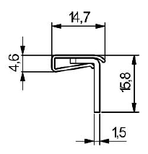
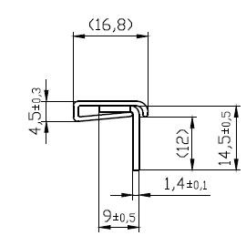
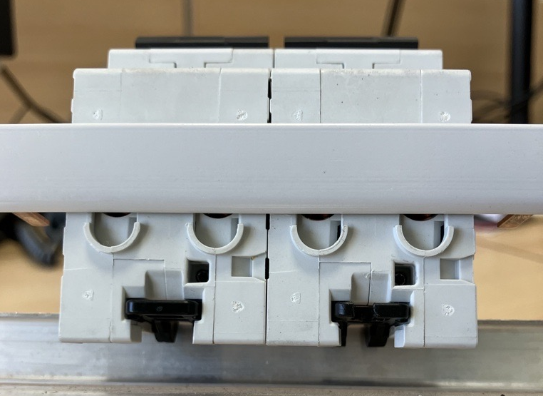
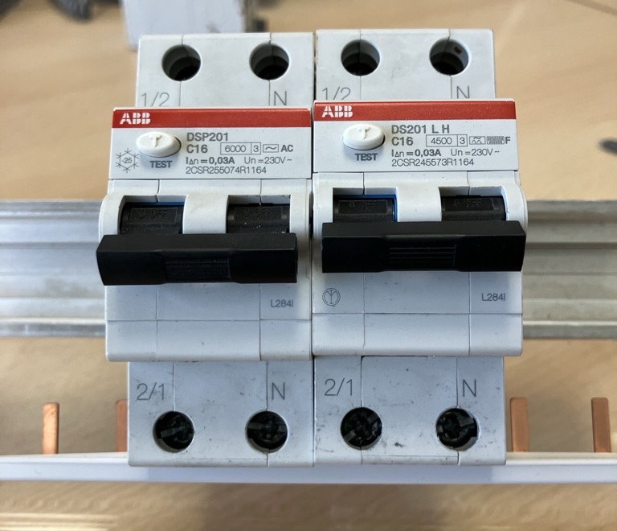
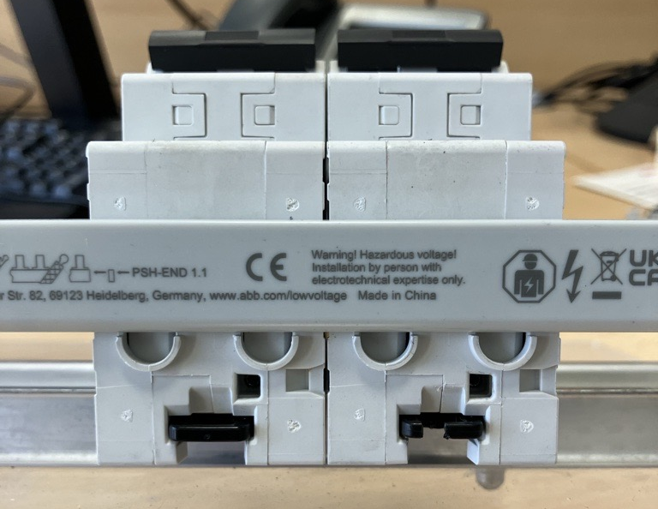
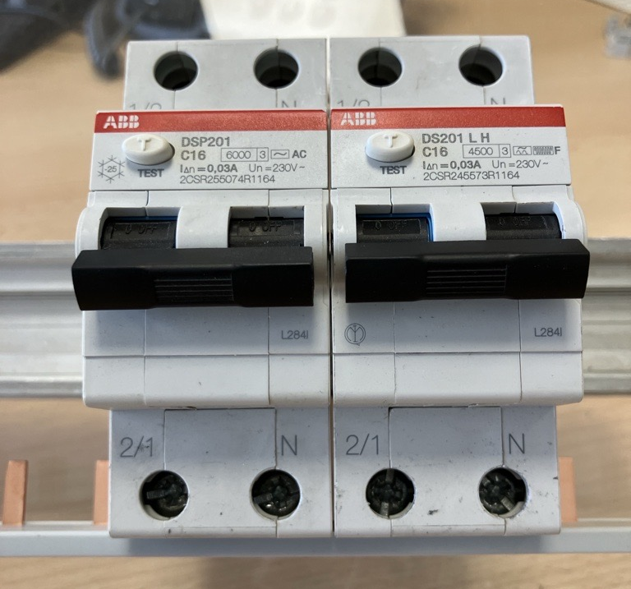
New Busbar PSHs
What’s changing? : PSH1 (single phase)
Actual Model
New Model
Insulation is bit bigger than previous (16,8mm vs 14,7mm) but this will not cause issues if mounted as in the pictures (correct way)

Slide 6
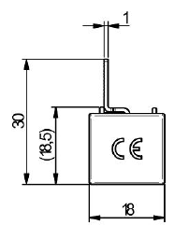
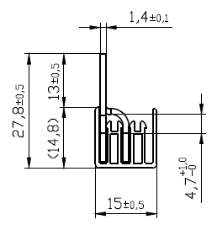
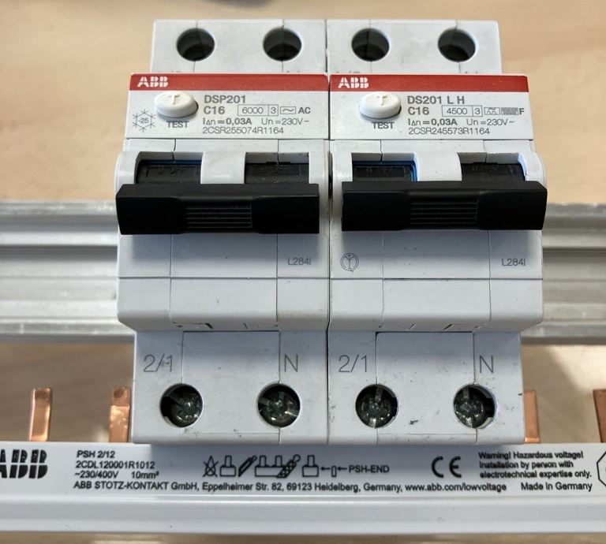
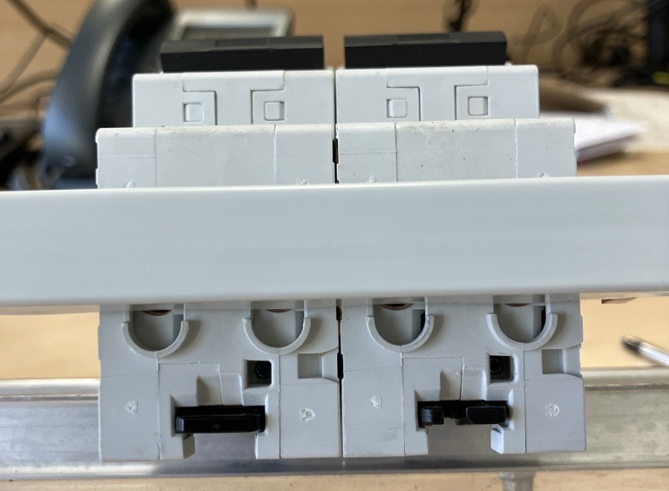
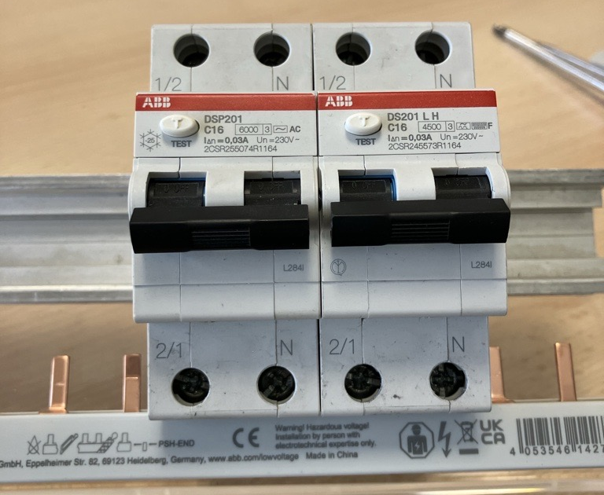
New Busbar PSHs
What’s changing? : PSH2 (double phase)
Actual Model
New Model
Comparable to the old ones, same access for the cable when busbar is installed

Slide 7
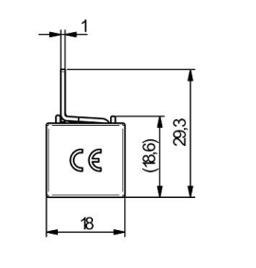
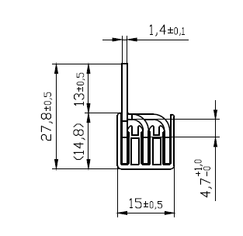
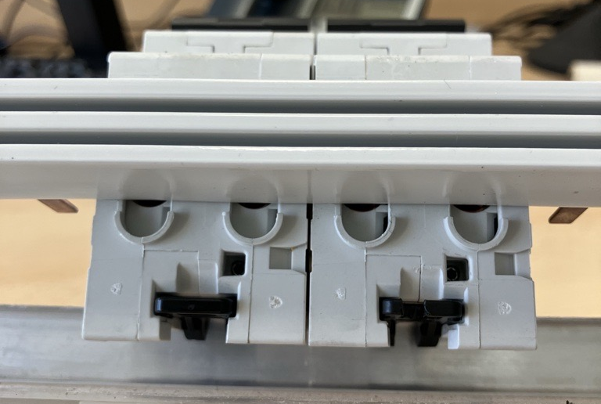
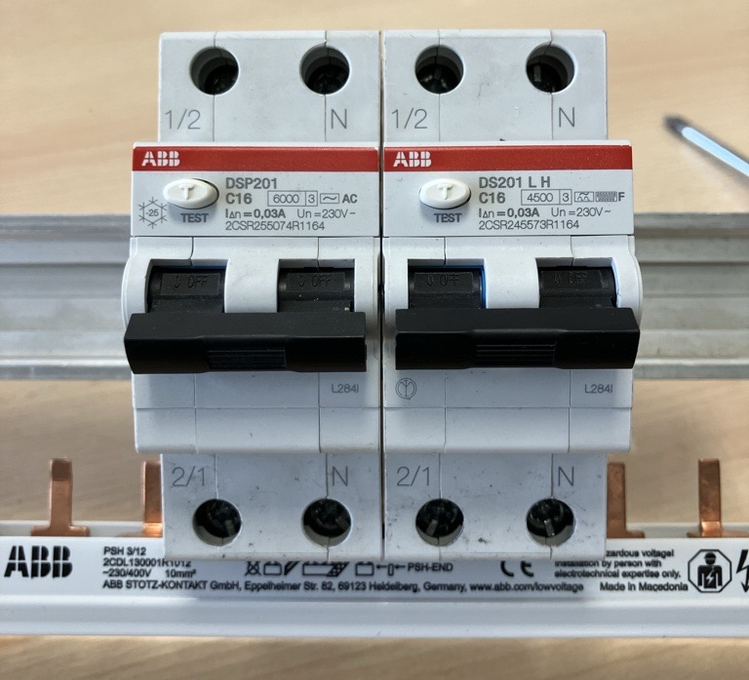
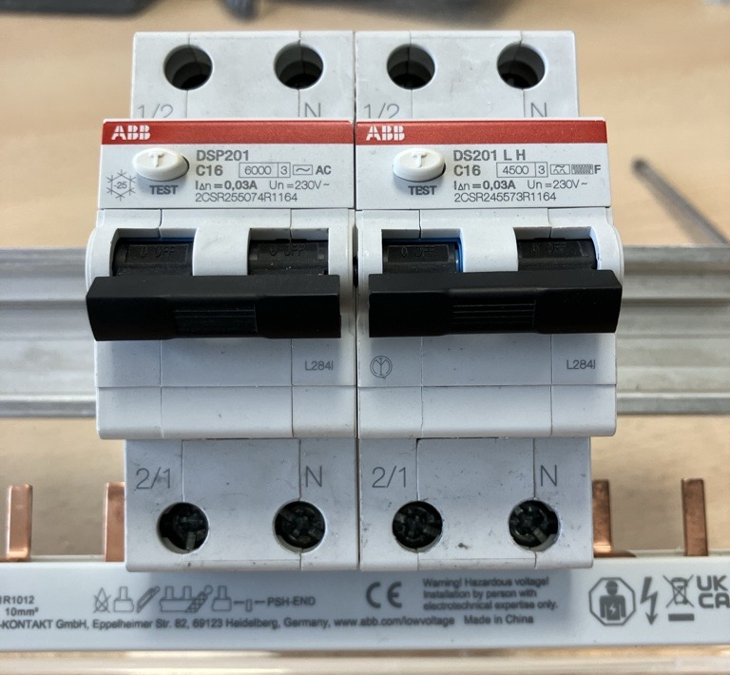
New Busbar PSHs
What’s changing? : PSH3 (triple phase)
Actual Model
New Model
Comparable to the old ones, same access for the cable when busbar is installed

Slide 8
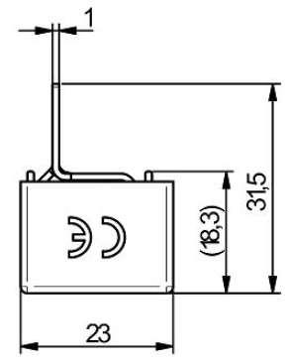
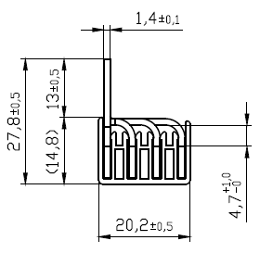
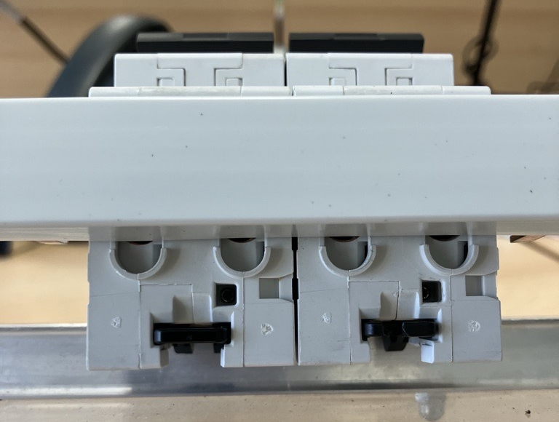
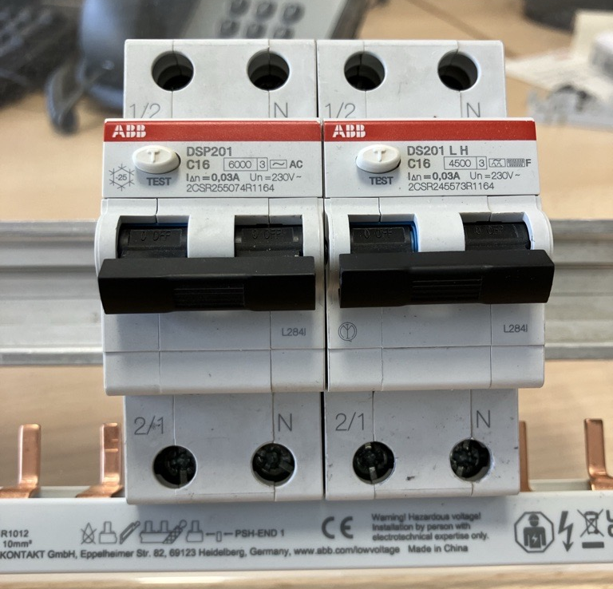
New Busbar PSHs
What’s changing? : PSH4 (double phase)
Actual Model
New Model
Comparable to the old ones, same access for the cable when busbar is installed

Slide 9
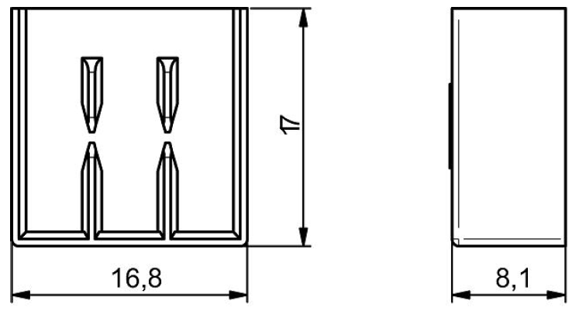
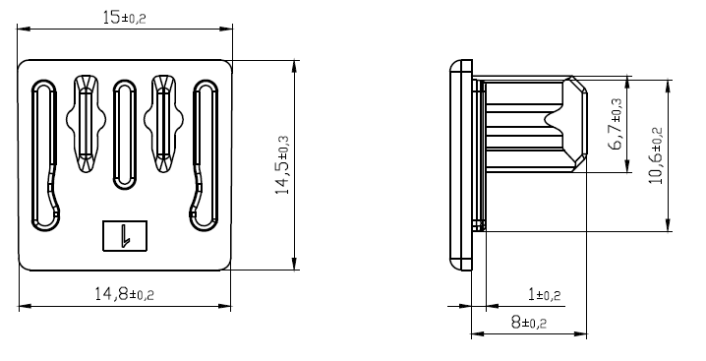
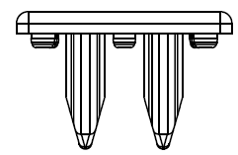
New Busbar PSHs
What’s changing?: End Caps for PSH2 and PSH3
PSH- END
ACTUAL ONE
PSH- END
NEW ONE

Slide 10
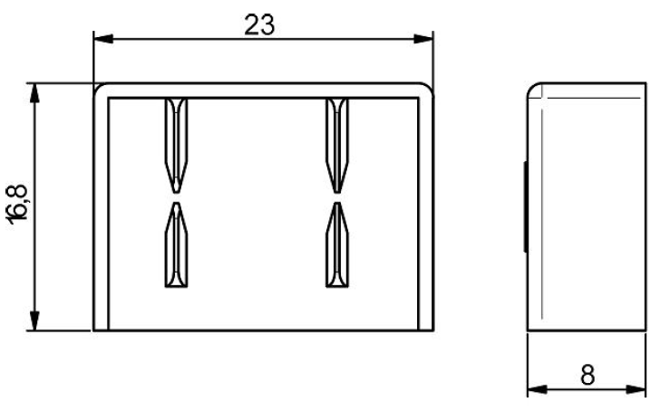
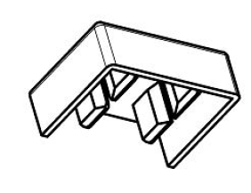
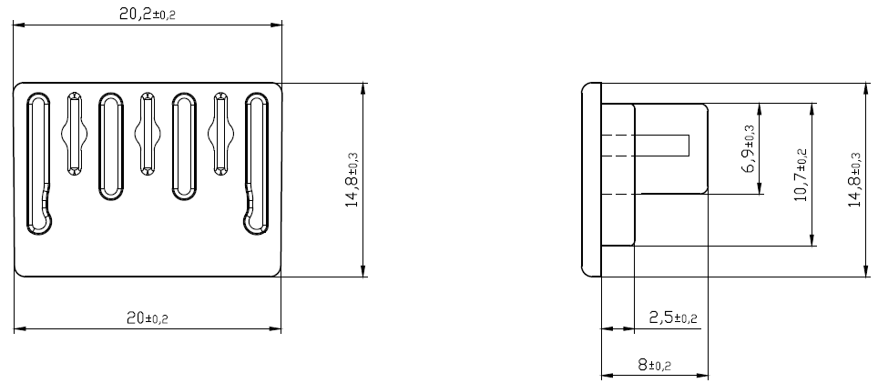
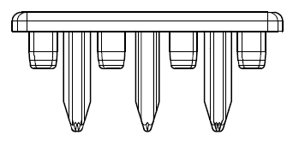
New Busbar PSHs
What’s changing?: End Caps for PSH4
PSH- END 1
ACTUAL ONE
PSH- END 1
NEW ONE

Slide 11
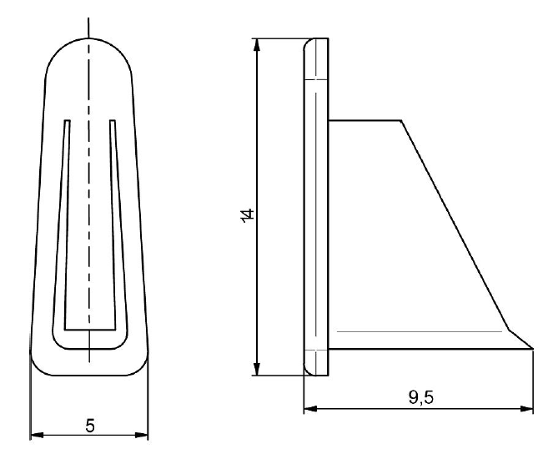
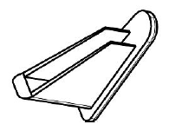
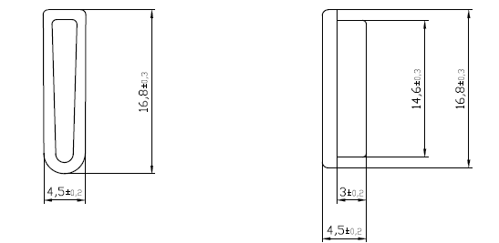
New Busbar PSHs
What’s changing?: End Caps for PSH1
PSH- END 1.1
ACTUAL ONE
PSH- END 1.1
NEW ONE

