Slide 1
— ABB Let’s write the future. Together.
January, 2024

Slide 2
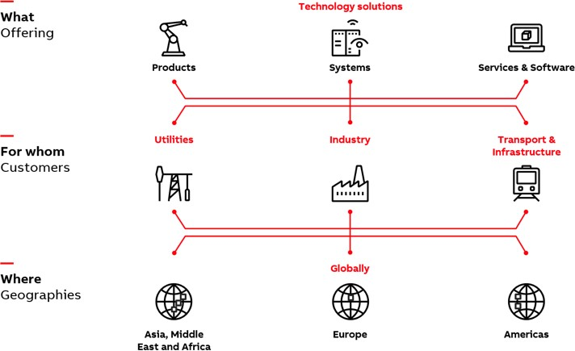
This is what we do
—
ABB in Canada is a leading technology company that energizes the transformation of society and industry to achieve a more productive, sustainable future. By connecting software to its electrification, robotics, automation and motion portfolio, ABB pushes the boundaries of technology to drive performance to new levels. With a history of excellence stretching back more than 100 years, ABB’s success is driven by 3 200 talented employees in our 33 locations from coast to coast.

Slide 3
Well positioned across global markets
ABB is a technology leader in electrification and automation, enabling a more sustainable and resource-efficient future.
The company’s solutions connect engineering know-how and software to optimize how things are manufactured, moved, powered and operated.
—
Employees
Countries
Revenues
~105,000
>100
~$29 bn
Europe
Americas
AMEA
~$10.3 bn
~$9.6 bn
~$9.6 bn
2022 figures

Slide 4
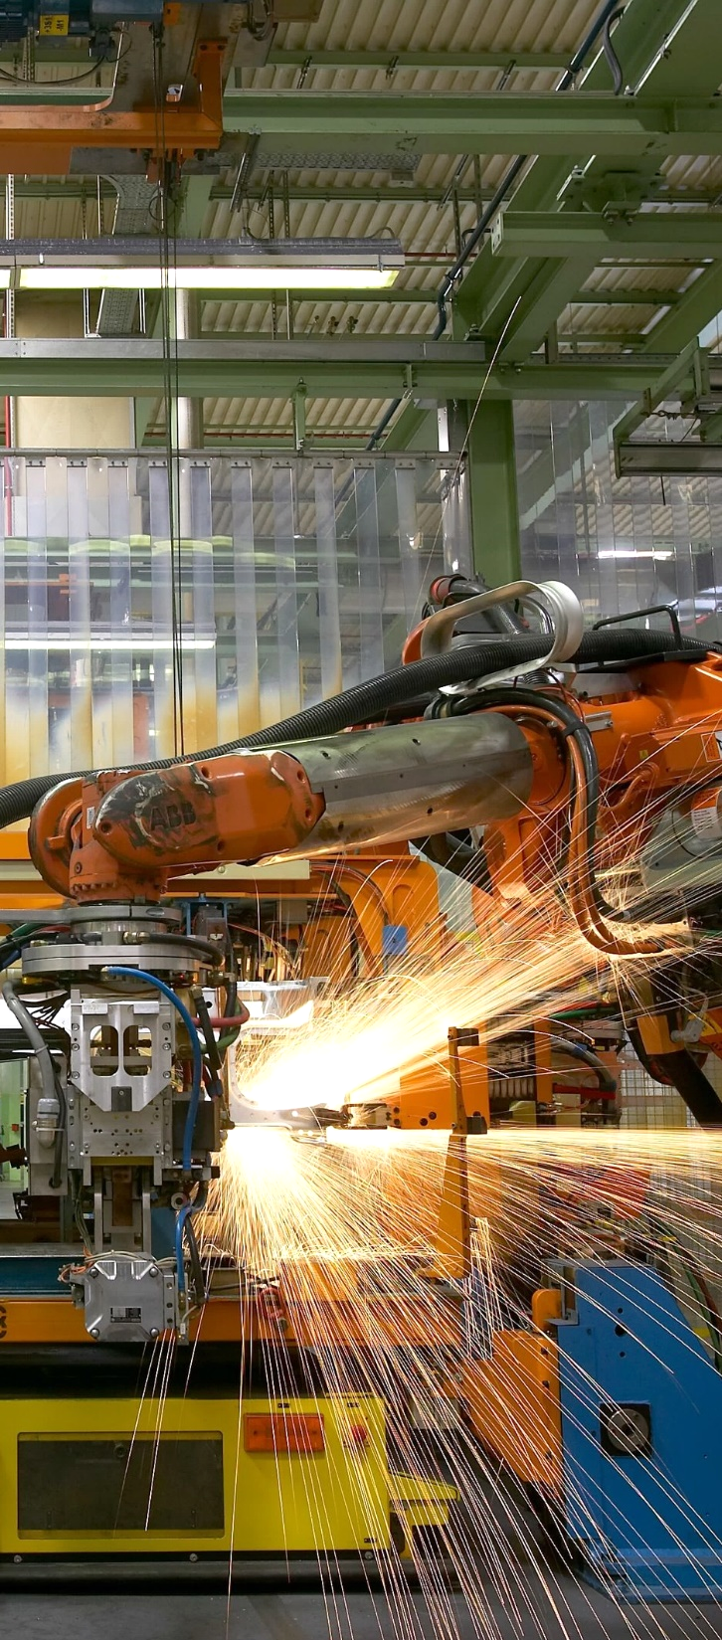
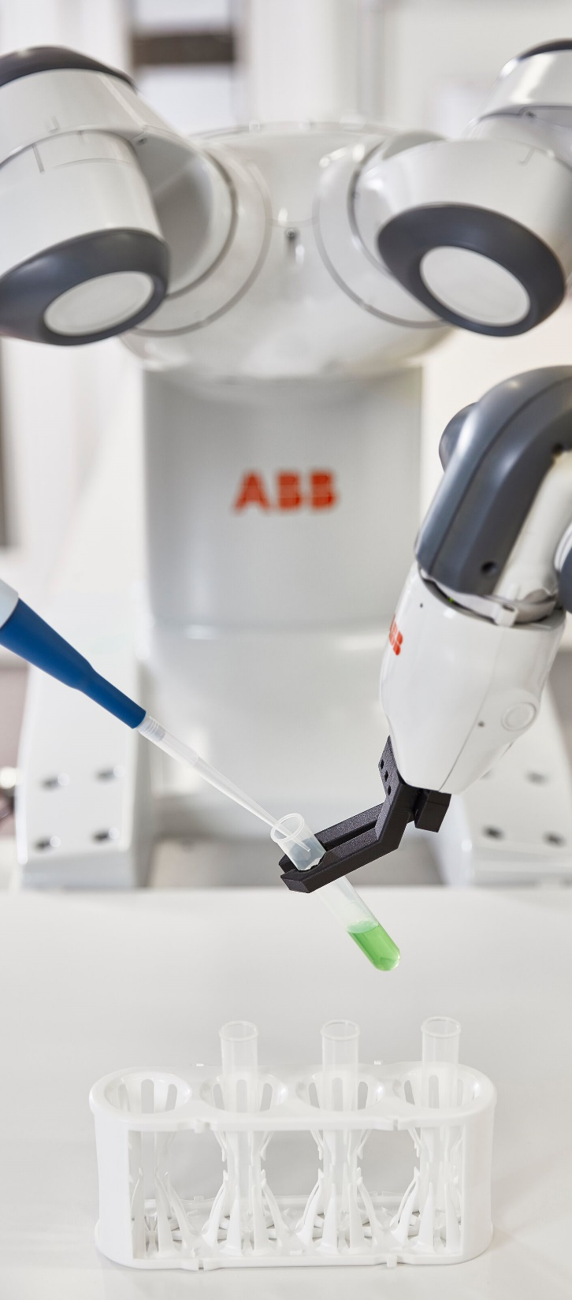
—
ABB has been pushing the boundaries of technology for +140 years

Slide 5
ABB Way Forward
—
Following our purpose and leveraging our strong positions in Electrification, Motion, Process Automation and Robotics & Discrete Automation, we aim to create superior value for
all our stakeholders. With our purpose at its core,
the way we operate – the ABB Way – is our lever to
implement our strategy.
By pushing the boundaries of technology and embedding sustainability in everything we do, our people drive the performance of our market- leading and empowered businesses to new levels. Together with our common values, strong brand and governance framework, the ABB Way is leading us to become a more focused, successful, value-creating company.

Slide 6
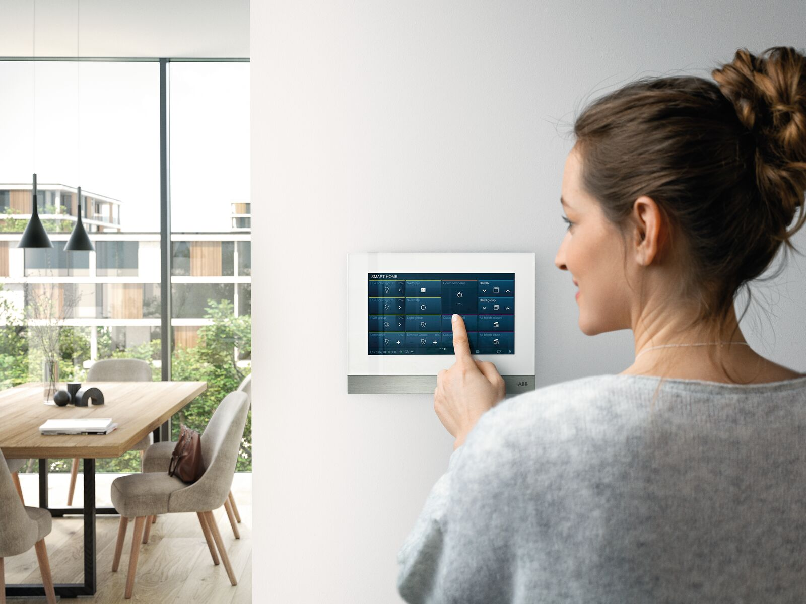
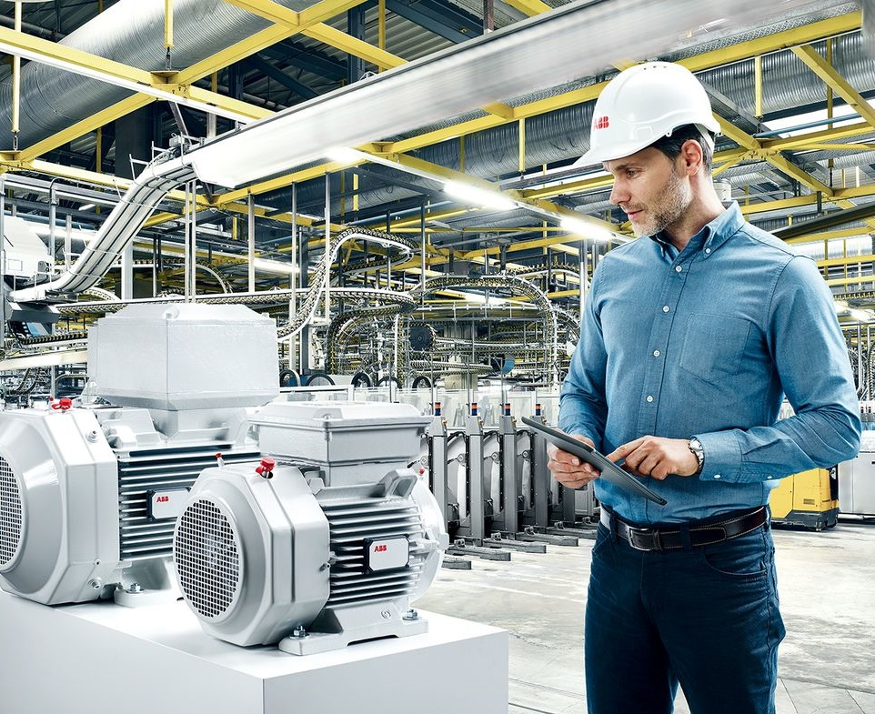
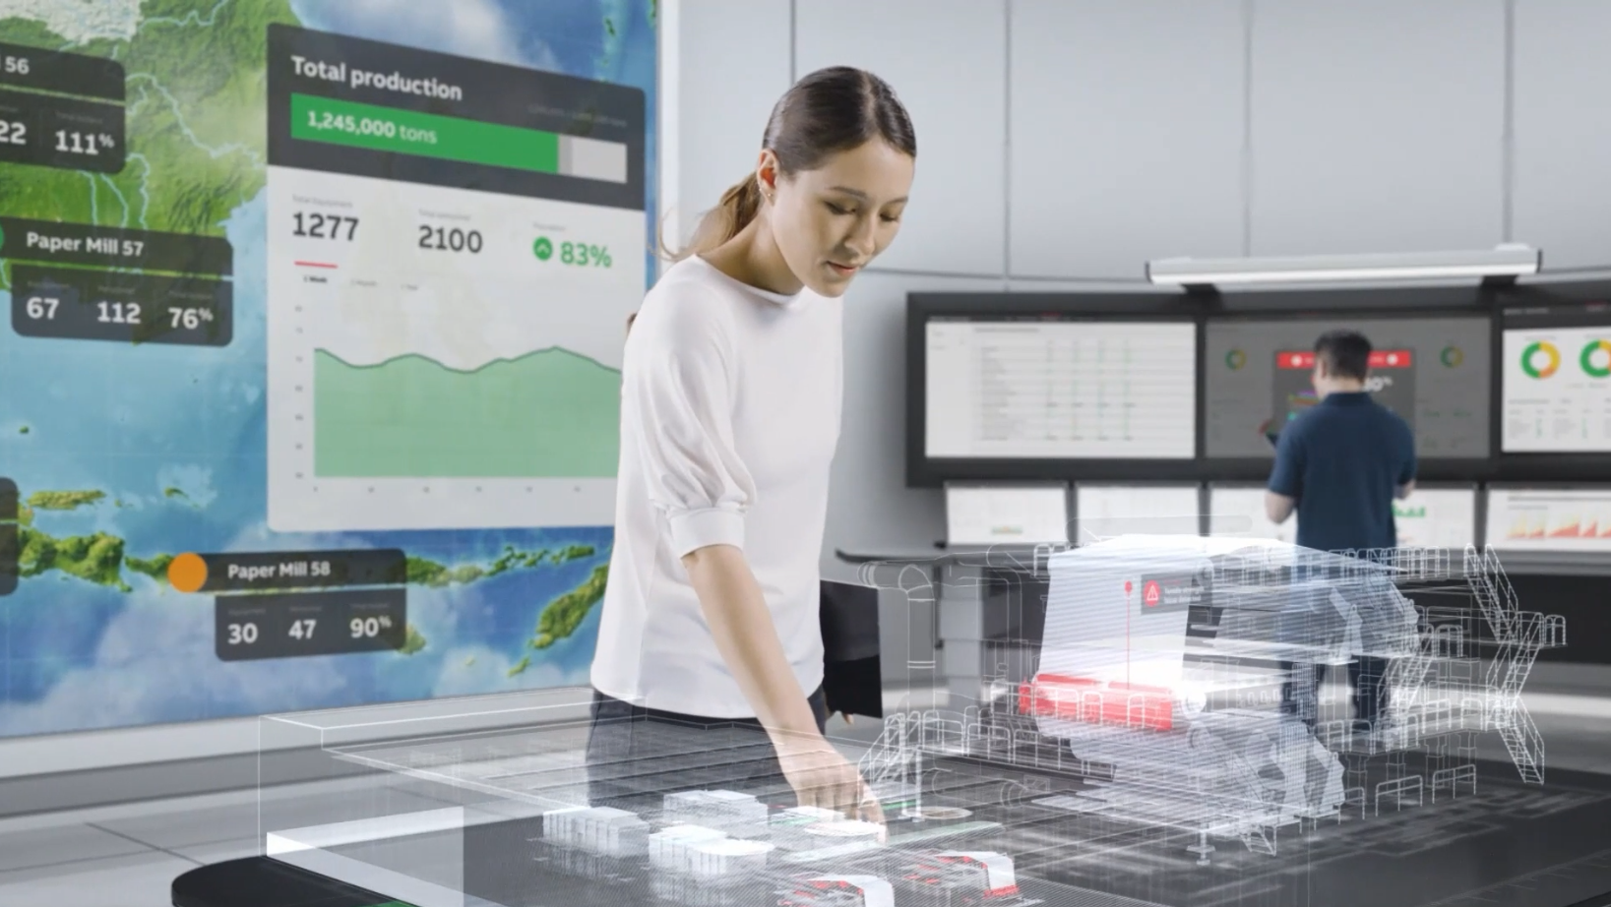
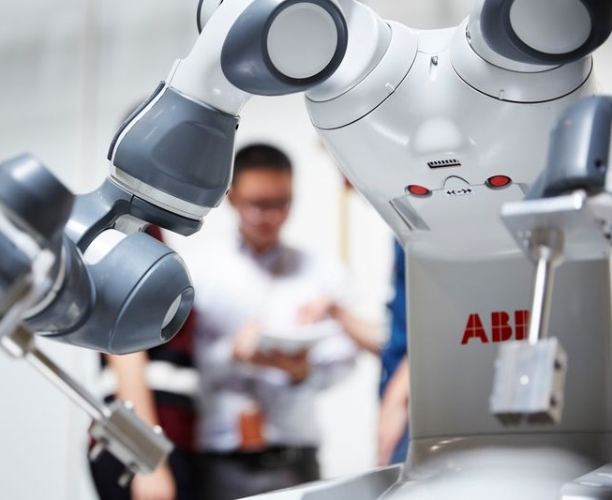
Our business areas
—
Electrification
Motion
Process Automation
Robotics & Discrete Automation

Slide 7
ABB in Canada
At a glance
—
Region headquarters
Montreal, Quebec
~ 3,200 employees
in Canada
15
Manufacturing & assembly locations
Global Centre for Emergency Lighting R&D
Over ~ 100 years of technological innovation in Canada
18
sales & service locations
33 locations
coast to coast
Over 70 million digitally enabled devices that create the foundation of the IIoT
Ranked in top 100 Canada’s Best Employers (2021 to 2024)
North American Center of Excellence for E- Mobility
Close to $400K given to Canadian communities in 2023

Slide 8
The Canada story
Strategically growing in the markets we serve
—
Balance through strategic acquisitions
1989 | ABB acquires the Westinghouse transmission & distribution business, marking ABB’s entrance to North American power and industrial market
1990 | ABB acquires Bomem Inc. a leader in FTIR technologies, pushing the envelope for quality and precision of analytical products and systems
1999 | ABB acquires Elsag Bailey (US $2 bn), supporting growth in various process industries
2008 | ABB acquires Ber-Mac Electrical and Instrumentation, expanding its presence and capabilities in the oil and gas sector
2009 | ABB acquires Sinai Engineering Corporation, to enhance its presence and capabilities in Western Canada.
2010 | ABB acquires Ventyx (US $1 bn), adding robust enterprise software to our portfolio
2011 | ABB acquires Baldor (US $4.2 bn), supporting growth with industrial motors and drives
2011 | ABB acquires Envitech Energy to strengthen its offering and solutions for the rail infrastructure market
2012 | ABB acquires Thomas & Betts (US $3.9 bn), supporting growth with distributors and electrification products
2013 | ABB acquires Power-One (US $1 bn), supporting growth in renewable energy markets
2017 | ABB acquires B&R to close the gap in machine and factory automation, creating a comprehensive automation portfolio
2018 | ABB acquires GEIS (US $2.6bn) supporting growth with electrification products

Slide 9
—
The Canada story
Over 100 years of technology innovation
CANADA | ELECTRIFICATION | MOTION | ROBOTICS & DISCRETE AUTOMATION | PROCESS AUTOMATION
1930 ASEA is officially incorporated, and BBC is established in Canada 1950 BBC erects its first factory in Canada 1970 BBC inaugurates the Varennes High Voltage Transformer factory 1988 ASEA and BBC Canada merge to form ABB 2016 ABB invest $35 million to build high- tech facility in Quebec City 2016 ABB invests $90 million to create state-of-the-art 300,000 square foot headquarters in Montreal | 2014 ABB’s Enviline traction power technology is selected for the Vancouver Evergreen Line Rapid Transit Project 2016 ABB establishes Global Technology Development Center for Emergency Lighting in Quebec 2017 ABB establishes North American Center for Excellence in E-Mobility in Montreal 2022 ABB Canada a trusted partner in ventilation in Louis-Hippolyte Lafontaine tunnels of Montreal, with ABB drives, such as our ACS880-17. | 2003 Liquid cooled drives for tunnel boring machines, a custom solution for a Canadian customer. These tunnel machines are now used around the world. 2004 ACH550, a true HVAC 600v drive for the Canadian market. Improving Energy Efficieny in buildings and hospitals. 2008 ACS880 Active Front-End drives for Ultra-Low harmonics. With this technology, ABB kept power grids clean and providing outstanding motor performance! 2019 Drives awarded a contract with Metrolinx to expand Toronto's Light Rail Transit system that will be 60% faster than current travel times | 1994 Ford Motor Co. Ltd. Awards major contract to ABB to provide sophisticated robot systems 1999 ABB robotics Canada develops innovative process for welding/processing plastic gas tanks for the automotive industry 2003 General Motors awards contract to ABB to supply stamping line, automated de- stacking systems, end-of-line systems and robot integration for its plant in Lordstown, Ohio 2011 ABB FlexArc products/cells are assembled and produced in Canada 2016 First truly collaborative robot – YuMi - installed in Canada 2017 ABB completes acquisition of B&R | 1999 Measurement & Analytics marks its first export into space for Canadian Space Agency’s MOPITT instrument launched by NASA 2003 ABB develops VRS 3000 Underground Voltage Regulation Systems (UGVRS), first heavy-duty, skid-mounted, portable SVC designed to regulate voltage in mine distribution systems 2005 ABB obtains contract to deliver North America’s largest friction mine hoist for Mosaic’s Esterhazy Potash Operation in Saskatchewan 2013 ABB signs space contract with Harris to develop three additional interferometers for NASA’s next generation LEO weather satellites. 2018 ABB enters the Space 2.0 market by winning contract from GHGSat to build highly innovative payloads for monitoring greenhouse gases from space. 2021 launched ABB Ability™ comprehensive natural gas leak and greenhouse gas measuring systems using an ultra sensitive OA-ICOS sensor 2022 ABB wins its largest space contract to date with Earth Daily Analytics for satellite imaging technology to detect environmental change in near real time 2023 ABB contracts with Seaspan's Vancouver Shipyard to deliver a complete propulsion system for the first of the Canadian Coast Guard's new-generation polar icebreakers, slated to be the world's largest and most powerful diesel-electric icebreaker in 2030.

Slide 10
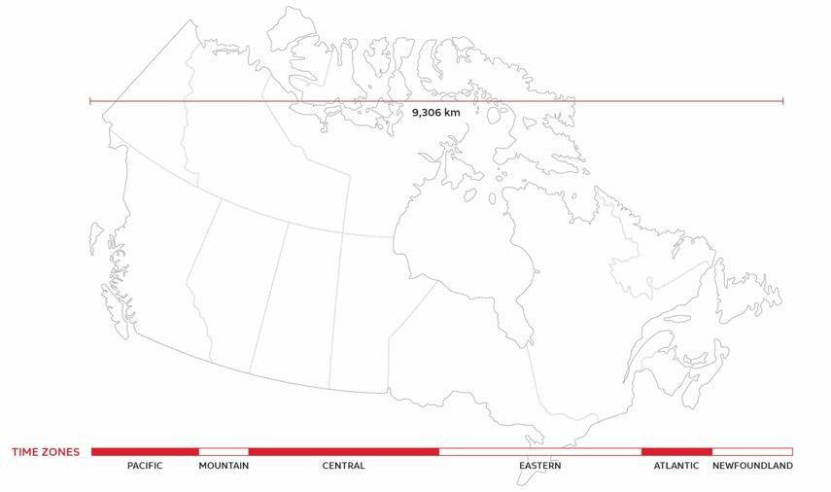
ABB in Canada employees coast to coast
—
British Columbia 64
Newfoundland and Labrador 5
Alberta
172
Manitoba
8
Quebec
2494
Saskatchewan
8
Ontario
416
Nova Scotia 15

Slide 11
ABB in Canada locations
—
40 functions across 33 locations
British Columbia 1 sales & service location
1 distribution center
Quebec 8 manufacturing & assembly facility
4 sales & service locations
3 distribution centers
Alberta 3 manufacturing & assembly facility
1 sales & service location
3 distribution centers
Nova Scotia 1 sales & service location
Saskatchewan 1 sales & service location
Newfoundland and Labrador 1 sales & service location
Manitoba 1 sales & service location
Ontario 4 manufacturing & assembly facility
7 sales & service location
1 distribution centers
British Columbia 1
Manitoba
1
Alberta
8
Newfoundland and Labrador 1
Quebec
13
Saskatchewan
1
Ontario
7
Nova Scotia 1

Slide 12
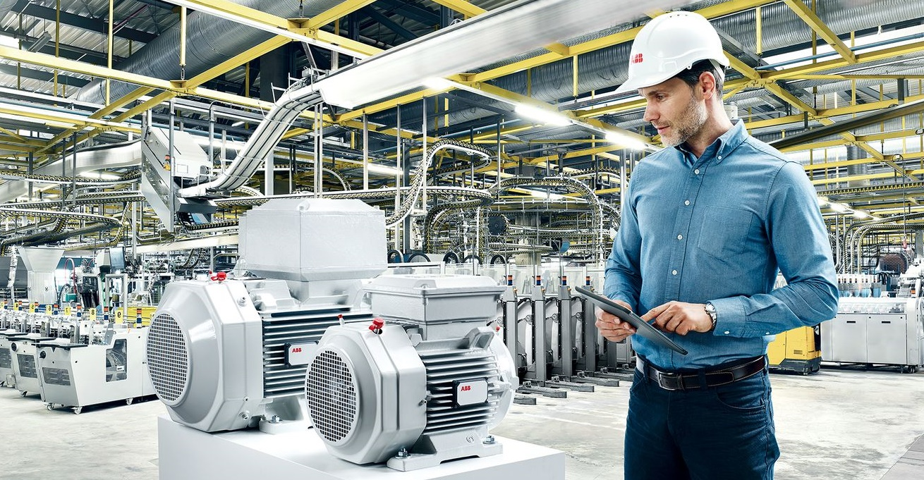
Fully decentralized business model with around 20 divisions
—
BUSINESS AREA
Electrification
Motion
Process Automation
Robotics & Discrete Automation
Distribution Solutions
IEC LV Motors
Energy Industries
Robotics
Smart Power
Large Motors & Generators
Process Industries
Machine Automation
Smart Buildings
NEMA Motors
Marine & Ports
DIVISION
Installation Products
Drive Products
Measurement & Analytics
Service
System Drives
Motion Service
Traction
E-mobility¹
1. Reported as part of “Corporate and Other” as of Q1 2023.

Slide 13
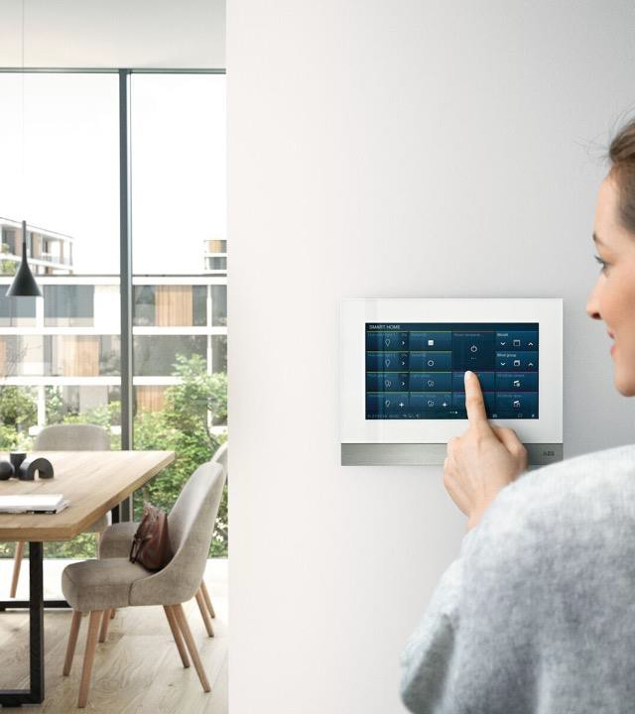
Electrification
—
Writing the future of safe, smart and
sustainable electrification.
ABB's Electrification business offers a wide-ranging portfolio of products, digital solutions and services, from substation to socket, enabling safe, smart and sustainable electrification.
Employees 1970

Slide 14
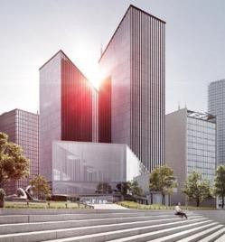
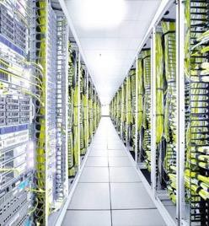
Electrification in Canada
—
Electrifying the world in a safe, smart and sustainable way
OUR BUSINESS
SELECTED CUSTOMER SEGMENTS
Canada #2
#4 Low voltage
#3 in MCCB
#3 in ACB
#1 Installation products
2,012 employees
Commercial buildings
Data centers
Utilities
Offering
Electrical distribution, control and power solutions
Building and living solutions
Installation products for industrial, commercial, and utility applications
Life cycle management and services
Typical customers
Electrical distributors and contractors
OEMs, system integrators and panel builders
Consultants, EPCs

Slide 15
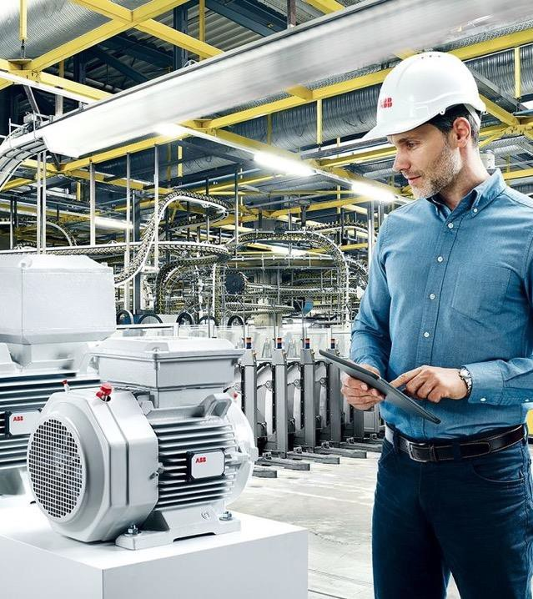
Motion
—
Writing the future of safe, smart and
sustainable electrification.
ABB's Motion business is the largest supplier of drives and motors, globally. We provide customers with the complete range of electrical motors, generators, drives and services, as well as integrated digital powertrain solutions.
Employees 163

Slide 16
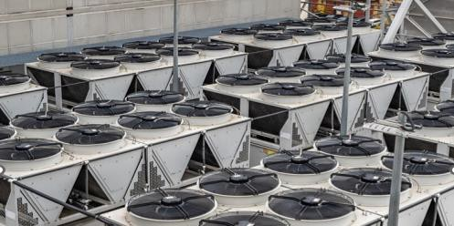
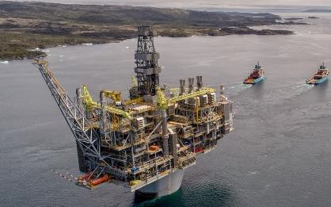
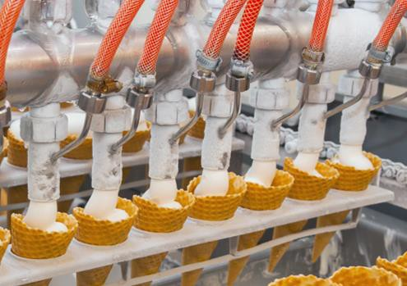
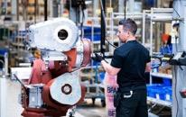
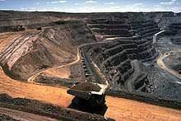
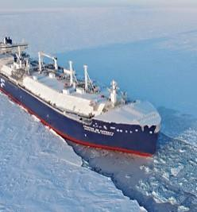
Motion in Canada
—
We keep the world turning - while saving energy everyday
Our business
Motion Canada Major Industry Segments
Canada #1
#1 in LV NEMA Motors
#1 / #2 in LV Drives
HVAC - Infrastructure
Oil & Gas
Food & Beverage
Water & Wastewater
163 employees – Local Sales Unit
Offering
NEMA Motors
Large Motors and Generators
LV Drives & System Drives
Services and Digital Solutions
General Machinery
Pulp & Paper
Mining
Marine & Ports
Customer Types
Distributors ▪
OEMs ▪
System integrators End customers
1Original Equipment Manufacturer

Slide 17
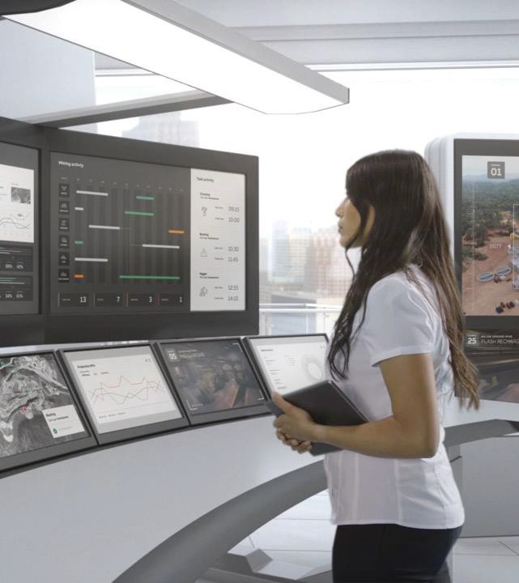
Process Automation
—
Writing the future of safe, smart and
sustainable operations.
ABB's Process Automation business offers a broad range of solutions for process and hybrid industries, including industry- specific integrated automation, electrification and digital solutions, control technologies, software and advanced services, as well as measurement & analytics, and marine and turbocharging offerings.
Employees 889

Slide 18
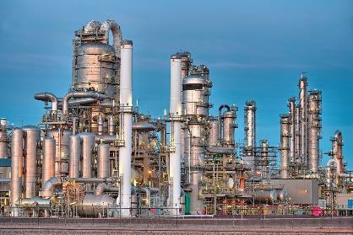
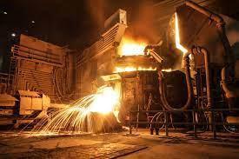
Process Automation in Canada
—
Writing the future of safe and smart operations
OUR BUSINESS
SELECTED CUSTOMER SEGMENTS
Canada #2
#1 in DCS & process automation #3 in measurement & analytics
#1 in marine & ports
Chemicals & Refining
Water & Wastewater
Power Generation
Oil & Gas
~889 employees Offering
Integrated industry-specific solutions
Process control (DCS)
Measurement & analytics
Industrial Applications
Mining & Mineral processing
Typical customers
End customers
EPC
OEM
Pulp & Paper
Marine & Ports

Slide 19
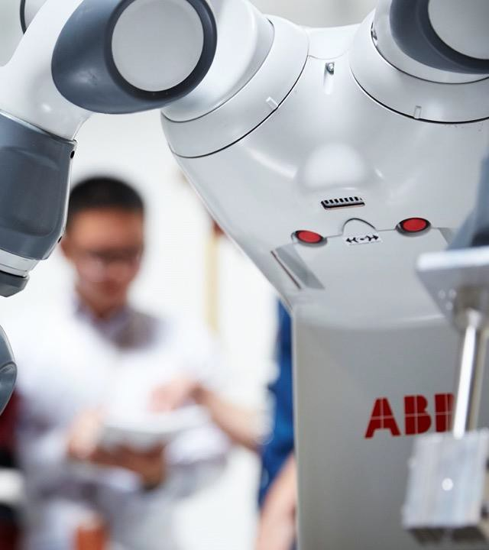
Robotics & Discrete Automation
—
Writing the future of flexible manufacturing
and smart machines.
ABB's Robotics & Discrete Automation business provides value-added solutions in robotics, machine and factory automation. Our integrated automation solutions, our application expertise across a wide scope of industries and our global presence deliver tangible customer value.
Employees 72

Slide 20
Robotics & Discrete Automation in Canada
—
Writing the future of flexible manufacturing and smart machines
OUR BUSINESS
SELECTED CUSTOMER SEGMENTS
Canada #2
Innovation leader for machine automation
Consumer Segments &
Service Robotics
Machine Automation
General Industry
72 employees
Offering
Machine & factory automation
Robotics
Typical customers
Auto OEMs
Auto Tier 1
Electronics
End customers
Machinery OEMs
System integrators

Slide 21
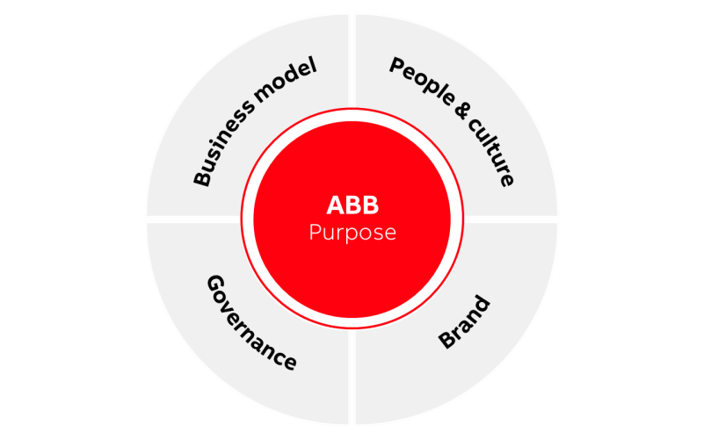
The ABB Way
Our operating model
—
With our company purpose at its core, the ABB Way empowers our divisions with full ownership and accountability for their strategies, performance and resources, while serving as the “glue” that holds our Group together.
The ABB Way consists of two parts; “how” we operate and create superior value, namely with our Business model, People & culture, Brand and Governance, and our purpose, “why” we are in business.
The ABB Way provides standardized policies, processes and systems, including portfolio, performance and risk management as well as internal control and compliance.

Slide 22
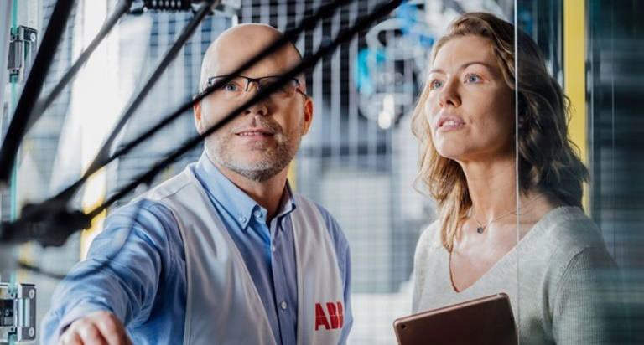
Our priorities
—
Market leadership
Technology & digital People
Portfolio management Sustainability
Financial performance

Slide 23
The ABB purpose
—
—
Creating success
We enable a more sustainable and resource-efficient future with our technology leadership in electrification and automation.
—
Addressing the
world’s energy challenges
—
Transforming
industries
—
Embedding
sustainability
—
Leading with technology

Slide 24
ABB values
—
ABB values Courage Care Curiosity Collaboration

Slide 25
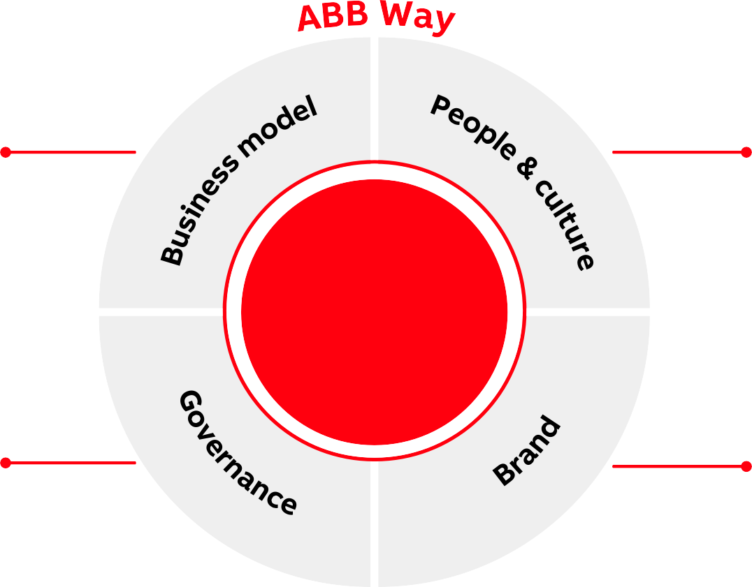
The ABB Way
—
Decentralized setup
– full Division accountability
Performance management Portfolio management
Values People Leadership
ABB
Purpose
Code of conduct
Internal control & compliance
Risk management
Regulations, processes and policies
Positioning
Reputation management

Slide 26
Our priorities
—
Market leadership
Market leadership is key to the long-term success of our divisions. We aim to maintain or strengthen a no. 1 or no. 2 position in all markets by providing our customers with leading products, systems and solutions. Market leadership helps to improve profitability, drive superior returns and enable growth opportunities for our people.

Slide 27
Our priorities
—
Technology & digital
Our world-class technology and domain-led digital capabilities are deeply embedded in our DNA. Maintaining and improving our innovation, technology and digital leadership is a strategic priority across divisions. Pushing the boundaries of technology and digital enables us to help our customers attain new levels of performance and clearly differentiate ABB’s offering.

Slide 28
Accelerating value creation through digital
—
__
Focused on creating superior customer value
Differentiation through
domain expertise
Expansion driven
by businesses

Slide 29
ABB AbilityTM
Insight. It’s the power to see and understand how something works in a new way, to unravel complexity and take action. It comes from visibility, intelligence and experience. It’s what makes transformation possible.
ABB Ability solutions combine ABB’s deep domain expertise with connectivity and software innovation to empower real-time, data-driven decisions for safer, smarter operations that maximize resource efficiency and contribute to a low-carbon future.
Our large portfolio of digital solutions helps organizations automate, optimize and future-proof their business to achieve new heights of
performance and drive sustainable progress.

Slide 30
Our priorities
People
We believe our people are the most critical ingredient to our long-term success. A culture of diversity, inclusion and equal opportunity is critical to our business success and makes us stronger. Relying on our people’s unique attitude, experience and domain expertise, we push the boundaries of technology to drive performance, shape new business models and find new ways of working that make our customers, partners and society better off.

Slide 31
Our priorities
Portfolio management
Through active portfolio management we systematically evolve our portfolio at all levels of the organization to reinforce our divisions’ market leadership by investing in growth, M&A activities and portfolio consolidation. On the one hand, we continuously question whether we are the best owner of our divisions; on the other, we steer our businesses in line with their respective strategic mandates. Lastly, we actively pursue synergetic acquisition opportunities to fill white-spots and steer our overall portfolio mix towards high-growth sectors.

Slide 32
Our priorities
Sustainability
At ABB, we are at the core of accelerating the energy transition. Every day, we empower customers across the globe to optimize, electrify and decarbonize their operations, making how we move, produce, work, and live more sustainable and resource efficient overall.
Our sustainability agenda is fully in line with this mission.
It is aligned with international standards and frameworks and underpinned by our culture of integrity and transparency.
Embedded across our business, it aims to enable a low-carbon society, preserve resources, and promote social progress for a net-zero future.

Slide 33
We enable a low- carbon society
—
Acknowledged history in sustainability, with a new level of ambition
Rooted in purpose, embedding sustainability across all aspects of value chain
We preserve resources
We promote social progress
INTEGRITY AND TRANSPARENCY

Slide 34
Main sustainability ambitions
2030 targets
—
We enable a
low-carbon society
We preserve
resources
We promote
social progress
CUSTOMER
– Carbon neutrality in own operations
80% of ABB products & solutions covered by circularity approach
Zero waste to landfill²
Supplier Sustainability
Framework
Zero harm to our people and
contractors
Comprehensive D&I framework³;
25% women among ABB leaders
Top-tier employee engagement score in our industry
Impactful support for community-building initiatives
ABB
Support our customers in reducing annual CO₂ emissions by >100 Mt¹
Work with most impactful suppliers to reduce their emissions by 50%
SOCIETY
SUPPLIER
Sustainable Value Chain
INTEGRITY AND TRANSPARENCY ACROSS OUR VALUE CHAIN
Savings in the year 2030 from solutions provided to customers 2021-30
Wherever local conditions allow
3. Diversity & Inclusion framework

Slide 35
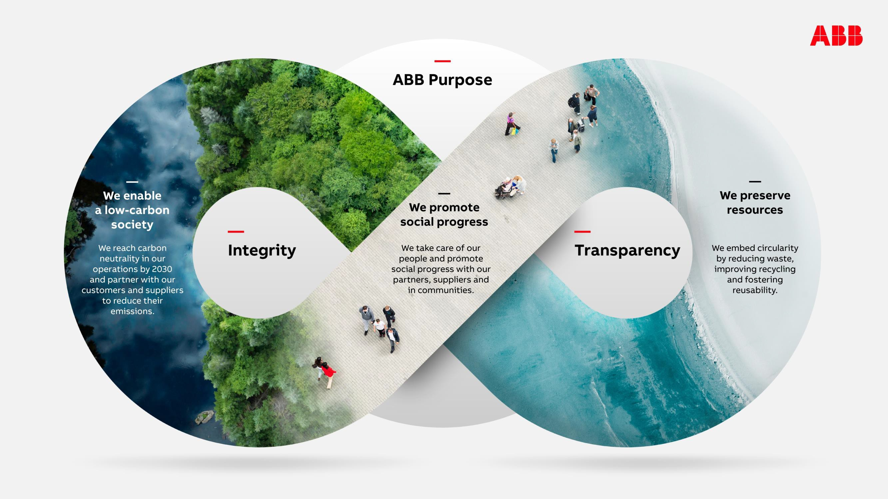

Slide 36
Our priorities
Financial performance
By pairing our strategic priorities with a continuous improvement mindset, we aim to deliver improved performance in line with our financial framework:
7% average annual revenue growth through
economic cycle¹
18% operational EBITA margin²
Electrification: 22%
Motion: 11%
Process Automation: 25%
Robotics & Discrete Automation: 16%

Slide 37
ABB Canada Organization
—
Vince Pesce
Country Holding Officer
Katie Bessette Country HR Manager and HRBP – ELIP Hub
Isabelle Lamarre
Regional General Counsel for Americas
Carley Tietolman Country and EL Communications Manager
Said Elaissi Country and EL HSE Manager
Melanie Benoit
Country Tax Manager
Mike Golden Country Security Manager
Evan Balaila
Country IS Manager
Joseph Simard Country Real Estate Manager
Samantha Lebreux Country Trade Compliance Officer

