Slide 1
ReliaGear® neXT full IP20 offering
POWER PANELBOARDS
Plug in and break out
Doc No: 1SQC900004N0201

Slide 2
—
ReliaGear® neXT full IP20
Table of contents
01. IP20 explained 3–4
02. Value proposition 5–7
03. Offering overview 8–9
04. Product compatibility 10–15
05. empower configurator (panelboard) 16–22
06. empower configurator (breaker) 23–29
07. Component ordering for replacement/retrofit 30–35
08. Helpful documents and links 36–37

Slide 3
— IP20 explained
1

Slide 4
Degrees of protection
Ingress protection 20 (IP20) explained
General
In an installation, the degree of protection required for electrical equipment depends on the environmental characteristics. The degree of protection, ensured by the enclosure of equipment or by the cubicle containing the equipment, is expressed by the IP code, which indicates the level of protection against access to hazardous parts, the ingress of foreign bodies and/or the ingress of water, in compliance with IEC 60529, IEC 60947-1. Besides the IP symbol, the complete code has two figures followed (optionally) by two additional letters. A short description of the elements used in IP coding is shown at right.
IP... code | Digit | Specifications for installation protection | Protection of persons
First digit |  | Against ingress of foreign bodies | Against access to hazardous parts with:
 | 0 | No protection | No protection
 | 1 | Diameter > 50 mm | Back of hand
 | 2 | Diameter > 12.5 mm | Finger
 | 3 | Diameter > 2.5 mm | Tool
 | 4 | Diameter > 1 mm | Wire
 | 5 | Limited protection against dust | Wire
 | 6 | Total protection against dust | Wire
Second digit |  | Against entrance of water having harmful effect
 | 0 | No protection
 | 1 | Vertical dripping
 | 2 | Dripping at a vertical angle of < 15°
 | 3 | Rain at a vertical angle of < 60°
 | 4 | Splashing
 | 5 | Low pressure water jet
 | 6 | Powerful water jets
 | 7 | Temporary immersion
 | 8 | Permanent immersion

Slide 5
— Value proposition
2

Slide 6
ReliaGear® neXT full IP20 advantages
Take power panel innovation to the neXT level
24
/
7
Enhanced safety
The next level of protection
Improved finger-safe bus stack that meets IP20 standards
Service entrance/finger-safe lug barriers for main/feeder circuit breakers
IP20 finger-safe main lug barrier
Insert and remove components while reducing the risk of contact with conductive parts
Easy installation
Modular, flexible, fast
Plug-in, single-tool simplicity
Circuit breakers install anywhere on the bus stack
Field-reversible bus stack
Field-swappable ground and neutral locations
Outstanding reliability
Connections you can depend on
Spring-loaded circuit breaker plug-in connectors with thicker plating for durability
Levering features reduce installation and removal force
Magnetic forces generated by a short circuit make an even tighter connection
No more bolted joints that can become loose or require torque checks

Slide 7
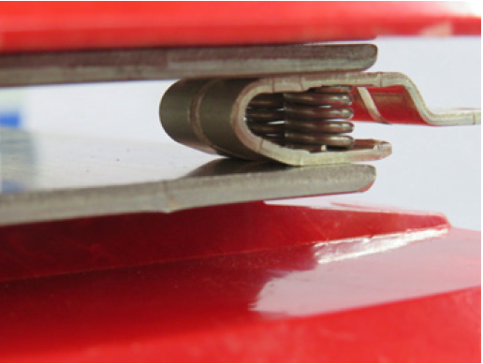
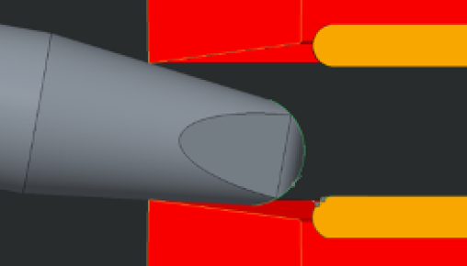
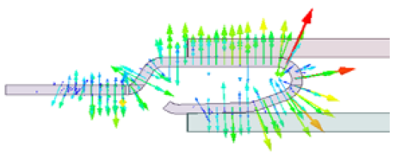
ReliaGear® neXT full IP20
Enhanced safety features
Plug-in connectors
IP20 bus stack
The ReliaGear clip assembly is a patented solution that
provides a repeatable, reliable contact force, ensuring a secure and robust connection.
The system has been thoughtfully designed so that breaker insertion is as easy as possible while maintaining contact integrity.
During fault currents, the ReliaGear design takes advantage of the physics of electromagnetic repulsion to strengthen the connection and ensure the joint remains intact.
The patented IP20 finger-
safe ReliaGear neXT design incorporates a molded-in mechanical barrier that protects certain configurations of the main bus stack against accidental contact of solid objects of sizes larger than
12.5 mm.
In addition to finger-safe, the design minimizes risk of a forgotten tool or a disconnected wire coming
in contact with the bus system. Testing was completed and
compliance verified using properly calibrated equipment.

Slide 8
— Offering overview
3

Slide 9
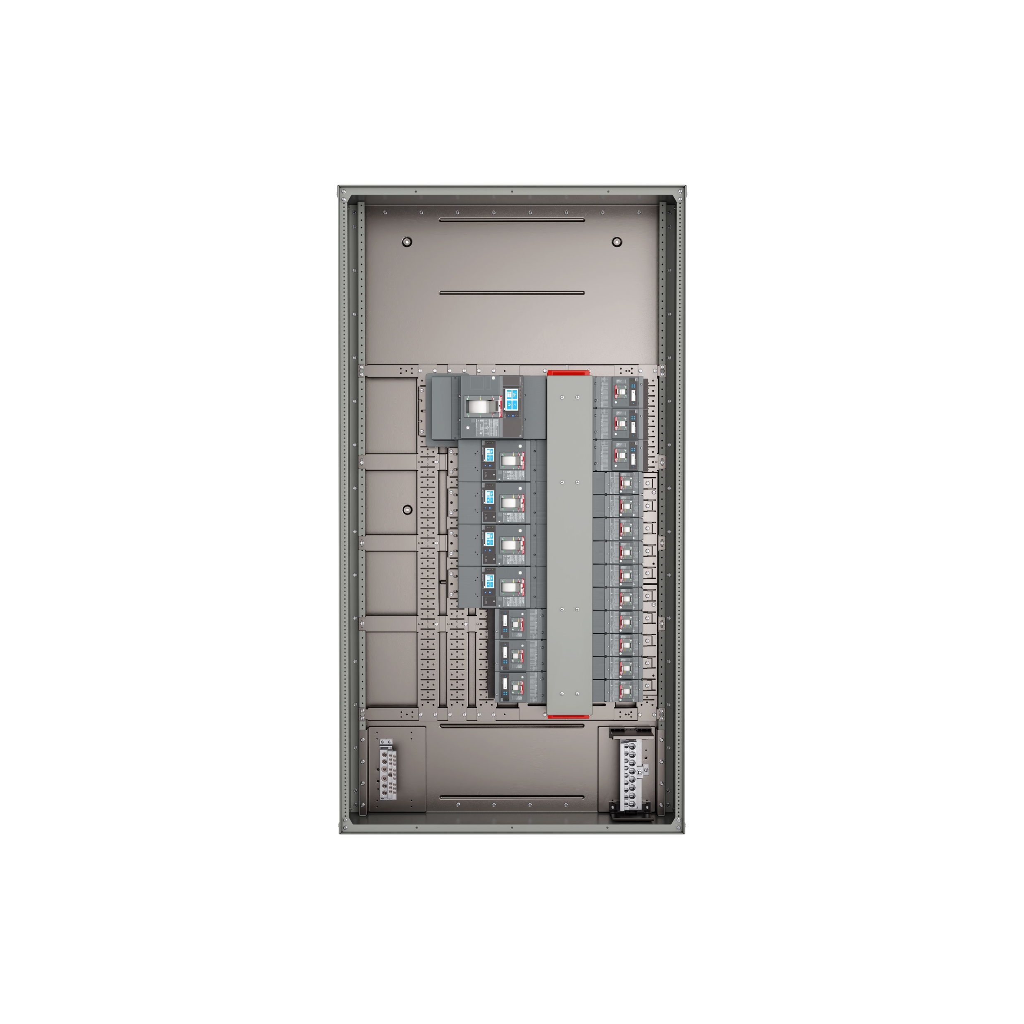
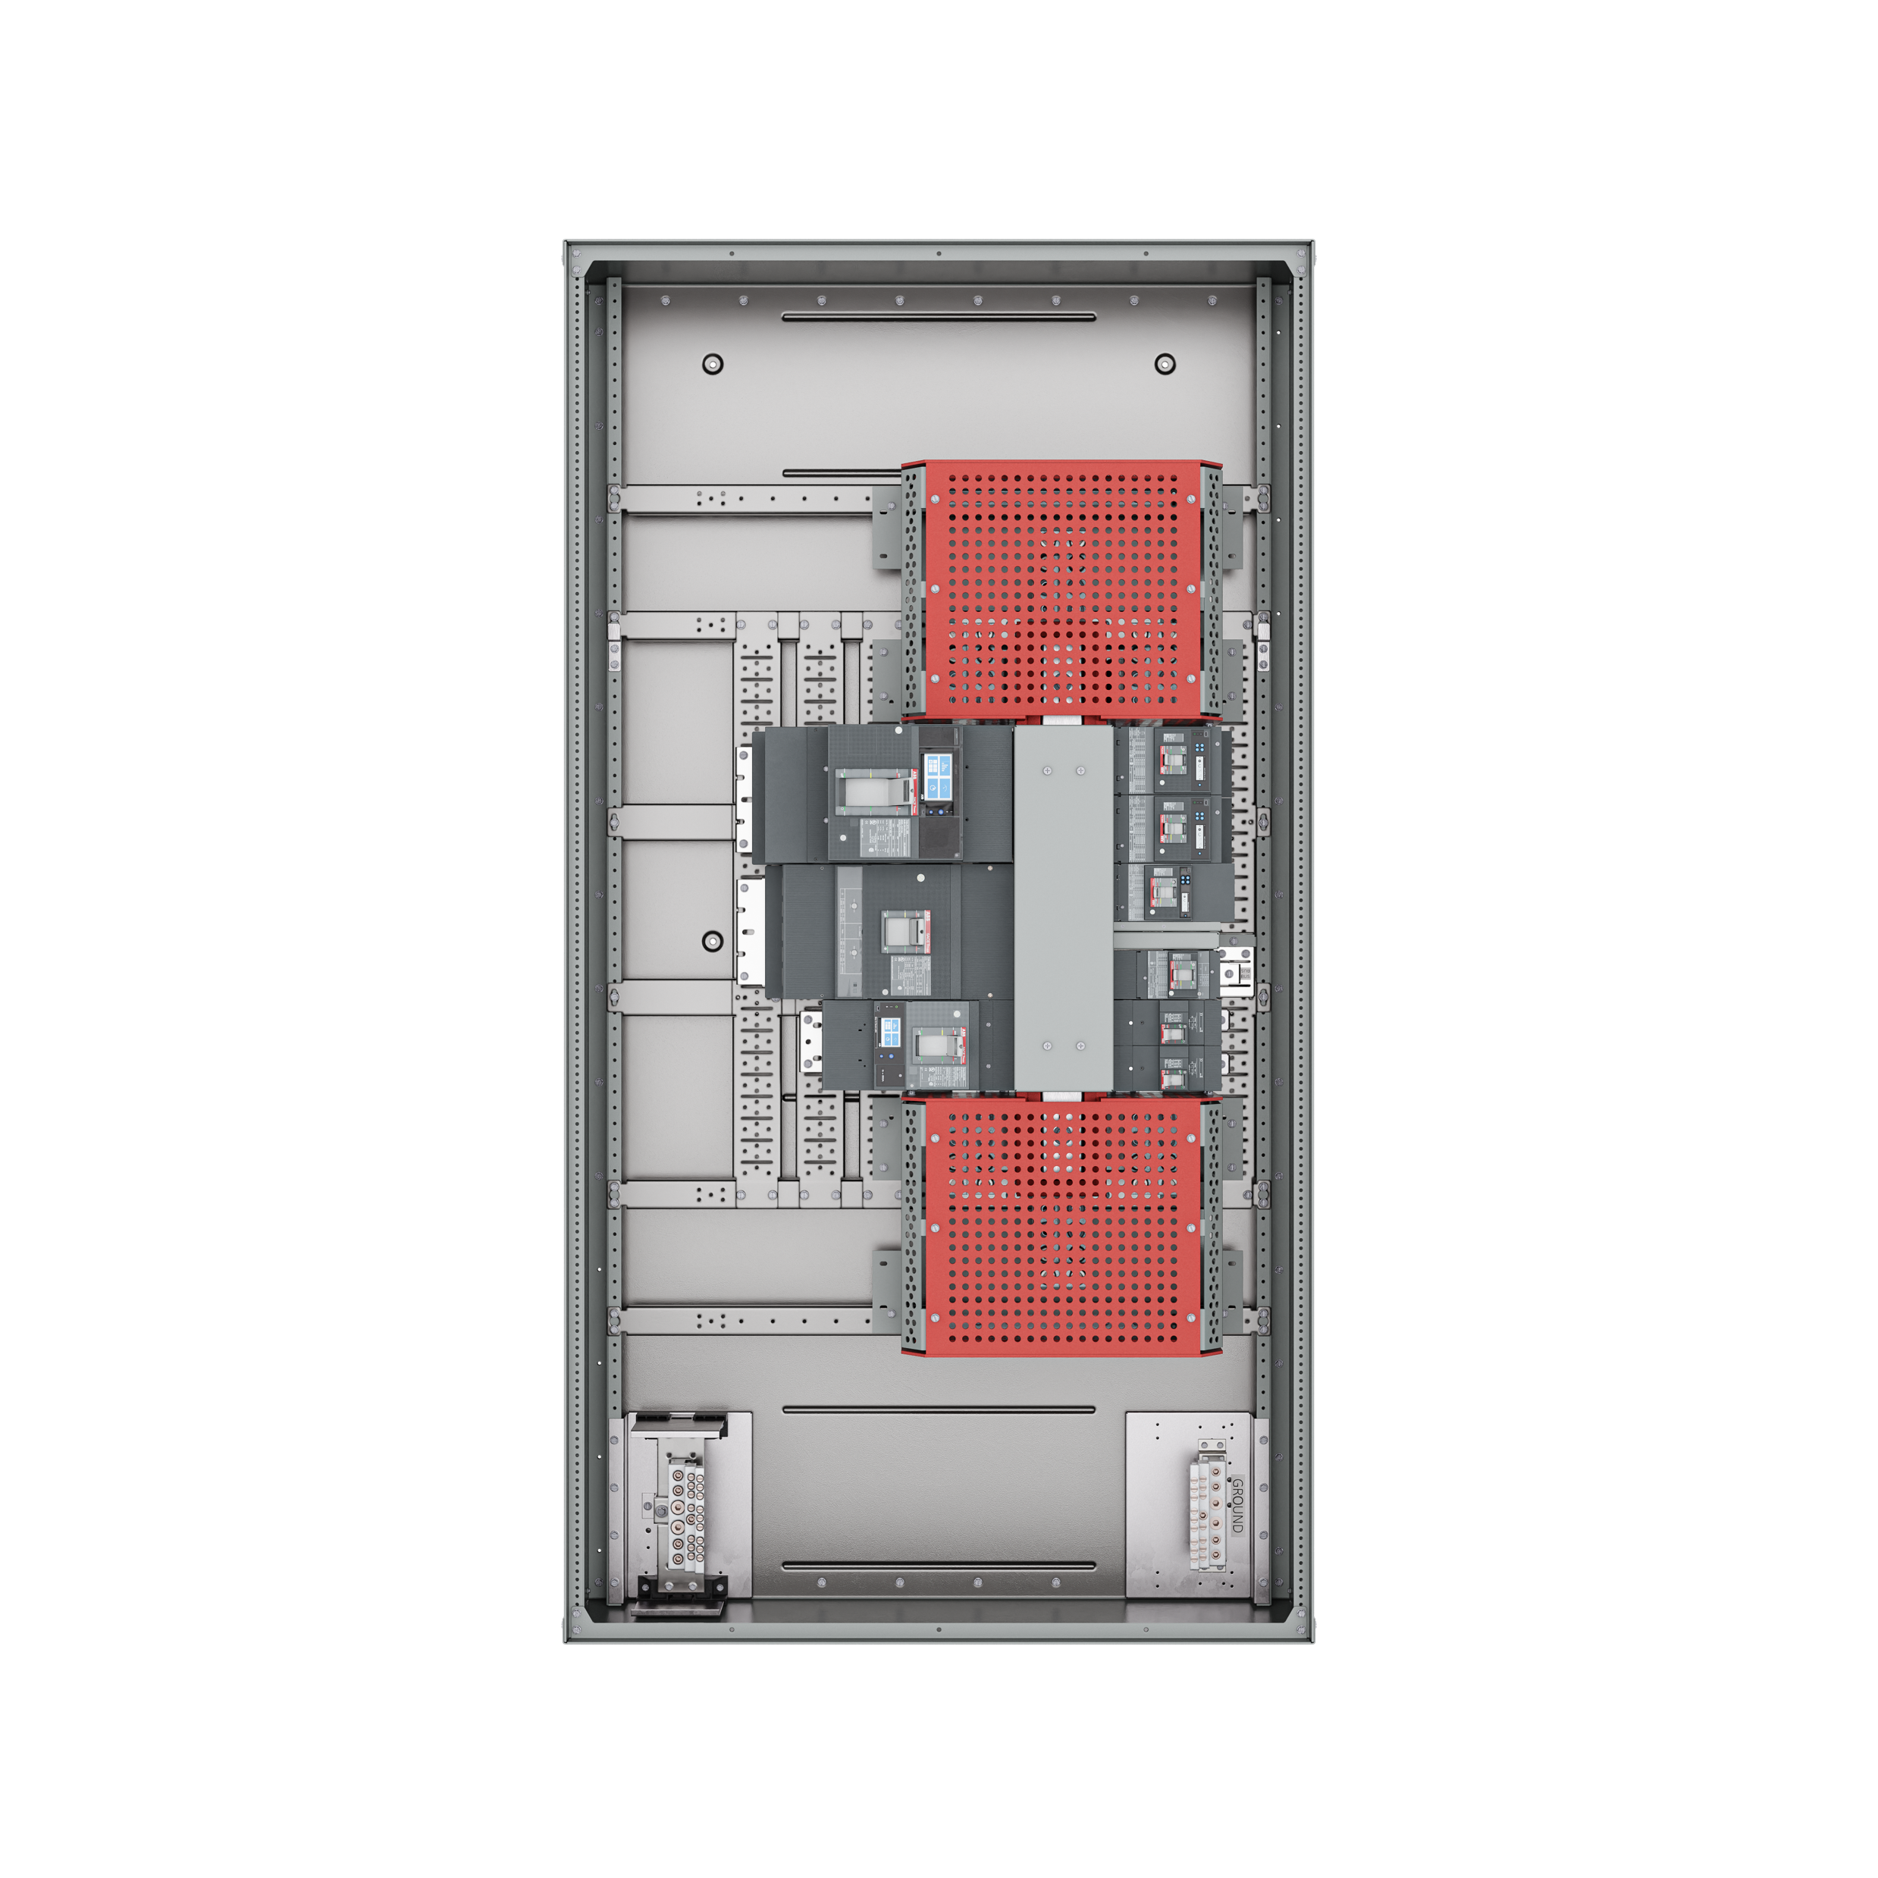
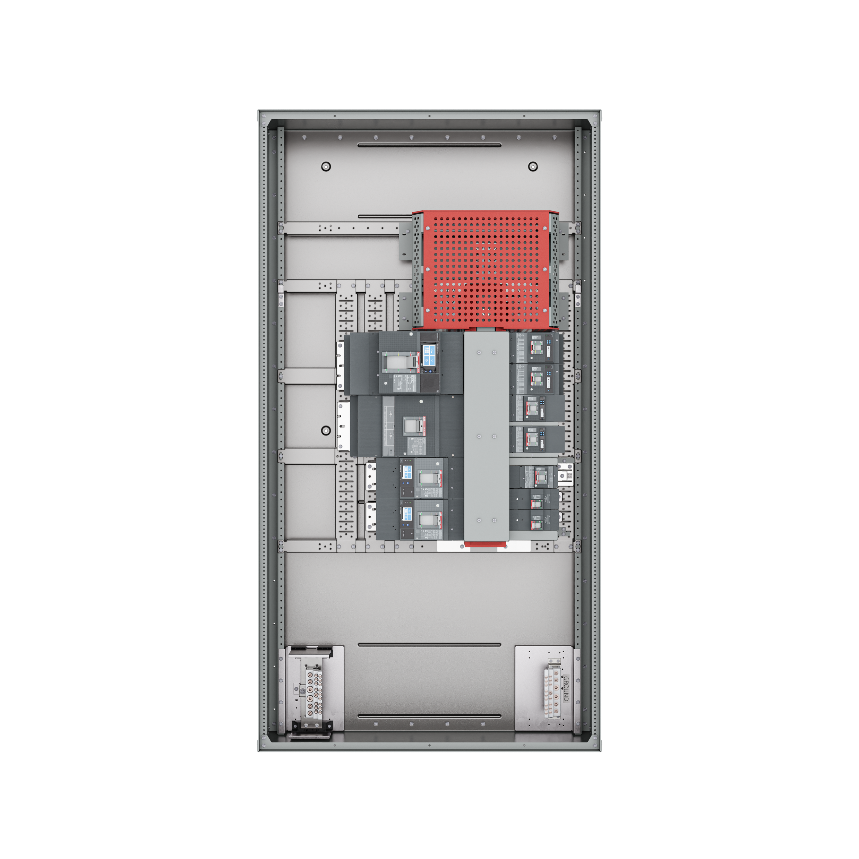
ReliaGear® neXT full IP20
Product overview
IP20 main lug +
feed-through
IP20 horizontal
main breaker
Specifications:
3P3W and 3P4W — 600 V, 480 V, 240 V, 600/347 V, 480/277 V, 208/120 V
Fully rated 200 kAIC at 240 V AC, 200 kAIC at 480 V AC, 100 kAIC at 600 V AC
Main circuit breakers: Up to 1200 A horizontal
Main lugs: 250 A–1200 A
Plug-in branch circuit breakers: 15–1200 A
Enclosures: NEMA Type 1, 2, 3R, 4/4X, 12
Standards and approvals:
ANSI/NEMA PB 1, panelboards
ANSI/NFPA 70, National Electrical Code
UL 489, molded-case circuit breakers and circuit-breaker enclosures
UL 50, enclosures for electrical equipment
UL 67, panelboards
cUL listing for low voltage power panels
Seismic certification according to ICC-ES AC156
IP20 main lug

Slide 10
— Product compatibility
4

Slide 11
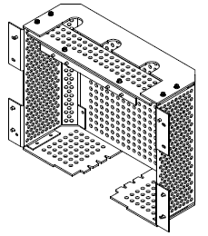
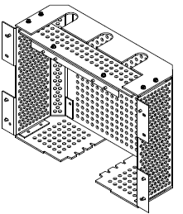
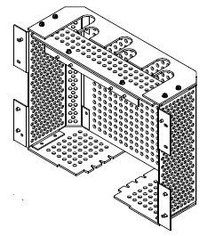
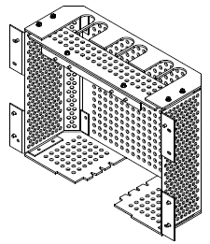
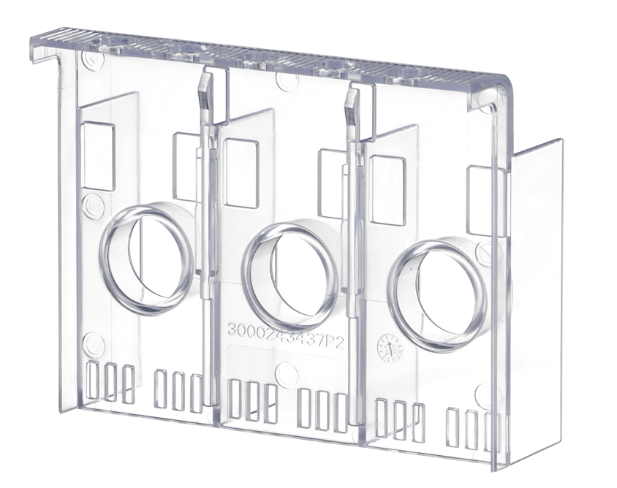
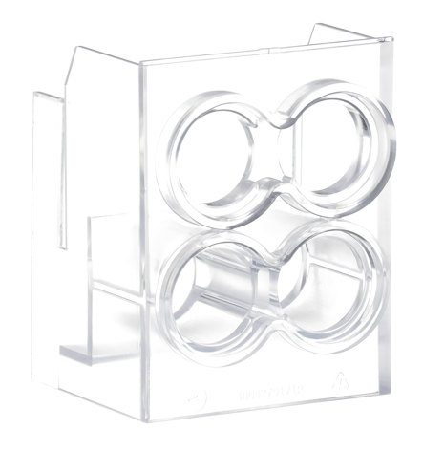
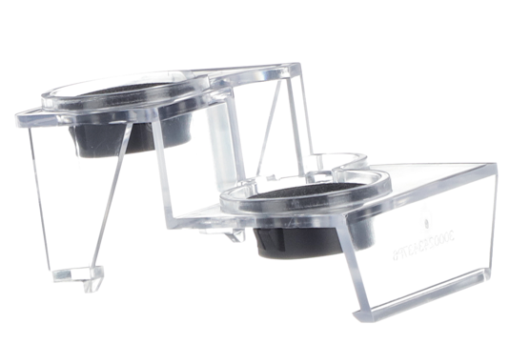
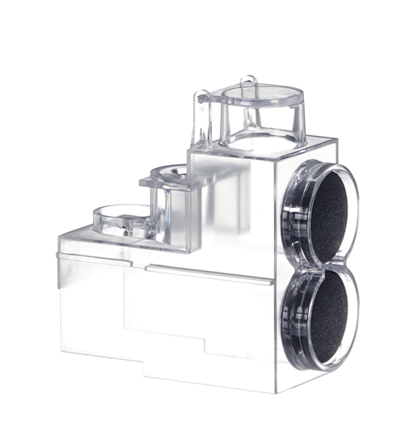
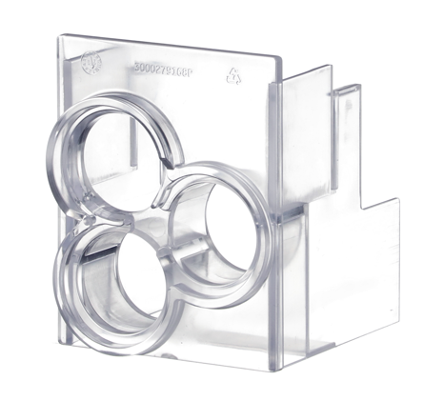
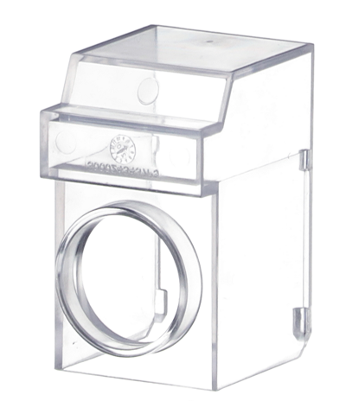
Product compatibility
Overview
Full IP20 configurations
Main breaker, horizontally mounted
Main breaker, horizontally mounted + feed-through lugs
Main lugs
Main lugs + feed-through lugs
All main/feeder breakers have service entrance/finger-safe lug barriers; examples below:
(1) #2–750 MCM
(2) #2–750 MCM
(3) #2– 750 MCM
(4) #2–750 MCM
Can be used with either #2–600 MCM lug or 3/0–750 MCM lug with anywhere from 1 to 4 cables per phase
Service entrance/finger-safe lug barriers offering
Breaker frame | Ampacity | Poles | Max. SCCR | Allowed for full IP20 panels | Main/ feeder | Wire ranges allowed
XT1 | 125 A | 3 | 65 kA (480 V) | Y | F | (1) No. 10–2/0 AWG
XT2 | 125 A | 3 | 200 kA (480 V) | Y | F | (1) No. 10–2/0 AWG
XT4 | 250 A | 3 | 200 kA (480 V) | Y | M / F | (1) 4 AWG–350 MCM (1) 3/0 AWG–350 MCM
XT5 | 400/600 A | 3 | 200 kA (480 V) | Y | M / F | (2) 2/0 AWG–500 MCM (2) 500 MCM–750 MCM (coming soon)
XT6 | 800 A | 3 | 65 kA (480 V) | Y | M / F | (3) 2/0 AWG–400 MCM (2) 500 MCM–750 MCM (coming soon)
XT7 | 1200 A | 3 | 100 kA (480 V) | Y | M / F | (4) 4/0 AWG–500 MCM (3) 500 MCM–750 MCM
A2 | 250 A | 2 | 25 kA (240 V) | Y | F | (1) 1 AWG–250 MCM (Cu) (1) 2/0 AWG–300 MCM (Al)
FB | 100 A | 1, 2 | 150 kA (480 V) | N | N/A | N/A
TEY | 125 A | 1, 2 | 65 kA (480/277 V) | N | N/A | N/A

Slide 12
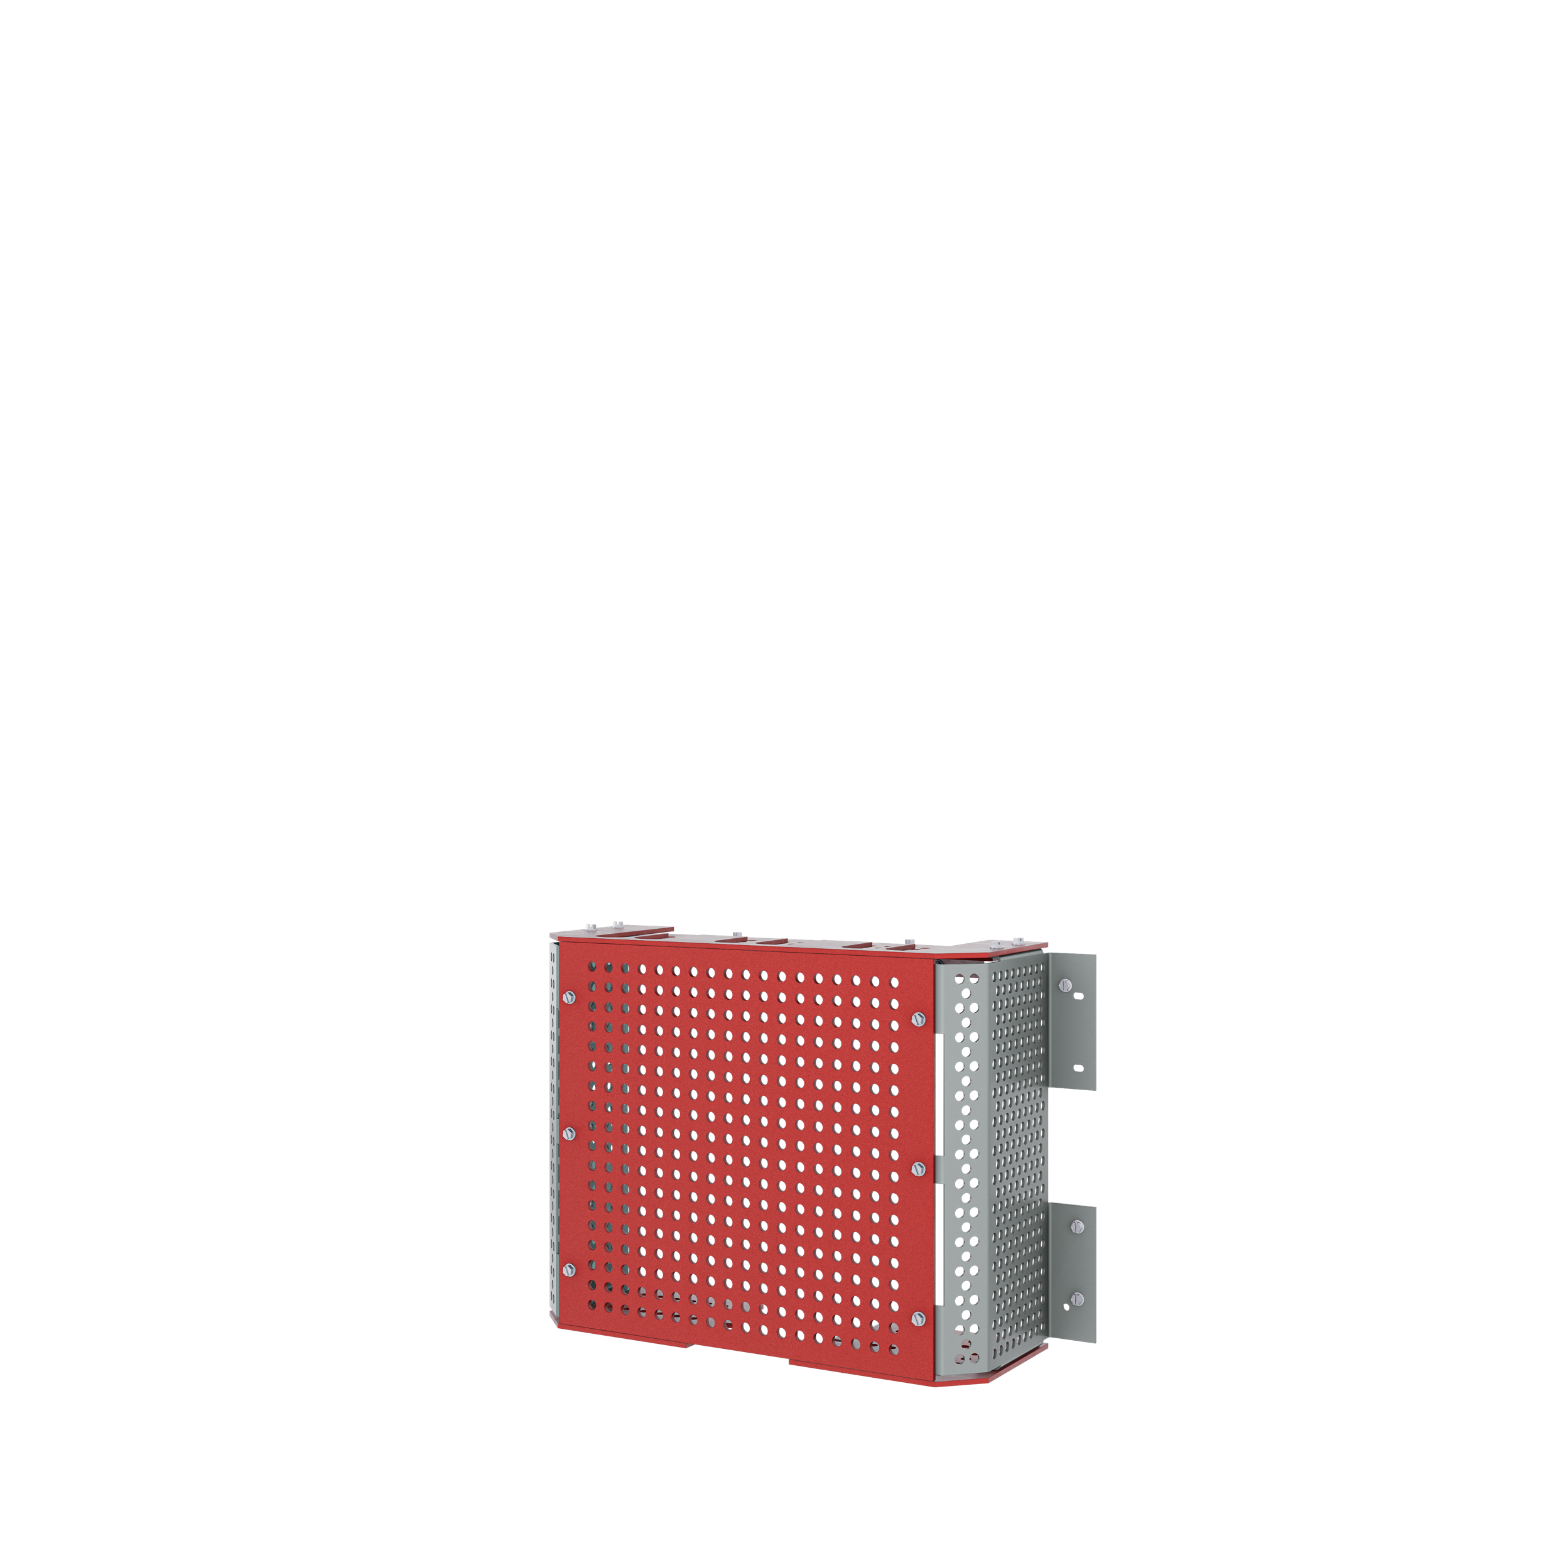
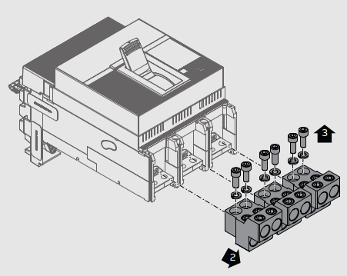
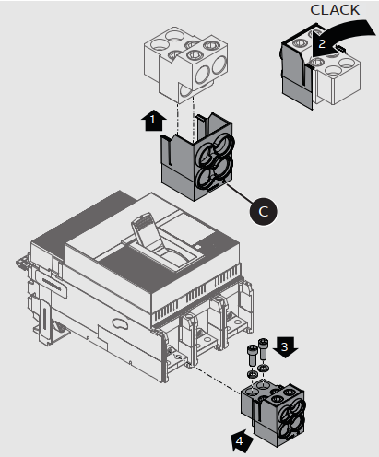
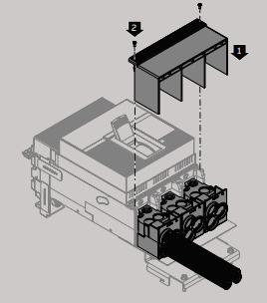
IP20 barriers
Assembly process
IP20 main lug barrier kit assembly
Service entrance/finger-safe lug barrier installation
Top barrier
1
Front
barrier
Support
brackets
Bottom barriers
Barrier ships in a flat pack, to be assembled at customer site
(1) additional horizontal mounting rail is installed in enclosure
Main wires should be brought into the enclosure before the IP20 top and front barriers are installed
Customer selects top barrier based on number of cables
For detailed instructions, see Full IP20 Main Lug instruction sheet
3
2
For detailed instructions, see Service entrance/finger-safe lug barrier installation instructions

Slide 13
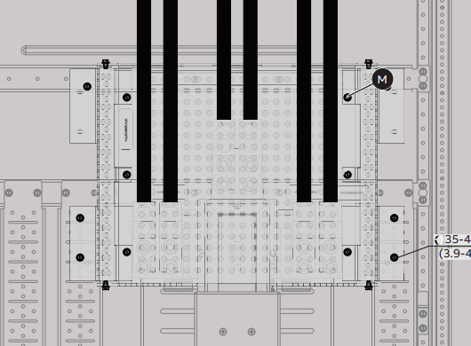
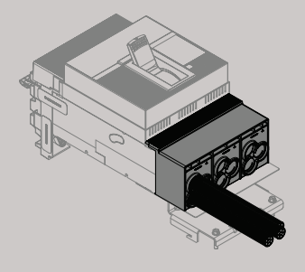
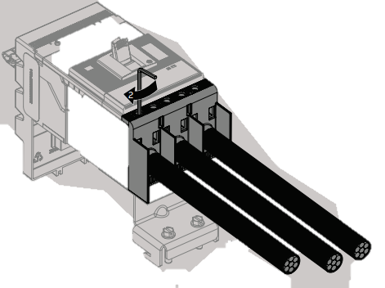
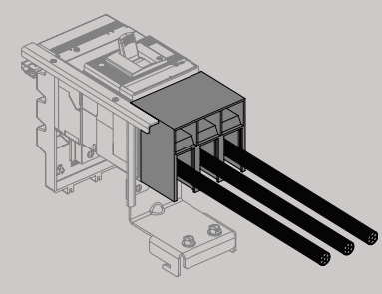
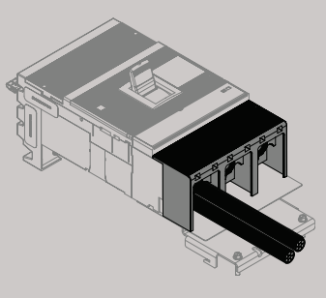
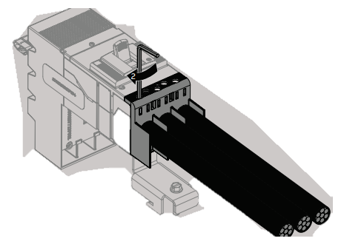
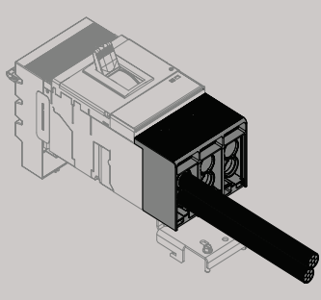
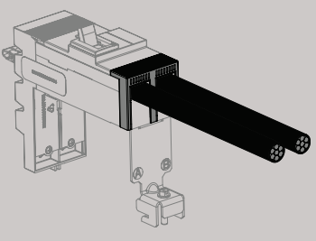
ReliaGear® neXT full IP20
Finger-safe connections
XT7
XT4
XT2
XT6
XT1
XT5
A2

Slide 14
ReliaGear® neXT full IP20
Summary
Panel types offered:
IP20 (finger-safe) connections:
Other considerations:
Horizontally mounted MCB
Horizontally mounted MCB + feed-through lug
Main lug only
Main lug + feed-through lug
Plug-in breaker (line side)*: Provided by the ReliaGear neXT line side connector technology and the ReliaGear neXT inherently finger-safe bus stack
Plug-in breaker (load side)*: Provided by pre-installed service entrance/finger-safe lug barriers (not available in all breaker frames)
Main lug/feed-through lug: Provided by the main lug barrier kit, which covers the bus stack lug pads and mechanical lugs
Neutrals and grounds will NOT be barriered off (NOT finger-safe)
The IP20 main lug barrier kit, horizontal mounting rail and service entrance/finger-safe lug barriers can all be ordered separately to retrofit existing panels in the field, barring restrictions
* For plug-in (horizontally mounted) MCBs, the line and load sides are reversed MCB = main circuit breaker

Slide 15
ReliaGear® neXT full IP20
Restrictions
Full IP20 is NOT available for the following configurations:
Single-phase voltage: 120/240 V 1-phase 3-wire
DC voltages: 125 V DC and 250 V DC 2-wire
Vertical main breakers
Dual main lugs
Compression lugs
Dual main compression lugs
FB or TEY breakers (service entrance/finger-safe lug barriers are not available)

Slide 16
— empower configurator (panelboard)
5

Slide 17
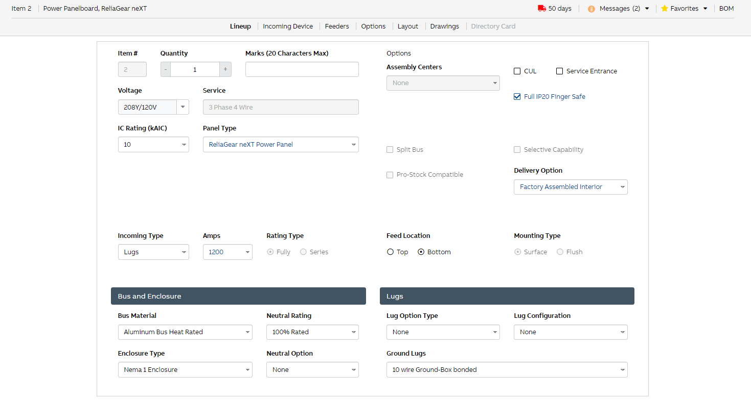
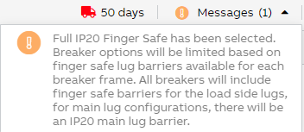
empower panelboard configurator
Selections

Slide 18
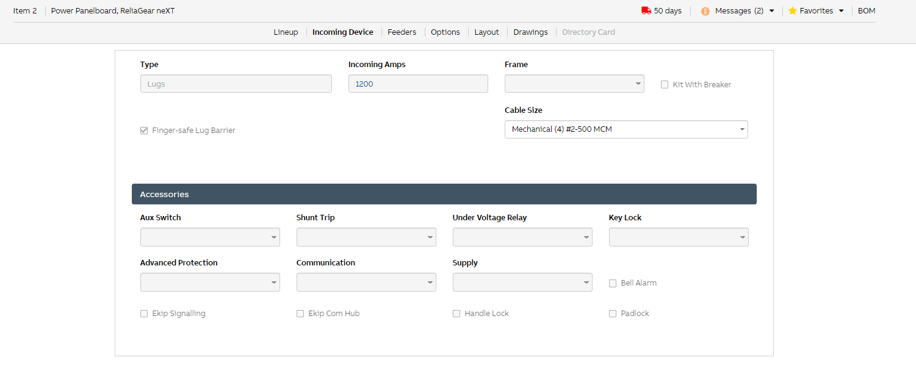
empower panelboard configurator
Main lug
On incoming device tab:
Once full IP20 finger-safe has been selected on lineup tab, the finger-safe lug barrier will be selected and cannot be unchecked

Slide 19
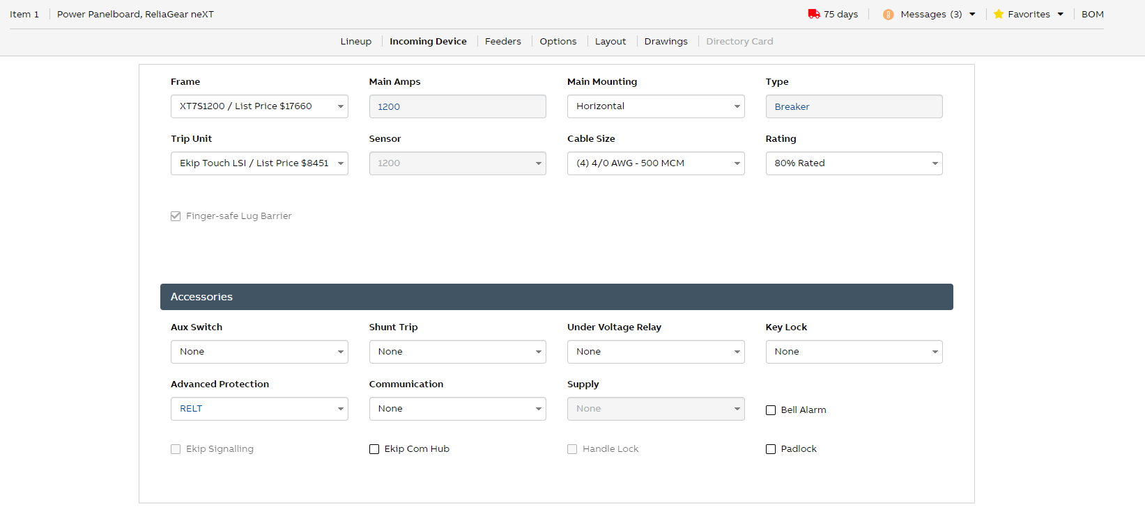
empower panelboard configurator
Horizontal main breaker
On incoming device tab:
Once full IP20 finger-safe has been selected on lineup tab, the finger-safe lug barrier will be selected and cannot be unchecked

Slide 20
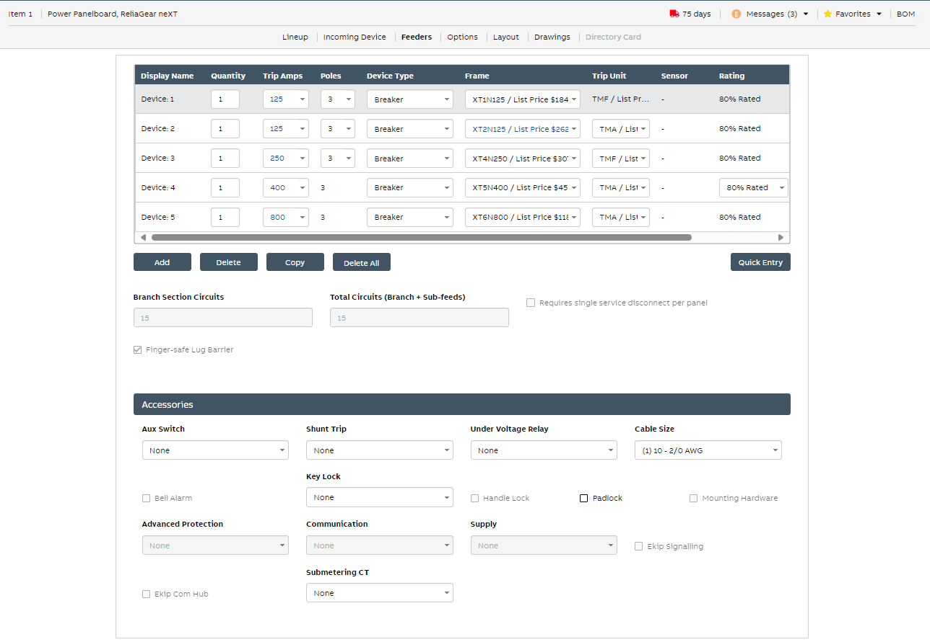
empower panelboard configurator
Feeders
On feeders tab:
Once full IP20 finger-safe has been selected on lineup tab, feeder breakers that can be added to panel will be limited based on the breakers that have service entrance/IP20 finger-safe lug barriers available
For all feeders, finger-safe lug barrier will be selected and cannot be unchecked

Slide 21
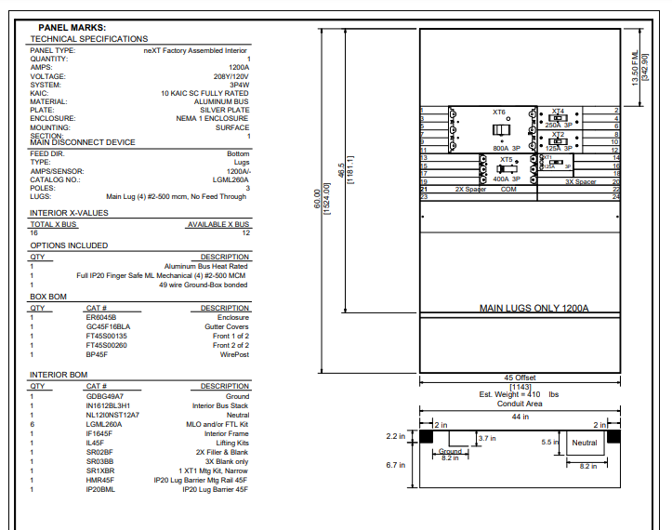
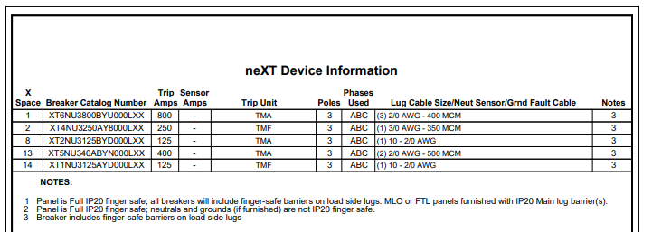
empower panelboard configurator
Main lug drawing
In breaker catalog number, the 16th digit = L represents service entrance/ finger-safe lug barriers
Under options included, there will be an additional note that says: “Full IP20 finger-safe barrier main lug”
Catalogs for IP20 main lug barrier and horizontal mounting rail

Slide 22
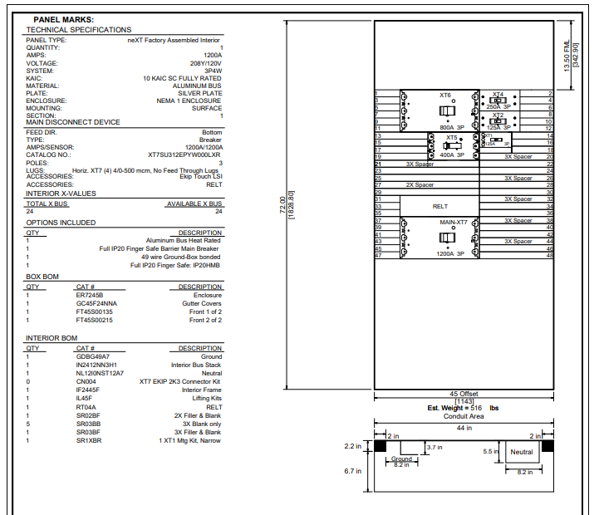
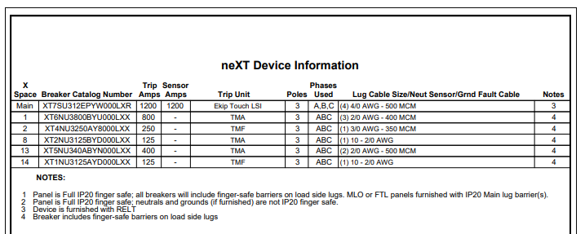
empower panelboard configurator
Horizontal main breaker drawing
In breaker catalog number, the 16th digit = L represents service entrance/ finger-safe lug barriers
Under options included, there will be an additional note that says: “Full IP20 finger-safe main breaker”

Slide 23
— empower configurator (breaker)
6

Slide 24
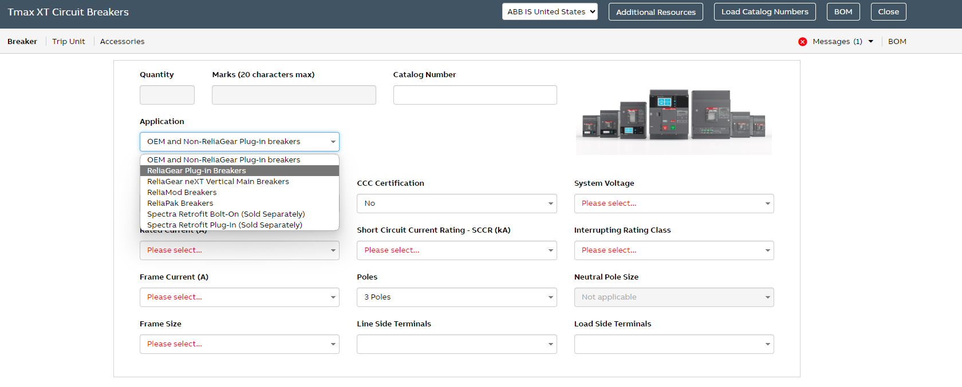
empower breaker configurator
Service entrance/finger-safe barrier selection process
1
Start by selecting “ReliaGear plug-in breakers” under Application.

Slide 25
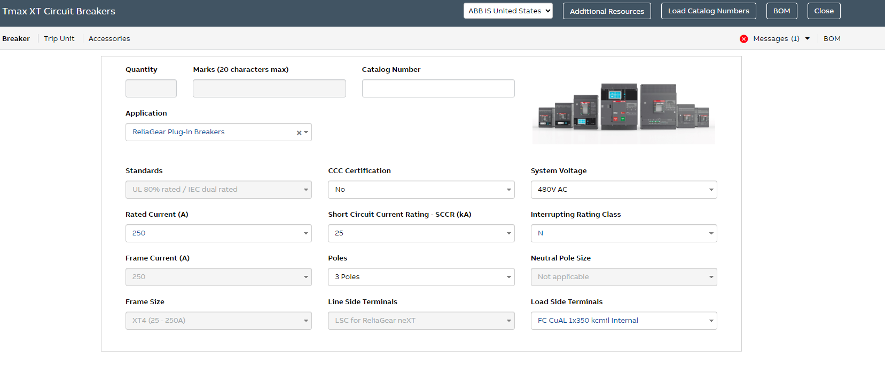
empower breaker configurator
Service entrance/finger-safe barrier selection process
2
Then, complete the rest of your desired selections on the Breaker tab (should look like this screen).

Slide 26
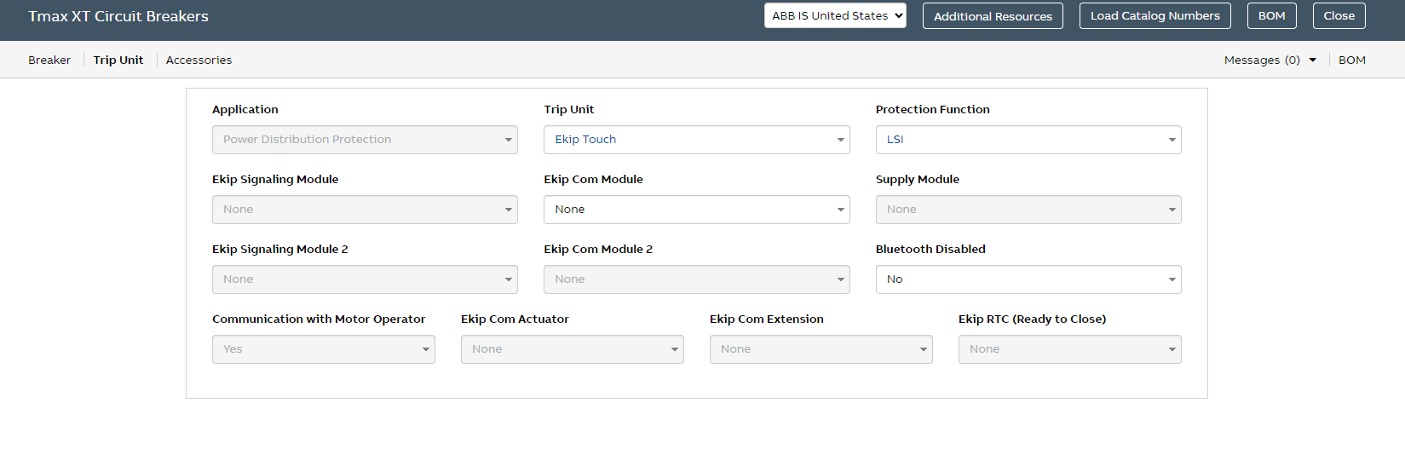
empower breaker configurator
Service entrance/finger-safe barrier selection process
3
Next, go to the Trip Unit tab, and select desired trip unit, protection function and any other Ekip modules.

Slide 27
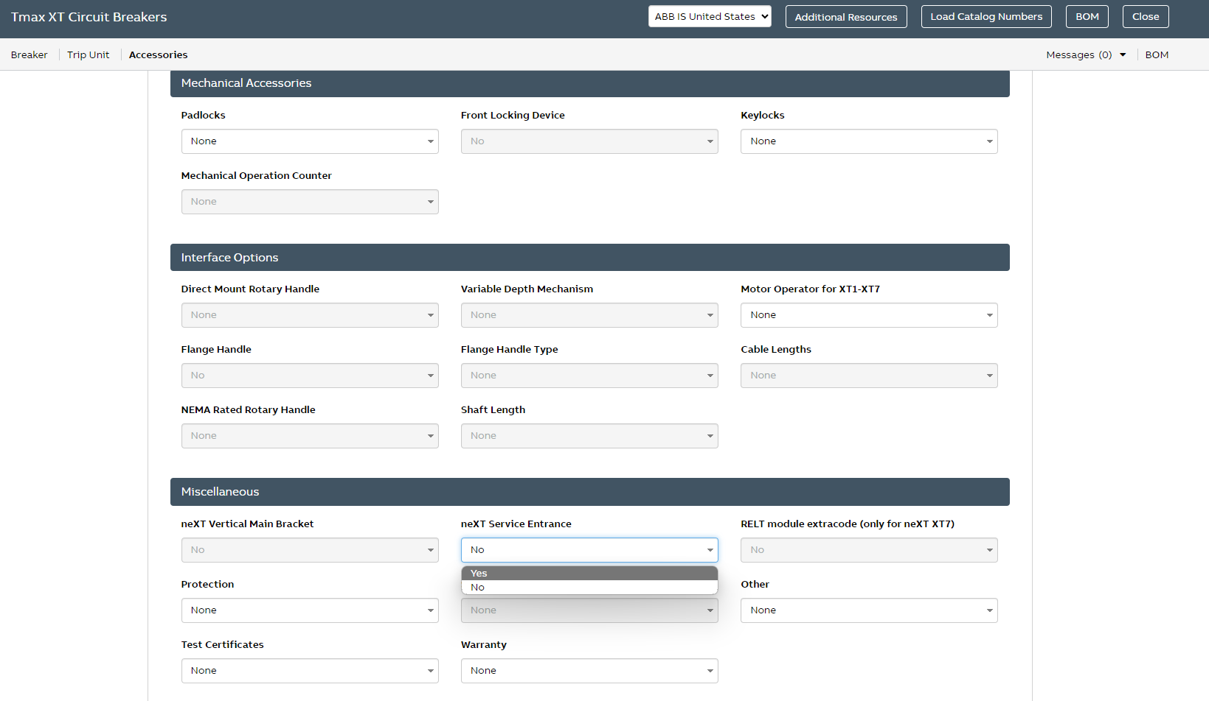
empower breaker configurator
Service entrance/finger-safe barrier selection process
4
Finally, navigate to the Accessories tab and scroll to the bottom under Miscellaneous, find the selection for neXT Service Entrance and select Yes. This will now drive the service entrance/finger-safe lug barriers on the load-side lugs of the plug-in breaker.

Slide 28
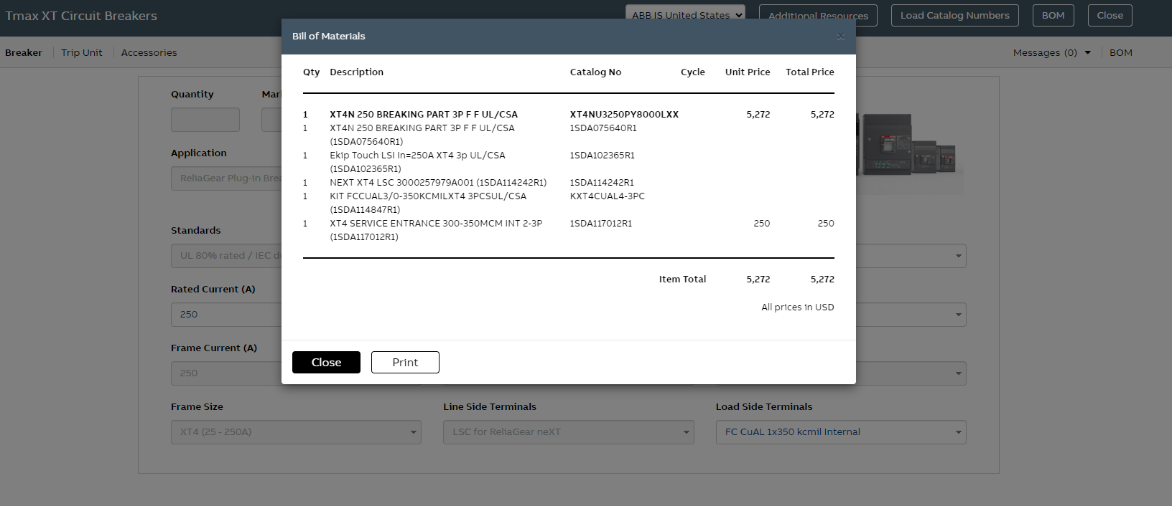
empower breaker configurator
Service entrance/finger-safe barrier selection process
5
As a final check, you can navigate back to the Breaker tab, and on the far right, click on BOM. This will show you the catalog number of the breaker and the 1SDA BOM. Note that digit 16 of the catalog number is an “L” to represent service entrance/ finger-safe lug barriers.

Slide 29
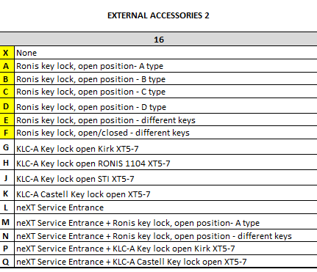
empower breaker configurator
Service entrance/finger-safe barrier selection process – Digit 16 explained
Based on other external accessories, such as Kirk locks or Ronis locks, that may be added to your configured XT breaker, the 16th digit of the breaker catalog number may change when also paired with the service entrance/ finger-safe lug barrier selection
Please note the digits (L, M, N, P, Q) boxed in red to the left, used when other accessories are paired with service entrance barriers

Slide 30
— Component ordering for replacement/ retrofit
7

Slide 31
IP20 main lug barrier
Ordering code
Part identifier |  | Type
IP20B | IP20 Barrier | ML | Main lug
Ordering code
IP20BML

Slide 32
Horizontal mounting rail
Ordering codes
Part identifier |  | Width |  | Orientation
HMR | Horizontal mounting rail | 30 | 30" | C | Center
 |  | 40 | 40" | F | Offset
 |  | 45 | 45"
Ordering codes
HMR30C
HMR40F
HMR45C
HMR45F

Slide 33
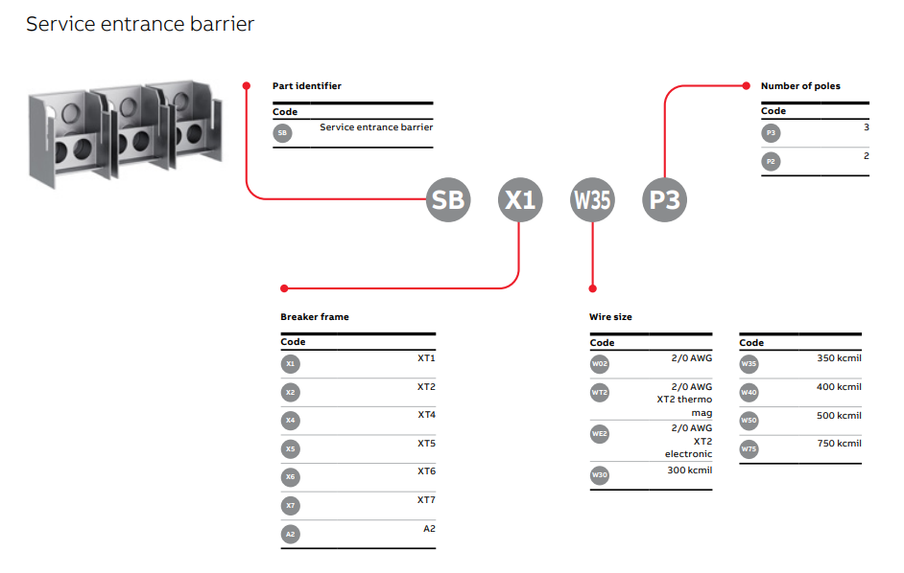
Service entrance/finger-safe lug barriers
Ordering codes for kits
Not every combination is possible; see following slides

Slide 34
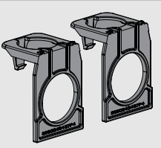
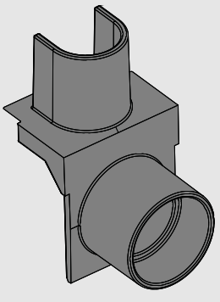
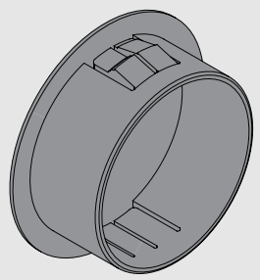
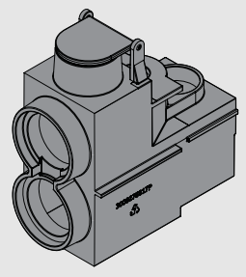
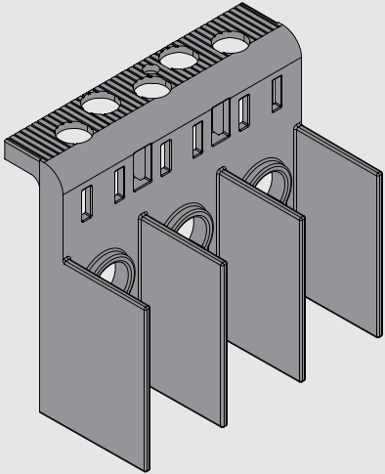
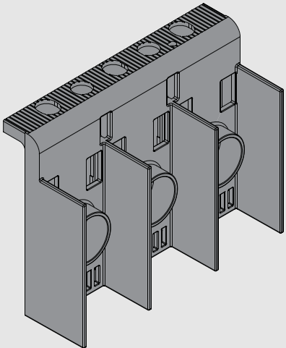
Service entrance/finger-safe lug barriers
Ordering codes for kits
A2 ((1) 1 AWG–250 MCM (Cu) or (1) 2/0 AWG–300 MCM (Al))
 | 3P | 2P
 | N/A | SBA2W30P2
XT2 EKIP (#10-2/0 AWG)
 | 3P | 2P
 | SBX2WE2P3 | SBX2WE2P2
XT5 ((2) 2/0 AWG–500 MCM)
 | 3P | 2P
 | SBX5W50P3 | SBX5W50P2
XT1 (#10–2/0 AWG)
 | 3P | 2P
 | SBX1W02P3 | –
XT4 (4 AWG–350 MCM int.)
 | 3P |  | 2P
 | SBX4W30P3 | – | SBX4W30P3
XT5 ((2) 500 MCM–750 MCM) coming soon
 | 3P | 2P
 | SBX5W75P3 | SBX5W75P2
XT2 TMF/A (#10–2/0 AWG)
 | 3P | 2P
 | SBX2WT2P3 | SBX2WT2P2
XT4 (3/0 AWG–350 MCM ext.)
 | 3P | 2P
 | SBX4W35P3 | SBX4W35P2
XT6 ((3) 2/0 AWG–400 MCM)
 | 3P | 2P
 | SBX6W40P3 | SBX6W40P2

Slide 35
Service entrance/finger-safe lug barriers
Ordering codes for kits
XT6 ((2) 500 MCM–750 MCM) coming soon
 | 3P | 2P
 | SBX6W75P3 | SBX6W75P2
XT7 ((4) 4/0 AWG–500 MCM)
 | 3P | 2P
 | SBX7W50P3 | SBX7W50P2
XT7 ((3) 500 MCM–750 MCM)
 | 3P | 2P
 | SBX7W75P3 | SBX7W75P2

Slide 36
— Helpful documents and links
8

Slide 37
ReliaGear® neXT Full IP20
Helpful links and documents
Installation instructions:
Service entrance/finger-safe lug barrier installation instructions
Full IP20 main lug instruction sheet
Supporting documentation:
ReliaGear plug-in XT breakers white paper
ReliaGear neXT sales powerpoint — full offering
ReliaGear neXT power panel global catalog
empower links:
empower Quote
empower XT Breaker Configurator
empower Flow

