Slide 1
F&B Segment Electrification Solutions
confidential
Electrification products | distribution solutions | digital, February 2018
A summary of the Solutions Guide document
Ganesh Kulathu, Digital Solutions Specialist
Padmasri Krishnamurthy, Digital Lead

Slide 2
F&B Segment Electrification Solutions - Guidebook
Content

Slide 3
F&B Segment Electrification Solutions - Guidebook
Content
Introduction
Industry needs and customer trends
Key Performance Indicators (KPI)
Use case for F&B plant electrification solutions
Operational considerations
Constructing the solution
Solution components
Detailing the solution
Mapping KPIs, solutions and products
Conclusion

Slide 4
F&B Segment Electrification Solutions - Guidebook
I. Introduction

Slide 5
F&B Segment Electrification Solutions - Guidebook
I. Introduction
Background
F&B manufacturing and ancillary industry
  largest on the planet, about 1.2 million F&B production plants worldwide
  Impacts almost all human beings and domesticated pets
  Present in both urban and rural parts of the world

Slide 6
F&B Segment Electrification Solutions - Guidebook
I. Introduction
Challenges and expectations (1/2)
Mainly attributed to globalization and diverse cultural ‘mix’
  Market related
    Shorter product cycles
      High levels of hygiene, nutritional value, health consciousness etc.
        Stringent food safety and quality
        Adapting to local market preferences
        Cost-consciousness
  Business related
    Intense competition and minimal margins
    Innovation, new market pursuits, deeper market penetration, faster time-to-market
    ‘Business climate’ change due to M&A, consolidations etc.

Slide 7
F&B Segment Electrification Solutions - Guidebook
I. Introduction
Challenges and expectations (2/2)
  Process related
    Relentless quality
    High level of personnel safety
    Optimal supply and delivery chain
    Efficient production process chain
Meeting above challenges essential to ensure survival, sustenance and prosperity of F&B players.
Directly/indirectly deployed technologies need to be
safe, reliable, eco-efficient, smart and futuristic.

Slide 8
F&B Segment Electrification Solutions - Guidebook
II. Industry needs and customer trends

Slide 9
F&B Segment Electrification Solutions - Guidebook
II. Industry needs and customer trends
Outstanding trends
  Reduced labor and human interface
  Increased prevalence of ‘smart-enabled’ and ‘self-learning’ equipment
  More demand for skilled technical experts
  Shift towards energy-efficient solutions
  Cost pressure driven by emerging market countries
  Energy efficiency
    is the major cost driver for the F&B factory production process
    is addressed through electrification solutions
  Reduction of Total Cost of Ownership (TCO)
  High priority for safety
  Overall Equipment Effectiveness (OEE) improvements
Electrification solutions contribute towards energy efficiency.

Slide 10
F&B Segment Electrification Solutions - Guidebook
II. Industry needs and customer trends
Across F&B industries (soft-drinks, dairy, beer etc.)
  High quality, healthy/safe food products with maximum shelf life
  Local presence in emerging markets
  Minimum cost and optimum value
  Energy efficiency solutions to reduce consumption of water and energy
  Minimal raw material wastage
  High quality of power
  Predictive maintenance of equipment
  High levels of automation; new solutions that are easy retrofit-able
  Compliance of performance and safety standards
  Best returns on CAPEX based investments
  Safety of plant, personnel
  Reliability, production/service continuity
  Reliable, proactive supplier to do business with

Slide 11
F&B Segment Electrification Solutions - Guidebook
III. Key Performance Indicators

Slide 12
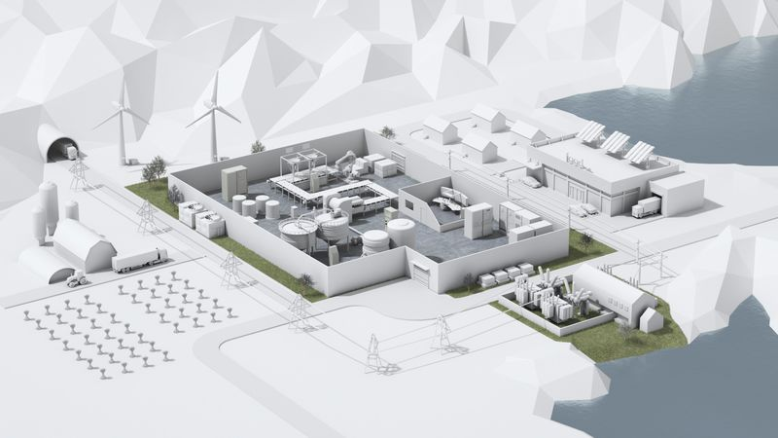
F&B Segment Electrification Solutions - Guidebook
III. Key Performance Indicators (KPI)
Derived from needs, trends
  Safety
  Food and people
  Cost
  Optimizing TCO
  Increased asset utilization
  Continuous operation
  Quality
  Manufactured product quality
  Power quality
  Technologies adapted to variable ambient conditions
  Trusted partner (supplier)

Slide 13
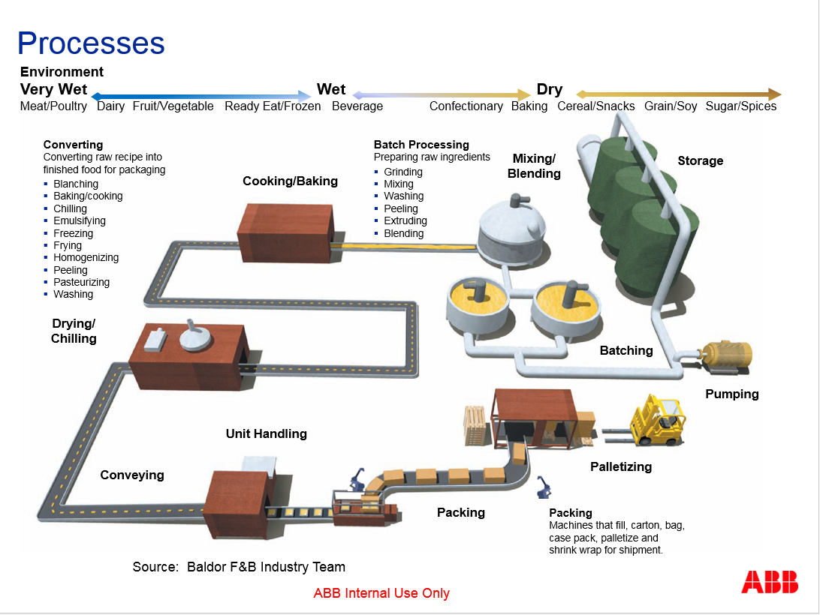
F&B Segment Electrification Solutions - Guidebook
III. Key Performance Indicators (KPI)
Generic example of F&B plant process flow
Big plants may have all of the processes/sub-processes in a single location
Others may have these processes/sub-processes in a split manner, across multiple locations, reflecting their roles in the supply chain.
  Likely to have dedicated power distribution equipment and systems.
ABB’s contemporary and upcoming power distribution products could contribute to operational aspects of the F&B industry production chain.

Slide 14
F&B Segment Electrification Solutions - Guidebook
IV. Use case for F&B plant electrification solutions

Slide 15
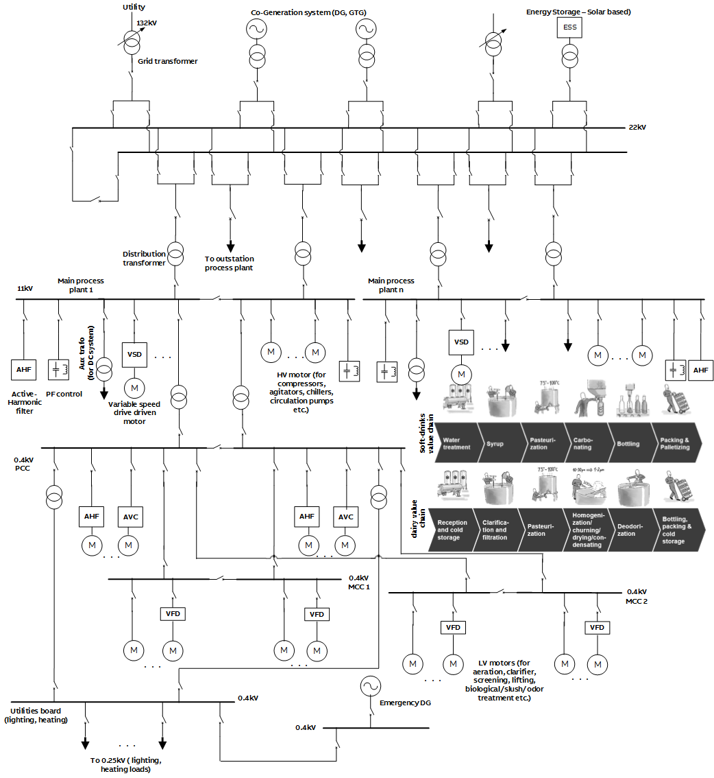
F&B Segment Electrification Solutions - Guidebook
IV. Use case for F&B plant electrification solutions
SLD and process (1/2)
Describing main power evacuation center with multiple power sources
Main process plant area substation to power motors/drives etc. associated with rotating machinery.
Examples of main processes for soft-drinks chain, dairy chain, beer are mentioned.
(Note: SLD arrangement, voltage levels etc. is for representation purposes only, in order to establish the intended electrification solutions).

Slide 16
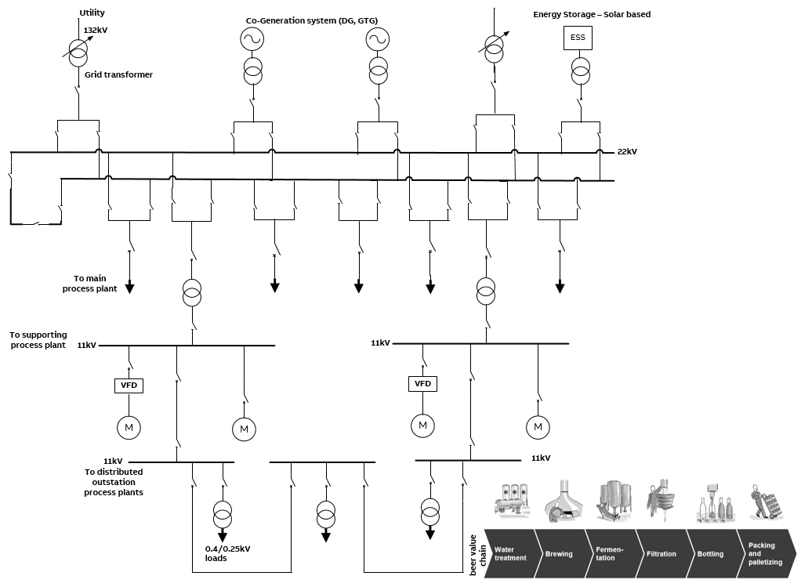
F&B Segment Electrification Solutions - Guidebook
IV. Use case for F&B plant electrification solutions
SLD and process (2/2)
Supporting process plant area like water treatment plants having an associated substation with bulk motor/drive loads to drive heavy duty pumps.

Slide 17
F&B Segment Electrification Solutions - Guidebook
IV. Use case for F&B plant electrification solutions
Elements in the plant power distribution system
Power sources
  Connectivity to power utility grid through 1 or more grid transformers (132/22kV)
  Co-generation based on gas, diesel or steam and battery based energy storage system (ESS), powered by solar energy
  Power network
  22kV double busbar system at the main power evacuation center (selection of single or double busbar system is based on cost, reliability, single or diverse power sources etc.)
  Distribution transformers to transport power to the downstream process plants/voltage levels
  11kV single busbar system at main and supporting process areas. Alternately, 6.6kV or 3.3kV are also possible. 0.4kV at low voltage level.
  HV and LV motors associated with compressors, agitators, chillers, circulating pumps and also for slush/odor/biological treatments, aeration, clarifier applications etc.
  Power factor and power quality improvement equipment like power factor controllers, active harmonic filters etc.

Slide 18
F&B Segment Electrification Solutions - Guidebook
IV. Use case for F&B plant electrification solutions
Typical and common F&B processes
1st stage: Water treatment or cold storage
2nd stage: Syrup mixing or filtration or brewing or sieving
3rd stage: Pasteurization or Fermentation
4th stage: Carbonating or churning-drying-condensation or filtration
5th stage: Bottling or deodorization
6th stage: Packing-palletizing or packing-cold storage
  Catered to by the main process and supporting area substations and associated power distribution network.
  Each process has its own set of requirements related to monitoring, ensuring hygiene, temperature, environment impact, reduced wastage, precision, time controlled actions, response times etc.
Also map to KPIs: safety, cost and quality

Slide 19
F&B Segment Electrification Solutions - Guidebook
IV. Use case for F&B plant electrification solutions
Linking F&B processes to electrification requirements
Transformers
  Grid transformer: 22kV side voltage control
  Monitoring of all transformers (winding, oil temperatures etc.)
Co-generation: power control, load-sharing, peak shaving etc., when working in parallel or isolation with utility power supply
Gas or Air Insulated Switchgear (GIS, AIS) based on space availability, busbar arrangement etc.
Robust power network and equipment protection
Automated control
For energy usage optimization, power quality and power factor improvements, high product quality, lower operation & maintenance costs, system reliability and availability etc.
  VSDs
  Power factor controllers, harmonic filters, inverter bridges, energy storage or active rectifiers etc.
  Power automation, data collection and analytics
  Flexible service offerings for maintenance and upkeep of equipment and system
Also map to KPIs: safety, cost and quality

Slide 20
F&B Segment Electrification Solutions - Guidebook
V. Operational considerations

Slide 21
F&B Segment Electrification Solutions - Guidebook
V. Operational considerations
Related to power system equipment
Equipment aging
Extending equipment life through maintenance
Avoiding maintenance mistakes
Upgrade or update wisely to create safer and efficient systems
Intelligent maintenance
Process visualization
Smart energy monitoring
Protection systems
‘Straighten the sags and kill the spikes’ – Power Quality
Multiple-power source management
Collaboration with solution providers/vendors

Slide 22
F&B Segment Electrification Solutions - Guidebook
VI. Constructing the solution

Slide 23
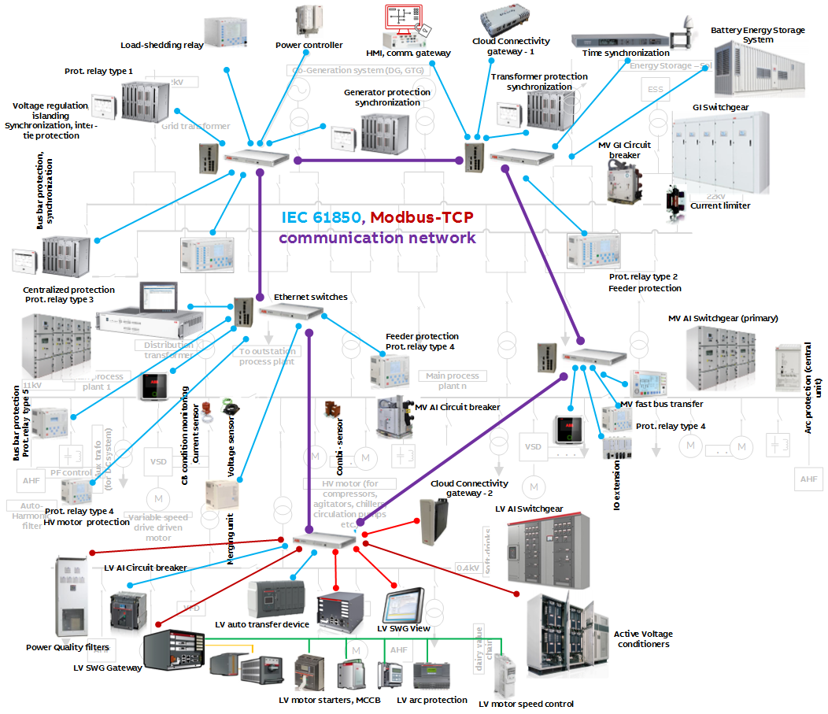
F&B Segment Electrification Solutions - Guidebook
VI. Constructing the solution
System overview (1/3)
Describes the following at power evacuation center and main process substations:
  primary and secondary equipment
  substation infrastructure (indoor)
  proposed equipment at different voltage levels, depending on type of solutions or applications or usage required
  network connectivity
  communication network

Slide 24
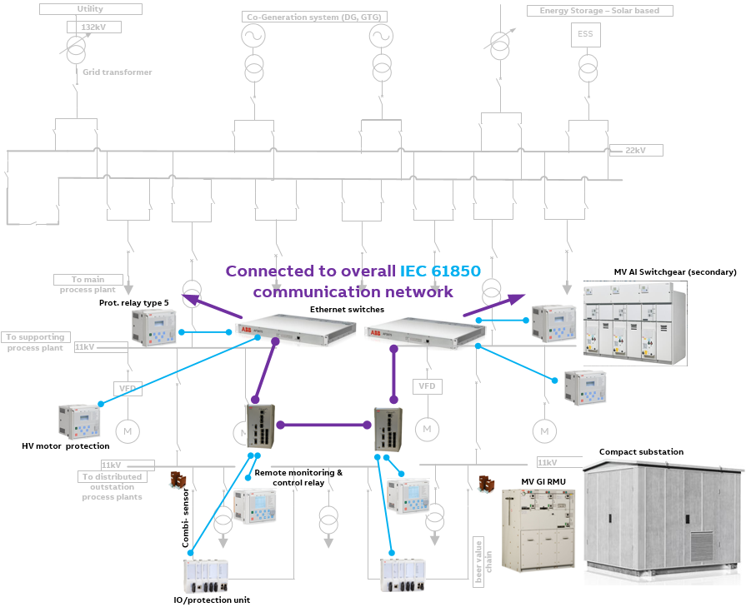
F&B Segment Electrification Solutions - Guidebook
VI. Constructing the solution
System overview (2/3)
Describes the following at supporting process plant and distributed outstation substations :
  primary and secondary equipment (indoor and outdoor)
  substation infrastructure
  proposed protection and related equipment at different voltage levels
  network connectivity
  communication network

Slide 25
F&B Segment Electrification Solutions - Guidebook
VI. Constructing the solution
System overview (3/3)
Note: In this section, only generic names of the equipment are used in the solution context. There could be more equipment that may not be listed in this section. For more details, please refer the main solution guidebook (MS Word document).
Also, it might be so that only some of the total feature/functionality set of the above products could be used in the context of the solutions described in this section. This should not be misconstrued or misinterpreted as a constraint or limitation in any manner.
Some product combinations in the below solutions may not be applicable in actual practice (eg. LV Motor controller types 5 and 6) and therefore should be considered conceptual in the context of this solution guidebook.

Slide 26
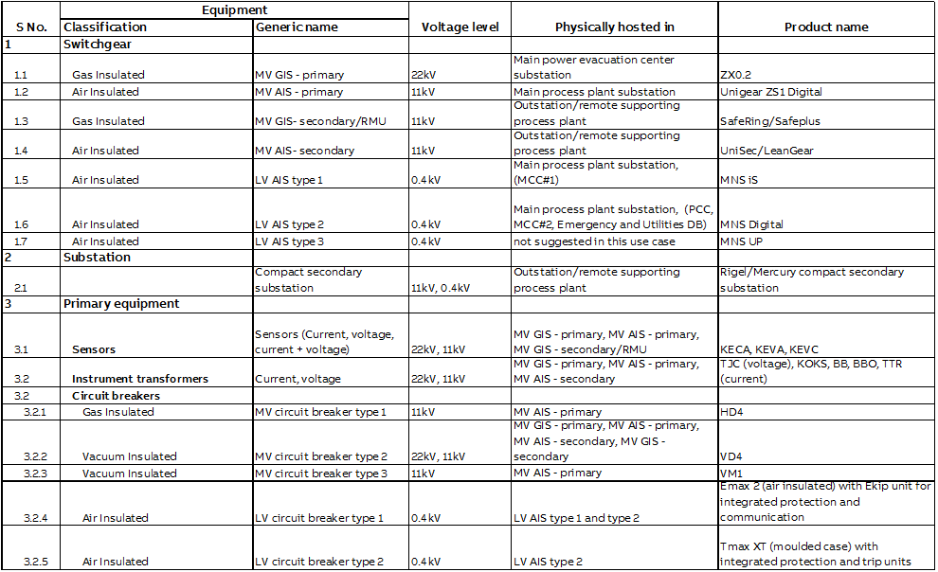
F&B Segment Electrification Solutions - Guidebook
VI. Constructing the solution
List of products used and referencing to ABB product offerings, not restricted to EPDS offering (1/4)

Slide 27
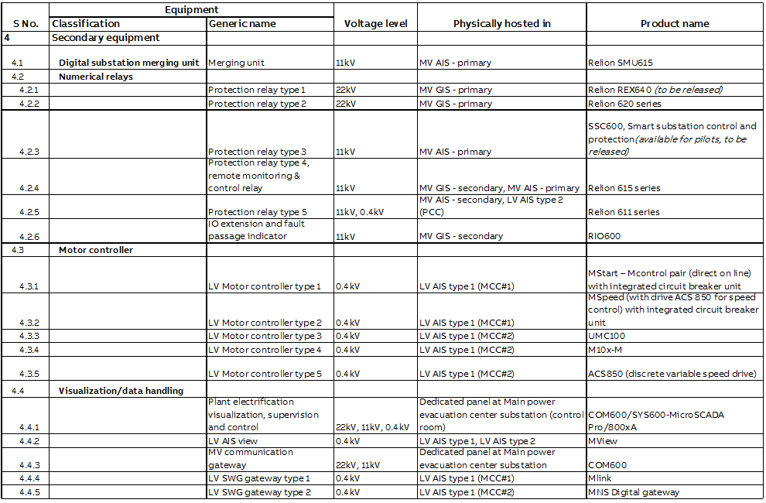
F&B Segment Electrification Solutions - Guidebook
VI. Constructing the solution
List of products used and referencing to ABB product offerings, not restricted to EPDS offering (2/4)

Slide 28
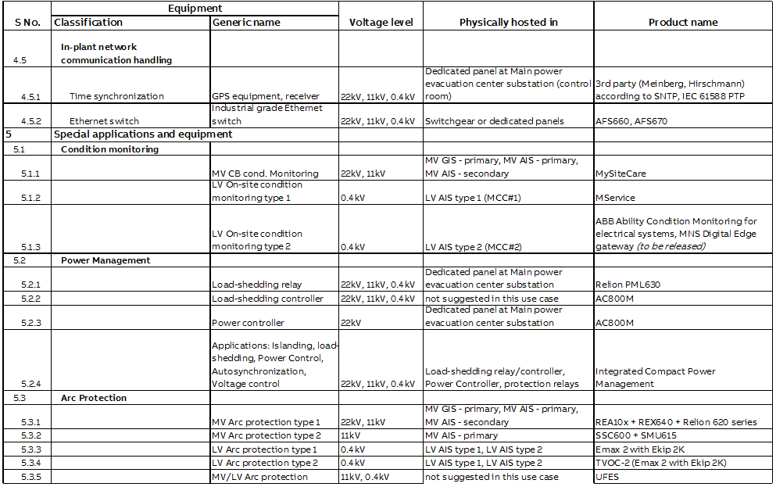
F&B Segment Electrification Solutions - Guidebook
VI. Constructing the solution
List of products used and referencing to ABB product offerings, not restricted to EPDS offering (3/4)

Slide 29
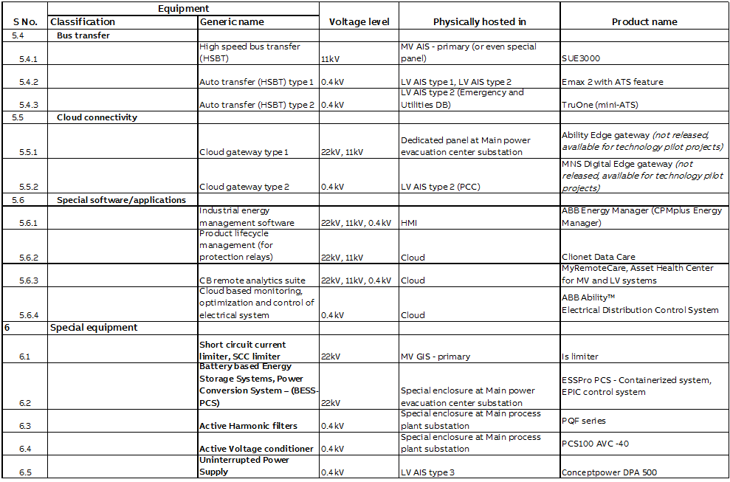
F&B Segment Electrification Solutions - Guidebook
VI. Constructing the solution
List of products used and referencing to ABB product offerings, not restricted to EPDS offering (4/4)

Slide 30
F&B Segment Electrification Solutions - Guidebook
VI. Constructing the solution
List of suggested solutions
Contd.
IEC 61850 based power automation system
Islanding and fast load-shedding
In plant power generation (co-generation)
Power generation control and voltage regulation
Automatic synchronization
Gas insulated, air insulated switchgear and equipment layout
Power automation system AND dedicated/advanced protection (to secure each part of the network)
Bus bar protection
Fast acting and coordinated arc protection system
Short circuit current limiters facilitating system augmentation
High-speed bus transfer / Automatic transfer switching
Power Quality monitoring and corrective control
Communication system redundancy
Intelligent substation asset analytics aiding predictive maintenance
Interface to Distributed Control System (DCS)
Above solutions use mentioned products from the previous slide.

Slide 31
F&B Segment Electrification Solutions - Guidebook
VI. Constructing the solution
1. IEC 61850 based power automation system
Contd.
Merging units, protection relays, communication/data gateways, process visualization
Advantages:
  Saving in copper wiring, environmental friendly
  Reduced space requirements in switchgear and substation
  Increased safety
  Supervised communication
  Ensures interoperability across vendor equipment
  Offers maximum reliability and availability
  Guaranteed real-time performance
  Is future proof
  Reduces cost of ownership
  Time synchronization of above equipment using:
  IEC 61588 Precision Time Protocol (PTP) for microsecond level resolution/ accuracy
  Simple Network Time Protocol (SNTP) for millisecond level resolution/ accuracy; also used for LV systems (switchgear circuit breakers, data gateway on-site condition monitoring)

Slide 32
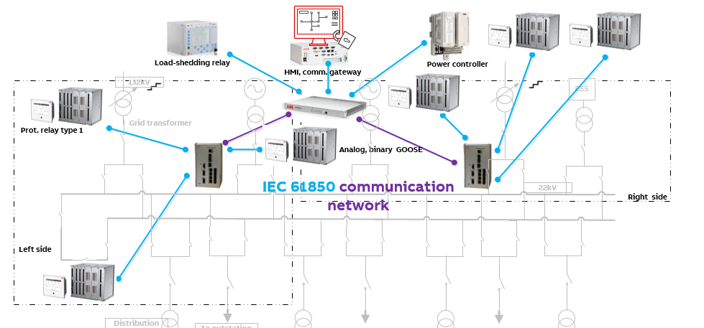
F&B Segment Electrification Solutions - Guidebook
VI. Constructing the solution
2. Islanding and load-shedding (1/3)
Islanding is required:
  When utility grid and in-plant generation work in parallel.
  To save plant power network being ‘sucked in’ due to grid side faults.
Voltage vector shift (VVS) based on detection of:
  Under or overvoltage
  Over or under frequency
  Rapid fall of frequency (df/dt)
  Reverse power flow (reactive power)
Performed by Protection relay type 1, associated with grid transformers.

Slide 33
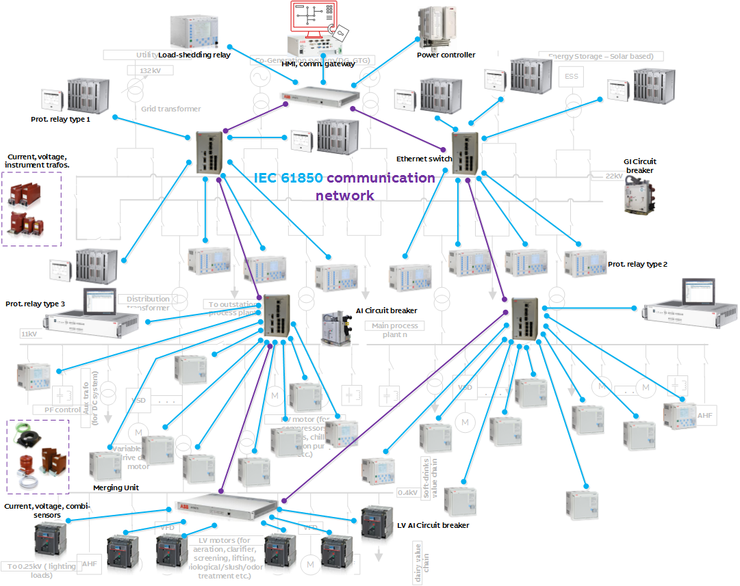
F&B Segment Electrification Solutions - Guidebook
VI. Constructing the solution
2. Islanding and load-shedding (2/3)
Load-shedding is required to prevent blackouts:
  Post-islanding event or in already islanded network, if in-plant power generation is insufficient to meet power demand.
  To maintain power balance by shedding low-priority loads to match loss of power source(s)
  Within tens of milliseconds to ensure frequency stability.
  Ensuring power to critical loads in plant
Carried out at lowest possible voltage level (granularity), say 11kV or 0.4kV outgoing feeder level.

Slide 34
F&B Segment Electrification Solutions - Guidebook
VI. Constructing the solution
2. Islanding and load-shedding (3/3)
Performed by dedicated load-shedding relay (protection relay type 3)
  Supported by protection relays (types 1,2,3), merging units, intelligent circuit breakers and power controller
  Based on IEC 61850 GOOSE
  Supports other load-shed modes
    Overload or maximum demand violation (peak shaving) based
    Manual actions based on amount of power or load priority
    Under-frequency load-shedding as a backup to contingency based/fast load-shedding
  Combined islanding and load-shedding solution ensures
  uninterrupted, reliable supply of power with an assured quality
    no shutdowns due to unexpected power network disturbances
    food safety at every stage in the process chain and continuity of operations

Slide 35
F&B Segment Electrification Solutions - Guidebook
VI. Constructing the solution
3. In-plant power generation
To supplement or fully meet plant load demand, together or fully independent of utility power supply.
  Diesel or gas (or steam) based generators
  Solar based power generation, supplemented with battery based energy stored systems (BESS). Applications using BESS – PCS (Power Conversion System)
  Peak shaving
  Capacity firming
  Frequency regulation
  Load leveling
  Peak shaving
  Power quality
  Spinning reserve

Slide 36
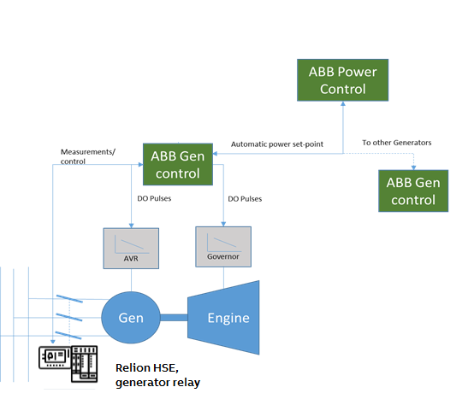
F&B Segment Electrification Solutions - Guidebook
VI. Constructing the solution
4. Power generation & voltage control (1/4)
Power (Generation) control is required:
  When there are multiple (parallel) power generating sources, capable of adjusting their (respective) active/reactive power outputs
    in accordance with the individual capacities of the power sources
    as per overall system requirement
  When utility grid and in-plant generation work in parallel or when the system is islanded and working only on in-plant generation.
  Performed by power controller (secondary control) with support from protection relay type 1 (generators, ESS and grid transformers).

Slide 37
F&B Segment Electrification Solutions - Guidebook
VI. Constructing the solution
4. Power generation & voltage control (2/4)
  Power control function combines several generators’ and ESS’s topical data.
  In accordance with objectives at coupling point with utility or maintaining voltage/frequency of islanded system, individual power source (generator, ESS) contribution is ascertained.
  Power controller issues frequency/voltage regulation commands to Protection relay type 1, associated with generators
    Governor (GOV) and Automatic Voltage regulators (AVR), primary controllers, effect changes in speed and excitation.
  Power controller issues active/reactive power set-points executed by performed by ESS controller to regulate inverter outputs.
  Based on IEC 61850 binary/analog GOOSE

Slide 38
F&B Segment Electrification Solutions - Guidebook
VI. Constructing the solution
4. Power generation & voltage control (3/4)
Voltage control is required:
  To control plant-side voltage by regulating grid transformers’ tap positions (motor driven on-line tap changers), during parallel operation
  To maintain plant system voltage when islanded.
When in parallel operation:
  Manual control of single tap-changer
  Automatic control of tap changers of grid transformers (master/follower)
  Can be run independently or coordinated with the power control function, depending on the objective at the tie line.
  Based on IEC 61850 binary/analog GOOSE

Slide 39
F&B Segment Electrification Solutions - Guidebook
VI. Constructing the solution
4. Power generation & voltage control (4/4)
  Voltage control can either performed by
  Grid transformer protection relays (type 1) based on:
    Master (grid transformer 1) /follower (grid transformer 2)
    Negative reactance
    Minimizing circulating current
  or
  Power controller (secondary control) with support from protection relay type 1 (generators, ESS and grid transformers)
    To maintain voltage of plant system by controlling reactive power of a particular power source, when islanded (see power generator control)
  Maintaining designated voltage in an electrical power system:
  Important for proper operation for electrical power equipment
  To prevent damage such as overheating of generators and motors
  Enables system to withstand and prevent voltage collapse, caused by sudden increase in load

Slide 40
F&B Segment Electrification Solutions - Guidebook
VI. Constructing the solution
  5. Automatic-synchronization (1/3)
Synchronization functionality is required:
  To connect an ‘incoming’ power source (generator, ESS) to the main power evacuation bus bar (after generator trip or total power failure)
  To connect islanded plant power network back with utility grid
  To reconnect two parts of the plant networks (“left side” and “right side”)
  Performed by Protection relay type 1, associated with utility grid transformers, power sources and bus coupler
  On selection of a circuit breaker to be synchronized:
  Voltage, frequency, phase across both sides compared

Slide 41
F&B Segment Electrification Solutions - Guidebook
VI. Constructing the solution
  5. Automatic-synchronization (2/3)
  Power source GOV/AVR issued regulation commands for frequency/voltage change
    To increase/decrease speed and/or excitation
    Can be done manually (relay HMI) or automatically
  Once synchronizing conditions are reached, circuit breaker can be closed manually or automatically.
  For synchronizing bus coupler or utility incomer circuit breaker, regulation of multiple generators’ frequency/voltage involved (from ‘running’ side).
    Protection relay type 1 ‘responsible’ for synchronizing circuit breaker, publishes the voltage and frequency difference to ‘participating’ generators’ protection relay type 1.
    They in turn issue regulation commands to respective GOV/AVR.
  Based on IEC 61850 binary/analog GOOSE
The advantage of such a distributed auto-synchronization function:
  Eliminates the need of dedicated voltage selection scheme and complexity
  Ensures complete safety of the switchgear equipment and generators

Slide 42
F&B Segment Electrification Solutions - Guidebook
VI. Constructing the solution
  5. Automatic-synchronization (3/3)
  Safeguards customer investment.
  Single protection relay type 1 for islanding, power control, voltage control and auto-synchronizer provides a great advantage to the customer

Slide 43
F&B Segment Electrification Solutions - Guidebook
VI. Constructing the solution
  6. GIS, AIS switchgear and other equipment layout (1/5)
  Gas Insulated Switchgear (GIS):
  At main power evacuation center as 22kV indoor primary switchgear.
  At outstation water treatment plant in Ring Main Unit (RMU) as 11kV secondary switchgear, housed on an outdoor compact substation.
  Comprises of
    Conventional instrument transformers or voltage, current or combined sensors
    Protection relays types 1, 2, 4 and extension IO units (for fault passage indication)
    SF6 circuit breaker
    Communication equipment like Ethernet switches, cabling etc.
  Air Insulated Switchgear (AIS):
  At main process plant as 11kV indoor primary switchgear. (Other voltage levels (6.6, 3.3kV) too will have same arrangement.
  At outstation/remote support process plant as 11kV indoor secondary switchgear.
  At main process plant as 0.4kV low voltage switchgear (PCC, MCC, Emergency and Utilities board)

Slide 44
F&B Segment Electrification Solutions - Guidebook
VI. Constructing the solution
  6. GIS, AIS switchgear and other equipment layout (2/5)
  11kV Air Insulated Switchgear (AIS), contd.:
  Comprises of
    Protection relay type 3 and merging units for centralized protection and control (as an alternative for bay specific protection unit based approach) in main process substation.
    Dedicated protection relays (type 4) for back up/redundant protection at incomers and special protection like capacitor banks.
    Protection relay type 5 for bus (section) bar protection / feeder protection in outstation/remote supporting process area
    Extension IO for additional bay, substation input-output handling
    High Speed Bus Transfer (HSBT) relay at 11kV (or 6.6/3.3kV)
    Vacuum circuit breaker at 11kV (or 6.6/3.3kV)
    Communication equipment like Ethernet switches, cabling etc.

Slide 45
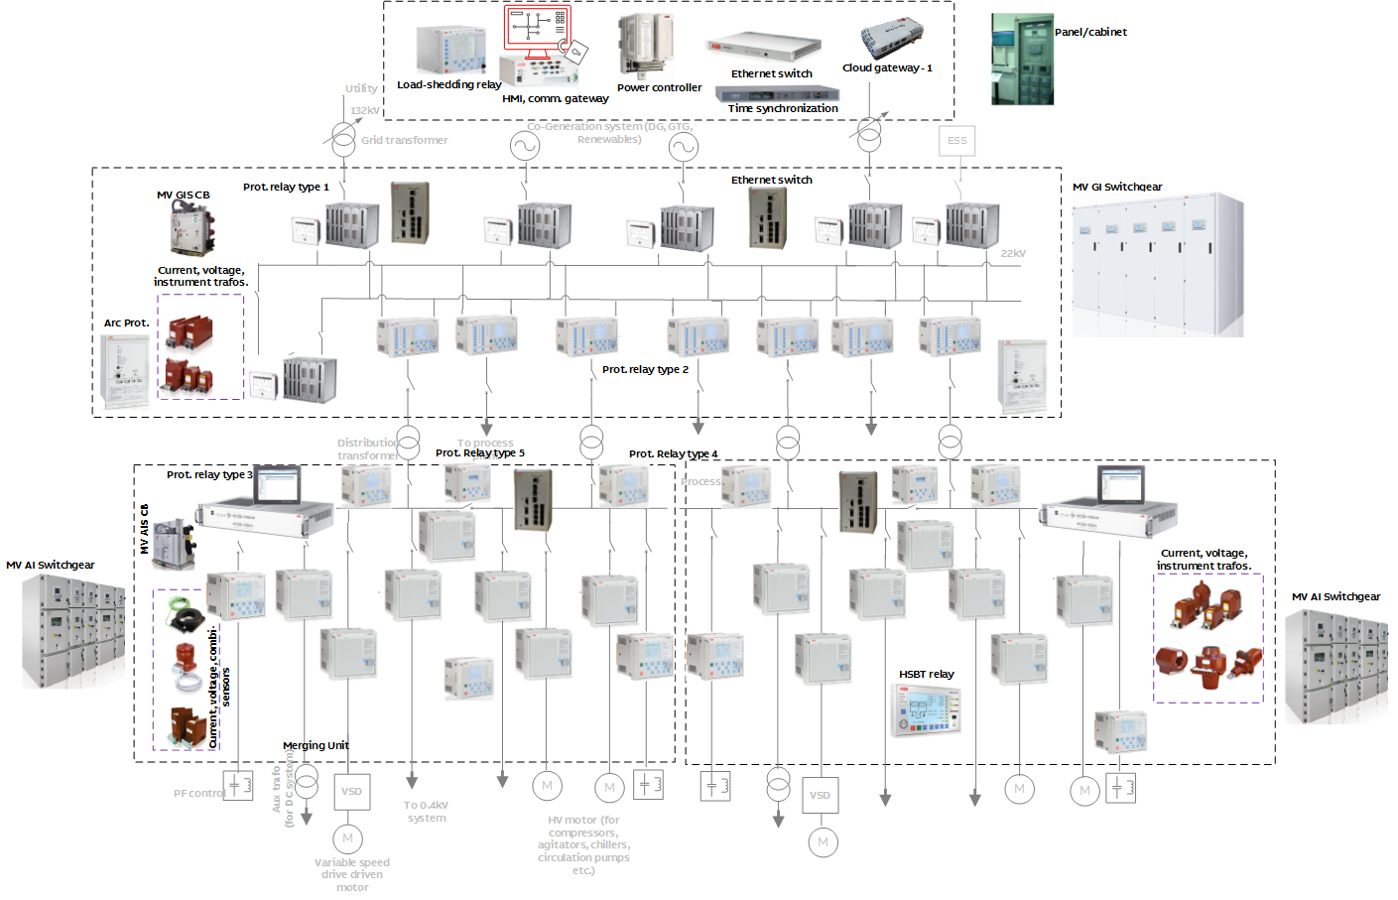
F&B Segment Electrification Solutions - Guidebook
VI. Constructing the solution
  6. GIS, AIS switchgear and other equipment layout (3/5)… 22kV, 11kV equipment

Slide 46
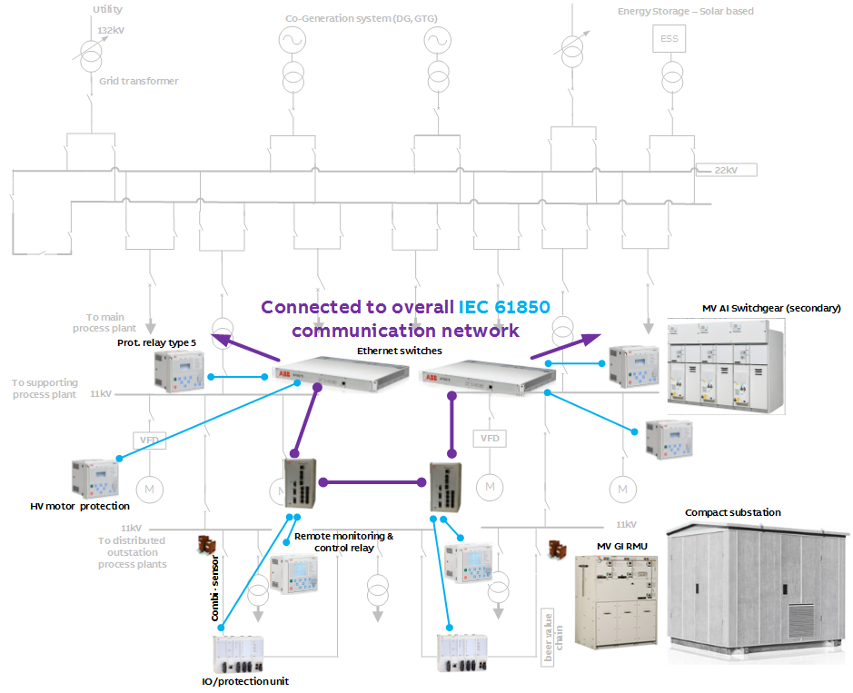
F&B Segment Electrification Solutions - Guidebook
VI. Constructing the solution
  6. GIS, AIS switchgear and other equipment layout (3/5)… 22kV, 11kV equipment

Slide 47
F&B Segment Electrification Solutions - Guidebook
VI. Constructing the solution
  6. GIS, AIS switchgear and other equipment layout (4/5)
  0.4kV Air Insulated Switchgear (AIS) comprising of
    Protection relay type 5 for PCC incomer protection in the main process area
    LV circuit breaker (AI) type 1 circuit breaker integrated with protection, measurement and control functions at PCC feeders, MCC#1 and MCC#2 incomers and bus coupler and at emergency board.
      Automatic Transfer Switch (ATS), integrated with bus coupler circuit breaker at PCC, MCCs.
      Dedicated mini-ATS at Emergency-Utility board coupling point
      Combined motor starter, control (direct on line and speed control), with integrated protection and trip units in MCC
      LV circuit breaker (moulded case) type 2 circuit breaker integrated with protection functions and trip unit.
    Switchgear visualization panel
    Cloud connectivity gateway type 2 for 0.4kV system
    Switchgear visualization panel at all boards
    Switchgear monitoring + diagnostic unit at MCC#1
    Communication equipment like Ethernet switches, cabling etc.

Slide 48
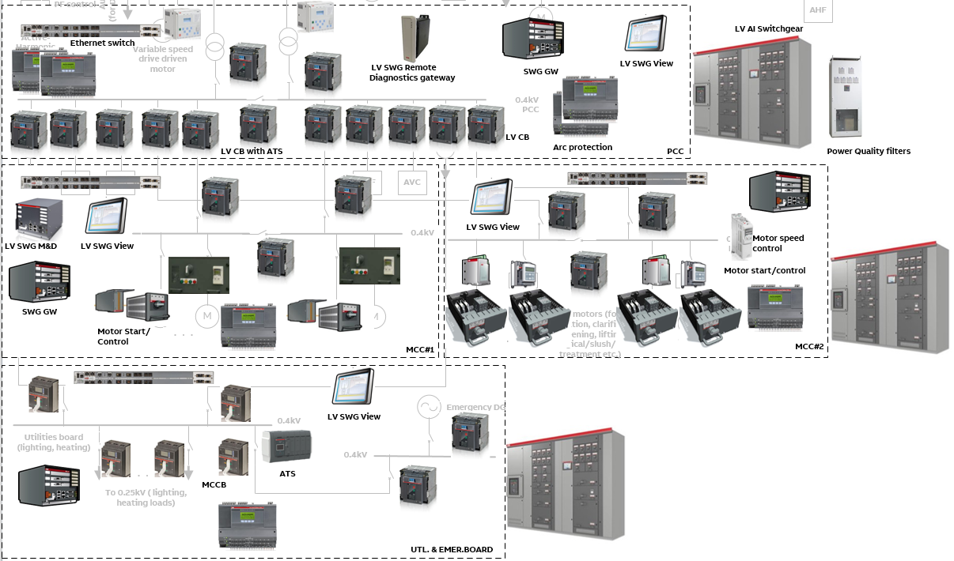
F&B Segment Electrification Solutions - Guidebook
VI. Constructing the solution
  6. GIS, AIS switchgear and other equipment layout (5/5) … 0.4kV equipment

Slide 49
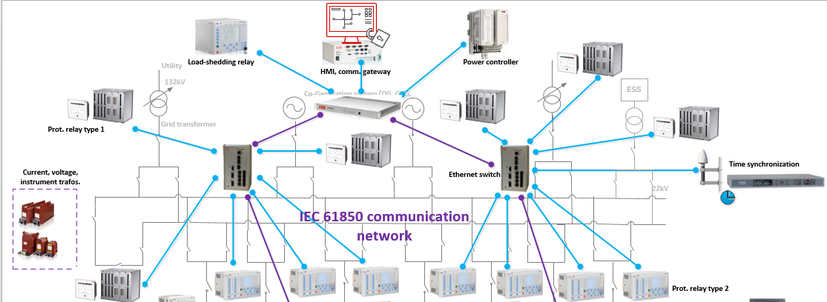
F&B Segment Electrification Solutions - Guidebook
VI. Constructing the solution
  7. Power automation system & dedicated/advanced protection (1/5)
Discrete set of protection systems at 22kV, 11kV (or 6.6/3.3kV) and 0.4kV levels
Power automation setup integrates all 3 levels of systems/devices
Protection relays perform basic/advanced, dedicated protection functions, measurement, monitoring and control functions.
Cross-bay or even across voltage levels or process level interlocking using IEC 61850 GOOSE.
Discrete high-end protection relays based on types 1 and 2 at main power evacuation center.
22kV protection system at main power evacuation center

Slide 50
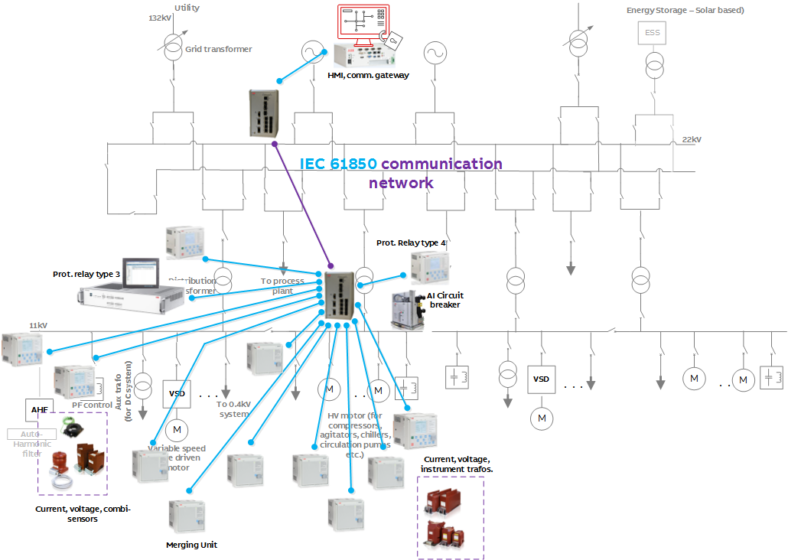
F&B Segment Electrification Solutions - Guidebook
VI. Constructing the solution
  7. Power automation system & dedicated/advanced protection (2/5)
Merging units at all 11kV feeders at main process plant
Centralized protection unit is the main protection relay (type 3) for all 11kV feeders (cables, transformer and motor).
Incomer feeder protection units (type 4) as backup protection, capacitor or voltage protection.
Dedicated or centralized approach or combo depending on importance of feeder
11kV protection system at main process area substation
Centralized protection based on relay type 3, merging units, specific protection relay type 4

Slide 51
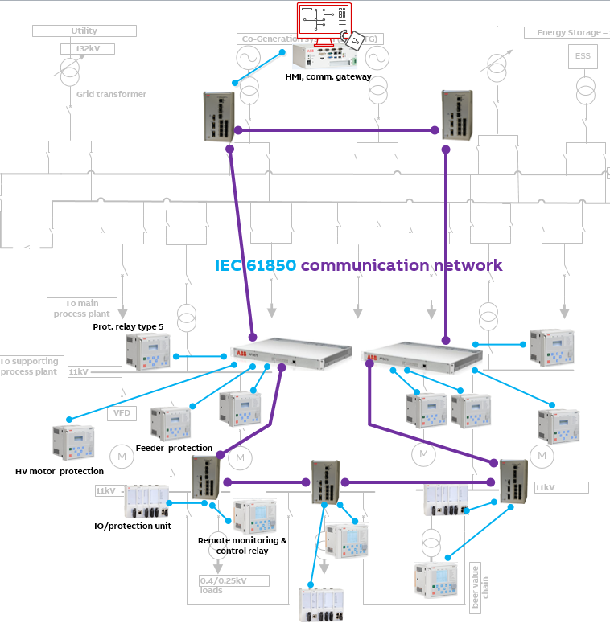
F&B Segment Electrification Solutions - Guidebook
VI. Constructing the solution
  7. Power automation system & dedicated/advanced protection (3/5)
Dedicated protection relays (type 5) for feeder and motor protection in the secondary indoor substation
Outdoor RMU based compact substation has protection unit type 4 (protection + RMU automation controller) and IO units that double up as fault passage indicators (FPI) for SFU based feeders.
11kV protection system at remote supporting process area substation
Discrete bay protection based on relay types 4, 5, IO unit

Slide 52
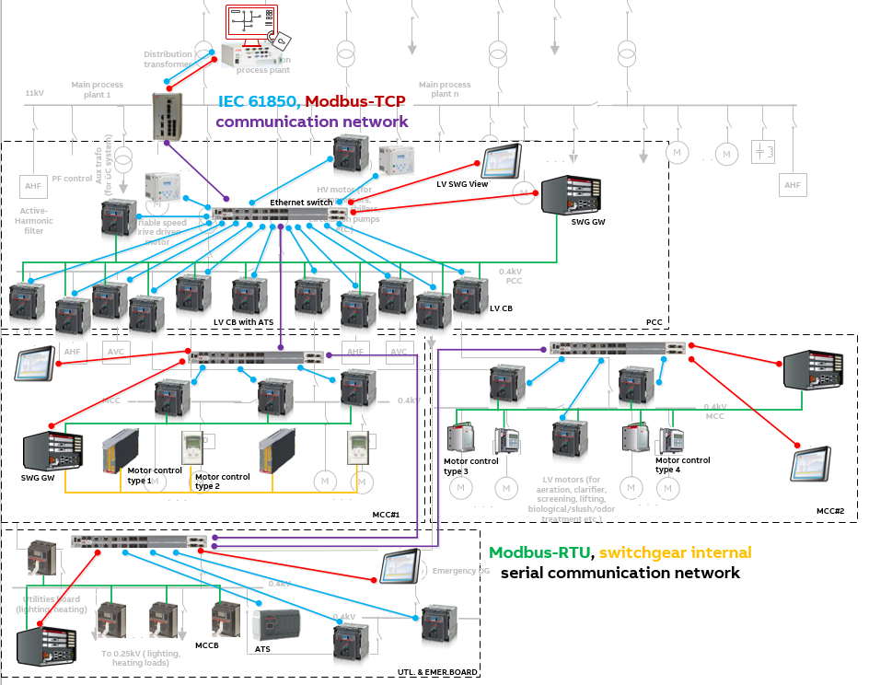
F&B Segment Electrification Solutions - Guidebook
VI. Constructing the solution
  7. Power automation system & dedicated/advanced protection, energy efficiency (4/5)
PCC incomer feeders protected protection relay type 5.
The PCC, MCC#1, MCC#2, Emergency distribution boards’ incomer and bus coupler feeders are protected by LV circuit breaker type 1.
Motor controller types 1 and 2 (MCC#1) incorporate integrated protection functionality and trip units.
Motor controller types 3 and 4 (MCC#2) also incorporate integrated protection functionality together with LV circuit breaker type 2.
The incoming and outgoing feeders in the utilities board are protected by the LV circuit breaker type 2, which also incorporates protection functionality.
0.4kV protection system at main process area

Slide 53
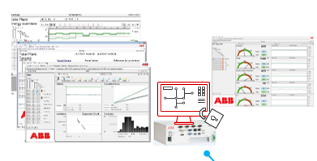
F&B Segment Electrification Solutions - Guidebook
VI. Constructing the solution
  7. Power automation system, dedicated/advanced protection, energy efficiency (5/5)
  Energy optimization software package integrated with the HMI
    within the same physical device or a separate computer
  Ensures addressing the need for real-time energy monitoring and reporting
  Scalable and modular to provide complete load balancing and optimization of energy use and supply of the entire facility of the F&B customer
  For a corporate, multi-site F&B customer installations, multiple facilities can be integrated to provide a company-wide solution and to allow highly visual comparisons, benchmarking and the sharing of best practices between the production facilities.

Slide 54
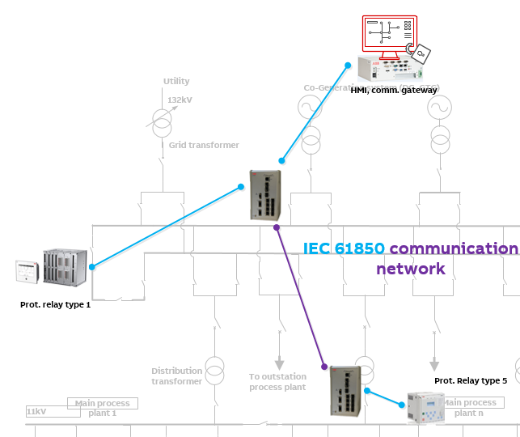
F&B Segment Electrification Solutions - Guidebook
VI. Constructing the solution
  8. Busbar protection
High-impedance based busbar protection at 22kV, 11kV levels
Provision in centralized protection unit for low-impedance principle based busbar protection
Fast acting busbar protection:
  Saves entire switchgear lineup from severe faults such as flashovers
  Ensures personnel safety and saving of customer investment

Slide 55
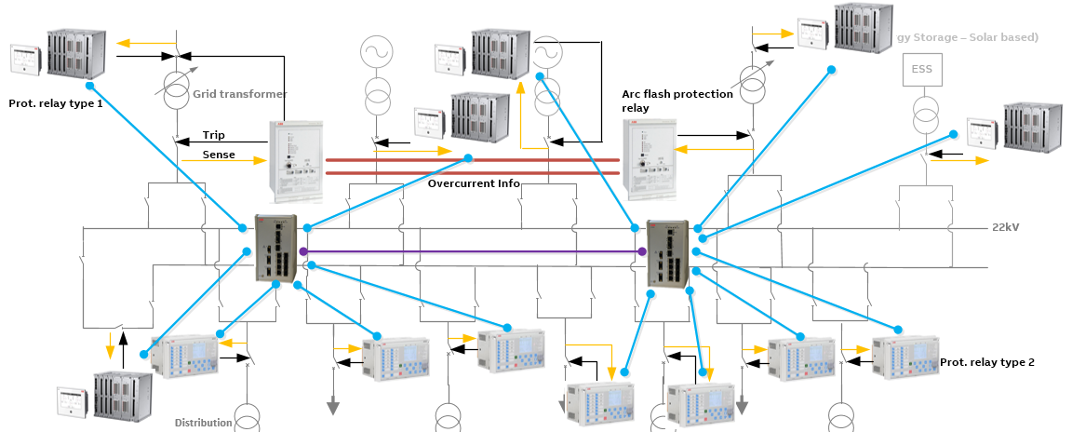
F&B Segment Electrification Solutions - Guidebook
VI. Constructing the solution
  9. Fast acting and coordinated arc protection (1/3)
Required at all voltage levels to ensure personnel and equipment safety
Based on a coordinated approach between dedicated arc protection relays
  Working on combination of light and phase overcurrent/earth fault measurement
  Isolate utility incomers (power feeding)
At 22kV, protection relay types 1 and 2 sense arc flash and enable fast and selective arc protection.

Slide 56
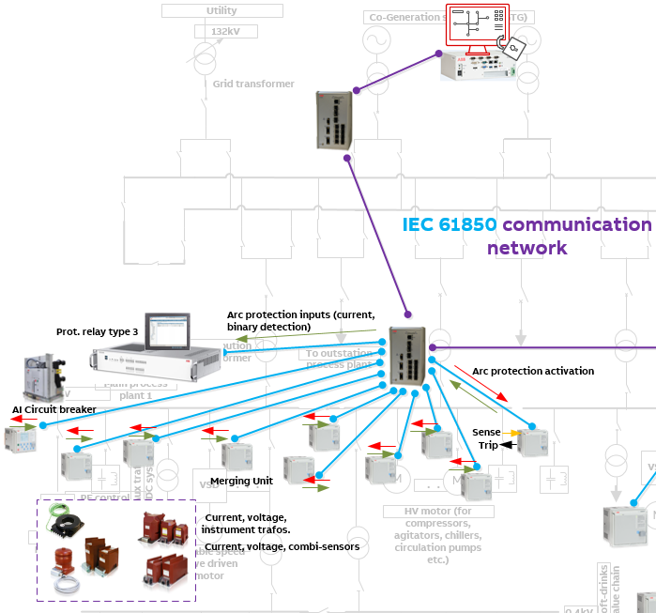
F&B Segment Electrification Solutions - Guidebook
VI. Constructing the solution
  9. Fast acting and coordinated arc protection (2/3)
At 11kV (main process plant) with centralized protection, detection is done by merging units.
Based on light detection/OC/EF, trip commands are issued through merging units or protection relay type 4.
At other locations, dedicated protection relay type 4 could be used.

Slide 57
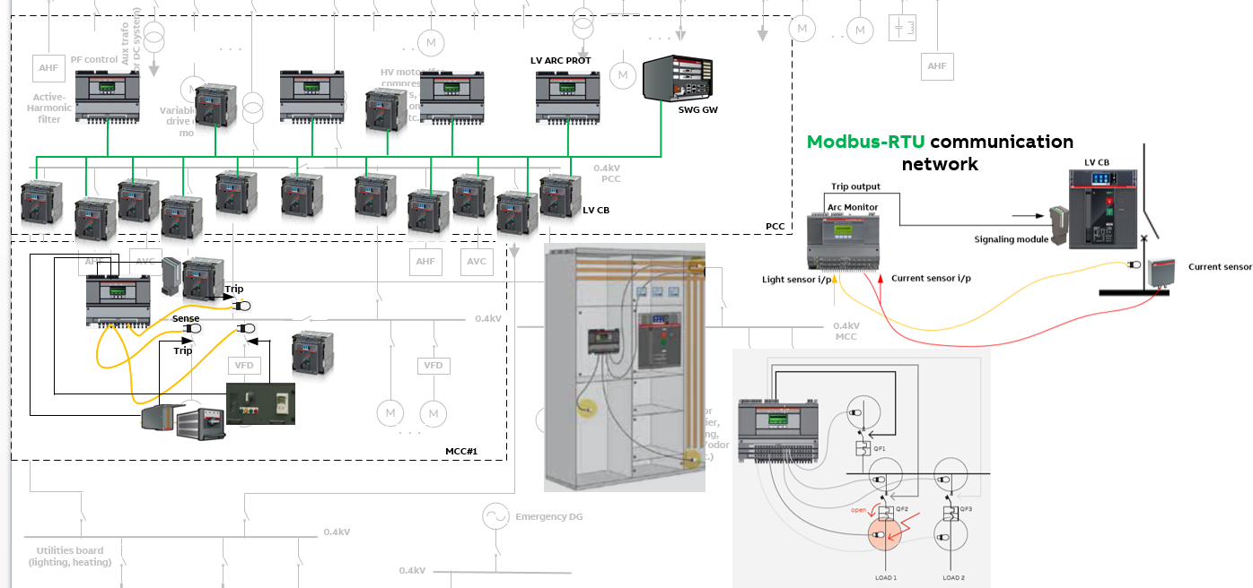
F&B Segment Electrification Solutions - Guidebook
VI. Constructing the solution
  9. Fast acting and coordinated arc protection (3/3)
At 0.4kV a combination of a dedicated LV arc protection device type 2 and LV circuit breaker type 1 (dedicated LV arc protection device type 1) is deployed.
A comprehensive arc protection system can be realized that can trip up to 3 circuit breakers in the LV switchgear.
For handling more circuit breakers, additional dedicated LV arc protection device type 2 units will be required.

Slide 58
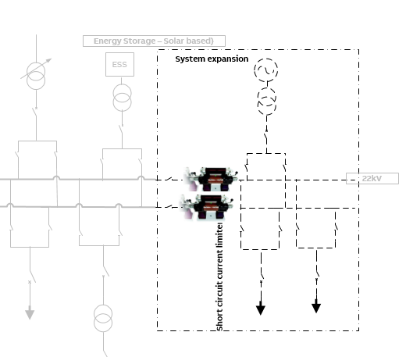
F&B Segment Electrification Solutions - Guidebook
VI. Constructing the solution
  10. Short Circuit Current limiters (1/2)
  Increasing manufacturing capacity implies that power distribution arrangement also needs augmentation
    New load feeders need to be added at the 22kV level to cater to the new process plant(s).
    Additional power source(s) may also be needed, if existing sources cannot cater to increased load.
  System expansions also mean increasing short-circuit levels.
  SCC limiters installed in each phase (like fuse) between the bus bar sections of the existing and new extension panels, also separated by bus coupler circuit breakers.
  For a short-circuit fault, the SCC senses the additional fault level and trips the bus section circuit breakers, separating the existing and new extensions within 0.6 ms.
  The short-circuit levels in the existing section are then back to pre-extension levels.

Slide 59
F&B Segment Electrification Solutions - Guidebook
VI. Constructing the solution
  10. Short Circuit Current limiters (2/2)
  SCCs ensure the following:
    An easy system extension
    Customer need not invest in replacement of bus bars and circuit breaker equipment etc. for the new fault ratings.
    Therefore, 22kV switchgear downtime and production losses are also prevented.

Slide 60
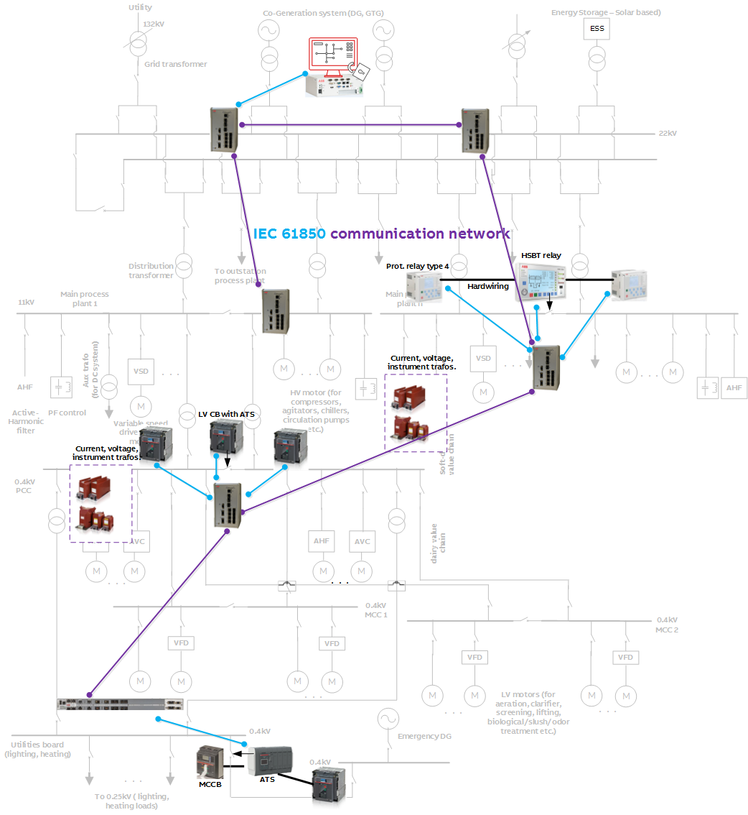
F&B Segment Electrification Solutions - Guidebook
VI. Constructing the solution
  11. HSBT and ATS (1/2)
Required to ensure power supply to essential electrical equipment, when changing over from one (faulty) incomer to other (healthy) incomer.
All loads on faulty section transferred on to healthy incomer.
  Zero loss of productivity and finished goods’ deliveries to the supply chain
  Safety of equipment and personnel
Required when load-shedding is not operational.
Required at 11kV and 0.4kV levels in the plant, with critical loads.
Coordinated approach between incomer protection devices and HSBT/ATS device

Slide 61
F&B Segment Electrification Solutions - Guidebook
VI. Constructing the solution
  11. HSBT and ATS (2/2)
The 11kV main process plant HSBT solution would comprise of the following:
  Dedicated HSBT relay
  Protection relay type 4 at incomers with high-speed binary output contacts, detect fault conditions like undervoltage or underfrequency.
  Interface between the HSBT relay and incomer relays is based on dedicated hardwiring.
  HSBT ensures total transfer time of about 30-75 milliseconds, depending on type of circuit breaker.
  ATS system at 0.4kV level:
  Comprises of ATS functionality built into AIS circuit breaker
  Dedicated ATS at the DG emergency feeder incomer at utility board
  Coordinates with incomer circuit breakers with protection (undervoltage) functionality.
  Ensures transfer time of about 120-150 milliseconds.

Slide 62
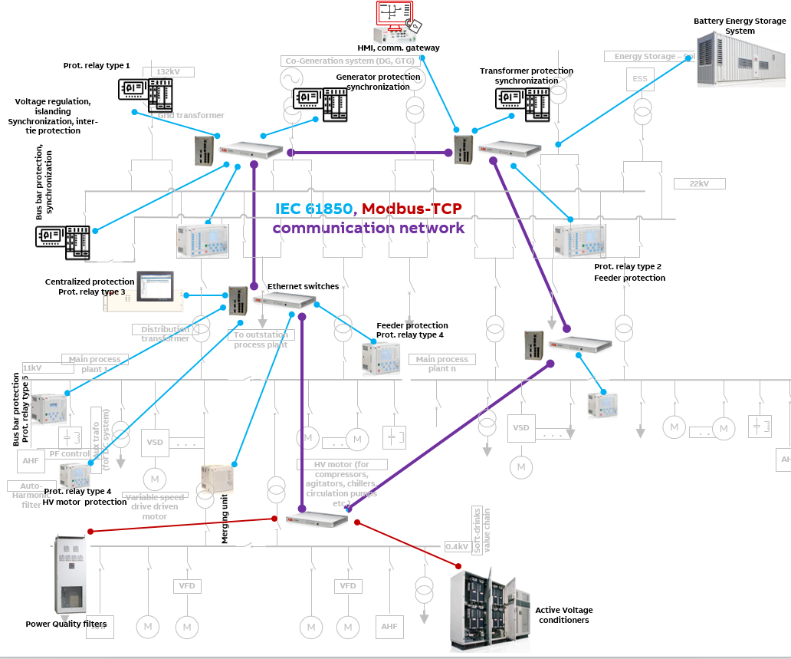
F&B Segment Electrification Solutions - Guidebook
VI. Constructing the solution
  12. Power Quality monitoring and corrective control
Multiple levels of PQ monitoring and possible control actions
Protection relay types 1, 2, 3, 4 can detect PQ conditions and generate alarms. Corrective actions can be configured.
Energy Storage System (ESS) and power control functions can control and supply required reactive power to boost voltage profile.
Dedicated Active Voltage Conditioner (AVC) at 0.4kV to ensure instant response to PQ events such as voltage sags and swells, through continuous voltage regulation.
Dedicated Active Harmonic Filter (AHC) at 11kV and 0.4kV
  To monitor harmonic content in line currents
  To generate/inject compensating current in phase opposition to the ‘polluting current’
  To eliminate deviations automatically

Slide 63
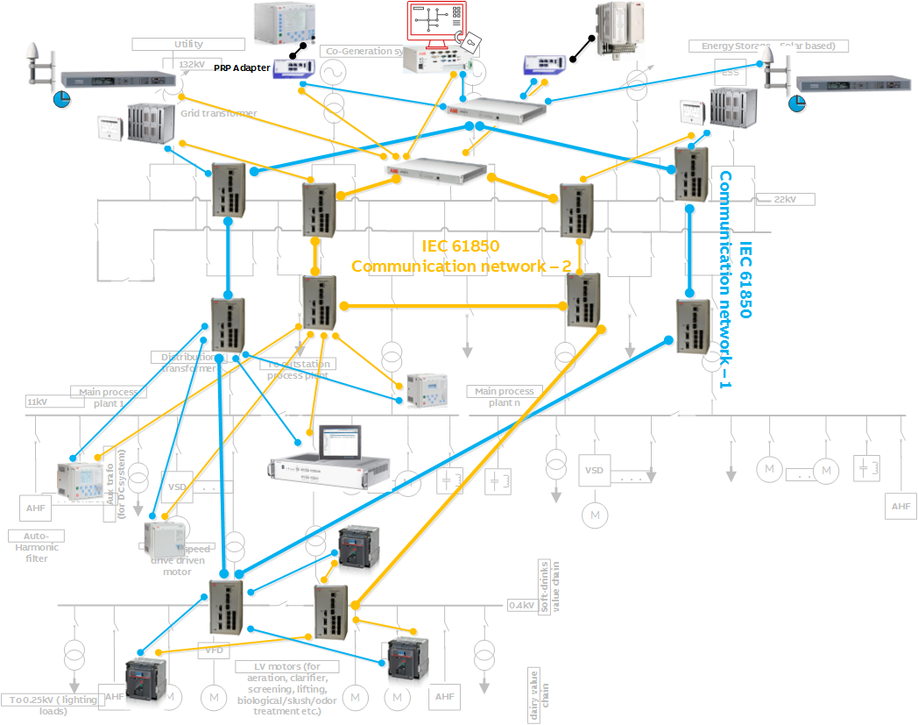
F&B Segment Electrification Solutions - Guidebook
VI. Constructing the solution
  13. Communication system redundancy (1/2)
  To ensure data communication network reliability and availability from IEC 61850 devices* in the network.
  Duplication of IEC 61850 communication network based on IEC 62349-3 Parallel Redundancy Protocol (PRP)
  Each IEC 61850 device (or any other with redundant ports) is connected to both networks.
  Devices with single port are connected through a PRP adapter (also called ‘Redbox’.
  GPS + Time server are duplicated
*Note: Devices on Modbus-TCP and other Ethernet based protocols also supported

Slide 64
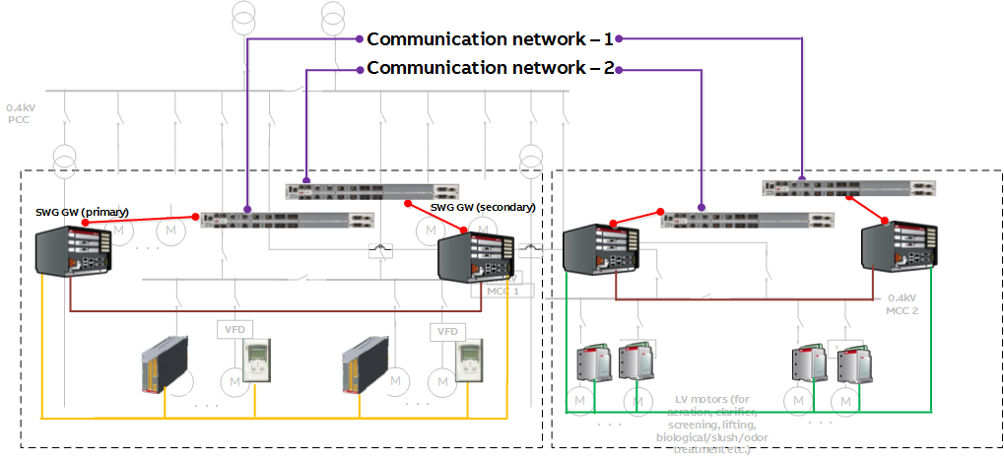
F&B Segment Electrification Solutions - Guidebook
VI. Constructing the solution
  13. Communication system redundancy (2/2)
0.4kV system redundancy at the MCC#1 and MCC#2 levels for important motor feeders to be accessed/controlled without loss of system availability.
In the MCC#2, motor controller type 4 units with dual RS485 communication ports.
This arrangement provides:
  Primary and secondary switchgear gateway units, connected to two separate communication networks.
  Capability of the upper level system to read information simultaneously from primary and secondary switchgear gateway units.
  Increased process availability
  An inbuilt functionality controlling switching commands permissions

Slide 65
F&B Segment Electrification Solutions - Guidebook
VI. Constructing the solution
  14. Intelligent substation asset analytics (1/2)
To maintain substation assets (transformers, switchgear, circuit breakers, motors etc.) proactively using condition monitoring and predictive maintenance.
To ensure longevity of service, reduce or eliminate outages.
To run operations with minimal equipment inventory
Illustrated example shows monitoring of:
  11kV circuit breaker’s temperature, partial discharge sensing + equipment tagging info.
  0.4kV LV circuit breaker, motor controllers provide energy data, equipment data
Two levels of Edge gateways are proposed, one each for MV and LV respectively
  Cloud gateway type 1 (MV equipment) is gets data directly from downstream protection relays on IEC 61850 or Modbus-TCP,
  Cloud gateway type 2 gets data from the LV switchgear gateway units.
Predominantly non-real time data (near-real time and off-line) from 11kV and 0.4kV devices sent to enterprise data (Edge) gateway.
  Full loop of ‘sense’ (sensors, instrument transformers) to ‘monitor’ (merging units, protection relays, dedicated condition monitoring equipment, substation controller, HMI/gateway) to ‘analyze’ (applications in cloud) to ‘act/respond’ (preventive maintenance) is completed.

Slide 66
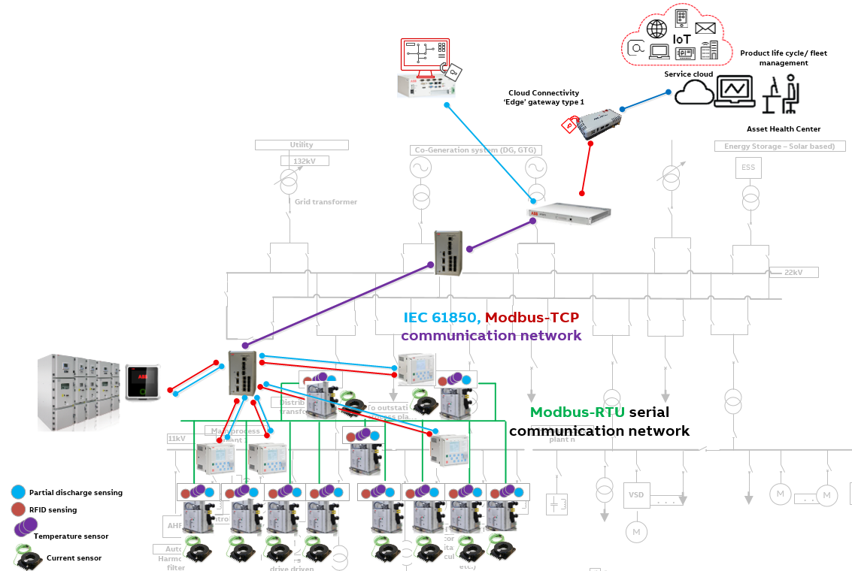
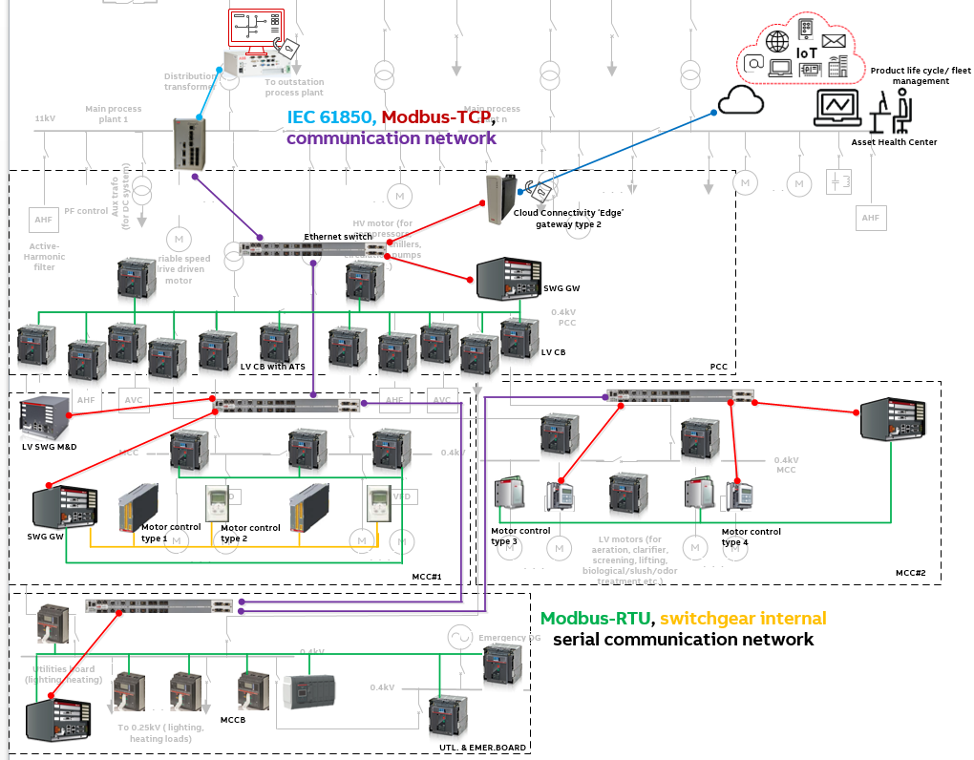
F&B Segment Electrification Solutions - Guidebook
VI. Constructing the solution
  14. Intelligent substation asset analytics (2/2) - MV
Intelligent substation asset analytics (2/2) - LV

Slide 67
F&B Segment Electrification Solutions - Guidebook
VI. Constructing the solution
  15. Interface to Distributed Control System (DCS)
Interface of electrification automation system with the process DCS:
  To have an integrated approach to the plant monitoring and operations
  To send electrification process information (measurements, process alarms/events, substation auxiliary system information etc.)
  To facilitate control of equipment such as circuit breaker operation for motor on/off operations
  To run applications that may use both manufacturing process and electrification data and to initiate automated actions in the electrification process.
  Improving overall operational efficiency

Slide 68
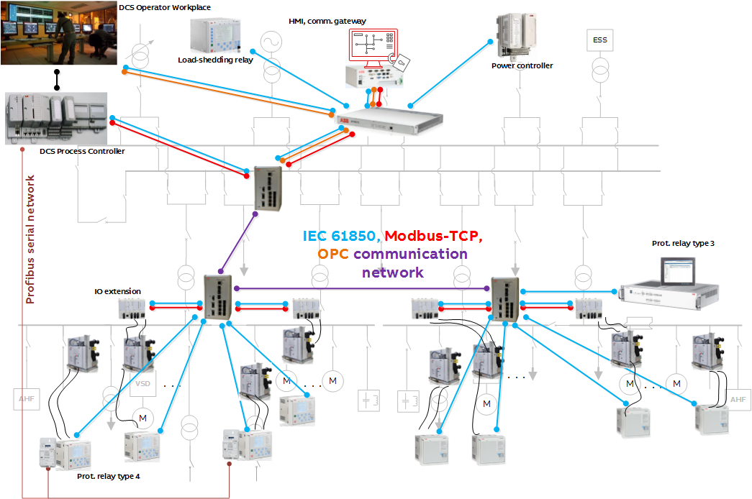
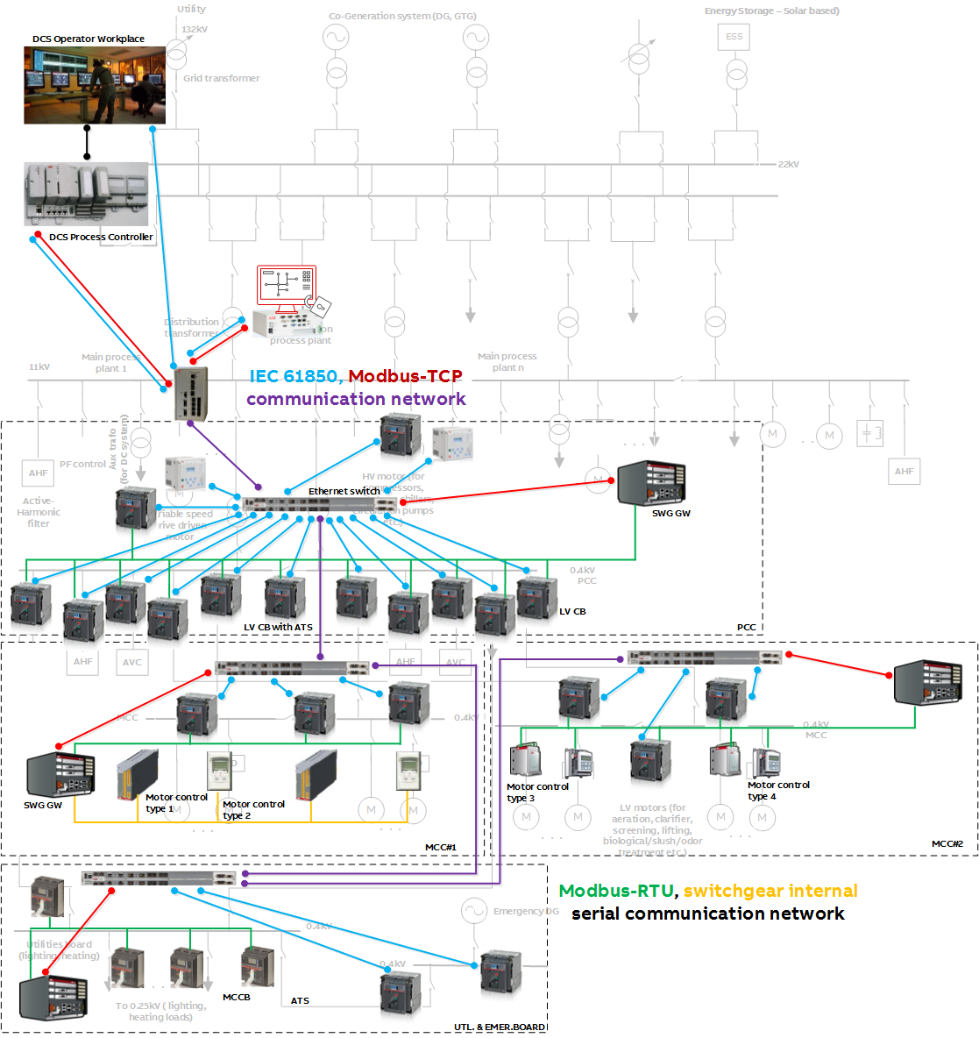
F&B Segment Electrification Solutions - Guidebook
VI. Constructing the solution
  15. DCS interface - MV
DCS interface – LV (option 1)

Slide 69
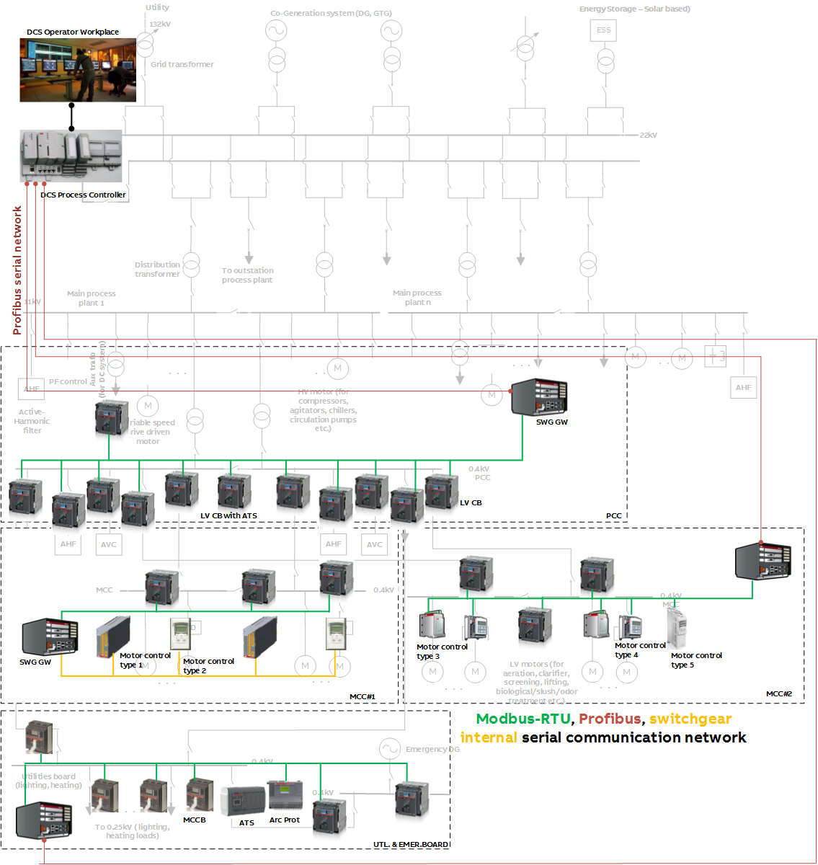
F&B Segment Electrification Solutions - Guidebook
VI. Constructing the solution
  15. DCS interface – LV (option 2)

Slide 70
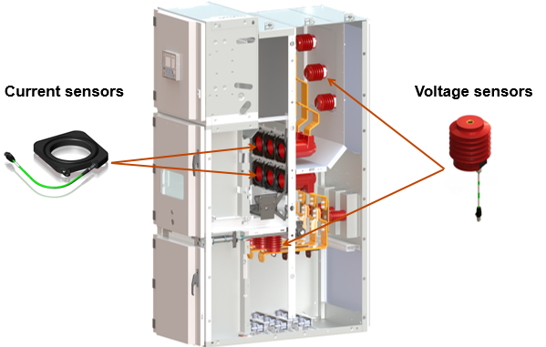
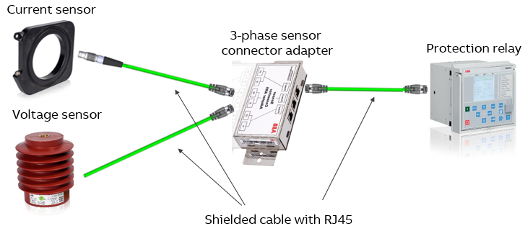
F&B Segment Electrification Solutions - Guidebook
VI. Constructing the solution (illustration of some solution parts)
11kV Primary AIS with sensors
Sensors to protection relay connectivity

Slide 71
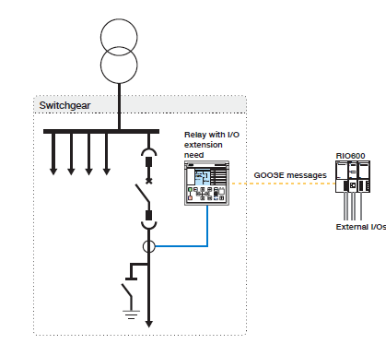
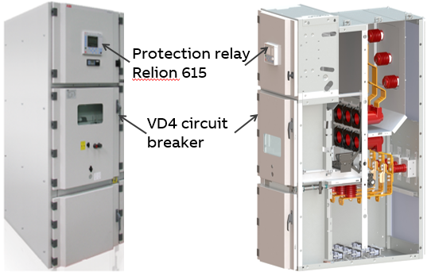
F&B Segment Electrification Solutions - Guidebook
VI. Constructing the solution (illustration of some solution parts)
11kV Primary AIS with protection relay
Extending relay IO’s with extension IO unit

Slide 72
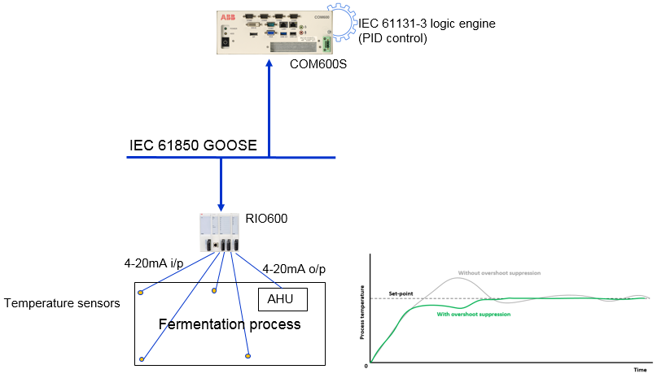
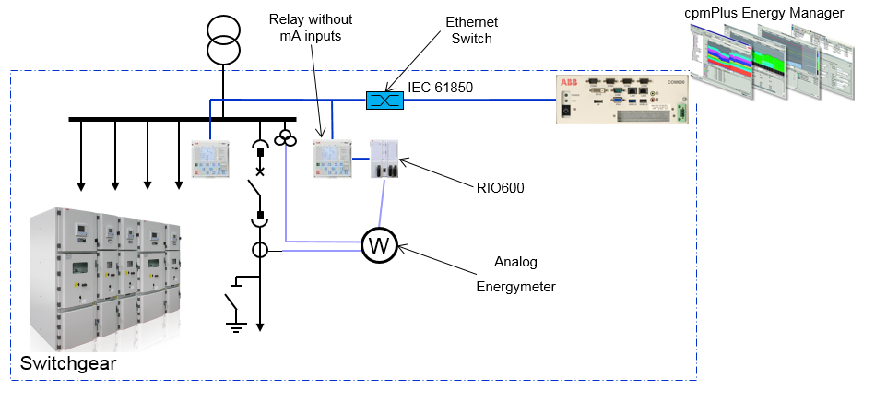
F&B Segment Electrification Solutions - Guidebook
VI. Constructing the solution (illustration of some solution parts)
Deploying software on top of power automation for energy efficiency
Executing application logic in HMI/gateway

Slide 73
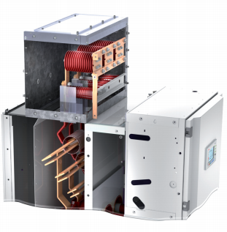
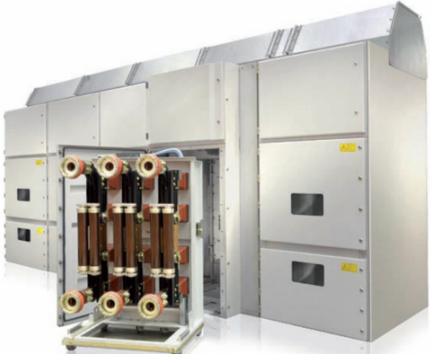
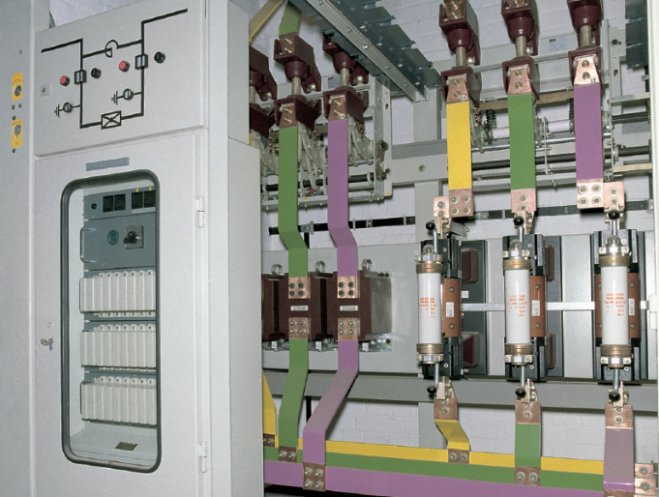
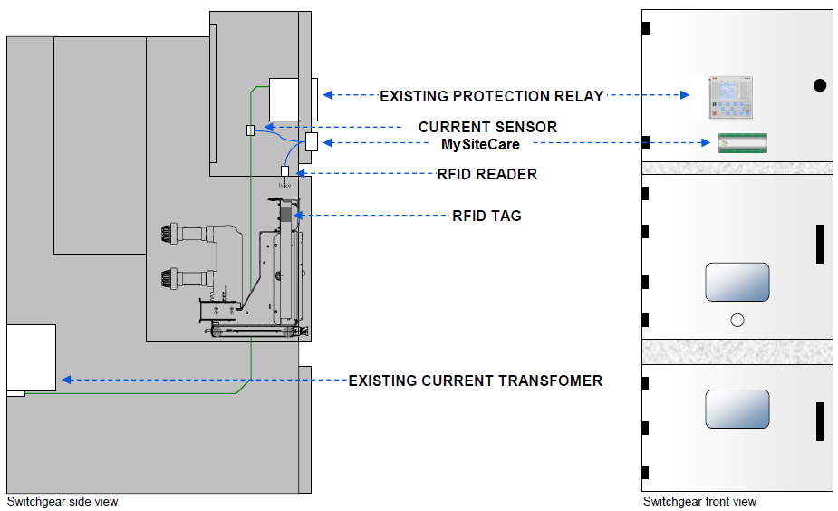
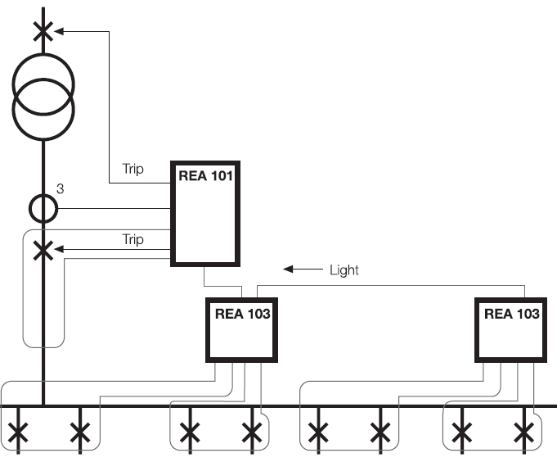
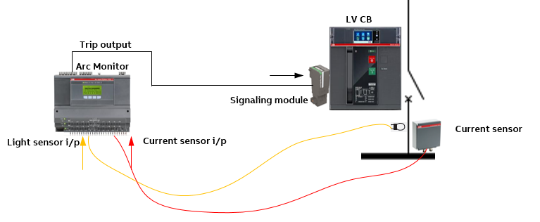
F&B Segment Electrification Solutions - Guidebook
VI. Constructing the solution (illustration of some solution parts)
Arrangement for CB condition monitoring
Dedicated arc protection, Short-Circuit Current limiter

Slide 74
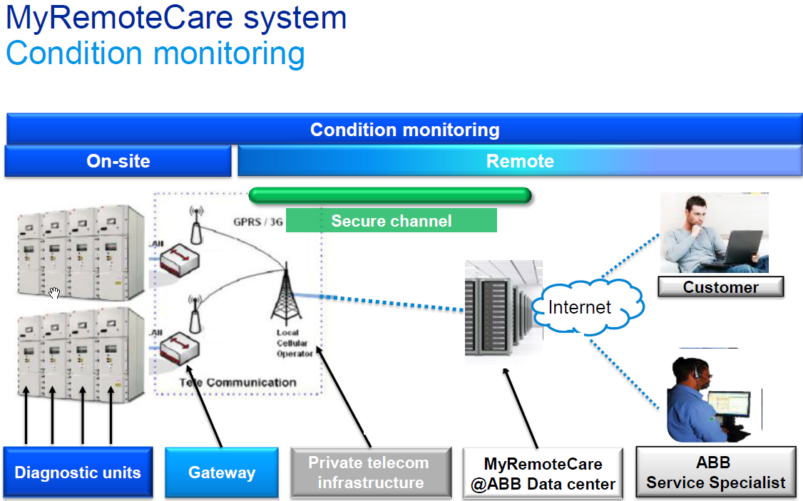
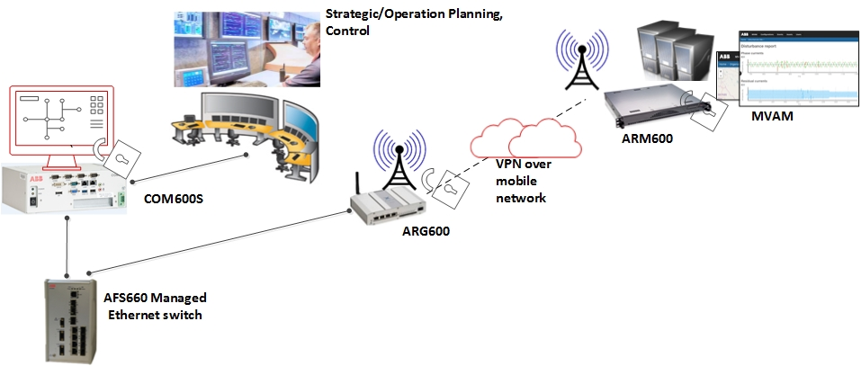
F&B Segment Electrification Solutions - Guidebook
VI. Constructing the solution (illustration of some solution parts)
Cloud application – 1 (MRC)
Cloud application – 2 (MVAM)

Slide 75
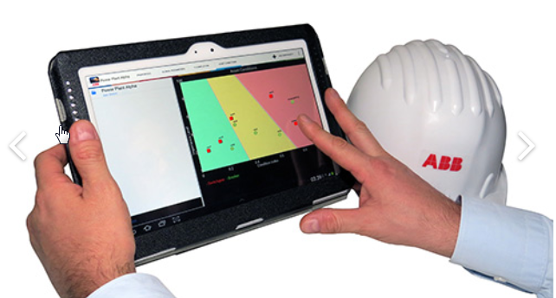





F&B Segment Electrification Solutions - Guidebook
VI. Constructing the solution (illustration of some solution parts)
Cloud application – 3 (MSC)
Cloud application – 4 (Asset Health Center)

Slide 76
F&B Segment Electrification Solutions - Guidebook
VII. Mapping KPIs, solutions and products

Slide 77
F&B Segment Electrification Solutions - Guidebook
VII. Mapping KPIs to solutions to products
Value mapping to products (1/3)
KPI | Solution | Components/Products
Food safety People Safety Manufactured product quality Reduce outages (smart system management) Continuous operations Preventing unplanned downtime and lost production | IEC 61850 based power automation system Islanding and fast load-shedding In plant power generation Power generation control and voltage regulation Automatic synchronization Power automation system AND dedicated/advanced protection (to secure each part of the network) Busbar protection High-speed bus transfer / Automatic transfer switching Power Quality monitoring and control Communication system redundancy Cybersecurity DCS Interface | AFS660, AFS670 GPS/time servers Relion PML630 Relion 611, 615, 620 series, REX640 SSC600, Relion SMU615 Emax, Emax2 + Ekip, MStart+MControl, UMC100, M10x-M, Tmax AC 800M + Small PMS library COM600S, SYS600, MView, Mlink SUE3000 TruOne – ATS Relion 611 series ESSPro PCS PQF series PCS100 AVC -40 ARx600, ABB Ability Edge gateway, MNS Digital Edge gateway MNS iS, MNS Digital MySiteCare, MySiteCondition, MyRemoteCare, MService, ABB Ability Condition Monitoring, ABB Ability EDCS Clionet Data Care, MVAM , Asset Health Center Low voltage motors UPS Conceptpower DPA 500

Slide 78
F&B Segment Electrification Solutions - Guidebook
VII. Mapping KPIs to solutions to products
Value mapping to products (2/3)
KPI | Solution | Components/Products
Food safety during storage (maintaining supply voltage, temperature) | Power generation control and voltage regulation Power automation system (temperature control) | Relion REX640, REU615 AC 800M + Small PMS library SSC600 RIO600 COM600S, MView, Mlink, ABB Ability Condition Monitoring
People (operational) safety Protection of capital investment on assets Preventing unplanned downtime and lost production | Fast acting and coordinated arc protection system Gas insulated, air insulated switchgear and equipment layout Power automation system AND dedicated/advanced protection (to secure each part of the network) Bus bar protection Short circuit current limiters facilitating system augmentation Power automation system (substation HMI) | KEVA, KECA, KEVC series VD4, HD4, EMax2 Unigear ZS1 Digital, ZX1.2, SafeRing/Safeplus, UniSec/LeanGear, MNS Digital Rigel/Mercury compact secondary substation UFES, REA10x, EMax 2 Relion 611, 615, 620 series, REX640 SSC600, Relion SMU615 Is-limiter Surge arrestor (MWD) COM600S, SYS600, MView, Mlink, MNS Digital Gateway, ABB Ability Condition Monitoring

Slide 79
F&B Segment Electrification Solutions - Guidebook
VII. Mapping KPIs to solutions to products
Value mapping to products (3/3)
KPI | Solution | Components/Products
Increased asset utilization Optimized total cost of ownership Protection of capital investment Increased operational efficiency Trusted partner for long term partnership, solution oriented, on-site support | Short circuit current limiters facilitating system augmentation Power automation system AND dedicated/advanced protection (to secure each part of the network) Gas insulated, air insulated switchgear and equipment layout Intelligent substation asset analytics aiding predictive maintenance | Is-limiter Relion 611, 615, 620 series, REX640 Relion SMU615, SSCP VD4, HD4, EMax2 Unigear ZS1 Digital, ZX1.2, SafeRing/Safeplus, UniSec/LeanGear, MNS iS, MNS Digital ARx600, ABB Ability Edge gateway, MNS Digital Edge gateway MySiteCare, MySiteCondition, MyRemoteCare Clionet Data Care, MVAM , Asset Health Center, MService, ABB Ability Condition Monitoring, ABB Ability EDCS SUE3000 ESSPro PCS PCS100 AVC -40
Ambient insensitivity | (product characteristics) | All equipment can operate in harsh climate (temperature and humidity)

Slide 80
F&B Segment Electrification Solutions - Guidebook
VIII. Conclusion

Slide 81
F&B Segment Electrification Solutions - Guidebook
VIII. Conclusion
  Takeaways
  Using the suggested F&B plant use case, all necessary solutions have been suggested, which in turn have been mapped to specific ABB products and solutions in the power distribution area are clearly identified, justified.
  These ABB solutions and products are further mapped to the identified key customer KPIs.
  Based on the above, it is quite clear that ABB’s products and solutions can ensure a major contribution towards making a safer, more reliable and smarter F&B process.

