Slide 1
ABB Robotics-Press Automation
ABB DMRO Press Automation; Carlos Pastor, Pau Pérez, Ramon Casanelles 2016-06-09
RobotWare StampApp

Slide 2
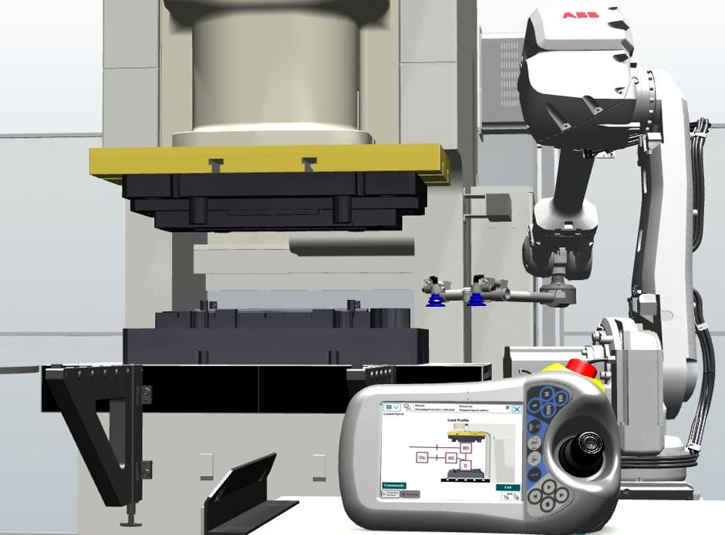
RobotWare StampApp
The core component of StampPack
RobotWare StampApp is the core value of StampPack, a Stamping Function Package, to facilitate the automation of different variety of Stamping cells.
StampApp provides a friendly environment to integrate, program and operate robotic stamping cells. Its configuration tool brings an unprecedented flexibility for stamping processes.
RobotWare StampApp includes:
Wizard to facilitate robot programming
HMI to easily interact with the robot
Basic pre-engineered interphase to connect robot with cell devices.
Configurator to edit (if required) production processes.
Differentiated value proposition: Integration, programming and operation of robotic stamping cells made easy!

Slide 3
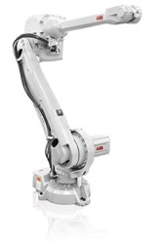
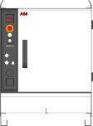
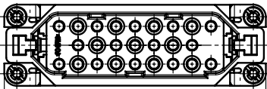
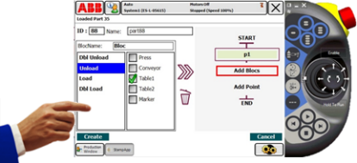
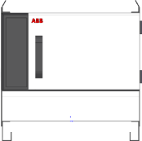
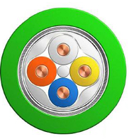
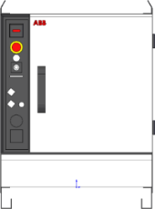
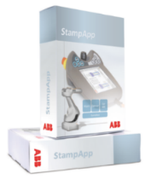
RobotWare StampApp
The core component of StampPack
StampPack main components:
Robot
(IRB 2600 / 4600 most common’s, but could be any other)
IRC5
RobotWare StampApp
(Option):
Connection box
Robot Safety interface
If not included in StampPack, to added by Integrator / End customer
Connection box
Safety interface box
IRC5

Slide 4
Main product features StampApp, the application software for Press Cells
Examples of Stamping cells based on StampPack / StampApp:
1 device
2 devices
3 devices
4 devices
5 devices
Press Line

Slide 5
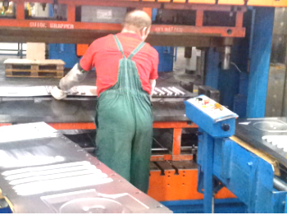
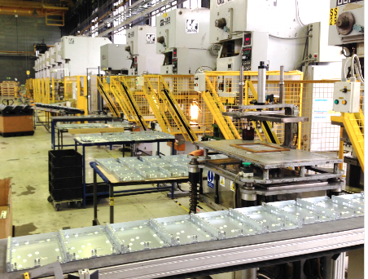
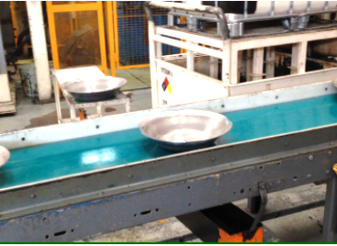
Reference examples of installations (Non automated)

Slide 6
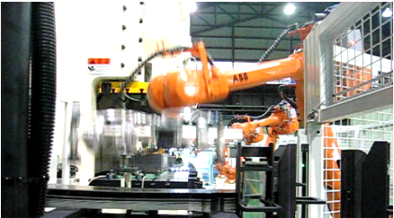
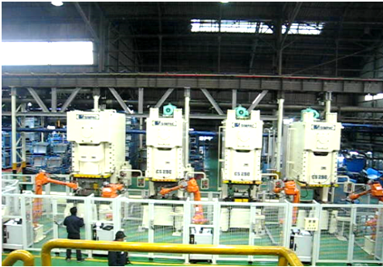
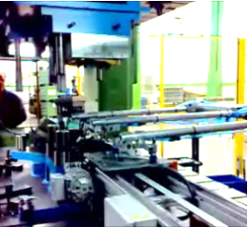
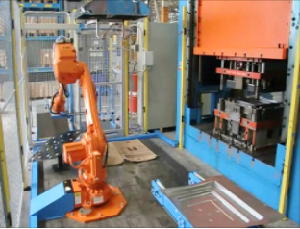
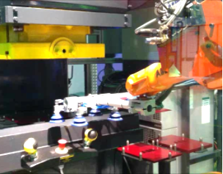
Reference examples of automated cells

Slide 7
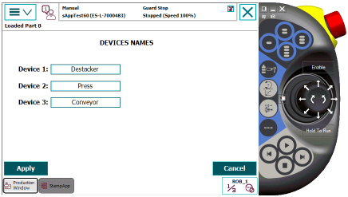
StampApp
3 devices layout example: Cell configuration
Defining a cell topology
Setting up a Robot system with 3 devices through standard Robot Installation Manager
Assigning names to each cell device
Press
Conveyor
Destacker
Defining no. devices
Click for details
Robot

Slide 8
StampApp 3 devices layout example: How to program:
Press
Same IO Interface per device
Program Steps:
Step 1: Part Name and ID
Step 2: Program Structure
Step 3: Teaching
De-stacker
Conveyor
Robot

Slide 9
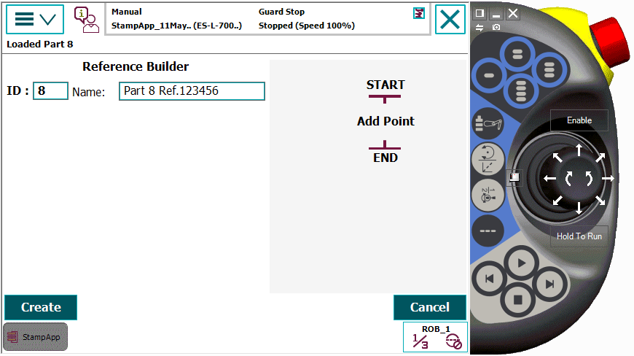
StampApp Step 1: Part ID and Name
Press
Destacker
Conveyor
Robot

Slide 10
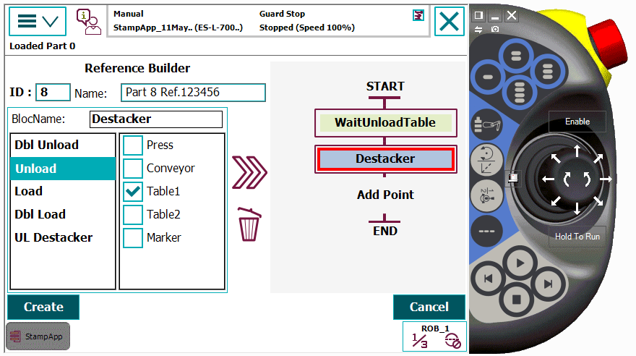
StampApp Step 2: Program structure definition - Destacker
Press
De-stacker
Conveyor
Robot

Slide 11
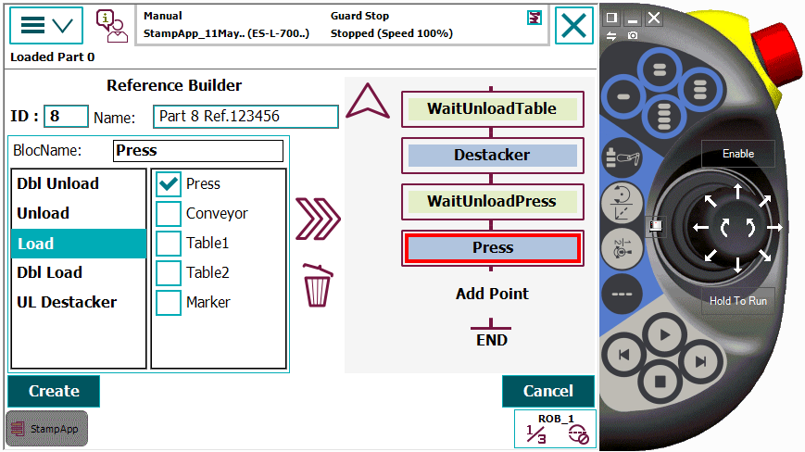
StampApp Step 2: Program structure definition - Press
Press
De-stacker
Conveyor
Robot

Slide 12
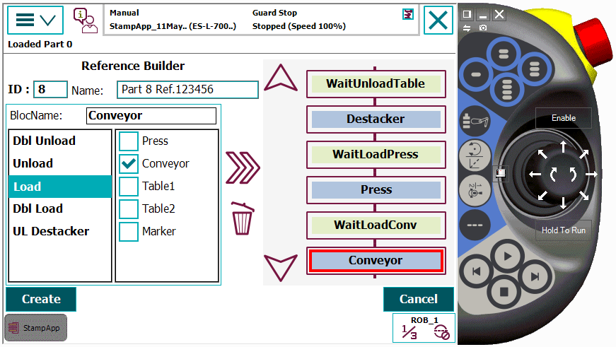
StampApp Step 2: Program structure definition - Conveyor
Press
De-stacker
Conveyor
Robot
Program structure (Step 2)
has been completed

Slide 13
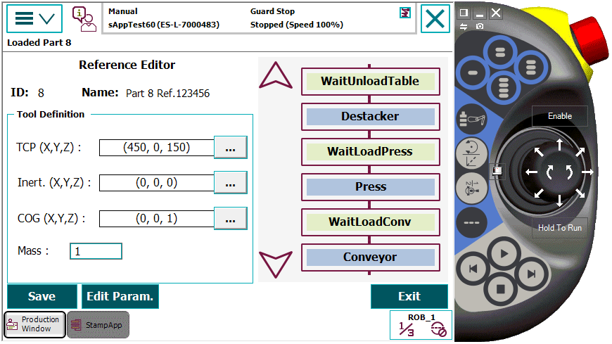
StampApp Step 3: Programming
Press
Conveyor
Destacker
Robot

Slide 14
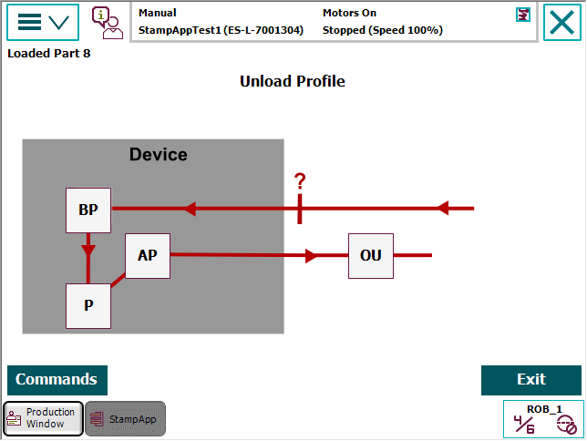
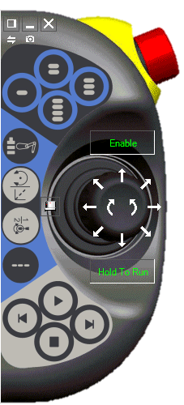
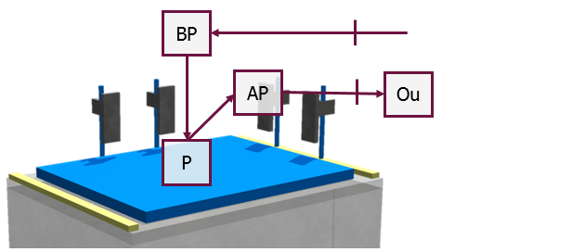
StampApp Step 3: Programming destacking paths and points
Press
De-stacker
Conveyor
Robot
Editing default profile
Click for details

Slide 15
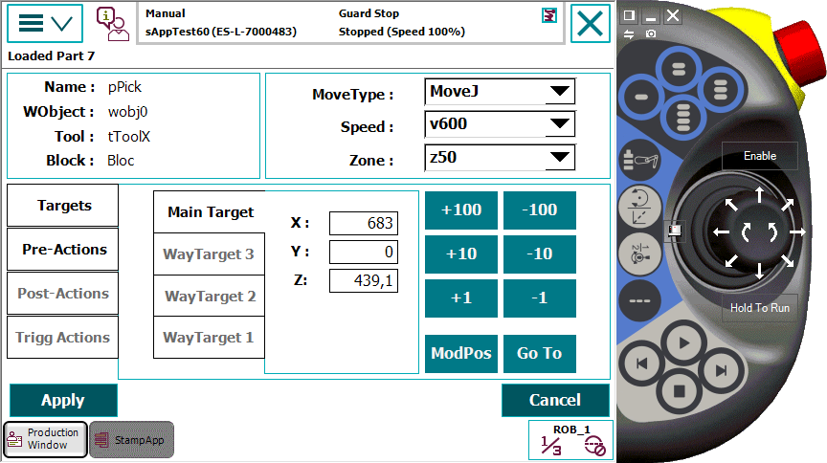
StampApp Step 3: ModPos, Move type, Speed, zone….
Press
De-stacker
Conveyor
Robot

Slide 16
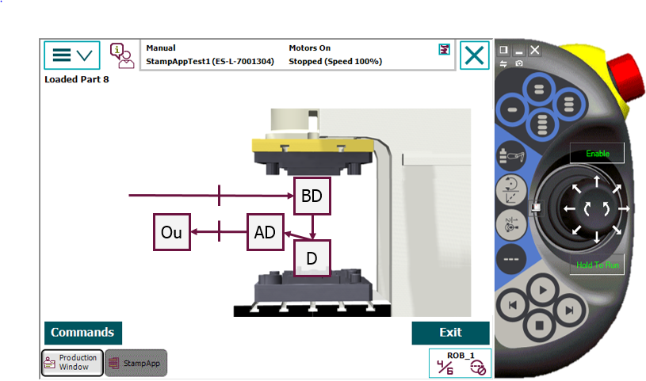
StampApp Step 3: Programming press paths and points
Press
De-stacker
Conveyor
Robot

Slide 17
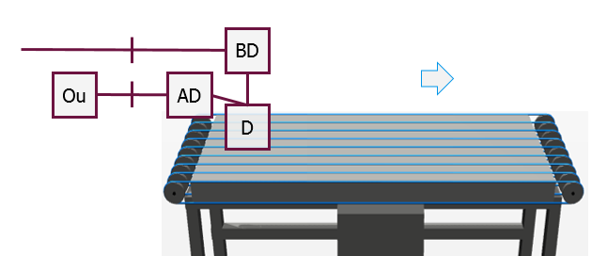
StampApp Step 3: Programming conveyor path and points
Press
De-stacker
Conveyor
Robot

Slide 19
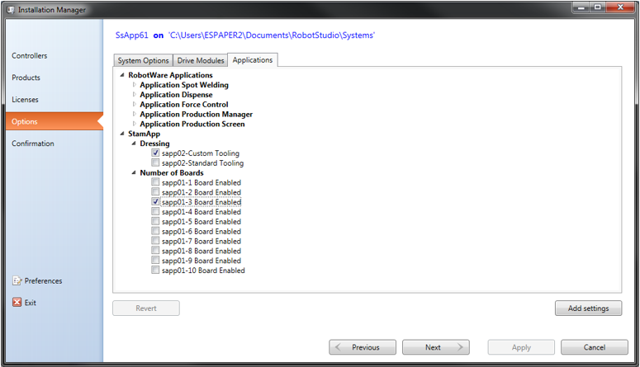
StampApp
Defining no. of devices
Setting up a Robot system with 3 devices through the standard Robot Installation Manager
Back

Slide 20
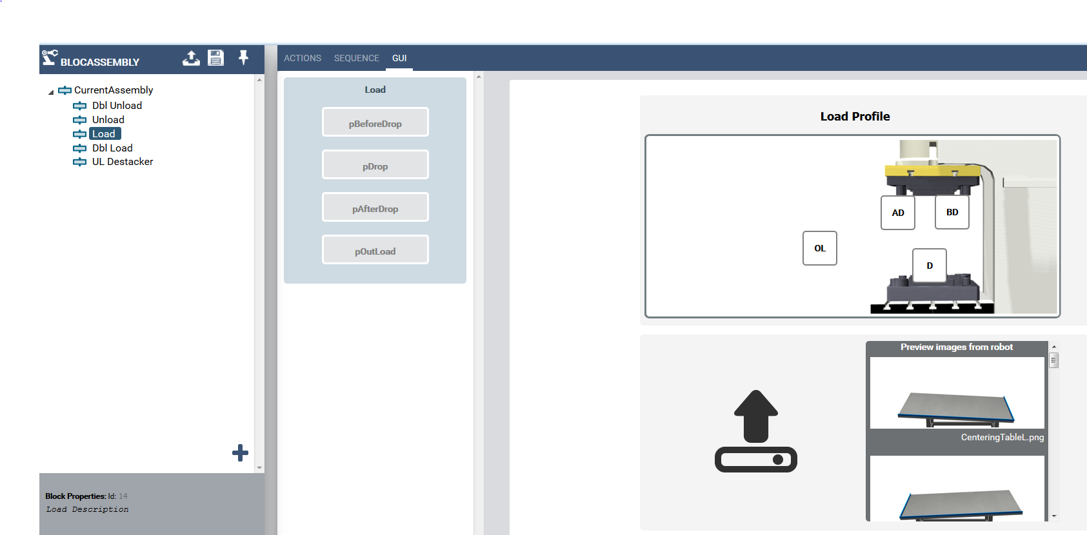
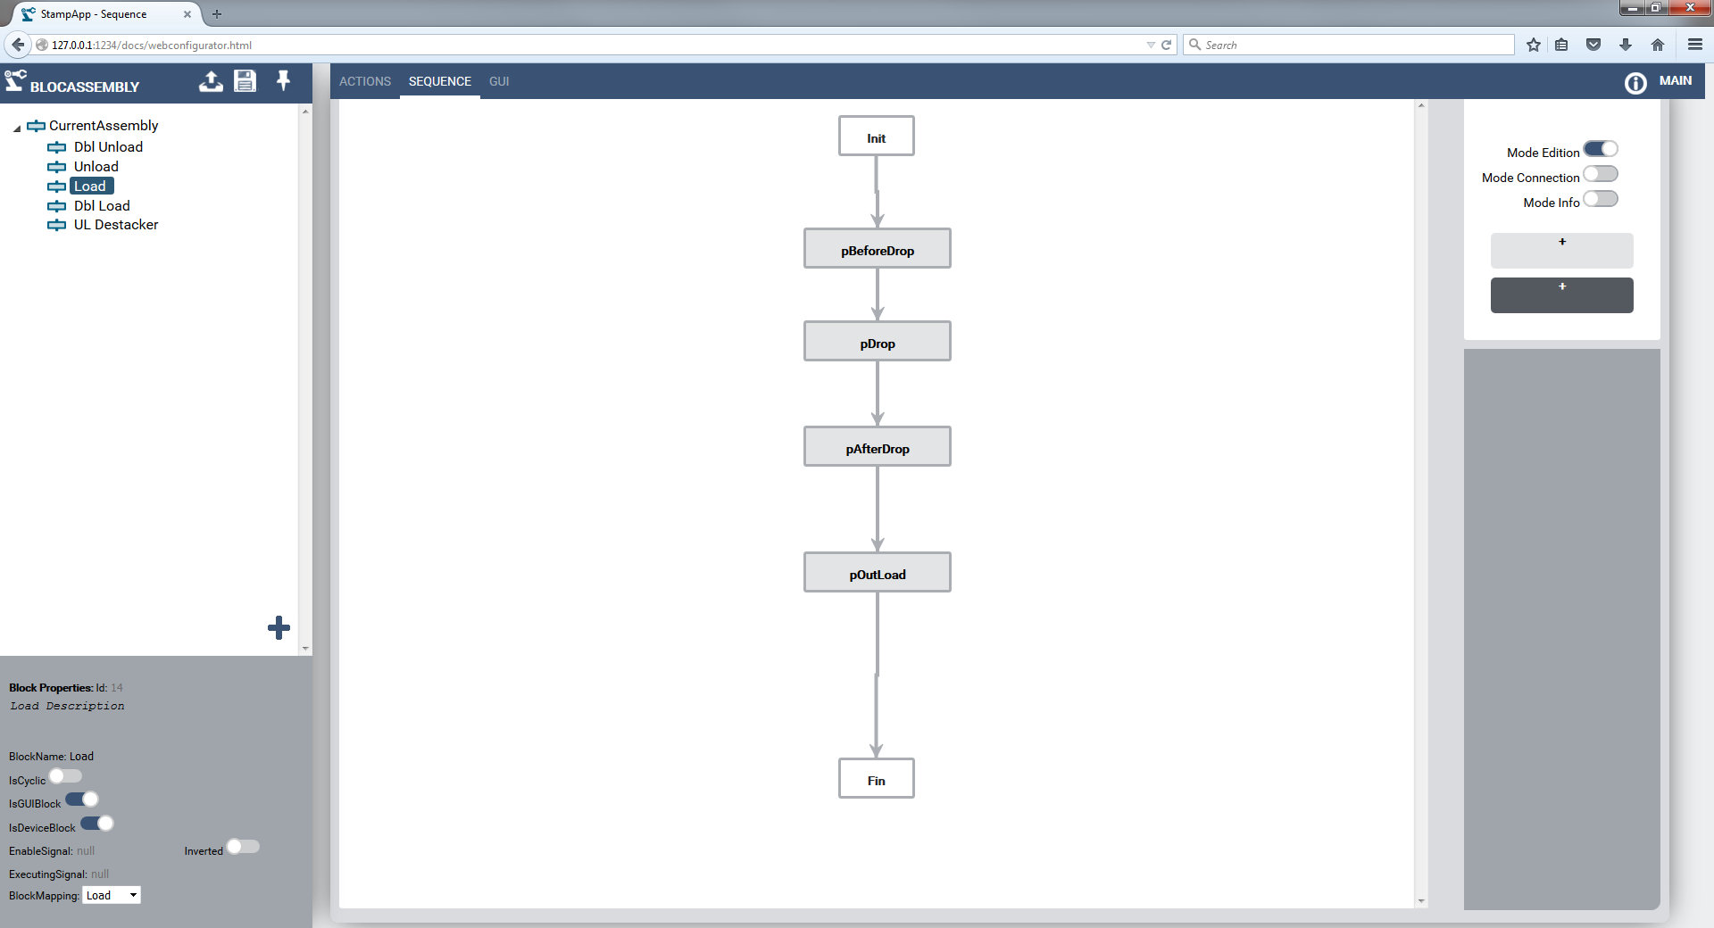
StampApp
Editing block profile
Editing default profile, through StampApp Configurator
StampApp Configurator is a web application running on the robot, accessible trough any web browser
Back

