Slide 1
ABB Alarm Lifecycle Management Managing the human factor
Statoil Snow-White, LNG process plant, northern Norway
Thomas-Christian Skovholt, Product Manager

Slide 2
Introducing the human factor
Control room operator behavior
“I think with my spine.”

Slide 3
Overwhelmed operators may not react quickly or correctly
In the process automation industry, up to 90% of accidents are attributable to human error.
Notes:
Source: http://www.hse.gov.uk/chemicals/workshop/human-factors-09/accident-investigation-lessons.pdf

Slide 4
Imagine this scenario
There’s an unusual situation
Your pulse starts racing
Then, alarms start ringing and keep ringing
In this situation, operators are supposed to perform a full safety and process evaluation before performing the corrective actions. And all of this needs to be completed in a limited amount of time.*
*Normally, this is performed by teams of experts—not just one operator.

Slide 5
Not just an imagined scenario anymore
What has happened
Milford Haven
Texas City
Excessive number of alarms in emergency situation (85% were defined as high priority)
“Had the alarm sounded properly as the blowdown drum was flooding, it could have alerted operators to the emergency situation.”
Resulted in fatal explosion—15 killed, 170 injured
Resulted in explosion and fire
Air France 447
“At the heart of this tragedy is the fact that the stall alarms were ignored” and the situation was misinterpreted
Resulted in a downed airplane, killing 228 on board
Reduced operator response effectiveness
Notes:
Texas City: This was one of the five alarms over several hours, which could have mitigated this incident, but for a variety of reasons, none of them were “useful”. We suggest that the original column alarms are the most interesting in that, since one high level came in, but the next did not, the operators would have been led to conclude that the column level was between these two points (when in fact the level was rising to overflow)
Air France:
The start of the incident was a pivot tube not working, leading to confusion regarding the situation.
Deepwater Horizon:
Standing Alarms where ‘inhibited’ to allow crew to sleep and muster alarm was set to manual activation, then the fatal blowout and explosion occurred. Explosion, 11 deaths

Slide 6
The automation paradox
“... the more reliable and greater the scope of automation, the greater the demand on the operator when it fails.”
Users are being pacified.
Important clues are overlooked or misinterpreted.
Modern digital control systems hide most of the process from the operator and alarms are required to direct the operator’s attention as well as annunciate problems.
Notes:
The automation paradox sates that the more reliable and greater scope of automation, the greater the demand on the operator when it fails.
Current control systems hide most of the process from the operator and alarms are required to direct the operator’s attention as well as annunciate problems.

Slide 7
How digitization has impacted operators
Too many alarms implemented without formal review
Operators are overloaded beyond their design limit
No understanding of the subsequent operator burden
Pre-digitization (1960) = 100 alarms per operator
Digitized (2000+) = 4,000 alarms per operator
Notes:
The capability of today’s automations systems to generate and route alarms to the operator is far in excess of the operator’s capability to process and respond to these alarms. This means “the operator is overloaded beyond his design limit”. He has only so much attention to give and multiple simultaneous alarms happening at too fast a rate that it’s nearly impossible to deal with. We need to manage and design alarm systems with this in mind.
--------------
We are still challenging a perception that the more alarms “the better the plant is protected.”
“Alarm” is used as an umbrella term covering many notification types.
--------------
You could look at the history of alarm systems and point out the step change in technology in the 70s and 80s and the lack of attention to what this will do to the human. Holifield’s book has a compelling graph which has about 100 alarms per operator in 1960, rising exponentially to nearly 4000 per operator in 2000.

Slide 8
How you can help operators
Enable
Involve
Use alarms as a toolset to help perform correct actions and direct attention appropriately
Operators notes (via Alarm Helper) act as feedback to alarm reviews
We need to manage and design alarm systems with the operators in mind.
Notes:
Operators can only direct their attention to one alarm at a time. With multiple, rapid, simultaneous alarms happening, it's nearly impossible for operators to handle.
Bi-weekly meetings → Review alarms → Continuous Alarm Optimization
Remember that the current control system hides most of the process from the operator and the alarms are required to direct the operator’s attention as well as annunciate problems.

Slide 9
Make an alarm management strategy
Low hanging fruit: focus on top 10 alarms
Continuous bi-weekly reviews
Evolution
Revolution
Complete redesign and alarm rationalization
Bulk updates
Both approaches may be used,
at different points in time
Notes:
Evolution is always required and revolution maybe required if earlier lifecycle steps were skipped (eg rationalization not done before implementation) or you decide on a major project or upgrade/redesign.
Both work toward the same goal: a well functioning alarm system that helps the operators take the right actions. Both approaches are needed at different points in time!
The Revolution look at all alarms, a one-off job.
The evolution is a continious review process
Revolutionize/Rationalize:
1) Is an operator action needed?
Example: Go through which alarms should be an alarm (action needed) or just an event (no action).
2) Align alarm priorities across the plant:
Example: Moving from alarm priority based on the type of instrument, to what is the most important to the operators of a plant
3) Alarm Helper - response descriptions
Evolution/Optimize:
Methods used to vary according to the “maturity” of the alarm system:
Step 1: Top 10 frequent and longest standing alarms
Step 2: Flooding and chattering alarms
Step 3: Grouping, loop tuning and process
Make changes to: HW maintenance, programming of controllers (libraries), set points, default settings, Alarm Helper texts etc.

Slide 10
Plan for success from the start
Every digital automation control system* needs an alarm management solution
And the relevant services to ensure adoption
* Let’s start with 800xA
Notes:
ABB would strongly encourage the inclusion of software and services within original orders and not at FAT or commission.
The aim is to get it correct first time.
Relevant for greenfield and brownfield.

Slide 11
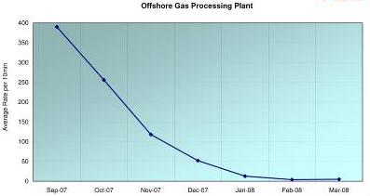
Reference case
Gas processing, Egypt
Problem
Too many alarms / safety issue
Numerous plant shutdowns led to lost production
Solution
ABB lead alarm diagnosis, alarm rationalization and implementation of new design
Benefits
Alarm rates reduced
400 → 8 alarms/10 min
Improved plant uptime
From 25 → 6 shutdowns/yr
Higher production per year
Estimated USD 2M/yr
Figure 1. Alarm rate reduction over time
Notes:
BG Rashpetco / Rashid petroleum Company, Egypt
Used: AlarmInsight: Expert Tool

Slide 12
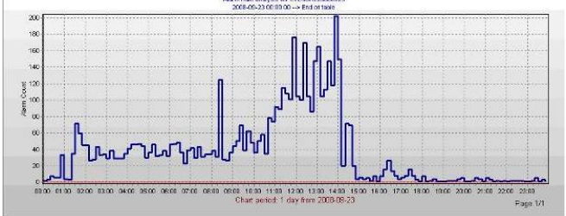
Reference case
Power generation, United Kingdom
Problem
Operators missing key alarms
Safety compromised
Solution
Alarm system redesign and rationalization
Chaired by ABB consulting
Bulk update of DCS controllers
Benefits
Alarm rates significantly reduced
Operators able to proactively identify and prevent problems from escalating
Improved plant uptime
Improved focus on safety
Figure 2. Sudden alarm rate reduction when DCS was bulk updated with new alarm design from alarm rationalization
Notes:
Premier Power LTD , Northern Ireland. 50% of Northern Irelands power capacity.
Used: AlarmInsight Expert Tool, early version of Alarm Rationalization Tool

Slide 13
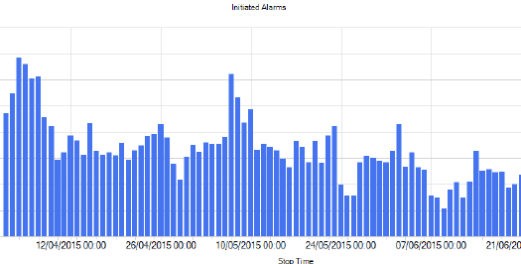
Reference case
Heavy oil production, Canada
Problem
Too many alarms
Missing operator response texts
Solution
Installed AlarmInsight® software
Started continuous alarm optimization process
Used AlarmInsight to detect bad actors and manage process
Benefits
Alarm rates significantly reduced
Operators able to proactively identify and prevent problems from escalating
Operator response help available
Figure 3. Continuous alarm rate reduction. Spikes due to new sections coming online.
Notes:
Calgary Canada 2015, on demand.
Used: (AlarmInsight: Alarm Analysis, Event Log, Alarm Helper, Alarm Change Recorder, Event Consolidation DB, Custom master alarm DB)

Slide 14
Alarm Lifecycle Management benefits
Move from reactive to proactive
Compliance with industry standards and good practice
Improved safety and environmental performance
More efficient plant operation
Increased production and equipment availability
Smoother start up and shutdown
Operational human factors improvements
Reduces operator stress
Enables operators to be proactive

Slide 15
Enabling efficient alarm management
Lifecycle approach to alarm management
“My alarms are under control and I want to ensure they stay that way.”
“I know what my problem is and I need help fixing it.”
Sustain
Continuous and/or periodic support services
Implement
“I don’t know what my problem is.”
Consulting Services and AlarmInsight Software
Diagnose
Alarm benchmarking services
Notes:
ABB provides one platform for the entire alarm management lifecycle. The division is based on the customers awareness/understanding of alarm management.

Slide 16
Overview
Complete offering
Diagnose
Basic Benchmarking Service Extracting only alarm and events data for benchmarking reports and recommendations
Implement
Kick Start Service Training, alarm philosophy, basic alarm logging/reporting and nuisance alarm management
Standard Alarm Rationalization Service Full Alarm Rationalization chaired by ABB, setting alarm priorities and operator response, input for Alarm Helper and DCS bulk updates (using ART)
Advanced Alarm Rationalization Service Grouping, state-based alarming and suppression (using ART, Expert Tool Alarm Analysis)
AlarmInsight Software Installed on-site, IT project delivery, enables efficient alarm management throughout the lifecycle of the plant
Sustain
Continuous Alarm Optimization Periodic reviews and support to ensure adoption of AlarmInsight Software and alarm management processes
Alarm System Maintenance Periodic health checks, product support
Analyze alarm system performance metrics and manage the alarm system according to EEMUA 191, ISA 18.2, IEC 62682.
Notes:
The value comes from implementing the results of alarm management. The services offering exemplifies this.
NEW: Defined “Basic benchmarking” – program to roll this out globally..The Basic Benchmarking would upsell opportunities the Implement/Sustain phases.
The software can be purchased separately.

Slide 17
Basic Benchmarking Service
Predefined package
Customer DCS
Alarm log dump
ABB Services
Alarm data analysis
Customer
Predefined report:
- Alarm Benchmarking Report
-Recommendations
1 month of data (or similar)
Making use of AlarmInsight Expert Tool or similar
Comparing customer alarm rates with best practices and recommending next steps
Notes:
Benchmarking report = (ISA/ EEMUA)

Slide 18
AlarmInsight
Software for the entire alarm management lifecycle
AlarmInsight®
Alarm performance monitoring and nuisance alarm management
Bulk alarm rationalization
Real-time alarm information for operators
Software is integrated and proven with 800xA today and in the future.
Notes:
The software package consists of web interfaces, databases and a data integration layers»
Software both for services and for permanent installation.
Software is integrated and proven with 800xA.
AlarmInsight is for managing and monitoring the Alarm System. → it is not the real-time features like alarm lists alarm shelving and grouping that you perform in the 800xA operator interface.
→ 800xA acts as the Alarm System.

Slide 19
AlarmInsight
Software overview
Alarm monitoring and analysis Basic and enterprise data logging
KPI-Report/.pdf (KPI)
Automatically generated KPI reports: daily, weekly, monthly
AlarmAnalysis (AA)
Manually set filters, analyze and generate reports
EventLog Viewer (EL)
Manually set filters, find root cause and sequence of events
Expert Tool (ET)
Service tool for ad-hoc ,deep-dive analysis supporting improvement work: used in all phases (client)
Alarm management Lifecycle management
Alarm Rationalization Tool
Alarm Rationalization and Continuous Alarm reviews, Management of change/ Master Alarm Database (SQL)
Input for Alarm Helper and DCS bulk updates
Both a services tool and on-site server implementation
Alarm Change Recorder (ACR)
Monitor changes to alarm attributes/ values in the distributed control system
Track changes during operation and modifications
Real-time information Per site / for control
room operator
AlarmHelper (AH)
Operator support: How to react to an alarm and collect feedback from operators
Context-sensitive presentation of input from Rationalization, design and modification work
Basic: Logging and alarm KPI reporting , log collection from multiple sources
Enterprise features: Multi-site alarm consolidation, office network reports, large datasets
Notes:
KEY: Reports and analysis is done on historical data collected in the Event Consolidation Database (near real time)
The Alarm rationalization tool fills an important space in the AlarmInsight portfolio- now enabling the entire alarm management lifecycle. Connecting everything together – one-off services and continuous optimizations.
ART fills the role as input for Alarm Helper.
The Alarm Monitoring and Analysis applications and Alarm Rationalization Tool can be used with most DCS systems providing alarm and events via OPC-AE interfaces.
The Alarm Change Recorder and Alarm Helper are integrated with 800xA 5.1 and up.

Slide 20
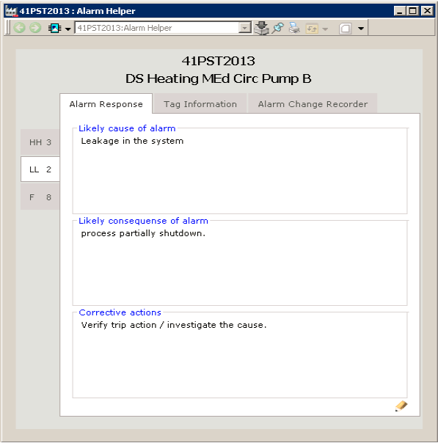
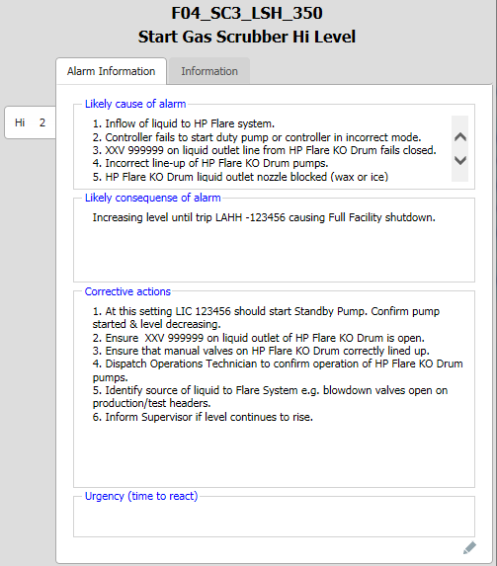
AlarmInsight
Real-time information
Called up directly from the alarm list on 800xA control panel
Alarm Help for operators:
What does the alarm mean and how to remedy the issue
Capture operator feedback (for future alarm reviews)
Can include change recorder historical alarm attribute values
Populated/updated via AlarmInsight Alarm Rationalization Tool
LAH – 123456
Flare Knock Out Drum – High level
5 min
Notes:
Alarms are not always simple and may have multiple causes – it is in this context that Alarm Help is valuable. Also this KO Drum high level would be a rare alarm which the operator may not have seen before – hence usefulness of Alarm Help

Slide 21
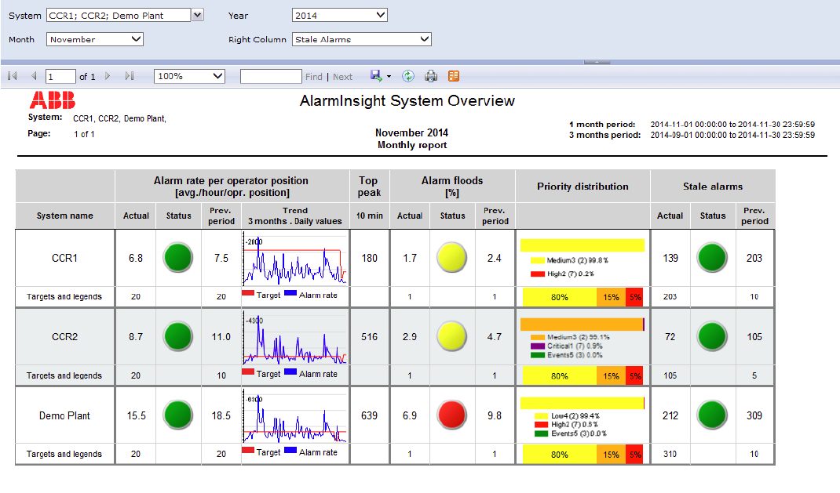
AlarmInsight
Alarm reporting
Monitor and benchmark alarm performance through predefined KPI Report, including collection of historical data
Web based

Slide 22
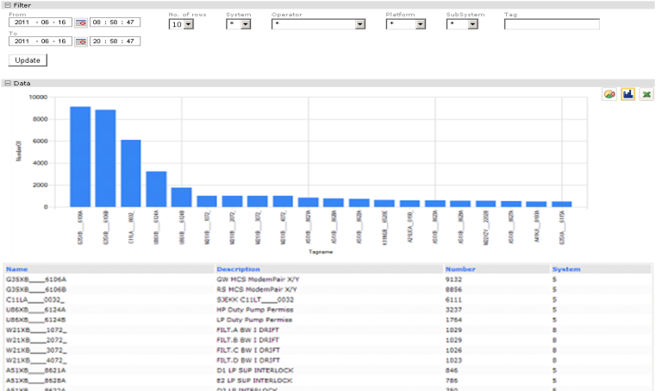
AlarmInsight
Analysis and drill down I
Find most frequent alarms, longest standing alarms, etc., and plan improvement activities with Alarm Analysis/Expert Tool Ad–Hoc reports, manual filter settings, and historical data
Web based

Slide 23
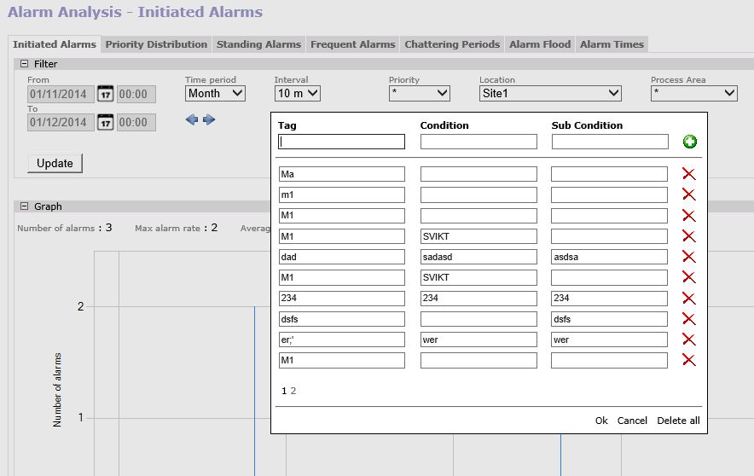
AlarmInsight
Analysis and drill down II
Exclude alarms already identified for rationalization and drill down further to find the next set of bad alarms
“Preview” impact (on KPIs) of “fixing” a particular nuisance alarm

Slide 24
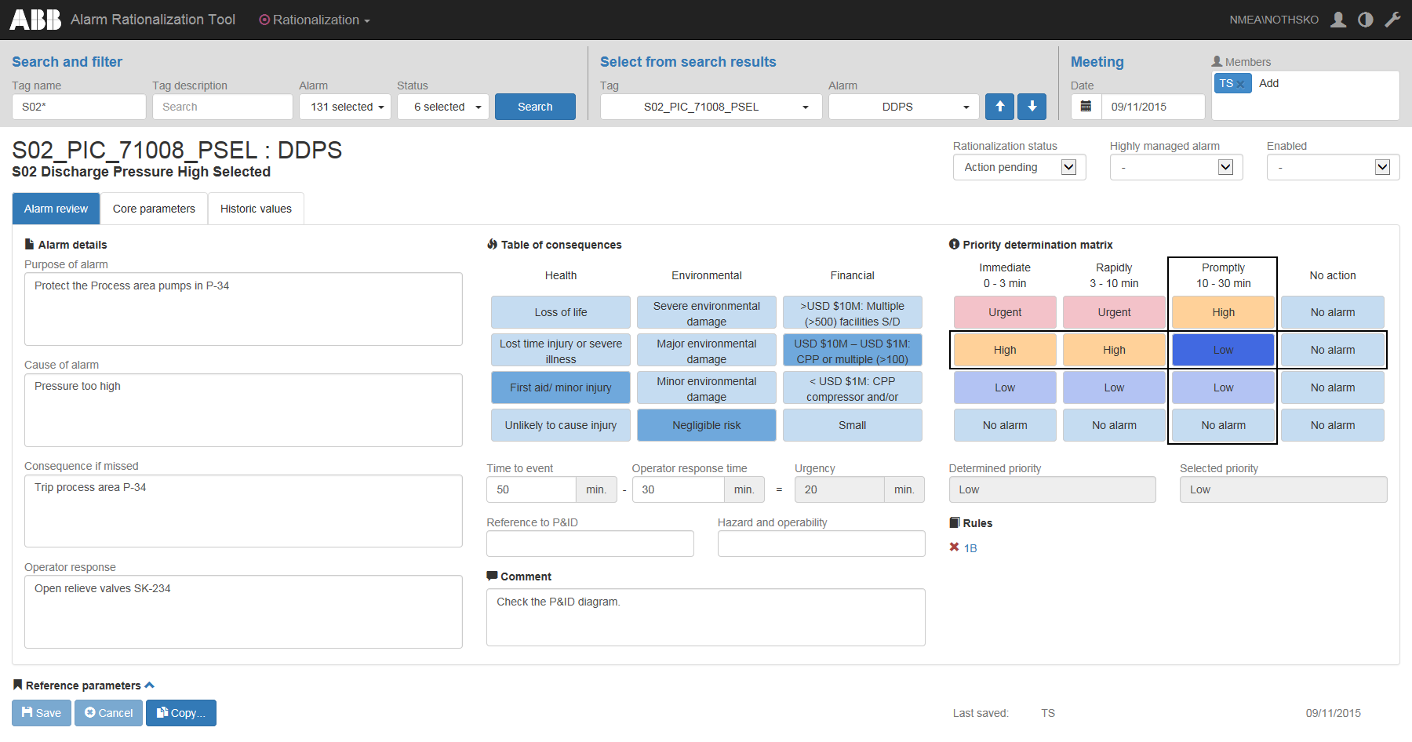
AlarmInsight
Lifecycle Alarm design, rationalization and optimization
Document the alarm settings
in the master alarm database
Use the Alarm Rationalization Tool to efficiently rationalize alarms and optimize alarm settings and operator response texts throughout the lifecycle
Web based
Notes:
Key: Time saving Copy and Rules, Alarm Helper texts, review alarm priorities, data import/export.

Slide 25
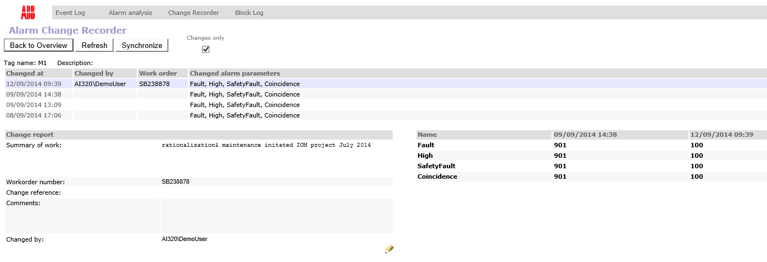
AlarmInsight
Alarm Change - MoC
Alarm system audits and alarm setting enforcement
Monitor changes to alarm attributes directly from 800xA.
Add references to work orders
Web based

Slide 26
AlarmInsight
Alarm Rationalization Workflow
Bulk upload
or
implement manually into DCS
DCS
Alarm attributes data dump file from controllers
AI ART
DCS
New alarm Priority and attributes
Alarm Philosophy
Document
MoC/store records in DB
Export data
Import data
Rationalize Alarms
Transform data file into ART format (Excel)
Operator response texts
Manual work
Meetings chaired by ABB
800xA
AlarmInsight
Alarm Rationalization Tool
AlarmInsight Alarm Helper population

Slide 27
Sustain
Continuous improvement
Consider:
1
2
Processes change over time
Equipment wear and tear
Plant conditions and equipment are in a constant state of flux
It is a continuous job to monitor and optimize
4
3
New extensions or upgrades
within the plant
Change of equipment that
affects alarm settings
Alarms should change as the plant changes.
Notes:
ABB Alarm Lifecycle Management provides
On-site or remote services

Slide 28
What customers say about ABB Services
UK North Sea:
“A number of shutdowns have been avoided due to the low level of alarms the operators now have to deal with, which enables them to react in a more timely and proactive manner. Several instances of savings in the region of USD 0.2–0.5M in lost production have been recorded.”
Rashid Petroleum Company (Egypt):
“This is what success looks like. WDDM alone had only 6 trips in 2008 compared to 25 in 2007, and 17 in just the second half of 2006. This has significant business value.”

Slide 29
What customers say about ABB AlarmInsight software
Calgary, Canada:
“AlarmInsight AlarmAnalysis is far beyond competitors capabilities.”
Houston, United States of America:
“The future Alarm Analysis capabilities and Master Alarm Database are all very interesting to us.”
Calgary, Canada:
“This is what we are looking for–we are interested in the whole package.”
Oslo, Norway:
“The alarm exclusion feature will be really useful to us.”
Burlington, Canada:
“This is a great package.”

Slide 30
Consulting services references
Highlights
BP
Aberdeen/North Sea
Support to alarm improvement and rationalization projects
Benchmark assessments
Alarm strategy documents
Projects, Aberdeen/GPO
Alarm rationalization reviews (Quad 204, SCPX and SD-2 projects)
Corporate, Sunbury
Preparation and delivery of global alarm management training program
Alarm management consulting support
Alarm rationalization reviews
Sharjah
Benchmark assessment
Alarm rationalization reviews
Azerbaijan
Alarm management FEED scoping studies
Customized operations and maintenance training
Full lifecycle alarm rationalization and offshore implementation
BG Group, Aberdeen, Egypt and Tunisia
Full lifecycle alarm rationalization and management
Benchmark assessment
Alarm philosophy documents
Alarm management mentoring and coaching
Continuous improvement services
Periodic audits
Alarm flood management services

Slide 31
Consulting services references
Highlights
Huntsman, UK
Full lifecycle alarm rationalization and management
Continuous improvement support
ICI Polyurethanes, Wilton, UK
Trip and alarm design, full lifecycle alarm rationalization and management
ConocoPhillips, Norway
Alarm management support
ConocoPhillips, Aberdeen
Benchmark assessment
Full lifecycle alarm rationalization and management support
Britannia Operator Ltd, UK – Alarm management health check
Chevron, UK – Alarm management health check
ExxonMobil, UK, NO – Training
Maersk, DK – Training
Nexen, UK – Alarm management health check
Shell, UK – Alarm management assessment
TAQA – Alarm management health check
E.ON, UK
Alarm management software installation and support
Customized alarm management training
ADCO, Abu Dhabi – Benchmark assessment and software
Gasco, Abu Dhabi – Benchmark assessment and software
GlaxoSmithKline, Singapore – Benchmark assessment
Apache, AU – Alarm Rationalization reviews
QGC/BG, AU – Alarm Rationalization
BlueScope Steel, AU – Alarm management strategy and benchmark

Slide 32
System installation references
Various options of AlarmInsight – current versions
North America
ExxonMobil Hebron (KPI, AA, EL, BL, AH- CA/)
ExxonMobil Pt.Thomson (AA,BL,EL,ACR,AH - USA)
Devon Energy JackFish2 (AA,EL, ACR, AH– CA)
Devon Energy JackFish3 (AA,EL, ACR, AH– CA)
Asia
Maersk Oil Qatar Al Shaheen platform, Loc A
Maersk Oil Qatar Al Shaheen platform, Loc B
Gasco Habshan complex
Takreer Ruwais Refinery
Australia
Visy Tumut Brisbane
Queensland Gas Company Chinchilla, Queensland
Europe
ConocoPhillips J-Block (AA,EL, ET - UK)
E.ON Benelux Maasvlakte (NL)
Indaver Antwerp (BE)
Indaver Doel (BE)
Indaver Ijmuiden (BE)
Nexen Buzzard platform (UK)
Petroplus Antwerp (BE)
Talisman Energy Inc. Fulmar platform (UK)
E.ON UK Holford Gas Storage (EC, ET,KPI, UK)
BP Sangachal Terminal – ACG Azerbaijan (AA, EL, ET, KPI – UK)

Slide 33
System installation references
Various options of AlarmInsight – current versions
Denmark
Amerada Hess South Arne platform
Aarhus Karlshamn Århus
Dalum Papir Odense
DONG E&P Siri platform
Energinet.dk Ll Torup
IS Vestforbrænding Glostrup
Haldor Topsøe Frederikssund
Maersk Oil & Gas AS Dan B Platform
Maersk Oil & Gas AS Dan F platform
Maersk Oil & Gas AS Dan FG platform
Maersk Oil & Gas AS Dan Utility
Maersk Oil & Gas AS Esbjerg
Maersk Oil & Gas AS Gorm platform
Maersk Oil & Gas AS Halfdan platform
Maersk Oil & Gas AS Harald platform
Maersk Oil & Gas AS Rolf platform
Maersk Oil & Gas AS Skjold platform
Maersk Oil & Gas AS Tyra East platform
Maersk Oil & Gas AS Tyra SE platform
Maersk Oil & Gas AS Tyra West platform
Norway
Shell Ormen Lange (ACR,AH, BL)
Statoil Snøhvit (BL,EL,AA)
Statoil Sleipner (ACR, AA,EL, BL)
Statoil Gudrun (ACR, AA,EL, BL)
Statoil Aasta Hansteen (AA,KPI,EL,BL,ACR,AH)
Shell Draugen (AH, ACR,EL, BL)
Maersk Vincent (AA,EL)
ConocoPhillips Ekofisk (KPI, BL)
ENI Goliat (AA,EL,AH,ACR, BL, not commisioned)
Statoil Kårstø
BP Ula (EL, AH)
BP Valhall (EL,BL )
Statoil Sture (BL)
Statoil Heimdal (KPI, EL)
Teekay Knarr (BL, KPI)
Statoil Grane (EL, BL)
Hess Sedje Ceiba (AA,EL,BL,ACR )
Dana WIDP (planned)
Sweden
Korsnäs AB Gävle

Slide 34
Learn more
Watch “Getting Alarm Management Right First Time” webinar by Colin Bartliff https://www.youtube.com/watch?v=-Yp1uU4p5t8
Watch “Alarm Management in the Regulatory Spotlight” webinar By Joan Evans https://www.youtube.com/watch?v=2rCt-slGm30
Visit the “Human Factors” blog by Tony Atkinson www.tinyurl.com/humanfactorsblog http://uk.inside.abb.com/cawp/seitp202/db362514c262e753c1257bce004f4347.aspx http://new.abb.com/docs/librariesprovider53/about-downloads/human-factors-in-the-workplace.pdf?sfvrsn=2 Additional training courses and seminars http://new.abb.com/uk/about/our-businesses/process-automation-division/consulting/training-events

Slide 35
Contact information
Product manager: Thomas C Skovholt
Contact and support: NO-AlarmInsightSupport@abb.com
Software Orders: ogp.products@no.abb.com
abb.com Alarm Services Link
abb.com Software Link

Slide 37
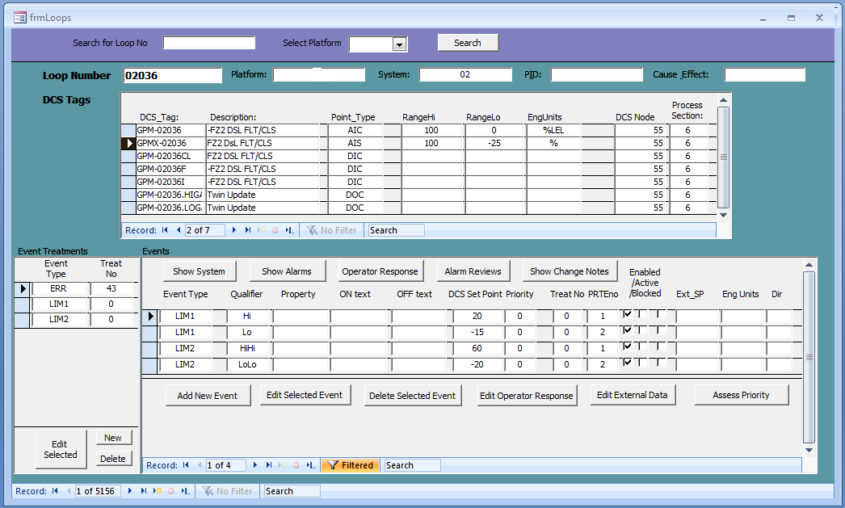
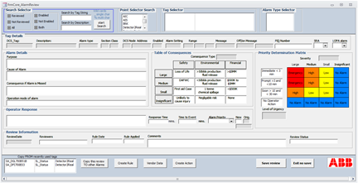
Evolution and experience
Started in late 1990s with the realization that spreadsheets could not handle the large amounts of alarm configuration data
Redeveloped in 2012 to focus on Alarm Reviews as a follow on to work ABB undertook on EEMUA191 revision 3
Integrated into AlarmInsight
1990s
2003
2012
2015
Notes:
Key: time saving Copy & Rules, Alarm Helper texts, review alarm priorities, data import/export

Slide 38
Insight® portfolio
Insight®
AlarmInsight®
SafetyInsight®
OperationInsight™
Manage and monitor the alarm system
Analysis and reporting
Real-time alarm information
Managing alarm settings
Manage and monitor the safety system
Provide reports and documentation on safety functions
Manage the day-to-day operations in the control room
Listing of blocked, forced and suppressed alarms
Record and share shift information

Slide 39
Why ABB Alarm Management
One vendor, one complete solution
Design
Implement
Operate
Alarm Consulting
ABB is active in establishing best practices as part of international industry standards such as the new IEC 62682
Alarm System Services
Alarm Software
ABB 800xA and competitor Process Automation Control Systems

Slide 40
Why ABB Alarm Management
One solution, continuous improvement
Diagnose
Implement
Sustain
UK Consulting ,
NO/ DK Advanced Services
Alarm Rationalization
Finger Print analysis
Alarm Design
DCS System
Configuration
Alarm Consulting
System Design
System Delivery
System Health Services
Alarm System Services
Certified LBUs
AlarmInsight
ART
AlarmInsight
DCS integration
AlarmInsight
Monitor and Optimize
Alarm Software
ABB 800xA and competitor Process Automation Control Systems

Slide 41
AlarmInsight
Architecture
All components and database on one physical or virtual server
Office:
Make reports available outside the «factory»/ control network
Client installation
Expert
tool
KPI reports
Alarm
Analysis
Event
Log
Change
Recorder
Alarm
Helper
Alarm
Rationalization
Tool
BlockLog
(OI)
OPC-DA
800xA Aspect/web
Event Consolidation Database (SQL)
OPC-AE
(Master) Alarm Database (SQL)
PLANT NETWORK
CONTROL NETWORK
Collect data from various sources
Third-party DCS
800xA History
800xA
Some components are also available in the System 800xA pricelist as:
800xA History and reports
800xA Alarm operations

Slide 42
AlarmInsight
Small standalone architecture
All components and database on one physical server
Installed on a PC
Transfer data to AH vi Excel
DCS controllers updated manually
KPI reports
Alarm
Helper
(800xA only)
Alarm
Rationalization
Tool
(incl. SQL Express)
Event Consolidation db
Alarm Helper db
PLANT NETWORK
CONTROL NETWORK
Collect data from various sources
800xA History
800xA
Third-party DCS
Some components are also available in the System 800xA pricelist as:
800xA History and reports
800xA Alarm operations

Slide 43
800xA and AlarmInsight
How to choose software (1)
Monitor, Manage and Optimize
(Near real time or offline, historical data)
Manage the
Alarm System
or
Use the Alarm System
800xA control room interface
real time

Slide 44
800xA and AlarmInsight
How to choose software (2)
With only 800xA,
Cannot complete ad-hoc queries or dill downs
Must configure everything in advance
Wait at least two plus weeks for your first report
Cannot look at extend time intervals (only what’s available via 800xA memory
800xA alarm handling
The alarm system
core 800xA
800xA Operations
Manage the alarm system
AlarmInsight
800xA History & Reports
Alarm lists
1. Grouping
2. Shelving
3. Pre-defined alarm analysis (KPIs)
4. AlarmInsight Alarm Helper
Deeper Insight + Lifecycle Management
1. Alarm Analysis
2. EventLog Viewer
2. ART
3. Expert Tool
6. Alarm Change Recorder
Monitoring
1. AlarmInsight KPI reports
2. AlarmInsight Event Consolidation Database (historical alarm data)
With alarm management software:
Comply with international standards
Gain deeper insight and analysis
Deeper drill down and filters for alarm analysis
Manage change easier (i.e. configure new installations)

Slide 45
Comparison
Software enterprise options
PC
Onsite Server
Additional Front-End web Server (all applications)
expertise
Office network
IT project delivery:
Cyber Security
Network
Plant network
800xA Operations
800xA Operations +
800xA History&Reports
AlarmInsight
full scope
AlarmInsight
Office network access
AlarmInsight
Consolidation – multiple sites
AlarmInsight
3rd party DCS
IT project delivery:
-IIS web server
-SQL server
-SQL maint. (Index, defragmentation etc)
-backup
-HW/OS/remote access
Expert Tool
Alarm Helper
Alarm Helper
Alarm Helper
Alarm Helper
KPI Reports
KPI Reports
KPI Reports
KPI Reports
KPI Reports
EventConsolid DB
EventConsolid DB
Alarm Rationalization Tool
EventConsolid DB
EventConsolid DB
EventConsolid DB
Alarm Analysis
Alarm Analysis
Alarm Analysis
Alarm Analysis
EventLog Viewer
EventLog Viewer
EventLog Viewer
EventLog Viewer
Alarm Change Recorder
Alarm Change Recorder
Alarm Rationalization T.
Alarm Rationalization T.
800xA
Control network
800xA
800xA
Smart Logger integration
DCS / event flow
understanding
800xA
800xA
800xA
DCS w/ OPC-AE, Seriel, Print

