Slide 1
Product Family Overview
2022
Power Supplies
Product Marketing

Slide 2
Primary switch mode power supplies
CP Power Supplies
The CP range offers the latest technology in a more compact package. Modern power supply units are a vital component in most areas of energy management and automation technology. ABB works with customers as a global partner in these areas, responding quickly to changing requirements and evolving demands of markets and applications. Five power supplies families
Single and three-phase devices
Economic and high-end variants
Space saving designs
Redunancy and buffering units
Accepts a wide input voltage

Slide 3
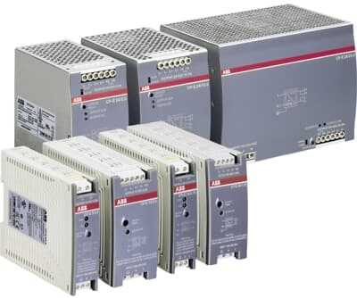
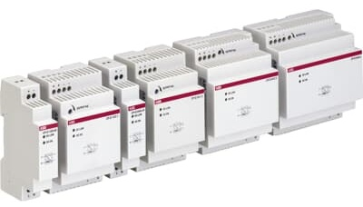
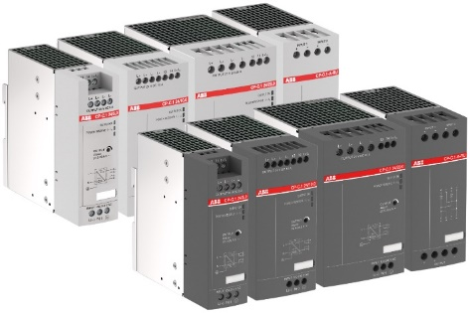
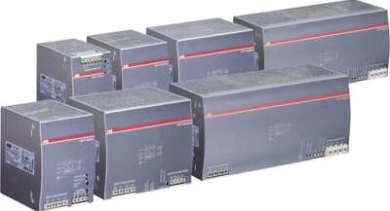
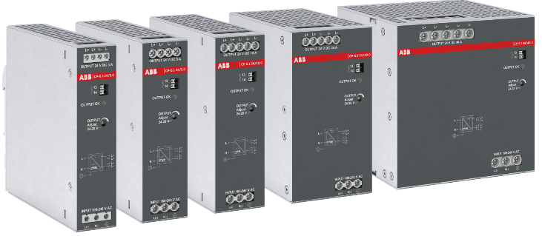
Primary switch mode power supplies
Overview
CP-D range
CP-E range
CP-T range
CP-S.1 range
CP-C.1 range
Power supplies in modular DIN rail component housing with a height of 91 mm (3.583 in)
High segment standard power supplies for your application with a perfect price/ performance ratio
High segment standard three-phase power supplies, the extension of the CP-E range up to to 960 W (40 A)
High segment automation power supply range – up to 960 W, compact design, power reserve and marine approval
High segment universal power supply range, power reserve continuously, ATEX/ IECEx, marine approval – Giving you the power to control

Slide 4
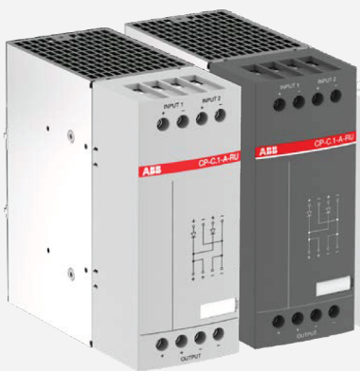
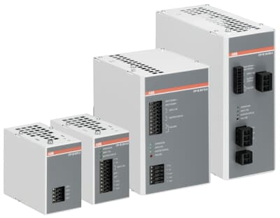
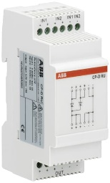
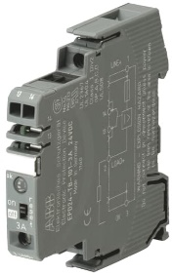
Primary switch mode power supplies
Overview - Assessories
CP redundancy modules
CP-B buffer modules
EPD24 protection device
CP-D RU in MDRC housing
CP-C.1-A-RU for a true redundant setup of two up to 56V DC power supplies
Buffering 24VDC supply of up to 572 s
Maintenance free, ultra-capacitor technology
Temperature resistant
no deep charge
Selective load protection, one electronic tripping characteristic.
Active current limitation on overload/short circuit
Current ratings 0.5...12 A

Slide 5
Power Supply
CP-D
Main Benefits
Output voltages 12 and 24 V DC
Output currents 0.42 A / 0.83 A / 1.3 A / 2.1 A / 2.5 A / 4.2 A
Power range 10 W, 25 W, 30 W, 60 W, 100 W
Wide range input 100-240 V AC (90-264 V AC, 120-375 V DC)
High efficiency of up to 89 %
Low power dissipation and low heating
Main Features
With narrow widths of just 18 to 90 mm, the CP-D range of switch mode power supplies are ideal for installation in distribution panels
Continuously adjustable output voltage (CP-D > 10 W) means units can be optimally adapted to each application, for example compensating for voltage drops caused by long line lengths
Additional redundancy unit CP-RUD provides true redundancy
Compact Modular DIN Rail

Slide 6
Power Supply
CP-E
Main Benefits
Adjustable output voltages 5 V, 12 V, 24 V, 48 V DC
Output currents 0.625 A / 0.75 A / 1.25 A / 2.5 A / 3 A / 5 A / 10 A / 20 A
Power range 15 W, 18 W, 30 W, 60 W, 120 W, 240 W, 480 W
High efficiency of up to 90 %
Low power dissipation and low heating
Ambient temperature range during operation -40...+70 °C
Main Features
Continuously adjustable output voltage: optimally adaptable to each application, for example compensating for voltage drops caused by long line lengths
24 V > 18 W devices offer an output/contact for output voltage monitoring and remote diagnosis
Redundance modules available to establish true redundancy
Cost Efficient Power Supply

Slide 7
Power Supply
CP-S.1
Main Benefits
Rated supply voltage range from 100-240 V AC / 100-250 V DC
Rated output voltage 24 V DC
Rated output current of 3.0 A, 5.0 A, 10.0 A, 20.0 A and 40.0 A
High efficiency of up to 94 %
Power reserve design of 150 % for 5 s to start heavy loads
Output voltage adjustable via front-face rotary potentiometer “OUTPUT Adjust”, 24-28 V
Main Features
Saves the valuable installation space of the control cabinet due to compact design and high efficiency
Coated PCBA and marine certification enables usage for e.g. wind, solar, marine applications
Parallel operation to increase power output or provide redundancy
High Efficiency and Reliability

Slide 8
Power Supply
CP-T
Main Benefits
Rated output voltages 24 V, 48 V DC
Rated output currents 5 A, 10 A, 20 A, 40 A
Rated output powers 120 W, 240 W, 480 W, 960 W
Typical efficiency of 93 %
Ambient temperature range during operation -40...+70 °C (480 W variants: -30...+70 °C)
Free convection cooling – no forced ventilator cooling
Main Features
Solid state output for function monitoring and remote diagnostics
For use in 340 - 575 V AC or 480 - 820 V DC supply systems
Continuously adjustable output voltage means units can be optimally adapted to each application, for example compensating for voltage drops caused by long line lengths
Advanced Three-Phase Power Supply

Slide 9
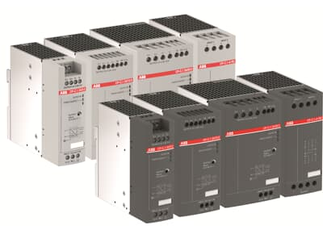
Power Supply
CP-C.1
Main Benefits
Rated output voltage 24 V DC
Rated output currents 5 A, 10 A, 20 A
Rated output powers 120 W, 240 W, 480 W
High efficiency up to 94 %
Ambient temperature range during operation -25...+70 °C
Extended ambient temperature range during operation -40...+70 °C with coated PCBA version
Main Features
Power reserve and switching of high peak currents help maximize system availability
High efficiency of up to 94 % lowers energy consumption, saving money and space and minimizing heat
Reliable in harsh environments due to application under extreme temperature conditions
High-Performance for Demanding Applications

Slide 10
Power Supply
CP-B Buffering Unit
Main Benefits
Rated input voltage 24 V DC
Rated currents 3 A DC, 10 A DC, 20 A DC
Expandable with CP-B EXT.2 module
LEDs for status indication
Latest ultracapacitor technology
High efficiency of more than 90%
Main Features
Maintenance-free
No deep discharge
Temperature resistant
Ultracapacitor-based buffering

Slide 11
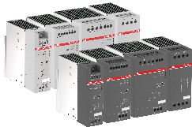
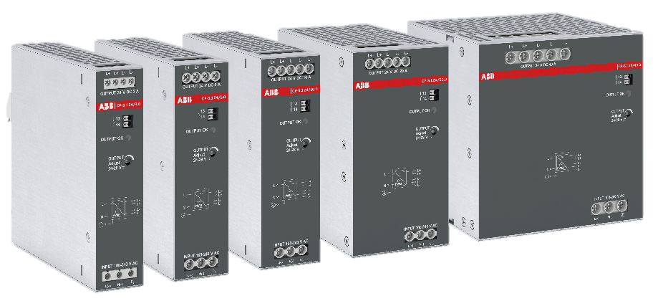
Complete Offering
CP-T
(3-phase)
CP-C.1
Performance
CP-S.1
CP-E
CP-B
(buffering unit)
CP-D
Cost Effective
Additional Features

