Slide 1
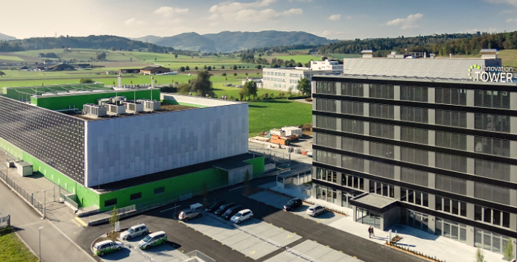
MNS®-Up
EVENT, Date
Power distribution and UPS in a single, compact system
Speaker, position

Slide 2
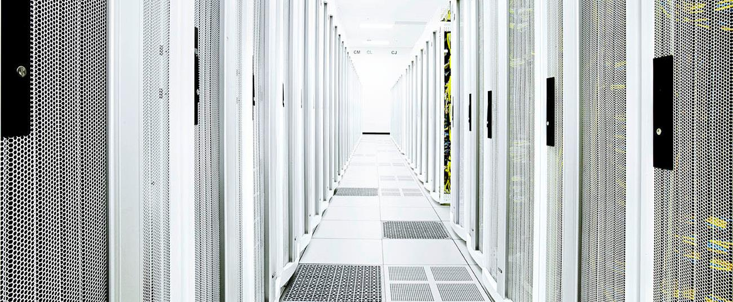
About us
ABB is the industry leader in low-voltage power supply
Proven expertise in data center technology and uninterruptible power supply (UPS)
Factories and service centers in 106 countries
Fast deliveries and responsive, professional local support

Slide 3
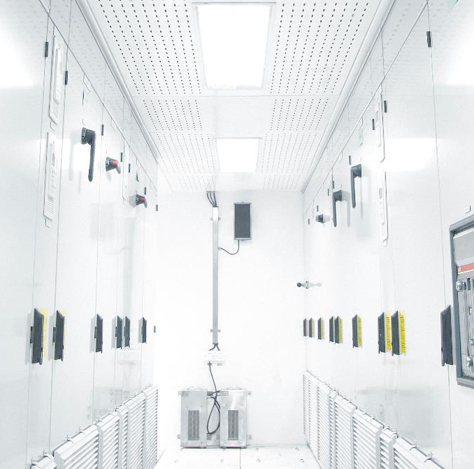
Data center drivers
Data centers need compact, configurable, switchgear and UPS that are easy to buy, install and maintain
Scale – fewer, larger facilities
Diversity of supply – multiple power sources
Intelligence – smart components that communicate and self-supervise
Failing small – failures contained, limiting impact on availability

Slide 4
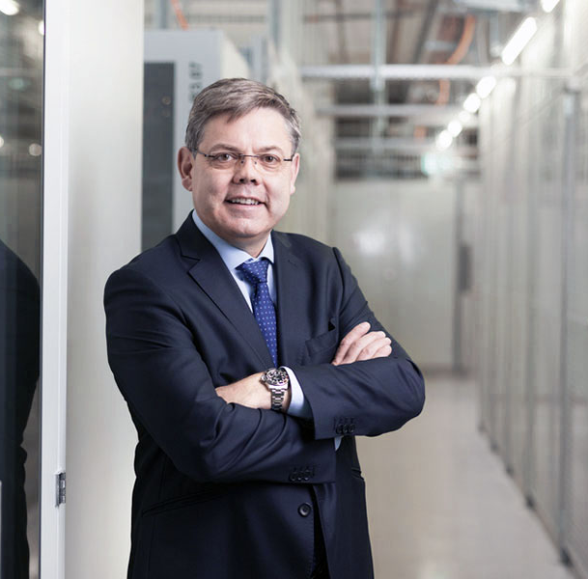
What this means for data center managers
Data center managers need to:
  Address mismatches between IT and power facilities, limiting physical data center space
  Scale power supply more effectively
  Find space savings for additional IT
  Improve up-time and productivity
  Improve energy efficiency
Franz Grüter
CEO
Green Data Center

Slide 5

How ABB responds
We at ABB understand:
  Overcapacity is just as serious a topic for data center operators as uptime
  Data center power supplies need to grow step by step in ways that save space and energy and that make investments predictable
  With fast installation and can-do, responsive support, ABB works hard to deliver to every customer the same high level of quality service
Ralf Heinemeyer
Managing Director
ABB
Electrification Solutions
Business Unit

Slide 6

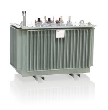

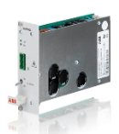
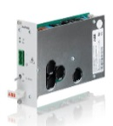
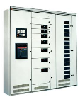



From a holistic perspective
Data Center electrical infrastructure from grid to chip
Utility
MV/ LV XFMR
SWGR
UPS
SWGR
PDU
RPP
Server PSU
Server
10-20 kV AC
400 V AC
400 V AC
400 V AC
380 V DC
12 V DC
Notes:
MNS-Up from ABB is a great example of a modular and scalable solution suited to hospital data centers.
Providing power distribution and uninterruptible power supply in a single, modular, scalable and compact system.
With its flexible design, MNS-Up can be configured in whatever space available whether in an L-shape, U-shape, in a straight line or back to back, without the need for external bus ducts or cables.

Slide 7
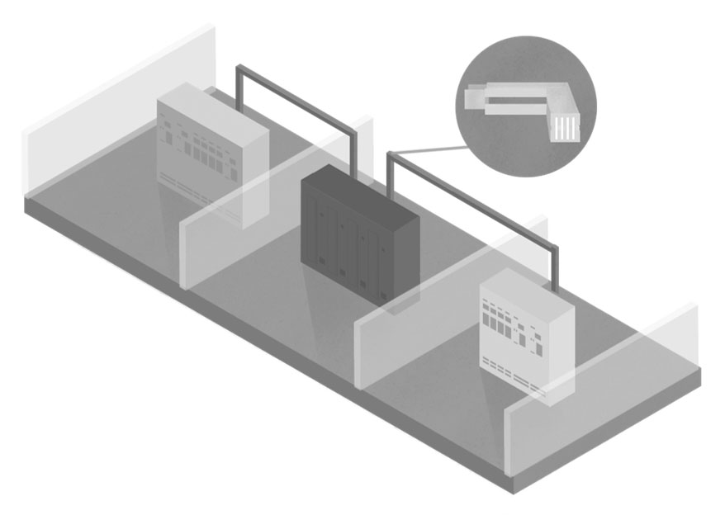
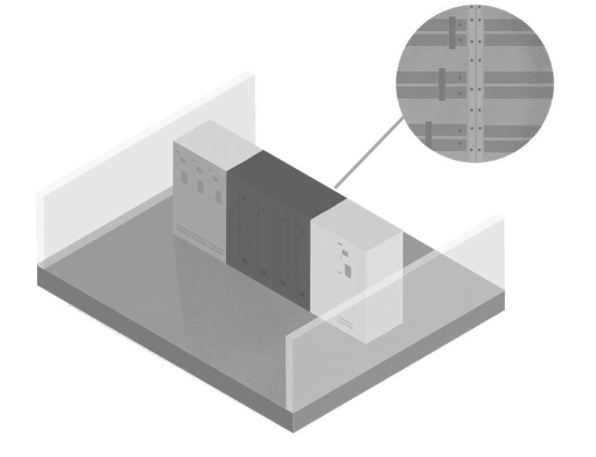
Conventional power supply solutions
Conventional power supply architectures use standalone assemblies for input and output switchgear and UPS.
  Assemblies physically separated
  Well known and established architecture
  Expensive and space-consuming topology
  Extensive power cabling / bus duct/ bus way
  Separate incoming / outgoing breaker sections
  Complex to scale
MNS-Up combines switchgear and UPS into an integrated, fully scalable assembly
Conventional power distribution system layout, with external bus duct or cable connections
MNS-Up: highly integrated layout, with internal bus bar connections

Slide 8
Tangible benefits
Simplification without any compromise in uptime, reliability and safety

Slide 9

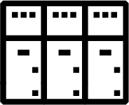

Compact uninterruptible solution with connectivity
Power distribution solution with connectivity to support mission critical power applications
Inside the box
Trusted UPS
Fully independent modular architecture (DPA)
Design-verified switchgear
ABB MNS switchgear with
Emax2 circuit breakers
Energy saving software
ABB Xtra VFI
ABB AbilityTM Mission Critical Power Control System
Notes:
The system comprises ABB‘s Conceptpower DPA 500 uninterruptible power supply (UPS) and ABB‘s MNS switchgear with Emax2 circuit breakers.
The Conceptpower DPA 500 was developed for data centers and other mission-critical facilities that demand zero downtime. Major international stock exchanges and data centers use Conceptpower DPA500, the online transformerless, double-conversion UPS of choice worldwide. MNS-Up’s UPS modules use a decentralized parallel architecture. Each module has its own input switch, bypass, UPS and output switch. Each module’s hardware and software operates self-sufficiently. As a result, each module is isolated from failures anywhere else in the system. Each module can also be removed for maintenance without shutting down the UPS.
MNS-Up combines the proven MNS switchgear with the space-saving new Emax2 circuit breaker. With four decades of technical development and 1.5 million systems installed around the world, MNS is the industry benchmark in operational safety, reliability and quality.
Our new and unique software feature Xtra VFI introduces a secure way to increase the efficiency of UPS systems that do not run on full load from day one. When load is very low compared to UPS system rated power, the over capacity is automatically switched to stand-by mode where modules consume much less power and thus help save energy.

Slide 10
Integrated power supply solution: MNS-Up
All-in-one: highly integrated layout with internal bus bar connections
Notes:
The system comprises ABB‘s Conceptpower DPA 500 uninterruptible power supply (UPS) and ABB‘s MNS switchgear with Emax2 circuit breakers.
The Conceptpower DPA 500 was developed for data centers and other mission-critical facilities that demand zero downtime. Major international stock exchanges and data centers use Conceptpower DPA500, the online transformerless, double-conversion UPS of choice worldwide. MNS-Up’s UPS modules use a decentralized parallel architecture. Each module has its own input switch, bypass, UPS and output switch. Each module’s hardware and software operates self-sufficiently. As a result, each module is isolated from failures anywhere else in the system. Each module can also be removed for maintenance without shutting down the UPS.
MNS-Up combines the proven MNS switchgear with the space-saving new Emax2 circuit breaker. With four decades of technical development and 1.5 million systems installed around the world, MNS is the industry benchmark in operational safety, reliability and quality.
Our new and unique software feature Xtra VFI introduces a secure way to increase the efficiency of UPS systems that do not run on full load from day one. When load is very low compared to UPS system rated power, the over capacity is automatically switched to stand-by mode where modules consume much less power and thus help save energy.

Slide 11
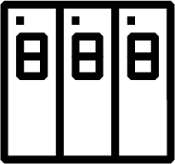
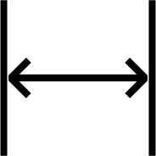
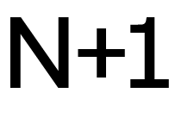
Smart solution
Flexible power
Modular expansion in 100 kW steps
Space saving
Built-in
redundancy
X 6 =
3MW
of
back-up
power
500kW system =
space saving of up to 20%
2MW system =
space saving of more than 30%
5 x 100 kW UPS modules
Notes:
The combination of modules expands in 100 kW steps, not only enabling flexible construction, but flexible power levels. Each frame of the system can support up to five 100 kW UPS modules and up to six frames can be combined to provide 3 MW of back-up power.
This means that even within the restricted space of a hospital basement, MNS-Up can provide the back-up power that a hospital data center needs to keep running and serve patients. Specifically, for a simple 500 kW system, the space saving can be up to 20% and for systems of 2MW or more, the footprint saving is more than 30%.
Flexible, modular, scalable, compact

Slide 12





Customer values
Cost effective: 10% cost savings
in electrical infrastructure
Easy to install: ready
for operation 20% faster
Compact assembly:
Space savings of
more than 30%
Pre-tested at Factory
Ease of service: lower operation & maintenance costs
Local service centers
Notes:
The modular system means that hospital providers only have to pay for the power that they’re using, and they can expand incrementally rather than investing in unnecessary capacity.
MNS-Up is fully factory tested, ensuring high-quality and safe power provision.
Installation is easy with no additional parts or cabling required.
With service centers in 106 countries, healthcare customers can be sure that they receive fast delivery and responsive local service.

Slide 13
Additional information
Technical data
Input voltage | 380/400/415 VAC +/- 15%, 35-70 Hz
Output voltage | 380/400/415 VAC +/- 1%, 50 or 60 Hz
Battery voltage | 400-650 VDC
Power factor | Input: 0.99 | Output: 1.0
Efficiency | Up to 96% in double conversion mode >99% in eco mode
Capacity | 500 kW (5 × 100 kW) per frame
Paralleling capability | Up to 6 frames (6 × 500 kW = 3.0 MW)
Bus bar | Main AC: 4-pole (100% N) up to 6300 A AC out: 3-pole up to 6300 A
IEC 61439-1/ -2 | Low-voltage switchgear and controlgear assemblies Part 1: General rules Part 2: Power switchgear and controlgear assemblies
IEC TR 61641 | Guide for testing under conditions of arcing due to internal fault
IEC 60950-1 | Information Technology Equipment – Safety Part 1: General requirements
IEC 62040-1/ -2/ -3 | Uninterruptible Power Systems (UPS) Part 1: General and safety requirements for UPS Part 2: Electromagnetic compatibility (EMC) requirements Part 3: Method of specifying the performance and test requirements

