Slide 1
ABB in data centers
Intelligent data needs intelligent power

Slide 2
How to use this presentation
This presentation consists of a slide deck which can be customized and presented to an external audience. Please include the slides that are relevant to your customer, while removing the slides that are not.
Slides 22-48 are product slides.
After customizing your presentation, please remove this slide.

Slide 3
Contents
Data centers
Market Drivers
ABB data center capability
Data center power flow
ABB packaging solutions
ABB packaging solutions inside
ABB medium voltage switchgear
ABB digital switchgear
ABB smart solutions
ABB low voltage switchgear
Transient Voltage Recovery Trafo (TVRT)
UPS
Grid scale power storage and power quality

Slide 4
Market drivers for the data center market

Slide 5
Drivers behind today’s data center
Smarter, larger, and more secure
Unprecedented scale
Wireless
Latency
20B connected devices by 2025 per Gartner, 50B per Cisco
3000 cell sites in New York City today vs 100K in 2025
Will drive edge computing cells located at point of operation
Security
Flexibility
Visibility
Target’s security breach was enabled through HVAC communication“back door” in 2012
Infrastructure must scale like IT loads
Infrastructure needs to follow “fail small” paradigm

Slide 6
Data center customers
Reliable power distribution
Reliable power supply
100% uptime

Slide 7
ABB data center capability

Slide 8
Who we are
Introducing ABB
1.
—
A trusted brand and a global partner with local expertise.
3.
—
An innovator constantly inventing and investing in new technologies, 7 R&D centers and over 8,000 technologists.
2.
—
A provider of leading edge
power and productivity solutions.
4.
—
A leader in the fourth industrial revolution with over 50 years of experience in software and connectivity.

Slide 9
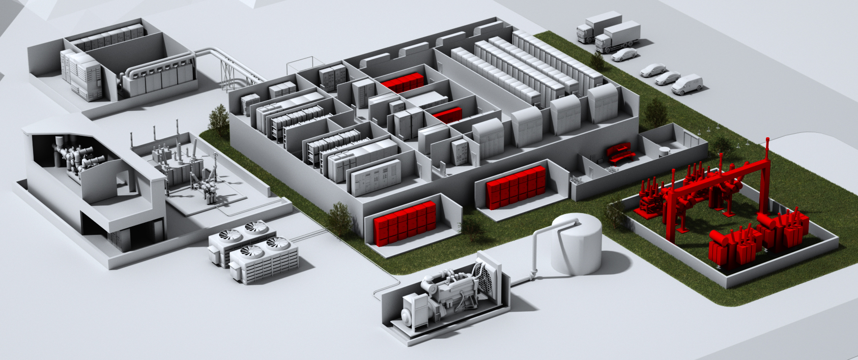
Supporting the global data center industry
A full range of products, solutions and services
ABB in summary
ABB in the data center industry
$1.4 billion
invested in R&D in 2015
490 TWh energy saved
by ABB drives
$36.4 billion
orders in 2015
Smart grid and micro grids
Motors and drives
Data center infrastructure management
Complete power train
Emergency power
Grid connections
Service, maintenance, repairs, upgrades
135,000
employees
5,600 training sessions
during global safety week
50% of revenues
related to energy efficiency and renewable energy

Slide 10
Data center power flow

Slide 11
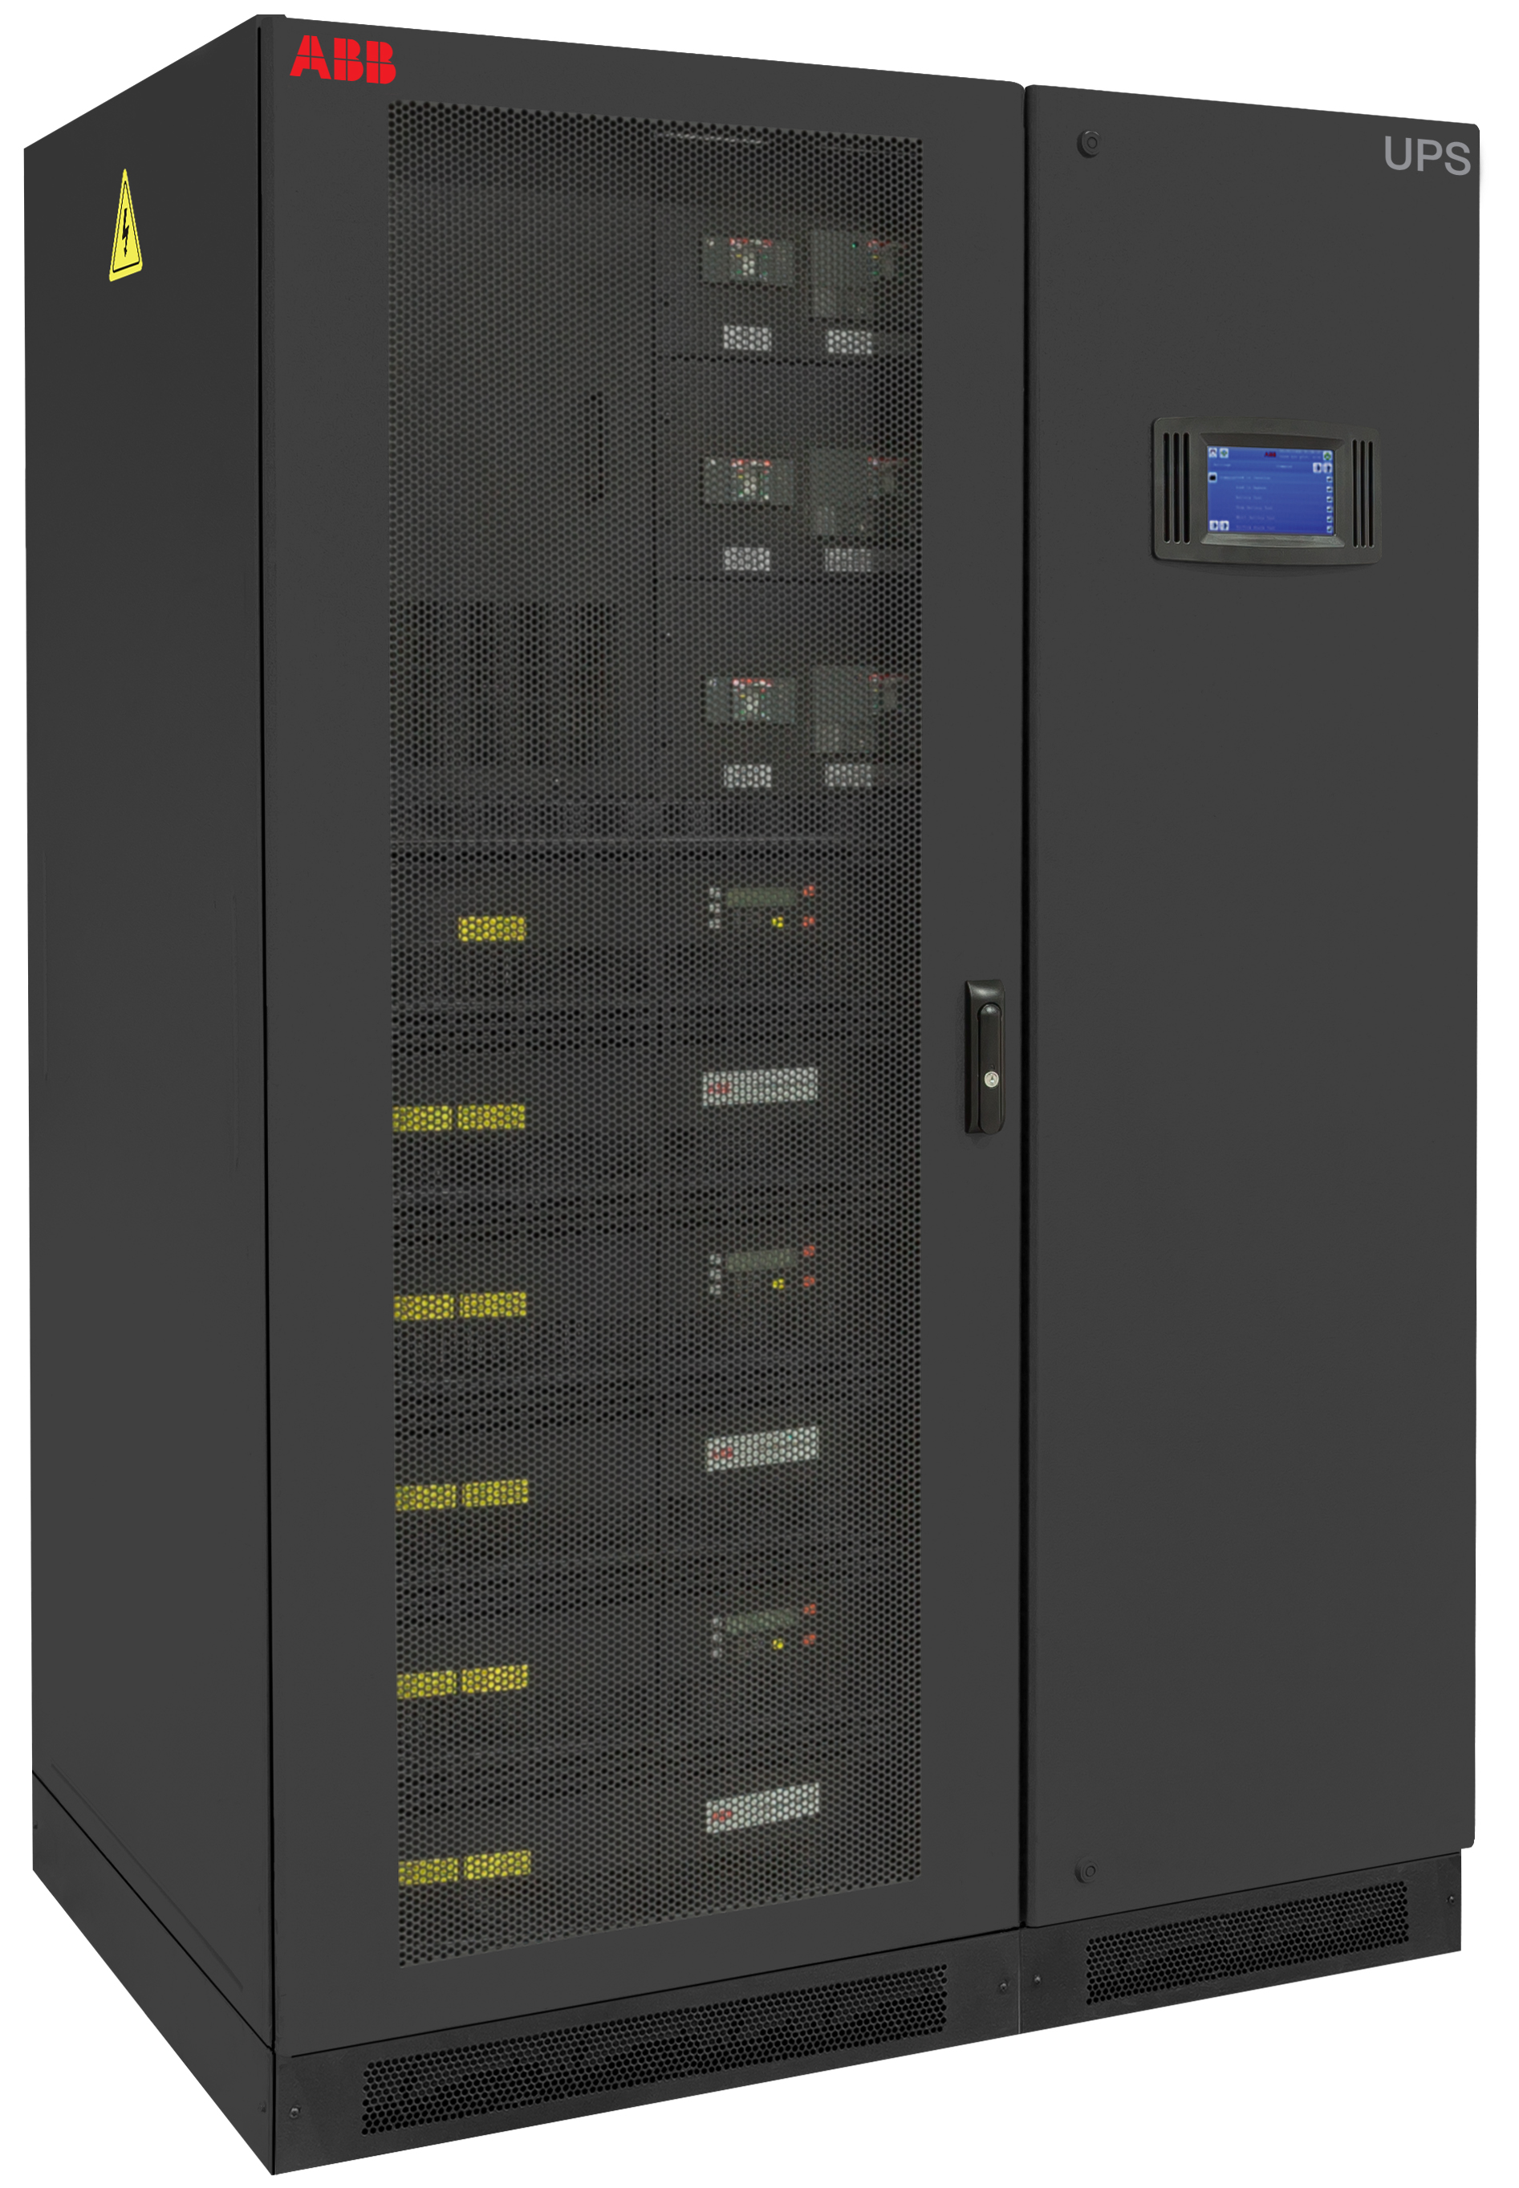
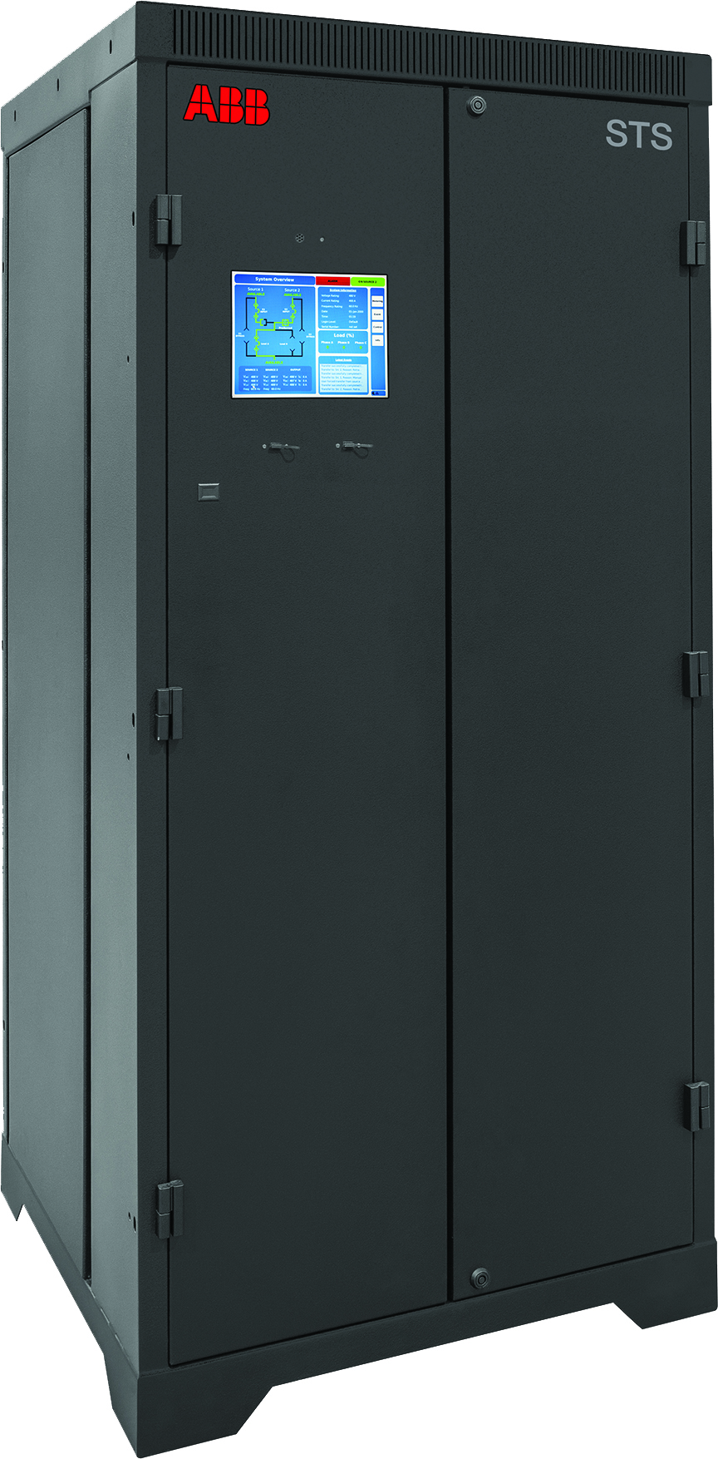
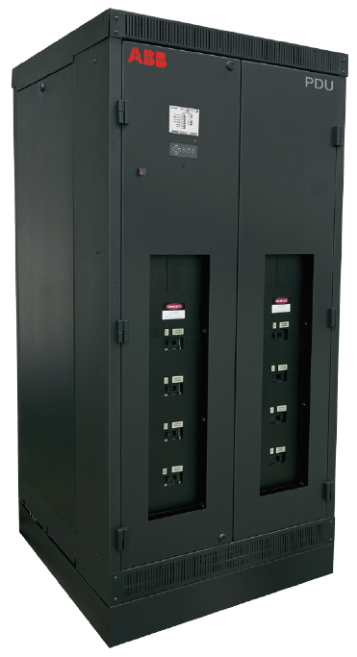
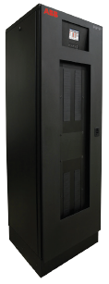
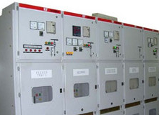
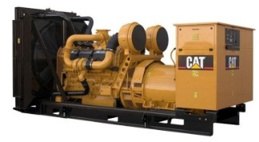
Mission critical power chain
Utility Source A
Substation A
Switchgear A + ATS
UPS-A
Critical load
A - Feed
Static Switch (STS)
Power Distribution Unit (PDU)
Remote Power Panel (RPP)
Battery
Generator
Static Switch (STS)
Power Distribution Unit (PDU)
Remote Power Panel (RPP)
B - Feed
Utility Source B
Substation B
Switchgear B + ATS
UPS-B

Slide 12
Mission critical power chain
What is inside the data center box
Data centers
MV switchgear
Paralleling switchgear
UPS systems
Transmission level
Sub-transmission level
Mobile substation
MV distribution transformers
LV distribution
UPS based - LV
PDU based – LV
Bus duct
Notes:
Today we are going to discuss an issue that is seen in the field mainly on distribution transformers and that is switching transients in transformers. From what we know about datacenter capex, 70% is Electrical and about 35% of that is transformer content. So this phenomenon has the opportunity of affecting/reaching many aspects of the topography of the datacenter.
As transformer content continues to grow with recent trends in renewables (step up units, including collector transformers and zig-zag grounding transformers). This issue has the opportunity of affecting more equipment than it does today.
Regardless on how long you plan to run your datacenter, your products need to have the correct technology and protection affixed. The upside to this is that ABB has the breadth of products and technologies to protect your investments.

Slide 13
ABB packaging solutions

Slide 14
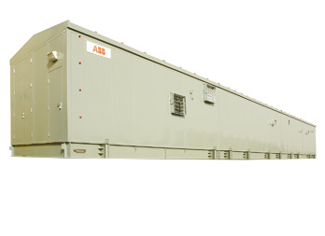
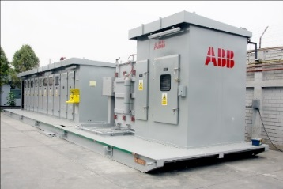
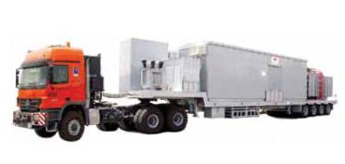
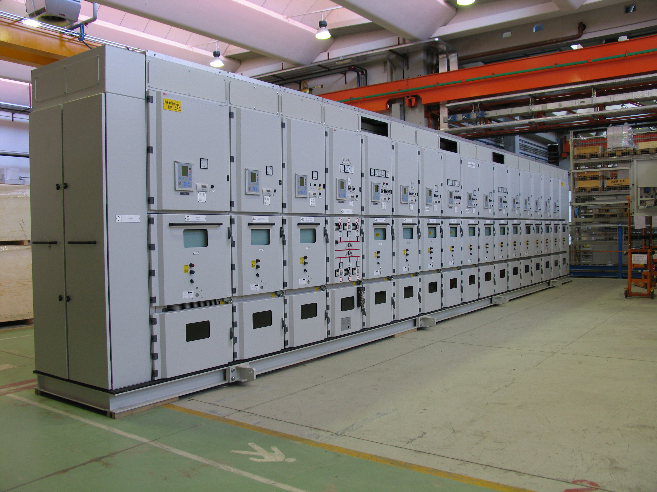
Electrification solutions for data centers
ABB portfolio includes different solutions to connect power to the data center. Main solutions can be divided into 6 categories:
eHouse - Metal enclosed and insulated building with distribution equipment , controls, and environmental equipment installed and coordinated in a factory setting.
Outdoor skid - Power distribution components (MV, transformer, &LV) installed and integrated on a steel frame for installation outdoors but not environmentally controlled.
Compact Secondary Substation (CSS) - Prefabricated substation which includes a LV Switchboard, transformer, and MV switchgear installed in a metal enclosure.
Mobile substation - Perfect solution, whenever industries need to provide interim grid connections and temporary power supplies. Equipment are mounted on a trailer or railcar.
Indoor skid - Prefabricated substation which includes indoor rated LV Switchboard, transformer, and MV switchgear for installation in a building.
Product packaging - Supply all electrical components loose with integration by electrical contractor and ABB Factories (MV switchgear, transformers, battery system, LV switchgear, Protection and Control packages (COM600 and ZENON).
Package #1 – eHouse
Package #2 – Outdoor skid
medium voltage connection
Package #3 – CSS
Package #4 –Mobile substation
Package #5 – Indoor skid
Package #6 Product packaging

Slide 15
eHouse overview
eHouse project scope and integration capability
Equipment installation
UPS & DC battery systems
Bus ducts
6.6kV air-insulated switchgear
Fire and gas systems
33 kV gas-insulated switchgear
HVAC
11 kV air-insulated switchgear
Low voltage drives
Medium voltage drives
Low voltage switchgear and MCC
Power management system

Slide 16
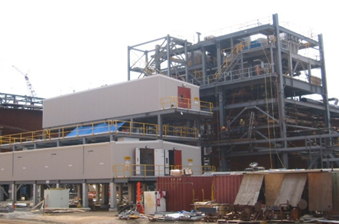
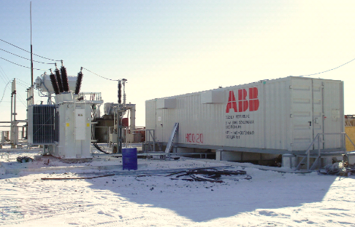
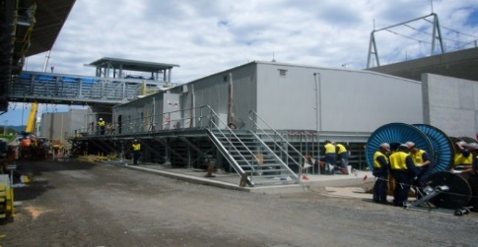
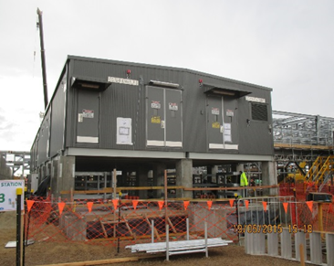
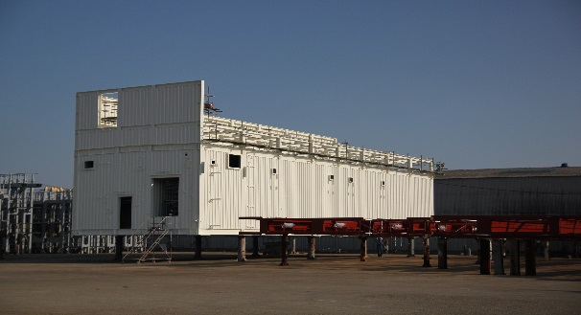
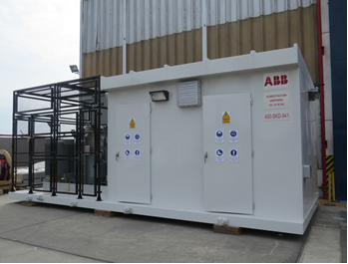
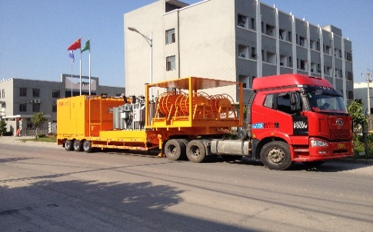
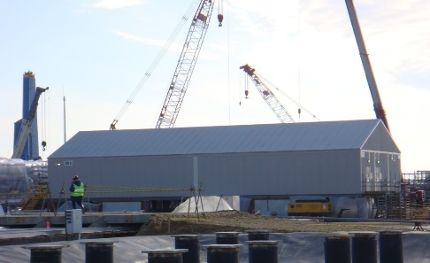
eHouse overview
How they look
Overview
The eHouse portfolio is segregated into the following areas:
Productized solution
Modularized design
Single large structures
Skid-mounted modules
Mobile substation

Slide 17
Product packaging overview
Project scope and integration capability
Equipment installation
UPS & DC battery systems
Bus ducts
6.6kV air-insulated switchgear
Fire and gas systems
33 kV gas-insulated switchgear
HVAC
11 kV air-insulated switchgear
Low voltage drives
Medium voltage drives
Low voltage switchgear and MCC
Power management system

Slide 18
Product packaging overview
What does it look like?
ABB system package scope
11 - 36kV switchboards
Cast resin transformers
UPS input switchboards
PDUs and RPPs
Chiller substations
Mechanical switchboards
Static transfer switches
Motor control centers
VFDs (variable frequency drives)
Electrical network monitoring system
*we can offer NON-ABB content if needed

Slide 19
Packaging solutions
What is inside?

Slide 20
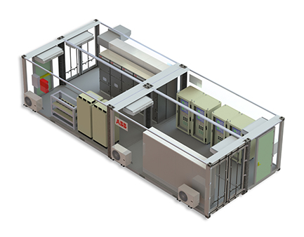
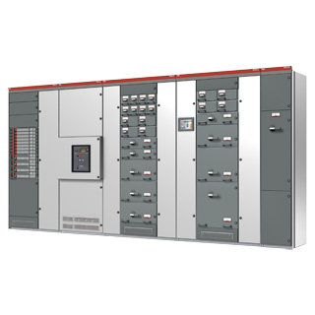
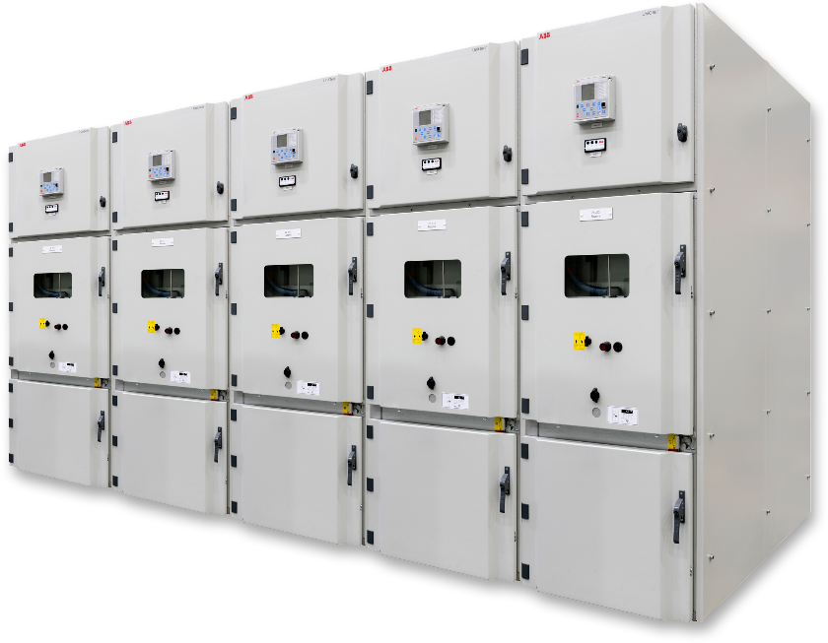
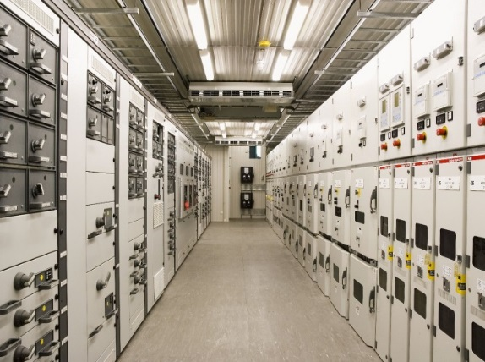
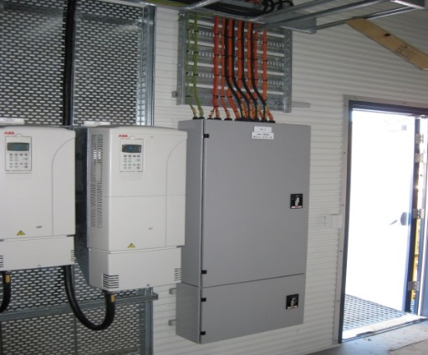
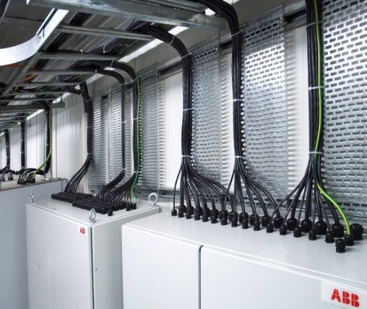
Packaging overview
Subelements
Overview
Typical electrical equipment located in the eHouse as follows:
Medium voltage switchgear
Low voltage switchgear
Battery back up equipment
Variable speed drives
Power Management System (eSI)
Free issue client panels

Slide 21
The ABB difference for data centers
Industrial design provides an edge
Product and system reliability
Robust ABB equipment prevents problems from occurring
Integration expertise in designing for what could go wrong
Greener, more efficient data centers
Expertise in renewables and energy integration
Safety in design and operation
Critical power for critical business
UPS solutions at LV and MV levels
True modular UPS benefits now available in megawatt power range

Slide 22
ABB MV switchgear

Slide 23
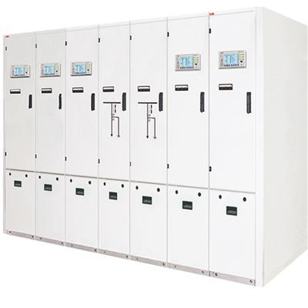
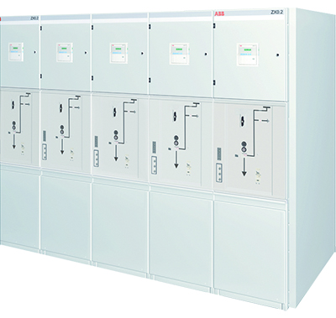
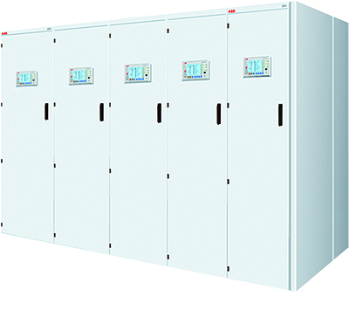
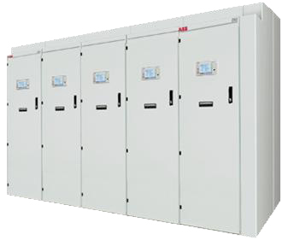
ZX series
MV gas-insulated switchgear portfolio
Single busbar | Single busbar | Single busbar | Single busbar | Double busbar
Up to | Up to | Up to | Up to | Up to
25 kA | 31.5 kA | 31.5 kA | 40 kA | 40 kA
1250 A | 2500 A | 2500 A | 2500 A* | 2500 A*
ZX0 | ZX0.2 | ZX1.2 | ZX2 | ZX2

Slide 24
ZX series
MV gas-insulated switchgear portfolio
Medium voltage switchgear for primary distribution up to 42 kV suitable for indoor installations. Panels are available as a single busbar, double busbar, back-to-back or double level solution.
Product range
Rated voltage up to 42 kV; rated feeder current up to 2500 A
Rated short time current up to 40 kA/3s
Key benefits
Partitioned function compartments lead to maximum safety
High voltage section totally independent of environmental influences
No effect of site altitude on dielectric strength
Independence of the environment makes for extremely long system life
Longer life than other system types
Variety of demanding applications
Key features
Vacuum circuit breaker
CMT welded stainless steel enclosures for modular design
Panels coupled by plug-in busbar connectors
No SF₆ gas work on site
View ports to check switch positions
Highly customized versions available
Switchgear can be back to wall installed
Available in digital version

Slide 25
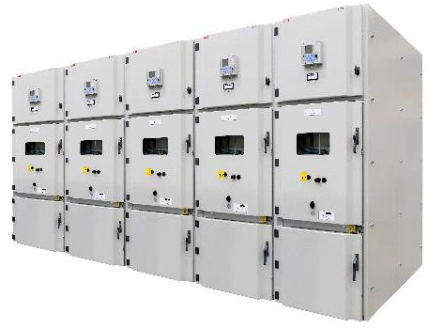
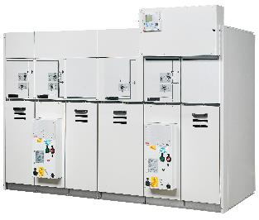
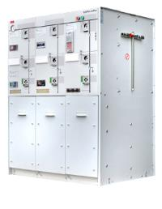
Introduction to MV switchgear - general
Primary and secondary distribution
Two main applications
Example: Power utility network
Primary distribution switchgear
Closer to HV transformer
Up to 4000 A and 63 kA
Mainly circuit breakers
Mainly project-specific
Secondary distribution switchgear
Closer to LV transformer
Up to 1250 A and 25 kA
CB, LBS and fuse
Often more standardized
P SWG
S SWG
Substation transformer
Distribution transformer
HV
MV
MV
LV
MV
LV
HV
MV
MV
LV
MV
LV

Slide 26
UniGear
MV air-insulated switchgear portfolio
Key benefits
Manufactured and supported on six continents
Approved for use in special applications such as marine, seismic and nuclear
Variety of demanding applications
Key features
Standards: IEC, CSA, GOST, GB/DL
Design: LSC-2B, PM
Internal arc class: A FLR
Highly customized versions available
Switchgear can be back to wall installed
Available in Digital version
 | UniGear product family Physical connection possible
UniGear ZS1 | Up to 50 kA / 4000 A |  |  |  |  |  | Widest coverage of technical requirements
UniGear 550 | Up to 31.5 kA / 1250 A |  |  |  |  |  | Smallest switchgear footprint
UniGear MCC | Up to 50 kA / 400 A |  |  |  |  |  | Contractor panel to feed electrical motors
UniGear 500R | Up to 31.5 kA / 2000 A |  |  |  |  |  | Very small footprint, removable circuit breaker
 |  | 12 kV |  | 17 kV |  | 24 kV

Slide 27
UniSec
MV air-insulated switchgear portfolio
Ratings
Rated voltage | Up to 24 kV
Rated current | Up to 1250 A
Rated short-time withstand current & IAC | Up to 25 kA @ 12-17 kV Up to 21 kA @ 24 kV
Rated frequency | 50 Hz / 60 Hz
Description
UniSec air-insulated switchgear is based on a highly flexible, modular concept with fewer parts and standardized solutions that can be readily configured to meet the specific needs of each application.
Key features
Designed and tested according to latest IEC 62271-200, GOST (RU) & GB (CN) standards
Internal arc proof IAC AF/AFL/AFLR with different gas exhausting variants
Loss of Service Continuity LSC2b/LSC21/LSC2 solutions available
Partition Metallic PM Classification
Load break switch, vacuum contactor, vacuum and SF6 circuit breakers
Anti-seismic and marine version available
Safe conditions for all applications

Slide 28
ABB MV digital switchgear

Slide 29
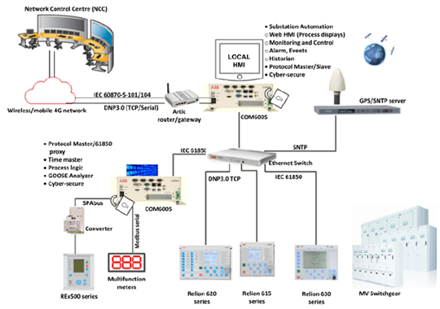
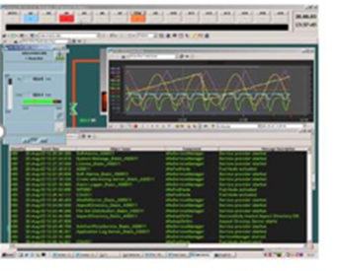
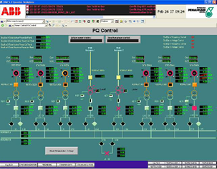
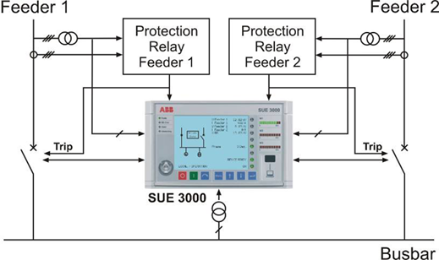
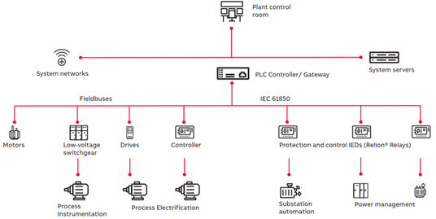
Digital Solution Center
Scalable digital solution offering
Level 1 – special applications
Level 2 – electrical control system
Level 3* - power management system
Pre-engineered product package, communication systems, customized Grid Automation, High speed transfer system (HSTS), Automatic transfer scheme (ATS), Low voltage transfer device (LVTD)
COM600/RTU based station HMI and gateway , scalable electrical control system (ECS) for MV/LV network, compact power management system with PML630 (cPMS)
Complete electrical control system (ECS) for MV/LV network, full scale power management system with Relion® and 800 xA
Available from all regional digital solution centers
Currently only available from SG digital solution center

Slide 30
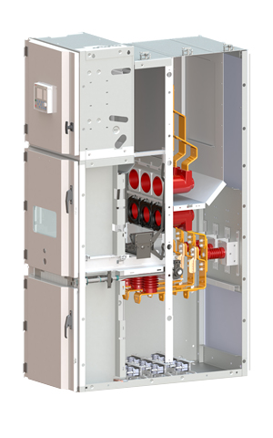
Sensors permit space savings
Safety
Low energy analog output eliminates hazard associated with open CTsecondary
Fewer wires to install makes switchgear easier to maintain
Solution is continuously self-supervising with maximized error detection
Savings
Form factor of voltage sensors = switchgear space savings
Size of current & voltage sensors = weight savings
Broad application range of the sensors = inventory savings
Significant energy savings during operation
Savings on total cost of ownership
Speed
Concept allows for compression of time from order to delivery
Late customization possible
Simplicity
Fewer wires to install, commission & maintain
Fewer parts to fail leads to increased reliability
Sustainability
Universal standards (IEC61850) enable future system expansion
Handle future load changes without mechanical reconfiguration of system
Lower lifetime environmental impact
Voltage
sensors
Current
sensors
MV sensors | Standards
Current sensors | IEC 60044-8 (2002) IEC 61869-10 (NEW) IEEE PSIM Working Group CSA Available Electronic current transformers
Voltage sensors | IEC 60044-7 (1999) IEC 61869-11 (NEW) IEEE PSIM Working Group CSA Available Electronic voltage transformers

Slide 31
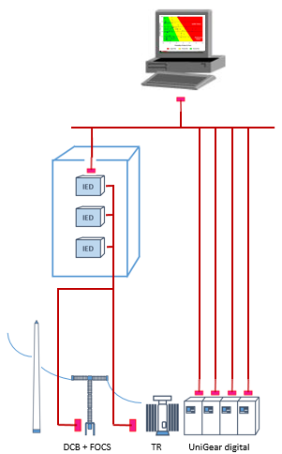
Conventional compared to Digital
Conventional substation (example MV)
Digital substation (example MV)
Primary components stand alone
Small foot-print integration
80% copper reduction
40% shorter installation time
50% less space required
Operational cost reduction
50% outage time reduction
Station local or remote HMI with asset management
Fiber optic communication buses

Slide 32
Smart solutions

Slide 33
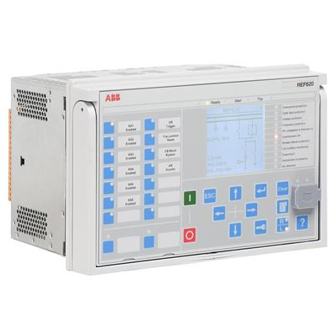
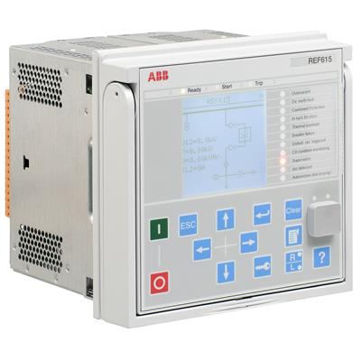
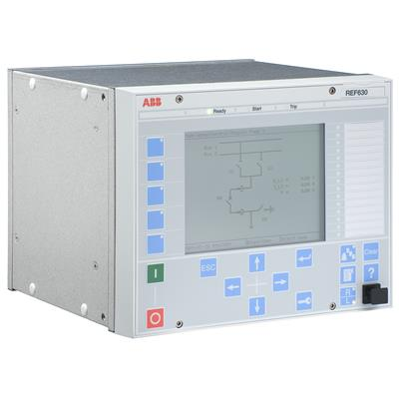
State-of-the-art protection technology
Relion® in UniGear
Native IEC 61850 ed.1 or ed.2 support
611 series version 2.0
615 series version 5.0 FP1
620 series version 2.0 FP1
630 series version 1.3
Feeder, Motor, Transformer, Busbar differential, Line differential, Generator, Capacitor and Voltage protections
Arc protection embedded (3 channels) for 615 & 620 series
Rogowski coil and voltage divider measurement support for 615 & 620 series
IEC 61850 9-2, SMV support in 615 & 620 series
HSR or PRP full redundancy
UG Digital support

Slide 34
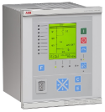
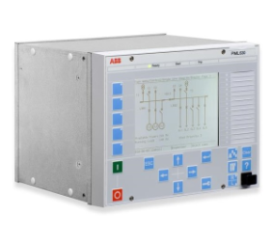
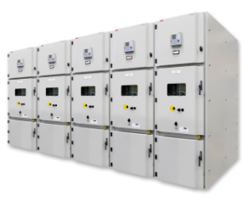
Load-shedding controller PML630
Protection against power outages and black-outs in industrial power systems; black-outs cause huge commercial losses
Dedicated load-shedding device based on the Relion® 630 series with inherited and specific features
Functionality based on ABB’s System 800xA – Power Management System
Combines power management functionality on protection and control relay platform
Uses benefits of IEC 61850 to deliver high performance and reliability
Legacy RE_500 relays (non–IEC 61850)
COM600
PML630
630, 620, 615 series relays
UniGear ZS1

Slide 35
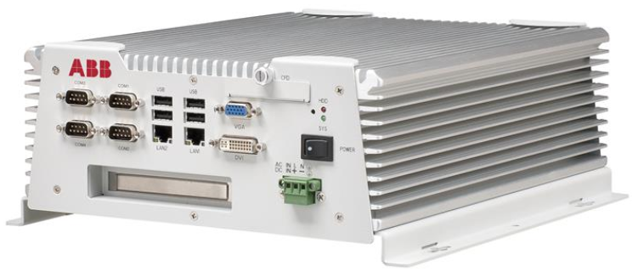
UniGear with Substation Automation
Distribution automation controller COM600
All-in-one: user interface solution, communication gateway functionality and automation platform
Ready for One point connection
Cost effective
Only one stop buy
Integration in low voltage compartment
User friendly
Efficient engineering and maintenance
Open solution, exactly what you need
Focused on Applications (e.g. load shedding interface)
Seamless Connectivity
Future proof concept

Slide 36
ABB LV switchgear

Slide 37
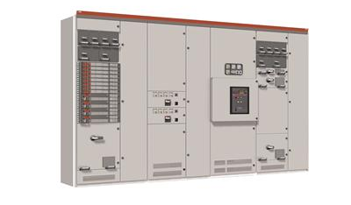
LV switchgear
Rating | Value
Electrical ratings
Current | Up to 6300 A ac
Voltage | Up to 690 V ac
Frequency | 50 Hz – 60 Hz
Motor starter sizes | Up to 355 kW
Starter coordination | Type 2, IEC 60947-4-1
Protection characteristics
Insulation coltage | 1000 V ac
Short circuit current | 30 kA – 100 kA (1sec)
Protection class | IP 20 – IP 54
Internal separation | Up to Form 4
Vibration | 0.7 g / 100 Hz
Shock | 15 g
Standards and approvals
Standards | IEC 61439-1and -2
Arc-resistance | IEC 61641 Criteria 1- 7
Conventional systems
MNS 3.0
MNS Rear
MNS-Up
Intelligent systems
MNS iS
MNS Digital (MNS 3.0, MNS Rear)
MNS-Up

Slide 38
Integrated power supply solution: MNS-Up
MNS-Up power center with integrated UPS
Power cable front connection that allows wall standing installation (based on MNS 3.0)
Modularity to extend the UPS power according the data center development
UPS (DPA-500) embedded in the power center in order to:
Eliminate power connections between switchgear and UPS and relevant cost; no cables / bus duct
Reduce on site activities and cost with integrate test before shipment
Reduce overall footprint removing upstream / downstream breakers to protect UPS – Power center connection
Electric rating
Same as MNS 3.0
UPS rating – DPA500
Input / output voltage | 380/400/415 VAC +/- 15%, 35-70 Hz
Battery voltage | 400-650 VDC
Efficiency | up to 96% in double conversion mode; >99% in eco mode
Capacity | 500 kW (5x100 kW) per frame
Paralleling capability | Up to 6 frames (6 x 500 kW = 3.0 MW)

Slide 39
Critical power for critical business
Evolution in LV distribution – Emax2
Evolution of the circuit breaker to a power manager with the ability to measure & manage loads dynamically.
Emax2 offers the most compact footprint to power ratio ever seen in the LV distribution switchgear world.
A native Network Analyzer analyzes the quality of energy consumed by the installation in terms of harmonic content, average value and long or short term changes in voltage.
The Emax2 range offers industry leading energy efficiency with lower losses per unit across the range.
Multiple communications protocols makes automation integration seamless i.e. into MNS Digital or directly into site electrical and management solutions

Slide 40
Transient Voltage Recovery Trafo (TVRT)
Dry type transformer

Slide 41
Transformer protection, general overview ABB Ability™
Plan for the unexpected - transient protection in transformers
Data center reliability
How is your transformer protected?
What’s the risk?
Involves frequent testing of equipment
Requires switching at primary voltages
Produces switching transients
Most susceptible when:
Short distance between circuit breaker and transformer
Lower BIL rated transformers
Restrikes & re-ignitions present
No protection
Most susceptible to transformer failure due to transients
Provides great protection against transients; does not protect for harmonic residence
Snubber circuits
Increased BIL but susceptible in certain system configurations
Does not limit over voltages or protect from resonance
“Hardened” liquid filled
Only solution that provides COMPLETE protection against any and all transients;
ABB TVRT® solution
Lower risk, higher reliability

Slide 42
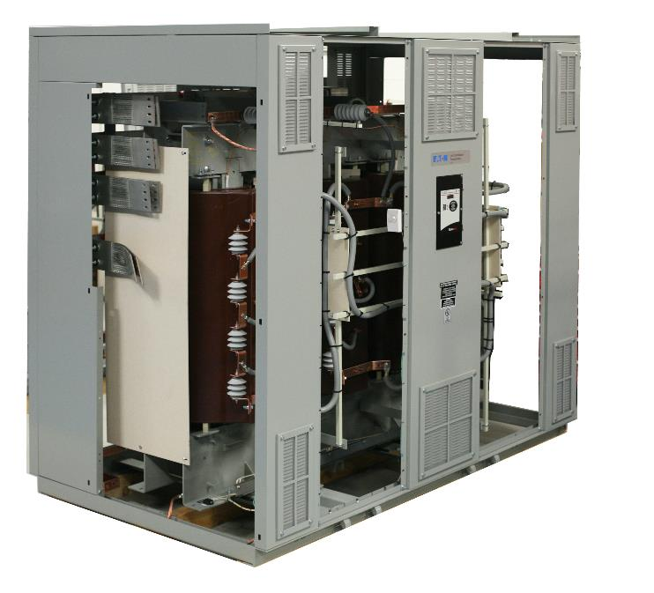
Peace of mind for switching environments
Peace of mind for switching environments
Transformer designed to specifically resist any and all fast transients produced during switching
Works in any system and for any switching environment; does not require a system study
Solution is completely dry, does not increase transformer dimensions, lower cost, and more effective than other solutions
Available for entire VCC and RESIBLOC dry-type transformer scope offering
Target applications: locations with frequent switching (> once/month) or intensive commissioning processes
Examples: heavy or large industry, multi-pulse rectifier duty, data centers, traction infrastructure, solar generation, etc.

Slide 43
UPS

Slide 44
Data centers and UPSs
TCO – technology drivers
Technology drivers - history
UPS efficiency – Eco-mode
IGBT based inverter and rectifier
Reduced switching and filter losses
Online efficiency > 96%
Efficiency optimized at typical load level
Eco-mode efficiency up 99%
Eco-mode
98% - 99%
Transformer-less UPS 2nd generation
96% - 97%
Transformer-less UPS 1st generation
90% - 95%
IGBT UPS
85% - 90%
Transistor UPS
80% - 85%
SCR UPS
75% - 80%

Slide 45
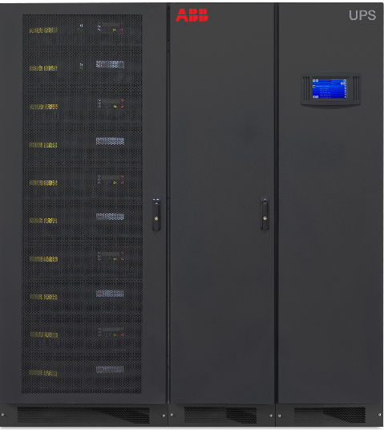
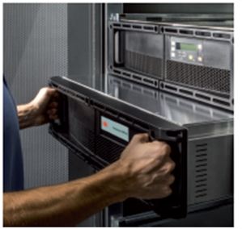
Data centers and UPSs
Modular UPS – decentralized design
Modular decentralized UPS
Vertically Scalable – 100kW to 500kW (or 400kW N+1)
Horizontal Scalable – up to 6 Cabinets in parallel – configuration up to 3MW
Online-swap modularity (OSM)
Serviceability – low MTTR
Flexibility – easily scalable to fit current and future needs
500kW unit (5 x 100kW)
Online-swap modularity (OSM)

Slide 46
Grid scale storage and power quality

Slide 47
Challenges of the future power grid
Long-term drivers for energy storage
Electricity usage on the rise
Electrification of everything – moving towards electricity as the primary source of power
Economic and population growth will lead to increasing demand for power
Coal plant retirements
Reducing baseload power capacity
Limited resources for ancillary services on the utility grid
Growth in renewables
Governments and industry moving towards solar and wind
Intermittent generation sources can reduce reliability on the electrical grid
Electrification of transportation
More users of EVs can increase peak loads placing more strain on the electrical grid
Increase in high speed rail
Proliferation of Smart Grid technology
Bi-directional flow of power requires additional coordination between power supply and demand
Tax and regulatory incentives
Electrification of everything – moving towards electricity as the primary source of power
Economic and population growth will lead to increasing demand for power

Slide 48
Power quality solutions
LV STATCOMs
Battery energy storage
Voltage Regulation
Power Factor Correction
Dynamic Reactive Power Compensation
Solutions from 100kVAr to 50 MVAr interconnect to any network
Added system stability and flexibility
Power quality improvements
Small to Large system sizing

