Slide 1
Enhanced 400-600A General & Heavy Duty Safety Switch
September 2023
U.S. Customer Presentation

Slide 2
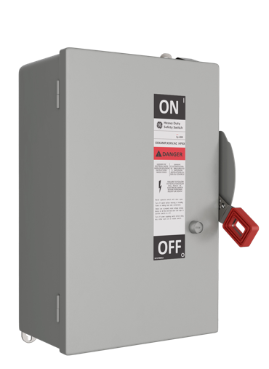
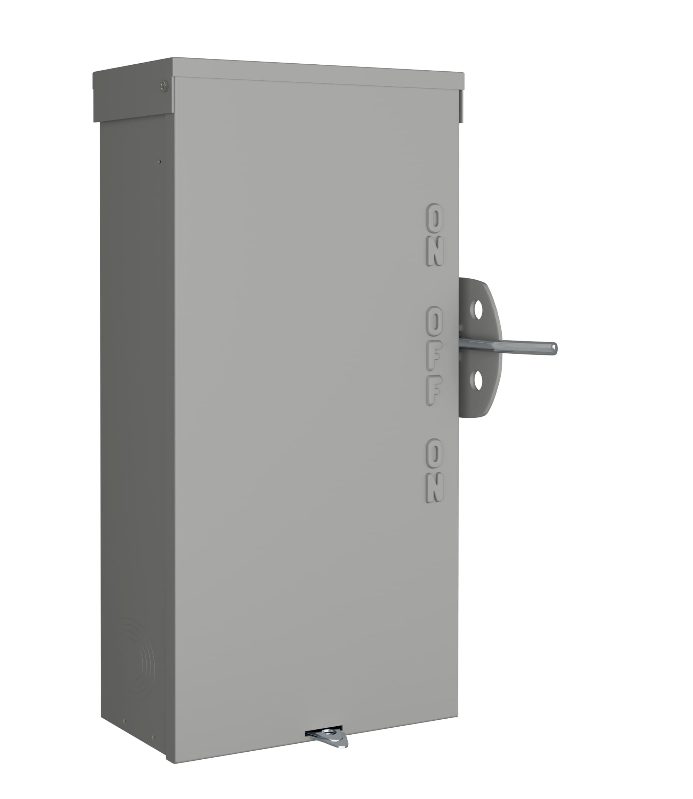
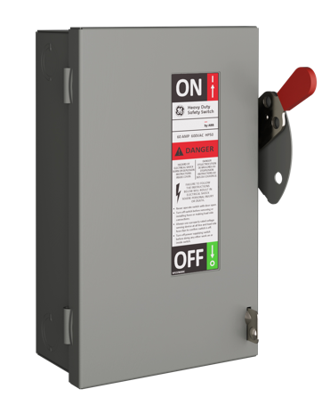
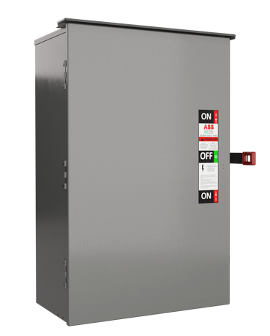
Make the safer choice with Spec-Setter
Whatever the application, ABB’s range of Spec-Setter safety switches consistently delivers exceptional safety and performance.
General duty switches Residential and light commercial use
Heavy duty switches Commercial and industrial use
Double throw switches For applications switching one load between two sources
Emergency transfer switches For connection to emergency generator
Built on decades of expertise, you can count on Spec-Setter to get the job done right.
Notes:
We’ve got options for indoor and rugged outdoor enclosures.
All Spec-Setter safety switches are UL listed and include options for rugged outdoor enclosures (Type 3R and/or Type 4/4X) specially designed to withstand the elements.

Slide 3
Why are we Launching this Product Line?
400-600A

Slide 4
Enhanced Features?

Slide 5
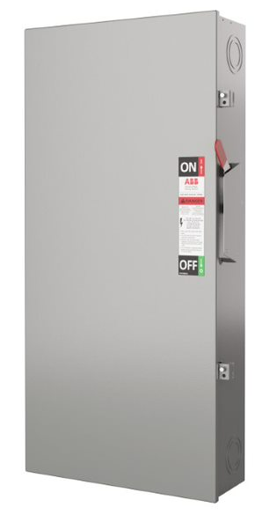
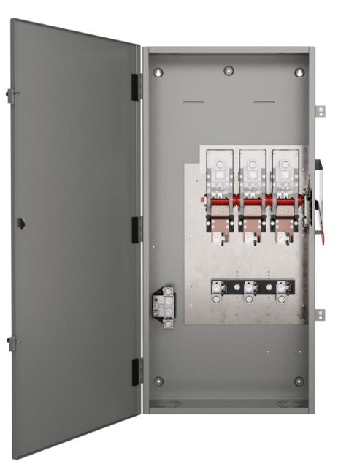
General Duty
400-600A
New Features
New Enclosure Sizes
New Mounting Bracket
Extended New Clear Lines Shields
Extended Factory Installed Neutral Kits
New Drop Handle
Add Type 3R Enclosure for Non-Fusible
Ratings
NEMA Type 1 indoor and Type 3R outdoor enclosures
Fusible and Non-fusible
Maximum voltage: 240 V AC, 250 V DC
200 k AIC (400 to 600 A models)
Easy Installation with Wall Mounting Bracket
Visible confirmation of plated
blade contact positions.
Drop Handle to Prevent Shipping Damage
Factory Installed Neutral Kits
Notes:
This material has a new enclosure, so there is a new enclosure size
A new mounting brackets that will be discussed later on this presentation
Clear Line Shield is now available for 400-600A. In the past, the clear line shield was only available in 30-200A General Duty Switches.
The factory-installed Neutral kits are now available in 400-600A. In the past, this feature was only available in 30-200A.
The drop handle is now a new feature. While shipping, the handle will be flush with the enclosure. This decreases the probability of the handle being damaged during shipping.

Slide 6
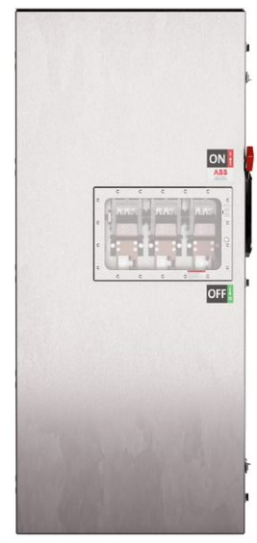
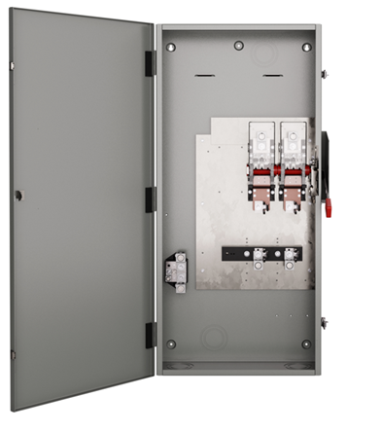
Heavy Duty
400-600A
New Features
New Enclosures Size
New Mounting Bracket
Extended Optional Viewing Window
New Line Shield
New Drop Handle
New Class T Fuse Kits
New NEMA 3R Dust Tight Enclosure with Drip Holes ( D)
Rating
NEMA Type 1 Indoor, 3R Outdoor, Stainless Steel (304 & 316) and 5/12 dust tight enclosures.
Fusible and Non-fusible
Maximum voltage: 240 V AC & 600V AC
200k AIC (30 to 600A models)
Easy Installation with Wall Mounting Bracket
Visible confirmation of plated
blade contact positions.
Clear view of contacts and fuses for instant verification
Drop Handle to Prevent Shipping Damage
Factory Installed Neutral Kits
Notes:
The new heavy-duty safety switches come in a new enclosure, so there is a new enclosure size
The new mounting bracket will be discussed later on in this presentation
We have extended the viewing window option for 400-600A. Currently, the viewing window option is only available in 30-200A.
30-200A Viewing Window Size is 13x9
400-600 Viewing Window Size is 13x5
The new design has a new line shield kit. Please refer to slide 9 for the new catalog number.
The drop handle is now a new feature. While shipping, the handle will be flush with the enclosure. This decreases the probability of the handle being damaged during shipping.
The 400-600A Heavy Duty Safety Switches also come with T Class fuse
Class T fuse has a lower let-through current compared to class J and R fuses. This is beneficial in non-motor applications such as modular metering and high-rise construction, where there's a large service, but the current needs to be limited for an individual meter.
We are also introducing a new enclosure type ( D). This is a NEMA 3R enclosure with a 5/12 gasket with drip holes.
-Verify the size of the viewing window of the
-Viewing Window is not extended 5/12 Enclosures
13x9 on the 200A viewing window…..13x5 on the new 400/600A viewing window
Class T fuse has lower let through current compared to class J and R fuses. This is beneficial in non-motor applications such as modular metering and high rise construction where the there's a large service but the current needs to be limited for an individual meter.
circuit rating

Slide 7
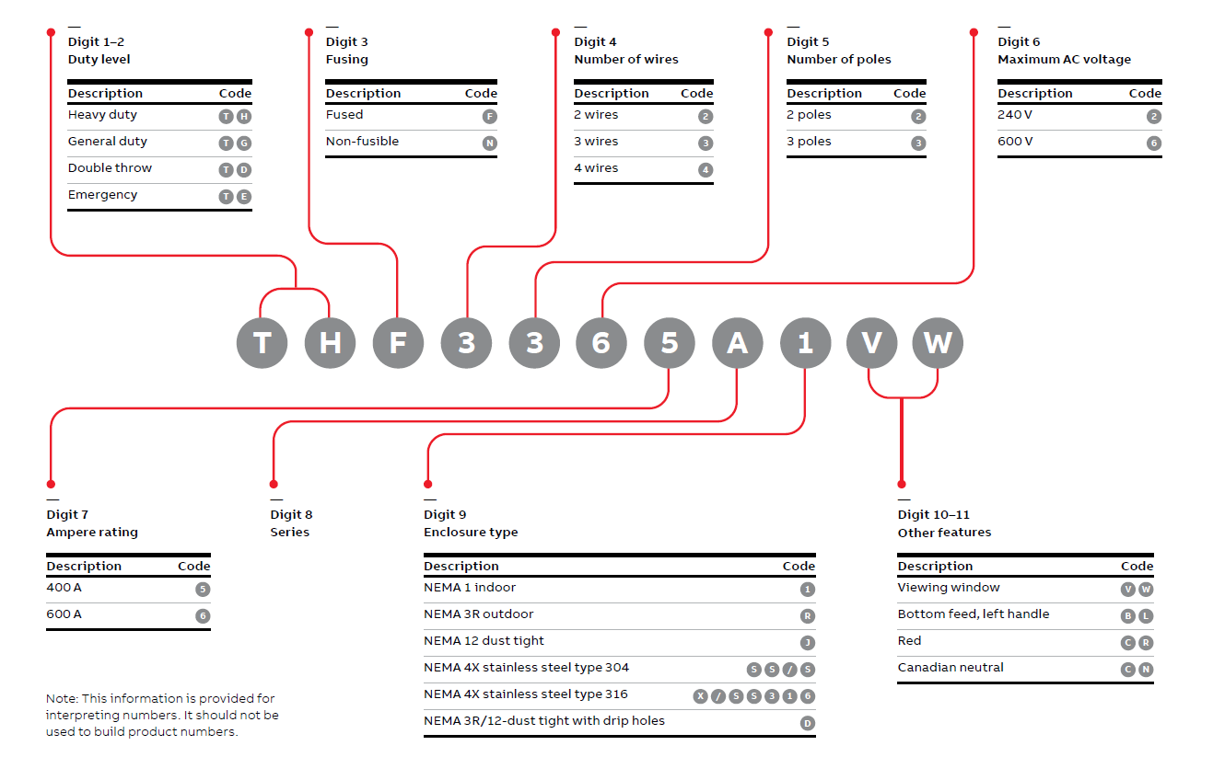
Product Number Structure
400-600A
Major Changes
3rd Digit (Fused vs Non –Fusible)
8th Digit (New Series Number)
9th Digit (Enclosure Type)
Digit 10-11 (Other Features)
Examples
THF3325A1 (NEMA 1)
TJF3325AR (NEMA 3R)
THF4325AS (SS-304)
THF4325AX (SS-316)
THF3365AD (Outdoor/Dust tight w/Holes)
Notes:
Please be mindful of the new catalog number structure. We will also follow this structure as we introduce new product to the market.
The major changes are below:
3rd Digit
In the past, we did not have to indicate fuse vs non-fuses. Now, the new catalog numbers requires the “N” for non-fused and “F” for fused
8th Digit
We have a new series number. The Letter “A” will be in all new catalog numbers
9 Digit
Please be mindful of the new code for the enclosure types
10-11th Digit
Please see examples of the how the part numbers changes per enclosure.

Slide 8
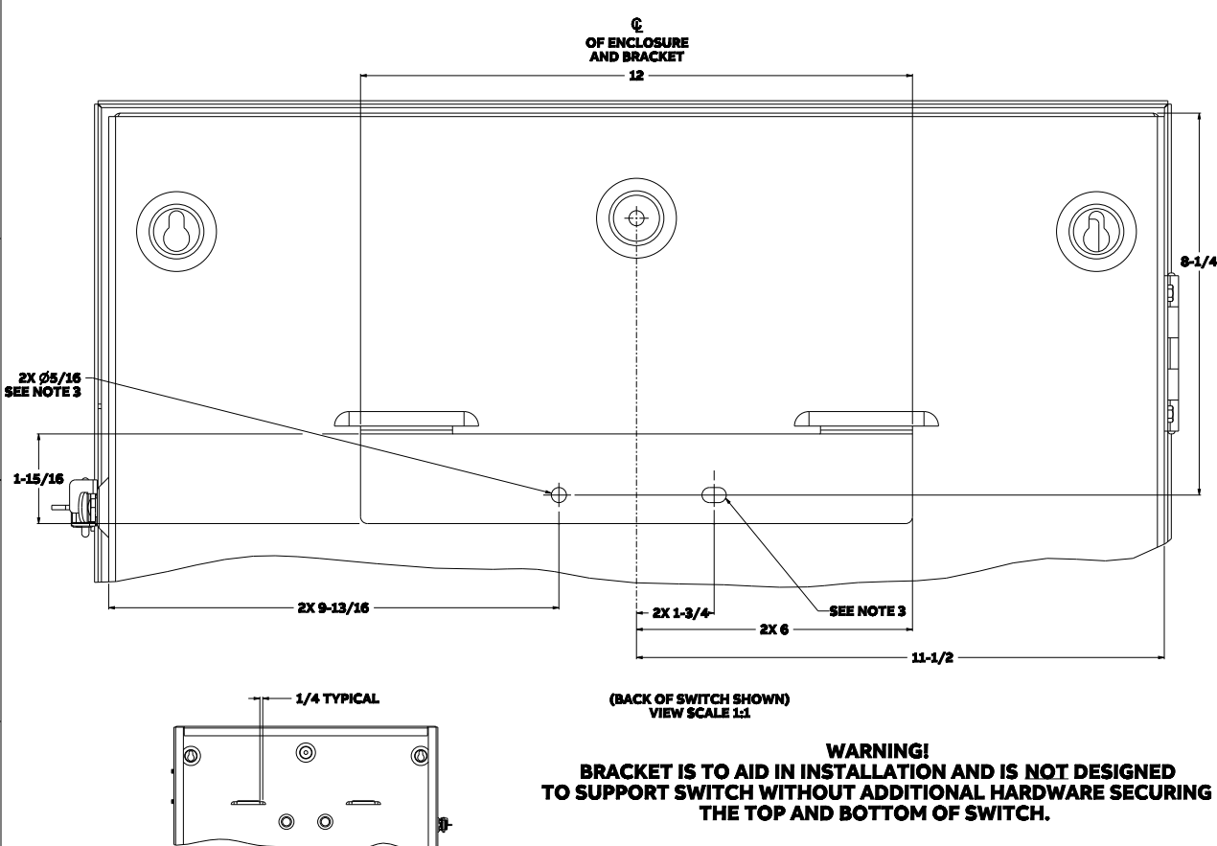
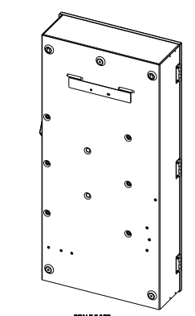
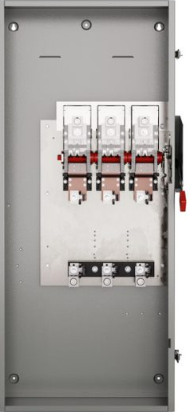
New Enclosures & Mounting Bracket
400- 600A
© 2023 ABB. All rights reserved.
Slide 8
May 8, 2023
Slide 8
Notes:
We are so excited about this new Mounting Bracket. The installation is similar to mounting a TV bracket. Please see the instructions below.
1. DEFINE SAFETY SWITCH LOCATION AND
ATTACH TEMPLATE TO WALL.
2. VERIFY THAT THE TEMPLATE IS LEVEL.
3. DRILL (2) MOUNTING HOLES IN WALL
FOR 1/4" or 5/16" FASTENER WHERE
INDICATED ON TEMPLATE.
4. PLACE (1) 1/4" OR 5/16" FASTENER
THROUGH ELONGATED SLOT IN
MOUNTING BRACKET AND TIGHTEN
PARTIALLY TO WALL.
5. PLACE (1) 1/4" OR 5/16" FASTENER
THROUGH SECOND HOLE IN
MOUNTING BRACKET AND TIGHTEN
PARTIALLY TO WALL.
6. TEAR AWAY MOUNTING TEMPLATE AND
TIGHTEN BOTH FASTENERS SECURELY.
7. LIFT ENCLOSURE AND ALIGN TABS OF
BRACKET WITH SLOTS IN REAR OF
ENCLOSURE.
8. ENCLOSURE CAN BE ADJUSTED 1/4" IN
EITHER DIRECTION HORIZONTALLY
AFTER BEING HUNG ON BRACKET.
9. ALL DIMENSIONS ARE IN INCHES.

Slide 9
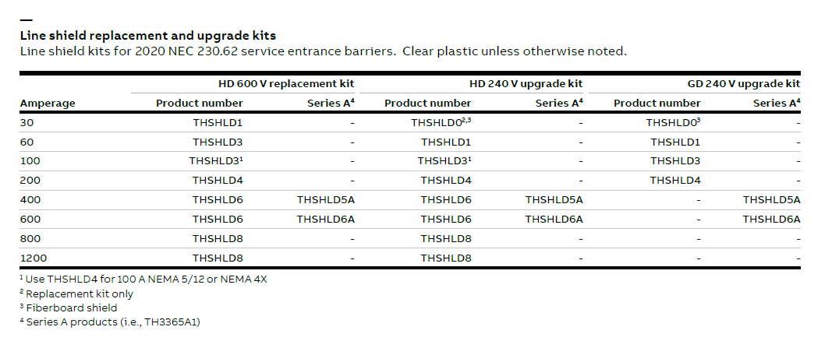
New Line Shield
400-600A
Notes:
Please remember the new catalog numbers for the line shield kits for the new 400-600A General Duty and Heavy Duty Safety Switches. In the past, 30-200A General Duty Safety switches only met NEC 2020 requirements. With the new enhancements, the full product offering now meets NEC 2020 requirements.

Slide 10
Count on
—
Easy installation
Easy availability
Easy protection

Slide 11
Easy installation
—
Save time and labor costs Switches are fully factory assembled and tested, ready to install.
Help prevent errors Simplified wiring and clear installation guides
Flex across applications Full range of safety switches from 30 to 1200A along with field installable accessory kits

Slide 12
—
Easy protection
Superior safety All switches meet or exceed cULus requirements and are fully tested at the factory before shipment.
Long, reliable service life
Mechanical endurances exceeding industry requirements

Slide 13
With ABB, you’re in safe hands
—
No matter the application, we’ve got you covered.
Decades of expertise and innovation in electrical safety
Continually evolving Spec-Setter product range
Global footprint and local expertise
Committed to working in partnership with you

Slide 14
— It’s time to make the switch
ABB’s Spec-Setter Safety Switches are the safer, more reliable choice, every time.
Easy installation Expertly engineered to save time, costs and labor
Exceptional availability Globally stocked, fast, intuitive ordering
Superior safety
Exceeding UL and cULus requirements
Ask for Spec-Setter Safety Switches –– because when it comes to your customers, the safer, the better.

