Slide 1
DS1
Epds Indoor control and protection products
Medium voltage transient-free capacitor switch Improved power quality and network reliability

Slide 2
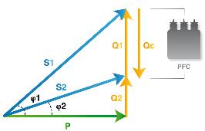
Capacitor solutions
Reactive power compensation
Capacitors are used to compensate reactive power in Power Factor Correction systems. PFC needs to provide high quality and reliable power safely, in order to guarantee stable and efficient service continuity

Slide 3
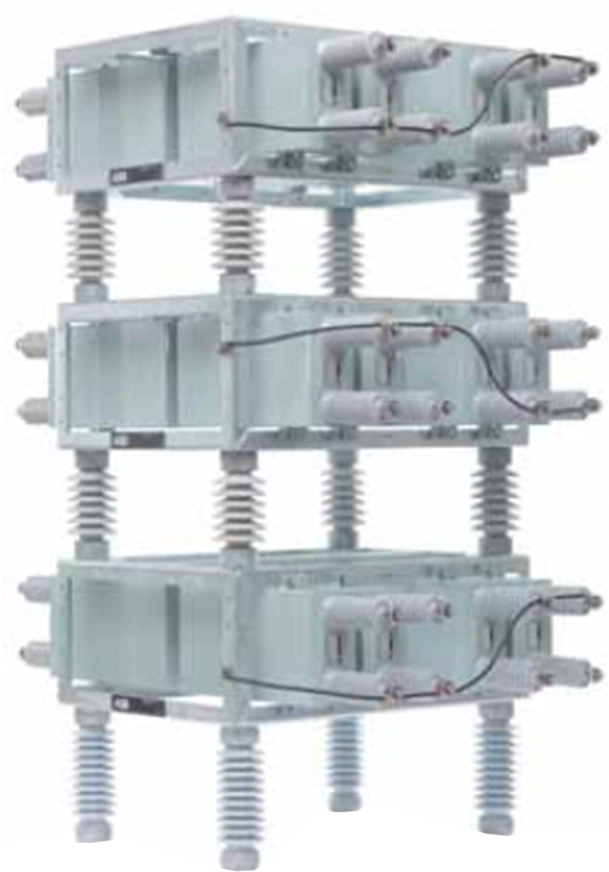
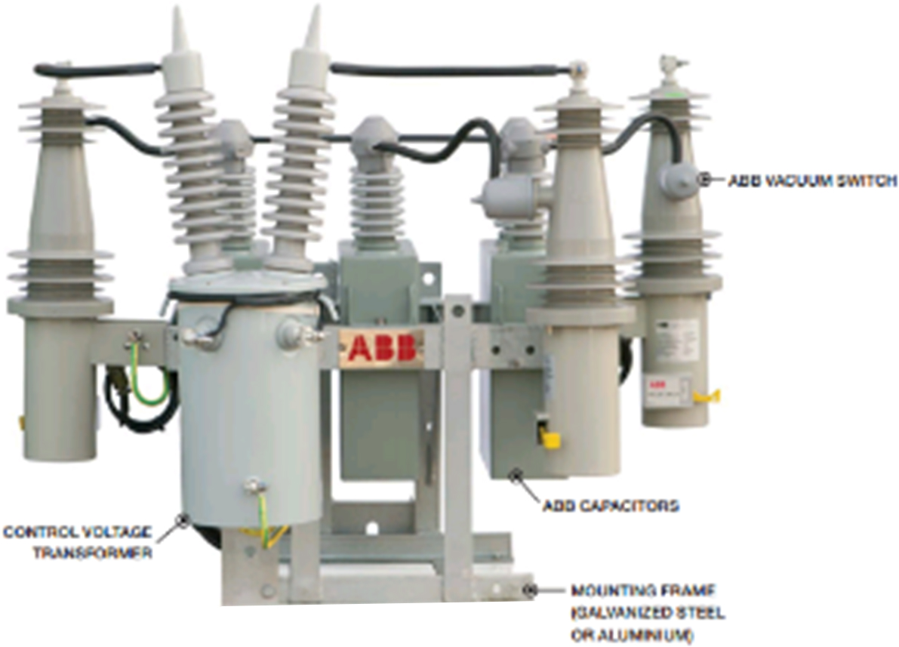
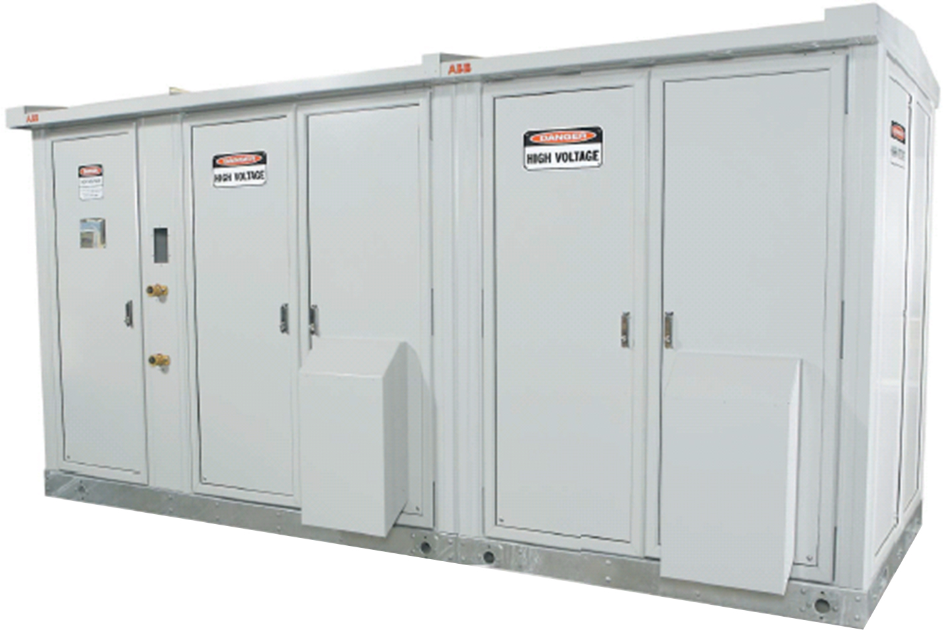
Capacitor solutions
ABB offering
Open rack
Outdoor
ABB Qrack
Pole mounted
Outdoor
ABB Qpole
Metal Enclosed
Indoor/Outdoor
ABB ABBACUS

Slide 4
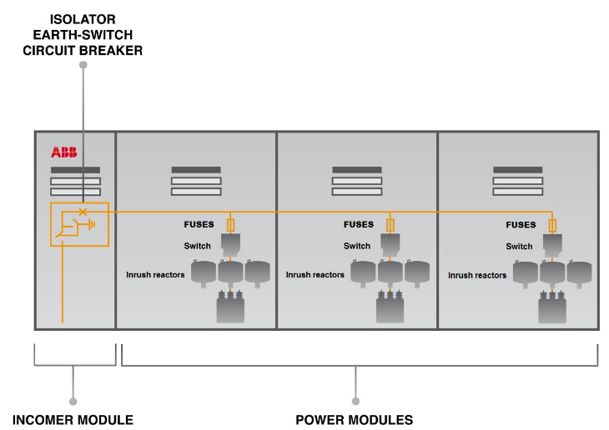
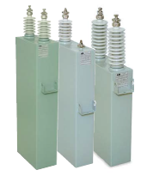
Capacitor solutions
Standard solution
Switching transients
Production stop
Network outage
Less $$$

Slide 5
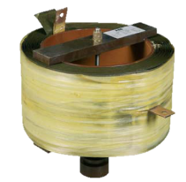
Capacitor solutions
Standard solution
Switching transients
Production stop
Network outage
Less $$$
Inrush reactors
Power losses
Space required
Less $

Slide 6
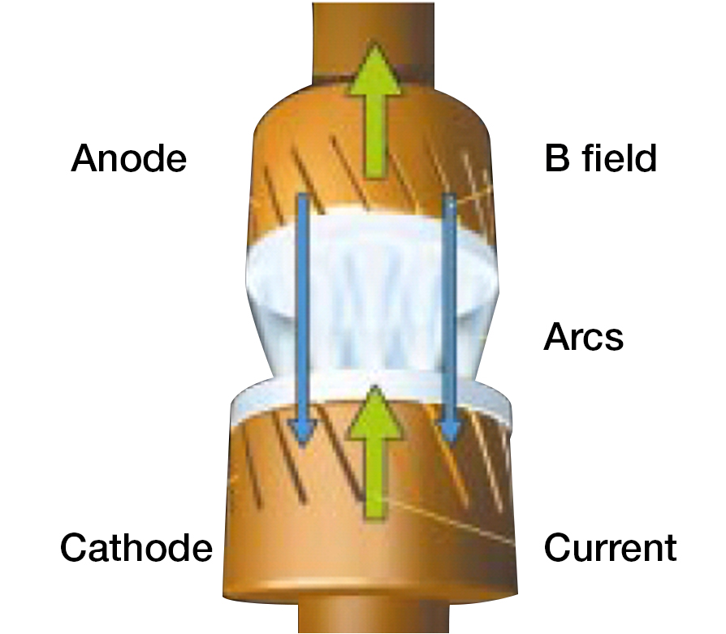
Capacitor solutions
Standard solution
Switching transients
Production stop
Network outage
Less $$$
Inrush reactors
Power losses
Space required
Less $
Restrike
Capacitor failure
Low power factor
Less $ $

Slide 7
Capacitor solutions
Customer challenges
Customer
Challenge
Results
Effects
Utility
Provide power quality with volatile load
Poor power quality and black-outs
Financial claims
Reputation drop
Industry
Maximize productivity and power factor
Lower efficiency and plant outages
Productivity losses
Higher electricity costs

Slide 8
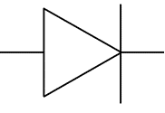
DS1 capacitor switch
New switching concept
Synchronization with AC network
Solid-state technology
Transient-free - Pre/Restrike-free switching

Slide 9
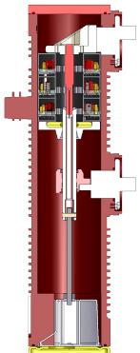
DS1 capacitor switch
Core innovation
Upper terminal
Main fixed contact
Semiconductor
Moving contact
Lower terminal
Dry air

Slide 10
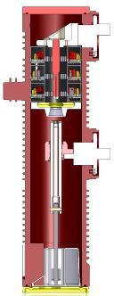
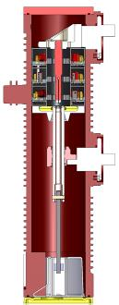
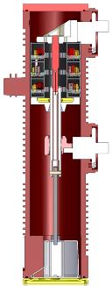
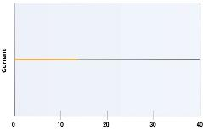
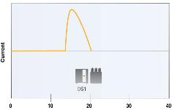
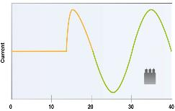
DS1 capacitor switch
Closing operation at zero voltage – no inrush current

Slide 11
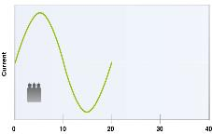
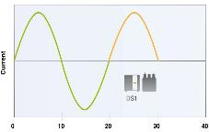
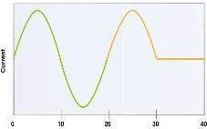
DS1 capacitor switch
Opening operation at zero current – no restrike

Slide 12
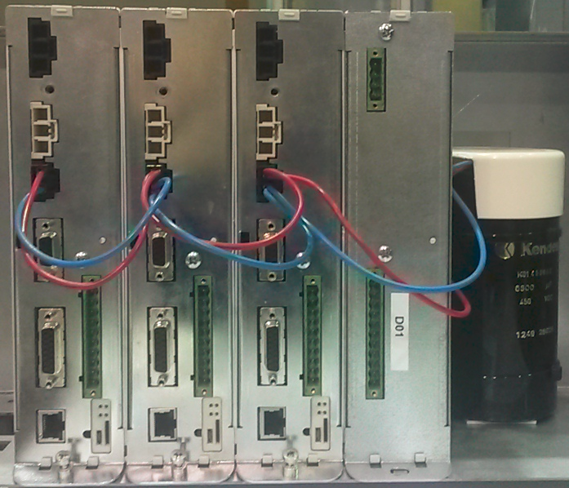
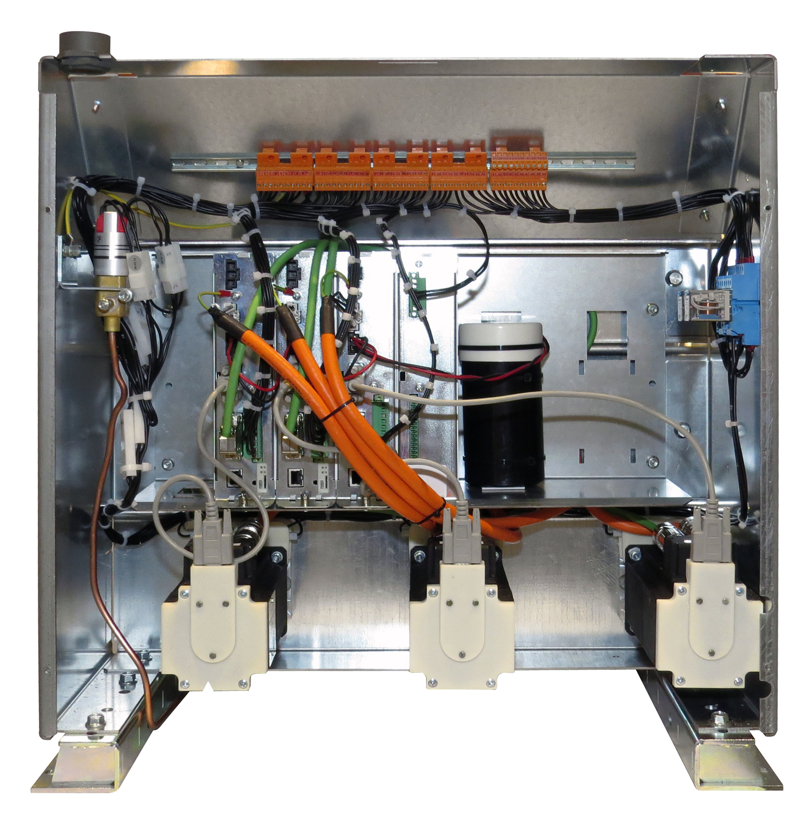
DS1 capacitor switch
Main components and features
The Control Unit performs full switch diagnostics by monitoring:
Control Unit status Current, voltage, temperature
Full motion control Actuation parameters after each operation
Micro motion control Actuation parameters before each operation
Synchronization Presence of bus voltage and rated frequency

Slide 13
DS1 capacitor switch
Main components and features
The Control Unit performs full switch diagnostics by monitoring:
Control Unit status Current, voltage, temperature
Full motion control Actuation parameters after each operation
Micro motion control Actuation parameters before each operation
Synchronization Presence of bus voltage and rated frequency
Motor winding and cabling Status and connection of servomotors

Slide 14
DS1 capacitor switch
Main components and features
The Control Unit performs full switch diagnostics by monitoring:
Control Unit status Current, voltage, temperature
Full motion control Actuation parameters after each operation
Micro motion control Actuation parameters before each operation
Synchronization Presence of bus voltage and rated frequency
Motor winding and cabling Status and connection of servomotors
Dry air pressure 3 levels of pressure (OK, Warning, Alarm)

Slide 15
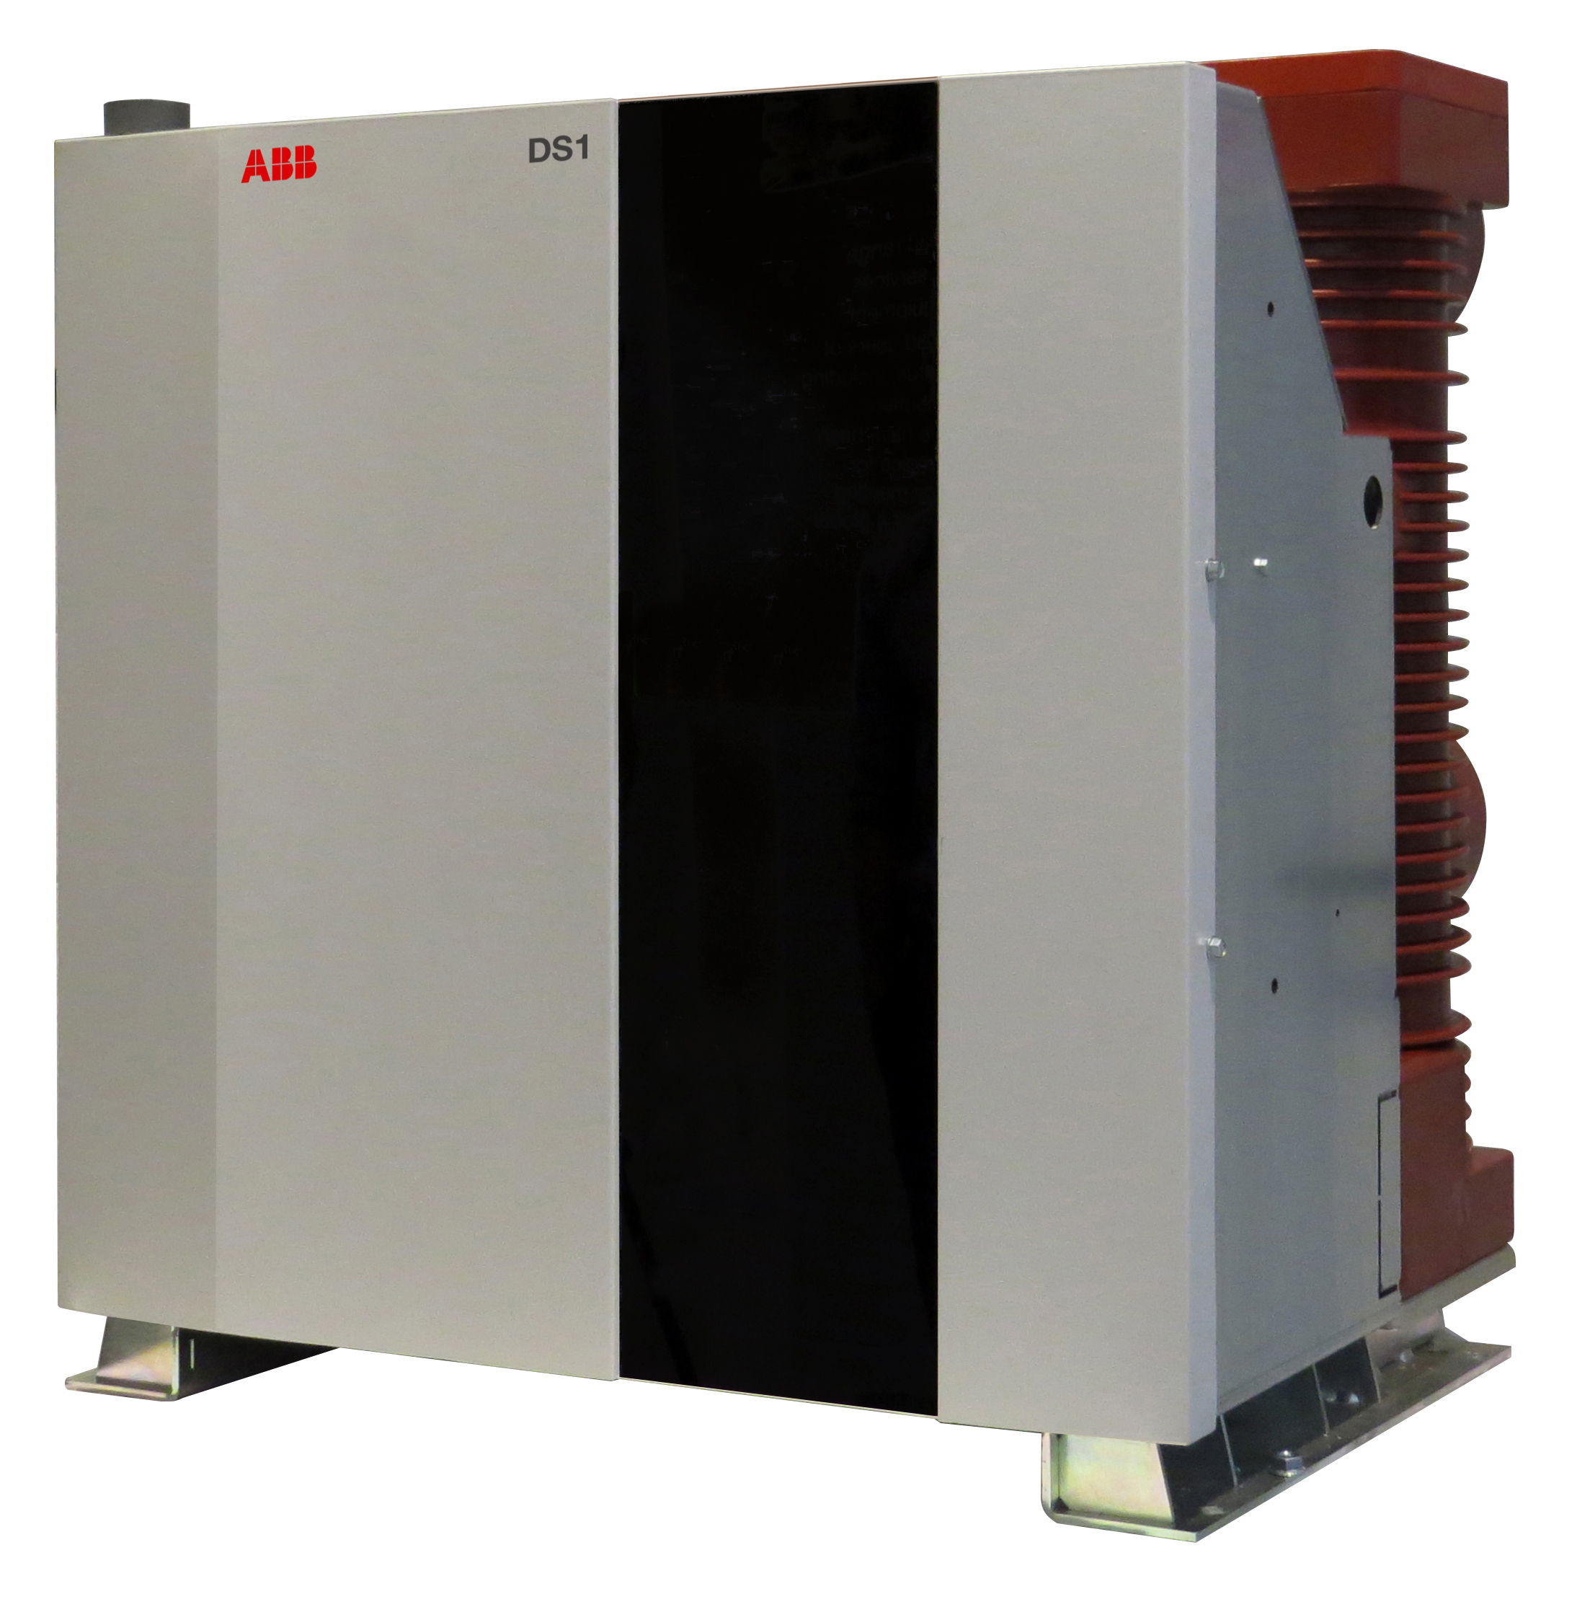
DS1 capacitor switch
Ratings
Rated frequency [Hz] | 60 | 50
Rated Voltage [kV] | 15.0 | 17.5
Rated Current [A] | 600 | 630
Mechanical Life [CO] | 50.000
STC [kA – s] | 20 - 0.5
Working Temp [°C] | -15…+55

Slide 16
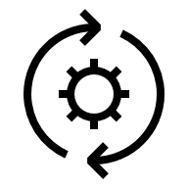
DS1 capacitor switch
Customer benefits
Process continuity
Transient-free
50,000 maintenance-free operations
Safety and protection
Restrike-free
Embedded diagnostics
Space saving
No inrush reactors
Compact solution

