Slide 1
ABB’s portfolio
A consolidated view

Slide 2
ABB Services Structured standard elements of service scope
1. Service Agreements
2. Installation & commissioning
3. Training
4. Spares
& Consumables
5. Maintenance
6. Repairs
7. Engineering
& Consulting
8. Advanced Services
9. Extension, Upgrades & Retrofits
10. End-of life Services
11. Replacement
Installation
On-site
Training
Spare parts
Preventive maintenance
Repair services
Engineering
Performance improvement Services
Upgrades
Decommissioning
Replacement
Commissioning
Classroom Training
Replacement Parts
Predictive maintenance
Workshop repairs
Planning and specification
Software
Resale
Simulation
Pre-owned parts
Refurbishment/
Reconditioning
services
System integration
Asset optimization
Hardware
Disposal and recycling
E-Learning
On-site condition monitoring
Extensions
Parts Kits
Customization
Op. excellence reliability
Programming services
Remote condition monitoring
Retrofit
Consumables
On-site repair
Configurations
Process safety
Life cycle assessment
Environmental compliance
Exchange unit
Inspections & diagnostics
Corrective maintenance
Consulting
Technical support
Benchmarking
and audits
System performance
Extended warranty
Holistic Efficiency Enhancement
Remote
Trouble-shooting
Project management
Maintenance Management
Parts and inventory management
Cyber Security
Software as a service
Data services
Data back-up
Data engineering

Slide 3
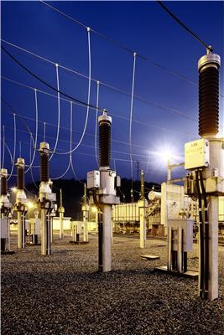
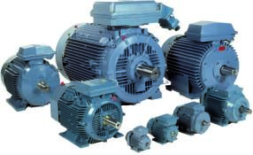
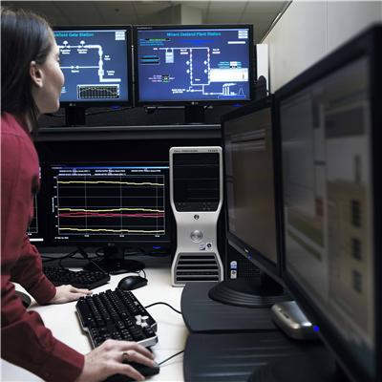
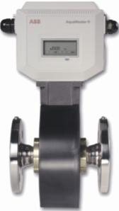
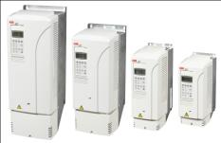
ABB’s full product & service portfolio
Power
Energy Efficiency
Intelligent Operation
Measurements
Switchyard
HV, MV, LV systems & equipment
Protection systems
PF improvement & harmonic filters
Machines & Motors
VVVF Drives
Soft-starters
Energy savings and audits
SCADA systems
DCS / PLC solutions
Optimization tools
Asset management
Remote monitoring & diagnostic
Flow meters
Quality analyzers
Pressure, level & temperature meters
Indicators, recorders & controllers

Slide 4
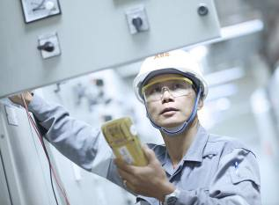
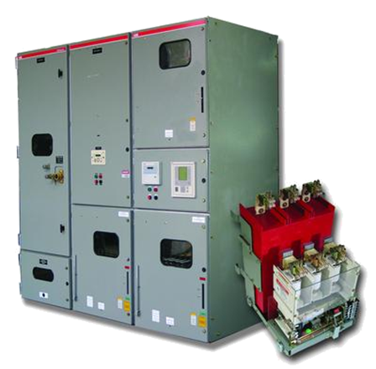
ABB’s full product & service portfolio
Health checks & condition monitoring
RLA & LEAP for electrical Static equipment
Machines & Motors
Control systems for boiler
Retrofit, Upgrades and expansions
HT breakers, transformers, CT/CVT, PT & LA
Protection systems
MV / LV Switchgear
Machines & Motors
Measurement, monitoring & optimization
Flow, pH, water quality
SCADA and DCS
Asset monitoring & management (leak detection, filters, pumps)
Smart distribution & metering

Slide 5
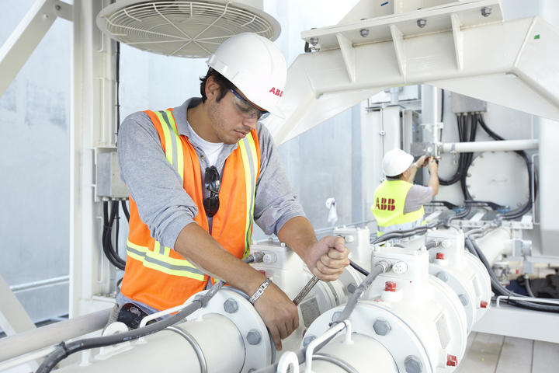
ABB’s full product & service portfolio
Energy management & Efficiency solutions
Power & process consultancy
PF improvement
Harmonic analysis & filters
Maximum demand control
Power availability & tariff driven operations
Demand forecasting, planning & scheduling
VVVF drives
High efficiency machines & motors

Slide 6
Energy Efficiency
What , How & Why

Slide 7
Challenges & concerns
Current situation and challenges –ABB perception
Capacity expansion vis-à-vis limited / no free land
Continuously growing energy bill
Utility & DG
Mounting operational costs
Untenable distribution & technical losses
Ageing assets and workforce
Liquidity crunch and limited O&M budgets
Limited flexibility to set & charge right price levels
Public expectations & demands
© ABB Group
February 10, 2014 | Slide 7

Slide 8
ABB Services Structured standard elements of service scope
1. Service Agreements
2. Installation & commissioning
3. Training
4. Spares
& Consumables
5. Maintenance
6. Repairs
7. Engineering
& Consulting
8. Advanced Services
9. Extension, Upgrades & Retrofits
10. End-of life Services
11. Replacement
Installation
On-site
Training
Spare parts
Preventive maintenance
Repair services
Engineering
Performance improvement Services
Upgrades
Decommissioning
Replacement
Commissioning
Classroom Training
Replacement Parts
Predictive maintenance
Workshop repairs
Planning and specification
Software
Resale
Asset optimization
Disposal and recycling
Simulation
E-Learning
Pre-owned parts
On-site condition monitoring
Refurbishment/
Reconditioning
services
System integration
Hardware
Audit Offerings:
Motor / Drive System Assessments & solutions
Power system Analysis
Power factor & Harmonic study
Energy Audit covering
Electrical
Thermal
Compressors
Pumps & Fans
Captive Power Plant Fingerprint
Cement Fingerprint
Control system Fingerprint
Health check of electrical equipment
Residual Life assessments of major electrical equipment
Parts Kits
Customization
Op. excellence reliability
Extensions
Programming services
Remote condition monitoring
Retrofit
Consumables
On-site repair
Configurations
Process safety
Life cycle assessment
Environmental compliance
Exchange unit
Inspections & diagnostics
Corrective maintenance
Consulting
Technical support
Benchmarking
and audits
System performance
Extended warranty
Holistic Efficiency Enhancement
Remote
Trouble-shooting
Project management
Maintenance Management
Parts and inventory management
Cyber Security
Software as a service
Data services
Data back-up
Data engineering

Slide 9
EE Portfolio from ABB
Service Offering
Product Offering
ELECTRICAL | THERMAL | PROCESS | GENERAL
Power System study | Boiler Fingerprint | Cement Fingerprinting | Comprehensive Energy Audits (electrical, thermal, compressors, pumps fans)
Power Quality study | Waste heat recovery solution | Paper Fingerprinting | Equipment Performance Management
Assessment of Motors, Transformers and other electrical equipment | Carbon In ash analyzer | Control system Fingerprinting | Condition Monitoring
Study of utilities (Compressors, pumps, fans etc.) | Ultra High Power transformers for Electric Arc Furnaces in Iron and steel | Byproduct gas optimization | Remote monitoring
Premium Efficiency motors (IE1, IE2, IE3, IE3+) |  | Expert Optimizer | Power plant fingerprinting
MV, LV Drives, Softstarters |  | O2 and CO Monitor | Energy Management System
PF Correction equipment and Harmonic filters |  | LIMS | Renewable energy sources
Green Transformers |  | Robotics | DCS Systems
Permanent Magnet Synchronous motors and Gearless Mill drives |  | Electromagnetic stirrers | Solar

Slide 10
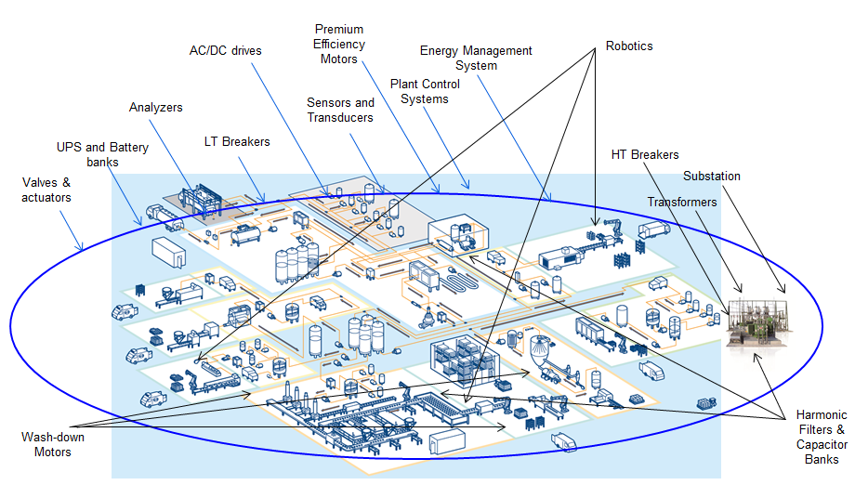
Energy Efficiency in Food and Beverage

Slide 11
Energy Efficiency in Cement
Burning process optimization
(3-10%)
Optimize the use of fossil energy
within the desired quality parameters
Grinding Optimization
(3-10%)
Optimize the use of electrical energy
within the target quality
Heat Recovery
(18-20%)
Produce electricity from
waste heat
Alternative fuel management
(3-10%)
Optimize the use of alternative fuels within environmental constraints
Blending optimization
(2-3%)
Optimize the raw mix for
easy burning and right clinker
quality
Blending optimization
(2-3%)
Minimize the use of clinker (1-3%),
Optimize the use of electrical
energy (3-10%)
Material transport
(6-15%)
Variable speed drives & High Efficiency Motors
Fans
(10-15%)
Variable speed drives & High Efficiency Motors
Clinker cooler
(8-15%)
Multidrives
Mills
(1-3%)
Variable Speed Drives,
GMDs & High Efficiency Motors
Captive Power Plant
(8-12%)
Boiler optimization & Auxiliary power consumption reduction

Slide 12
Power System FingerPrint
Focus Area
Power quality
Harmonics
Reactive power
Load distribution and balancing
Protection systems
Sizing and suitability
Generation/Consumption
Operation philosophy
Potential Improvements
Power factor
Reduced Harmonics
Extended asset life
Increased availability
Integrated Electrical & Process control
Integrated load management
Predictive maintenance
Condition based monitoring
Power Transformers
HT Breakers
MV Breakers
Aux. Power systems
DG & Gennerators
UPS and Battery banks

Slide 13
Control System FingerPrint
Focus Area
System status
System administration
Alarms & events
System security
Interfacing & interlocking
Instruments status
Potential Improvements
Asset management
Alarm management
Reporting & analysis
Cyber security
Back up management
Software upgrades
Hardware upgrades
Corporate Information System
Sensors & transducers
Analyzers
Plant control system
Sub Control Systems
(Weighing, Vib. Mon.)
Valves & dampers
AC/DC drives
Quality / Lab
Systems

Slide 14
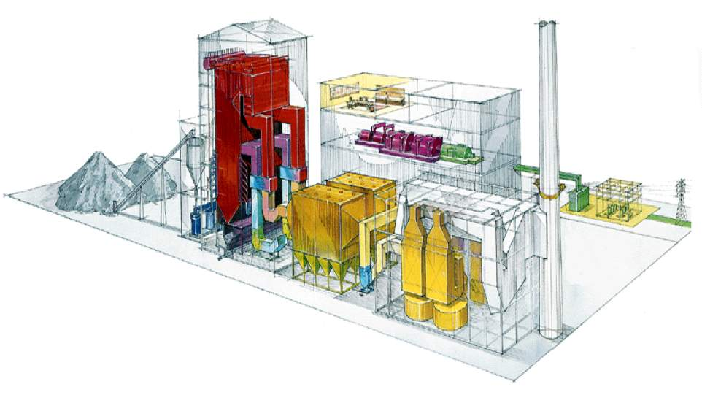
Captive Power Plant FingerPrint
Continuous Emission
Monitoring (CEMS)
Boiler
optimization
Boiler startup
& control
Carbon in Ash
Monitoring (TSA)
Combustion
Optimization
Systems (COS)
Steam Turbine
+ Generator
Burner Mgmt Systems
eBOP assessment
Captive Power Generation : 8 – 12%
Boiler optimization : 3 – 4 %
Auxiliary power consumption : 5 -8%

Slide 15
One ABB
An integrated approach

Slide 16
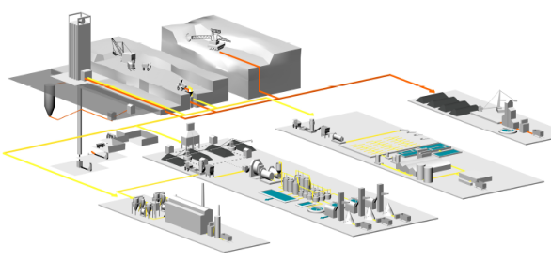
Extended BU services: holistic client approach
PP
Medium Voltage
DM
Motors & Generators
LP
Control Products
PA
Control Technology
PA
Measurement Products
PA
Minerals
Typical mining site
Core BU Services: Service specialists in existing BUs with focused scope
Minerals & Mining Extended BU Services team coordinating across BUs
Extended BU Services: BU Minerals driving One ABB approach for selected customers:
Managing front-end for services across ABB (incl. 3rd party), but without customer exclusivity
Pulling through expertise from various BUs
Using domain expertise to develop new industry solutions
Open pit mining
Coal processing
Under-ground mining
Mineral processing
Ore concentration

Slide 17
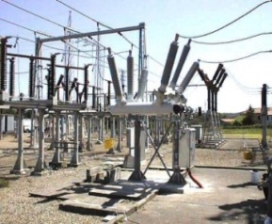
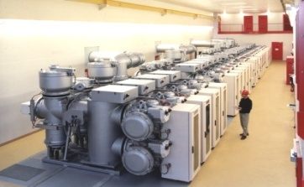
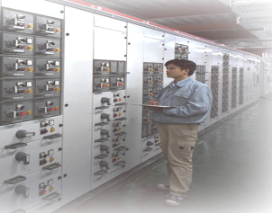
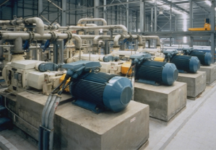
Integrated Process and Power Automation Concept & benefits
Grid connection
Power Generation
Power Automation
Generator
Protection & Control IEDs
Transformer
Transformer
HV
Transformer
Protection & Control IED
MV
Transformer
Protection & Control IED
Protection & Control IED
Variable Speed Drive
LV
LV Switchgear
Motor Controller
Variable Speed Drive
Process Automation
Motors
Notes:
Integrated Process and Power Automation, which is Electrical Integration with ABB’s System 800xA
This means
CLICK
Full Plant Integration with System 800xA, i.e. using one system for both process automation and power automation
CLICK
Electrical Integration based on Open Standards, utilizing open fieldbus solutions and IEC 61850 to integrated all areas
CLICK
Complete Portfolio from ABB, meaning ABB has the products, expertise and experience to deliver fully integrated systems

Slide 18
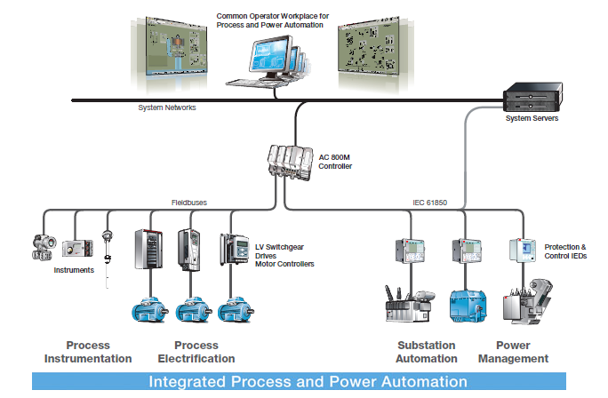
Integrated Process and Power Automation Electrical Integration with System 800xA
Full Plant Integration with System 800xA
Electrical Integration Based on Open Standards
Notes:
Integrated Process and Power Automation, which is Electrical Integration with ABB’s System 800xA
This means
CLICK
Full Plant Integration with System 800xA, i.e. using one system for both process automation and power automation
CLICK
Electrical Integration based on Open Standards, utilizing open fieldbus solutions and IEC 61850 to integrated all areas
CLICK
Complete Portfolio from ABB, meaning ABB has the products, expertise and experience to deliver fully integrated systems

