Slide 1
myABB portal
CUSTOMER PRESENTATION
ABB service solutions 24/7
2021
9AKK108208

Slide 2
ABB provides a range of products, systems and services for your industry
To maximize productivity, you need quick and easy access to information on your installed base
Aluminum
Cement
Chemicals and Refinery
Data Centers
Food and Beverage
Marine and Ports
Metals
Mining
Oil and Gas
Power Generation
Pulp and Paper
Water
Process Automation
Electrification
Motion
Robotics and Discrete Automation
Digitalization: ABB Ability™ platform

Slide 3
myABB
Gateway to manage your ABB Service relationship
24/7 access to ABB
Self service solutions, saving time and money
Optimize lifecycle management
Minimize capital outlays and optimize operational budgets
Improve assets performance
Plan maintenance operations and minimize downtime
Boost operational efficiency
Make the right operational decisions
Single online entry point for what you need today!
Notes:
myABB your gateway to services
24/7 access to ABB
Find the right information, saving time and money
View your installed base plus a wealth of relevant information
Get quick and easy access to expert contacts
Visit one-stop-shop for spare parts
Optimize lifecycle management
Minimize capital outlays and optimize operational budgets
Refer while planning capital projects
Identify upgrades, replacement and inventory level alternatives
Set maintenance strategy and make end of assets life decisions
Improve assets performance
Plan maintenance operations and minimize downtime
Review recommended service options and schedules
Explore service history and evaluate service agreements
Access product and technical documentation
Boost operational efficiency
Make the right operational decisions
Identify relevant training offerings
Retrieve the latest maintenance information and updates
Review your equipment criticality
www.abb.com/myabb
myABB – your personalized channel compliments ABB services, helping you to maximize equipment availability, optimize the lifecycle of assets and improve operational efficiency and performance.
Register for an account today at www.abb.com/myabb

Slide 4
myABB
Know the integrity of your spare parts inventory
Get access to services and functionalities through widgets
Get all information in one place
Give ABB a buzz
Check on the status of support cases
Engage in long term automation planning
Access other applications such as My Control System, myRobot, mySpareParts Analyzer
Stay up to date on your recommended service

Slide 5
Customizable experience
Arrange applications the way you want to see them
Access applications based on your relationship with ABB
See contract entitlements
Purchase spare parts
Get technical documentation including user manuals, drawings, specifications
Participate in user forums
See products and services purchase history
Receive product and service alerts

Slide 6
myABB applications
ABB Library
Business Online
Contact Us
My Installations
My Control System
ABB document repository
eCommerce platform
Directory of ABB contacts
Installed based information
Control systems diagnostics
My Learning
myRobot
mySpare Parts Analyzer
Product Registration
Products, Parts and Consumables
Access to ABB training courses
Monitoring of remote enabled robots
Displays part number validation, risk and lifecycle status
Allows registration of missing products
Parts and products search on all ABB products
Remote Condition Monitoring
Support Case Tracking
Service Agreements
Recommended Services
Access to monitoring and diagnostics services
Case Management platform
Information on current service agreement and entitlements
View ABB recommended services and schedule

Slide 7
myABB/my Control System
Increase productivity, minimize costs and extend the useful life of your ABB control products and systems
Self service tool, available 24/7
Stay updated with email notifications and receive relevant information for selected systems (SIDs)
Access relevant subscriptions and software licenses of the control system
Check software status of the control system, quickly access relevant safety reports, alerts or product documents
Improve performance by continuously enhancing the control system with system specific software updates
Monitor the overall health and equipment status of your system
Protect ABB control system against malware infection and cyber-attacks with the latest Microsoft® security updates and verified 3rd party Antivirus files
Uncover issues that limit current system performance through automatic collection and analysis of data

Slide 8
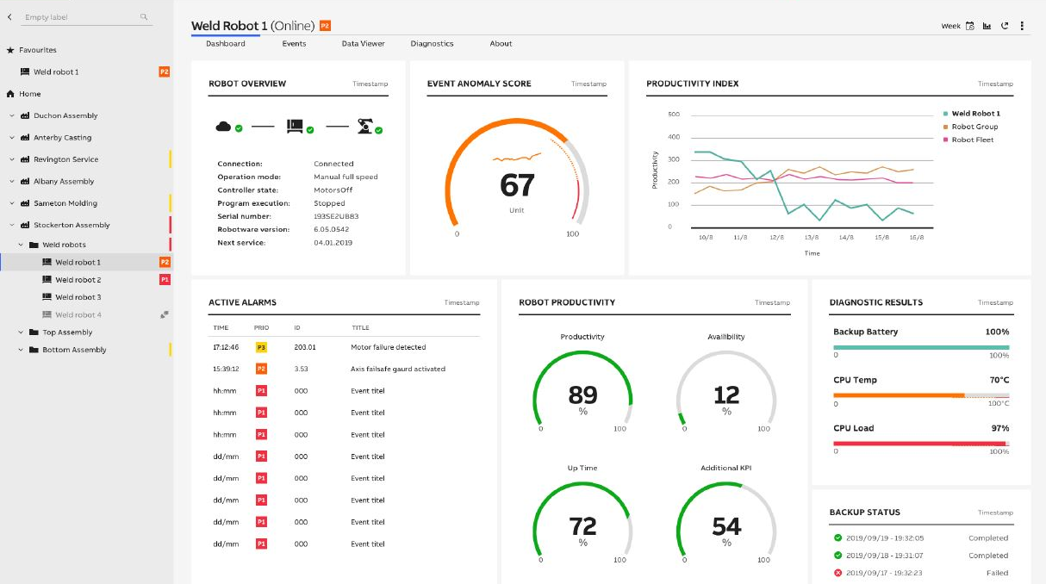
myABB/myRobot (ABB Ability™ Connected Services)
Enable faster response times, fewer incidents and measurable production increase
Maximize Uptime and Productivity
Remotely monitor, troubleshoot, backup and optimize individual as well as entire fleets of robots
Use data-driven insights for proactive maintenance and faster issue resolution, thereby adding an additional 2 hours of production per robot per month
Name and arrange your robots to reflect your operations
Troubleshoot problems by creating dashboards and watching physical parameters , alarms and events
Identify highly stressed robots and prioritize preventive maintenance activities and spare parts management

Slide 9
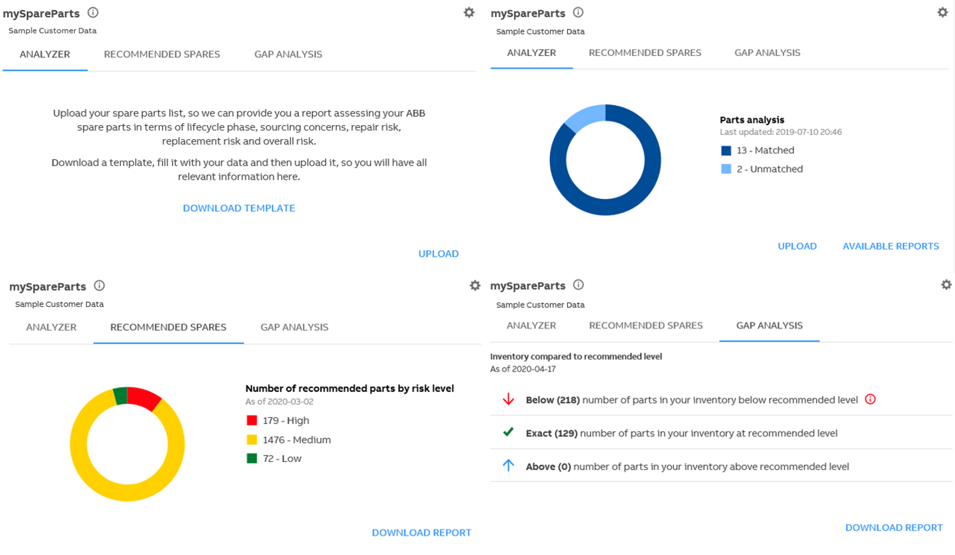
myABB/mySpare Parts Analyzer
Ensure production availability and prevent stock-related interruptions or delays
Validate your part numbers quickly
Access key elements concerning your site’s spare parts quality through a centralized platform
Validate part number quality by uploading your existing spares into an excel template
Get a recommended spares report based on your installed base
Identify risks arising from potential spare parts related problems through gap analysis

Slide 10
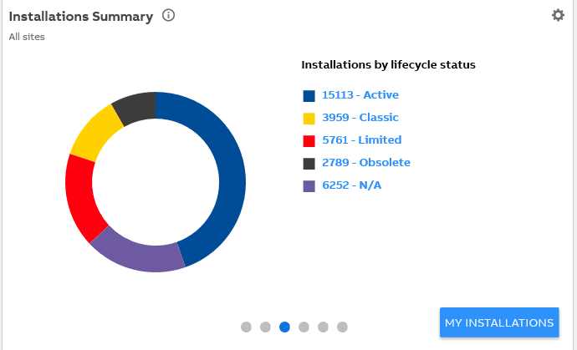
myABB/My Installations
Plan your automation modernization
Installation summary
View all ABB products installed at your plant site
View ABB products installed throughout your corporation.
View current product lifecycle status and next scheduled lifecycle change.
Ensure you purchase the correct replacement parts
Track your ABB product related service events
Monitor warranty status

Slide 11
myABB/Business Online
eCommerce capabilities
Order spare parts on-line
Access extensive ABB product catalog
Utilize the eCommerce functionality*
Order parts
Get electronics quote
Check availability
Check pricing
Part number supersession for older parts
Check order history
Access quote history

Slide 12
myABB/ABB Library
Web tool for searching for documents
View all product technical documentation
User Manuals
Data and specifications
Drawing and schematics
Trouble shooting guides
Product alerts
Access presentations
Promotional brochures and flyers
Publications
Get reports
Safety reports

Slide 13
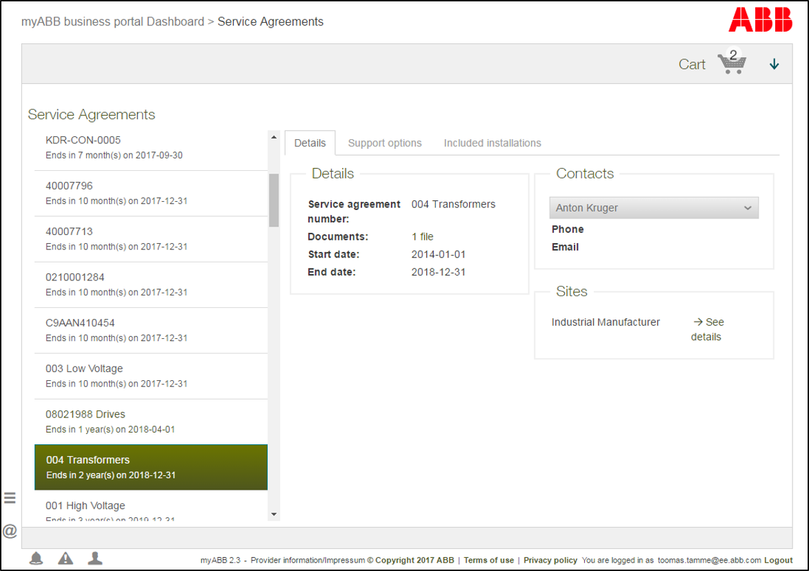
myABB/Service Agreements
One ABB approach
Single entry point for service agreements
See details, support options and included installations
Request agreements extensions

Slide 14
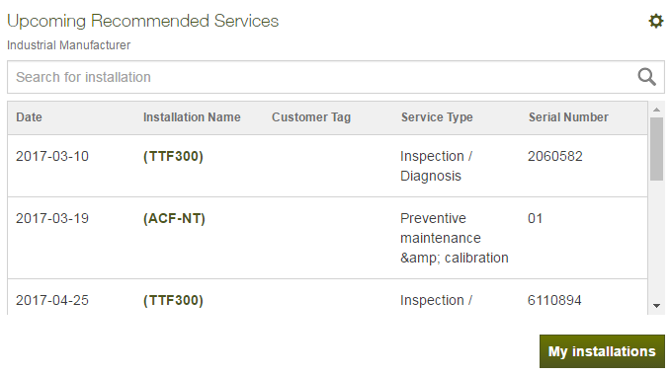
myABB/Recommended Services
Service advice tailored to increase the availability of your ABB equipment
See upcoming recommended services
See service options and schedules recommendations
Increase the longevity and availability of your ABB equipment

Slide 15
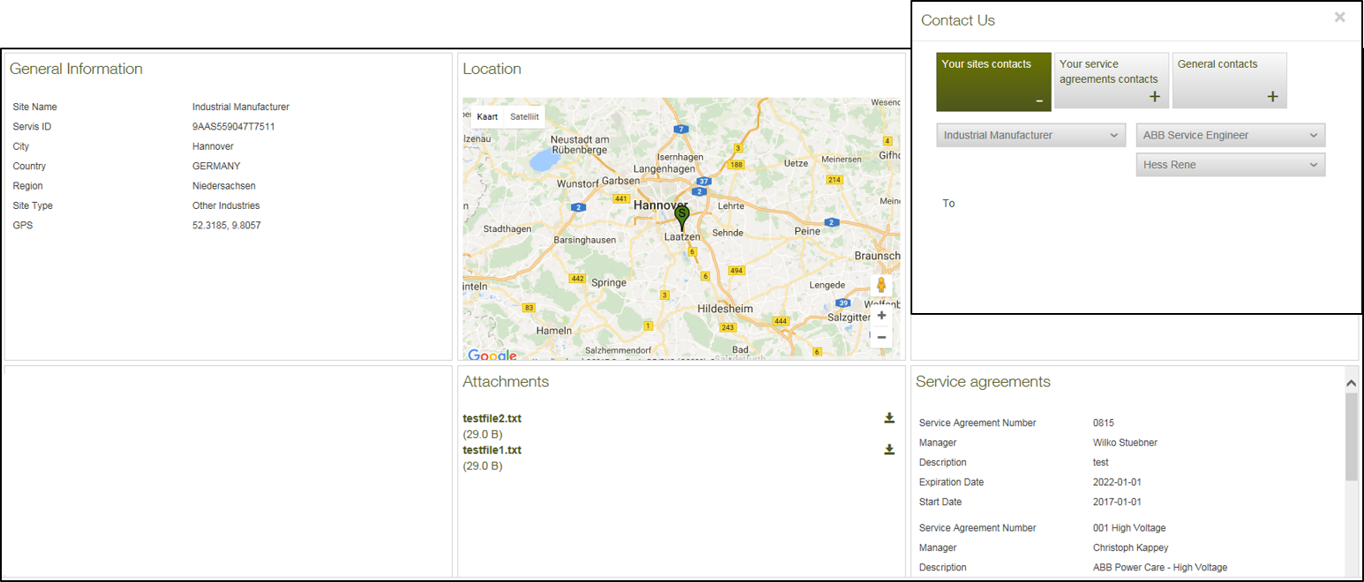
myABB/Contact Us and Site details
24/7 access to ABB
Quick and easy access to ABB experts
Access to site specific contacts, attached documents and agreements

Slide 16
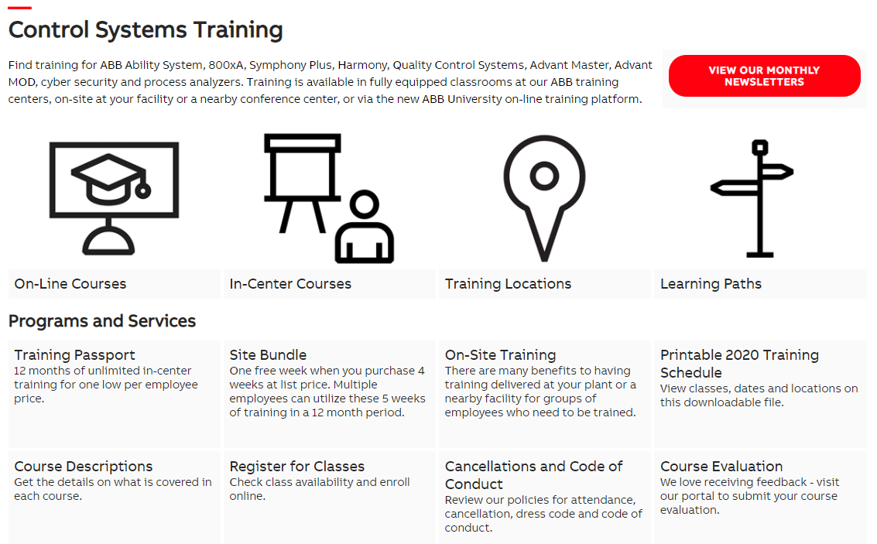
myABB/My Learning
Training designed to help you get the most out of your ABB equipment
Access training schedule
See available training courses
Attend instructor-led courses
Select the training mode that works best for you:
ABB Training Centers
On-site
Nearby conference center
On-line

Slide 17
Support case tracking
Submit new support cases
Case description and resolution
Case engineer assigned
Track status of existing cases
New
Pending
Solution Provided
Closed
See history of support cases
Open date
Close data
Case number

Slide 18
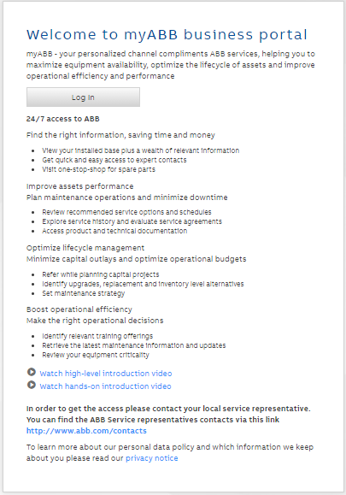
Register for an account today!

