Slide 1
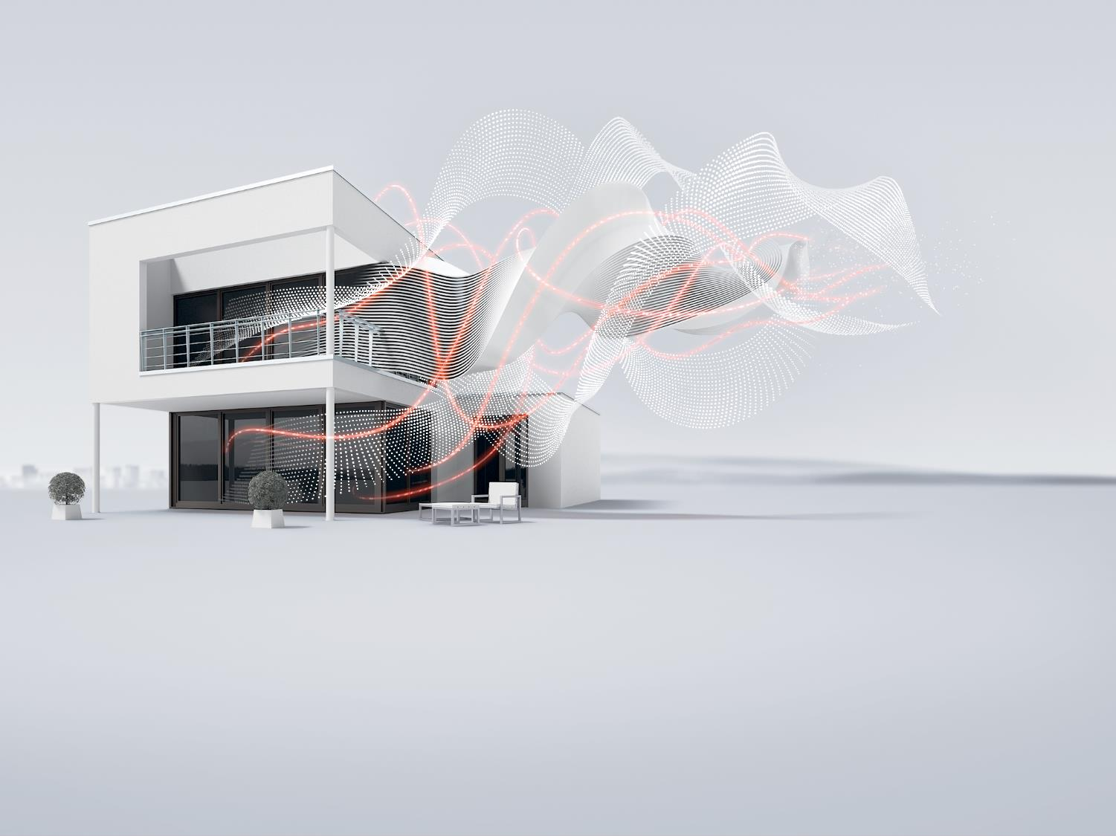
Accessories for MCBs and RCDs
ELSB GPG Energy Distribution, Global Product Management

Slide 2
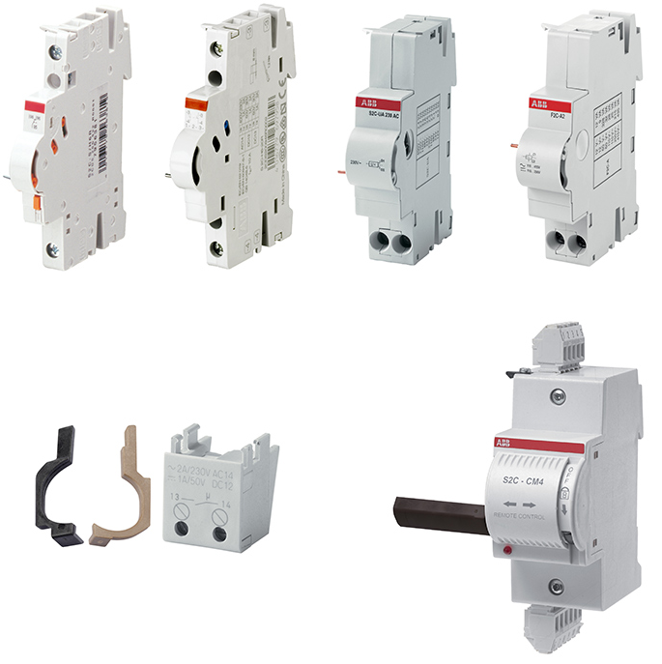
Accessories Portfolio
Overview
System ProM accessories
The System pro M compact© is the ABB range of miniature circuit breakers and residual current devices. This established system provides all the required accessories to complete your installation.
The accessory range is wide-ranging and consists of auxiliary and signal contacts, shunt trips, under voltage releases, motor operating devices and automatic reclosing units, busbars.
Various options and assembly schemes with the main protection devices are possible.

Slide 3




Accessories Portfolio
Overview
Wide range of accessories to accomplish customer needs
Global availability: SKUs for IEC and UL applications
Increase safety and comfort of the installation
Easy to install thanks to the “Plug and play” coupling of products

Slide 4
Accessories Portfolio
Main functionalities
Signalization
Auxiliary and signal contacts ensure better monitoring of the installation by verifying on/off status and providing the information
Switch
Shunt trips, overvoltage and under voltage releases ensure the control of associated RCCBs depending on the voltage supplied
Control
Motor operating units allow remote control of RCCBs, while Auto-reclosing units guarantee non-stop protection of the RCCB in case of nuisance tripping.
Connect
Busbars, Terminals and Installation Material which allow safer and quicker installation
Wide range of accessories to accomplish customer needs

Slide 5
Accessories Portfolio
Commercial designiation
S2C – H6RU
Family
S2
F2
…
Standard Information
U : UL 489 Version
‘’ : IEC/EN Version
Version
C : Pro M Compact
‘’ : Classic
Installation Information
R : Mounted Right
L : Mounted Left
Product Type
AR : Auto Reclosing Unit
BP : Mechanical Triping Device
CM : Motor Operating Device
EST : Plug-in Base
H : Auxiliary Contact
H-BF: Auxiliary Contact, Bottom Fitting
H–L: Auxiliary Contact, Left Fitting
IH : Coupling Interface
NT : Switched Neutral
OR : Over Voltage Release
S : Signal Contact
S/H : Signal/Auxiliary Contact
ST : Shunt Trip
UR : Under Voltage Release
Functionality
6 : CO Contact
01 : 1NC Contact
10 : 1NO Contact
11 : 1NO/1NC Contact
02 : 2NC Contact
20 : 2 NO Contact

Slide 6
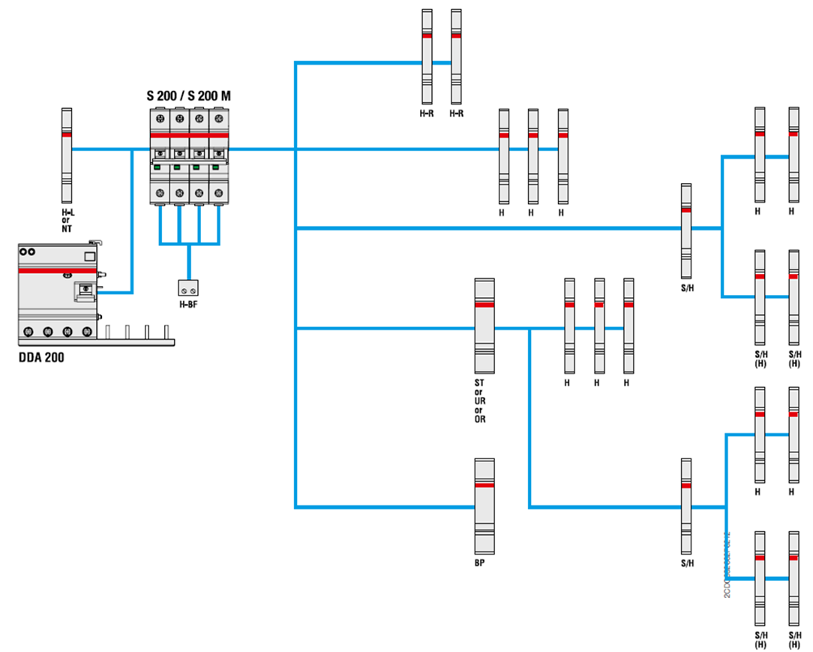
Accessories Portfolio
Selection tables
Selection tables available on the ABB catalog allow an easier selection of the combination of auxiliary elements with the main protection device.

Slide 7
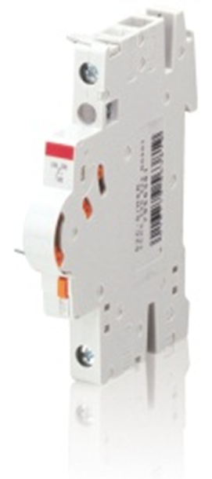
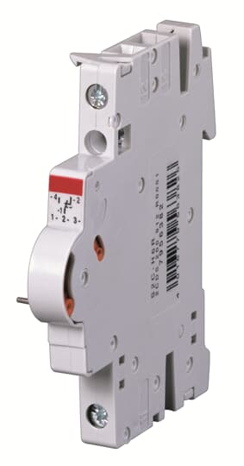
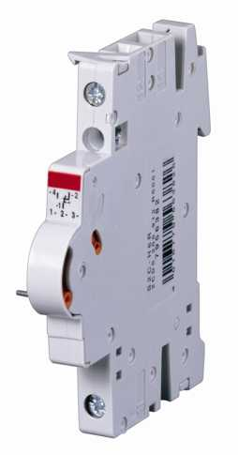
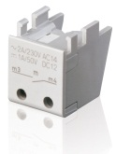
Accessories Portfolio
Signalation - Overview
Product name | S2C-S/H6 | S2C-H6R | S2C-HxxR | S2C-HxxL | S2C-Hxx
Description | Sign/Aux | Auxiliary | Auxiliary | Auxiliary | Auxiliary
Technical features | 1CO | 1CO | 1NO/NC 2NO 2NC | 1NO/1NC 2NO 2NC | 1NC 1NO

Slide 8
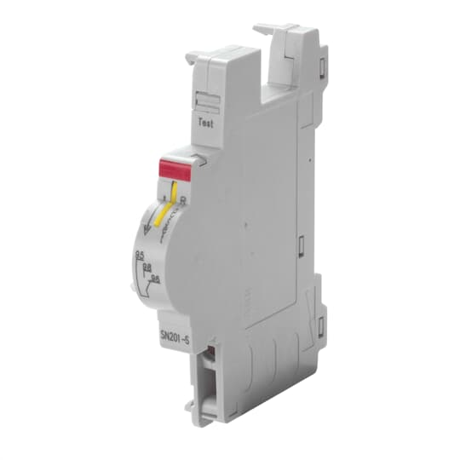
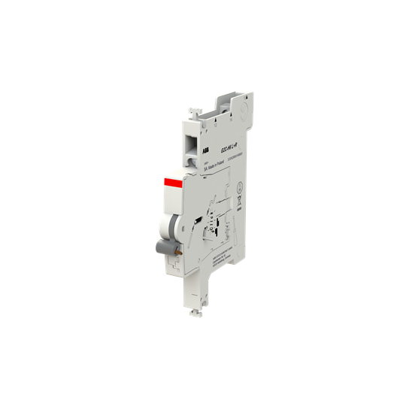
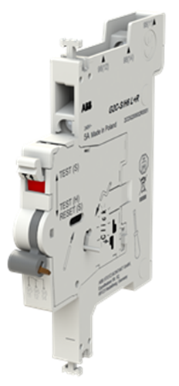
Accessories Portfolio
Signalation - Overview
Product name | SN201 | SN201-IH | G2C | G2C-S | S2C-H6RU* | S2C-S6RU*
Description | Signal | Aux/Interf | Auxiliary | Aux/Signal | Auxiliary | Signal
Technical features | 1 CO | 1CO | - | - | only for range U/UP/UDC

Slide 9
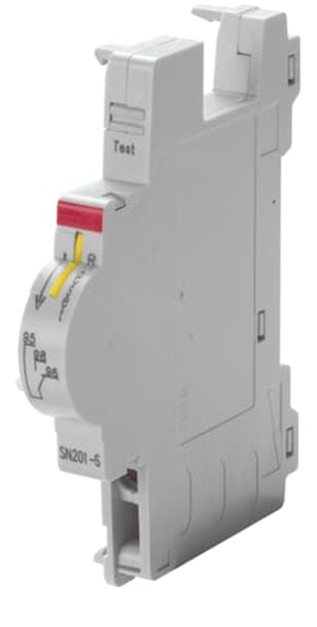
Accessories Portfolio
Signalation - Overview
Signal contacts
Signal contacts indicate if a device tripped due to a failure (overcurrent/short-circuit for MCBs and RCBOs; earth fault for RCCBs and RCBOs).
Auxiliary contacts
Auxiliary contacts indicate the position of the contacts, independent if a failure occurred or the device was operated manually

Slide 10
Accessories Portfolio
Signalation – Signal/Auxiliary Contact S2C-S/H6R
A selector allows to choose between signal operation and auxiliary operation.
Suitable for MCBs S 200/SN 201/RCDs F 200/DS 200/DS201-DS202C/ DS203NC/DSE201 M/AFDD S-ARC1/Switch disconnectors SD 200 series.
Utilization category:
    AC14 1A/400V & 2A/230V
    DC12 1A/220V & 1,5A/110V
    DC13 2A/60V & 4A/24V
Cross section of conductors: 0.75 – 2.5 mm²
Mechanical servicse life: 10.000 operations
Dimensions: 85x69x8.8 mm

Slide 11

Accessories Portfolio
Signalation – Auxiliary Contact S2C-H6R & S2C-HxxR
Auxiliary contacts with 4 contact configurations.
Suitable for MCBs/RCDs/AFDD/Switch disconnectors SD200.
Utilization category:
  AC14 1A/400V & 2A/230V
  DC12 1A/220V & 1,5A/110V
Cross section of conductors:
  0.75 – 2.5 mm²
Mechanical servicse life: 10.000 operations
Dimensions: 85x69x8.8 mm

Slide 12
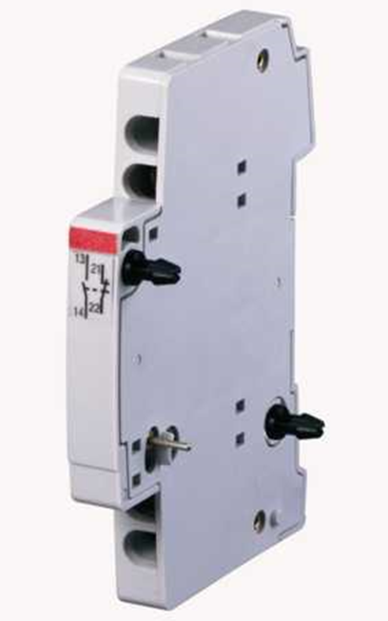
Accessories Portfolio
Signalation – Auxiliary Contact S2C-HxxL
Auxiliary contacts with 3 contact configurations.
S2C-HxxL, especially when using a motor operating device, is a possibility to add a contact as the right side mounted ones do not fit within this combination.
Suitable for MCBs/RCDs/AFDD/Switch disconnectors SD200.
Utilization category:
  AC14: 1A/400V & 2A/230V
  DC12/DC13: 1A/50V & 2A/30V
  DC13 2A/60V & 4A/24V
Cross section of conductors:
  0.75 – 2.5 mm² , (up to 2 x 1.5 mm² )
Mechanical servicse life: 10.000 operations
Dimensions: 85x69x8.8 mm

Slide 13
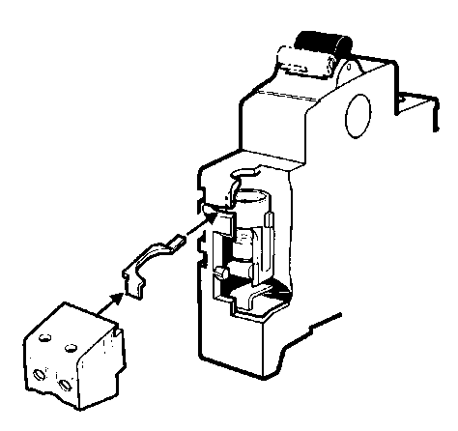
Accessories Portfolio
Signalation – Auxiliary Contact S2C-Hxx
Unique bottom-fitting contact, simple and spacesaving solution, also intended for retrofitting.
Suitable for S 200 compac range/DS201/DSE 201 M/Switch disconnectors SD 200 series.
Utilization category:
  AC14 2A/230V
  DC13 1A /50V & 2A/30V
Cross section of conductors:
  0.75 – 2.5 mm²
Mechanical servicse life: 4.000 operations
Dimensions: 29x17x17.5 mm

Slide 14
Accessories Portfolio
Signalation – Signal Contact SN201-S
Indication of the device contact positions only after the automatic release of the MCBs/RCBOs due to overcurrent.
Suitable for SN201 MCBs and DS203NC RCBOs.
Utilization category:
  AC14 1A/400V & 2A/230V
  DC12 1A /220V & 1.5A/110V
  DC13 2A /60V & 4A/24V
Cross section of conductors:
  2x1.5 mm²
Dimensions: 85x68x8.9 mm

Slide 15
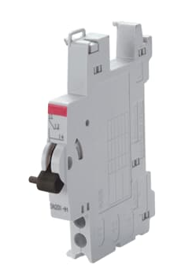
Accessories Portfolio
Signalation – Interface/Auxiliary Contact SN201-IH
Indication of the device contact positions.
The auxiliary contact SN201-IH can be used as an interface module between SN201, DS203NC and other compact auxiliary elements.
Suitable for SN201 MCBs and DS203NC RCBOs.
Utilization category:
  AC14 1A/400V & 2A/230V
  DC12 1A /220V & 1.5A/110V
  DC13 2A /60V & 4A/24V
Cross section of conductors:
  2x1.5 mm²
Dimensions: 85x68x8.9 mm

Slide 16
Accessories Portfolio
Signalation – Auxiliary Contact G2C
Provide the status of the protection device.
Suitable for S200C devices.
Can be mounted both on left and right (only left S203C).
Minimum application voltage:
  24V AC/DC
Minimum application current:
  10mA AC
  200mA DC – 2mA AC
Cross section of conductors (flexible/rigid):
  0.75…2.5 mm²
  1…2.5/ 2x1.5 mm²
  Dimensions: 92x69x8.7 mm

Slide 17

Accessories Portfolio
Signalation – Auxiliary/Signal Contact G2C-S/H
Can act as an auxiliary contact r as a signal contact . The user can change the function at the moment of installation.
Used as signal contact it provides the information about the automatic tripping of the protection devices.
Main features:
  Test button on the front to simulate the function (acting as a function H or S)
  Reset button for the contacts (function S)
  Tripping signal on the front (function S)
  Version with golden contacts, available for low current as well as low voltage applications.
Same characteristics of G2C in addition to:
  Minimum application voltage: 12V AC/DC
  Minimum application current: 25mA DC

Slide 18
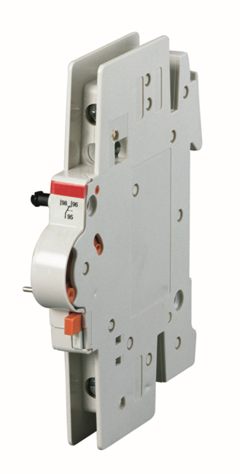
Accessories Portfolio
Signalation – Auxiliary Contact S2C-H6R U
Suitable for S200U / S200UP / S200UDC
Rating according UL 489 / CSA22-2 No.5:
  1A / 480 VAC
  2A / 277 VAC
  1.5 A / 125 VDC
  2A / 60 VDC
  4 A / 24 VDC
Cross section of conductors:
  0.75 – 2.5 mm²
Dimensions: 100x69x8.8 mm

Slide 19
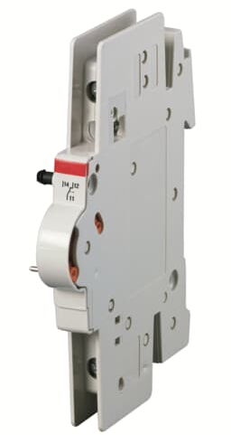
Accessories Portfolio
Signalation – Signal Contact S2C-S6R U
Suitable for S200U / S200UP / S200UDC
Rating according UL 489 / CSA22-2 No.5:
  1A / 480 VAC
  2A / 277 VAC
  1.5 A / 125 VDC
  2A / 60 VDC
  4 A / 24 VDC
Cross section of conductors:
  0.75 – 2.5 mm²
Dimensions: 100x69x8.8 mm

Slide 20
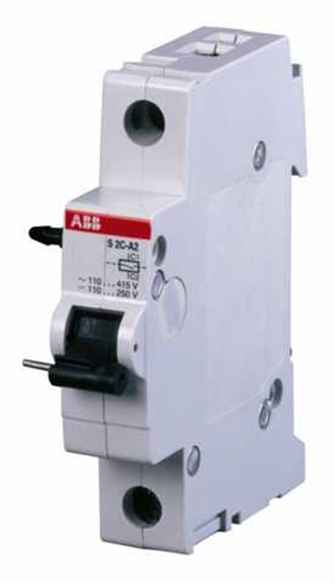
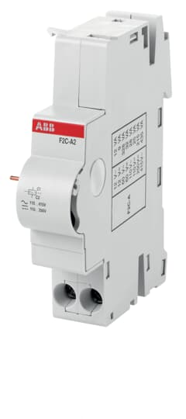
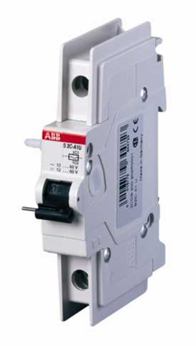
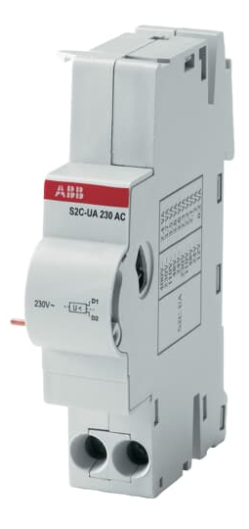
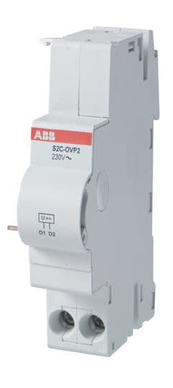
Accessories Portfolio
Switch - Overview
Product name | S2C-Ax | F2C-Ax | S2C-AxU | S2C-UA | S2C-OVP
Description | Shunt trip | Shunt trip | Shunt trip | Undervoltage release | Overvoltage release
Technical features | Rated voltage: A1: AC/DC 12…60 V A2: AC 110…415 V/DC 110…250 V | Rated voltage: A1: AC/DC 12…60 V A2: AC 110…415 V/DC 110…250 V | Rated voltage: A1: AC/DC 12…60 V A2: AC 110…415 V/DC 110…250 V | Rated voltage: 12,24,48,110,230 V DC 24,48,110, 230,400 V AC | Max Tripping voltage: OVP1: 275 V OVP2: 290 V

Slide 21
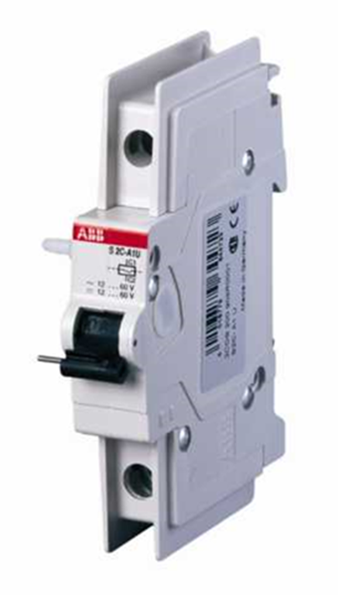
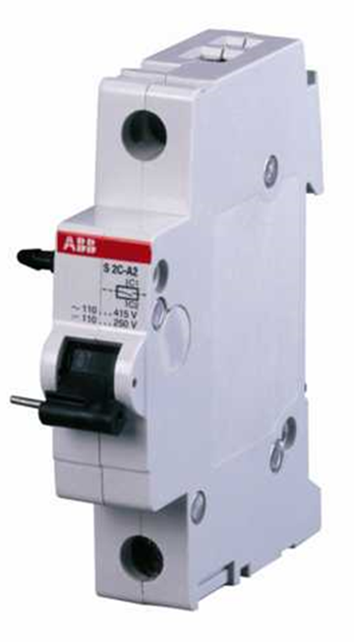
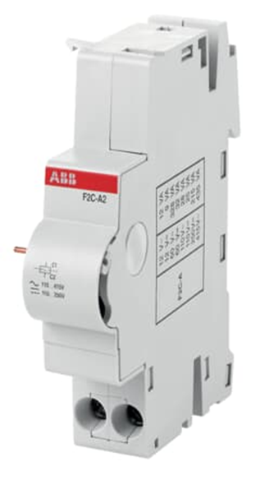
Accessories Portfolio
Switch – Shunt Trips
Shunt Trips allows to open remotely the associated device when a voltage is applied; tripping mechanism use a coil as for MCBs. To trip a shunt it is necessary to choose the right voltage and make sure the corresponding I_{bmax} is provided by the power supply used. If the power supply can provide higher currents the shunt trip will reduce the current to I_{bmax}.
As the shunt tripped the inner contact is open. The electrical circuit is disconnected even if the shunt trip is still powered on.
The free-tripping mechanism of the shunt trip allows a restart of the MCB or RCBO only after the shunt trip gets no external release signal anymore.
Suitable for MCBs S 200 series, RCBOs DS 200 series, SD 200 switch disconnectors series.

Slide 22
Accessories Portfolio
Switch – Shunt Trips S2C-Ax
Suitable for System pro M compact S200 Range/SN201/F200/S200
Rated Voltage:
  12…60V AC/DC (S2C-A1)
  110…415V AC/ 110…250v V DC (S2C-A2)
Max release duration: <10 ms @ rated voltage
Min release voltage:
  8.4V AC, 8.4V DC (S2C-A1)
  77V AC, 77V DC (S2C-A1)
Coil resistance:
  3.7 Ω (S2C-A1)
  225 Ω (S2C-A2)
Dimensions: 88x69x17.5 mm

Slide 23
Accessories Portfolio
Switch – Shunt Trips F2C-Ax
Suitable for RCCBs F 200 series/RCBOs DS201/DS201 (2019)/DS202C/DSE201 M/AFDD S-ARC1.
It can be used with MCBs SN201 and RCBOs DS203NC series by means of SN201-IH interface module.
Rated Voltage:
  12…60V AC/DC (F2C-A1)
  110…415V AC/ 110…250v V DC (F2C-A2)
Max release duration: <10 ms
Min release voltage:
  6V AC, 4.5V DC (S2C-A1)
  75V AC, 55V DC (S2C-A1)
Coil resistance:
  5.5 Ω (S2C-A1)
  1355 Ω (S2C-A2)
Dimensions: 88x69x17.5 mm

Slide 24
Accessories Portfolio
Switch – Shunt Trips S2C-AxU
Suitable for for S200U/S200UP/S200UDC
Rated Voltage:
  12…60V AC/DC (S2C-A1U)
  110…415V AC/ 110…250v V DC (S2C-A2U)
Max release duration: <10 ms
Min release voltage:
  7V AC, 10V DC (S2C-A1U)
  55V AC, 80V DC (S2C-A1U)
Coil resistance:
  3.7 Ω (S2C-A1U)
  225 Ω (S2C-A2U)
Dimensions: 100x69x17.5 mm

Slide 25
Accessories Portfolio
Switch – Undervoltage Release
Undervoltage release allows to protect the load in the event of a voltage drop (between 70% and 35% of its rated value). It’s a positive safety device, it trips when the voltage is disconnected. It ca be shut down (i.e emergency stop) by means of a button.
Suitable for MCBs S 200 series, RCCBs F200 series and RCBOs DS201, DS201 (2019), DS202C, DSE201 M, AFDD S-ARC1 series, DS 200 series, SD 200 switch disconnectors series.
It can be used with MCBs SN201 and RCBOs DS203NC series by means of SN201-IH interface module.

Slide 26
Accessories Portfolio
Switch – Undervoltage Release S2C-UAxx DC & S2C-UAxx AC
Suitable for System pro M compact/SN201/F200/DS200
Rated Voltage:
  12, 24, 48, 110, 230, 400 V
Cross section of conductors:
  2x1.5 mm²
Versions: 10
V | 12 | 24 | 48 | 110 | 230 | 400
AC | - | y | y | y | y | y
DC | y | y | y | y | y | -

Slide 27
Accessorie Portfolio
Switch – Overvoltage Release
Overvoltage release to monitor voltage between the neutral and phase; when an overvoltage reaches the threshold value, the OVP device causes the tripping of the associated MCB or RCCB.
Suitable for MCBs of the S200 series up to 63 A, and RCCBs of the F200 series up to 100 A and RCBOs DS201, DS201 (2019), DS202C, DSE201 M, AFDD S-ARC1 series, SD 200 switch disconnectors series.
It can be used with MCBs SN201 and RCBOs DS203NC series by means of SN201-IH interface module.

Slide 28
Accessorie Portfolio
Switch – Overvoltage Release S2C-OVPx
Suitable for system pro M compact/F200/DS200
Rated Voltage:
  230VAC
Max non tripping voltage AC:
  253V
Max tripping voltage AC:
  270V (S2C-OVP1)
  290V (S2C-OVP2)
Tripping time:
  < 1s @ 290V AC
  < 0.1 @ 380V ac
Max duration of impulse command: 7ms

Slide 29
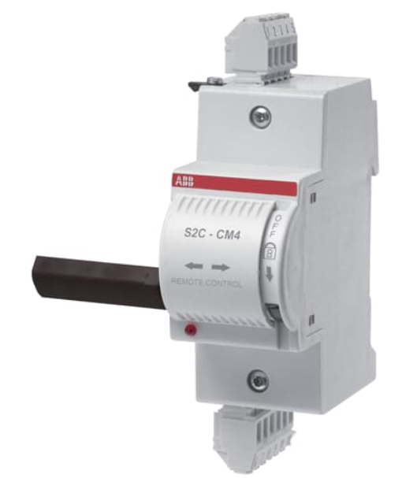
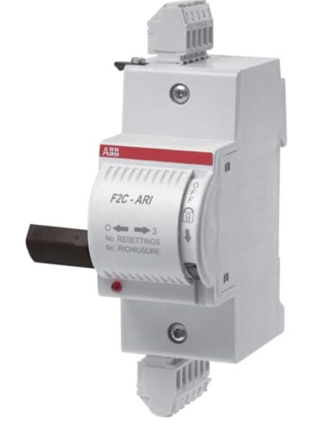
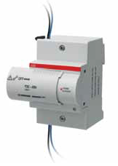
Accessories Portfolio
Control - Overview
Product name | x2C-CM | F2C-ARI | F2C-ARH
Description | Motor operating | Auto-reclosing unit | Home automatic resetting
Technical features | Supply voltage: 12 ... 30 V AC 12 ... 48 V DC | Supply voltage: 12 ... 30 V AC 12 ... 48 V DC | Supply voltage: 230 V AC

Slide 30
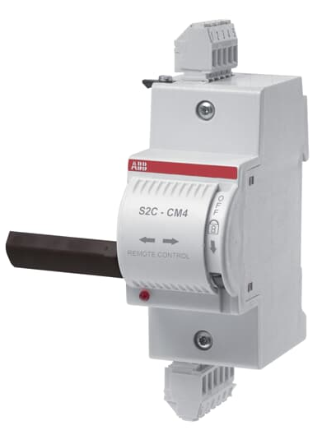
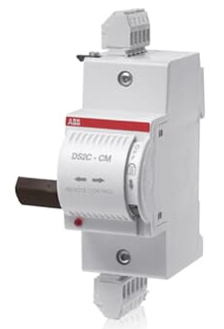
Accessories Portfolio
Control – Motor Operating Device
ABB control devices allow to remote open and close System pro M compact© devices they are linked to; suitable for S200L, S200, S200M, S200P up to 63A and any RCCB F200 series up to 100A. Control devices are equipped with an internal power reserve which guarantees the opening of the associated device even during power lack. Systems are unsensible to electrical disturbances due to their integrated control system, allowing a 100ms activation delay.
Motor operating devices allow the remote control of the coupled device. They are especially suitable in centralized systems (either large size or difficult to access) and whenever multiple daily intervention are needed such as unattended electrical lines or safety lines.

Slide 31
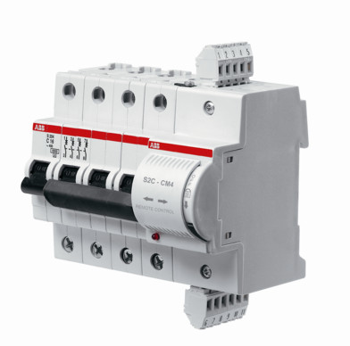
Accessories Portfolio
Control - Motor Operating Device x2C-CM
Suitable for S200 series MCBs, SD200 switch disconnectors,F200 RCCBs, RCBOs DS201, DS201 (2019), DS202C.
Supply:
  12…30V AC + 10% - 15%
  12…48V DC + 10% - 15%
Make time at ambient temperature: < 1s
Opening time at ambient temperature: < 0.5s
Number of operations: < 20.000
Cables length of control circuit: < 1500m
Cables cross-section: < 2.5 mm2
Versions: S2C-CMx/F2C-CMx/DS2C-CMx

Slide 32
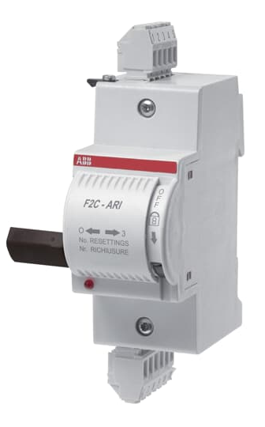
Accessories Portfolio
Control – Auto Reclosing Units
Auto-reclosing units are used to automatically operate the reclosing of the associated device in case of untimely intervention such as overcurrent due to lightning.
Those devices are particularly suitable in unattended systems and whenever service continuity must be guaranteed.
F2C-ARI systems perform three reclosing attempts, if all have a negative outcome the system lock and a manual intervention is required.

Slide 33
Accessories Portfolio
Control – Auto Reclosing Units F2C ARI & F2C-ARI 30
Suitable for F200 series RCCBs,up to 100A.
Supply:
  12…30V AC + 10% - 15%
  12…48V DC + 10% - 15%
Number of automatic reset attempts: 3
Waiting time between reset attempts:
  3s (F2C ARI)
  30s (F2C ARI 30)
Closing time at ambient temperature: <1s
Opening time at ambient temperature: < 0.5s
Number of operations: < 20.000
Cables length of control circuit: < 1500m
Cables cross-section: < 2.5 mm2

Slide 34
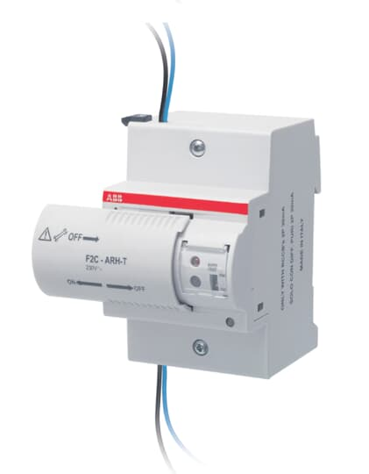
Accessories Portfolio
Control – Home Automatic Resetting Units
Auto-reclosing units are used to automatically operate the reclosing of the associated device in case of untimely intervention such as overcurrent due to lightning.
This devices recloses the associated residual current device, only after having checked that
there are no effective faults in the system protected by the RCCB.

Slide 35
Accessories Portfolio
Control –Home Automatic Resetting Units FSC-ARH & F2C-ARHT
Suitable for 2-pole RCCB series with 30 mA or 100 mA sensitivities, max 63A.
Supply:
  230 VAC
Number of automatic reset attempts: 1
Reset time for counter of automatic reclosing attempts:
  12s
Number of operations: < 10.000
Cables cross-section: < 2.5 mm2
Signal contact rated current: 3A
F2X-ARH-T allows the RCCB automatic test every six months

Slide 36
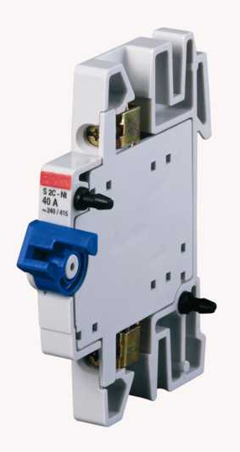
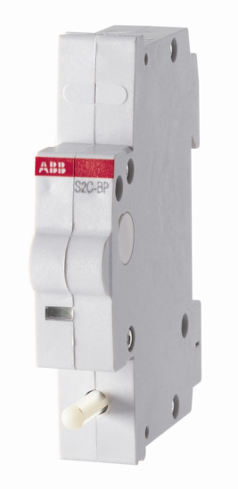
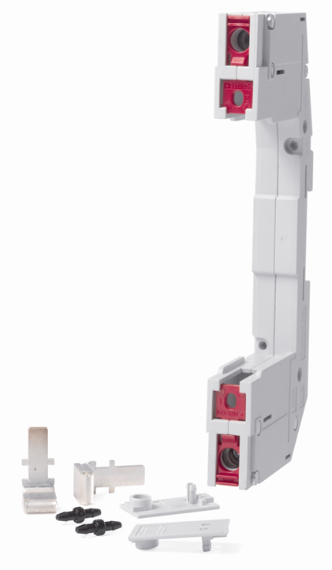
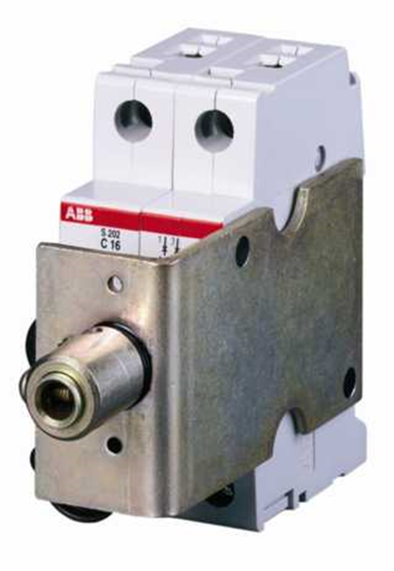
Accessories Portfolio
Others
Product name | S2C-NT | S2C-BP | S2C-EST | S2C-DH
Description | Hand operated neutral | Mechanical tripping | Plug-in base | Rotatory operating mechanism
Technical features | Rated current: 40A max | - | - | S200 devices only

Slide 37
Accessories Portfolio
Others – Hand Operated Neutral S2C-NT
Hand operated neutral has to be mounted to the left side of the MCB and be snaped on the DIN rail. It is used for measuring duties where the neutral conductor must be in the open position. Due to the special design of the handle the neutral will make before the MCB is closed.
Suitable for System pro M compact/SD 200 switch disconnectors series.
Rated Current:
    40A max
Cross section of conductors: 10 mm²
Dimensions: 85x69x8.8 mm

Slide 38
Accessories Portfolio
Others – Mechanical Tripping Device S2C-BP
Mechanical tripping device causes the automatic tripping of the circuit-breakers which it is associated to, when the panel or the door of the electrical switchboard are opened or removed.
To be installed behind the component.
Suitable for MCBs S 200 series (on both sides)/DS200 (right side only)/SD200 switch disconnectors series.

Slide 39
Accessories Portfolio
Others – Plug-in Base Device S2C-EST
Plug-in base is used to transform a standard circuit-breaker of the S200 and F200 range in a plug-in device which can be pulled out of the circuit where it is installed in one operation.
Suitable for MCBs S200 series/RCCBs F200 series (up to 63A)/ RCBOs DS201/DS202C/AFDD S-ARC1 series.

Slide 40
Accessories Portfolio
Others – Rotary Operating Mechanism S2C-DH
Rotary operating mechanism allows the actuation of 2-, 3- or 4pole miniature circuit-breakers in closed distribution boards (allows manual control from outside the enclosoure) for driveaxles of 5 or 6 mm².
Suitable for S200 devices only

Slide 41

Accessories Portfolio
Connect - Busbars
Busbars: | PS | PS…CB | PS…BP | PS…BP-C | PS…DC
Suitable for: | MCB: S200, S200M, S200P RCD: F200, DDA-blocks | MCB: S200, S200M, S200P, S200MUC, S200MTUC | MCB: SU200M, S200UDC, S200U, S200UP | MCB: SU200M, S200UDC, S200U, S200UP | MCBs, Fuseholders E90
Standards: | for IEC applications IEC/EN 60947-1 | for IEC / UL applications IEC/EN 60947-1 UL1077 | for IEC / UL applications IEC/EN 60947-1 UL489 | for IEC / UL applications IEC/EN 60947-1 UL508 | for IEC applications IEC/EN 60947-1

Slide 42
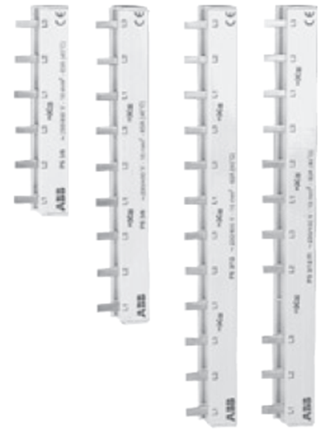
Accessories Portfolio
Connect - Busbars
Busbars systems are used to enable the safe and economic cross connection of MCBs, RCCBs and RCBOs.
Suitable for MCBs S200, S200M, S200P…/RCDs F200, DDA200/S800
Commercial nomenclature:
PS / /
1 2 3 4 5 6 6 7
Number of pins
Applications
Phases
1: 1P
2: 2P
3: 3P
4: 4P
Wire cross section
-: 10 mm²
6: 6 mm²
16: 16 mm²
30: 30mm²

