Slide 1
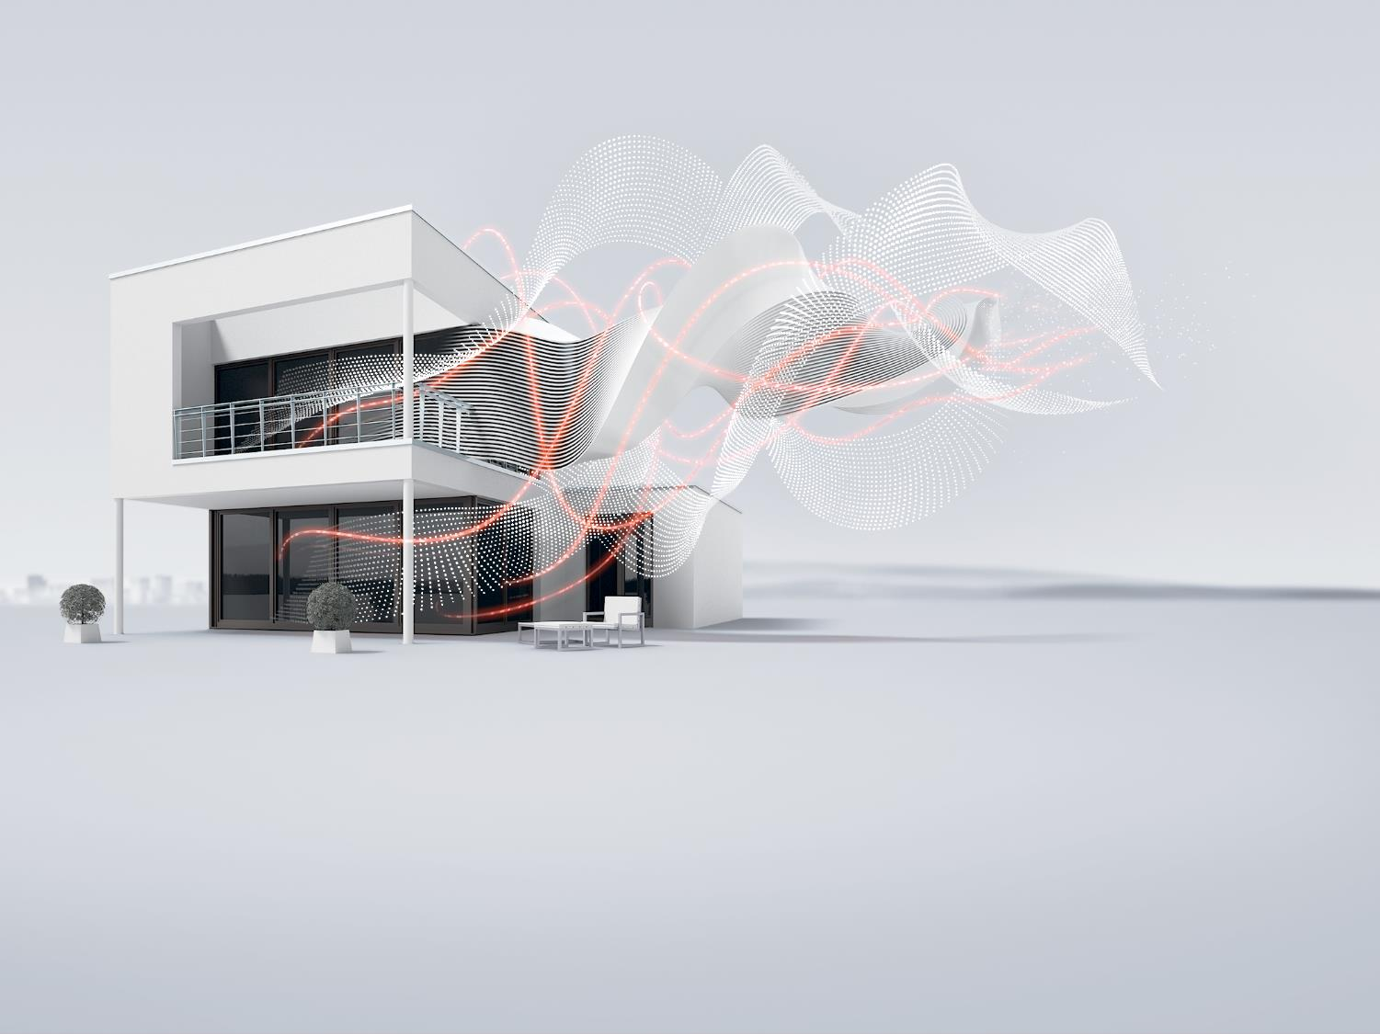

Busbars
Accessories for MCBs S 200, RCDs F 200 and DS 200 series
ELSB GPG Energy Distribution, Global Product Management

Slide 2

Busbars
Overview
Series: | Busbars PS | Busbars PS…CB | Busbars PS…BP | Busbars PS…BP-C | Busbars PS…DC
Suitable for: | MCB: S200, S200M, S200P RCD: F200, DDA-blocks | MCB: S200, S200M, S200P, S200MUC, S200MTUC | MCB: SU200M, S200UDC, S200U, S200UP | MCB: SU200M, S200UDC, S200U, S200UP | MCBs, Fuseholders E90
Standards: | for IEC applications IEC/EN 60947-1 | for IEC / UL applications IEC/EN 60947-1 UL1077 | for IEC / UL applications IEC/EN 60947-1 UL489 | for IEC / UL applications IEC/EN 60947-1 UL508 | for IEC applications IEC/EN 60947-1
Approvals: | - | UL508 | UL489 | UL489 | -

Slide 3




Busbars
Overview
Different ranges for different applications: compliance with IEC/EN and UL standards
Fast and easy installation
Clear classification of phases
Compliance with the highest requirements for protection against accidental contact

Slide 4
Busbars
Type Designation
Starting form type code it is possible to obtain all the necessary information about the characteristics the selected busbar has.
PS / /
1 2 3 4 5 6 7 7
Phases
1: | 1 phase
2: | 2 phases
3: | 3 phases
4: | 4 phases
Applications
…
Number of pins
Wire cross section
6: | 6 mm²
-: | 10 mm²
16: | 16 mm²
30: | 30 mm²

Slide 5
Busbars
Type Designation
Starting form type code it is possible to obtain all the necessary information about the characteristics the selected busbar includes.
6 7 7
Applications
 | 6 | 7 | 7
Busbar connection of MCBs and RCDs, N of the RCD omitted | F | I
Use for the neutral (E.g. phase order: L1-N-L2-N-L3-N-L1-N… etc.) | N
Slot for auxiliary contact | H
Slot for 2 auxiliary contact | H | 2
Trimmable pins |  |  | A
Busbar for devices 3Ph+ N with 1Ph+N (E.g. phase order: L1-L2-L3-N-L1-N-L2-N-L1-N-…) | N | N
Busbar for IT-grids | I | T
Busbar for UL 489 (Branch Protection) | B | P
Busbar for UL 1077 (Supplementary Protection) | S | P

Slide 6
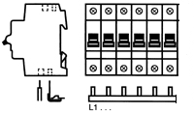
Busbars
Selection Criterion
Step 1 - Preliminary information
Step 2 - Wiring examples
Type of devices
Number of devices
Presence of auxiliary contacts
Number of phases
Phases sequence
Rated current
Top/bottom installation
Pre-assembled/suitable for cutting
The suitable busbar for the desired application can be found with the help of wiring examples on ABB catalogue.
Place for mounting Phase(s) indication

Slide 7
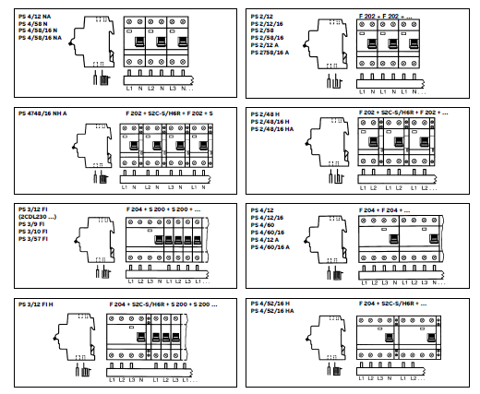
Busbars
Selection Criterion
Step 2 - Wiring examples
Several wiring examples are available according to:
Phases
Phases sequence
Number of pins
Main protection device
Mounting position

Slide 8
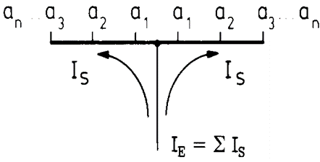
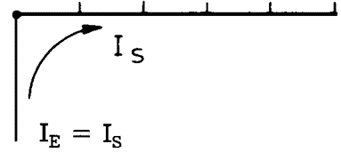
Busbars
Feeding Position
Side feeding Middle feeding
Busbars can be feed both from the side and from the middle.
Middle feeding is a viable solution when side one present a current Is too high to be stand; this solution split in two currents Is and the busbar supports higher rated currents.
In case of feed in from the middle of the busbar it needs to be ensured, that the sum of junction currents per side must not exceed the max busbar current Is/phase.
Irrespective of the current carrying capacity of the busbar, the maximum rated current of the devices terminal may not be exceeded.

Slide 9
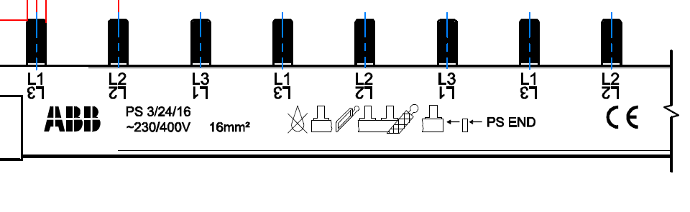
Busbars
Printing
Main information are printed on the busbar as well
Type code
Handling instructions
Phase sequence (except 1 phase busbars) both at 0°(in case of bottom mounting) and 180° (top mounting)
Cross section is further specified
Requested type of end cap

Slide 10
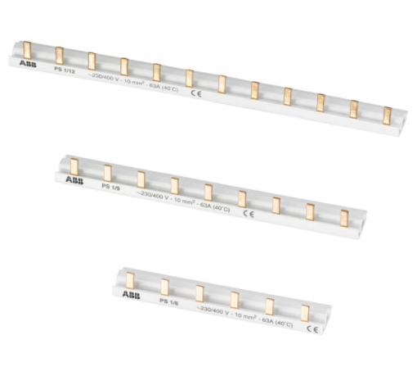
Busbars
Busbars PS – Product Range
Suitable for:
  MCB: S200, S200M, S200P
  RCD: F200, DDA-blocks
Pre-assembled busbar:
  1/3 phases
Cuttable busbars:
  1/2/3/4 phases
Rated current:
  80-125A/690 VAC, 690 VDC (AST feeder terminal)
  100-125A/690 VAC, 690 VDC (SZ-ESK feeder terminal)
Feeder terminals, shock protection caps and end caps available as accessories

Slide 11
Busbars
Busbars PS – Technical Data
Electrical Data | Standards |  | IEC/EN 60947-1
 | Approvals |  | -
 | Rated voltage Ue |  | 1P, 2P, 3P, 4P: 690V AC, 690V DC
 | Current carrying capacity |  | 10 mm² | 16 mm² | 30 mm²
 |  | End feeding | 63 | 80 | 120
 |  | Non end feeding | 100 | 130 | 160
Install. | Cross-section |  | 10 mm² | 16 mm² | 30 mm²
Accessories | Shock-protection |  | BSK, SZ-BSK
 | Feeder terminals |  | Range AST, SZ-ESK
 | End caps |  | Range END, PS-END, PSB-END

Slide 12
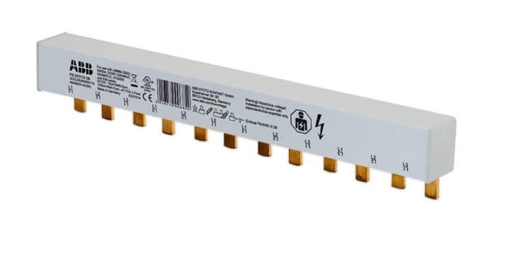
Busbars
Busbars PS…CB – Product Range
Suitable for:
  MCB: S200, S200M, S200P, S200MUC, S200MTUC
Cuttable busbars:
  1/2/3 phases
Rated current:
  115A/1000V AC/DC (AST…CB feeder terminal)
  115A/690V AC/DC (SZ-ESK SP feeder terminal)
Feeder terminals, shock protection caps and end caps available as accessories

Slide 13
Busbars
Busbars PS…CB – Technical Data
Electrical Data | Standards |  | IEC/EN 60947-1 UL1077
 | Approvals |  | UL508
 | Rated voltage Ue |  | 1P: 1000V AC/DC 2P,2P: 600V AC/DC
 | Current carrying capacity |  | 18 mm² | 25 mm²
 |  | End feeding | 80A | 100A
 |  | Non end feeding | 160A | 200A
Install. | Cross-section |  | 18 mm² | 25 mm²
Accessories | Shock-protection |  | BSK CB
 | Feeder terminals |  | AST 35/15…CB; AST35/38…CB SZ-ESK SP
 | End caps |  | PS-END SP; PS-END1 SP

Slide 14
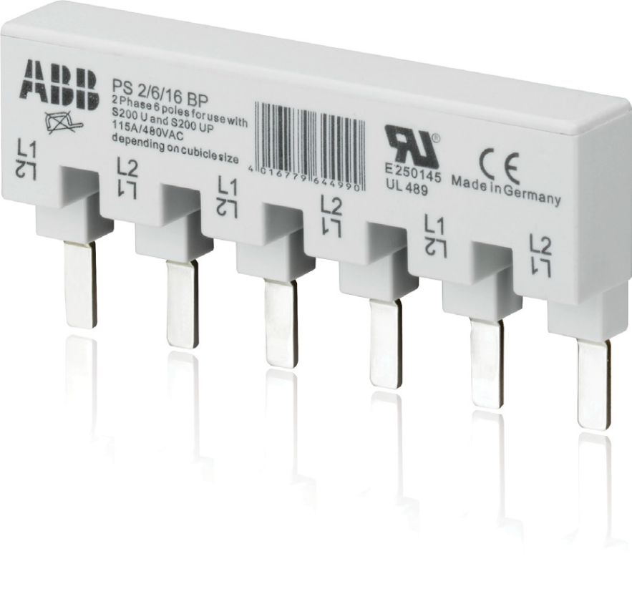
Busbars
Busbars PS…BP – Product Range
Suitable for:
  MCB: SU200M, S200UDC, S200U, S200UP
Pre-assembled busbars:
  1/2/3 phases
Existing busbars can be combined with 6/12/18 pins available for adaptation to the application
Rated current:
  115A/480VAC
Feeder terminals and shock protection caps with UL approval available as accessories

Slide 15
Busbars
Busbars PS…BP – Technical Data
Electrical Data | Standards |  | IEC/EN 60947-1 UL489
 | Approvals |  | UL489
 | Rated voltage Ue |  | 1P, 2P, 3P: 480 V AC
 | Current carrying capacity |  | 16 mm²
 |  | End feeding | 80A
Install. | Cross-section |  | 16 mm²
Accessories | Shock-protection |  | BSK BP
 | Feeder terminals |  | AST 35/15 BP SZ-ESK BP
 | End caps |  | -

Slide 16
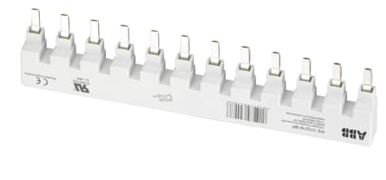
Busbars
Busbars PS…BP-C – Product Range
Suitable for:
  MCB: SU200M, S200UDC, S200U, S200UP
  RCD: F200, DDA-blocks
Cuttable busbars:
  1/2/3 phases
Rated current:
  115A/1000V AC/DC (75° wire)
  95A/1000V AC/DC (60° wire)
Feeder terminals, shock protection caps and end caps available as accessories

Slide 17
Busbars
Busbars PS…BP-C – Technical Data
Electrical Data | Standards |  | IEC/EN 60947-1 UL508
 | Approvals |  | UL508
 | Rated voltage Ue |  | 600V AC/DC
 | Current carrying capacity |  | 25 mm²
 |  | End feeding | 100A
 |  | Non end feeding | 200A
Install. | Cross-section |  | 25 mm²
Accessories | Shock-protection |  | BSK BP-C
 | Feeder terminals |  | AST 35/58 BP-C
 | End caps |  | PS-END 3 BP-C

Slide 18
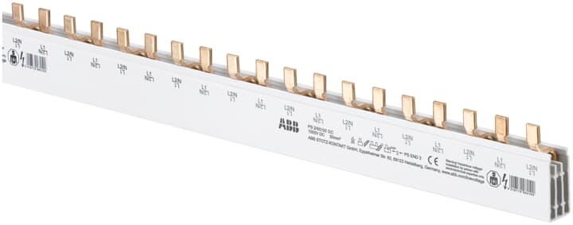
Busbars
Busbars PS…DC – Product Range
Suitable for:
  MCBs
  Fuseholders
For use in applications up to 1000V DC
Cuttable busbars:
  1/2 phases
Feeder terminals and end caps available as accessories

Slide 19
Busbars
Busbars PS…DC – Technical Data
Electrical Data | Standards |  | IEC/EN 60947-1
 | Approvals |  | -
 | Rated voltage Ue |  | 690V AC / 1000V DC
 | Current carrying capacity |  | 30 mm²
 |  | End feeding | 100A
 |  | Non end feeding | 160A
Install. | Cross-section |  | 30 mm²
Accessories | Shock-protection |  | -
 | Feeder terminals |  | AST 35/18 DC (1P busbar) AST 35/45 DC (2P busbar)
 | End caps |  | PS-END0; PS-END3

Slide 20
Busbars
Other Ranges
PSH Busbars
Busbars for SN201
Busbars for S200C
Suitable for:
  MCB: SH200
  RCD: FH200
Cuttable busbars:
  1/2/3/4 phases
Rated current:
  63 A
End caps available as accessories
Suitable for:
  SN201
  F200 + SN201
Pre-assembled busbars:
  2/4 phases (F200 + SN201)
Cuttable busbars:
  1/3 phases (SN201)
Rated current:
  63A
Feed-in and end caps available as accessories
Suitable for:
  S200C MCBs compact range
Pre-assembled busbars :
  1/2/3/4 phases
Cuttable busbars:
  3/4 phases
Rated current:
  63A
Feeder terminals and end caps available as accessories

