Slide 1

Industrial Solutions NEMA Starters
Notes:
This presentation will discuss ABB EPIS NEMA Starters

Slide 2
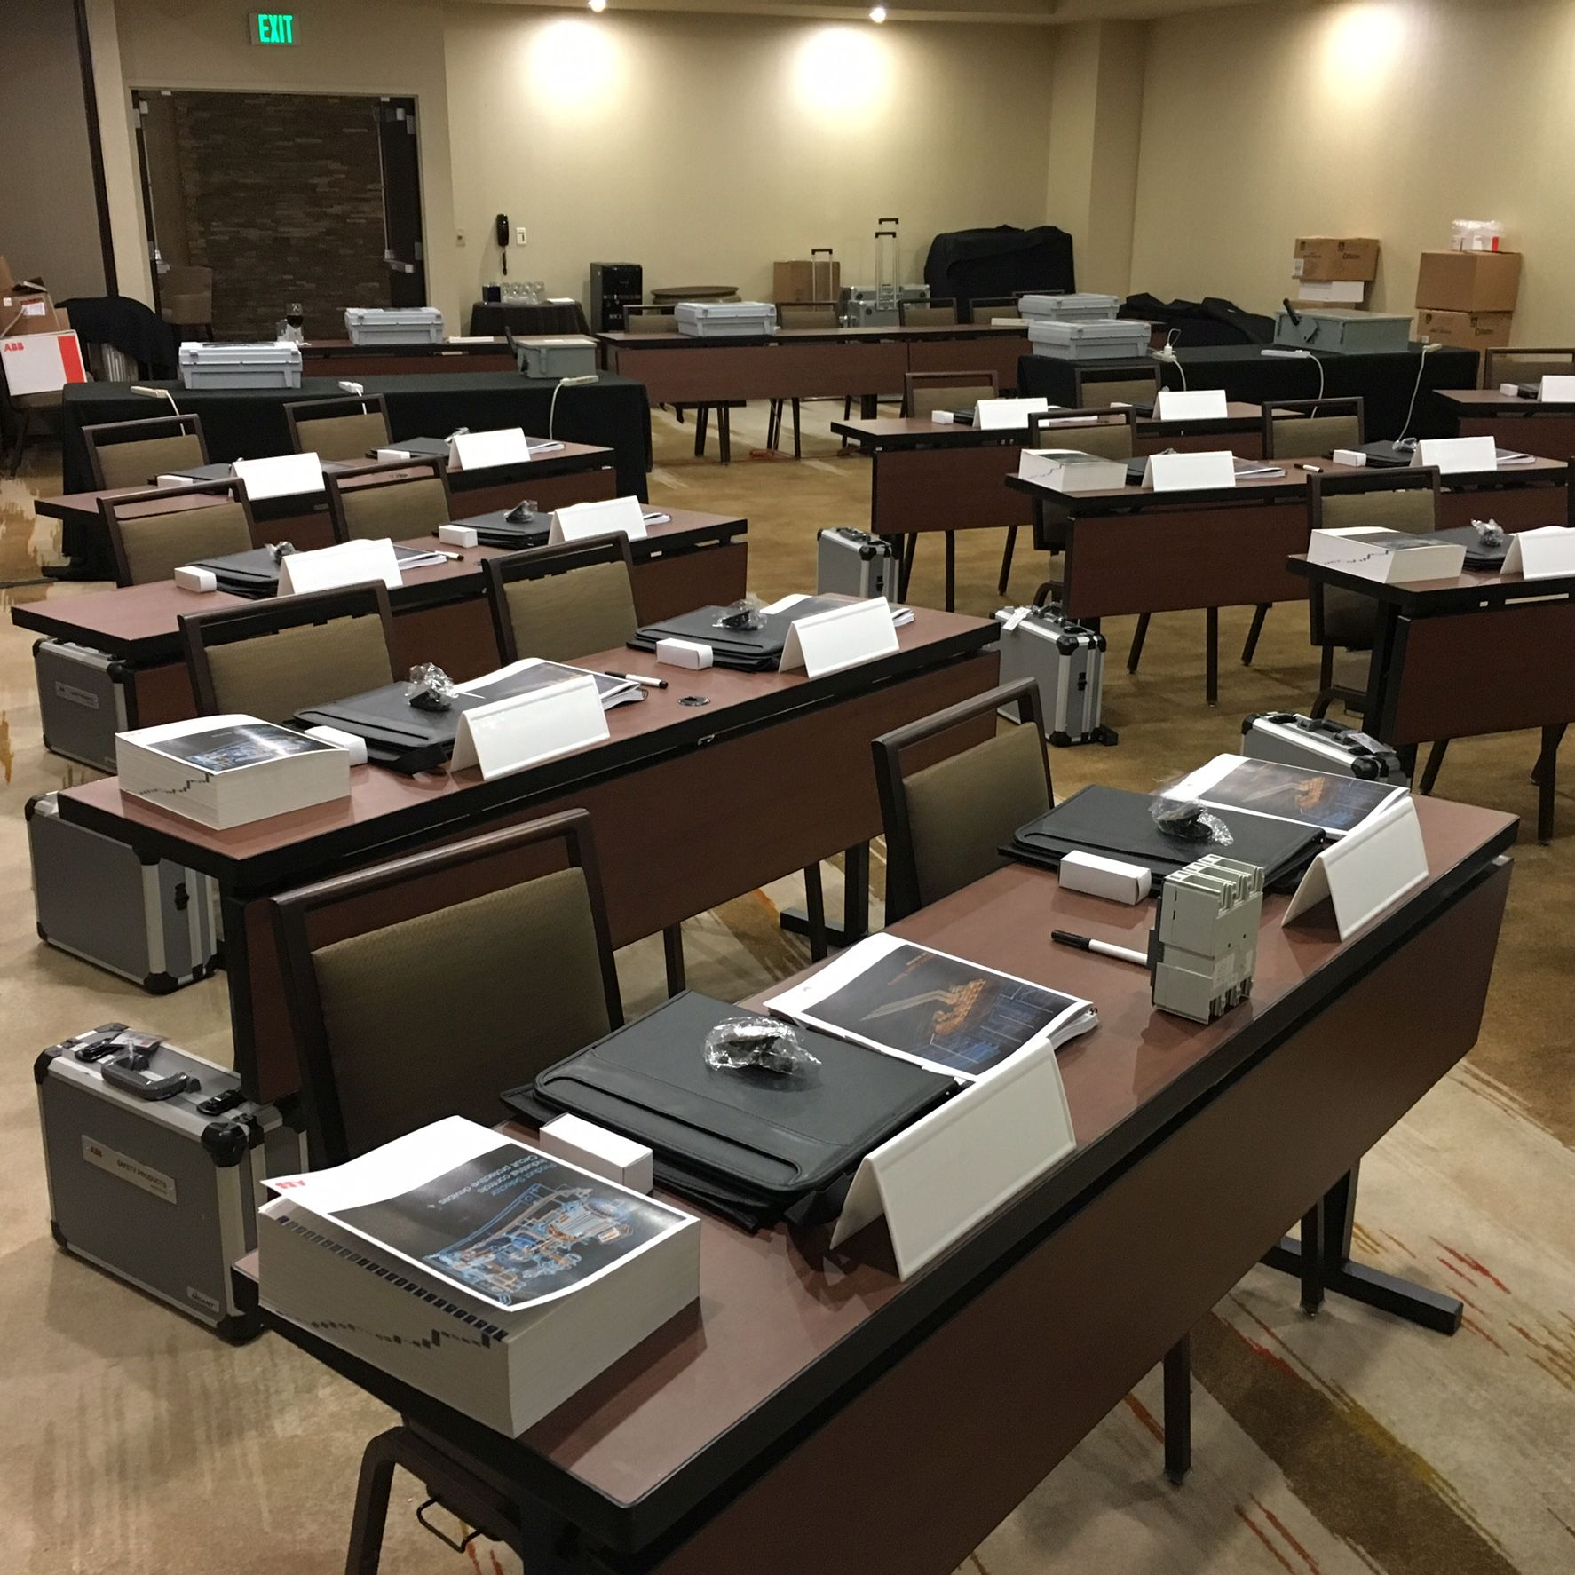
ABB NEMA Starters
Disclaimer
The information in this document is subject to change without notice and should not be construed as a commitment by ABB. ABB assumes no responsibility for any errors that may appear in this document.
In no event shall ABB be liable for direct, indirect, special, incidental or consequential damages of any nature or kind arising from the use of this document, nor shall ABB be liable for incidental or consequential damages arising from the use of any software or hardware described in this document.
© Copyright [2022] ABB. All rights reserved.
Notes:
Intro Portion - disclaimer
If there are non-ABB people in the crowd, you will need this. Don‘t read it out loud, word for word. Click it up there, leave it for a few seconds while you talk about what‘s coming, then move on.

Slide 3
ABB NEMA starters
Topics to be covered
General NEMA starter information.
ABB starter features
ABB starter renewal parts
ABB starter accessories
Key questions to ask for starters
ABB starter sales and marketing resources

Slide 4
NEMA standards (1/2)
Standards provide uniformity in ratings and application of electrical products.
National Electrical Manufacturers’ Association.
  Founded prior to 1940 by
    Associated Manufacturers of Electrical Supplies
    Electric Power Club
Representation consists of domestic electrical device manufacturers.
Notes:
NEMA, standing for National Electrical Manufacturers Association was created pre-1940’s and was intended to bring functional interchangeability amongst manufacturers. You may need to change the mounting points, but anyone’s NEMA size 1 starter can be used on a 10HP motor at 480V.

Slide 5
NEMA standards (2/2)
Electrical interchangeability among manufacturers for a given NEMA size.
Replaceable power contacts.
Encapsulated coils.
Enough reserve capacity to ensure performance over broad applications under NEC without assessment of life requirements.
Class 20 overload protection.
Notes:
In order for a starter to be rated NEMA, it has to meet certain characteristics. First there has to be the aforementioned functional interchangeability amongst manufacturers. Next it has to have replaceable contacts. As your probably aware, each time a contact opens, an arc is created, causing damage to the contact surfaces. With a circuit breaker, it’s not unusual to turn the breaker on, and it stays on for 20 or 30 years. Contacts on starters however may be opening and closing many times an hour. They will need to be replaced. It didn’t make sense to have to replace the whole starter because the contacts wore out, so the contacts need to be replaceable. Coils will wear out too. Just as it sounds, a coil is a winding of wire. In order to be able to replace it easily, the wire must be encapsulated so it doesn’t come unwound when being replaced. Enough reserve capacity to ensure …. it means NEMA starters are typically considered to be capable of 10 million operations. Class 20 overload protection means that in a locked rotor condition, the overload will hold for 20 seconds, the NEMA standard. On electronic overloads they are factory set at class 20, but you have the option of selecting Class 10 or Class 30, which as you might guess gives you 10 seconds or 30 seconds in a locked rotor condition.

Slide 6
NEMA device ratings
Complete line of power contactors, starters, starter assemblies, and accessories from NEMA Size 0 to NEMA Size 9.
NEMA Size | Enclosed continuous ampere rating | 1 Phase HP at 115V-120V | 1 Phase HP at 230V-240V | 3 Phase HP at 230V-240V | 3 Phase HP at 460V-600V
00 0 1 | 9 18 27 | 1/3 1 2 | 1 2 3 | 1 ½ 3 7 ½ | 2 5 10
2 3 | 45 90 | 3 - | 7 ½ - | 15 30 | 25 50
4 5 | 135 270 | - - | - - | 50 100 | 100 200
6 7 | 540 810 | - - | - - | 200 300 | 400 600
8 9 | 1215 2250 | - - | - - | 450 800 | 900 1600
Notes:
Here is the table that all NEMA starter manufacturers design their starters to. Not only does it list all of the horsepower ratings for different voltages, but also shows the maximum current rating for each NEMA size.

Slide 7
ABB IS 300 line
Across-the-line starters.
Combination starters.
Reduced voltage starters.
Reversing forms.
Two-speed.
Notes:
Across the line starters are just a magnetic starter either in an enclosure or open, (no enclosure). When the coil is energized, the power contacts close allowing current to go to the motor. With this type of starter, you experience an inrush of current, typically six times the full load amps of the motor when it is turned on. Similarly to a car, it takes more energy to get a motor up to speed than it does to keep it at speed.

Slide 8
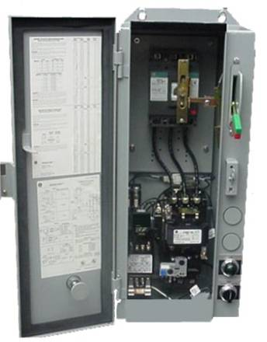
NEMA Combination Starters
Disconnect Types
- Fusible Switch
- Non-fusible Switch
- Thermal Magnetic Circuit Breaker
- Magnetic Only Circuit Breaker (MCP)
Notes:
As you’re probably aware, adding a disconnecting means to the starter enclosure makes it a combination starter. There are four disconnecting means available. Most common is the fusible switch. Non-fusible switches are also available. As far as circuit breakers, thermal magnetic breakers are available but not very common. Magnetic only circuit breakers are widely used. There is no need for thermal overcurrent protection in the breaker as the overload rely performs this task, and the magnetic only breakers are less expensive than the thermal mags. These breakers can also be accessorized with shunt trips, bell alarms and auxiliary contacts while fusible switches can have only auxiliary contacts. You may hear the term MCP in these applications. This is just another name for the magnetic only breaker and stands for Motor Circuit Protector. It’s the name of a manufacturers line of magnetic only breakers but has become synonymous in the industry with these breakers, similar to Kleenex and facial tissues. Our line of magnetic only breakers is called Mag-Break

Slide 9
ABB IS 300 line
Across-the-line starters.
Combination starters.
Reduced voltage starters.
Reversing forms.
Two-speed.
Notes:
Reduced voltage starters are an older technology used in applications where higher horse powers are needed. If you started a size 6 starter with an across the line starter, considering the typical 6 times nominal current inrush, you’d get a temporary current surge of about 3000A, enough to brown out some plants. Reduce voltage starters are kind of like putting a transmission on the starter. They’ll start the motor using different methods aimed at reducing current on initial startup then increase the current to full load amps as the motor gets to full speed. You’ll hear terms like Star-delta, Wye-delta, and Autotransformer when discussing these. These days, Solidstate starters and even drives are used for these applications.
Reversing starters are still used as a cost effective way to make the motor go in both directions. Two speed motors are also still used, but in a lot of cases, people are moving up to drives where they can have many speeds available instead of just two.

Slide 10
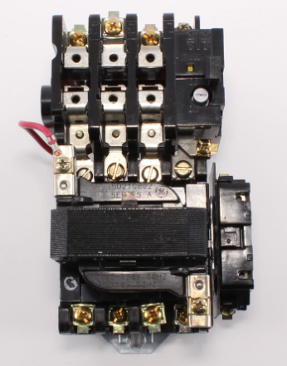
Contactor Features
  Staggered line and power terminals on Size 0 and Size 1
  Captive saddle clamps on line/load terminals
  Permanent terminal markers on both line/load terminals
  Hardened magnet faces
  Straight-through wiring
Notes:
Hardened magnet faces mean long mechanical life for the starter.

Slide 11
Contactor Features
  Staggered line and power terminals on Size 0 and Size 1
  Captive saddle clamps on line/load terminals
  Permanent terminal markers on both line/load terminals
  Hardened magnet faces
  Straight-through wiring
Notes:
The 300 line contactor has staggered line and load terminals on Size 0 and 1 reducing the possibility of arcing between terminals. In addition captive saddle clamps on the terminals simplify wiring with a strong connection and no fork or ring terminals needed.

Slide 12
Contactor Features
  Staggered line and power terminals on Size 0 and Size 1
  Captive saddle clamps on line/load terminals
  Permanent terminal markers on both line/load terminals
  Hardened magnet faces
  Straight-through wiring
Notes:
Permanently stamped tabs on the line and load terminals clearly indicate wire locations, making wiring easier.

Slide 13
Contactor Features
  Staggered line and power terminals on Size 0 and Size 1
  Captive saddle clamps on line/load terminals
  Permanent terminal markers on both line/load terminals
  Hardened magnet faces
  Straight-through wiring
Notes:
Hardened magnet faces mean long mechanical life for the starter.

Slide 14
Contactor Features
  Staggered line and power terminals on Size 0 and Size 1
  Captive saddle clamps on line/load terminals
  Permanent terminal markers on both line/load terminals
  Hardened magnet faces
  Straight-through wiring
Notes:
Straight thru wiring also simplifies installation.

Slide 15
Power + Control
480 Volt
3 Phase
Safety
Switch
Safety
Switch
Safety
Switch
Fuse 1
Fuse 2
Fuse 3
Fuse 4
Fuse 6
2
H1
X1
H3
120 Volt
H2
Fuse 5
H4
X2
M
M
M
OL
OL
OL
3∅
Motor
3 HP 480V
1800 RPM
GND
Notes:
When a control power transformer is used in a combination starter application, the primary of the transformer is powered between the disconnecting means, and the starter. This is done so when the disconnect is turned off, the control power is also de-energized.

Slide 16
Contactor Features
  Tapped holes on the line terminal for control wiring
Notes:
Tapped holes on the front of the contactor are for control power transformer installation, leaving the power wire terminals for power wiring only.

Slide 17
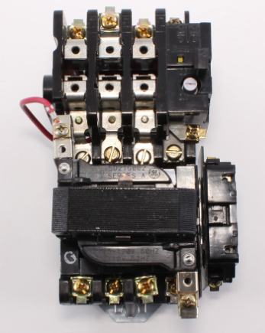
Contactor Features
  - Tool-less tear down for contact inspection or replacement and coil replacement
Notes:
One unique feature to the CR300 line contactor is you can both check for contact wear or replacement, and replace the coil without the use of tools. The first step is to lift the coil wire tabs up and swing them away from the coil terminals. Be careful to swing them straight up and down and not toward the sides.

Slide 18
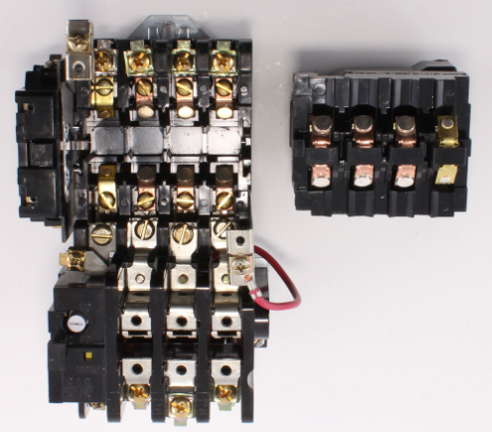
Contactor Features
  - Tool-less tear down for contact inspection or replacement
Notes:
Once the coil wire tabs are out of the way, lift up the coil, magnet, and moveable contacts assembly. The contacts, both stationary and moveable, can now be inspected and replaced if needed.

Slide 19
Contactor Features
  - Contact replacement without power wiring removal
Notes:
If contact replacement is needed, the stationary contacts can be replaced without the need to remove the power wiring. We’ve added a second set of screws to hold these contacts in place so there is no danger of mixing up the power wires when re-installing them thus no danger of changing the rotation of the motor.

Slide 20
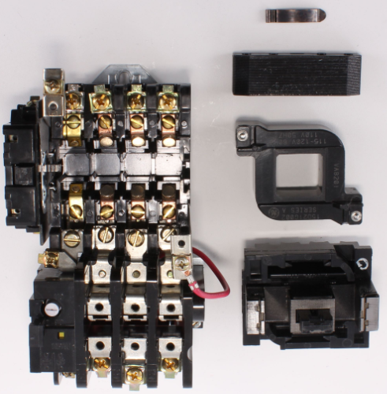
Contactor Features
Spring Retainer Clip
Upper Magnet
Coil
Lower Magnet
  - Tool-less tear down for coil replacement
Notes:
Continuing the disassembly, remove the spring retainer clip from the upper magnet, lift the upper magnet up, and remove the coil from the lower magnet. Reinstall the new coil in the reverse order.

Slide 21
Contactor Features
Spring Retainer Clip
Upper Magnet
Lower Magnet
  Control power rating and part number permanently stamped on coil
Notes:
Note that the coil’s voltage rating and part number is etched onto it and will not rub or wear off.

Slide 22
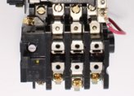
Overload Relays – Bi-metallic
Standard Class 20, bi-metallic form
Optional ambient compensated forms
Field installable heaters
Visible trip indication
Weld check
Reset on the upstroke
Optional NO auxiliary contacts
+/-10% trip adjustment knob
Notes:
Now let’s discuss how overcurrent protection is accomplished in the NEMA starter. Bi-metallic overloads are designed to deflect as heat in the element increases. Because they may be installed in a room with high temperatures, the element could deflect more quickly than it should. As a result, ambient compensated versions of these overload relays are available.

Slide 23
Overload Relays – Bi-metallic
Standard Class 20, bi-metallic form
Optional ambient compensated forms
Field installable heaters
Visible trip indication
Weld check
Reset on the upstroke
Optional NO auxiliary contacts
+/-10% trip adjustment knob
Notes:
Now let’s discuss how overcurrent protection is accomplished in the NEMA starter. Bi-metallic overloads are designed to deflect as heat in the element increases. Because they may be installed in a room with high temperatures, the element could deflect more quickly than it should. As a result, ambient compensated versions of these overload relays are available.

Slide 24
Overload Relays – Bi-metallic
Standard Class 20, bi-metallic form
Optional ambient compensated forms
Field installable heaters
Visible trip indication
Weld check
Reset on the upstroke
Optional NO auxiliary contacts
+/-10% trip adjustment knob
Notes:
Field installable heaters provide precise overcurrent protection allowing the installer to fine tune the amperage allowed to get through to the motor.

Slide 25
Overload Relays – Bi-metallic
Standard Class 20, bi-metallic form
Optional ambient compensated forms
Field installable heaters
Visible trip indication
Weld check
Reset on the upstroke
Optional NO auxiliary contacts
+/-10% trip adjustment knob
Notes:
When the overload trips, the yellow visible trip indicator clearly shows a tripped condition.

Slide 26
Overload Relays – Bi-metallic
Standard Class 20, bi-metallic form
Optional ambient compensated forms
Field installable heaters
Visible trip indication
Weld check
Reset on the upstroke
Optional NO auxiliary contacts
+/-10% trip adjustment knob
Notes:
The weld check button is used to verify that the overload contact is in fact opening when the overload trips. Pushing it in will manually trip the overload relay. You should see the yellow trip indicator pop up, and the overload contact should now be open. Resetting the overload should again latch the overload contact closed.

Slide 27
Overload Relays – Bi-metallic
Standard Class 20, bi-metallic form
Optional ambient compensated forms
Field installable heaters
Visible trip indication
Weld check
Reset on the upstroke
Optional NO auxiliary contacts
+/-10% trip adjustment knob
Notes:
You’ll notice when resetting the overload using the reset bar that the yellow indicator doesn’t go away until your finger is moving away from the overload. This is a safety feature designed so your finger is moving away from the starter in case you’re closing the circuit into a potentially dangerous situation.

Slide 28
Overload Relays – Bi-metallic
Standard Class 20, bi-metallic form
Optional ambient compensated forms
Field installable heaters
Visible trip indication
Weld check
Reset on the upstroke
Optional NO auxiliary contacts
+/-10% trip adjustment knob
Notes:
In addition to the standard normally closed overload contact, an optional normally open contact, sometimes called an alarm contact, is available. This can be used to alert someone that the overload has tripped, or tied into some kind of automation system causing another action to take place.

Slide 29
Overload Relays – Bi-metallic
Standard Class 20, bi-metallic form
Optional ambient compensated forms
Field installable heaters
Visible trip indication
Weld check
Reset on the upstroke
Optional NO auxiliary contacts
+/-10% trip adjustment knob
Notes:
Standard on the bimetallic overload is a white dial that can be used to fine tune the heater amperage by giving you a + or – 10% adjustment.

Slide 30
Overload Relays – Solid State
Solid State Overload Relay
+/- 2% Trip Accuracy
Selectable Trip Class: 10, 20, & 30
Phase Loss Protection
1NO/1NC Contacts - Standard
Ambient Insensitive
No heaters
2:1 Trip Range
Power Factor Correction Capacitor Terminals –Standard
Available Remote Reset Option
Notes:
Another type of overcurrent protection on the NEMA starter is the solid state overload. The solid state overload has a trip accuracy of +/- 2% because it’s reading actual current as opposed to relying on metal deflecting due to heat.

Slide 31
Overload Relays – Solid State
Solid State Overload Relay
+/- 2% Trip Accuracy
Selectable Trip Class: 10, 20, & 30
Phase Loss Protection
1NO/1NC Contacts - Standard
Ambient Insensitive
No heaters
2:1 Trip Range
Power Factor Correction Capacitor Terminals –Standard
Available Remote Reset Option
Notes:
Another type of overcurrent protection on the NEMA starter is the solid state overload. The solid state overload has a trip accuracy of +/- 2% because it’s reading actual current as opposed to relying on metal deflecting due to heat.

Slide 32
Overload Relays – Solid State
Solid State Overload Relay
+/- 2% Trip Accuracy
Selectable Trip Class: 10, 20, & 30
Phase Loss Protection
1NO/1NC Contacts - Standard
Ambient Insensitive
No heaters
2:1 Trip Range
Power Factor Correction Capacitor Terminals –Standard
Available Remote Reset Option
Notes:
A slide switch is provided allowing the installer to choose between Class 10, 20, and 30 protection. It is set to Class 20 from the factory as that is the NEMA standard.

Slide 33
Overload Relays – Solid State
Solid State Overload Relay
+/- 2% Trip Accuracy
Selectable Trip Class: 10, 20, & 30
Phase Loss Protection
1NO/1NC Contacts - Standard
Ambient Insensitive
No heaters
2:1 Trip Range
Power Factor Correction Capacitor Terminals –Standard
Available Remote Reset Option
Notes:
Phase loss protection is standard on this overload relay negating the need for an under voltage release accessory on the breaker feeding the motor.

Slide 34
Overload Relays – Solid State
Solid State Overload Relay
+/- 2% Trip Accuracy
Selectable Trip Class: 10, 20, & 30
Phase Loss Protection
1NO/1NC Contacts - Standard
Ambient Insensitive
No heaters
2:1 Trip Range
Power Factor Correction Capacitor Terminals –Standard
Available Remote Reset Option
Notes:
In addition to the normally closed overload contact, a normally open overload contact is also standard.

Slide 35
Overload Relays – Solid State
Solid State Overload Relay
+/- 2% Trip Accuracy
Selectable Trip Class: 10, 20, & 30
Phase Loss Protection
1NO/1NC Contacts - Standard
Ambient Insensitive
No heaters
2:1 Trip Range
Power Factor Correction Capacitor Terminals –Standard
Available Remote Reset Option
Notes:
Unlike the bimetallic version, this overload uses CT’s to read current so it is ambient insensitive. You save the cost of the ambient compensating option needed on the bimetallic overload.

Slide 36
Overload Relays – Solid State
Solid State Overload Relay
+/- 2% Trip Accuracy
Selectable Trip Class: 10, 20, & 30
Phase Loss Protection
1NO/1NC Contacts - Standard
Ambient Insensitive
No heaters
2:1 Trip Range
Power Factor Correction Capacitor Terminals –Standard
Available Remote Reset Option
Notes:
And because these overloads use an adjustable dial to set the amperage, there are no overload heaters involved. Since heaters are no longer needed, inventory cost and space are reduced for both the distributor and the end user.

Slide 37
Overload Relays – Solid State
Solid State Overload Relay
+/- 2% Trip Accuracy
Selectable Trip Class: 10, 20, & 30
Phase Loss Protection
1NO/1NC Contacts - Standard
Ambient Insensitive
No heaters
2:1 Trip Range
Power Factor Correction Capacitor Terminals –Standard
Available Remote Reset Option
Notes:
The amperage range on these adjustable overloads come with a 2 to 1 ratio, meaning the maximum amperage of the range is just slightly more than twice the value of the minimum amperage. Amperage ranges of 6.5-13.5 and 13-27 are examples. Note the small overlap in adjacent ranges so you’re not tied to one absolute end of a range.

Slide 38
Overload Relays – Solid State
Solid State Overload Relay
+/- 2% Trip Accuracy
Selectable Trip Class: 10, 20, & 30
Phase Loss Protection
1NO/1NC Contacts - Standard
Ambient Insensitive
No heaters
2:1 Trip Range
Power Factor Correction Capacitor Terminals –Standard
Available Remote Reset Option
Notes:
Another feature that is optional on the bimetallic overload but standard on the solidstate overload is power factor correction capacitor terminals.

Slide 39
Overload Relays – Solid State
Solid State Overload Relay
+/- 2% Trip Accuracy
Selectable Trip Class: 10, 20, & 30
Phase Loss Protection
1NO/1NC Contacts - Standard
Ambient Insensitive
No heaters
2:1 Trip Range
Power Factor Correction Capacitor Terminals –Standard
Available Remote Reset Option
Notes:
An optional feature that’s available on the Solidstate overload but not available on the bimetallic overload at all is the remote reset option, allowing you the capability to reset the overload from a remote location.

Slide 40
Service parts
Contact kits.
Encapsulated coils.
Crossbars.
Magnet assemblies.
Heaters.
Return springs.
Cover for movable contacts.
Molded stationary contact support.
Notes:
As far as renewal parts, you can literally build a complete starter from the renewal parts items listed in the “Previous Control Catalog”, section 13, pages 2 & 3.

Slide 41
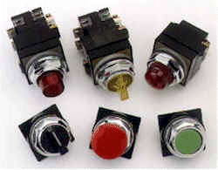
NEMA Starter Accessories
Base and adder auxiliary contact blocks
NEMA 30mm Pilot Devices
Control Power Transformers
Notes:
Common accessories for NEMA starters include both base and adder auxiliary contacts. You can have up to four contacts on each side of a full voltage non-reversing starter, and base contacts can be added without the use of tools.

Slide 42
NEMA Starter Accessories
Base and adder auxiliary contact blocks
NEMA 30mm Pilot Devices
Control Power Transformers
Notes:
Control Power Transformers are used where the motor voltage is 480 and there are pilot devices on the starter. Typically the control power voltage will be stepped down to 120V for safety reasons when human interface is involved. These transformers are available from standard VA to 200 extra VA.

Slide 43
NEMA Starter Accessories
Base and adder auxiliary contact blocks
NEMA 30mm Pilot Devices
Control Power Transformers
Notes:
Pilot devices used in the NEMA starters and combination starters are the NEMA 30mm type. A wide variety of these are available including pushbuttons, both standard and illuminated, selector switches, and indicating lights in standard, LED, and press-to-test versions.

Slide 44
Specification information
Line voltage and frequency.
Load – HP.
Number of phases.
Full load current.
Enclosure.
Ambient temperatures.
Control voltage.
Overload protection.
Notes:
The information needed to properly quote a starter is shown here.

Slide 45
Sales & marketing resources
ABB Electrification Website:
https://electrification.us.abb.com/products/starters/nema-starters
Publication Library:
Pumping Panels
Small Project Product Selection Guide
Controls Catalog/SmartCatalog:
https://electrification.us.abb.com/control-catalog
Notes:
Some sales and marketing resources to get further information on the 300-Line NEMA Starters

