Slide 1
Installation solutions for F&B industry
V1
FEBRUARY 2020
Anti-microbial
ABB Electrification - Installation Products business line
Notes:
ELIP internet page F&B Anti-microbial =
https://new.abb.com/low-voltage/industries/food-beverage/elip-f-b-1_continuous-operation/elip-f-b-2_anti-microbial

Slide 2
Installation solutions for F&B
Content list
Your challenges to be solved
Your challenges to be solved – issues in daily practice
Engineered installation innovation – technology base
Case study – proving it in practice
1
Engineered installation solutions for F&B
2
Adaptaflex – Flexible liquidtight metallic conduits
Wire and cable management
Notes:
ELIP internet page Anti-Microbial =
https://new.abb.com/low-voltage/industries/food-beverage/elip-f-b-1_continuous-operation/elip-f-b-2_anti-microbial

Slide 3
Your challenges to be solved
Anti-microbial

Slide 4
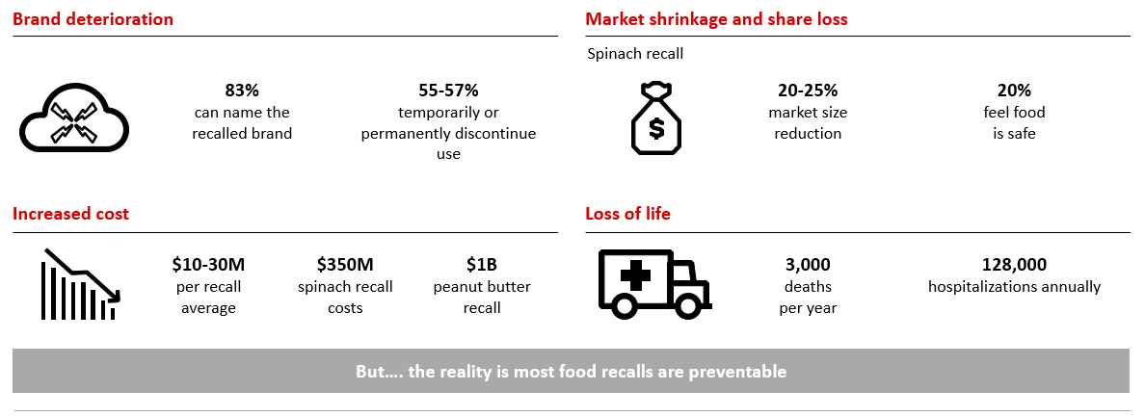
Importance of food safety
The impact of recalls

Slide 5
Your challenges to be solved
The impact of bacteria on installation products
Need of smooth surfaces
Integral anti microbal protection
Stand-off wall brackets
Poor cable protection choices contributes to the collective cost of millions linked to bacterial contamination and knock-on effects of downtime.
Liquid tight conduits with integral anti-microbial protection: ultimately reducing the amount of downtime and material cost spent on maintaining cable protection systems.
Processing equipment mounted on stand-off wall brackets to enable cleaning of all surfaces, including the back and bottom sides.
Round edges
Products with round edges don’t provide a base for bacteria. Water can fall off.

Slide 6
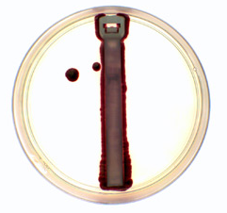
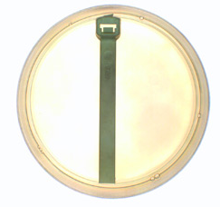
Engineered installation solutions
Ty-Fast Ag+ | bacteria-resistant cable ties
Situation
Solution
Result
Facing the challenge of maintaining a clean environment in the presence of heat, moisture and organic materials
When using cable ties in these applications, their notches and grooves provide a hospitable environment for bacteria and other microbes.
Ty-Fast Ag+ bacteria-resistant cable ties:
The industry’s first cable ties to inhibit microbial growth.
Prevent the growth of bacteria, fungi and mold on the cable ties’ surfaces.
  Molded from an FDA-compliant nylon resin
  Blended with an EPA-registered antimicrobial silver ion additive
Third-party testing has indicated that Ty-Fast Ag+ bacteria-resistant cable ties:
Reduce common bacteria on the cable ties’ surfaces by more than 99.9 percent.
Tests were compliant with:
ISO22196, Measurement of Antibacterial Activity on Plastic Surfaces
Measured the additive’s effect on E. coli and S. aureus bacteria specimens.
Further details:
UL® recognized, RoHS and FDA compliant
Fungus inert in accordance with MIL-T-152B standard.
The antimicrobial efficacy lasts a minimum of 2 years from manufacturer under normal-use conditions.

Slide 7
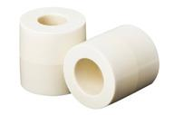
Engineered installation solutions
SuperClean™ wall offset spacers | Properly cleaning and sanitizing behind or between equipment
Situation
Solution
Result
The FDA’s Food Safety Modernization Act now requires:
Everything attached to the walls inside food processing areas
To be offset, allowing for 360˚ access and clean around.
The industry’s first wall offset spacers that inhibit bacterial growth on the spacer surface
Made from our Ag+ FDA-compliant nylon resin
Containing silver ions to inhibit the growth of bacteria, fungus and mold on the spacer surface.
Cylindrical design with no exposed flat surfaces
To prevent the collection and retention of liquids or debris
Ag+ material is 99.9% effective at killing E. coli, Staphylococcus and Salmonella on the treated material surface compared to untreated material.*
Meeting Sanitary design principles
Meeting European Hygienic Engineering Design Guidelines (EHEDG).
Due to the non-metallic construction:
Corrosion isn’t an issue.
Lighter in weight and more economical than comparable stainless steel spacers.
Ready to install = faster and easier to use than custom-fabricated solutions ”

Slide 8
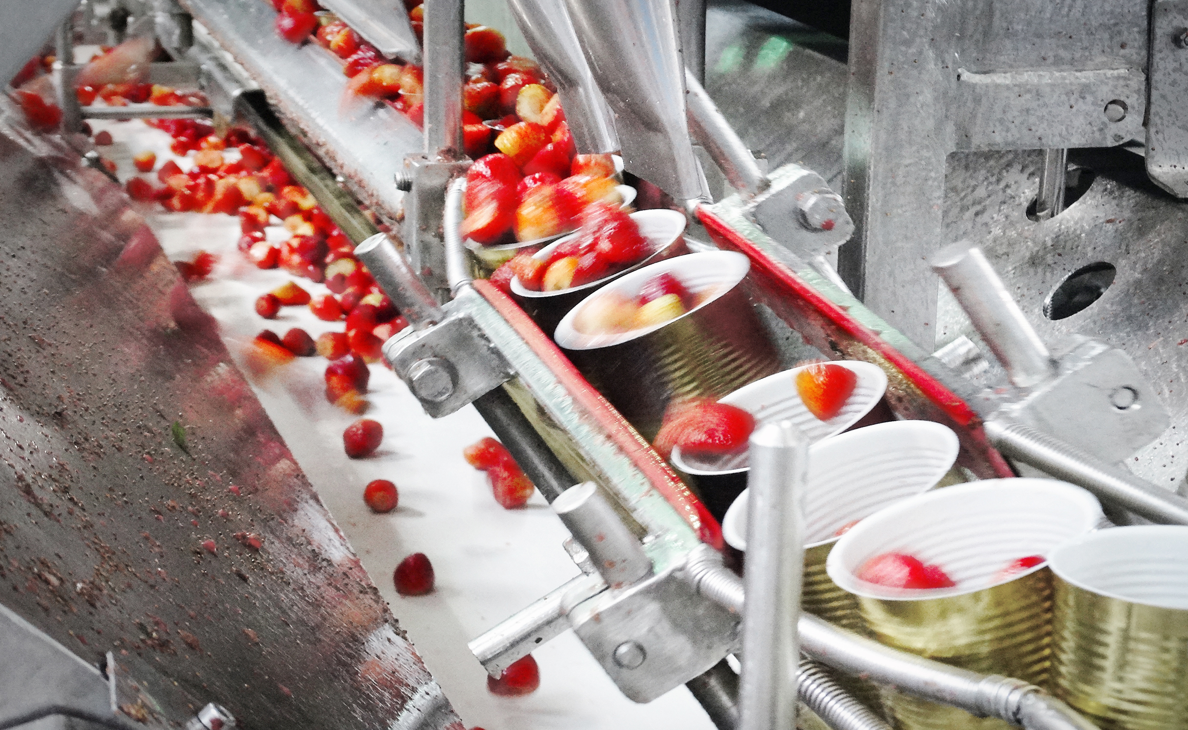
Case study
Anti-microbial | How to clean and sanitize behind or between equipment in processing area’s
Case studies
Challenge for all F&B processors
In practise
Our most recent situations:
Beef processing
Poultry processing
Snack food
Bakery
Properly cleaning and sanitizing
Behind or between equipment
In your processing area‘s
To do this properly you must be able:
  to provide enough space
  to clean all sides of the equipment.
Many F&B processors started
to fabricate or buy existing offsets to give them the room they needed to clean but were creating an even bigger risk for bacteria contamination
because of the offsets or material they were using to make the offsets did not prevent bacteria growth
Most difficult spot to clean behind
What was the real issue?
Equipment mounted directly to the wall.
It leaves enough space for bacteria to hide and spread.
The space between the wall and the equipment is so small that it makes it impossible to clean.
The material used to offset the equipment:
did not prevent bacteria growth
absorbed the dirty wash down water
Would catch old particles of food to decay and they were not able to remove it.

Slide 9
Engineered installation solutions for F&B
Anti-microbial

Slide 10
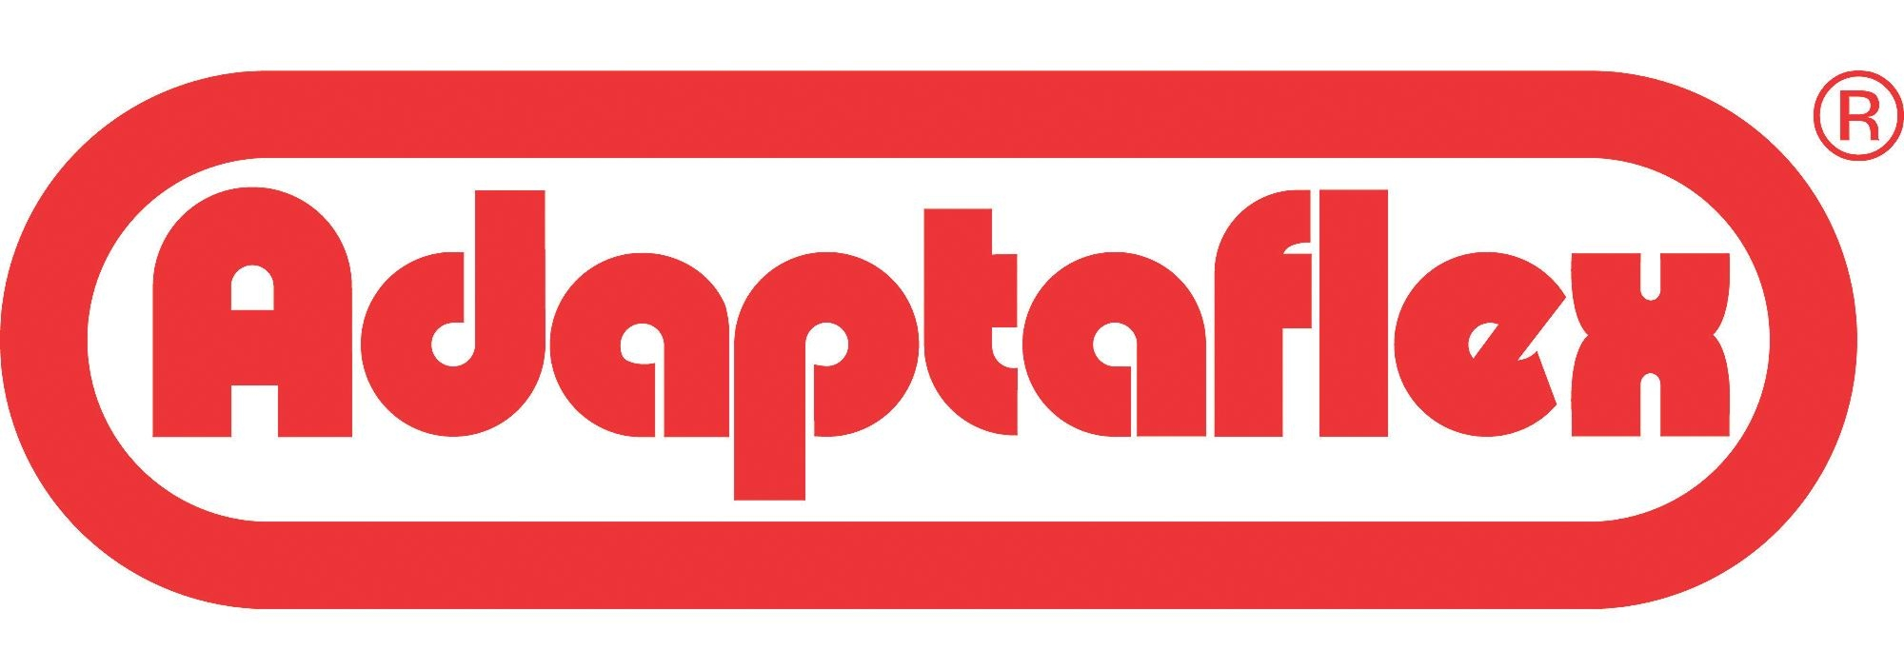
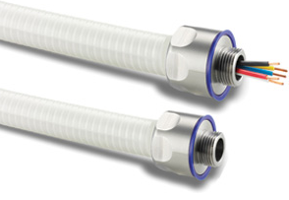
F&B Installation portfolio
ABB Adaptaflex Cable Protection systems
One of world’s leading broadest range in cable protection
  One of the world’s leading and broadest ranges in cable protection
    International approvals, for manufacturing and product ranges
    Ensure safety and quality levels to maintain for now and in in the future.
  Combining innovative solutions with dedicated manufacturing
    Over 6000 products in metallic and non-metallic flexible conduit systems
    For the protection of critical power and data cable
    Designed and tested to withstand:
    constant vibrations, water ingress, offer corrosion resistance
Intensive research and development activities

Slide 11
Certifications
Third party testing & approvals for Adaptaflex
IEC61386
BSI Kitemark
ISO9001 Quality standard
Performance classification standard
Achieved third party accreditation to the IEC61386 Standard from the British Standards Institution (BSI). IEC61386 conformance guarantees that products meet performance specifications for fatigue life, operating temperature, non-flame propagation, IP ratings amongst other criteria.
Manufacturer to third party accreditation
through the BSI Kitemark scheme. The Kitemark is one of the world’s premier symbols of trust, integrity and quality. Manufacturers with the Kitemark are an elite club of some of the world’s best companies being annually tested to ensure continued compliance.
Adaptaflex conform to ISO 9001:2000
The internationally recognised standard for Quality Management Systems. This standard reflects the procedures and management processes throughout the whole of the company.
BS EN ISO14001
EU directive 2002/95/EC
Customer support
Environmental standard
Controlling the impact of manufacturing activities on the environment is a major challenge. Again Adaptaflex lead the way by being the first conduit manufacturer to comply with this Standard.
Meeting the requirements of EU directive 2002/95/EC on the restriction of the use of certain hazardous substances (RoHS).
This forms part of the legislation on waste management and is aligned with the waste electrical and electronic equipment (WEEE)
All our products are backed up by full technical support team, sales teams, customer care team and in-house marketing specialists.
All dedicated teams working together to ensure that you have the best of support in the market place.
Notes:
Adaptaflex catalogue: certification page / update 2018

Slide 12
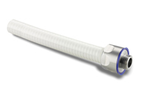
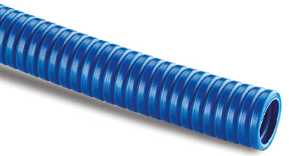
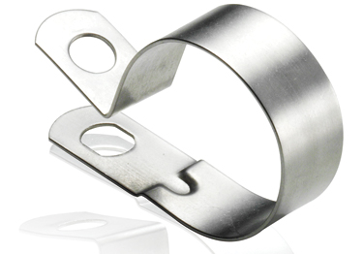
Installation solutions for F&B
Cable Protection Systems | Flexible liquidtight metallic conduits
Conduits
Fittings
Accessoires
Silver icons disrupts microbial cell function results in the death of the cell - 99% in two hours, 80% reduction > 15 min
High chemical resistance
High operation temperatures
Face seal materials adhere to FDA and European Food Contact regulations
Stainless steel material industry recognized
Single piece fitting technology - no multiple components
High IP for continual jet wash applications
Fully stainless steel 316 accessories
Including locking nuts and conduit supports
Specific solutions for F&B industry
Notes:
https://new.abb.com/low-voltage/products/conduit-fittings

Slide 13
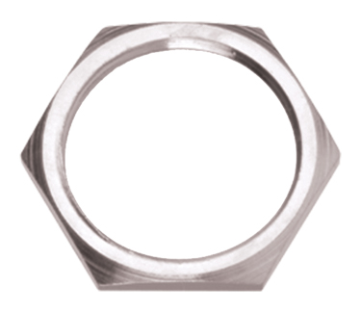
Installation solutions for F&B
Cable Protection Systems | Flexible liquidtight metallic conduits
Antimicrobial conduit - Type SAMHL, SSAMHL, SAMHURL
Liquidtight system with high chemical resistance for high operating temperatures
    Type SSAMHL 20/25M : antimicrobial - stainless steel core - string with Bio-Coat®
    Type SAMHLURL 20/25M : antimicrobial - galvanized steel core - string with Bio-Coat® + UR file number E135398
    Type SAMHL 20/25M : antimicrobial - galvanized steel core – string with Bio-Coat® + CE
Anti-bacteria: The integrated antimicrobial additive attacks bacteria that comes into contact with it,
    eliminating up to 86% of bacteria in the first 15 minutes
    eliminating by up to 99% in just 2 hours
    anti-microbial protection incorporated into a FDA, EC and FSA compliant DuPont Hytrel® thermoplastic jacket.
Safety : IP40-IP69 rated, suitable for indoor splash zone areas or food processing equipment
Certification: CE, BS EN 61386-1,-23, NSF 14159-1-2014 & NSF 169-2009
High corrosion resistance/ high chemical resistant/ high fatigue life / high flexibility
Operating temperature range: -50°C to +130°C
Notes:
SAMHL : http://new.abb.com/low-voltage/products/conduit-fittings/adaptaflex/metallic-products/metallic-conduits/type-samhl
SSAMHL : http://new.abb.com/low-voltage/products/conduit-fittings/adaptaflex/metallic-products/metallic-conduits/type-ssamhl
SAMHURL: https://new.abb.com/low-voltage/products/conduit-fittings/adaptaflex/metallic-products/metallic-conduits/type-samhurl

Slide 14
Installation solutions for F&B
Cable Protection Systems | Flexible liquidtight metallic conduits
Type SAM one piece fitting
Single piece, liquidtight for high temperature 316 stainless steel anti-microbial conduit
High IP for continual jet wash applications
  IP69 protection for indoor splash zone areas or food processing equipment.
  316 Stainless Steel.
  Face seal materials adhere to FDA (Food and Drug Administration) and European Food Contact regulations
Easy assembly - Unique single piece design - no multiple components
Certifications: Approvals CE, BS EN 61386-1,-23, NSF14159-1-2014, NSF169-2009, UL514b Suitable for food zone non-contact areas
Temperature range: Static: -50ºC to +130ºC, Moving: -5ºC to +150ºC
Very high corrosion resistance, Very high chemical resistance, Very high fatigue life
Notes:
https://new.abb.com/low-voltage/products/conduit-fittings/adaptaflex/metallic-products/metallic-fittings/type-sam

Slide 15
Installation solutions for F&B
Cable Protection Systems | Flexible liquidtight metallic conduits
F&B locknut
316 Stainless steel locknut for securing threaded fittings into knock outs and fixing holes
Very high corrosion and chemical resistance: 316 Stainless steel locknut for securing threaded fittings into knock outs and fixing holes.
Suitable for food zone non-contact areas.
Temperature range: Static : -50ºC to +130ºC, Moving: -5ºC to +150ºC
Very high fatigue life
Notes:
https://new.abb.com/low-voltage/products/conduit-fittings/adaptaflex/metallic-products/metallic-accessories/f-b-locknut

Slide 16
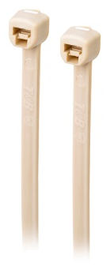
Installation solutions for F&B
Wire and Cable management
  Ty-Fast® Ag+® bacteria-resistant cable ties
Bacteria-resistant cable ties industry’s first cable ties to inhibit microbial growth
  Antimicrobial silver ion additive helps reduce surface bacteria 99.9 %
  Protects itself against bacteria, mold and fungus
  Helps to reduce infection rate and spread of bacteria by not hosting microbial growth
  Promotes a clean environment – 99.9% effective for bacterial reduction
  Made from FDA-approved resin with EPA registered antimicrobial
  Easy cable management Offers reliable Ty-Fast cable tie design
  UL recognized, RoHS and FDA compliant
Notes:
https://new.abb.com/low-voltage/news/ty-fast-ag-bacteria-resistant-cable-ties-industry-first-cable-ties-to-inhibit-microbial-growth

Slide 17
Engineered installation solutions
SuperClean™ wall offset spacers | Properly cleaning and sanitizing behind or between equipment
Situation
Solution
Result
The FDA’s Food Safety Modernization Act now requires:
Everything attached to the walls inside food processing areas
To be offset, allowing for 360˚ access and clean around.
The industry’s first wall offset spacers that inhibit bacterial growth on the spacer surface
Made from our Ag+ FDA-compliant nylon resin
Containing silver ions to inhibit the growth of bacteria, fungus and mold on the spacer surface.
Cylindrical design with no exposed flat surfaces
To prevent the collection and retention of liquids or debris
Ag+ material is 99.9% effective at killing E. coli, Staphylococcus and Salmonella on the treated material surface compared to untreated material.*
Meeting Sanitary design principles
Meeting European Hygienic Engineering Design Guidelines (EHEDG).
Due to the non-metallic construction:
Corrosion isn’t an issue.
Lighter in weight and more economical than comparable stainless steel spacers.
Ready to install = faster and easier to use than custom-fabricated solutions ”

Slide 18
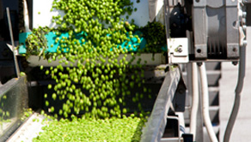
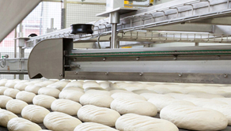
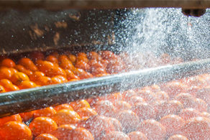
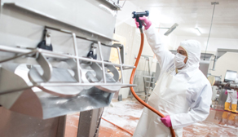

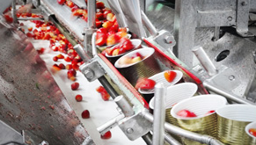
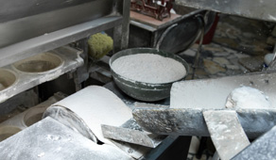
Installation solutions for Food & Beverage
Corrosion
Dust and liquidtight
Ingress protection
Chemical resistance
x
Extreme temperatures
Anti-microbial
Explosionproof
x
Notes:
Click on the images to go to the internet pages

