Slide 1
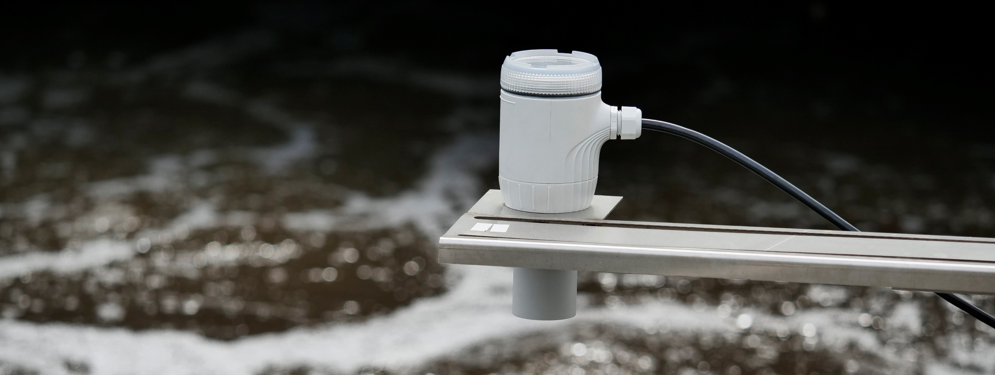
LST200 –ultrasonic level transmitter
LSt200 INTRODUCTION training, 2021
An easy choice for intelligent level measurement
Jack Mingyi Wang, Global Product Manager, Ultrasonic Level Products
Notes:
Welcome to ABB LST200 ultrasonic level transmitter training, This training aims to provide basic understanding of the LST200 including principle and applications, guidance during model selection, installation and commissioning

Slide 2
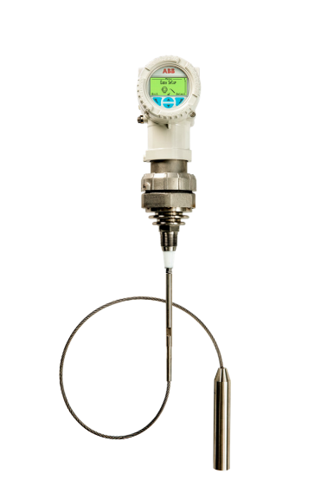
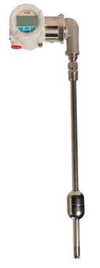
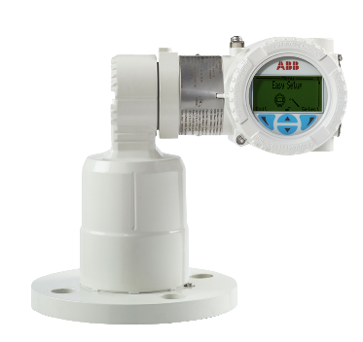
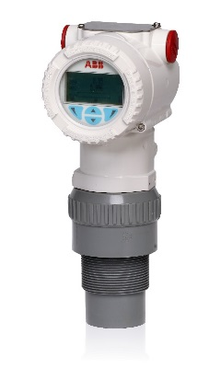
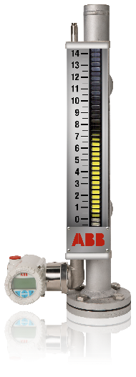
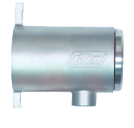
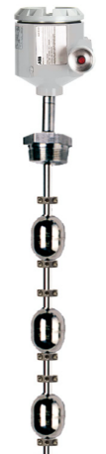
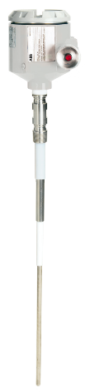



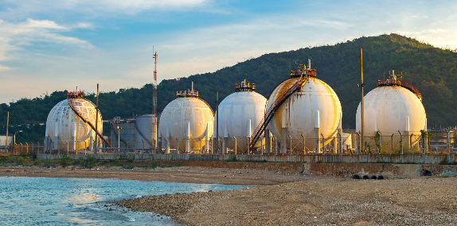
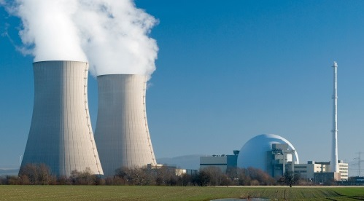
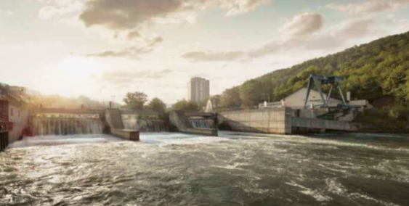
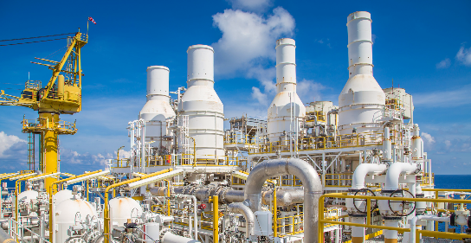
Overview
ABB level measurement family
Magnetostrictive
Guided wave radar
Laser
Ultrasonic
Magnetic Level gauge
Level switches
Oil & Gas
Power plant
Water & Wastewater
Chemical & Petrol Chemical
Notes:
ABB level measurement products have a long history of almost 50 years if we trace back to the age of famous K-TEK products.
Now, it is a big family including both continuous and point level devices serving various industries all over the world

Slide 3
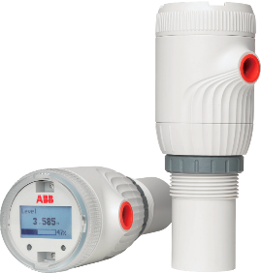

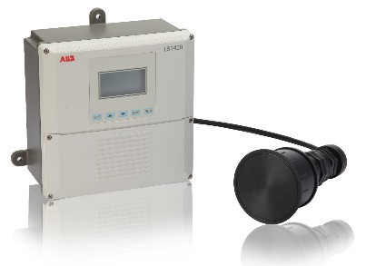

Overview
ABB ultrasonic level transmitter portfolio
LST200
LST300
LST400
Introducing…
Winner of Red-dot which only awards ” sought-after seal of quality that feature an outstanding design”
Essential design for water & wastewater
Lower total expenditure
All-around transmitter with leading feature
ATEX, IEC, FM & NEPSI for hazardous area
Accuracy of ±2mm or 0.2% of full span
-40ºC - 85ºC
Standard corrosion resistant PVDF sensor and metal housing with seperate conpartment
False echo filtering
Survives where others fail
Remote option for challenging installation
Up to 30m range even for difficult solids measurement
Five relays for pump control
Notes:
As for transmitters based on ultrasonic principle, we have the newborn LST200 which we are going to introduce today,
LST300 the all-around transmitter with leading features
And LST400, the remote option with stronger power, that could survive where others fail

Slide 4


Overview
How does the ultrasonic level transmitter work
Ultrasonic pulses travel at a certain speed V in the direction of product surface. When some of the energy is reflected and travels back towards the sensor, by measuring the time(t) elapsed between the initial pulse and the reflected one, the electronics can calculate the distance (D)
Signal Pulse
(at speed
of ultrasound)
Return Pulse
(at speed
of ultrasound)
Distance
D = V
2
Empty distance
Level
Notes:
The ultrasonic devices take advantage of time of flight principle, because the ultrasound travels at a certain speed.
By measuring the time(t) elapsed between the initial pulse LST200 launch and the reflected one, the electronics can calculate the distance and know the position of the level

Slide 5
Overview
An important concepts in ultrasonic measurement
Beam angle
We are using sound. The transducer functions much like a speaker of a sound system. Unlike a laser, it is not easy to focus the beam to a small target, so the width of the beam which contains the peak ultrasonic power could be large
The beam angle α is the angle in which relative power is more than 50% (or -3dB)of the peak ultrasonic power.
The beam angle α is the reference parameter during installation
α
Peak ultrasonic power
Half peak ultrasonic power
Notes:
There are some important things to know about ultrasonic devices .
The transducer functions much like a loudspeaker and there is an area, where 50% of the sound power concentrate, as showed here in yellow,
the angle in which the power concentrate is called the beam angle or half-power angle
During installation, we expect to have as less obstacles within the beam angle, so that we could get a strong and clean echo reflected from the real level

Slide 6
LST200 ultrasonic level transmitter
Features

Slide 7
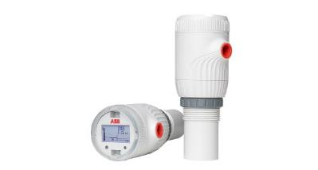
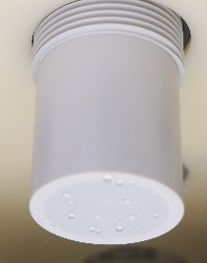

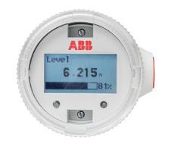
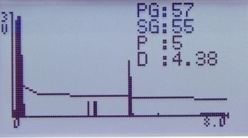
LST200 introduction
At a glance
  LST200
Sensor
HMI options
2-wire instrument with 4-20mA output
Temperature:-30 to 60 °C
Accuracy and repeatability: ±3mm or 0.25% of full span (largest of the two) with temperature compensation
IP66/67 /68
Housing material: poly carbonate
Long proven smart algorithm
        Range: 8m for liquids
        Minimum blanking distance: 0.35m
        -3dB Beam angle: 10°
        Process connection: Using nut or M56X3.0 thread， length 35mm
        Material: Poly carbonate
        Pressure: -4 to 44 psi (-0.25 to 3.0 bar)
        Active surface for anti-condensation
        Push buttons
        Blue backlight
        Easy setup menu for quick commissioning
        Real-time waveform & Diagnostics messages
        No HMI option
        Low-cost blind version for setup with additional LCD or FDI software in computer(in progress)
Notes:
From the LST200’s specification, we can tell that all the features are focused on the needs of water and wastewater treatment
The backlit and the way of easy setup will relieve the inconvenience during outdoor commissioning and operating, poly carbonate housing with IP68 protection eliminate the risk of flooding and corrosion, 3rd party proved EMC and smart algorithm safeguard the device when expose to interference from storm, lightning and temperature change

Slide 8
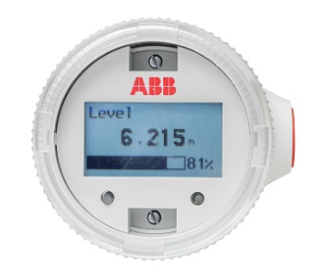

LST200 introduction
How LST200 lower your total expenditures
  Saving of Ownership
Saving from Purchasing
Saving from Stability
        Simple commissioning
  Easy setup menu
  Clear backlight
  Essential function
        Less shutdown
  Non-contact measurement with active sensor surface
  Anti-noise and adaptive algorithm
        Immediate maintenance and service
  Modular design
  Standby inventory and spare parts
  Waveform display
  Diagnostic message
    Lower capital costs with essential design
  IP66/67/68
  Plastic (PC) enclosure with anti-condensation active surface
  4-20mA output
    Easy selection between 2 options
  LCD
  Standard without LCD
    Fast delivery and status tracking
  2 weeks lead time or less
  Order tracking App
We know level measurement: ABB has 40 years experience in level measurement with various solutions and long operating experience.
LST200 inherits a long-proven algorithm
  GAP technology
  Noise filtering algorithm
  Temperature compensation
All-around quality control
  Type test by 3rd party
  Stress test by accelerating aging speed
  Vast field testing on various customer sites
  Routine test for every unit
Notes:
During the design phase of LST200, “lower customers total expenditures” is the key target.
Features like easier for setup, clear blue backlit and essentially designed hardware and software are all water and wastewater industries need.
We limit it to only 2 options with and without LCD to save time for selection, offer 2 weeks lead time with specially developed App for tracking
For stability, LST200 inherits the long-proven algorithm based on vast on-site data and has further improvements based on even faster chip than ever before.
动画分屏介绍： 选型简单CX界面， 价格与LST300对比

Slide 9
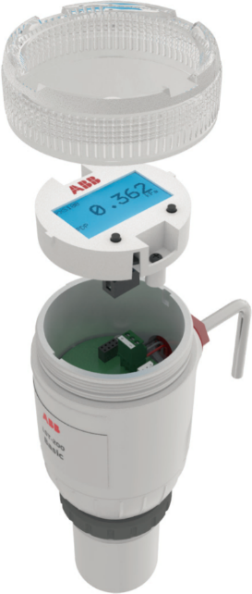
LST200 introduction
Structure
Modular design
The main parts of LST200 are LCD, electronics and sensor which are modular designed for more flexibility
Flexible inventory management and easy assembly for quick delivery
Simple exchangeable parts for quick and cost- effective service
LST200 sees the trend of the future and the modular designed electronics prepared LST200 for direct on-site updating in future
    NB-IoT
    Remote
Notes:
Customer can also benefit from the modular design: the spare parts are as simple as the cover, O-ring and LCD. And the sensor and electronics could be easily replaced or upgraded by service.
The modular design is also friendly to inventory management, quick delivery and possible future upgrade to meet customer needs

Slide 10
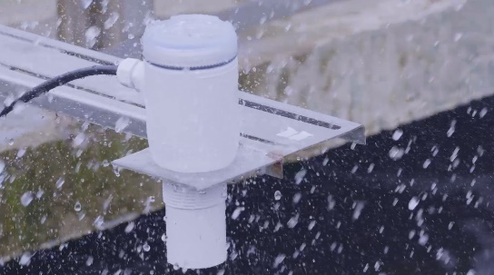
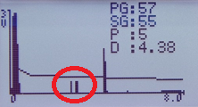
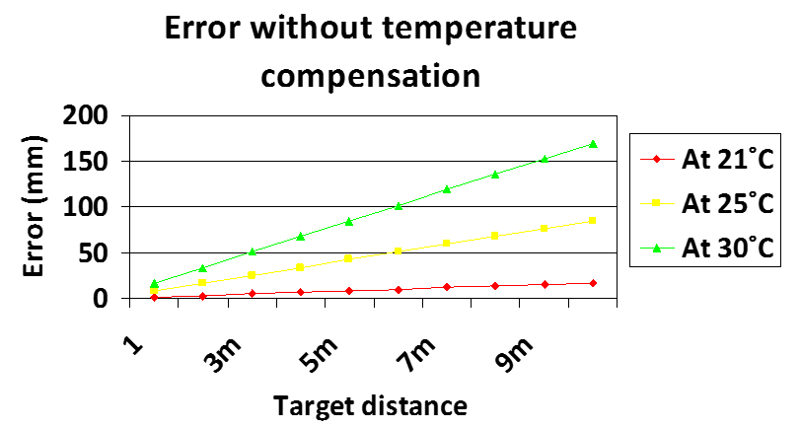
LST200 introduction
Long-proven algorithm for challenging applications
  GAP stabilizer
Noise filter
Temperature compensator
Factors like unstable surface, bulk solids, vapor would cause the strength of the echo unstable
GAP stabilizer will ensure a stable output by automatically adjusting the value of the power and gain according to the echo strength.
        Random noise from electronics and environment would cause false echo and output
        LST200’s noise filter algorithm would tell the real echo from the random ones so as to safeguard the device in harsh environment like storm
    Temperature changes the speed of sound by 0.6 m/s every 1ºC which results in a 1.7mm error per ºC, per meter measured.
    LST200 Embedded temperate sensor and compensation algorithm ensures the accuracy during summer and winter
Rome was not built in a day- LST algorithm evolves as rich experience data from customer sites accumulated
Notes:
How could LST200 deal with so many challenges? Let’s learn more about the LST200 algorithm
As we know, Factors like unstable surface, bulk solids, vapor would cause the strength of the echo signal unstable. Thanks to the GAP stabilizer, by changing the Gain, Amplitude and Number of the pulse, LST200 will ensure a stable output by automatically adjusting the echo strength to the expected level.
LST200 also has the embedded noise filter which can tell the random noise from the real one, that’s why LST200 can ensure a stable output in a storm.
And to deal with the temperature drift, LST200 uses temperature sensor for compensation algorithm which ensures the accuracy during summer and winter

Slide 11
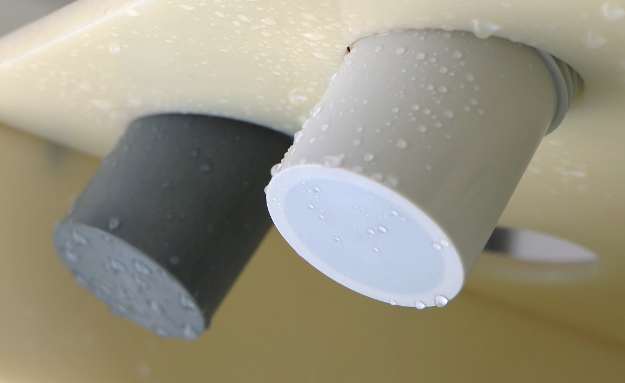
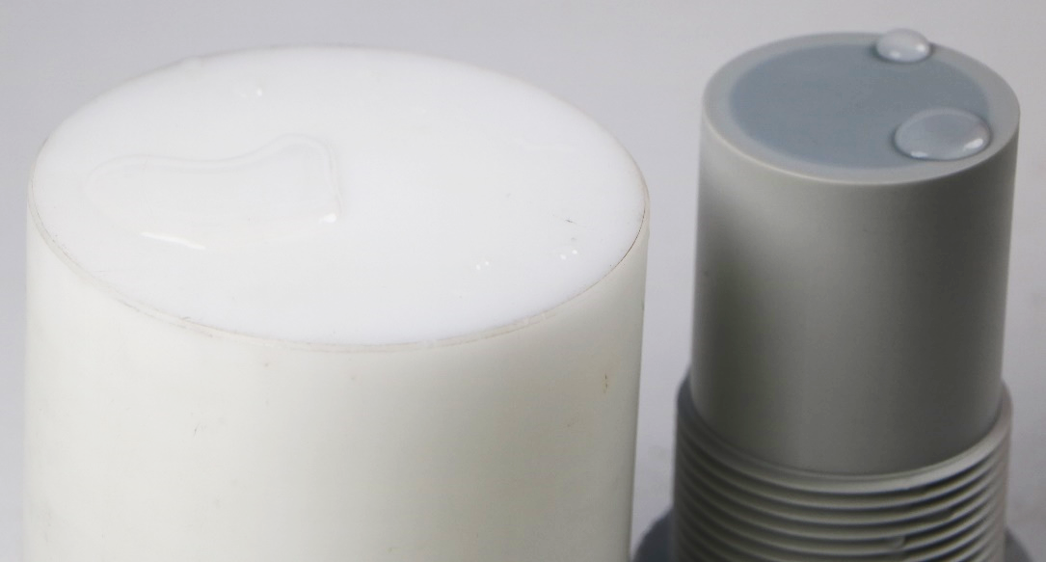
LST200 introduction
Active surface: patented anti-condensation technology based on “lotus effect”
LST200 VS PVDF sensor
PVDF is the most common material for ultrasonic products
Maintenance free
Condensation of water is commonly seen for outdoor, underground or tank applications especially in the morning of summertime or in some cold areas with hot water process
LST200 patented active surface could keep the sensor surface clean all the time so that no cleaning maintenance required
LST200 VS PTFE sensor
PTFE is well known for its “self-cleaning” feature which could also be seen in some ultrasonic products

Slide 12
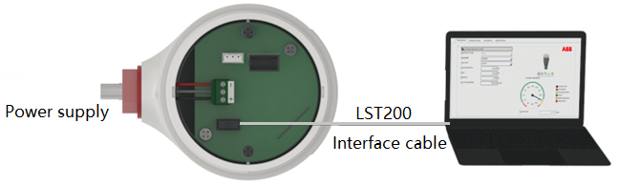
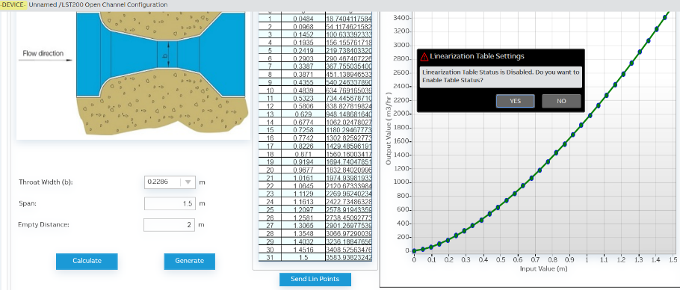
LST200 introduction
Friendly interface for quick setup
  2 buttons LCD
ABB FIM tool
Open channel flow calculator
        Blue backlight
        1 minute Easy Setup
        Real-time waveform & Diagnostics messages
    Graphical wizard
    Setting backup
    Easily duplicate the setup for large scale installations
    Online commissioning
Automatic calculation of 32 points linearization table based on rich flume models such as
  Parshall flumes
  Triangular notch thin plate weir
  Rectangular throated flume
Notes:
How could LST200 deal with so many challenges? Let’s learn more about the LST200 algorithm
As we know, Factors like unstable surface, bulk solids, vapor would cause the strength of the echo signal unstable. Thanks to the GAP stabilizer, by changing the Gain, Amplitude and Number of the pulse, LST200 will ensure a stable output by automatically adjusting the echo strength to the expected level.
LST200 also has the embedded noise filter which can tell the random noise from the real one, that’s why LST200 can ensure a stable output in a storm.
And to deal with the temperature drift, LST200 uses temperature sensor for compensation algorithm which ensures the accuracy during summer and winter

Slide 13
LST200 ultrasonic level transmitter
Applications

Slide 14
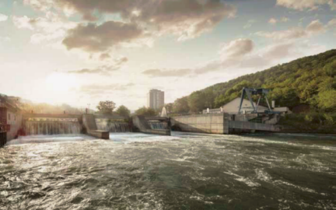
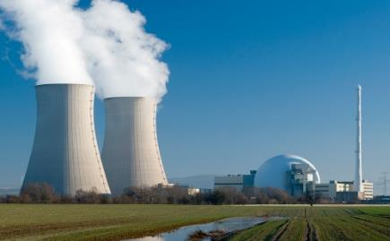
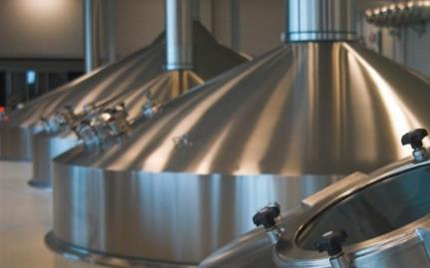
LST200 introduction
Where does the ultrasonic level transmitter work
        Water and Wastewater
Power
Food & Beverage
        Storage tank
        Pump control
        Open channel flow
        Lagoons & settling ponds
    Water treatment and storage
    Coal level in coal bunker
Mixing Tanks
Water Tanks
Feed Silo’s
Notes:
After a quick review of the ultrasonic principle, we know that it is a non-contact device that could be used in numerous industries, but the most common application is water and wastewater treatment

Slide 15




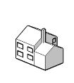
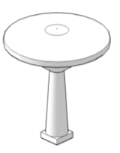
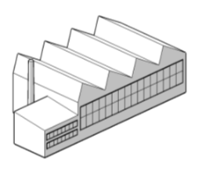





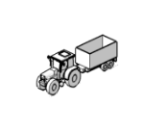

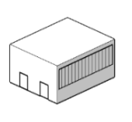


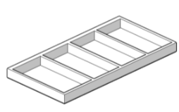
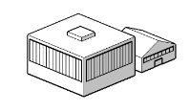
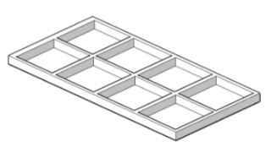




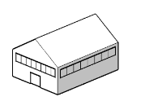


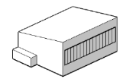
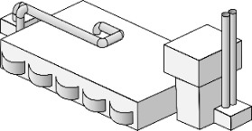

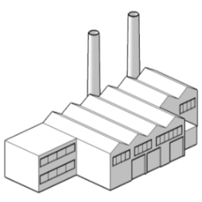

LST200 introduction
Where does the ultrasonic level transmitter work
Water and wastewater industry
There is a large demand for level measurement in the water and wastewater industry where ultrasonic level transmitters are popular due to the stability and cost-effectiveness in these easy applications (without high pressure and temperature, no hazardous article, etc.) including:
  Lagoons & settling ponds
  Wet wells, lift stations and pumping stations
  Process basins including aeration, chlorine contact, skimmer tanks, sedimentation and flotation thickeners
  Open channels
Industrial Treatment and
Re-use Plants
Distribution Networks
Irrigation Networks
Pumping Stations
Desalination Plants
Municipal Treatment Plants
Wastewater Treatment and
Re-use Plants
Notes:
ultrasonic level transmitters are popular due to the stability and cost-effectiveness in these easy applications (without high pressure and temperature, no hazardous article) And in particular, open channels flow measurement is a typical cost-effective solution to measure flow by the help of level value and shape parameters of flumes

Slide 16
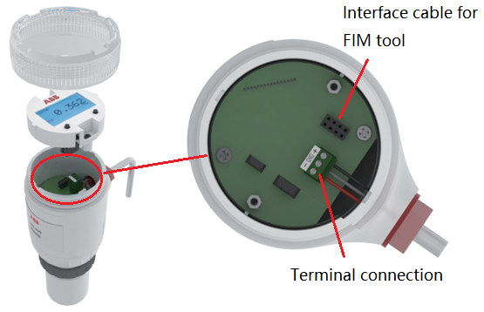
LST200 installation
To connect the LST200 instrument
2-wire device with 4~20mA output
Terminals
Max. cable cross section: 1.5 mm2 (AWG 16)
Power supply
LST200-Basic: 15 to 30 VDC.
LST200-LCD: 19 to 30 VDC.
Power consumption
60mW to 600mW
Analog output
Two-Wire output: 4 to 20 mA related to level/distance/volume/flow, full compensation for temperature effects
Notes:
LST200 is a 2-wire device with 4~20mA output, so the connection is quite simple. You need to remove the cover and LCD, unplug the green connector and connect the wire according to the mark on it. The port for LCD connection is also the one for interface cable if you need to use the FIM tool with a computer

Slide 17
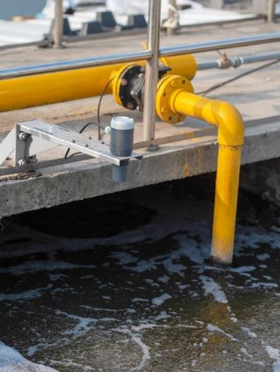
LST200 installation
Typical installations
Storage vessel
Open basin or channel
Storage vessels may have complicated inside structures which may block the way of ultrasound.
The mounting position should be considered to avoid possible obstacles within the LST200’s beam angle (10°)
An ultrasound guide pipe may be required if the structure was too complicated to be avoided
Installing over the open channel or basin are one of the most common applications for Ultrasonic level transmitter
An extended mounting bracket is required to ensure the instrument far away from walls and other obstacles like pipes and brackets
Notes:
Lst200 can be mounted on a storage vessel or open basin or channel.
Storage vessels may have complicated inside structures which may block the way of ultrasound.
The mounting position should be considered to avoid possible obstacles within the LST200’s beam angle (10°)
An ultrasound guide pipe may be required if the structure was too complicated to be avoided
Installing over the open channel or basin are one of the most common applications for Ultrasonic level transmitter
An extended mounting bracket is required to ensure the instrument far away from walls and other obstacles like pipes and brackets
切到罐体和明渠页一起介绍

Slide 18
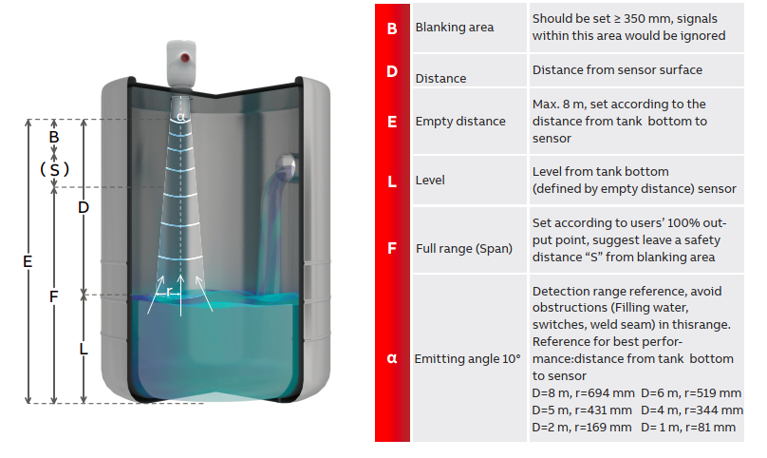
LST200 applications
Typical tank measurement
General guideline
Before installation, evaluate and try to avoid obstructions within the detection range “α”
Select a proper nozzle or pipe as suggested
Anti-water pad (like the surface of lotus leaves)is recommended if there were heavy vapor in the tank
Set the empty distance and span
Notes:
Now let’s have a look at some typical applications, all the pictures are LST200 test units collected from almost 20 kind customer sites.
For typical tank measurement, as explained, we need to try to avoid obstructions within the beam angle “α” , the suggested dimension of this area are listed in the table.
And if there are high possibility of condensation, Anti-water pad (like the surface of lotus leaves)is recommended.
After that everything you need to do is setting the Empty distance and span.

Slide 19
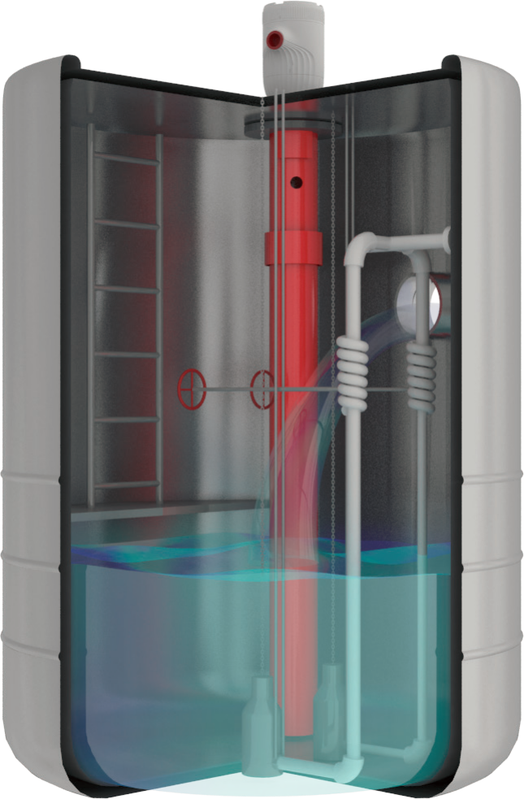
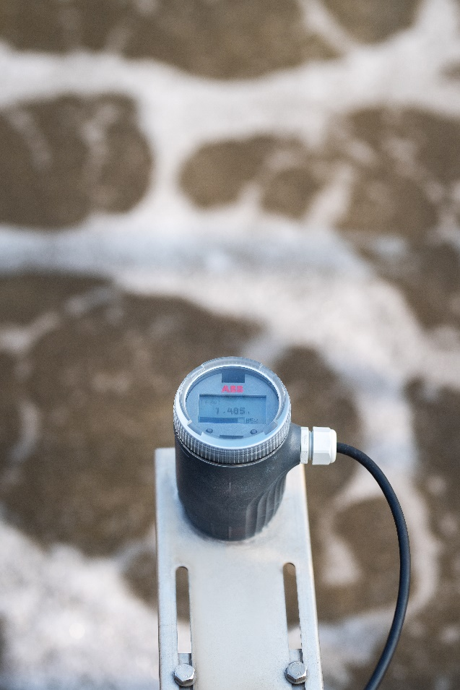


LST200 applications
700 Units---Municipal underground water monitor- successful story
Challenge and solution
Narrow space with obstacles like ladders—Try to install in the middle of the space , a sound guide pipe may be needed if the structure is too complicate
High humidity and water would condensate ——IP68 with patented active surface
Dark area, hard for installation—— blue backlit and easy setup menu, FIM tool for batch setup
Turbulence—GAP stabilizer and noise filter

Slide 20
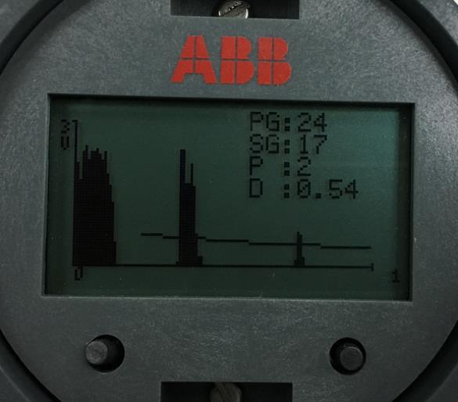
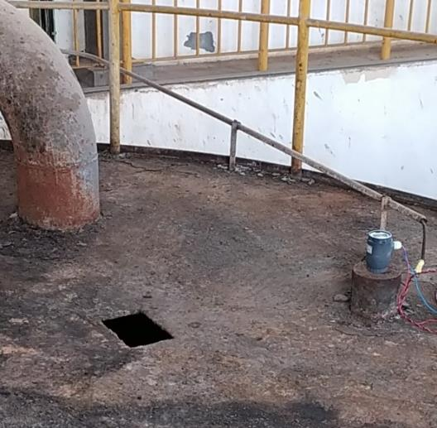

LST200 applications
Typical tank measurement - successful story
Sludge tank
Sludge is a big challenge due to the feature that absorbing ultrasound.
The customer used the waveform to check the strength of the signal and find the device only used power level P= 2 for their application ( “5” is the highest power level)
Result : Customer felt safe and decided to use LST200 and till now the device works in good condition at customer site
Note: the ultrasound absorption of sludge could vary a lot according to the water content
Notes:
These pictures come from a sludge tank, and Sludge is a big challenge due to the feature that absorbing ultrasound.
the ultrasound absorption of sludge could vary from 20% to 60% according to the water content
So for the device selection, we need to give some margin of the measuring distance . For example, if you want to measure a 5m sludge tank, you may need to choose an 8m device Also, a waveform check is recommended which will tell you if the echo is strong enough for this application
From the waveform showed here, the P value is only 2, which means the echo could be picked up by LST200 easily. And customer feel safe and happy to see the feedback of this waveform

Slide 21

LST200 applications
Typical tank measurement - successful story
Brine tank, chlorine tank
LST200’s enclosure is made from polycarbonate which is resistant to mild acid and base, chloride, oxidizer.
Notes:
LST200’s enclosure is made from polycarbonate which is resistant to mild acid and base, chloride, oxidizer.
And this customer use it to measure sodium hypochlorite solution.
Due to the limitation of the mounting space, the device is very close to the wall which is not recommended, but since the measuring distance is only 2 meters, although there is an attenuation, the signal is still strong enough to keep it working.

Slide 22


LST200 applications
Typical open basin & pond measurement
General guideline
Keep a certain distance from the wall according to the measuring distance (refer to the emitting angle )
Position the instrument in the middle if you need to measure a channel or weir
The bottom surface of the sensor should be in parallel with the water surface
The closer to the water surface the higher accuracy and stability you would get (400mm minimum considering the blocking distance and safety distance)
Notes:
There are also a lot of demand for open basin and pond measurement in water and wastewater factories
As same as mounting in the tank, you’d better to keep a certain distance from the wall according to the measuring distance by the help of an extended bracket.
The bottom surface of the sensor should be in parallel with and close to the water surface, but a minimum 400mm distance is recommended due to there is an unmeasurable blanking area of the device.
If you use it for open channel flow measurement, you need to position the instrument in the middle of the channel or weir

Slide 23


LST200 applications
Typical open basin & pond measurement - successful story
LST200 on aeration basin
An aeration basin (also called aeration lagoon) is a holding and/or treatment pond provided with artificial aeration to promote the biochemical oxidation of wastewaters.
High stability is achieved by a sophisticated algorithm (GAP) that enables the LST200 to detect and automatically compensate for any instability in the strength of the ultrasonic signal. This makes the LST200 a good choice in process basins for aeration, chlorine contact, skimmer tanks, sedimentation and flotation thickeners where there can be unstable surface echo from foam or turbulence.
Also, the backlit display with easy setup menu helps to simplify outdoor installation and commissioning.
Notes:
Aeration lagoon is common for wastewater treatment, the aeration makes the water surface unstable with foams.
LST200 can detect and automatically compensate for any instability in the strength of the ultrasonic echo.
This makes the LST200 a good choice in process basins where there can be unstable surface echo from foam or turbulence
Also, the backlit display with easy setup menu helps to simplify outdoor installation and commissioning.

Slide 24

LST200 applications
Typical open basin & pond measurement - successful story
LST200 on cooling tower
Foam and turbulence could cause diffused reflection which could make the strength of the return signal unstable
GAP technology will smartly adjust the signal strength and ensures LST200 always work at its best condition
Splash could cause random noise to the sensor
Nosie filtering algorithm will smartly identify the noise and get rid of them
Notes:
This picture comes from a cooling tower
Foam and turbulence could cause diffused reflection which could make the strength of the return signal unstable and Splash could cause random noise to the sensor
Thanks to the GAP stabilizer and noise filter, the device is still working in good condition after half a year

Slide 25


LST200 applications
Open channel flow - principle
Ultrasonic is a good partner with open channel flow
  In the water industry we often encounter open channels. Using a man-made structure
  with an open surface, water can flow freely relying only on the force of gravity. There are no pumps used and no pressure applied.
Today it has become common for a level meter to measure the flow through this channel by using only the level and a preconfigured relationship. This relationship is performed by using a linearization function.
V-Notch open channel
Notes:
Ultrasonic is a good partner with open channel flow
There is a fixed relationship between level and flowrate for open channel when boundary conditions are fixed. Hence, the ultrasonic instrument measures the level and calculates the flowrate through the formula.

Slide 26


LST200 applications
Open channel flow- applications
Applications and advantages
  Open channel flow measurement is widely used for agriculture, water/wastewater, power station, etc. with below advantages
  Easy set up and maintenance
  Wide measurement range
  Competitive prices
  Stable
Notes:
Open channel flow measurement by ultrasonic level transmitter is widely used for agriculture, water/wastewater, power station, etc. because of the easy setup and maintenance, wide measurement range, competitive price and stability

Slide 27

LST200 applications
Open channel flow- commissioning
It is not perfect as the traditional way
Low efficiency – communications, validations, etc.
Need an expert supporting offline
Need customer to have good understanding of the key parameters
High rate of mistakes when manually inputting the data
Dramatic workload when we get more applications
Notes:
The traditional way for open channel flow commissioning need the customer to have good understanding of the key parameters.
They need first to confirm the notch type, parameters, calculate and validate ,and then input all the data into transmitters manually
It would require dramatic workload when they get more applications

Slide 28
LST200 applications
LST200’s advanced Open channel flow measurement solution – no expert needed
Different from traditional ways, LST200…
Provide a friendly interface through ABB FIM tool
Automatic calculation of 32 points linearization table based on the flume type:
Rectangular thin plate weir
Triangular notch thin plate weir
Rectangular throated flume
Trapezoidal throated flume
U throated flume
Round nose horizontal broad crested weir
Parshall flumes
Palmer bowlus flume
Cut throat flume
Configure the parameters through FIM tool with LST200 FDI package
Transfer the settings to LST200 device
Notes:
Things change today, with ABB’s FIM tool on the computer, LST200 FDI software package provides a friendly interface.
It provides various flume type and will calculate and download the data automatically

Slide 29

LST200 applications
LST200’s advanced open channel flow measurement solution – measurement made easy
What you need to do…
Choose the channel type
Input the suggested dimension related parameters
Generate the linearization table
Send to LST200
Notes:
What you need to do is quite simple : In the flow mode, you can find the open channel page and you just need to choose the channel type, input the required dimensions and then, by the help of the pre-set formula you can “calculate” the maximum flowrate, “generate” a linearization table and send to the device.

Slide 30
LST200 ultrasonic level transmitter
Summary: ：An easy choice for intelligent level measurement

Slide 31

LST200 ultrasonic level transmitter
Summary
The easy choice for intelligent level measurement
Water and wastewater is a mature market with a lot of competitors
Based on repeated market research, LST200 absorbs expected features for the specific market and turns them into an essential design
The streamlined outlook with blue backlit, further simplified easy setup menu and GAP stabilizer algorithm are LST200’s key differentiation
Thanks to its modular design, user-friendly interface and built-in intelligence, it meets our customers’ key requirements for ease and reliability especially when they are considering total expenditure on the device from purchasing, to installation and maintenance.
Notes:
That’s all for today’s introduction and generally speaking LST200 is the easy choice for intelligent level measurement.
LST200 meets our customers’ key requirements for ease and reliability especially when they are considering total expenditures on the devices from purchasing, to installation and maintenance.
At last let’s watch a video from a water factory

