Slide 1
BU Measurement Products PL – Pressure
January 2013

Slide 2
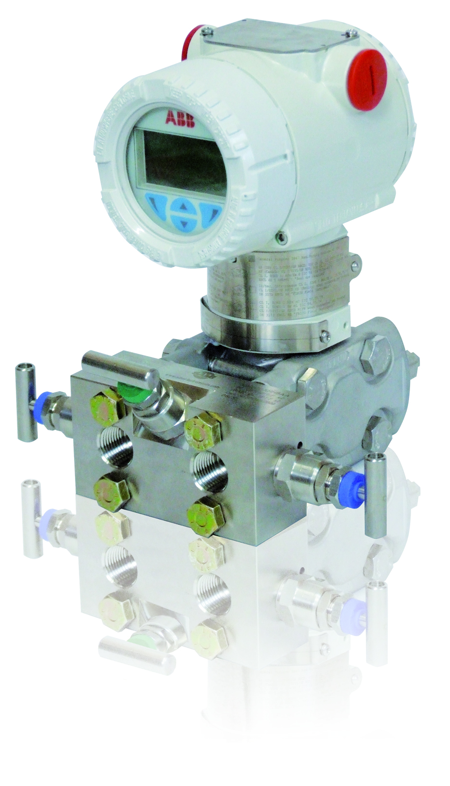
Introducing something new A more complete solution in one click
SR (special request procedure) generally takes about 3 days to be performed by our R&D dedicated team (faisibility checks, equipment preparation, etc.)
Now customers (and salespeople!) does not have to wait any longer: just the needed time for codification.
This important, time-saving option has been implemented on:
DP-Style transmitters | P-Style transmitters
266DSH | 266ASH
266PSH | 266GSH
266VSH | 266NSH
266MSH | 266HSH

Slide 3
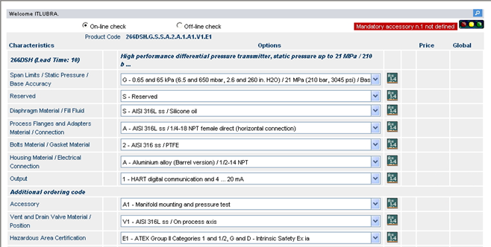
From January 2013 Manifold mounting right out of the catalogue
By selecting option ‘A1’ under ‘Accessory’ within the additional ordering information on our configuration tools, salespeople will be able to react to customers’ enquiries promptly.
Manifold mounting includes the pressure test of the assembly in conformity with PED and internal standards. Operating instructions and instruments datasheet (only involved models) will be alligned in the coming weeks.

Slide 4
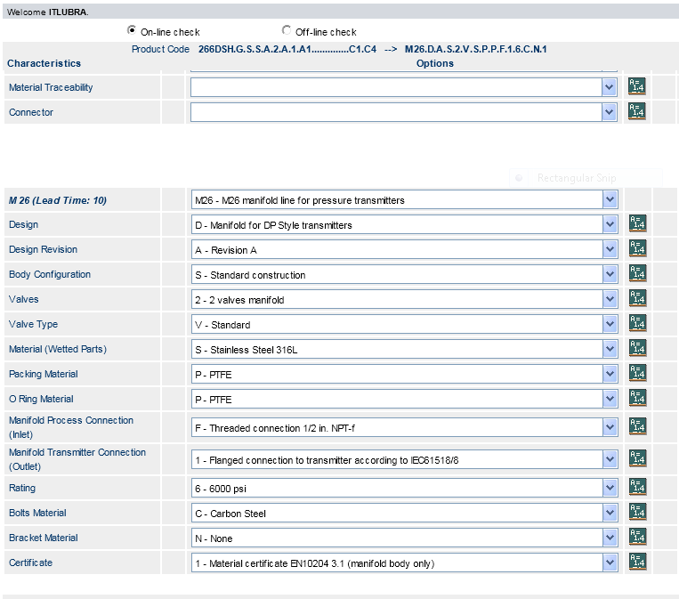
From January 2013 Manifold mounting right out of the catalogue
Manifolds will be sold as a pressure accessory (exactly like seals). They will be sold loose as well.

