Slide 1
ReliaGear® neXT
POWER PANELBOARDS
Factory Assembled and Bulk Pack Interiors

Slide 2
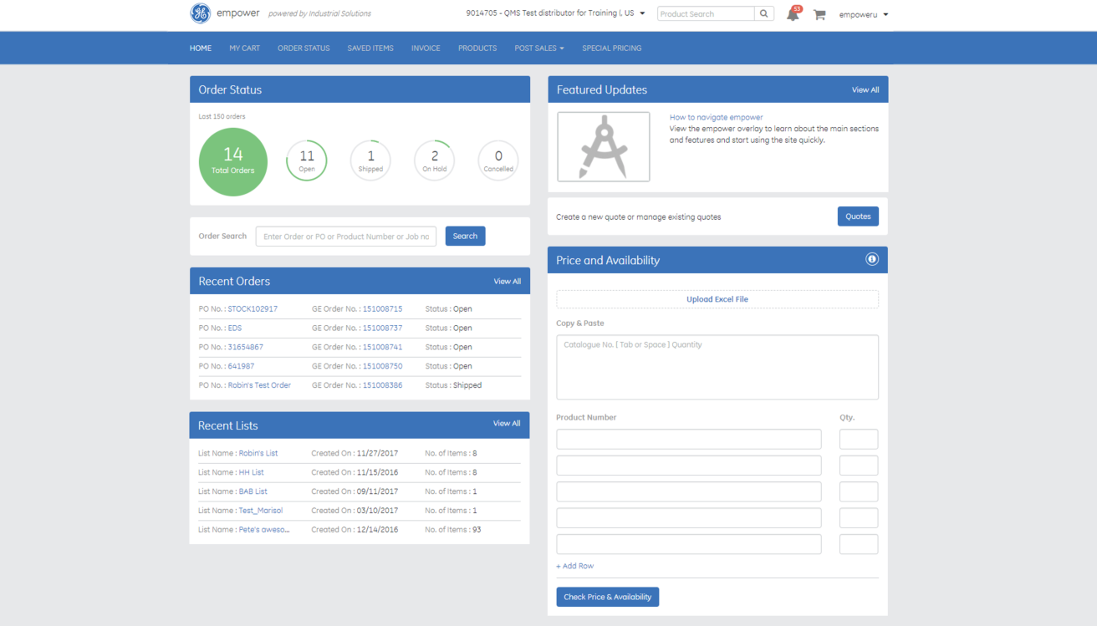
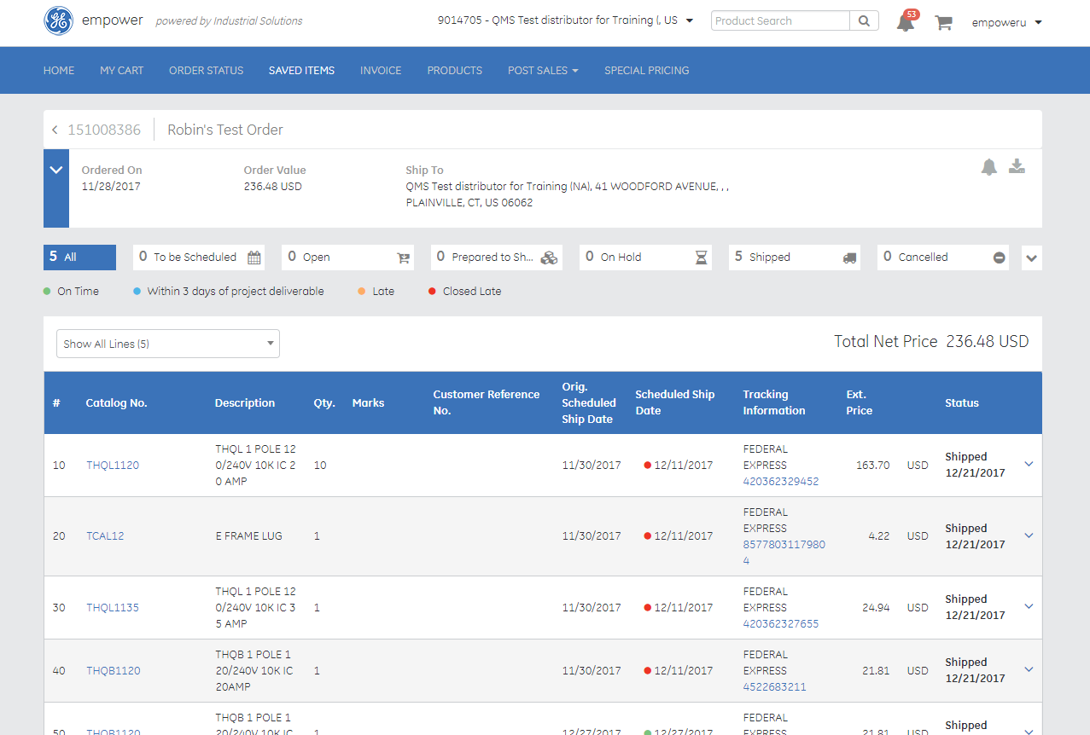
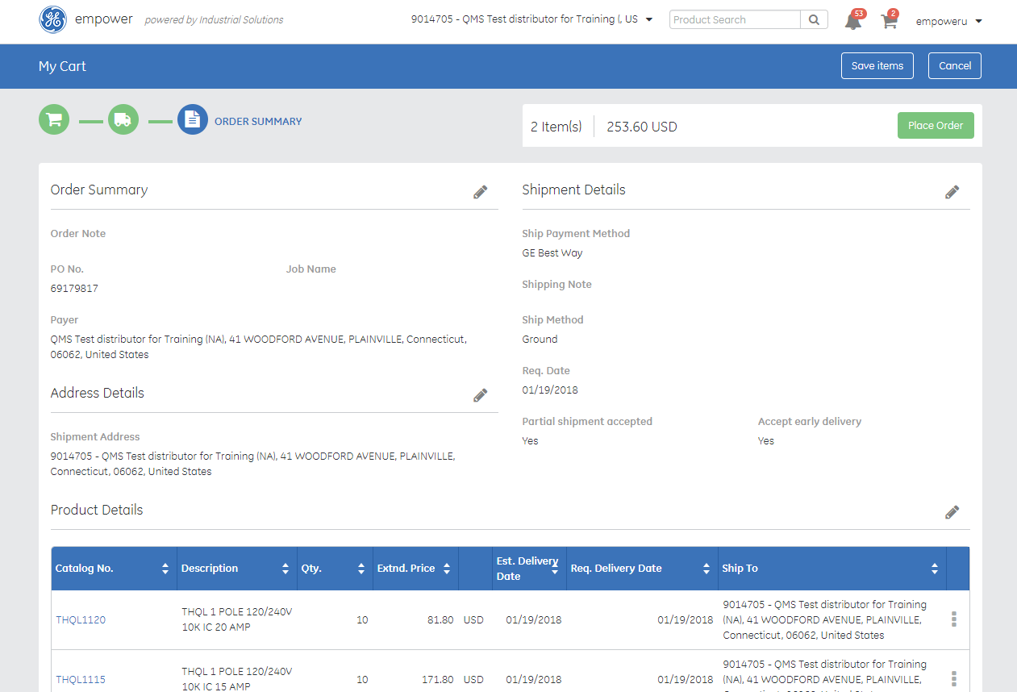
Easy ordering. Optimized logistics
empower the power to do more
Our premier digital commerce platform enables our employees, partners and customers to manage all aspects of their relationship from quote and bid to order and delivery tracking
eCommerce
Find, order and track products fast
Project Management
Manage configured items, generate bills of material and more
Product Configuration
Use online configurators to build any size project
Document Generation
Generate electronic documents with ease, from configured drawings to full proposals and submittal packages

Slide 3
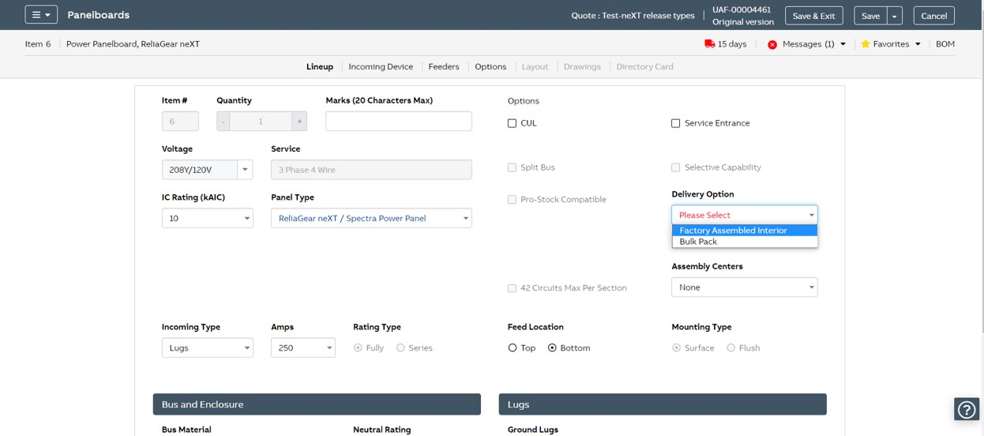
Select Your Interior Delivery Option

Slide 4
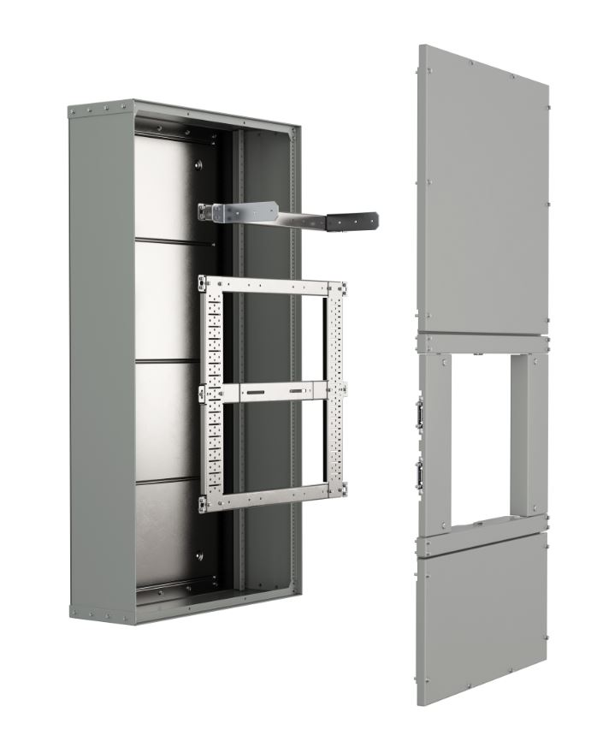
ReliaGear neXT options
Delivery – Bulk pack
Pallet 1
Pallet 2
Bulk Pack Logistics
Pallet 1: Enclosure, fronts, frame and wire post
Pallet 2: Unassembled bus, circuit breaker, ground, neutral
Bulk Pack Benefits
Jobsite management:
Everything you need in 2 shipments
Perfect for pre-installation testing needs
Single person installation
Easily add to existing
Quickly respond to changes in feed direction and circuit breaker layout

Slide 5
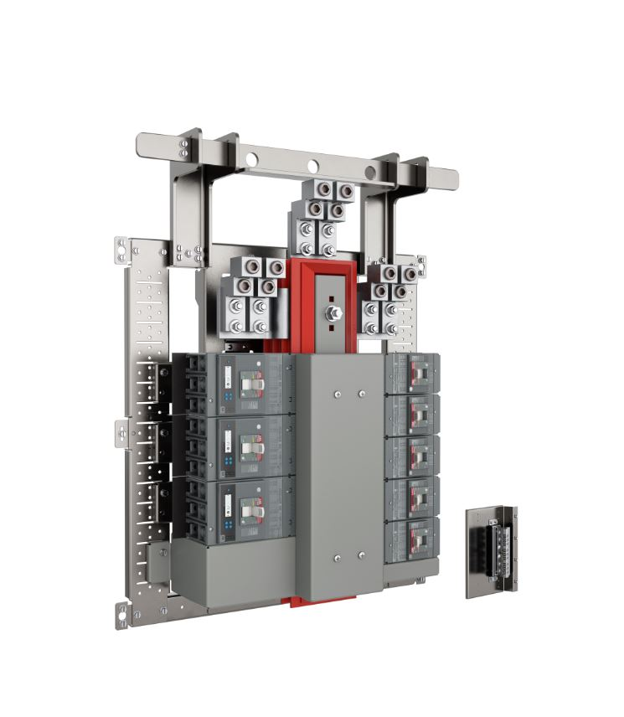
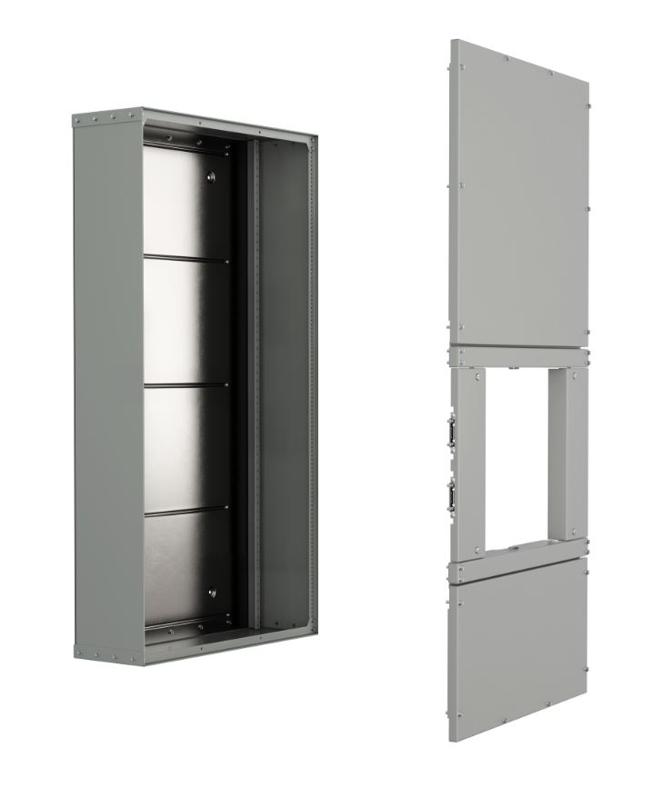
ReliaGear neXT options
Delivery – Assembled interior
Pallet 1
Pallet 2
Factory Assembled Logistics
Pallet 1: Preassembled enclosure and fronts
Pallet 2: Fully assembled interior. Unassembled ground and neutral blocks.
Factory Assembled Benefits
Product arrives configured per empower submittals documentation
Everything you need in 2 shipments
Perfect for large projects with multiple panels

