Slide 1
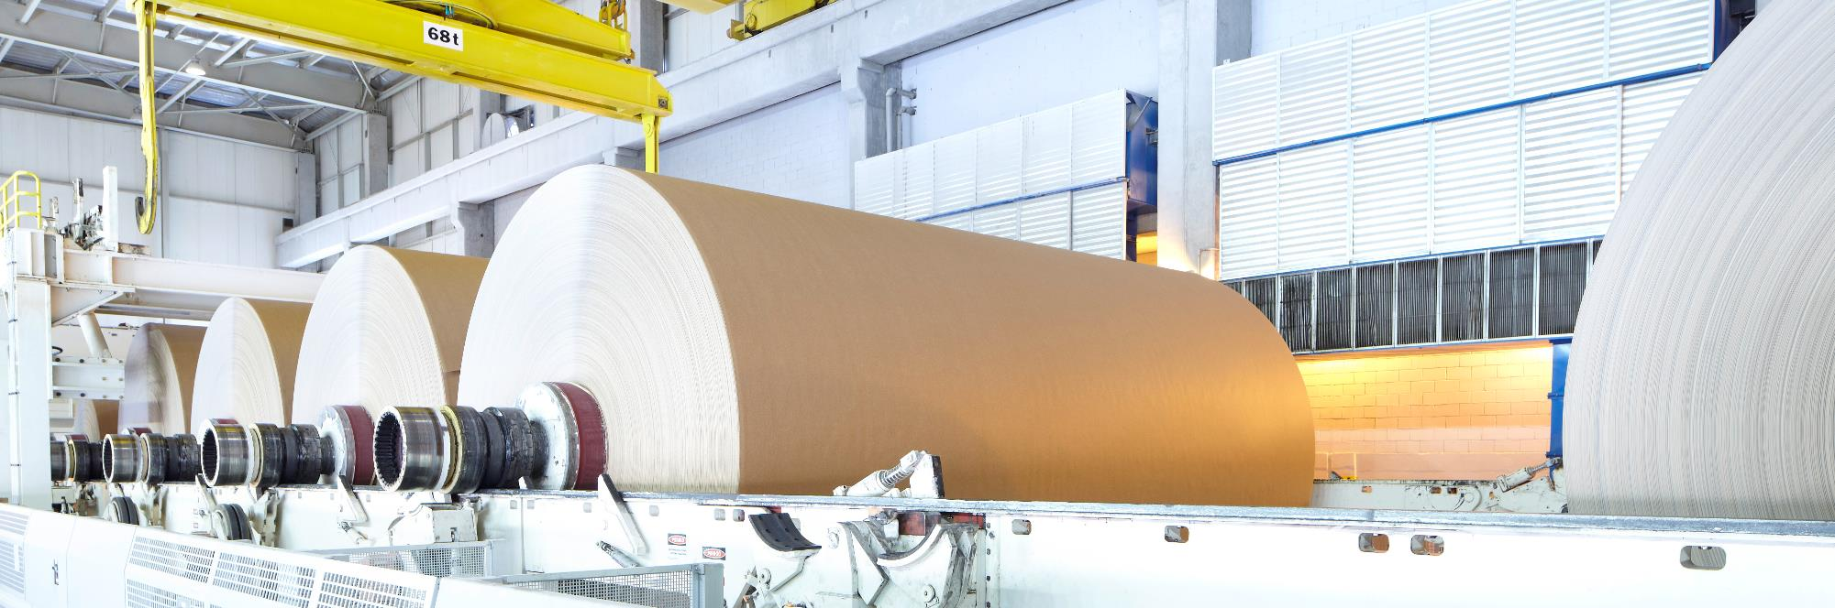

—
Measurement & Analytics
Force Measurement
Service made easy

Slide 2
01.
02.
03.
04.
05.
06.
07.
BL Force Measurement | Introduction to service
Measurement Care Agreement
Services by product line
Additional services
What is happening in the market
Health check services
Upgrades & Repairs

Slide 3

—
BL Force Measurement
Introduction to service
1

Slide 4







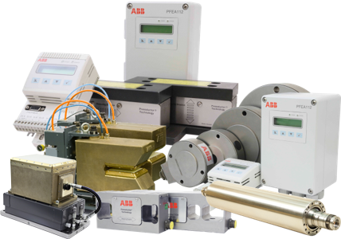
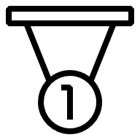
—
BL Force Measurement
At a glance
PRODUCT LINES
Flatness Measurement & Control
Dimension measurement
Roll Force measurement & Strip Tension measurement
Web Tension measurement
Combustion pressure measurement
Weighing
FACTORIES
Vasteras, Sweden
SERVICE CENTRES
Danbury CT, USA
Vasteras, Sweden
Shanghai, China
Mishima, Japan
Ratingen, Germany
240 talents worldwide
Represented in 30+ countries
1 Factory & 5 service centers
GLOBAL Service support
6 Product lines for metals, paper and marine industries
120+ Years of innovation
Award winning technology

Slide 5
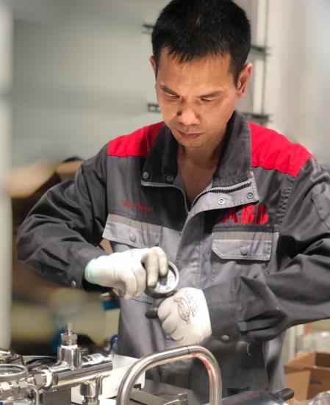
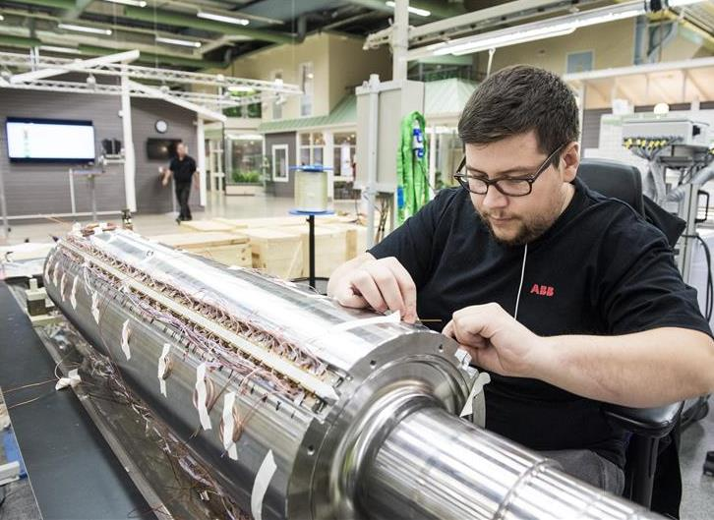

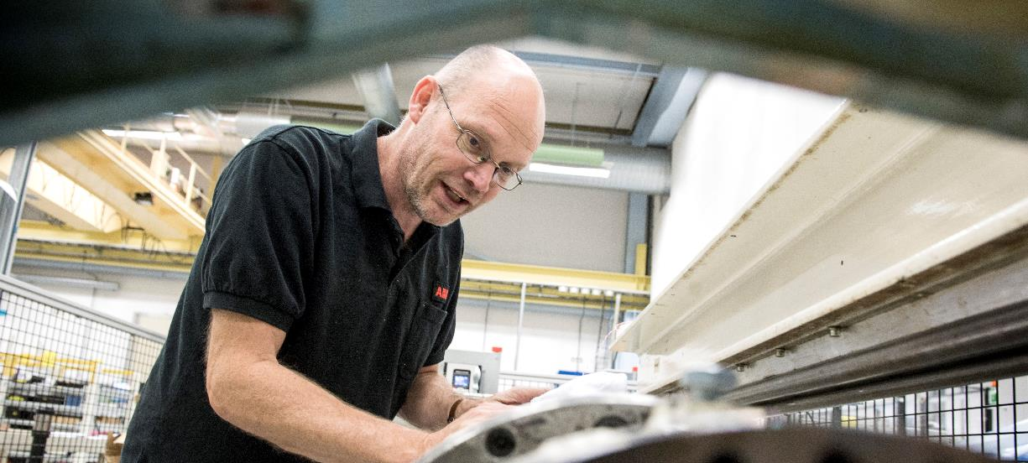


—
At the heart of what we do…
PEOPLE
Customers & Partners
Innovation & Digitalization

Slide 6

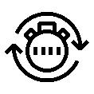






—
Good to keep in mind
Solutions can be targeted to specific customer needs
Connectivity
Skills
Productivity
Quality
“I run many sites and need quick access to a range of productivity data 24/7”
“My team keep retiring, I need simple solutions to ensure new starters can maintain and operate the plant effectively”
“I need ways to increase output using my limited engineering resources and budget”
“I need the highest accuracy and availability all of the time from my flatness control system to ensure the highest quality”

Slide 7

—
Measurement & Analytics service
Our services enables you to maximize your product lifecycle
Complete lifecycle services
Limited lifecycle services
Active
Classic
Limited
Obsolete
New products
Warranty
Tech support
Training
Spare parts available
ABB issues a lifecycle phase change
Service becomes expensive
Spare parts no longer available
Aligned with R&D work
New hardware & software
Notes:
Product Lifecycle Management, developed by ABB to improve the reliability of operations and support the serviceability of your production assets. At the heart of ABB's services is Product Lifecycle Management, a four-phase model based on the know-how and experience acquired by ABB during four decades in local and global markets.
Starts when the product is launched.
The end user benefits from different warranty options and other services such as training & technical support including product adjustment for optimum performance.
The active phase ends when the volume production of the product ceases.
Aligned with ABB's research & development work to provide continuing support for product while developing future generations.
New hardware and software development may be required to provide the maintenance techniques and upgrades needed to guarantee that the product continues to operate at its peak performance.
Spare parts are available as long as components and materials can be obtained.
Towards the end of the limited phase, services gradually become obsolete. In addition to the annual lifecycle status reviews, ABB issues a lifecycle phase change announcement, half a year prior the product becoming obsolete.
The ABB product is transferred to the obsolete phase when it is no longer possible to provide services at reasonable cost, or when ABB can no longer support the product technically, or the old technology is not available.

Slide 8





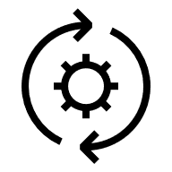

—
Measurement & Analytics
Service
INSTALLATION & COMMISSIONING
REPLACEMENT & END-OF-LIFE SERVICES
TRAINING
Increasing your accuracy & availability
Services to support your products during every lifecycle stage
EXTENSIONS, UPGRADES & RETROFITS
SPARES & CONSUMABLES
ADVANCED SERVICES
MAINTENANCE
TECHNICAL SUPPORT & REPAIRS
Active
Classic
Limited
Obsolete
Notes:
Products evolve as they transition through their lifecycle. Likewise, ABB’s support of those products evolves along with them. From installation to maintenance, repair and upgrades, at each stage of the product lifecycle, ABB offers services to meet your needs, priorities and values.
ABB can collect and analyze asset information 24/7 to identify, categorize and prioritize actions that improve productivity, increase efficiency and ensure security. This helps customers manage the challenges of an aging asset and regulatory requirements with a clear view of their total asset performance.
These services aren‘t a cost to customers. They are an investment. This investment improves operating efficiency of equipment, reduces the risk of unplanned downtime caused by equipment failure, and helps customers optimize their service budget with fixed prices available through a Measurement Care service agreement.
Describe which branches we work with and summarizes the production area we represent.
We are dedicated to optimizing your productivity and performance.
Enable improved utilization and performance of your measurement and control equipment, processes, and personnel.
Force Measurement provides comprehensive support – from planning and commissioning, through to complete life-cycle services for flatness, dimension and tension measurement.

Slide 9

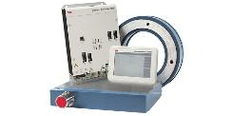


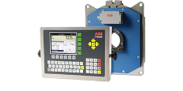
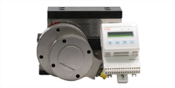

—
A solution for every measurement challenge
Force measurement
Flatness measurement
Thickness gauging
Roll force measurement
Strip tension
measurement
Strip width & position measurement
Weighing
Web tension measurement
Combustion pressure measurement

Slide 10





—
A service for every lifecycle stage
Service overview
Products | Spares & consumables | Commissioning | Repairs | Upgrades | Health Checks | Training | Lifecycle services
Flatness control | x | x | x | x | x | x | x
Thickness Gauge | x | x | x | x | x | x | x
Roll force measurement | x | x | x | X | x | x | x
Strip tension measurement | x | x | x | X |  | x | x
Strip width & position measurement | x | x | x | X |  | x | x
Weighing | x | x | x | X |  | x | x
Web tension measurement | x | x | x | x |  | x | x

Slide 11




—
Your dependable service partner
With you where and when you need us
Over
30
Service
employees
15
Global services
for more than
countries
70
Providing
services for over
years
Global service centers (2)
Regional service centers (5)

Slide 12
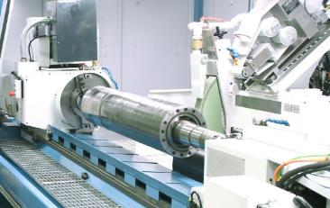
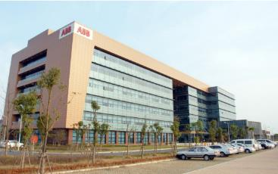

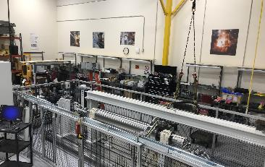
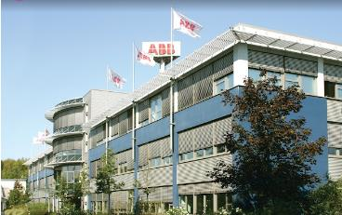



—
Repair centers
Across the globe
Västerås, Sweden
Kangqiao, Shanghai, China
Mishima, Tokyo, Japan
Danbury, CT USA
Ratingen, Germany
The Sweden repair center provides cover for all of the Force Measurement product portfolio for many regions.
The facility is equipped with the latest technology to ensure high quality workmanship.
The Kangqiao repair center has the capability to do test, inspection and repair for the domestic customers.
The repair center strictly follows established repair and faultfinding procedures, starting with visual inspection, cleaning, detailed inspection and diagnostic measurements, continuing with the actual repair work, and ending with functional tests.
The Danbury repair center has the capability to do test, inspection and repair for the North American customers.
The center offers a broad range of repair services for most force measurement product portfolio.
At Ratingen we aim for the fastest turnaround times possible. For most repairs, we can promise a repair with predefined lead time so you can plan for the repair. Every repair we do is accompanied by a report, detailing the faults found and the remedies taken.
TEST
INSPECT
REPAIR

Slide 13
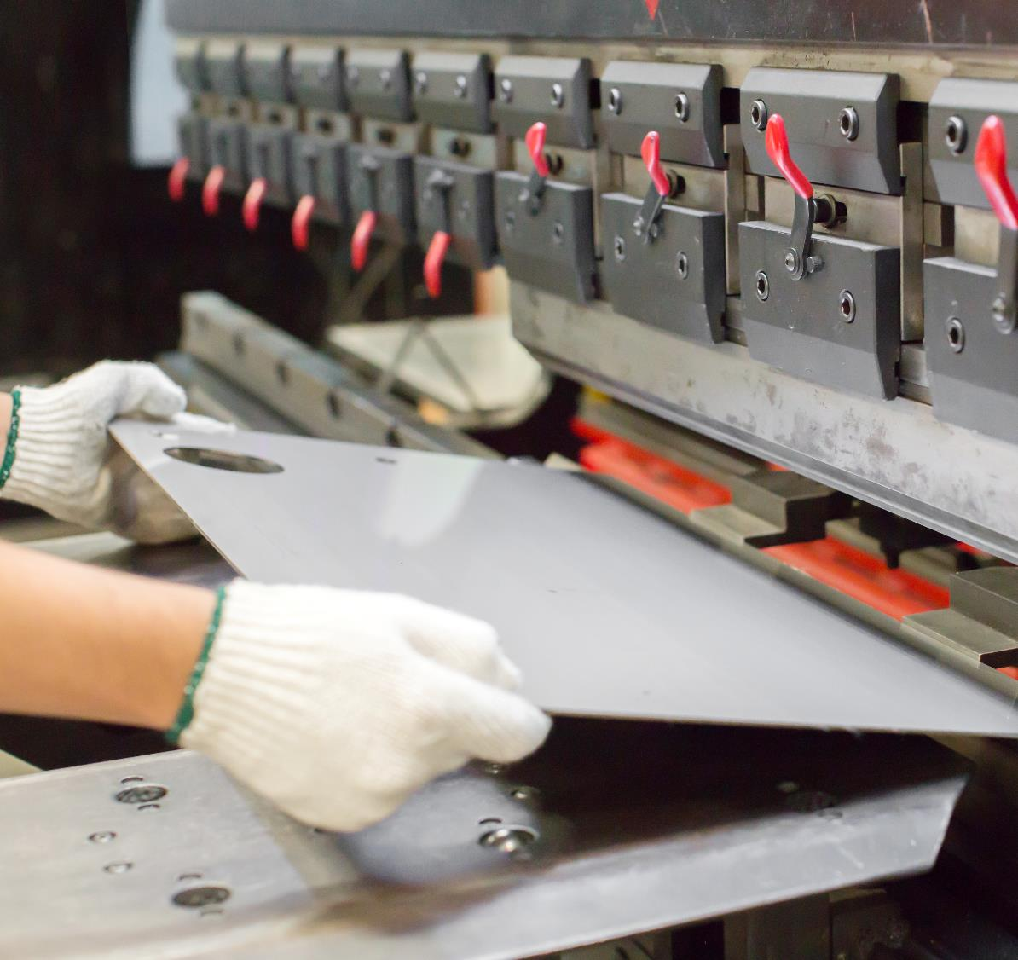
—
We put safety first
Risk assessment is included in all our work
What do we do together to avoid accidents?
Mandatory risk assessment from a personal safety perspective based on product and installation environment
  Routines for improved safety for employees, suppliers and customers
  Training
  Incident reporting
  Work environment policy
Adapted and certified work clothing and equipment

Slide 14
—
Measurement Care Agreement
Overview
2

Slide 15

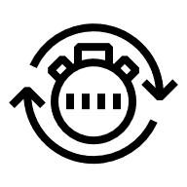

—
Measurement Care
Basic agreement: We cut complexity with professional contract management
Measurement Care
Rapid Response: We guarantee fast and flexible response to maximize your equipment uptime
Performance improvement
Lifecycle Management: We employ powerful tools and knowledge to optimize and extend your equipment life
Lifecycle management
Rapid response
Performance Improvement: We optimize connectivity, reliability and efficiency of your assets to increase speed and yield
Basic agreement
Notes:
Areas where we strive for partnership, and for the customer, lower total costs for maintenance. The services are common for all Force Measurement products.
Rapid response = We are at your service around the clock, quickly and efficiently. We promise to restore your production, assets and processes to full working order within the agreed timeframe.
Lifecycle management = Our extensive experience and solutions help you extend, analyze and optimize the lifecycle of your equipment
Performance improvements = We will help you optimize the availability and efficiency of devices and systems and in this way improve the profitability of your assets and production plants.
Additional services = Force Measurement’s professional training services qualify your engineers, maintenance and operations staff to get the most out of your investment.
Measurement Care service contracts
Force Measurement’s team of local and global specialists have the skills and experience to support your business. Providing quick resolutions, competent maintenance strategies and lifecycle management of your installed base.
Force Measurement’s customized service agreements secure long-term peak performance, minimize unexpected downtime and make CAPEX and OPEX budgets predictable.

Slide 16
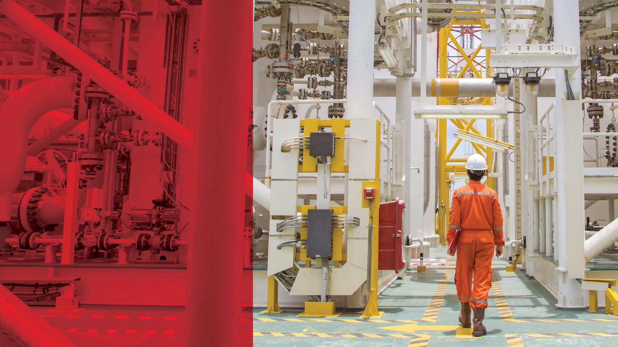


—
Rapid response
Technical/Remote support
Corrective maintenance
Workshop repairs
Measurement Care
Performance improvement
Lifecycle management
Rapid response
Basic agreement
Notes:
Rapid response services
Note! Remote support can be offered for all products.
There are some companies that offer repair of Force Measurement products but our experience is that they do not fulfil the requirement and quality that the customer should expect. We see many examples where the repaired product just work for a short period of time and with reduced functionallity and measurement accuracy.
Using experienced Force Measurement service engineers will reduce the maintenance and field services time to a minimum as well as ensure the best possible performance of the product.
We offer remote, on-site and work-shop repair services with fast turn around and service agreements.
We offer fast and efficient repair services and wide range of options including:
Remote support from a skilled and certified product expert
Self-repair through guided instruction
On-site service
Workshop repair
Exchange/replacement product
Trusting repairs by Force Measurement guarantees that the durability and functionality remains valid with the product, something that may get lost if another company does the repairs without the correct equipment and training.

Slide 17

—
Lifecycle management
Spare parts management
Preventive maintenance
Inspections & diagnostics
Measurement Care
Performance improvement
Lifecycle management
Rapid response
Basic agreement
Notes:
Lifecycle management services
Spare parts
Products spare parts can be purchased from the factory in Västerås. For emergency deliveries we offer spare part service via ABB Energy Inustries (Malmö, Sweden) via BOL. Spares are shipped the same day (if ordered before 16.00 hrs CET) or next day. Weighing spare parts can be purchased from our Ratinger Service Center in Germany.
Lifecycle assessment
After a complete site evaluation, Force Measurement develops a customized implementation plan for migration of your installed equipment and manages disposal of old equipment according to all environmental regulations.
In today’s global economy, it is critical that your plant stays competitive through increased productivity and efficiency. Force Measurement has developed cost-effective upgrade programs that enable low-risk, phased migration to the latest technology to improve productivity, efficiency and safety.
For products with life cycle status ”Classic”, ”Limited” and ”Obsolete” we offer spare part service via the factory and ABB Energy Industries Service Center via BOL. Spares are shipped the same day (if ordered before 16.00 hrs CET) or next day.
Force Measurement offers a life cycle management service to provide effective maintenance, migration and obsolescence planning - including a replacement procedure ensuring that product disposal meets all local environmental regulations.
The life cycle management model is a four-phase life cycle plan.
Active
Active product types are in volume production and are actively marketed and sold.
Full service support is available for Active products.
Classic
Classic product types are no longer in volume production.
Full service support is available for Classic product.
Limited
Limited product types are no longer in volume production
Service support is limited
Customers are recommended to replace products in Limited phase with a new superior product type in Active phase
Obsolete
Obsolete product types no longer in volume production
Service support is normally not available
Customers are strongly recommended to replace Obsolete product types with a new superior product type in Active phase

Slide 18

—
Performance improvement
Condition monitoring
Predictive maintenance
Measurement Care
Performance improvement
Lifecycle management
Rapid response
Basic agreement
Notes:
We offer advanced engineering and consulting services based on extensive experience and genuine know-how to identify new opportunities for improvements and solutions to possible upcoming problems.

Slide 19

—
Additional services
Training
Training is available either in the classroom, at your plant, via webinar or online using our eLearning courses. All are designed to train your plant personnel how to safely work, operate and maintain Force Measurement products.
Notes:
Learning in the modern era
For most of our products it is possible to do online training via the web to understand the basics of our products. For deeper knowledge (especially for preventive maintenance, service & fault tracing) we recommend instructor guided training where theory is put into practice with help of exercises, guided by skilled teachers with good pedagogical ability.
ABB University training
Offered for Stressometer Flatness measurement & Control systems
ABB Factory training
Offered for whole product range
On-site trainings
Trainings for operators and service staff whole product range using customer installed equipment
E-learnings
E-learnings via internet on a modern web-based platform (except Stressometer Flatness measuring & Control systems)
PAMA Training Portal
https://abb.sharepoint.com/sites/BUMPManagementDatabase/BUMPService/SitePages/Training_Management.aspx

Slide 20
—
Services by product line
Overview
3

Slide 21





—
A service for every lifecycle stage
Service overview
Products | Spares & consumables | Commissioning | Repairs | Upgrades | Health Checks | Training | Lifecycle services
Flatness control | x | x | x | x | x | x | x
Thickness Gauge | x | x | x | x | x | x | x
Roll force measurement | x | x | x | x | x | x | x
Strip tension measurement | x | x | x | x |  | x | x
Strip width & position measurement | X | x | x | x |  | x | x
Weighing | x | x | x | x |  | x | x
Web tension measurement | x | x | x | x |  | x | x
Notes:
Spares and consumables
Price according to price books from Force Measurement with standard lead times or emergency deliveries via Energy Industries service center Business On-Line (BOL).
How to order spares and consumables, see https://abb.sharepoint.com/sites/FMESalesForum/After-Sales-Services/SitePages/Welcome.aspx
Electronics repair
Price via Control Technologies service center Business On-Line (BOL).
How to order electronics repair, see https://abb.sharepoint.com/sites/FMESalesForum/After-Sales-Services/SitePages/Welcome.aspx
Commissioning and service
According to the rates in the price book 3BSE035426R1 (After Sales Service)
How to order installation and service, see https://abb.sharepoint.com/sites/FMESalesForum/After-Sales-Services/SitePages/Commissioning%20and%20Service.aspx
​Product training
To secure productivity in a plant, staff skills are essential. ABB has extensive experience in training all of the various occupational groups that in one way or the other, work with our products and systems. Characterizing for our courses are that theory is put into practice with help of exercises, guided by skilled teachers with good pedagogical ability.
We offer:
• Open, scheduled courses at our training center
• On-site training
• Customized training
• E-learning
E-learning
Free of charge. See, https://mylearning.abb.com
On-site training
On request, eg. find out customer demands and get a quote from your Area Sales manager
Stressometer training
Standard training for Stressometer avaliable at ABB University in Västerås. How to order and get prices see, https://abb.sharepoint.com/sites/FMESalesForum/SitePages/Product-training.aspx)
At customer site (get a quote from your Area Sales Manager)
Customized traing
On request, eg. find out customer demands and get a quote from your Area Sales manager

Slide 22
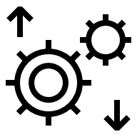




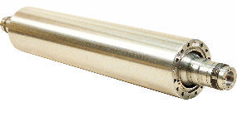
—
Stressometer Flatness systems
Flatness measurement and control in rolling mills
SOLUTION
SERVICE OFFERING
Unsurpassed measurement performance
Advanced flatness control (e.g. ESVD)
Superior long-term stability without need for recalibration on-site
Optimal Flatness Control through superior measurement step response
Measurements unaffected by strip temperature variations thanks to same thermal expansion of roll and sensor
Measurements undistorted by tension variations thanks to measurement of the whole force distribution at one instant
Superior measurement of strip edges thanks to sensor linearity and use of partly covered measurement zones
Resilient to harsh environments through Pressductor technology
Spares & Consumables
Repairs
Health checks
Lifecycle services
Commissioning
Upgrades
Training

Slide 23
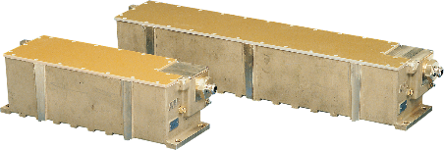
—
Millmate Strip Scanner system
Measuring strip width and position in rolling mills
SOLUTION
SERVICE OFFERING
Pulsed Eddy Current technology
Accurate and reliable measurement in severest environment
Not influenced by harsh environment
Superior long-term stability
Rugged sensor design
Minimal maintenance
Safe technology
Non-contact measurement
Spares & Consumables
Repairs
Commissioning
Lifecycle services
Training
Upgrades

Slide 24
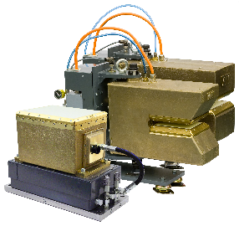
—
Millmate Thickness Gauge
Measuring thickness in rolling mills
SOLUTION
SERVICE OFFERING
Not influenced by harsh environment
Independent of alloy variations
Superior long-term stability
Rugged gauge design
Minimal maintenance
Safe technology
Non-contact measurement
Pulsed Eddy Current technology
Lab accuracy in the mill
Spares & Consumables
Repairs
Health checks
Lifecycle services
Commissioning
Upgrades
Training

Slide 25
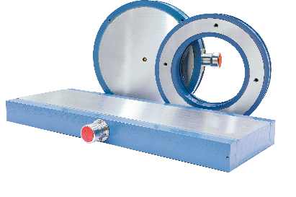
—
Millmate Roll Force system
Measuring the roll force in rolling mills
SOLUTION
SERVICE OFFERING
Robust Pressductor technology
Resiliant to harsh environments
Superior long-term stability without
signal drift
High accuracy & repeatability
Basically maintenance free with no need for recalibration
High overload tolerance
Custom made load cells
Easy to install and start-up
Spares & Consumables
Repairs
Health checks
Lifecycle services
Commissioning
Training
Upgrades

Slide 26
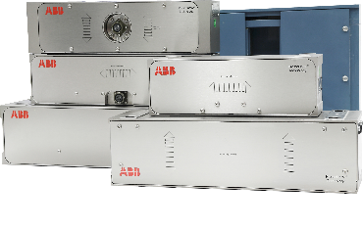
—
Millmate Strip tension measurement
Measuring the strip tension in rolling mills
SOLUTION
SERVICE OFFERING
Measuring the strip tension in rolling mills and process lines
Resiliant to harsh environments
Superior long-term stability without signal drift
High accuracy and repeatability
Basically maintenance free, no recalibration needed
High overload tolerance
Easy to install and start-up
Robust Pressductor technology
Repairs
Commissioning
Lifecycle services
Training
Spares & Consumables
Upgrades

Slide 27
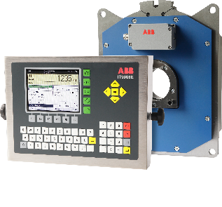
—
Weighing system
Weighing systems for the heavy industries
SOLUTION
SERVICE OFFERING
Identify the weight of materials in casters, hoppers, silos and on EOT-cranes
Load cells with high overload capability beyond competitor‘s cells, up to 250 or 400 %
Extended compensated operation temperature, up to + 180/200 °C (+ 356/392 °F)
Modular weighing controllers, possibility for extensions in a later stage, providing all interfaces for contemporary communication protocols.
Mechnically compatible to Pressductor load cells of the last generation
Strong local presence, offering engineered solutions and optimal installations
Weighing controllers for simple and for challenging applications
Freely programable weighing controllers for each application
Standard software for filling, batching, checking, remote control,
belt scales, etc.
Interfaces for Profibus, Profinet, Ethernet, Modbus, serial, digital, analog
Lifecycle services
Training
Upgrades
Spares & Consumables
Repairs
Commissioning

Slide 28
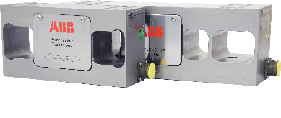
—
Web Tension system
Measuring the web tension in paper mills and converting
SOLUTION
SERVICE OFFERING
Robust Pressductor technology
Resiliant to harsh environments
Superior long-term stability without signal drift
High accuracy & repeatability
Basically maintenance free with no need for recalibration
High overload tolerance
Easy to install and start-up
Strong local presence, offering engineered solutions and optimal installations
Spares & Consumables
Repairs
Commissioning
Lifecycle services
Training
Upgrades

Slide 29
—
Additional services
4

Slide 30
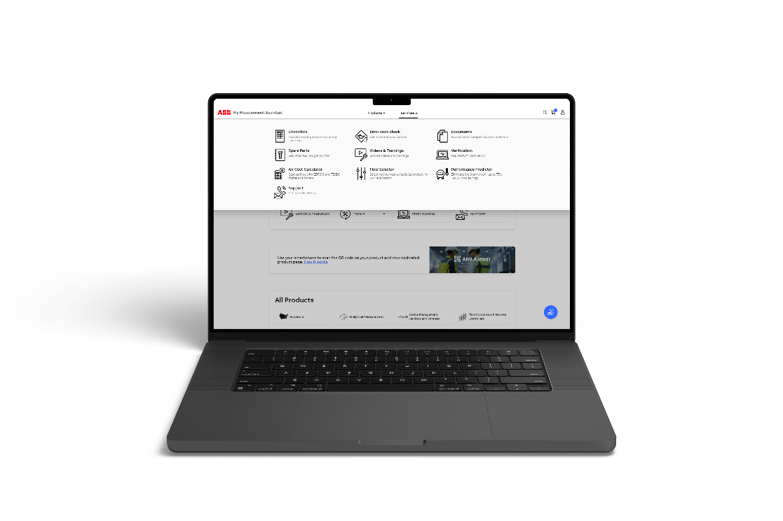
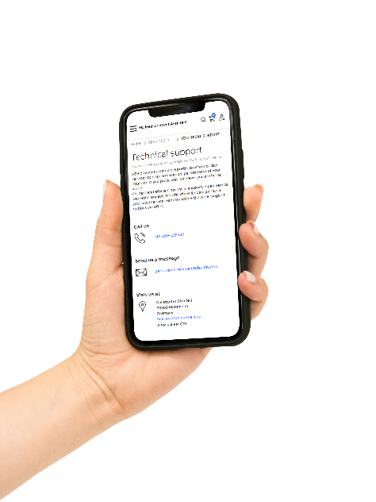

—
My Measurement Assistant
Spares & Consumables
Installation & commissioning
Training
Product documentation
Maintenance support

Slide 31


—
Basic Remote Assistance for Stressometer Flatness systems
Commissioning
Training
Repairs
Lifecycle services
Notes:
Remote assistance is provided in different ways and is commonly part of service contracts.
Remote assistance can be delivered in different ways
Self service: MyABB and My Measurement Assistance
Visual remote support, where an ABB Engineer can invite a customer to a video call
Remote connection to the product
MMA vs MyABB?
Two different ways to access info
Same log in to both tools
Both use data in ABB Library and ABB products
FM in MMA to start with Documentation (ABB Library) and contact info for support
Visual remote support
Internal licenses ordered and managed via MYIS, Process similar to ordering other 3rd party software, Anticipated license cost = $ 425 - $ 500 US per user/per year
Contact an ABB support representative through your normal support channel
The representative will review the case and ensure that the right specialist is assigned to support your case
Connect to Visual Remote Support •
Click on the link sent to you by an ABB specialist via email or SMS to start a remote session via a secure VPN channel
The link opens a web browser, and a call is automatically placed to the ABB specialist
When the call is connected, the ABB specialist can directly see the on-site video
The ABB specialist helps resolve the problem
The ABB specialist guides through the troubleshooting process with the aid of interactive tools that visualize the instructions

Slide 32
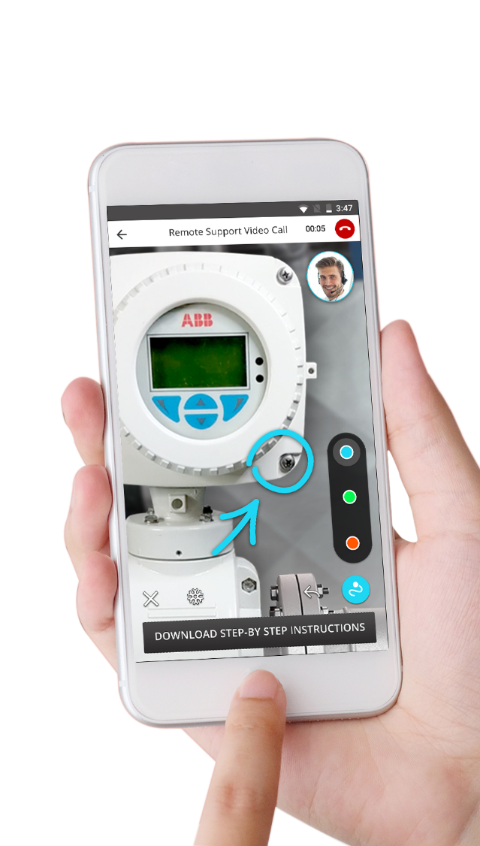
—
Visual Remote Support
Commissioning
Training
Repairs
Lifecycle services
Notes:
Remote assistance is provided in different ways and is commonly part of service contracts.
Remote assistance can be delivered in different ways
Self service: MyABB and My Measurement Assistance
Visual remote support, where an ABB Engineer can invite a customer to a video call
Remote connection to the product
MMA vs MyABB?
Two different ways to access info
Same log in to both tools
Both use data in ABB Library and ABB products
FM in MMA to start with Documentation (ABB Library) and contact info for support
Visual remote support
Internal licenses ordered and managed via MYIS, Process similar to ordering other 3rd party software, Anticipated license cost = $ 425 - $ 500 US per user/per year
Contact an ABB support representative through your normal support channel
The representative will review the case and ensure that the right specialist is assigned to support your case
Connect to Visual Remote Support •
Click on the link sent to you by an ABB specialist via email or SMS to start a remote session via a secure VPN channel
The link opens a web browser, and a call is automatically placed to the ABB specialist
When the call is connected, the ABB specialist can directly see the on-site video
The ABB specialist helps resolve the problem
The ABB specialist guides through the troubleshooting process with the aid of interactive tools that visualize the instructions

Slide 33
—
What is happening in the market
5

Slide 34
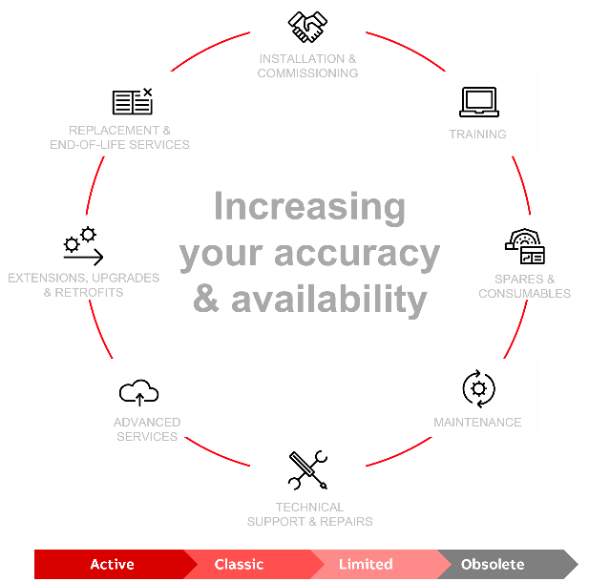
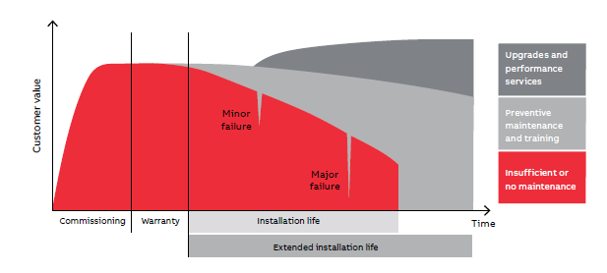
—
Force Measurement offering
Asset service life
Notes:
An assets service life and performance depend on care during the lifetime.
Performance will deteriorate over time if not serviced.
Services can be reactive to fix problems, proactive to prevent problems or enhance performance and extend asset installation life
The Force Measurement service offering support customers during the whole asset service life, from installation & commissioning to replacement

Slide 35
—
Increased availability
A facility’s service life
Facility value
Regular upgrades
and replacements
Maintenance &
support
Life cycle with little
or no maintenance
Warranty period
Facility's life cycle
Notes:
Increased availability
This slide schematically illustrates a facility's life cycle.
Start – full production – improvement
Maintenance strategies
Life cycle with little or no maintenance
Over time the facility value will decrease as the products performance will be less competative and there is a risk of product failure.
Maintenance & support
Over time the facility value will decrease as the products performance will be less competitive but the risk of product failure will be reduced.
Regular upgrades and replacements
Over time the facility value will increase due to new enhanced performance and functionallity.
Ask the customer which strategy they have and use it to create the ”right” service offer to the customer.

Slide 36







—
What is happening in the market
Our initiatives
Safety
Availability and cost-savings
Small investments
Increased service life
Purchase of services
Increased productivity
Energy efficiency
Cyber security
Notes:
Our initiatives
This slide shows the most common questions/needs that our customers face. The slide summarizes the previous slides presented for the topic "What is happening on the market?” We try to reflect what is happening at your company in our own initiatives for the future. It is important that we receive feedback to ensure that we are working with the right things.
Our initiatives/development areas can be summarized with:
Security
Risk analyses, equipment
Safety
Risk analyses, equipment
Availability and cost-savings
Advanced services such as life cycle assessment
Small investments
Upgrades
Increased service life
Preventive maintenance
Purchase of services
Large and small service agreements
Increased productivity
Consulting services, OEE measurements
Energy efficiency
Consulting services and products
Discuss this with the customer and ask them to choose what is most important to them (e.g. 3–4 points). The following slides about “Force Measurement's service assortment” should be able to answer this.

Slide 37
—
Health check services
6

Slide 38
—
Customer challenge
In-house expertise is becoming rarer for maintenance and troubleshooting
In-house expertise is typically not available
Retirements and other departures erode “institutional knowledge”
Staff changes challenge customers ability to standardize maintenance practices
Customers are looking for ways to ease the workload on their personnel
Notes:
One challenge for the customer is to keep in-house expertise in each rolling process step and expertise in each one of their measurement and control systems.
Modern mills have more and more automation and less and less staff. On top of that there are retirements and staff changes which lead to that troubleshooting takes more time when the in-house expertise is reduced.
One way to ease the customer’s workload is to hire external expertise, such as ABB, to check their equipment in a proactive way, or in some cases in a reactive way when they already have problems.

Slide 39


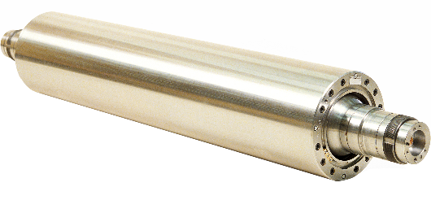
—
Health check
Supported products
Millmate thickness gauge system (C-frame)
Stressometer measurement roll
Stressometer flatness control
Millmate roll force system
Notes:
Besides trainings, spare part sales etc. we offer health checks as a service to help our customers on-site. The customer can pay us to perform any of the following four health check services that are currently available:
Millmate thickness gauge system (C-frame)
Stressometer measurement roll
Stressometer flatness control
Millmate roll force system

Slide 40
—
A service for every lifecycle stage
Service overview
Service | Stressometer | Roll Force Measurement | Strip Tension Measurement | Web Tension Measurement | Strip Width & Position Measurement | Thickness gauging | Weighing
ABB Ability Stressometer measuring roll health check | x
ABB Ability Stressometer flatness control health check | x
Millmate Thickness Gauge Health check |  |  |  |  |  | x
Millmate Roll force Health check |  | x
Life-cycle assessment | x | x | x | x | x | x | x
Notes:
ABB Ability Stressometer roll health check
On request, ask your Area Sales Manager for a quote or use local staff if applicable (eg. trained service engineer that can do the service)
ABB Ability Stressometer flatness control health check
On request, ask your Area Sales Manager for a quote or use local staff if applicable (eg. trained service engineer that can do the service)
Life-cycle assessment
On request, ask your Area Sales Manager for a quote or use local staff if applicable (eg. trained service engineer that can do the service)

Slide 41
—
Replacement & Upgrades
7

Slide 42
—
Measurement & Analytics service
Our services enables you to maximize your product lifecycle
Complete lifecycle services
Limited lifecycle services
Active
Classic
Limited
Obsolete
New products
Warranty
Tech support
Training
Spare parts available
ABB issues a lifecycle phase change
Service becomes expensive
Spare parts no longer available
Aligned with R&D work
New hardware & software
Notes:
New Product Introductions means a new system release enters Active phase, and normally, the previous release moves to Classic or Limited phase according to FME Life Cycle Policy. The rule is that systems shall remain maintained for at least 10 years in Classic and Limited phases, combined time.
Life cycle status and policy can be found via the links for your reference.
Upgrades are made available, so that we can offer customers to move their installed base to the latest release.

Slide 43
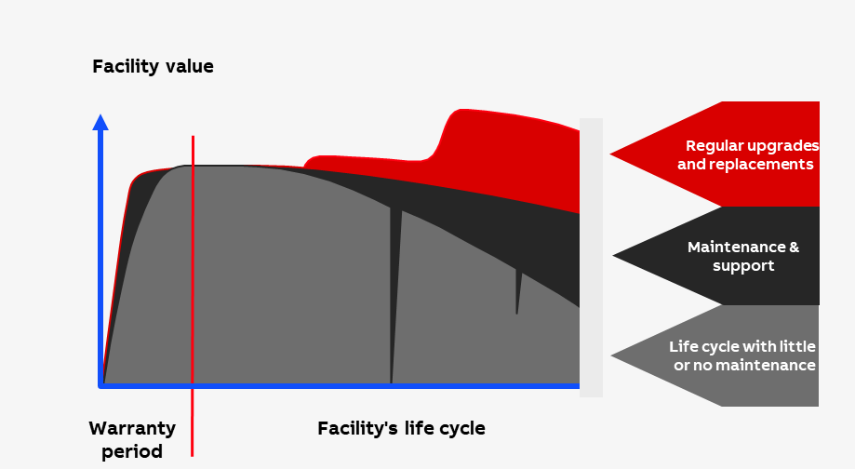
—
Replacements & upgrades
Overview
Extending life-time
  Maximizing operational time
  Reducing maintenance
Minimizing risk
  Assuring spare part availability
  Assuring support availability
  Improved cyber security
New features and functions
Performance improvement
Offering upgrades gives you more time with the customer
Notes:
Upgrading is motivated for the customer in order to maximize the operational time and reduce the required maintenance of the equipment, as older equipment tend to need more care. It is of course also important to assure that spare parts are available in case of failure and that there is still someone who has the competence to help with trouble shooting. A mature organization plans for exchanges and upgrades in order to minimize risk and to keep production running with a minimum of unplanned interruptions.
But most often it is not just keeping the equipment alive. We can also offer new features and functions and performance improvements. The customer will experience more value in their process.
A recent contribution to the list of improvements is the Cyber security updates. Such an upgrade may not contribute with a large order volume for us, but it is still motivated to work with as it helps the customer and builds our image as a responsible supplier. It also gives you, as a sales person, a reason to spend more time with the customer, which in turn can give you more leads and orders.

Slide 44

—
Replacements & upgrades
Cybersecurity
Available upgrades for Cyber Security
Upgrade kits including:
Computer -s with Windows 10 IoT LTSC
Software, Licenses, documentation
Stressometer:
  v7.0 to Win10 (v9.2) upgrade kit 3BSE096822R1
  v7.1 - v8.2 to Win10 upgrade kit 3BSE096823R1
  v8.3 - v9.1 to Win10 upgrade kit 3BSE096824R1
Millmate Thickness Gauging systems:
  PMG100ver3.1 - C-frame gauge - 3BSE096880R1
  Millmate Thickness Gauging PMG100 OS update (sharepoint.com)
  PMG200ver4.2 - Box gauge - 3BSE095477R1
  Box Gauge release material PMG200ver4.2 (sharepoint.com)
Notes:
More and more customers are aware of the cyber threats and what damage a hacker attack can do for the production.
ABB is taking its part of the responsibility by applying strict rules for our new product introductions.
In our offering today, Stressometer and Millmate Thickness Gauges are complying with ABB Minimum Cyber Security Requirements. This is a subset of the European Union IEC standard (62443).
Cyber security upgrades include new computers with Windows 10 Operating system, related software and documentation package. The respective links show more indepth material on the releases, so you can check this out later on.
There is presentation material included with information on the ABB take of cyber security and technical information. The intention with this material is not for you to fully understand every detail, rather to show the customer that we are taking cyber threats seriously and have implemented policies for safe-guarding the systems during their life cycle. For discussions in more detail, we can support you from the factory.

Slide 45

—
Replacements & upgrades
Cybersecurity
OS Hardening
Application
Ports
Services
SSD write protection
Policies
Definition of policies
Policy deployment
Policy enforcement
Password policies
Patch management policy
Network Hardening
Firewall rules
Application Hardening
User accounts
User Context for applications
Application and services executing with least privileges
Applications are digitally signed
Notes:
The most important aspects of what our cyber security offering includes is seen in this picture.
A key component in cyber security is ”system hardening” and includes aspects as Operating System, network as well as application and policies.
OS Hardening means that
the Windows OS is locked down to a minimalistic level for the application needs.
Network Hardening means that
The network is locked down to only allow application traffic.
Application Hardening, in the same manner, means that
The applications privileges within the system are limited to only perform actions within the application duties.
All new system releases are designed according to these rules and thoroughly tested at a special test center in India. You may have heard about DSAC testing.
There are also Policies that have been established to ensures consistency within ABB in our work to prevent cyber attacks.
These policies cover requirements on our products during development, production and deployment as well as in service deliveries.
This means that those of you who are doing service on ABB equipment on site are required to read and comply with these policies. This is valid also for other ABB employees, should you for instance share data using USB memories or similar; you need to assure that those memories are cleaned and do not contain virus. This is a very basic requirement, but often tempting to bypass. You need to be cautious. The way you work affects our customer’s cyber security and that means also the ABB reputation and our future business.

Slide 46
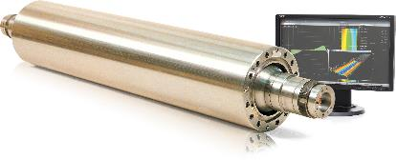
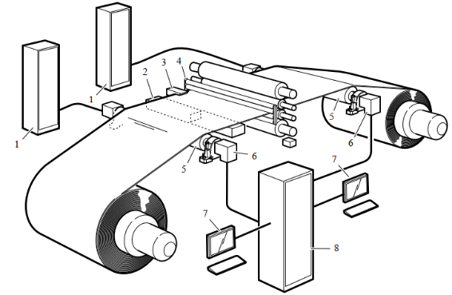
—
Replacements & upgrades
Stressometer product Lifecycle status
STR 9.2 FSA
STR 8.3 – 9.1 FSA
STR 8.1 – 8.2 FSA
STR 6.0 – 8.0 FSA
MP200F 1.1 – 5.0
QUSM200 – DS8
Active
Classic
Limited
Obsolete
Notes:
Stressometer 9.2 FSA release remains in the active phase, whereas the older system releases are in Classic, Limited or Obsolete phase. 8.1 release will go Obsolete from January 1st 2024.
I believe that most customers have been informed already about this change. If you have any installed base remaining where the customer has not been informed, please do so asap. Via the link in this presentation, you can find an External Obsolete notice to send to your customer.
All Stressometer versions up to 8.0 are obsolete from 2023-07-01.
Upgrades to 8.3 FC & SW on-case-by-case – request quotation and confirmation from your Area Market Manager.
Upgrade from 8.2 or 8.3 with DTU to 9.2: New FC (and new OS and new FL), one new PFSA297 and one new PFSA240-A per measuring roll.
In general a transition to next life cycle phase on Stressometer release level is triggered by aging electronics, primarily the computers used as Flatness Computer (FC) and/or Operator Station (OS).
Note that there are many components and sub-system parts that are used over several releases and that don’t transit to a new life cycle phase with the system release.

Slide 47

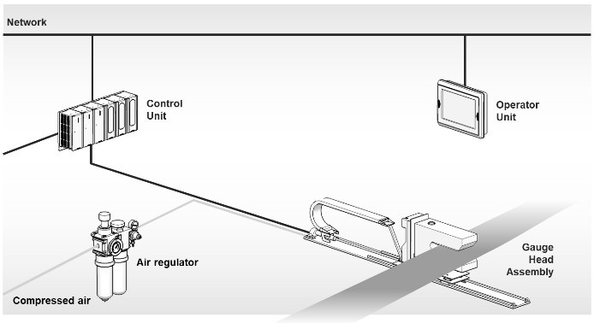
—
Replacements & upgrades
Product lifecycle | Millmate Thickness Gauge
PMG100ver3.1
PMG100ver2.5
PMG100ver2.0 – 2.4
PMG100ver3.0
Gauge head PMGG113/113-A
Active
Classic
Limited
Obsolete
Notes:
Back to the Life cycle:
For the C-frame gauges the PMG100ver3.1 release remains in the active phase, whereas the older system releases are in Limited or Obsolete phase. As most of you already know, the 2.5 release will go Obsolete next year. From January 1st 2024 we will no longer guarantee support for customers with spare parts and repairs, unless the parts are also used in other systems that are not obsolete. Most importantly, Gauge heads PMGG113 and PMGG113-A will no longer be supported.
I believe that most customers have been informed already about this change. If you have any installed base remaining where the customer has not been informed, please do so asap. Via the link in this presentation, you can find an External Obsolete notice to send to your customer.

Slide 48
—
Millmate Thickness Gauge
Upgrade scope depending on installed system
 | 3.1 | 3.0 | 2.5 | 2.4 and older
HMI CPU Windows 10 | x | x | x | x
Application SW 3.1 | x | x | x | x
OPC server and licens | x | x | x | x
Documentation | x | x | x | x
Calibration plates |  | x | x | x
Gauge head |  | x | x | x
Gauge holder |  |  | x | x
Integration | (x) | x | x | x
Control Unit |  |  |  | x
Hydraulic block, cables, position sensors |  |  |  | x
Notes:
The upgrade scope is depending on the installed system to upgrade. Newer systems only require a new HMI CPU, application SW, licenses and documentation, whereas the oldest releases require almost a complete, new system.

Slide 49
—
Success cases
8

Slide 50

—
Installation & commissioning
Aluminum | China
Engineers commissioned an ABB Stressometer Flatness System in 2.5 days for a Chinese aluminum leader
The Stressometer replaced a competing version that was installed only a few years before
Because of the fast, efficient start-up, the customer achieved better strip quality and higher productivity sooner than expected, eventually resulting in millions of dollars of additional value created

Slide 51

—
Remote start-up
Metals | Brazil
Metals customer purchased a full upgrade of their Roll force STR system. Installation and commissioning which was scheduled for May 2020 was delayed due to Covid restrictions.
The Sweden team supported the local team remotely to fully commission and install their new system, without delay.

Slide 52

—
Replacement
Metals | Taiwan
Winning over a customer to replace a deteriorating system from one of our competitors. Serious surface wearing of the BFI roll influenced the flatness and the quality of the steel produced by the customer.
The customer bought a complete Flatness control system, spare roll, spare parts, a set of flatness logger including training from the ABB University to ensure they upskill their staff to ensure the highest quality in the future.

Slide 53
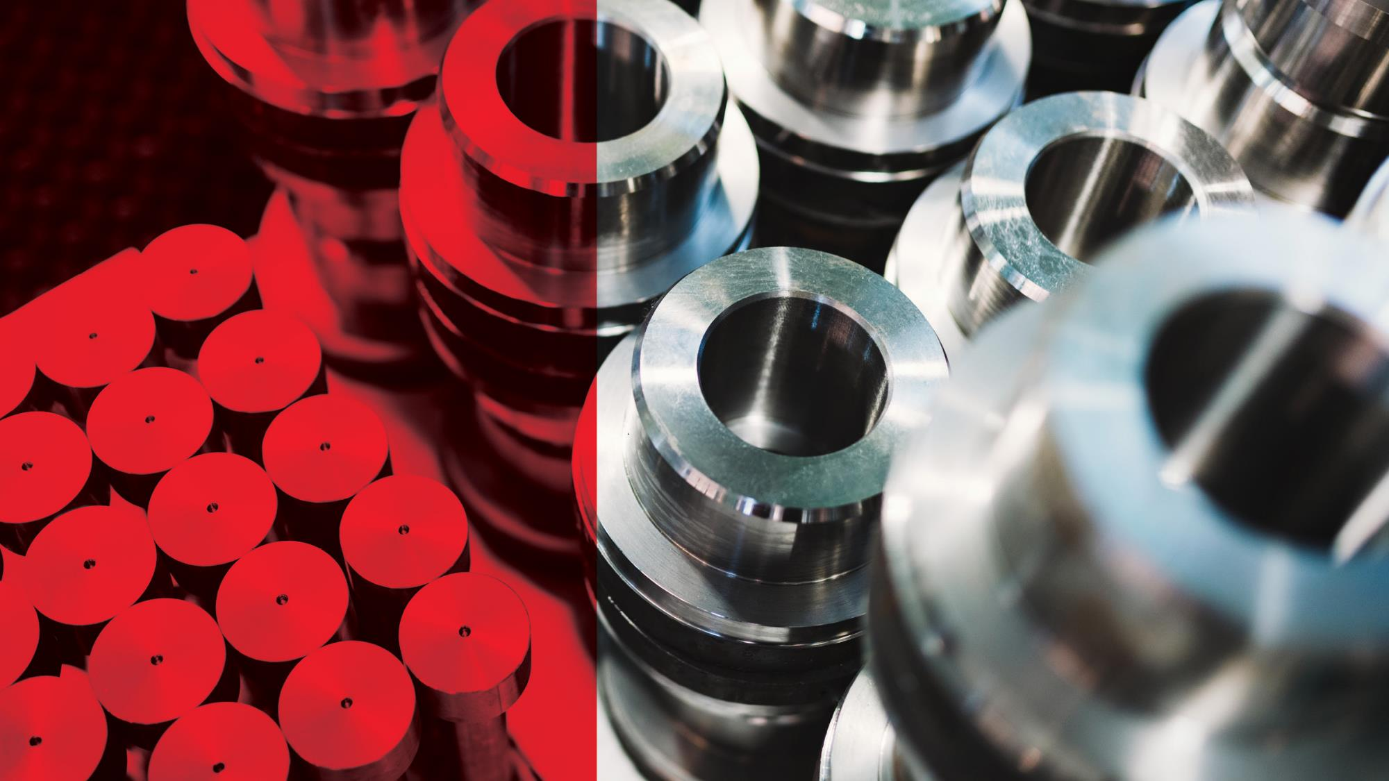
—
Replacement
Metals | China
A customer using a competitor’s flatness system was looking to improve the quality of their products. They also identified that there was an opportunity to increase their productivity if they partnered with experts.
They recognized that ABB’s Stressometer would improve their quality and with the service support offered they can reduce the maintenance burden on their own staff, and rely on ABB experts to support the entire lifecycle of their 1.8m USD investment in ABB products.

